Slide 1
Weekly Paper Reading Few-Shot Learning for Model Compression?
Haoli
2019-4-1

Slide 2
Outline
Few Shot Learning via Meta Learning
Few Shot Learning via Knowledge Distillation

Slide 3
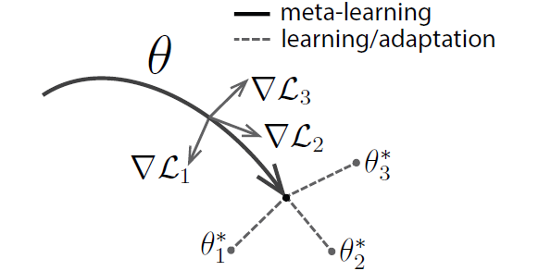


Model-Agnostic Meta-Learning (MAML)
ICML 2017

Slide 4
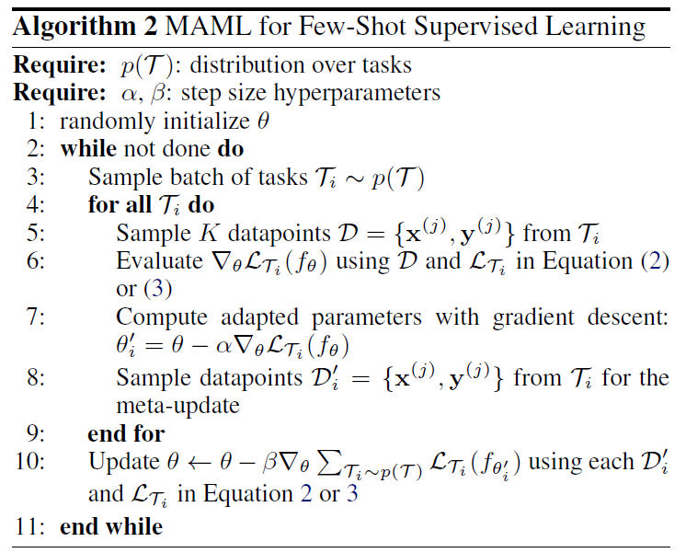
Model-Agnostic Meta-Learning (MAML)

Slide 5
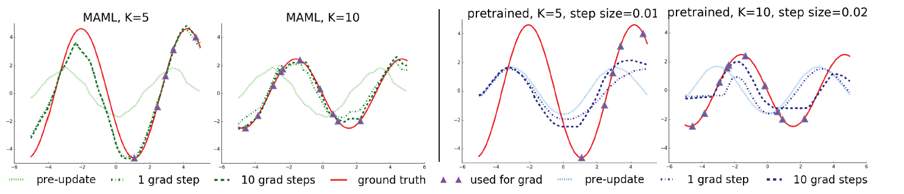
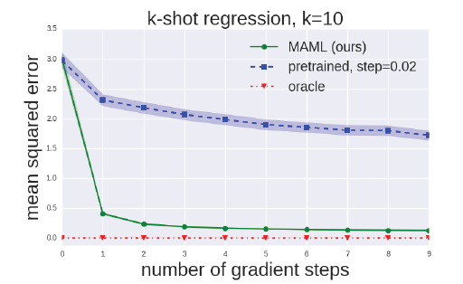
Model-Agnostic Meta-Learning (MAML)

Slide 6
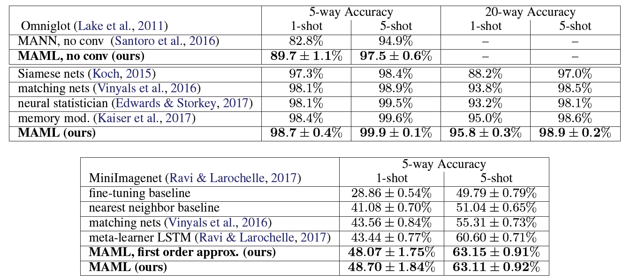
Model-Agnostic Meta-Learning (MAML)

Slide 7
Outline
Few Shot Learning via Meta Learning
Knowledge Distillation

Slide 8
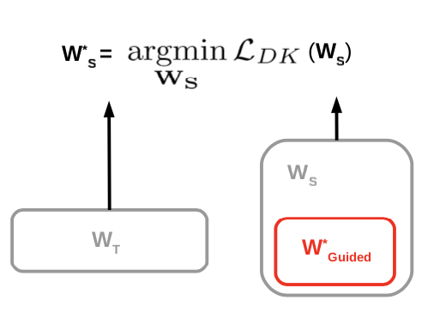
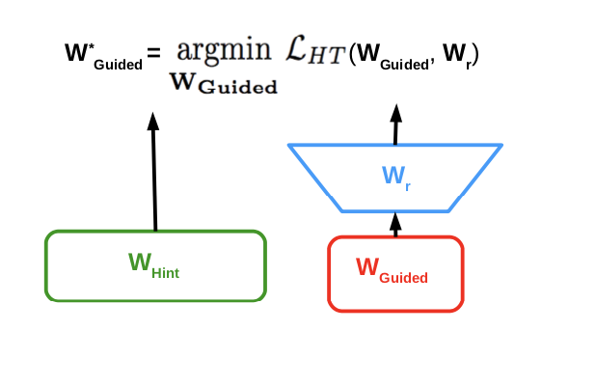
Knowledge Distillation
Output logits: KD
Hidden Layers: FitNet
One stage v.s. Two stage
Initialization v.s. Training from scratch

Slide 9
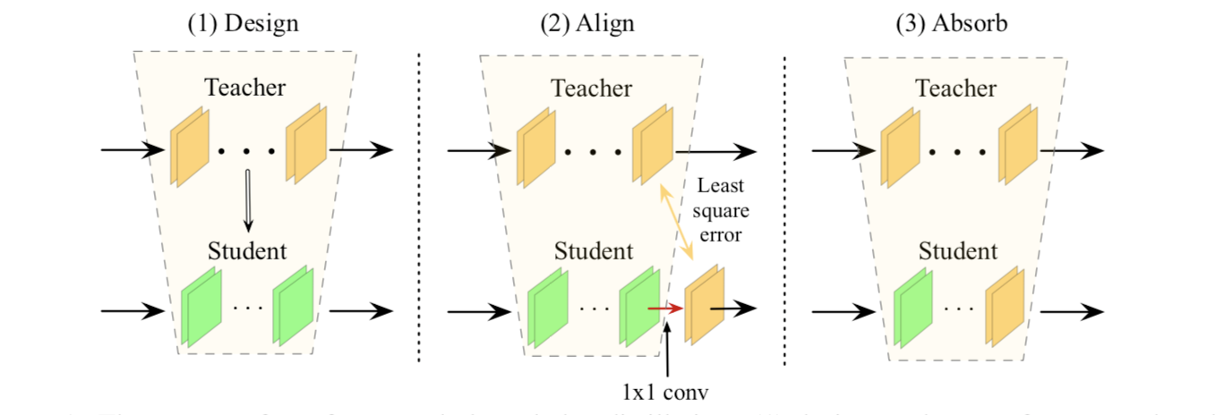
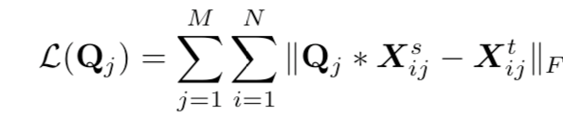
Knowledge Distillation with Few Data
Distill in the hidden layers
Insert 1x1 conv after each block
Solve the least square problem
Absorb the 1x1 conv into the previous kernels

Slide 10
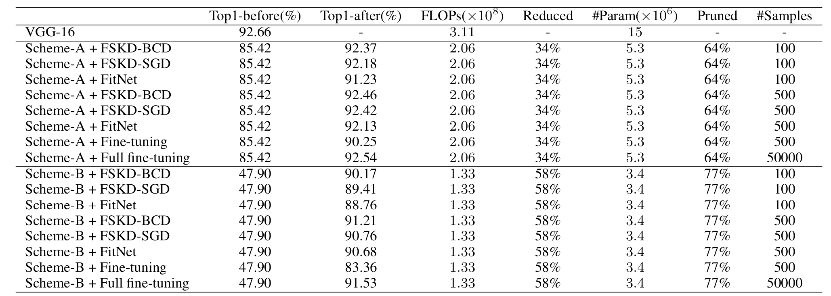
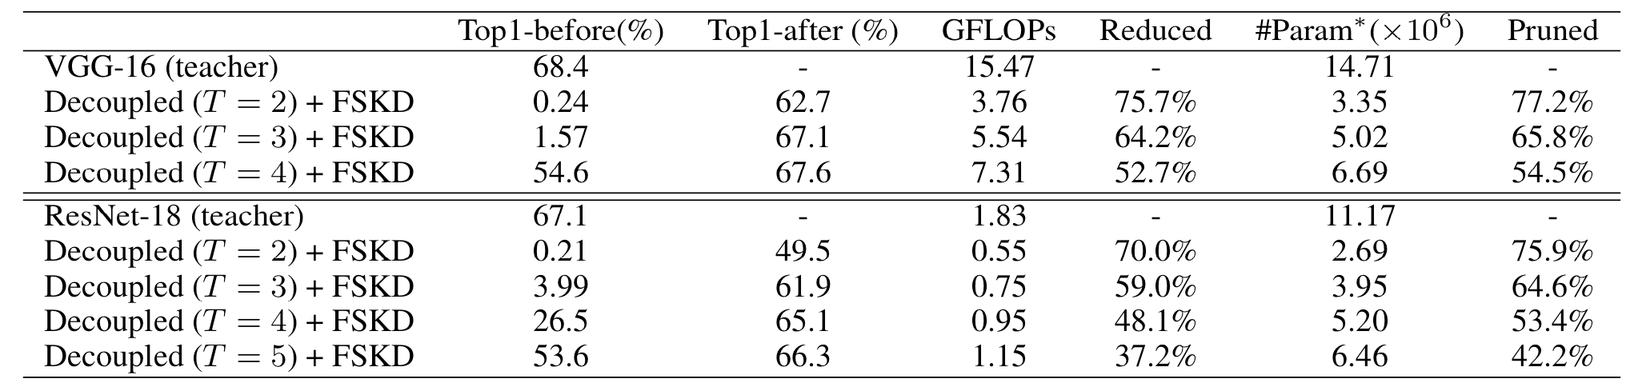
Knowledge Distillation with Few Data
On Cifar
On ImageNet

Slide 11
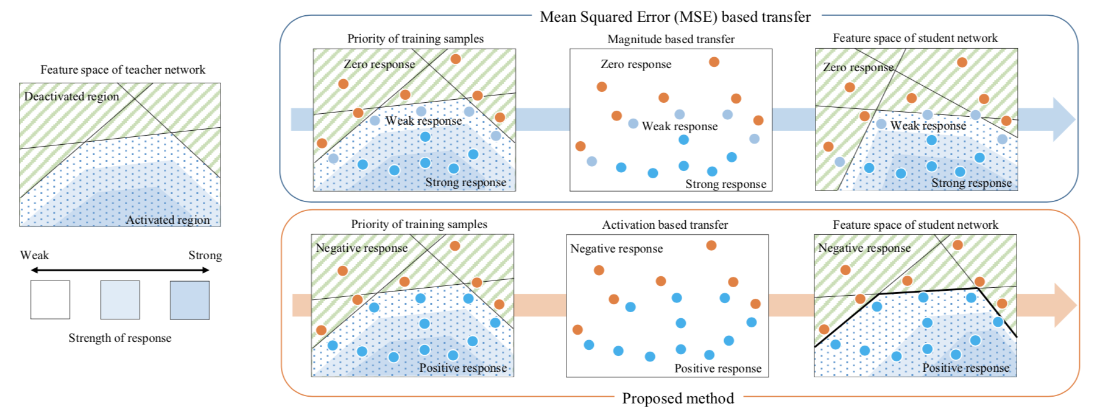
Activation Boundaries Knowledge Distillation

Slide 12
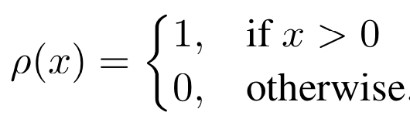
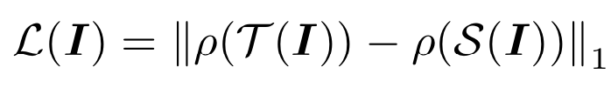
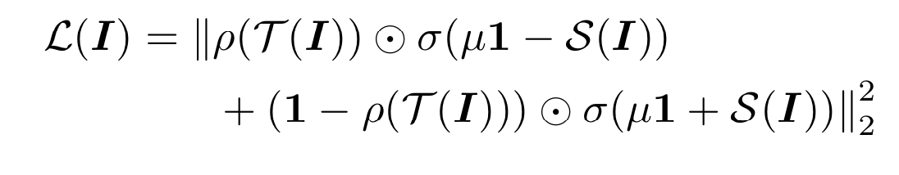
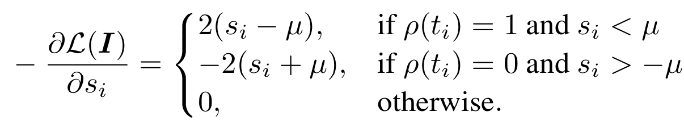
Activation Boundaries Knowledge Distillation

Slide 13
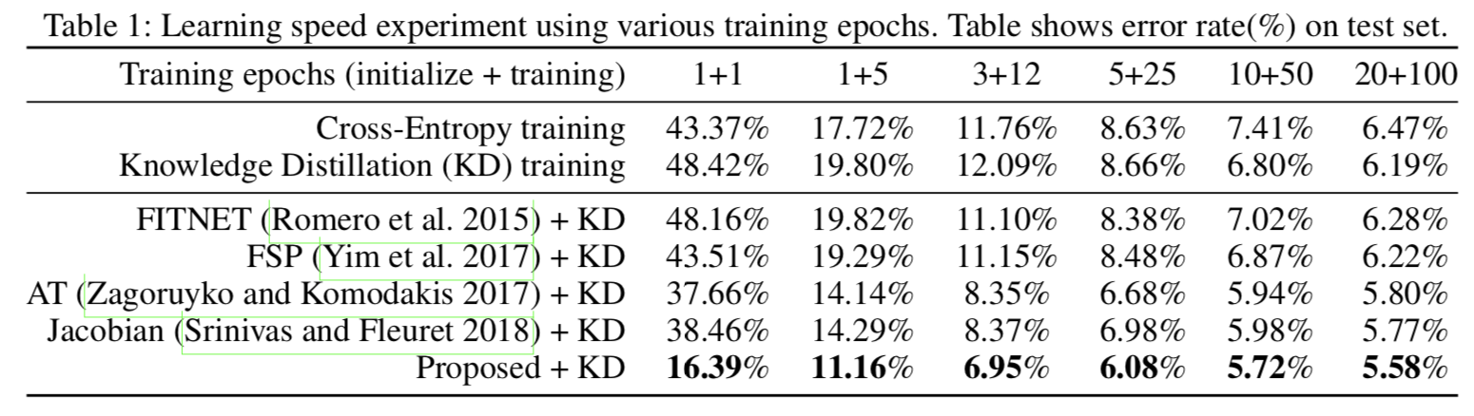
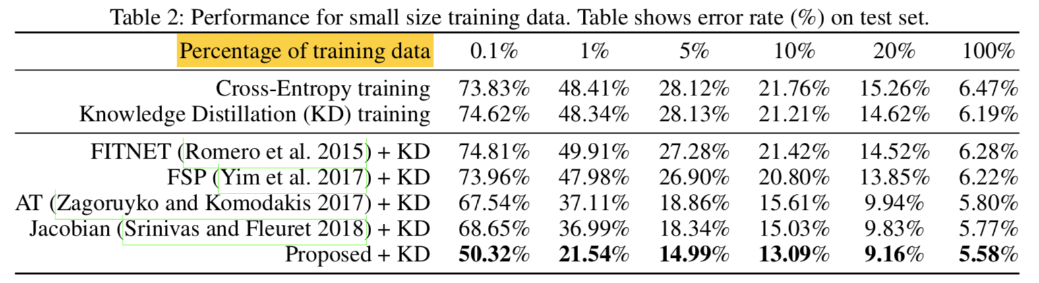
Activation Boundaries Knowledge Distillation

Slide 14
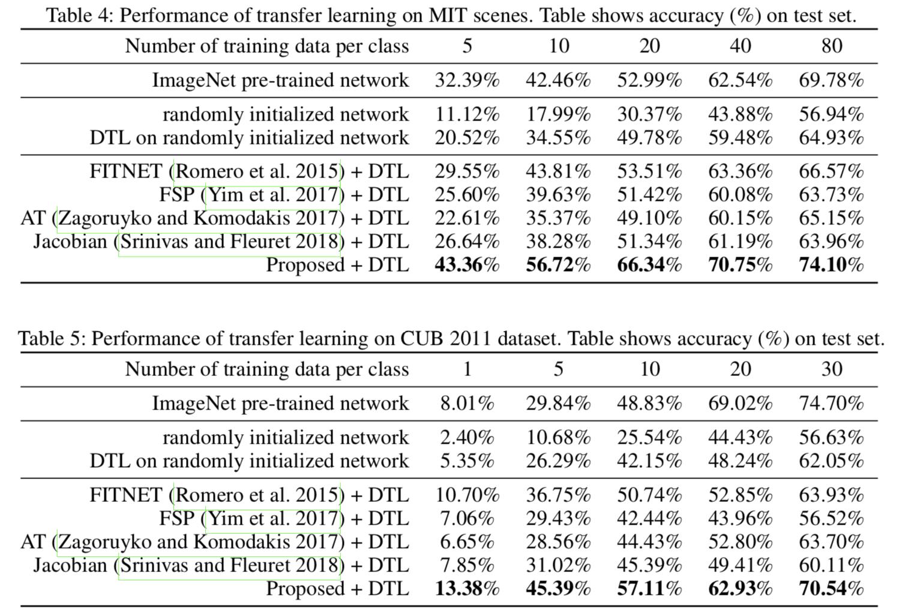
Activation Boundaries Knowledge Distillation

Slide 15
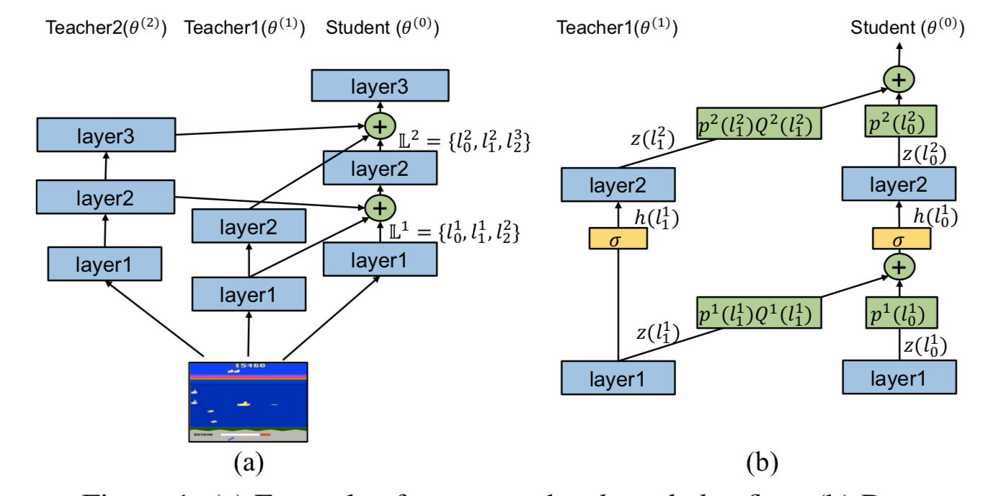
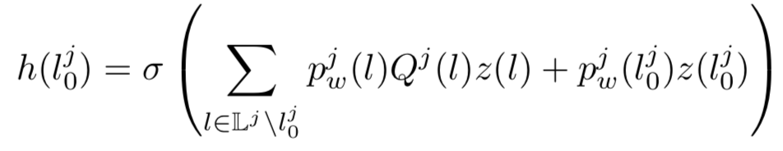
Multi Teacher Distillation

Slide 16
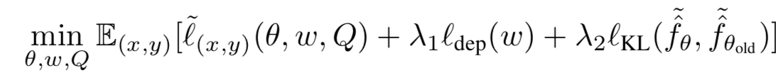
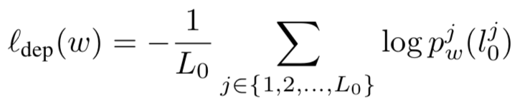
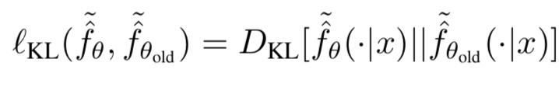
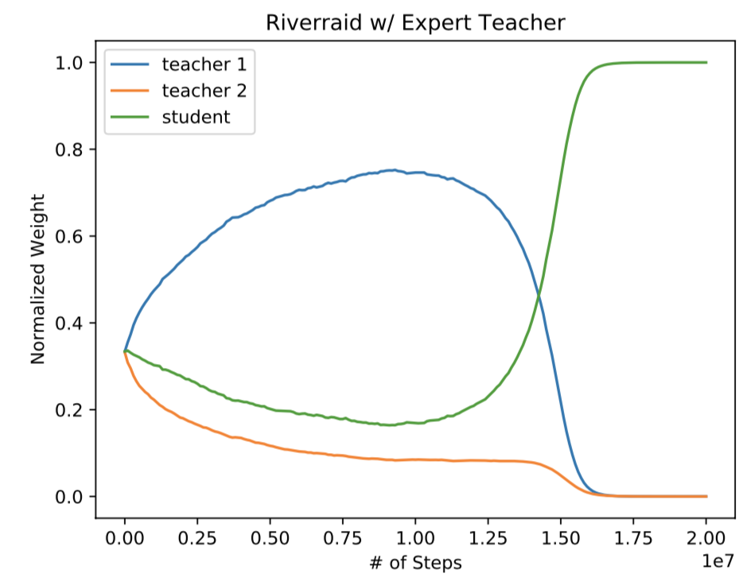
Multi Teacher Distillation

Slide 17
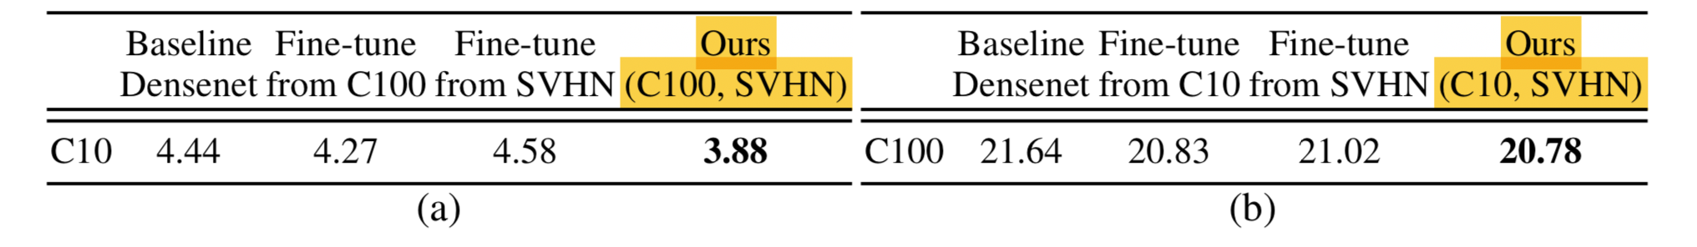
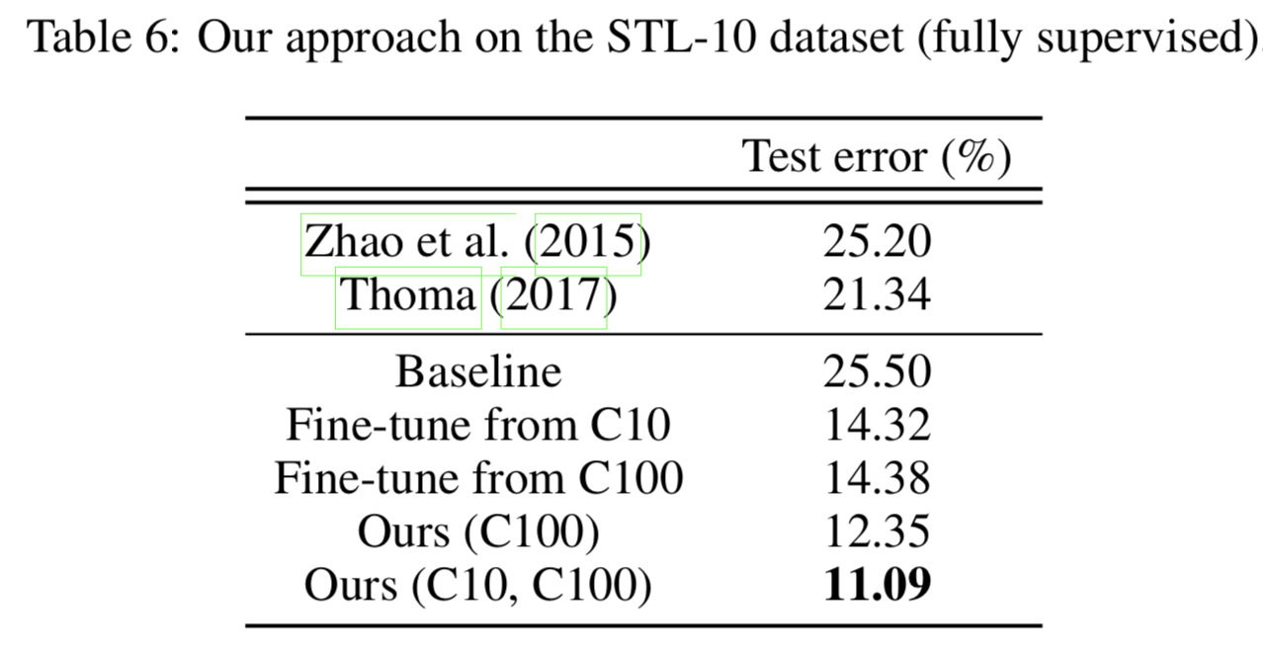
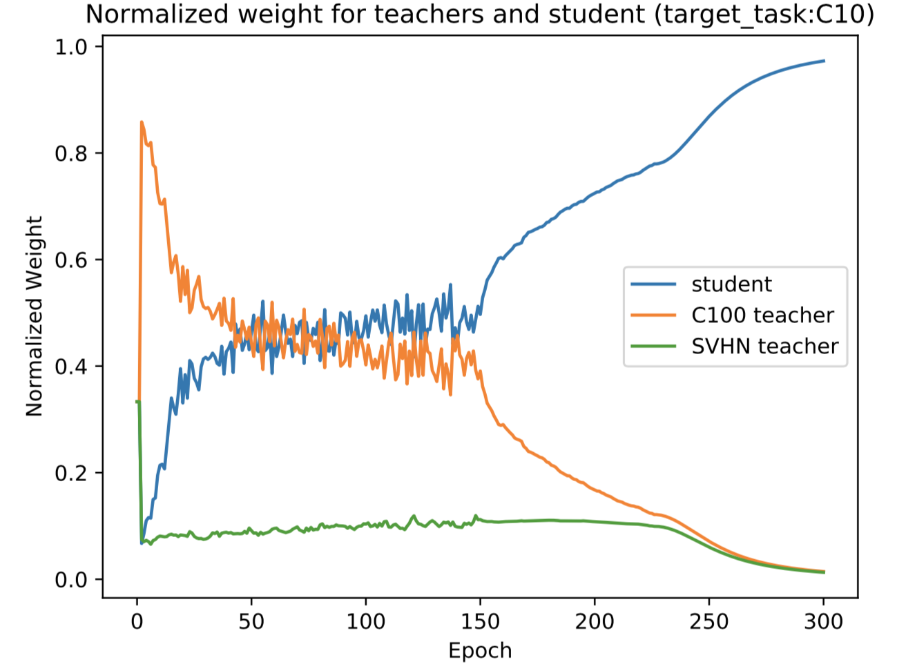
Multi Teacher Distillation

Slide 18
Thanks

