Slide 1
§6.3 Ablation Study — Training Diagnostics
qwen3-14B + LoRA r=32 · 2×H100-80GB · 50 steps · 2026-05-19
Theory: docs/plan_posterior_reward_walkthrough.md

Slide 2
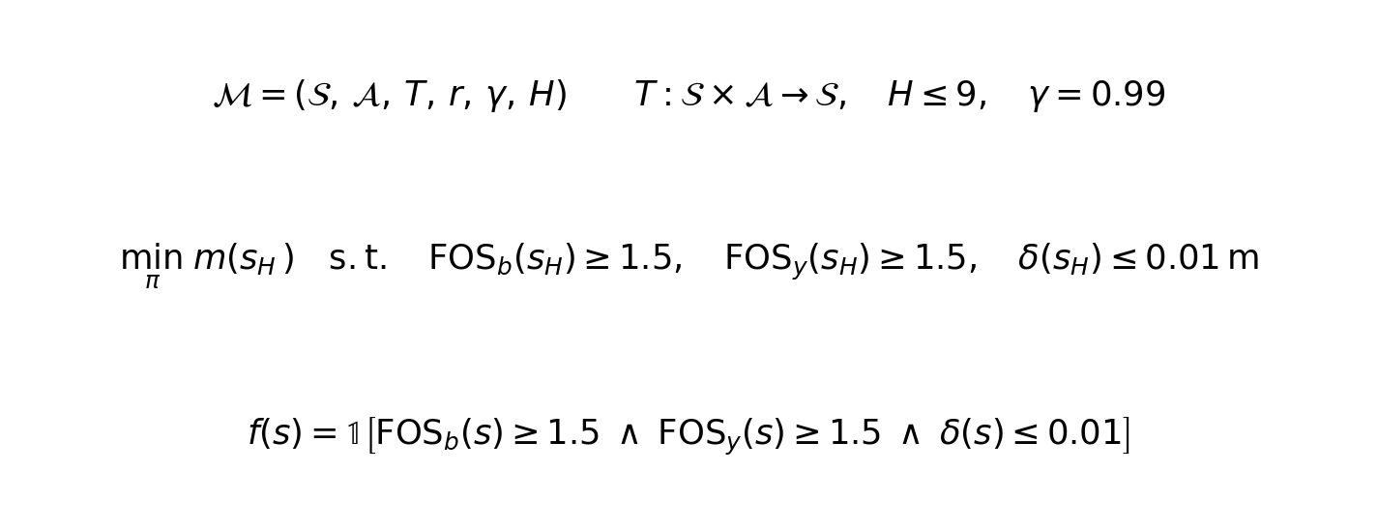
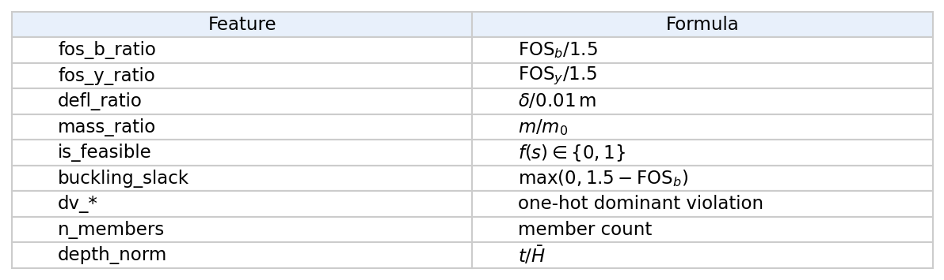
§0 — Truss Design MDP
State vector φ(s) ∈ ℝ¹⁴ (features.py:STATE_FEATURE_NAMES). Used in dead-end avoidance (§2.4) and forward-prediction grounding (§4.1).

Slide 3
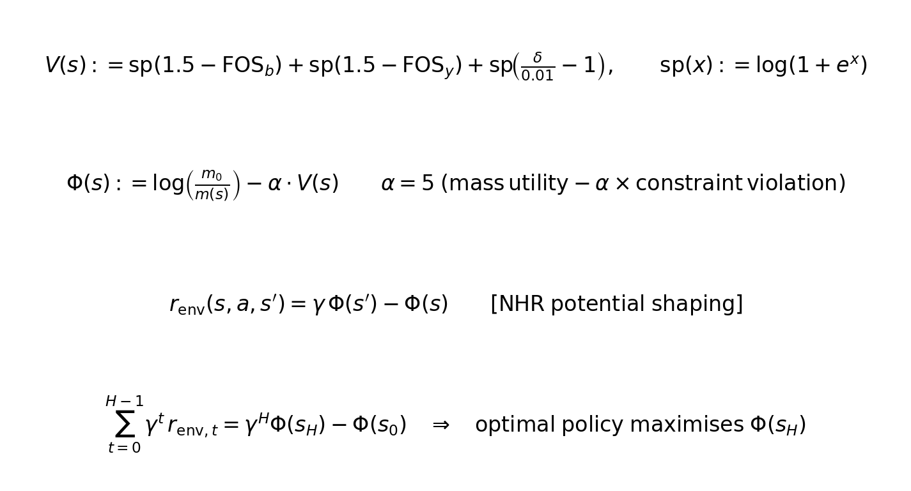
§1 — r_env: Lagrangian Potential Reward
NHR potential-based shaping (Ng, Harada & Russell, ICML 1999). Single hyperparameter α (Lagrange multiplier on feasibility). Telescoping property: no terminal bonus needed. Dense, deterministic, policy-agnostic (~10 ms/step via trussme FEA).

Slide 4
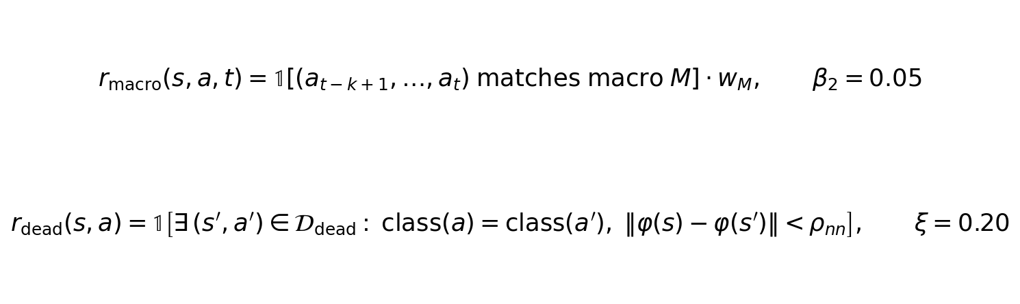
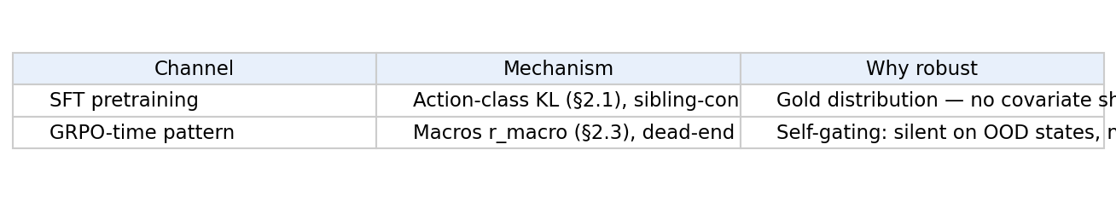
§2 — Modification Tree Signals: Macros & Dead-End Avoidance
ρ_nn = 5th-percentile of within-gold pairwise φ-distances (data constant, not a YAML param). State-conditioned regressors on gold data are NOT used at GRPO time (§2 rationale).

Slide 5
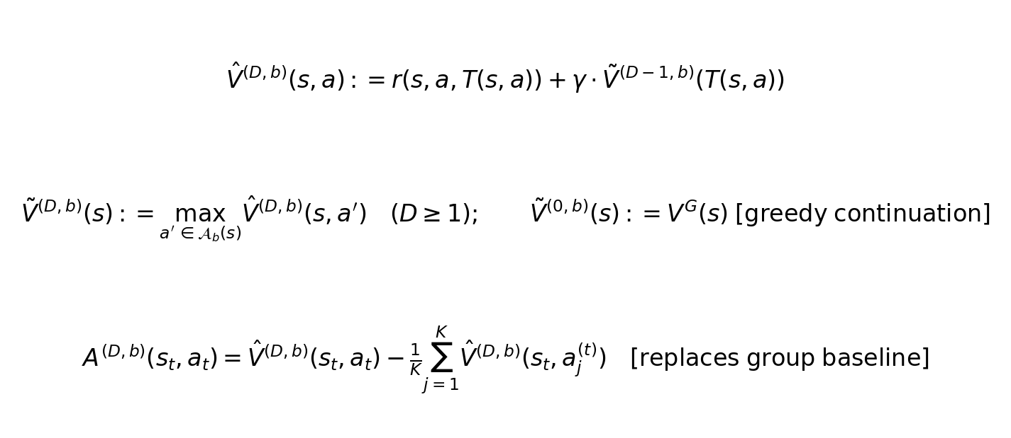
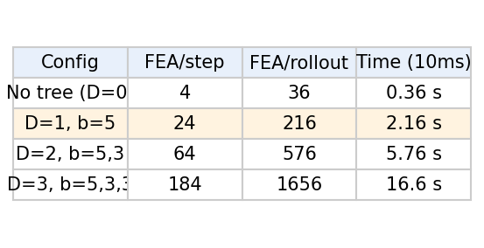
§3 — Online Tree-Expanded Value Estimation
Default: D=1, b=5 (stratified across 5 action classes). Per-step advantage replaces GRPO's trajectory-level group-relative baseline. V^G = greedy-on-Φ continuation to horizon H.

Slide 6
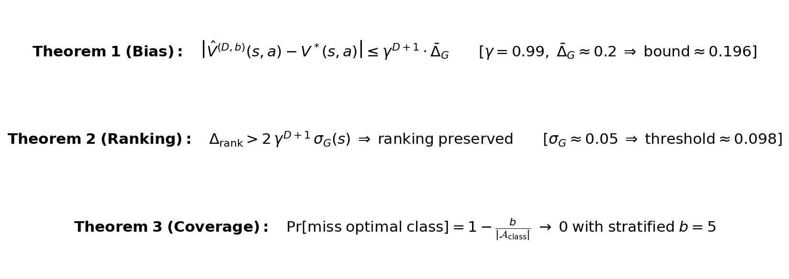
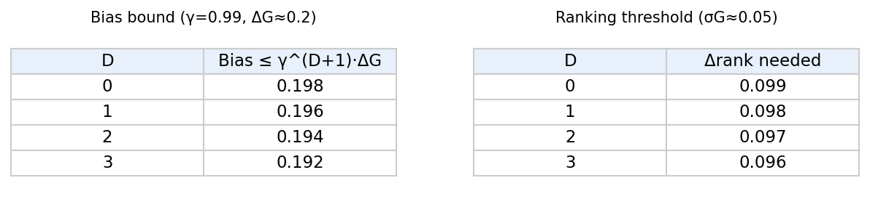
§3 — Theorem 1 (Bias) & Theorem 2 (Ranking)
Key insight: benefit of depth is ranking accuracy, not absolute bias reduction. Bias shrinks slowly with depth (γ≈1); variance σG across continuations is what limits ranking. D=0 sufficient for action-class ranking (Δrank~0.2); D=1 helps within-class (Δrank~0.05–0.15).

Slide 7
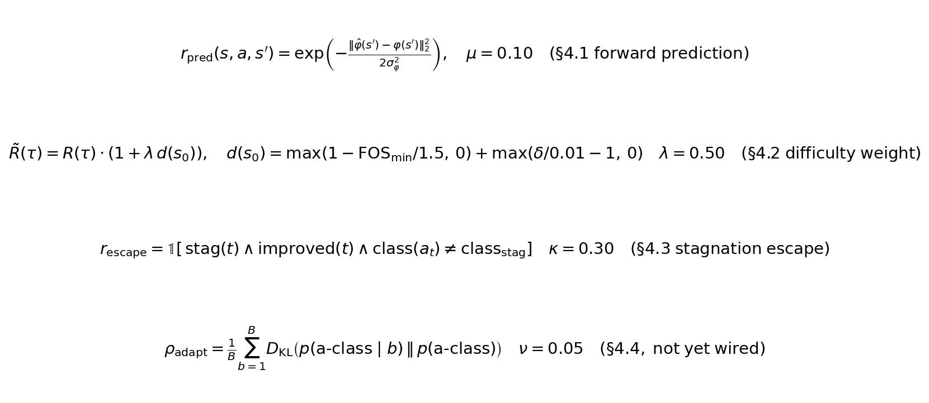
§4 — LLM-Capability Shaping Terms
§4.1 forces causal CoT–action coupling (vague post-hoc reasoning cannot earn r_pred). §4.3 stagnation escape requires action-class switch, not just any improvement. §4.4 ρ_adapt not yet wired (requires batch-level view across B problems).

Slide 8
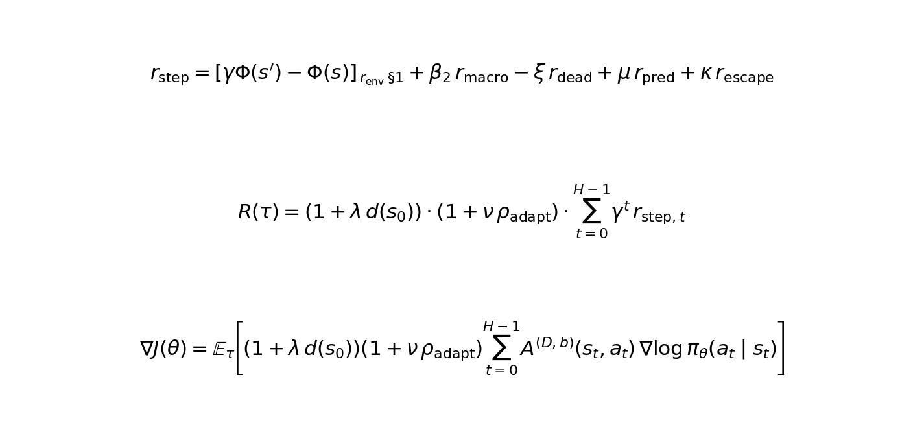
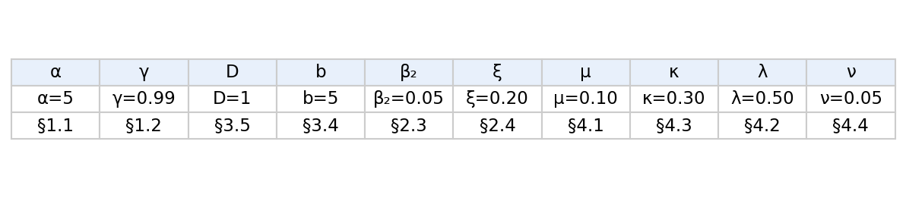
§6.1 — Full Reward Function & Policy Gradient
Trajectory multipliers (1+λd)(1+νρ_adapt) act as global gradient scaling; per-step tree advantage A^(D,b) handles within-trajectory credit assignment.

Slide 9
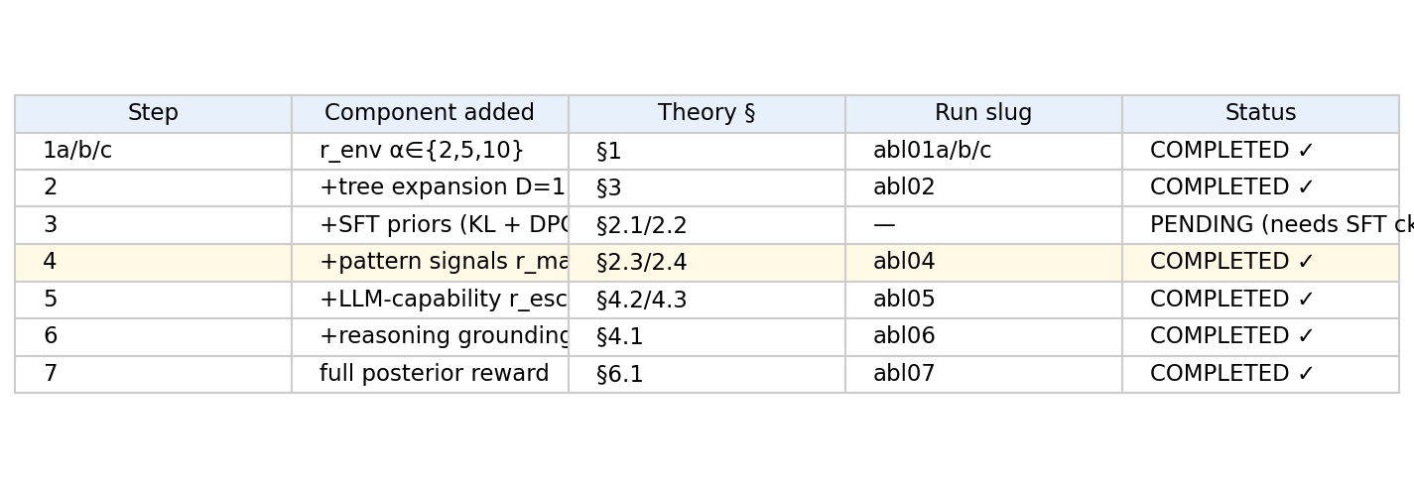
§6.3 — Ablation Sequence → This Experiment
All runs: qwen3_14b + LoRA r=32, ALLOW_BASE_GRPO=1 (no SFT warmstart), 50 steps, cosine LR from 5e-7. Step 3 requires warmstart_sft checkpoint (job 40929020 completed separately).

Slide 10
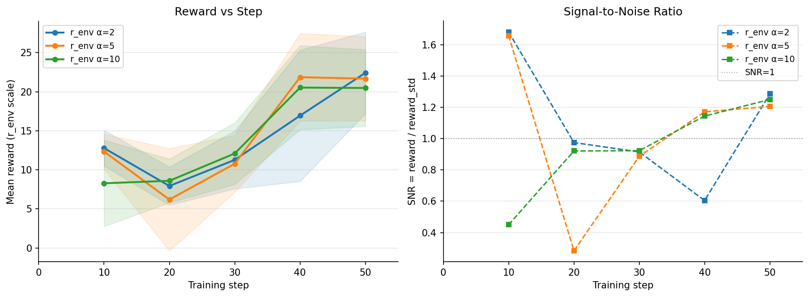
Step 1 — Baseline: r_env Only, α Sweep
Shaded band = ±0.3 reward_std. All three runs converge to similar final reward (~20–22). Consistent dip at step 20 across all runs — driven by LR schedule and data sampling, not α. SNR < 1 at step 20 (reward variance exceeds mean); recovers by step 40.

Slide 11
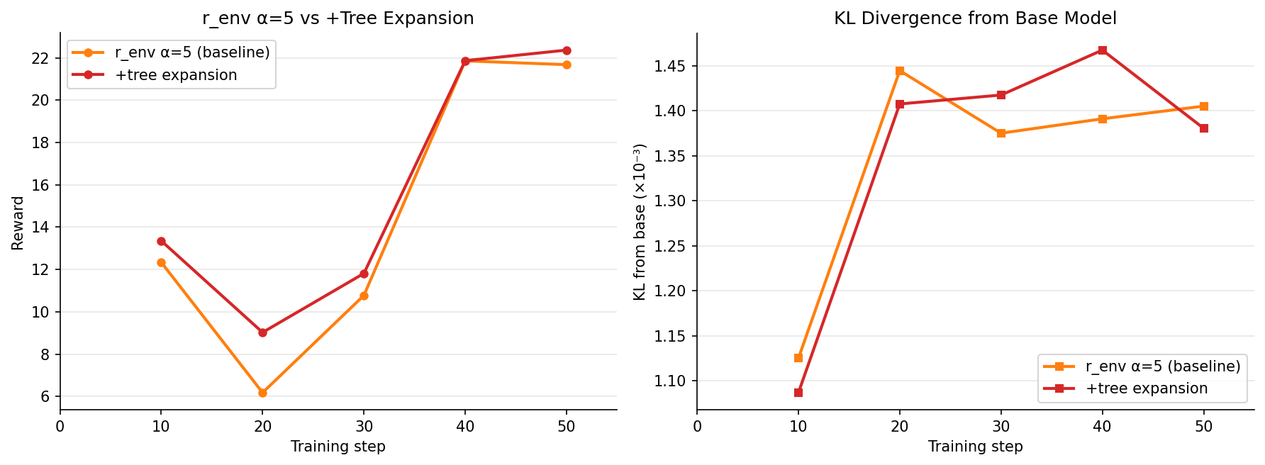
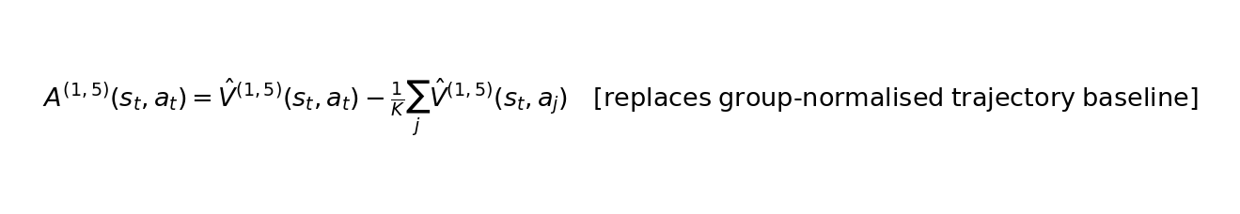
Step 2 — +Tree Expansion D=1, b=5
Tree expansion (abl02) matches α=2 baseline in final reward — tree advantage signal is entering but not yet separating from the r_env-only baseline at 50 steps. KL nearly identical.

Slide 12
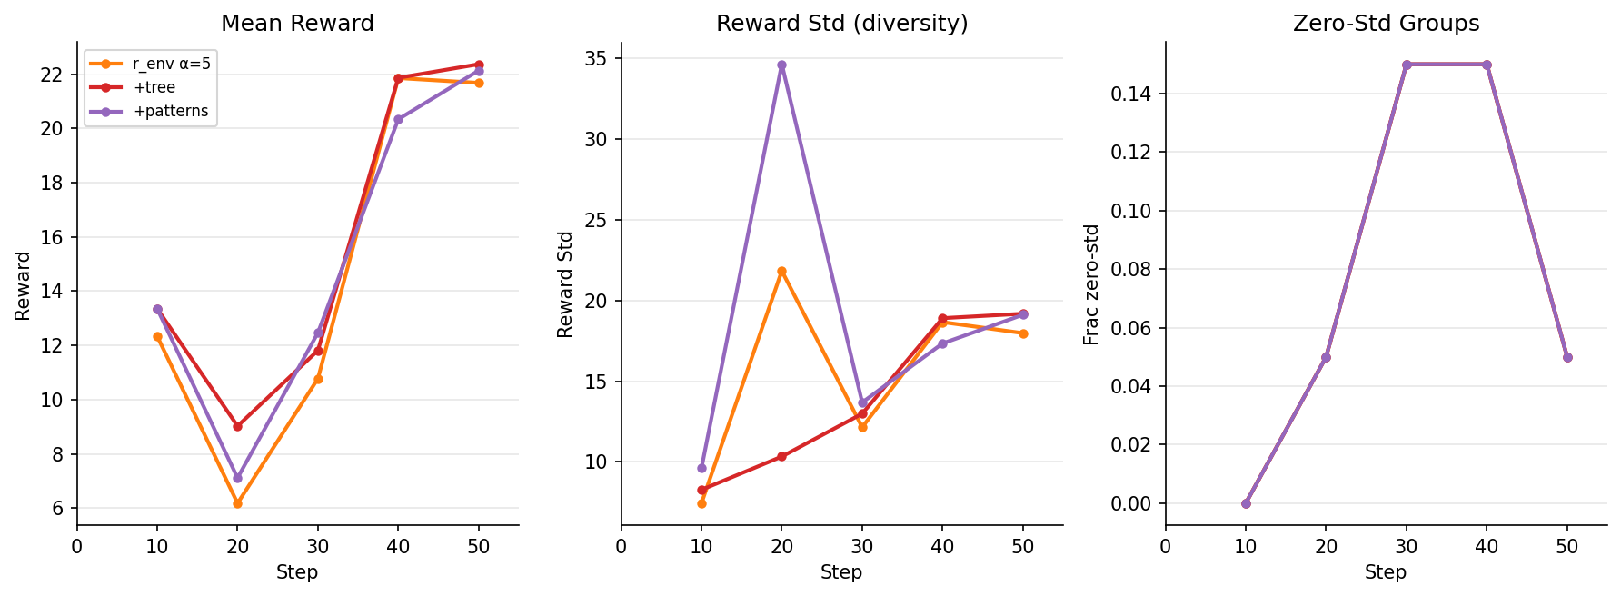
Step 4 — +Pattern Signals (r_macro, r_dead)
Pattern signals (abl04) produce no visible separation from tree baseline at 50 steps. frac_zero_std = 0.15 at steps 30–40 across all runs (same batches — driven by data sampling). Reward_std grows with training, indicating increasing rollout diversity.

Slide 13
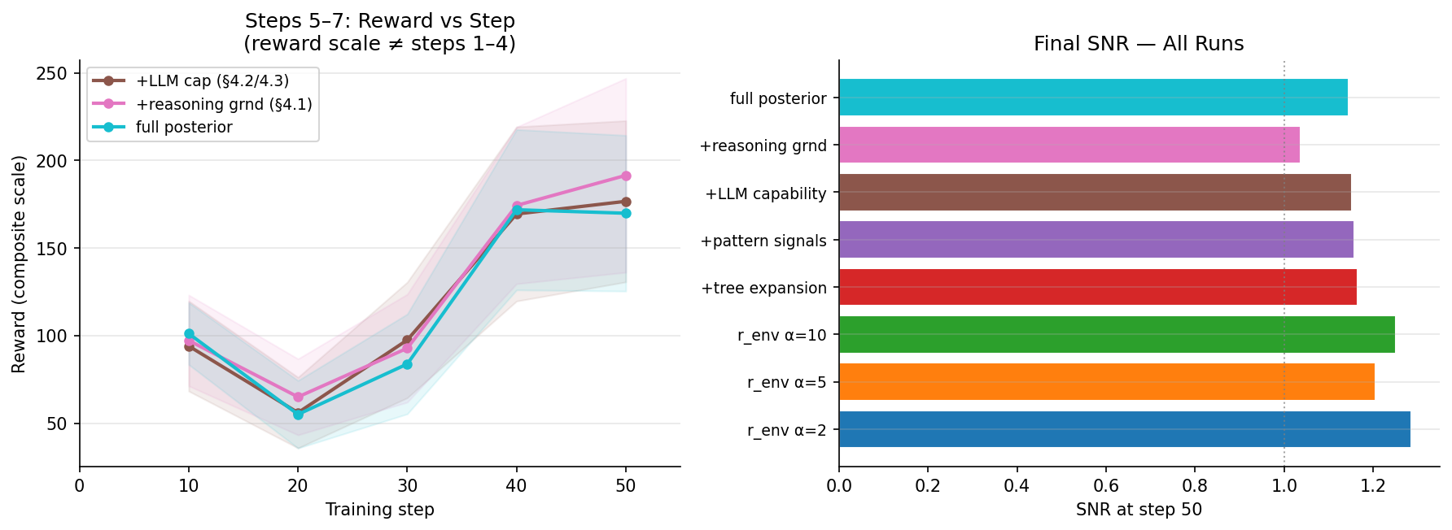
Steps 5–7 — LLM-Capability Terms & Full Posterior
Steps 5–7 reward scale is ~8–9× larger than steps 1–4 (additional reward terms accumulate). NOT directly comparable across step groups. Final SNR ~1.0–1.7 across all runs.

Slide 14
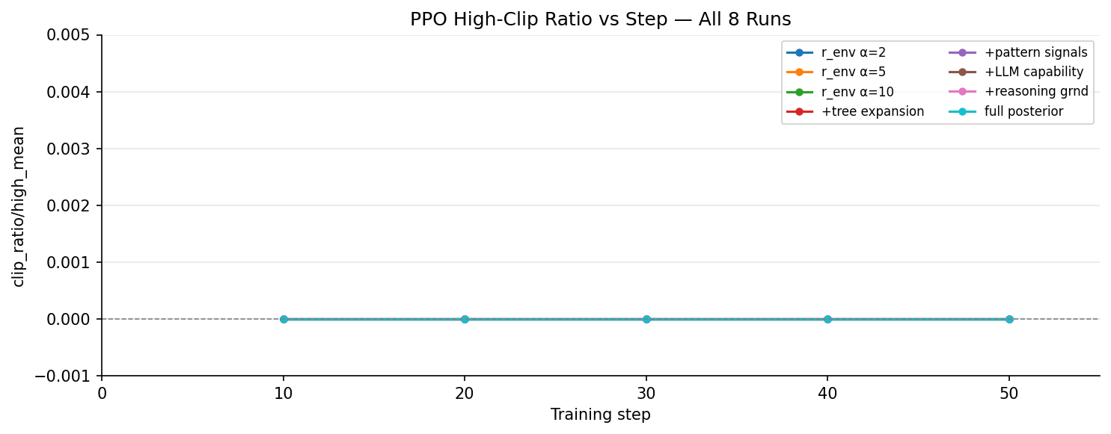

Diagnostic — PPO Clip Ratio (All Runs, All Steps)
clip_ratio/high_mean = 0.0000 at every logged step across all 8 runs (400 data points). The PPO clipping mechanism is never triggered. Policy ratio π_θ/π_θ_old stays within [1-ε, 1+ε] for all tokens. Consistent with KL~0.0013 — policy barely moves from base model. Indicates learning rate may be too small or ε too large for current setup.

Slide 15
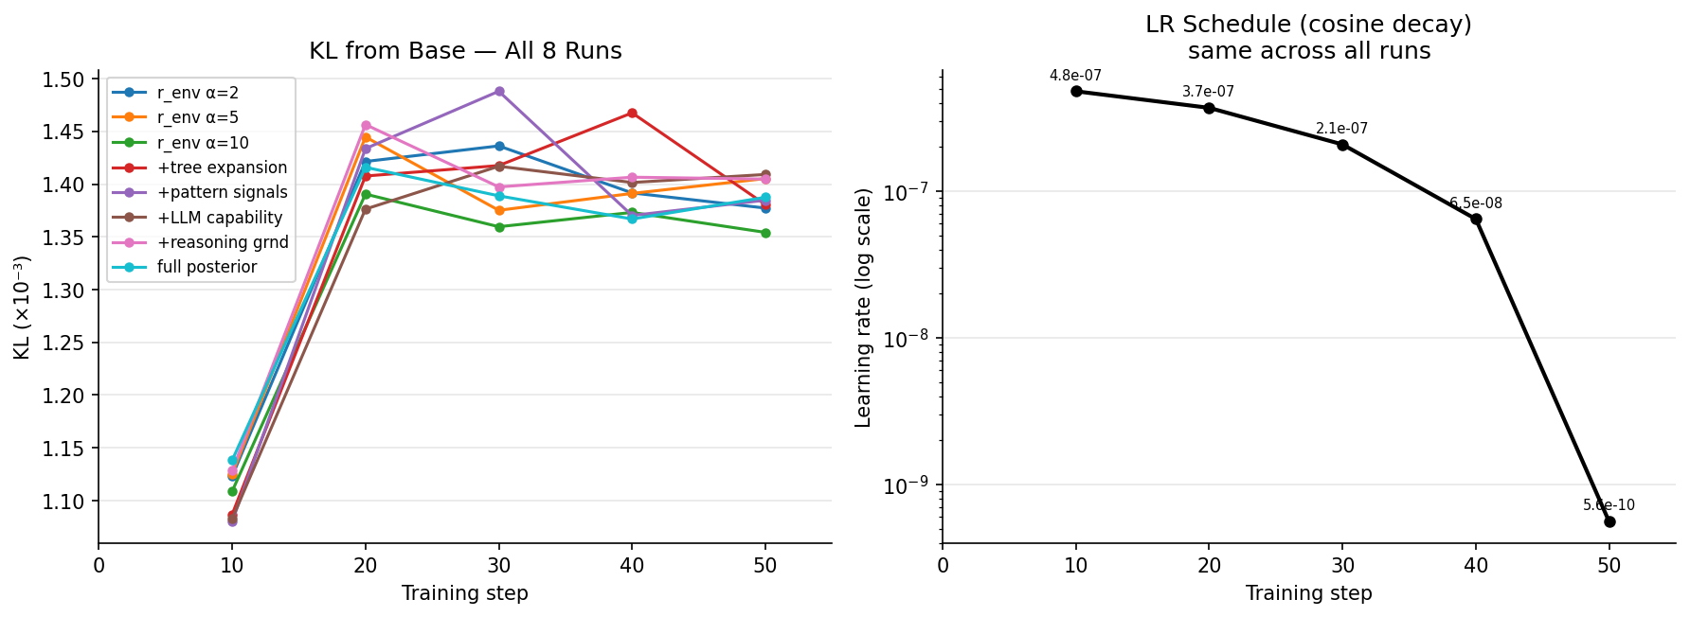
Diagnostic — KL Divergence from Base Model (All Runs)
KL plateaus at ~0.0013–0.0015 after step 10 and does not increase further. LR decays from 4.8×10⁻⁷ to 5.6×10⁻¹⁰ (860× reduction) over 50 steps — effective training ceases around step 45. Policy at step 50 is not converged; it is stopped.

Slide 16
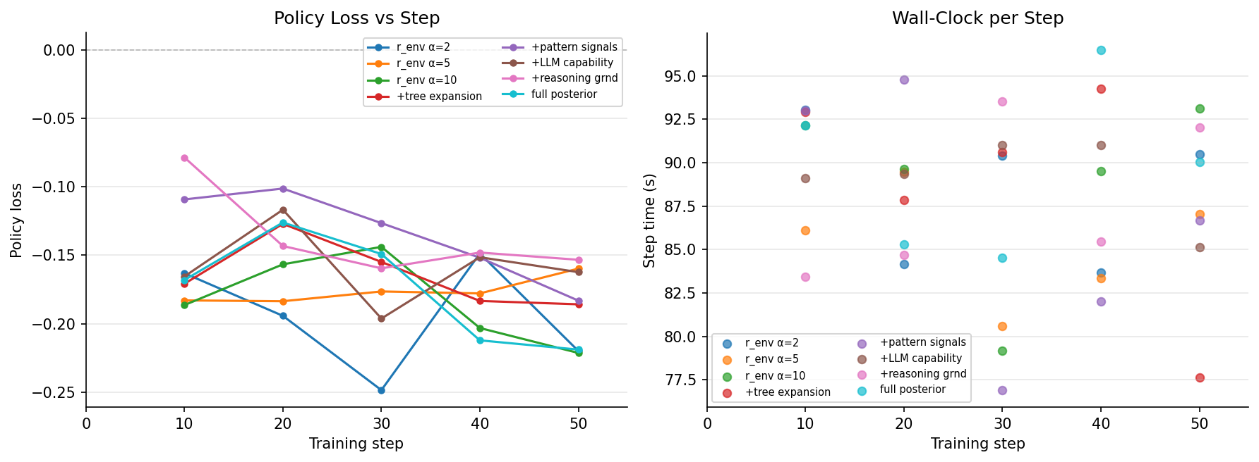
Diagnostic — Policy Loss & Step Time (All Runs)
Negative loss is expected in GRPO (policy gradient minimises negative expected reward). Loss magnitude increases as policy learns to differentiate. Step time ~80–94 s/step consistent across all runs (~75 min for 50 steps).

Slide 17
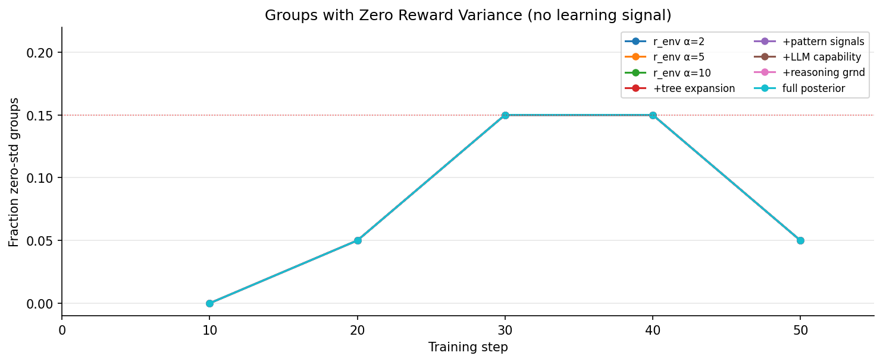
Diagnostic — Fraction of Zero-Std Rollout Groups
frac_zero_std = 0.0 / 0.05 / 0.15 / 0.15 / 0.05 pattern is IDENTICAL across all 8 runs — driven by data sampling order, not reward function. 15% of groups at steps 30–40 yield zero advantage (all K rollouts received equal reward). These samples contribute nothing to the gradient.

Slide 18
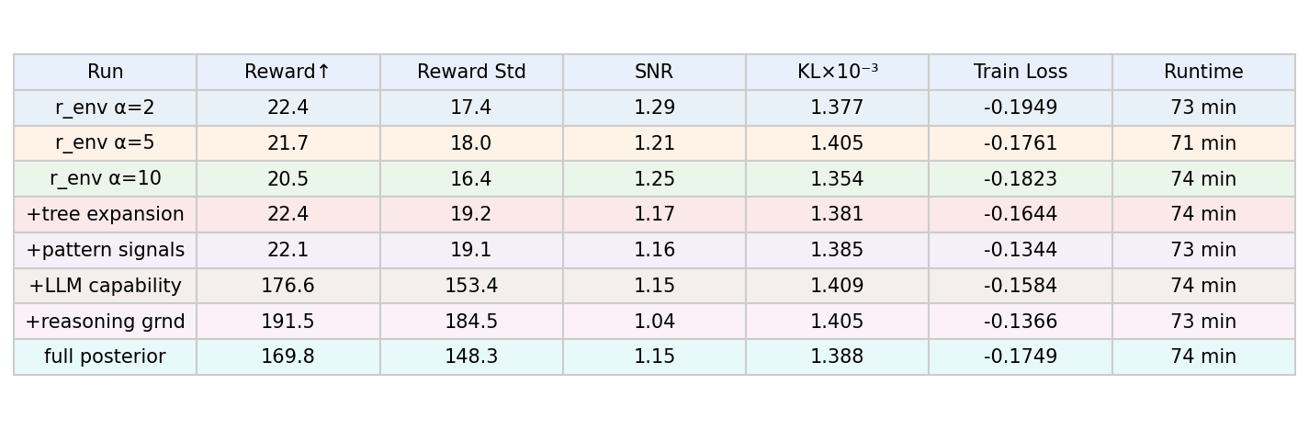
Summary — All Runs at Step 50
Reward scale differs between steps 1–4 (r_env only) and steps 5–7 (composite). clip_ratio/high = 0.0 and KL < 0.0015 across all runs indicate minimal policy movement. 50 steps = early training; LR reached ~0 before convergence.

