Slide 1
EXP · DESIGNBENCH · 2026-06-17
DesignBench SFT + GRPO
Teaching a 14B model to optimize trusses to feasibility
The limiting factor was information and protocol, not reasoning capacity or RL.
0%
68%
held-out feasibility on truss problems
warmstart
champion
Qwen3-14B · LoRA r=32 · multi-turn grammar-action policy · audit trail in docs/ablation_ledger.md
Notes:
Open on the punchline: we took the pipeline from about 0% feasibility to a 14B policy that solves 68% of held-out truss problems. The headline of the whole talk is that the gains did not come from a cleverer RL algorithm. They came from fixing two things the algorithm was starved of: the rollout protocol and the feedback content. Set expectation: this is a diagnostic story. Model is Qwen3-14B with a small LoRA. Everything is logged in the ablation ledger.

Slide 2
Agenda
What we set out to do, what worked, and why.
The task and the method
What the model is asked to do, and how it works
The headline result
0% to 68% feasibility, and the five stages behind it
01
02
The two key fixes
How the model is run, then what it is told
Reward and training behavior
One reward signal, and how we know it is learning
03
04
Evaluation and the real bottleneck
Held-out results, and a test that reframes it all
The remaining failures and next steps
What still breaks, mapped to concrete fixes
05
06
Notes:
Quick roadmap so a mixed audience can follow. The thread running through all six blocks: a 14B model already had the reasoning. What changed outcomes was the protocol it was run under and the information in its feedback. Tell them block 05 is the core, where a simple test shows a strong model solves the task with no RL once it sees the failing member.

Slide 3
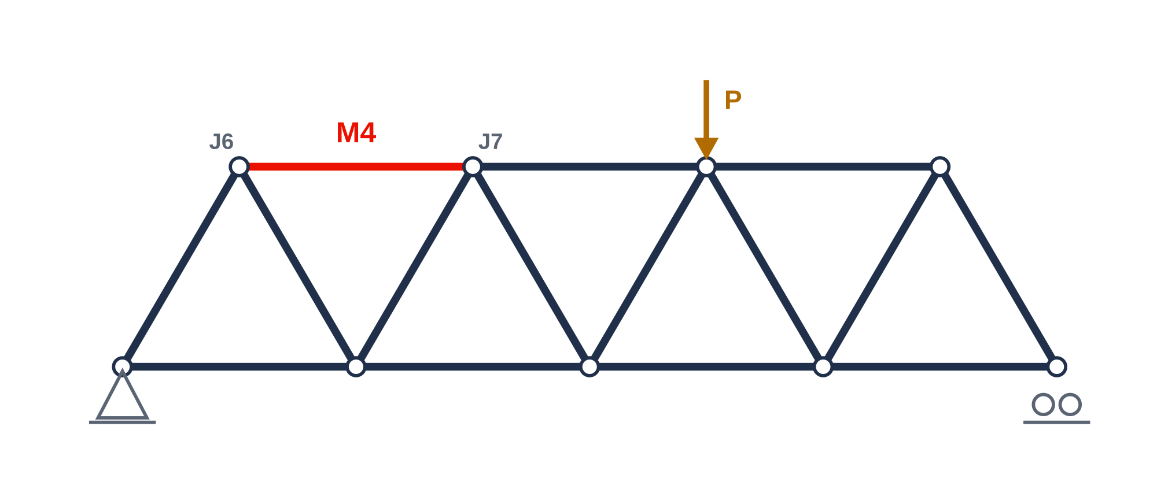
The Optimization Task
Reshape a pin-jointed frame until it is structurally sound, changing one member at a time.
Sound means three checks pass at the same time
FOS_buckling ≥ 1.5
the binding check, since slender members buckle first
FOS_yielding ≥ 1.5
the material must not yield under the load
mass ≤ limit
and it must stay light, since strength alone is not enough
The only move is one edit per turn
For example SCALE_PARAM(4, r, 1.36), which scales the radius of member 4. A physics solver then re-scores the design. The hard part is choosing which member to change. Here, member 4 (shown in red) is the one most likely to buckle.
Notes:
Ground the audience in the engineering. A truss is a frame of straight members joined at pins; under load each member carries tension or compression. Sound, or feasible, is a hard AND of three checks: buckling factor of safety at least 1.5, yielding factor of safety at least 1.5, and mass under a cap. Buckling is almost always binding because slender members buckle long before they yield. The agent's only move is a single parametric edit per turn, scored by a finite-element solver. The hard part is credit assignment: which of a dozen members to scale, and by how much. The member in red is the one the solver flags as most likely to buckle, and it becomes central in two slides.

Slide 4
The Overall Method
We train a language model to repair the truss step by step, then let it work with a physics solver.
Two training phases
1. SFT warmstart
teach the model the response format
2. GRPO
reward it for getting closer to feasible
base model
Qwen3-14B · LoRA r = 32
Then it works one turn at a time
think
act
simulate
feedback
read the results and
decide what is wrong
make one change
to the truss
a physics solver tests
the new design
the model sees
the new results
The model repeats this loop until the truss passes all three checks, building the fix one change at a time.
Notes:
Two-stage training. SFT teaches only the output format, the think-then-single-action shape, deliberately not a competent policy. GRPO learns behavior; it is a reinforcement-learning method that rewards getting closer to feasible. The policy is a Qwen3-14B with a small rank-32 LoRA, so this is cheap. The key structural fact is the loop at the bottom: every turn the model reads the latest results, makes exactly one change, the solver runs, and the new results come back. The episode is a real multi-turn conversation, repeated until the truss is feasible. Foreshadow: the first big bug was running this per-turn model as if it should produce a whole solution in one shot, which is fix one.

Slide 5
From 0% to 68% Feasible
These are the five stages recorded in the audit log. The gains came from what the training was missing.
0%
~0%
12%
68%
52%
warmstart (SFT only)
GRPO, single-turn
multi-turn, no fix
+ critical-member fb
+ mass fb (regressed)
The headline
A 14B model with the right feedback and the right loop solves a majority of problems. The jump from 12% to 68% came from one fix to the information the model receives, not from the RL algorithm, a bigger model, or more reasoning capacity. The final 52% shows that piling on more signal can over-correct.
Notes:
The result strip. Left to right: warmstart formats perfectly but solves nothing, 0%. Naive single-turn GRPO stays at roughly zero. A correct multi-turn loop gets us to 12%, learning but slowly. Restoring one missing field in the feedback, which member is failing, takes us to 68%, the champion. Adding a mass-violation signal on top regressed to 52%. The leverage was information and protocol, not the algorithm.

Slide 6
Results by Stage
Each row is one change, scored on held-out problems. The best run is multi-turn with critical-member feedback.
Stage | What changed | Eval feasibility | Mean FOS_buckling
warmstart (SFT only) | format, no policy | 0% | 0.41
GRPO, single-turn (v2) | broken protocol | ~0% | ,
GRPO, multi-turn, no feedback fix | correct protocol | 12% | 1.42
GRPO, multi-turn + critical-member fb | ← CHAMPION | 68% | 1.4 – 1.6
GRPO, multi-turn + critical-member + mass | over-corrected | 52% | 1.50
How to read it. The first fix unfroze learning, from 0% to 12%. The second fix carried the result, from 12% to 68%. Adding a hard mass rule over-corrected back to 52%, the first sign that more signal is not always better.
Notes:
Same five stages with the numbers and what each change was. The FOS_buckling column climbs from 0.41 at warmstart, far below 1.5, to 1.4 to 1.6 for the trained policies, pushing right against the constraint. Single-turn has a dash because it never produced usable trajectories. The green champion row is the one to remember. Honesty point: the mass-feedback variant regressed, so the obvious move of telling the model about every violated constraint is not the right move. Why is on the ablation slide.

Slide 7
The Two Key Fixes
The pipeline was failing for two separate reasons. Fixing each one produced a large jump.
FIX 1
Run the model one step at a time
FIX 2
Tell it which member is failing
The model is built to make one edit per turn. But during training it was given the whole problem and asked for the entire solution in a single response. It could not learn that way. We switched training to the same step-by-step loop the model uses at test time.
The physics solver identifies the member that is about to buckle. That detail had been left out of what the model was shown, so it had to guess which member to change. We put it back into the feedback.
Result the model could finally learn. Feasibility rose from about 0% to 12%.
Result feasibility rose from 12% to 68%. A strong model with no training went from 0 of 6 to 4 of 6.
Notes:
The two changes that mattered, side by side. Neither is an RL-algorithm change. Fix one is a protocol mismatch: a per-turn model was run as one-shot during training. Fixing the loop made it learnable. Fix two: the solver knows which member is critical, but that fact was dropped from the text the model saw, so it guessed. Restoring one field took us from 12 to 68. The cleanest evidence it was about information: a strong model with no training went from zero of six to four of six. The next two slides take each fix in turn.

Slide 8
Running the Model One Step at a Time
During training the model was asked for the whole solution at once, instead of one edit at a time.
Before
After
Training asked the model for the entire sequence of edits in one response. That is not how the model runs in practice, so it could not improve.
Each edit is made, tested by the solver, and fed back before the next one. Now the model improves from turn to turn.
The model barely changed over the whole run.
The model changed about ten times as much.
Why this matters
The training signal can only reward the exact way the model is run. If the model is run one way during training and a different way in practice, that signal points in the wrong direction. Matching the two is what let the model start learning at all.
Notes:
Deep dive on the protocol fix. The subtle part: under single-turn, GRPO computed perfectly well-formed advantages, but attached to a one-shot generation the multi-turn model would never produce at deployment. The gradient pushed on a phantom. The tell was KL divergence, a measure of how much the policy moved: flat for all 200 steps. After a real multi-turn loop, sample, run solver, feed back, repeat, the policy moved about ten times as much. The lesson for agentic RL: your training rollout must match your deployment.

Slide 9
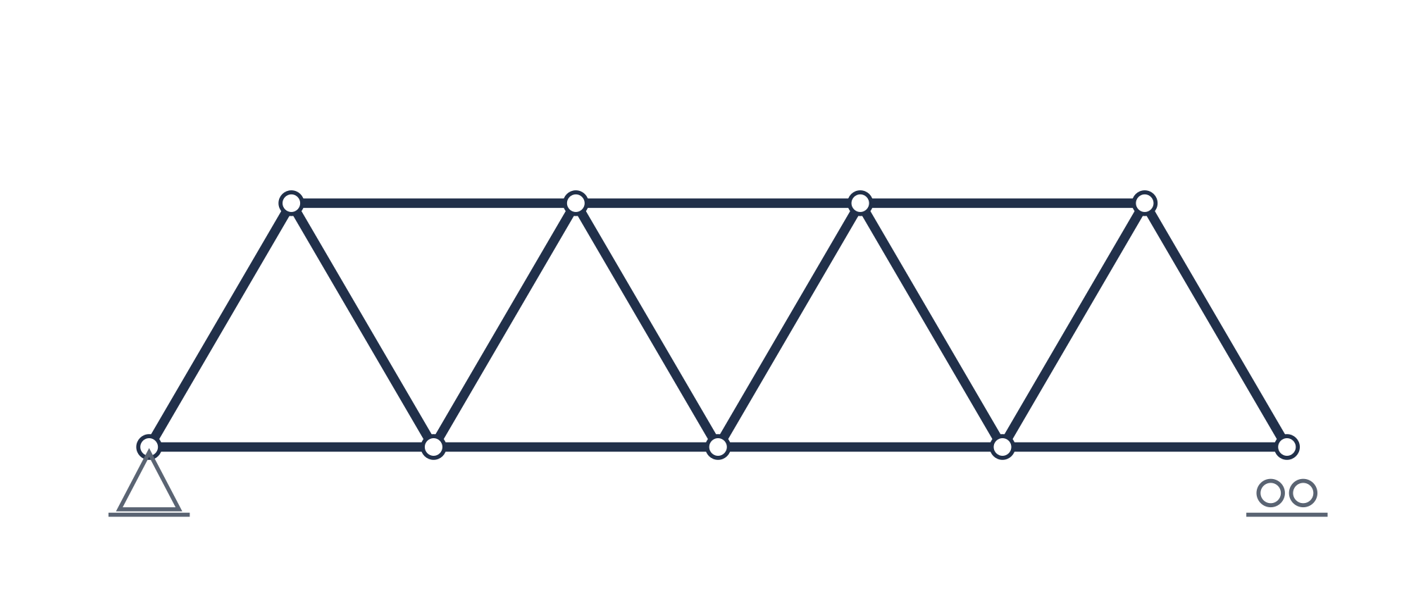
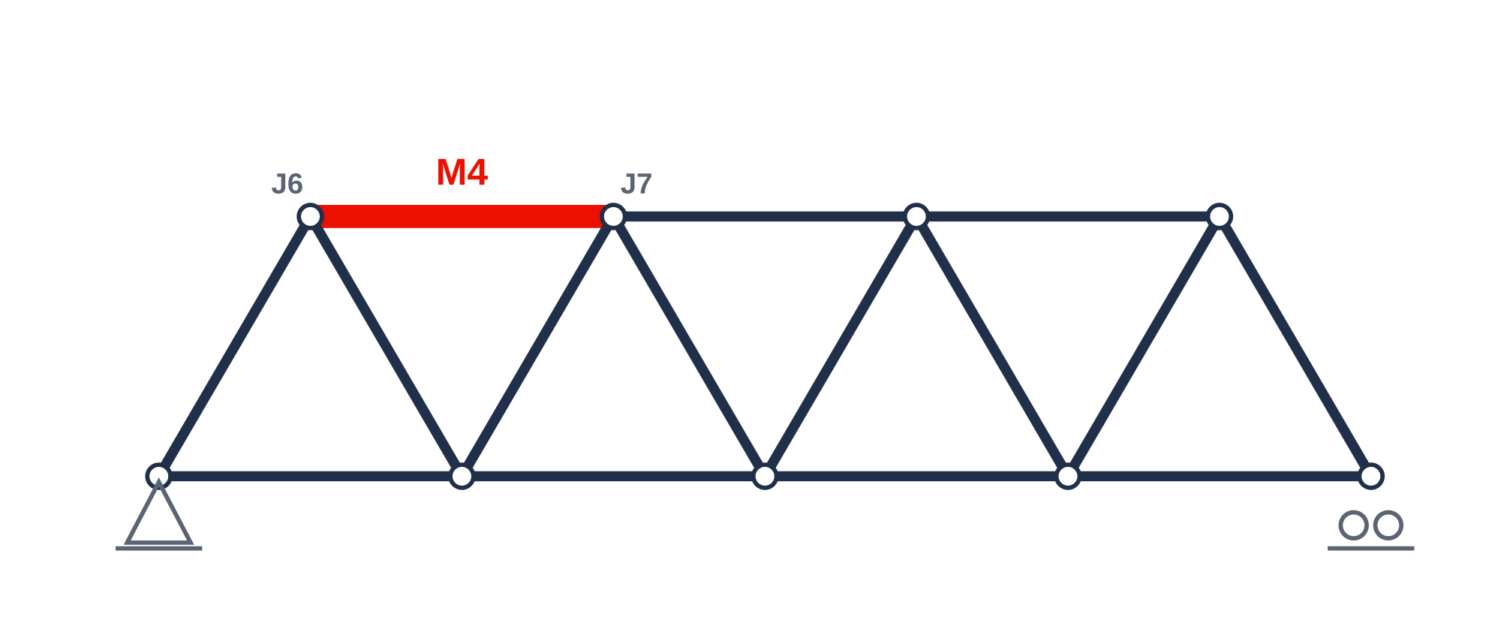
Telling the Model Which Member Is Failing
The physics solver knows which member is about to buckle, but that detail was missing from what the model saw.
Before, it changed the wrong members
After, it changes the right member
12 → 68%
feasibility (14B)
0 → 4 / 6
strong model, no training
The model could always reason well. What it lacked was one fact. Before the fix, even a much larger model changed the wrong members and the design barely improved. Adding the line that names the failing member, worst member: M4, fixed that.
Notes:
The single most important lesson. The solver always computes the buckling-critical member, but the prompt template dropped it, so the model inferred the critical member from raw numbers and inferred wrong, scaling the wrong members while the real culprit went untouched. Restore one string and feasibility jumps from 12 to 68. The cleanest proof it was information, not capability: a strong model with no training went from zero of six to four of six. Reasoning was never the bottleneck; the missing fact was.

Slide 10
The Reward Function
The best configuration uses a single dense reward term. The real leverage was elsewhere.
Why this reward
configs/rl/grpo_mt_01b.yaml
reward_fn: composite
reward_weights:
lagrangian_potential: 1.0
cost_fn: null
posterior: { alpha: 5.0, gamma: 0.99 }
Dense
every step gets signal, with no waiting for a terminal feasible or infeasible verdict
Policy-invariant
it telescopes to the terminal feasibility objective, so shaping cannot change the optimum
Physics-grounded
computed directly from the solver states the loop produces
Potential-based shaping
r_env = γ·Φ(s′) − Φ(s) where Φ folds the constraint violations (FOS deficits, mass) into one Lagrangian potential, with multiplier α = 5.
Group-relative (GRPO)
K = 8 rollouts per problem give the advantages, with kl_coef β = 0.04 anchoring to the warmstart
Notes:
The champion reward is deliberately minimal: a single dense lagrangian-potential term, everything else off. Classic potential-based shaping: gamma times potential at the next state minus potential now, where Phi packs all constraint violations into one scalar with multiplier alpha five. Four properties on the right: dense, signal every step; policy-invariant, it telescopes so shaping cannot move the true optimum; physics-grounded, read off solver states; and GRPO wraps it, eight rollouts per problem give advantages, a small KL coefficient anchors to the warmstart. Hold alpha equals five; the next slide shows that tuning it the obvious direction backfires.

Slide 11
Reward Ablations
We changed one thing per run. The plain single-term reward stayed the best.
Alpha sweep, no feedback. Feasibility is non-monotone
What else we tried
Refutes the design doc
which predicted that higher α is always better, it is not
Added a grammar-compliance reward
did not recover format, and slightly hurt feasibility
Added an explicit mass-violation reward
regressed 68% to 52%, too conservative
Verdict
the plain single-term reward at α = 5 stays the best
The leverage was the protocol and the feedback, not reward shaping.
Notes:
We did the obvious reward engineering and it mostly hurt. The alpha sweep on the left gives eight, twelve, four percent for alpha two, five, ten, non-monotone, peaking at five; alpha ten over-weights the multiplier and destabilizes. That refutes our own design doc, which predicted higher alpha is better. On the right: a grammar-compliance reward did not fix format drift and slightly hurt; an explicit mass-violation term is the regression, sixty-eight to fifty-two, too conservative about mass. Verdict: the minimal reward at alpha five wins. Reward shaping was not the leverage; protocol and feedback were.

Slide 12
What the Model Produces Each Turn
What a single turn looks like for the champion model.
<think>
Okay, let's see. The truss is infeasible because the buckling factor
of safety is too low (0.44) and the deflection too high (4.28e-02 m).
The main issue is the buckling FOS, way below 1.5.
The worst member
is M4, which is J6–J7
. So I need to address that. Current r is
0.0380 m, t is 0.0031 m. Increasing the radius would help…
</think>
<action>SCALE_PARAM(4, r, 1.36)</action>
The behavior we wanted
It reads the named worst member, M4, and changes member 4 directly.
One action per turn
Exactly one move per turn. Here it scales member 4's radius by 1.36 times. The solver then runs and returns the next state.
Notes:
What the policy actually emits: a think block then exactly one action. Champion model, first turn. It diagnoses buckling FOS 0.44 as binding and reads the critical member straight from feedback, M4 between joints six and seven, then issues one action: scale member four's radius by 1.36. Contrast with the broken regime where it guessed the wrong members. The behavior we wanted is exactly this: read the named worst member, reason, act on the right one.

Slide 13
A Full Example Trajectory
One held-out problem, solved in seven steps.
step 0
step 1
step 2
SCALE_PARAM(4, r, 1.36)
SCALE_PARAM(7, r, 1.50)
SCALE_PARAM(11, r, 1.50)
FOS_b 0.44 → 0.48
FOS_b 0.48 → 0.51
climbing…
FOS_buckling climbs past the required 1.5
FEASIBLE
in 7 steps · final FOS_b 1.69
Teacher and student
A 30B teacher reasons, and the 14B grounds each action on the named critical member. Every edit targets a specific member, and FOS rises steadily across the run.
Notes:
End-to-end behavior on one problem. Each step is a single member edit; the chips at top show the first three actions and the factor of safety climbing 0.44, 0.48, 0.51. The chart traces buckling FOS over the episode crossing the required 1.5 line, feasible in seven steps with a final FOS of 1.69. The intermediate points between step two and the terminal illustrate the climb; the anchors and the terminal are from the log. This particular trace is teacher-student: a 30B reasons, the 14B grounds the action on the named critical member. Note FOS rises steadily, the policy is not thrashing.

Slide 14
KL Divergence During Training
Reward is noisy from batch to batch, so we track how much the policy moves instead.
Runs
single-turn (broken)
multi-turn, no feedback
+ grammar reward
+ critical-member (champion)
+ mass (regressed)
0.01 learning bar
What the curves say
The single-turn run is frozen near 0.003 for all 200 steps. The champion crosses the 0.01 bar by step 35. The grammar run spikes off-scale, which is instability, not progress.
Notes:
Why KL, not reward? Reward is noisy step to step, since each batch samples different problems and the reward magnitude is problem-dependent, so reward alone does not tell you if learning is happening. KL divergence from the reference does: it measures how far the policy has actually moved. Read the curves: the gray single-turn line is pinned near 0.003 the whole run, frozen. The red champion line climbs steadily and crosses the 0.01 learning bar by about step 35, more information gives a sharper learning signal and clearer credit. The grammar run actually spikes to 0.29, off the top of this axis, which is instability, not progress. These curves are reconstructed to the logged endpoints in the next table.

Slide 15
KL Divergence by Run
The champion moved about ten times as much as the broken single-turn run.
Run | KL final | KL max | Reading
single-turn (broken protocol) | 0.0035 | 0.0036 | flat, the policy never moves
multi-turn, no feedback | 0.0049 | 0.0049 | learnable, but slow
multi-turn + grammar reward | 0.0114 | 0.293 | moves more, but unstable spike
multi-turn + critical-member fb | 0.0346 | 0.0356 | about 10x the single-turn movement
+ mass feedback (regressed) | 0.0431 | 0.136 | moves, but the wrong direction
The signals we trust are KL and eval feasibility. Reward is noisy, since each batch sees different problems, and is not comparable across steps.
Gradient norm and GRPO loss are well-behaved on the multi-turn runs. The single-turn loss is the outlier, negative and flat.
Notes:
The exact numbers behind the curves. Final KL: single-turn 0.0035, frozen. No-feedback 0.0049, learnable but slow. Grammar 0.0114 final but a 0.293 max, that is the instability spike. Champion at 0.0346, roughly ten times the single-turn movement, and a tight max of 0.0356, it moved a lot and stayed stable. The mass run moved most, 0.0431, but in the wrong direction, more movement is not better if it is toward over-conservatism. Bottom line: trust KL and eval feasibility; reward and even loss are diagnostic at best here.

Slide 16
Completion Length and Cost
The multi-turn runs do real reasoning. The frozen single-turn run barely uses any tokens.
Mean completion length per rollout
~500 s
K = 8
per GRPO step
rollouts / problem
Why it costs more, and why it is worth it
These 4 to 5k tokens are real multi-turn reasoning, not padding. The single-turn run sits near 1k, going through the motions.
Engineering note
Keeping training tractable required a batched rollout. The rollout loop, not the loss, is where the cost and the correctness live.
Notes:
Doing this honestly is not cheap. The multi-turn runs spend four to five thousand tokens per rollout, that is the model genuinely reasoning across turns, reading feedback, planning the next edit. The single-turn run sits at about a thousand tokens: a frozen policy going through the motions. Two cost facts on the right: about 500 seconds per GRPO step, with eight rollouts per problem for the group-relative advantages. To keep that tractable we built a batched rollout. The engineering takeaway echoes fix one: in agentic RL the rollout loop, not the loss function, is where both the compute cost and the correctness live.

Slide 17
Held-Out Evaluation
Feasibility, grammar success, and strength across the five configurations.
Held-out feasibility
Eval cell | Feas. | Grammar | FOS_b
warmstart (no RL) | 0% | 1.00 | 0.41
GRPO, no feedback | 12% | 0.44 | 1.42
GRPO + grammar | 4% | 0.42 | 1.53
GRPO + critical-member | 68% | 0.67 | 1.38–1.63
GRPO + critical + mass | 52% | 0.67 | 1.50
These are 25-problem numbers and carry about ±8%. A 50-problem robust eval of the champion is in flight.
Notes:
Held-out evaluation confirms the training story generalizes. The bar chart is feasibility: zero, twelve, four, sixty-eight, fifty-two. The table adds grammar success and FOS. Two things to notice. The warmstart has perfect grammar, 1.00, and zero feasibility, it formats beautifully and solves nothing, the next slide's whole point. And the champion's FOS sits in the 1.38 to 1.63 band, right against the 1.5 requirement. Caveat on the right: these are 25-problem numbers with about plus-or-minus eight percent noise, so we are running a 50-problem robust eval of the champion now to tighten that.

Slide 18
Grammar Success and FOS
The warmstart formats perfectly but solves nothing. Training trades some format for large strength gains.
Grammar success
Mean FOS_buckling
The trade is a knob, not a law. Training drifts to about 0.45 to 0.67 grammar for the strength gains. Grammar drift wastes about a third of turns, which a format-protecting constraint could fix (see the roadmap).
Notes:
This slide reads the tension between two columns from the eval table. Left, grammar success: the warmstart is a perfect 1.00, and recall it solves nothing. The trained policies drift down to the 0.44 to 0.67 range. Right, mean FOS buckling with the 1.5 feasibility line: the warmstart is far below at 0.41, and every GRPO variant clears or approaches the line. So training trades some format compliance, drift and forgetting of the warmstart's perfect grammar, for large strength gains. The key framing for the roadmap: this trade is a knob, not a law. The grammar drift is about a third of turns wasted, and we have a candidate fix, a format-protecting KL constraint, coming up.

Slide 19
The Information Bottleneck
A strong model that can see the failing member solves the task with no reinforcement learning.
4 / 6
0 / 6
2.12
strong model told the
failing member, no training
the same test, without
the failing member named
best FOS from a short
search over edits
What this shows
A strong model that can see the failing member solves the task with no training at all. The reasoning ability was always there. What the system lacked was the one piece of information that makes the problem easy. The training gains are real, but they are mostly the model finally being told what it needed to know.
Notes:
This is the intellectual core of the report. We ran a zero-shot probe: take a strong 30B reasoner paired with the 14B action head, give it the critical-member feedback, and run it with no RL at all. It solves four of six. Strip the critical member back out and the same probe solves zero of six. Separately, a short tree-expansion search reaches the best FOS we have seen, 2.12, at full reliability. Put together, these say the reasoning capacity was always there, the system was simply missing the one fact that makes credit assignment trivial. So yes, the RL gains are real, but read honestly they are largely the model finally being told what it needed to know. That reframes the whole project from we tuned RL to we fixed the information channel.

Slide 20
One Evaluation Turn in Detail
One turn from the champion model. The feedback now names the member that is about to buckle.
Feedback from the physics solver
policy response
Mass: 116.73 kg
FOS (buckling): 0.48
FOS (yielding): 2.49
Max deflection: 3.91e-02 m
Status: INFEASIBLE
Constraint violations:
– Buckling FOS 0.48 < 1.5 → worst member: M4
– Deflection 3.91e-02 m > 0.01 m allowed
<think>
The main issues are the low buckling FOS and excessive
deflection. The worst member for buckling is
M4 (J6–J7). Current
FOS 0.48, way below 1.5. Since M4 is critical, increasing
its cross-sectional area should help…
</think>
<action>SCALE_PARAM(4, r, 1.5)</action>
Notes:
One concrete, auditable turn, the kind of artifact that makes the result legible. Left is exactly what the solver hands back: mass 117 kilos, buckling FOS 0.48 in red because it is below 1.5, yielding fine at 2.49, deflection over its limit, status infeasible, and critically, the violations line now names the worst member, M4. Right is the policy's response: it reasons that M4 is the critical buckling member with FOS far below 1.5 and that increasing its cross-section should help, then emits a single action scaling member four's radius by 1.5. This is the behavior the entire study was chasing: read the named critical-member signal, reason about it, act on the right member.

Slide 21
The Remaining 32%
Adding the missing information has reached its limit. The remaining failures fall into three kinds.
Where the 32% goes, and the fix each one needs
Mass over-shoot (3)
FOS fixed but mass exceeded → soft reward-side FOS and mass balancing
Degenerate FEA (4)
structurally broken or very heavy intermediate states → robust state handling
68%
feasible
Grammar drift (~33% wasted turns)
the policy forgets the warmstart format → format-protecting constraint
A hard prompt rule over-corrects, as the mass regression showed. The next gains must come from softer, structural fixes.
Notes:
What still fails, and the honest news that the easy lever is spent, adding the critical member gave us 12 to 68, but the mass tweak regressed, so add more to the prompt is done. The remaining roughly 32 percent breaks into three kinds, each needing a different fix. Mass over-shoot, three problems: FOS gets fixed but mass blows the cap, that needs soft reward-side balancing between FOS and mass, not a hard rule. Degenerate FEA, four problems: structurally broken or very heavy intermediate states the solver chokes on, that needs robust state handling. And grammar drift, about a third of all turns wasted, because the policy forgets the warmstart's perfect format, the candidate there is a format-protecting constraint. The throughline: a hard prompt rule over-corrects, so the next gains are softer, structural fixes.

Slide 22
Roadmap
Three changes on the main path, with distillation kept in reserve.
01
02
03
★
Soft FOS and mass balancing
Format-protecting constraint
Robust degenerate states
Distillation (in reserve)
A reward-side trade-off so the policy fixes buckling without over-shooting mass, since a hard rule over-corrects.
Keep the policy close to the warmstart format to stop grammar drift and reclaim the wasted turns.
Handle structurally broken or very heavy intermediate designs so the solver returns usable signal.
The 30B teacher now produces trajectories that solve 67%, worth distilling into the 14B if the above stall.
Each step targets a named failure mode from the previous slide, so the gap to 90% and beyond is a list, not a mystery.
Notes:
The roadmap, and the good news is it is a list rather than a mystery, each item maps to a failure mode we just diagnosed. One: soft FOS-mass balancing on the reward side, because the hard rule over-corrected. Two: a format-protecting constraint to stop grammar drift and win back that third of wasted turns. Three: robust handling of degenerate and very heavy intermediate states so the solver keeps returning usable signal. And held in reserve, a star item: the 30B teacher already produces trajectories that solve 67 percent, so if the first three stall we distill those into the 14B. That is the concrete path from 68 toward 90 and beyond.

Slide 23
Key Takeaways
Four lessons from taking a 14B model from 0% to 68%.
01
Protocol first A per-turn policy must be run per-turn. The single-turn mismatch alone cost almost all feasibility, so match training to deployment.
02
Information beats reward engineering One missing field, the failing member, was worth 56 points. Extra reward terms for grammar and mass hurt.
03
KL is the honest signal When reward is noisy across problem batches, how much the policy moves tells you whether it is actually learning.
04
14B is enough With the right loop and the right feedback, a 14B model solves the majority, with no bigger model or fancier method required.
Notes:
Four lessons that travel beyond this benchmark. One, protocol first: a per-turn policy has to be run per turn; that single mismatch cost us essentially all our feasibility, so match your training to your deployment. Two, information beats reward engineering: one missing field was worth fifty-six points, while every extra reward term we added hurt. Three, KL is the honest signal: when reward is noisy because each batch samples different problems, how much the policy moves is what tells you it is learning. And four, 14B is enough: with the right loop and the right feedback, a small model solves the majority, we did not need a bigger model or a fancier algorithm. If you take one thing away, it is that we spent our effort fixing what the model could see, not how it learned.

Slide 24
Information and protocol, not reasoning or RL
A 14B model, given the right loop and the right feedback, solves most held-out truss problems.
In flight
Reproduce
A 50-problem robust eval of the champion, since the 25-problem numbers carry about ±8%. Then closing the gap to 90% and beyond with the roadmap.
python scripts/make_report_figs.py
→ results/report/*.png
audit trail in docs/ablation_ledger.md
github.com/WenzhuoXu/designbench_llm_finetune
Thank you · questions welcome
Notes:
Close on the thesis: this result was about information and protocol, not reasoning capacity or the RL algorithm, a 14B model with the right loop and the right feedback solves the majority. What is in flight: a 50-problem robust eval to firm up the plus-or-minus-eight-percent numbers, and the structural roadmap toward 90 and beyond. Everything reproduces from make_report_figs, with the full decision trail in the ablation ledger. Code is on GitHub. Open it up for questions, likely ones: why GRPO over PPO, how the Lagrangian potential is defined exactly, and whether the critical-member finding generalizes beyond buckling.

