Slide 1
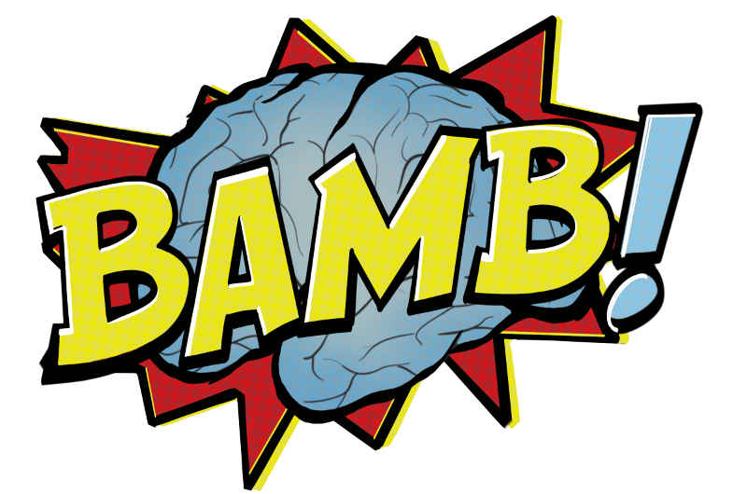
Tutorial 5: Drift-diffusion models
BAMB! Summer School Day 6

Slide 2

When to use a DDM
You want to incorporate both choice and response time
If you don’t care about RT, there are simpler models
You have two alternatives
If you have only one alternative, you can fit a Wald distribution instead
If you have more than two alternatives, you (probably) need to use a race model

Slide 3
Tutorial overview
Hour 1: Simulating the DDM by hand
Construct a DDM from first principles
Hour 2: Simulating the DDM using PyDDM
Use efficient and higher-accuracy methods to perform simulations
Hour 3: Fitting the DDM to data
Use PyDDM to fit the DDM to monkey random dot motion data
Hour 4: Generalized drift diffusion models (GDDMs)
Create variants of the DDM which are specialized to specific tasks or encapsulate distinct strategies

Slide 4
Models from this course related to DDM
DDM-HMM
When the emission is a response time and a choice
Bayesian (hierarchical) DDM
Parameter estimates with limited data, pooling across subjects, distributions of parameter estimates
DDM
Likelihood approximation network
Neural network for fitting complex DDM-like models that cannot be easily simulated
RL-DDM
Incorporating response time information into RL

Slide 5
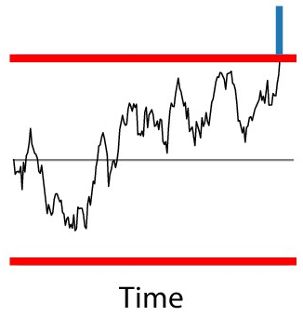
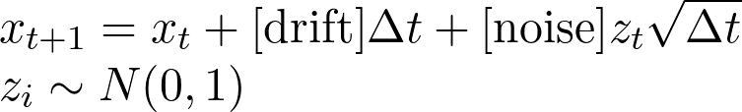
Hour 1: Simulating the DDM by hand
Basic algorithm
1. Set x to starting point
2. Set:
3. Check if x crosses a boundary. If so, you are done
4. Otherwise, go to (2)

Slide 6
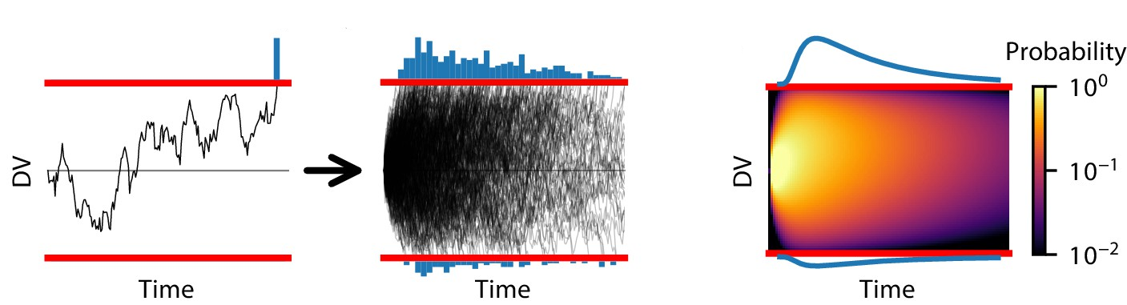
Hour 2: Simulating the DDM using PyDDM
Use more efficient methods to simulate the probability distribution of a trajectory’s position instead of one trial at a time

Slide 7
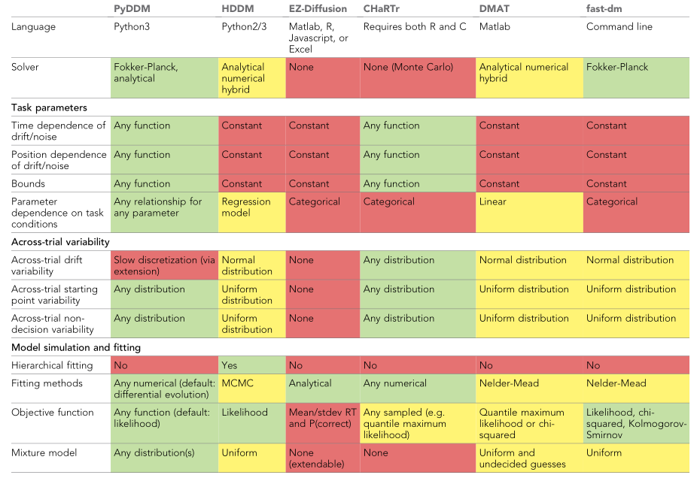
DDM libraries

Slide 8
How PyDDM works:
Construct a Model from its components
Model components:
Drift rate
Noise
Bound
Initial Condition
Non-decision time
Mixture model

Slide 9
Many model components are built-in:
Each component can be:
A constant value (e.g., 3)
A fittable parameter, given by the the name (e.g., param1)
A function which depends on:
Parameters
Task conditions
Magic arguments

Slide 10
Parameters and conditions
Parameters: Have the same value for the entire dataset
E.g. bound height
Conditions: May change from trial to trial
E.g. strength of motion coherence

Slide 11
Three objects to remember in PyDDM
Model: created by the gddm() function
May need to call model.fit() before using if there are parameters
Solution: Created using model.solve(conditions={...})
Sample: RT and choice data, either experimental or simulated data

Slide 12
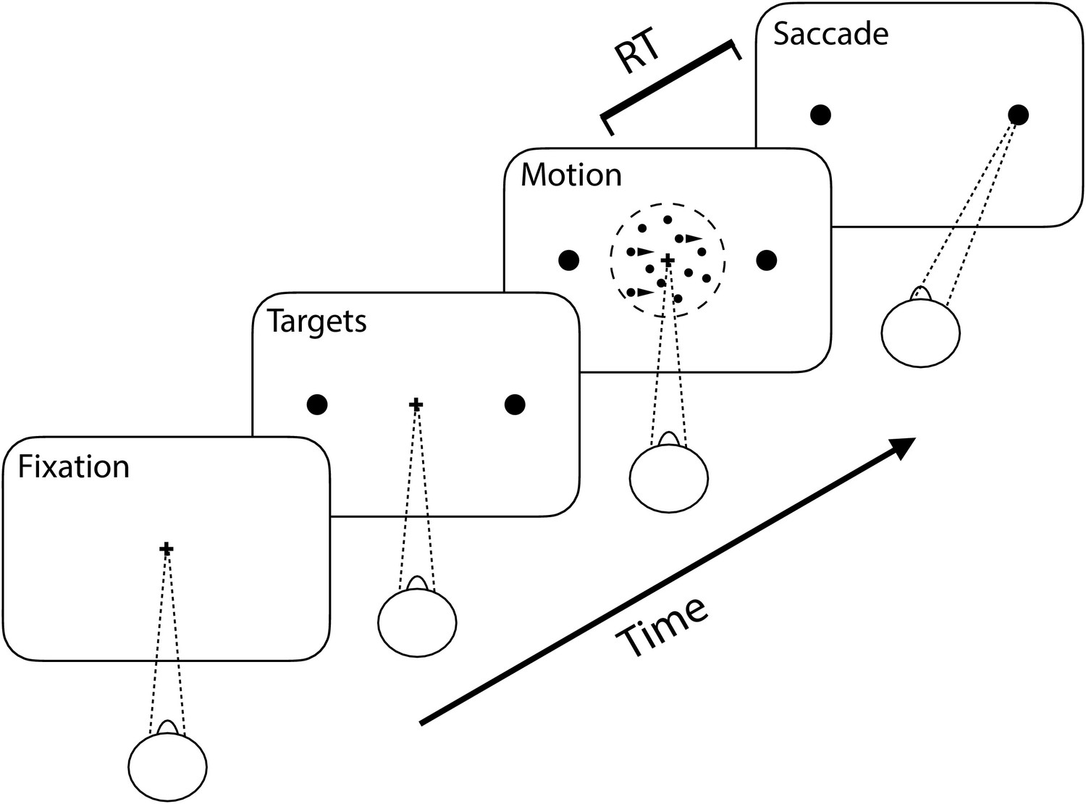
Hour 3: Fitting the DDM to data
Dataset: Monkeys performing the random dot motion task (Roitman and Shadlen, 2002)
Several levels of motion coherence
https://shadlenlab.columbia.edu/resources/RoitmanDataCode.html

Slide 13
Hour 4: Generalized DDMs (GDDMs)
Construct a more complex model, or a model for a more complex task
Magic arguments:
Time in the simulation t
Positions of the decision variable x
A vector of all simulation times T

Slide 14
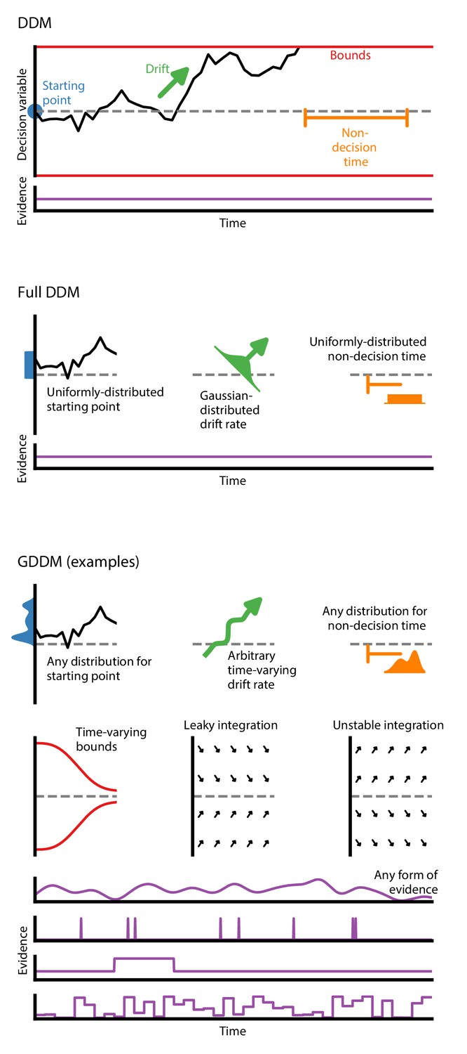
Example GDDMs

Slide 15
When should you use these GDDMs?
Response time distribution is not skewed
Consider leaky integration
The speed-accuracy tradeoff may change across the trial
Consider collapsing bounds
I think the agent may be more likely to choose one choice over another or have a prior
Consider a starting point or drift bias
Evidence is not constant in my task or it requires multisensory integration
Consider a more complex drift rate function
There is a large variability in motor actions
Consider non-decision time variability (but be careful! This can make the model non-recoverable)

