Slide 1
About access.mobile
access.mobile (AM) is a global mobile technology company
  Headquarters in Denver, CO USA & affiliate in Kampala, Uganda (access.mobile Uganda LTD)
  AM is locally registered in Uganda
AM designs proprietary mobile technology solutions for data capture and analytics in health and supply chain
HIPS uses AM’s mobile technology solutions for data capture and supply chain management

Slide 2
HIPS and AM’s mobile deployment mimics the paper data collection process previously used
HIPS and AM worked closely to develop mobile versions of the paper ledgers used for data collection in HIPS clinics
AM’s system uses mobile forms on Java-based feature phones deployed to clinic data managers by HIPS
Partner clinics send data on over 150 indicators monthly and quarterly
HIPS administrators and partner clinics can access the information on dashboards and export all forms using excel
Goals of project include:
  Improving efficiency of HIPS data collection process
    Evaluating solution by time, efficiency and ease of use
  Reducing stock outs of ARVs

Slide 3
Today, HIPS has rolled out the mobile solution nationally to all partner clinics without access to internet
Currently, 70 HIPS partner facilities across Uganda use amHealth and amSupply for data capture and supply chain management
  30 sites have internet access and do not use the solution
HIPS and AM rolled the program out in two phases:
  January 2012 = Phase 1, 38 private clinics
  March 2012 = Phase 2, 32 private clinics

Slide 4
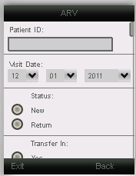
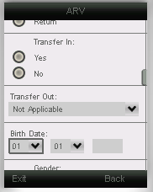
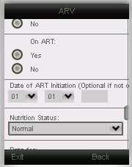
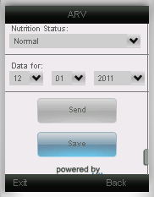
Sample Mobile Form

Slide 5
HIPS and AM are measuring the impact of the mobile deployment at partner clinics
Surveys administered as part of Phase 1 and Phase 2 trainings
Surveys tracked time, convenience, and efficiency
Identical surveys administered at Phase 1 training sessions in January and Phase 2 training sessions in March
Included 68 participants across all training sessions
  67 surveys included in analysis
  1 survey excluded because clinic data manager had not completed a HIPS reporting cycle and could not answer questions

Slide 6
Uganda HIPS Key Findings: Time
75% of clinics reported either one or two people are responsible for data entry and management
  The remaining 25% reported 3-5 individuals responsible for data entry and management
Clinics reported spending an average of 7.3 hours per week on data collection
  Urban clinics reported spending approximately 7.2 hours per week, while rural clinics spend an average of 6.4
Follow up surveys conducted with data managers show some sites citing a drop to 2 hours per week on data collection using mobile system

Slide 7
Uganda HIPS Key Findings: Convenience
70% of clinics had difficulty reporting on time
  78% of Urban and Rural clinics had difficulty reporting on time
30% of clinics had difficulty reporting correctly
  38% of rural sites had difficulty reporting correctly
53% of sites had difficulty reporting all indicators
  This was nearly uniform across site locations
  65% of sites disagreed or strongly disagreed that paper reporting was efficient
    12% of sites agreed that paper reporting was efficient, while the remaining clinics were neutral

Slide 8
Uganda HIPS Key Findings: Efficiency
52% of sites disagreed or strongly disagreed that paper reporting was efficient
61% of sites disagreed or strongly disagreed that the paper system helped reporting, while 26% agreed
  Rural and peri-urban sites were more likely to disagree or strongly disagree than urban sites

Slide 9
Uganda HIPS: Successes and Ongoing Lessons Learned
Successes
  High uptake in system use and high reporting rates
  Devices have been maintained by all sites with limited turnover or loss
  Positive user acceptance and feedback
  Strong working relationship with the HIPS team
Ongoing Lessons Learned
  Maintaining incentives to enter data will be critical
  Ongoing reminders for data entry essential
  High volume sites may require multiple devices

