Slide 1
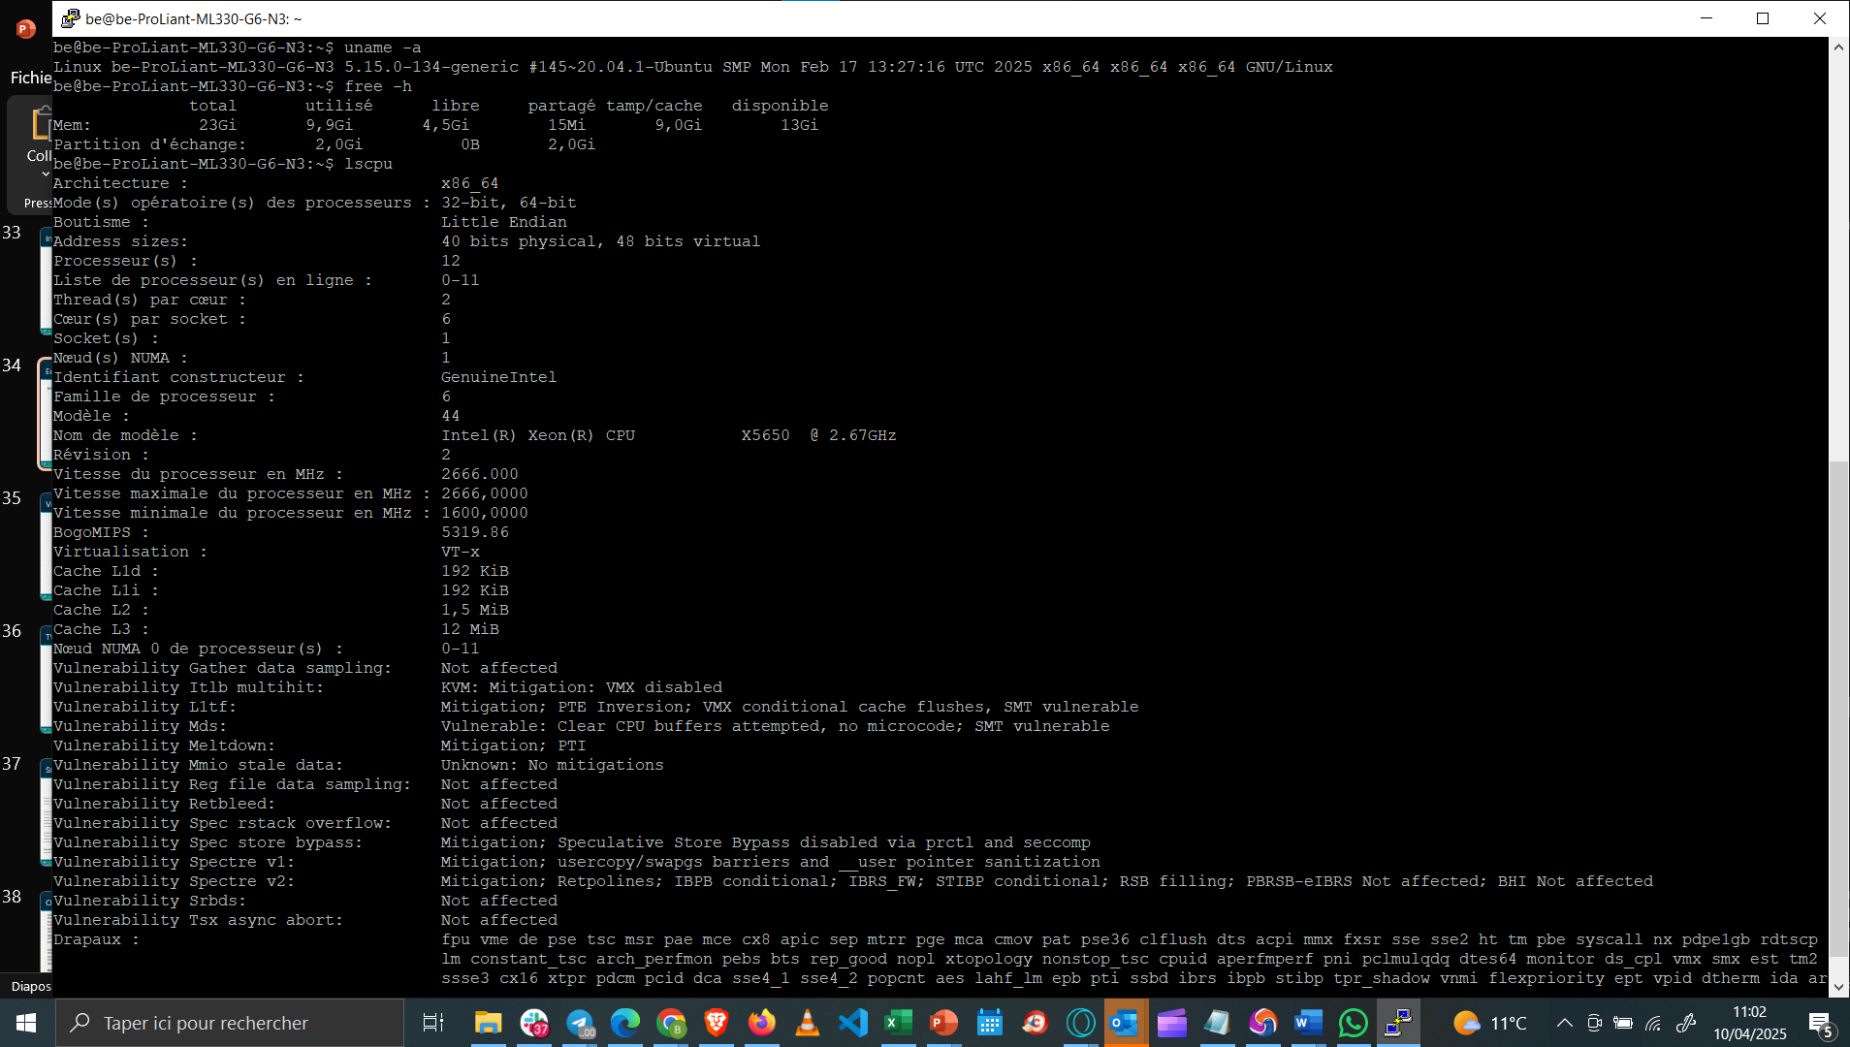
Currently Ubuntu 20
Will be upgraded to 22
24GB RAM
12 CPUs

Slide 2
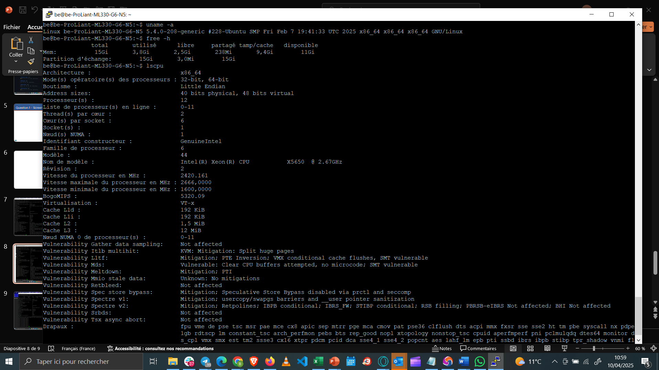
Currently Ubuntu 20
(5.4.0 Kernel is Ubuntu 20.04 LTS)
Will be upgraded to 22
16GB RAM
12 CPUs

Slide 3
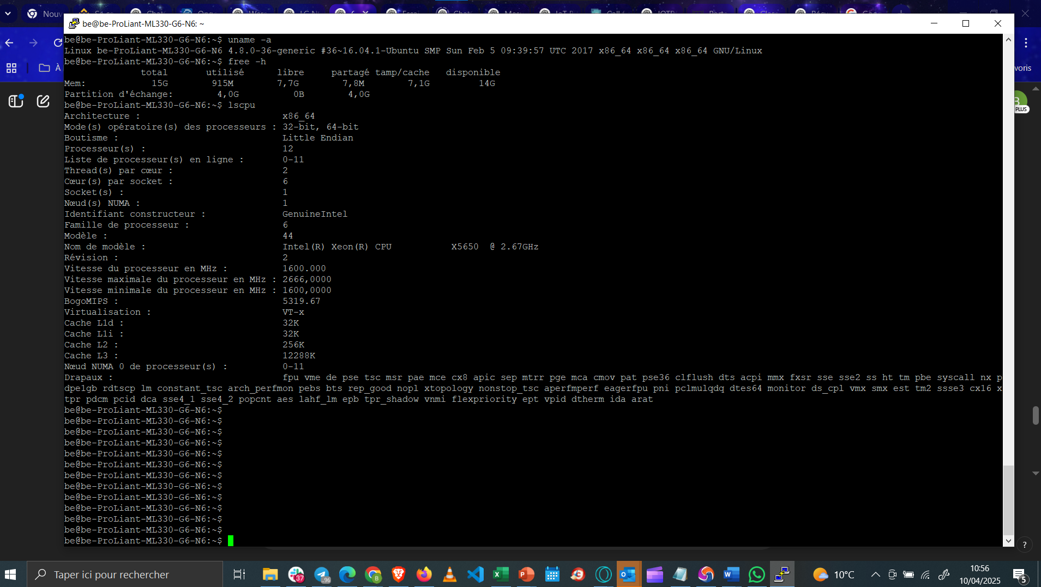
Currently Ubuntu 20
Will be upgraded to 22
16GB RAM
12 CPUs

Slide 4
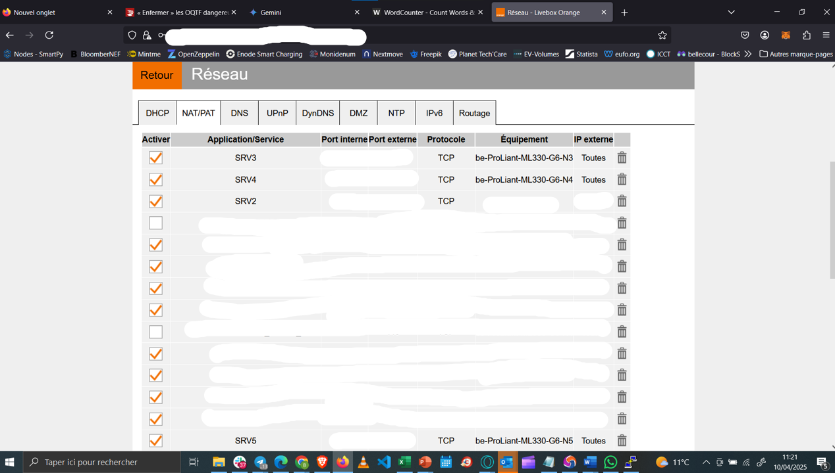
Serveur N6 is currently on the LAN as N4 (which is under maintenance)

