Slide 1
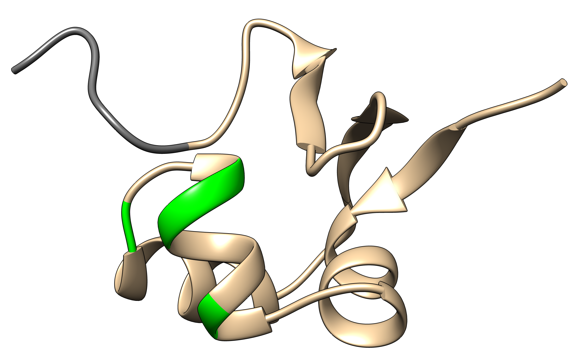
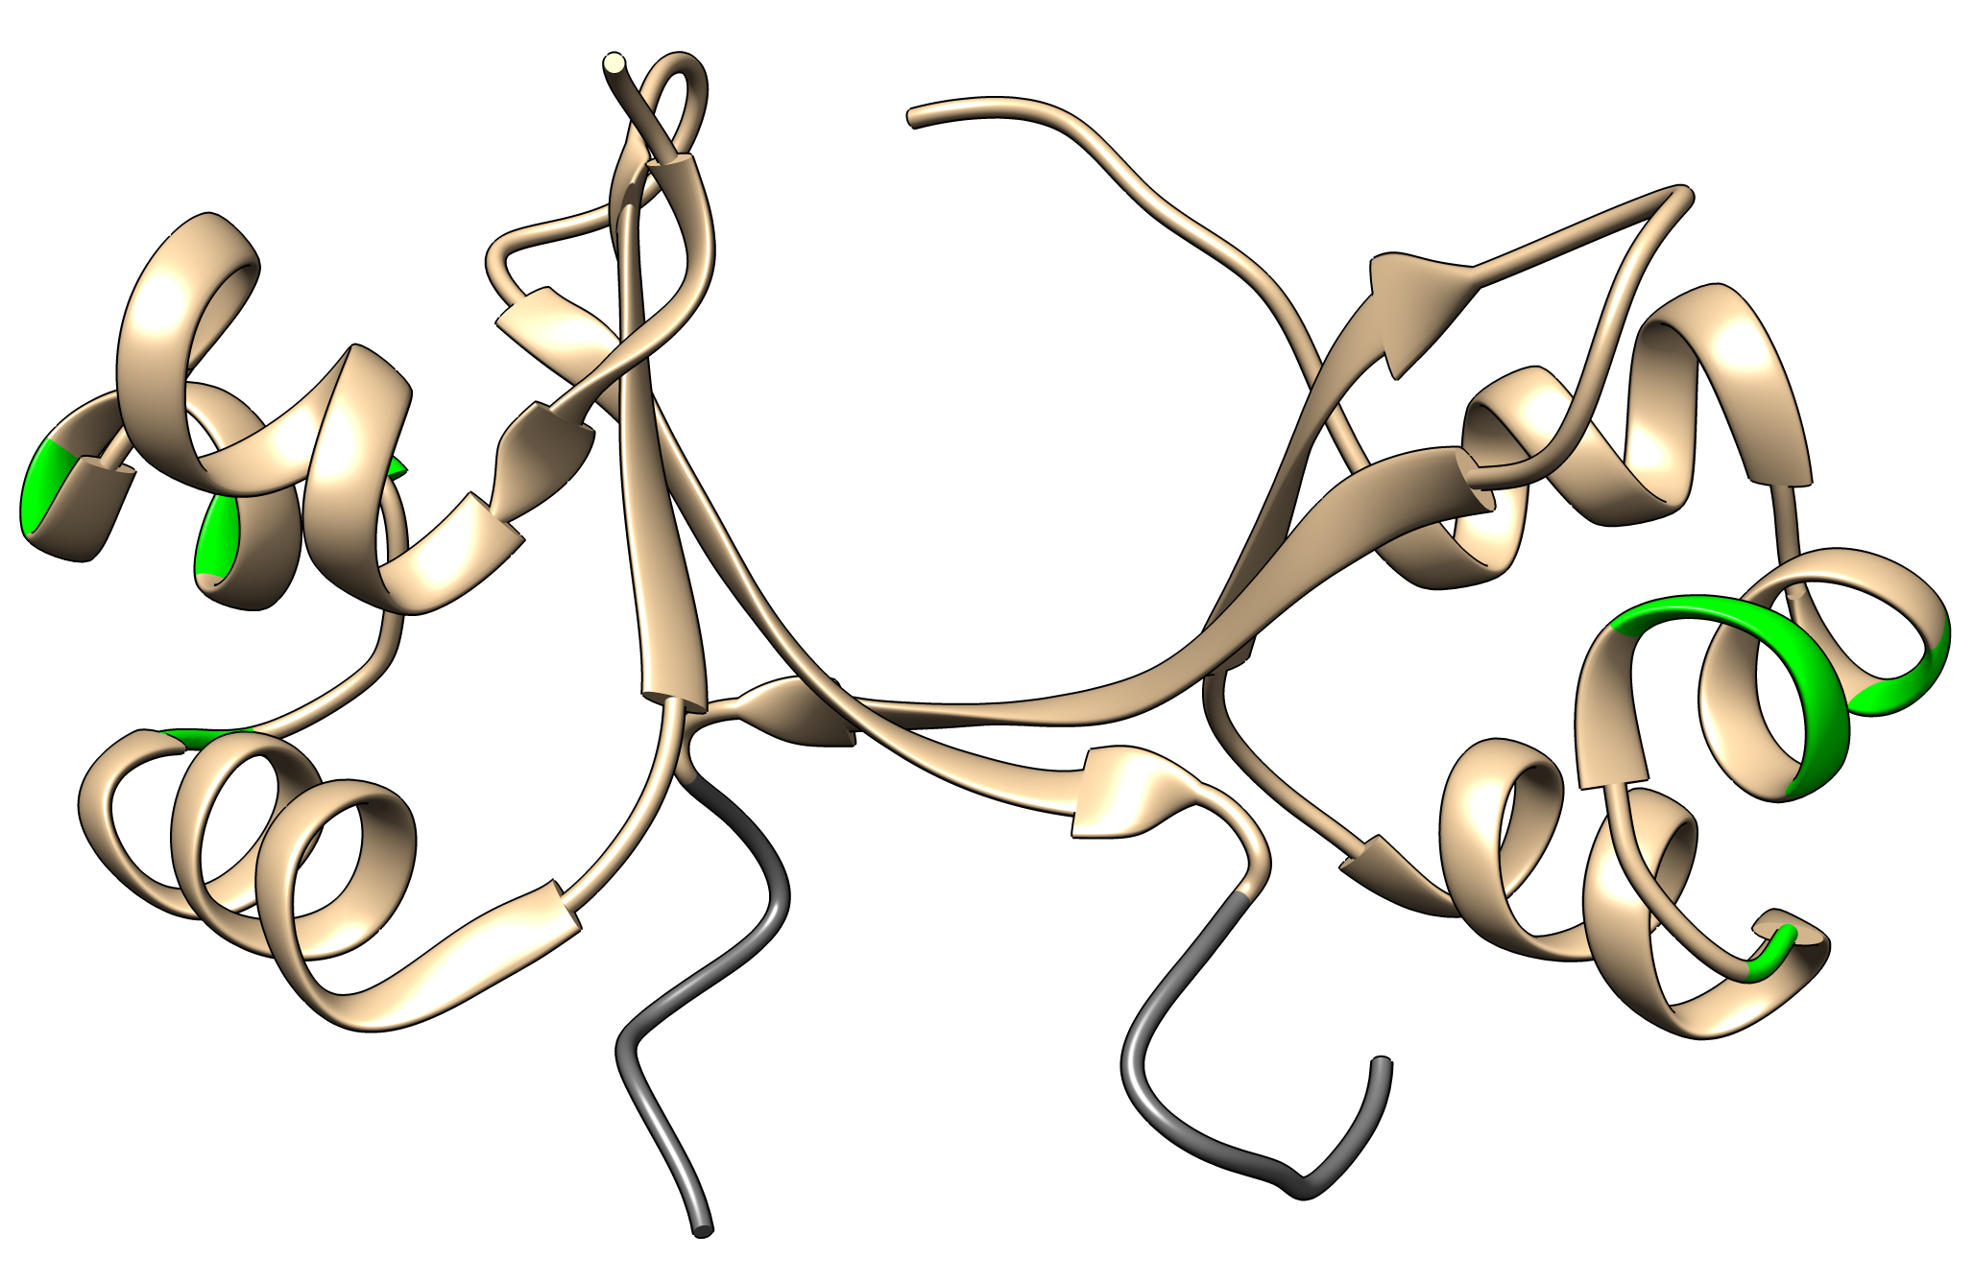
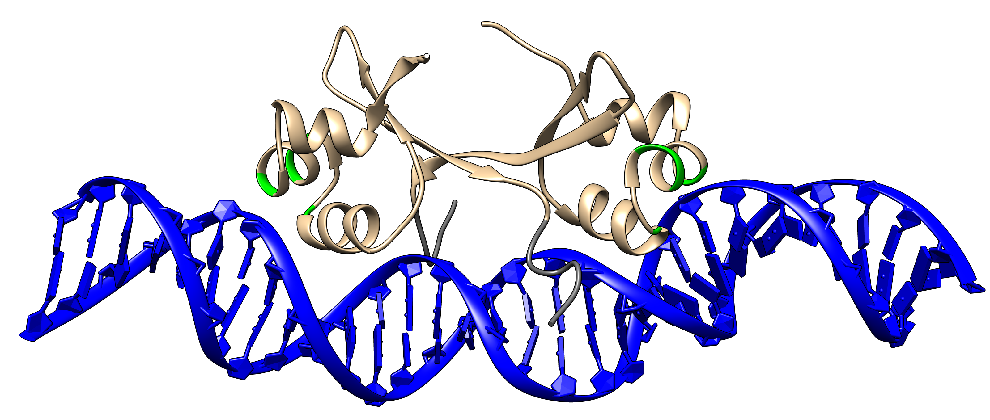


A.
B.
C.
D.
Wild Type Cro | MEQRITLKDY AMRFGQTKTA KDLGVYQSAI NKAIHAGRKI FLTINADGSV YAEEVKPFPS NKKTTA
Act3 Cro | MEQRITLKDY AMRFGQVKTA AELGVNQSAI NKAIHAGRKI FLTINADGSV YAEEVKPFPS NKKTTA
Act8 Cro | MEQRITLKDY AMRFGQTKTA VELGVNQSAI NKAIHAGRKI FLTINADGSV YAEEVKPFPS NKKTTA
E.
DNA Sequence | GCAACCATTA TCACCGCCGG TGATAAAATA GT CGTTGGTAAT AGTGGCGGCC ACTATTTTAT CA

