Slide 1
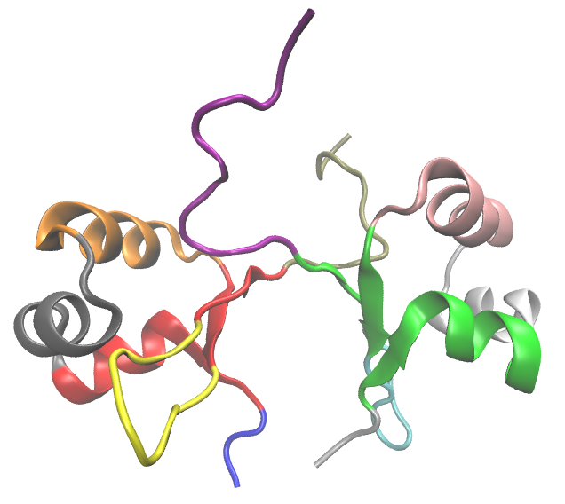
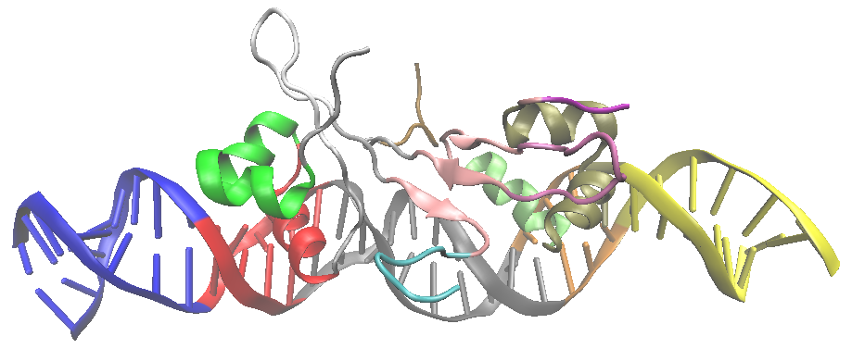
A.
B.
E.
C.
Wild Type
Act 3
F.
D.
Wild Type
Act 8
Unbound Dimer
DNA-Bound Dimers

