Slide 1
Sales Strategy & Plan Insert Company Name
Confidential
CEO: insert your own text
Chief Sales Officer: insert your own text
Date: insert your own text
Version: insert your own text
Contact Email: insert your own text
Replace this logo by your own logo

Slide 2
Executive Summary
Even if this slide is the first one of the presentation, it needs to be done last
Mission & Vision
Mission: Insert your own text
Vision: Insert your own text
Sales Strategic Objectives
Insert strategic objective #1
Insert strategic objective #2
Insert strategic objective #3
Key Initiatives
Insert your own text
Insert your own text
Insert your own text
Insert your own text
Insert your own text
Insert your own text
Insert your own text
Insert your own text
Insert your own text
Insert your own text
Insert your own text
Insert your own text
Depending on what you want to emphasize, you may decide to put different sections in the dark blue rectangle
Product, Price & Promotion
Product: Insert your own text
Price: Insert your own text
Promotion: Insert your own text
Sales Channel Model & Strategy
Sales Channel Model: Insert your own text
Sales Channel Strategy: Insert your own text
Budget & Headcounts
Budget: Insert your own text
Headcount: Insert your own text

Slide 3

Table of Contents
1.Internal Analysis
5.Implemen-tation
2.External Analysis
Sales Strategy & Plan
4.Sales Plan
3.Sales Strategy

Slide 4
Table of Contents
Internal Analysis
External Analysis
Sales Strategy
Sales Plan
Implementation
Second option to formalize your table of contents

Slide 5
Table of Content 1.Internal Analysis
1.Internal Analysis
5.Implemen-tation
2.External Analysis
Sales Strategy & Plan
4.Sales Plan
3.Sales Strategy

Slide 6
Table of Contents
Internal Analysis
External Analysis
Sales Strategy
Sales Plan
Implementation
Second option to formalize your table of contents

Slide 7
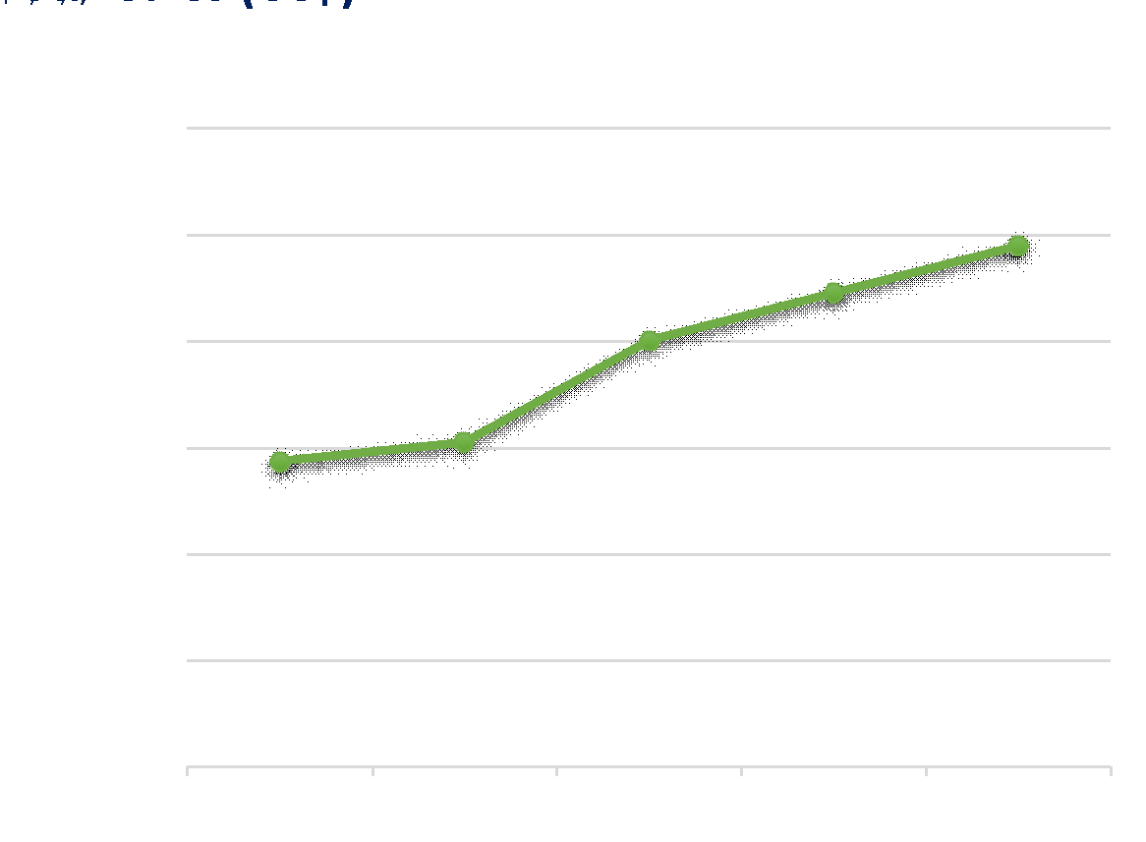
Total Sales History Replace this text with the key takeaway of this Powerpoint slide.
To edit this chart & table:
1.Open the excel sheet “Sales history and projection”
2.Edit
3.Copy paste the updated chart and table in this slide as an image
CAGR = 14%
The best practice is to always create the charts in Excel, and then copy past the charts in Powerpoint as an image. Creating charts from Powerpoint makes the Powerpoint application slowdown or even crash, especially if you have a presentation with many slides.

Slide 8
Total Sales History Replace this text with the key takeaway of this Powerpoint slide.
CAGR = 14%
CAGR means Compound Annual Growth Rate, that is to say the average sales growth that the company reaches every year. The formula to automatically calculate CAGR is in the first table of the Excel sheet “Sales History & Projection”

Slide 9
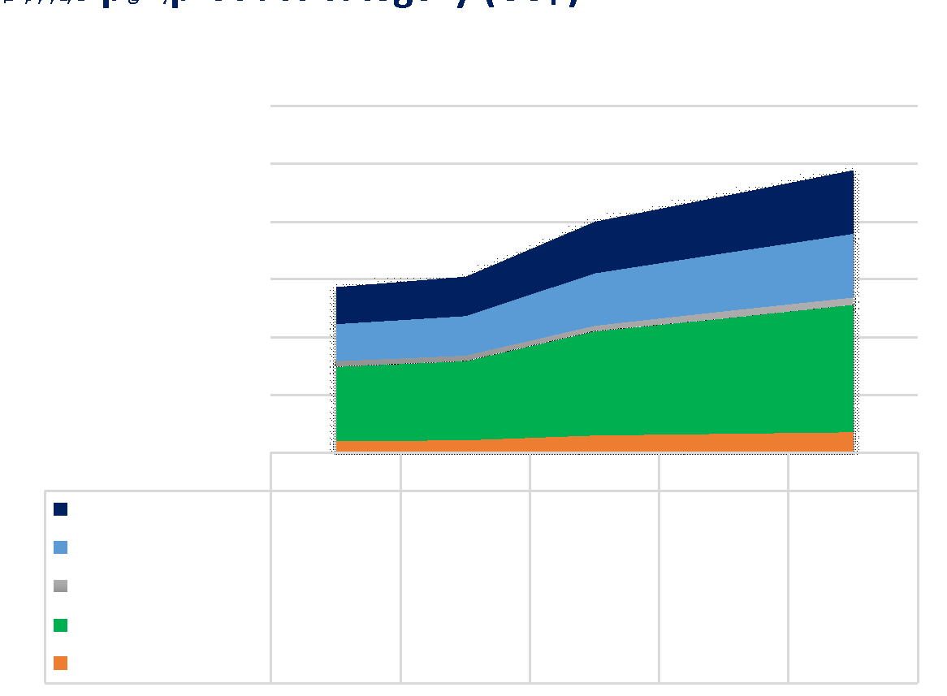
Sales History per Product Category Replace this text with the key takeaway of this Powerpoint slide.
In this slide and the following ones, we broke down the sales into different segments (e.g. products, product categories,…). Feel free to delete the slides which are irrelevant for your Business, and / or add different segments by reusing the tables and charts located in the Excel document “Sales History & Projection”

Slide 10
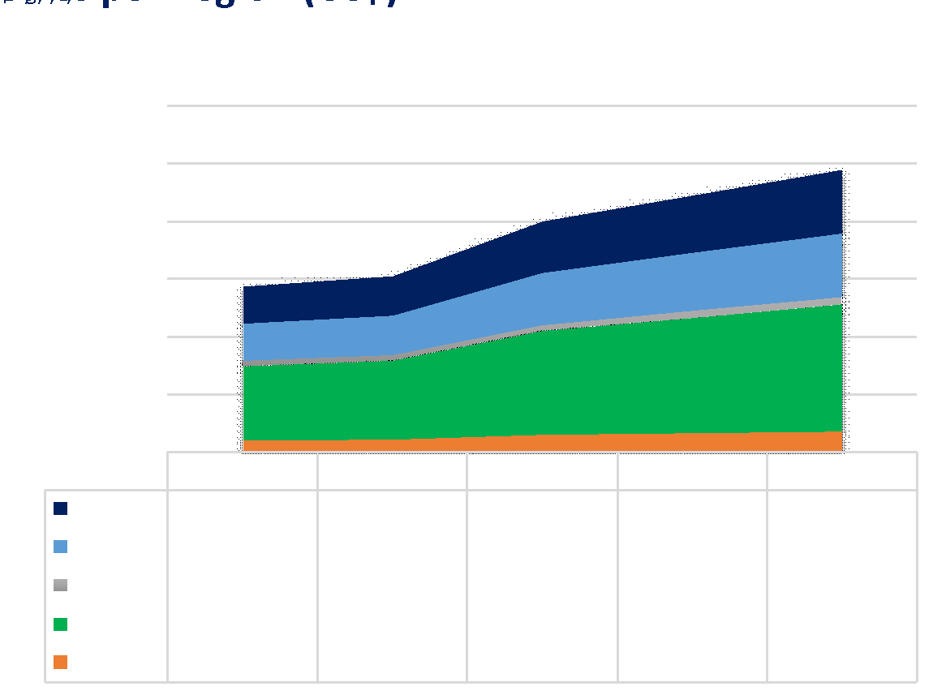
Sales History per Region Replace this text with the key takeaway of this Powerpoint slide.
If you need to illustrate your sales per region using a map, you can use the editable maps located in the Powerpoint presentation “Editable Maps Bundle”.
For example, if you are a global Organization, you may want to use a worldwide map and highlight with a different color the countries with the biggest sales.
Or if you are a national Organization located in the US, you may want to use a US map and highlight with a different color the States with the biggest sales.

Slide 11
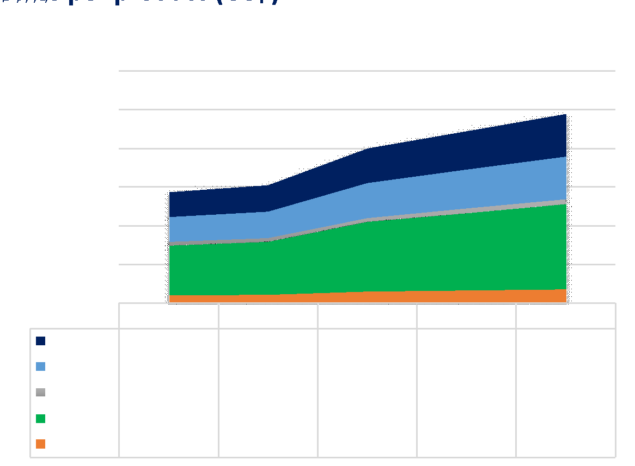
Sales History per Product Replace this text with the key takeaway of this Powerpoint slide.

Slide 12
Company Strengths & Weaknesses Replace this text with the key takeaway of this Powerpoint slide.
Strengths
Weaknesses
Insert you own text
Insert you own text
Insert you own text
Insert you own text
Insert you own text
Insert you own text
Insert you own text
Insert you own text
Insert you own text
Insert you own text
Insert you own text
Insert you own text
Insert you own text
Insert you own text
Describe what your Organization excels at and what separates it from the competition: a strong brand, loyal customer base, a strong balance sheet, unique technology, etc.
Describe what is stopping your Organization from performing at its optimum level: a weak brand, high levels of debt, an underperforming supply chain, etc.

Slide 13
Table of Content 2.External Analysis
1.Internal Analysis
5.Implemen-tation
2.External Analysis
Sales Strategy & Plan
4.Sales Plan
3.Sales Strategy

Slide 14
Table of Contents
Internal Analysis
External Analysis
Sales Strategy
Sales Plan
Implementation
Second option to formalize your table of contents

Slide 15
PESTLE Analysis Replace this text with the key takeaway of this Powerpoint slide.
Insert here any political factors that impact or could potentially impact the Business. These political factors can be local, national or international.
Examples: A new government, a new initiative, a change of policy, etc.
Political
Replace the text by your own text
Replace the text by your own text
Replace the text by your own text
Replace the text by your own text
PESTLE
Technological
Replace the text by your own text
Replace the text by your own text
Replace the text by your own text
Replace the text by your own text
P
T
Insert here any Economical factors that impact or could potentially impact the Business.
Examples: A change in disposable income, an economic downturns, the availability of bank loans, etc.
Economical
Replace the text by your own text
Replace the text by your own text
Replace the text by your own text
Replace the text by your own text
E
L
Legal
Replace the text by your own text
Replace the text by your own text
Replace the text by your own text
Replace the text by your own text
Insert here any Sociological factors that impact or could potentially impact the Business.
Examples: The demographic change of a company’s customers, a change in the cultural habits of the population, a change in lifestyle, etc.
Social
Replace the text by your own text
Replace the text by your own text
Replace the text by your own text
Replace the text by your own text
S
E
Environmental
Replace the text by your own text
Replace the text by your own text
Replace the text by your own text
Replace the text by your own text

Slide 16
PESTLE Analysis Replace this text with the key takeaway of this Powerpoint slide.
Insert here any Technological factors that impact or could potentially impact the Business.
Examples: A new software, device, patents, etc.
Political
Replace the text by your own text
Replace the text by your own text
Replace the text by your own text
Replace the text by your own text
PESTLE
Technological
Replace the text by your own text
Replace the text by your own text
Replace the text by your own text
Replace the text by your own text
P
T
Economical
Replace the text by your own text
Replace the text by your own text
Replace the text by your own text
Replace the text by your own text
Insert here any Legal factors that impact or could potentially impact the Business.
Examples: International selling laws, health and safety requirement, Data protection, competitive regulations, employment law, etc.
Legal
Replace the text by your own text
Replace the text by your own text
Replace the text by your own text
Replace the text by your own text
E
L
Social
Replace the text by your own text
Replace the text by your own text
Replace the text by your own text
Replace the text by your own text
S
E
Environmental
Replace the text by your own text
Replace the text by your own text
Replace the text by your own text
Replace the text by your own text
Insert here any Environmental factors that impact or could potentially impact the Business.
Examples: the use of plastic bags for goods, the use of electrical cars, customer values, environmental regulations, etc.

Slide 17
Target Market Replace this text with the key takeaway of this Powerpoint slide.
Target Market description
Describe in this text block your target market(s), that is to say the group of customers that you want to market your products to.
To identify your target market(s), you can use customer segmentations such as:
Geographic segmentation
Demographic/socioeconomic segmentation: gender, age, income, occupation, education, household size, and stage in the family life cycle)
Attitudes
Psychological profiles

Slide 18
Target Market Size & Growth Replace this text with the key takeaway of this Powerpoint slide.
TAM refers to the global revenue opportunity available for a product or service
Some sources of information such as government data, trade associations, financial data from major players and customer surveys should help you to provide a rough estimation
Description: Insert your own text
Size: Insert your own text
Growth: Insert your own text
Total Available Market (TAM)
Description: Insert your own text
Size: Insert your own text
Growth: Insert your own text
Serviceable Available Market (SAM)
Description: Insert your own text
Size: Insert your own text
Growth: Insert your own text
Target Market
Market
Share
Description: Insert your own text
Size: Insert your own text
Growth: Insert your own text

Slide 19
Target Market Size & Growth Replace this text with the key takeaway of this Powerpoint slide.
Description: Insert your own text
Size: Insert your own text
Growth: Insert your own text
Total Available Market (TAM)
SAM refers to the percentage of the Total Available Market (TAM) that you can actually serve
Description: Insert your own text
Size: Insert your own text
Growth: Insert your own text
Serviceable Available Market (SAM)
Description: Insert your own text
Size: Insert your own text
Growth: Insert your own text
Target Market
Market
Share
Description: Insert your own text
Size: Insert your own text
Growth: Insert your own text

Slide 20
Target Market Size & Growth Replace this text with the key takeaway of this Powerpoint slide.
Description: Insert your own text
Size: Insert your own text
Growth: Insert your own text
Total Available Market (TAM)
Description: Insert your own text
Size: Insert your own text
Growth: Insert your own text
Target market refers to the group of customers that you want to market your products to
Serviceable Available Market (SAM)
Description: Insert your own text
Size: Insert your own text
Growth: Insert your own text
Target Market
Market
Share
Description: Insert your own text
Size: Insert your own text
Growth: Insert your own text
Your market share refers to a percentage of your target market

Slide 21
Target Market Size & Growth Replace this text with the key takeaway of this Powerpoint slide.
A simple way of forecasting the market growth is to extrapolate historical data into the future
A more accurate way is to study growth drivers such as demographic information and sales growth in complementary products
Description: Insert your own text
Size: Insert your own text
Growth: Insert your own text
Total Available Market (TAM)
Description: Insert your own text
Size: Insert your own text
Growth: Insert your own text
Serviceable Available Market (SAM)
Description: Insert your own text
Size: Insert your own text
Growth: Insert your own text
Target Market
Market
Share
Description: Insert your own text
Size: Insert your own text
Growth: Insert your own text

Slide 22
Market Profitability Replace this text with the key takeaway of this Powerpoint slide.
Porter’s 5 Forces
Threat of new entrants
Insert you own text
Insert you own text
Insert you own text
The Porter’s Five Forces tool is helpful to assess the attractiveness and profitability of a market or industry by analyzing the forces acting upon it
Bargaining power of Suppliers
Rivalry among firms
Bargaining power of Buyers
Insert you own text
Insert you own text
Insert you own text
Insert you own text
Insert you own text
Insert you own text
Insert you own text
Insert you own text
Insert you own text
Threat of Substitute products
Insert you own text
Insert you own text
Insert you own text
Example within the airline industry: British Airways, British Midland, Virgin Atlantic

Slide 23
Market Profitability Replace this text with the key takeaway of this Powerpoint slide.
Porter’s 5 Forces
Threat of new entrants
Example within the airline industry: New foreign airlines or domestic airlines
Insert you own text
Insert you own text
Insert you own text
Example within the airline industry: Business travelers or Pleasure travelers
Bargaining power of Suppliers
Rivalry among firms
Bargaining power of Buyers
Insert you own text
Insert you own text
Insert you own text
Insert you own text
Insert you own text
Insert you own text
Insert you own text
Insert you own text
Insert you own text
Threat of Substitute products
Example within the airline industry: Fuel companies, Aircraft companies or Catering suppliers
Insert you own text
Insert you own text
Insert you own text
Example within the airline industry: Bus, Rail, Car
Video conferencing

Slide 24
Competitor Identification Replace this text with the key takeaway of this Powerpoint slide.
1. Key National Competitors
2. Key International Competitors
Competitor A
Competitor B
Competitor C
Competitor D
Competitor E
Competitor F
Competitor G
Competitor H
3. Substitutes
4. New Entrants
Competitor I
Competitor J
Competitor K
Competitor L
Competitor M
Competitor N
Competitor O

Slide 25
Competitor Comparison (1/2) Replace this text with the key takeaway of this Powerpoint slide.
 | Revenue | Profit | Market share | Main activity | Number of employee | Product quality | Insert your own text
Competitor A | Insert your own text | Insert your own text | Insert your own text | Insert your own text | Insert your own text | Insert your own text | Insert your own text
Competitor B | Insert your own text | Insert your own text | Insert your own text | Insert your own text | Insert your own text | Insert your own text | Insert your own text
Competitor D | Insert your own text | Insert your own text | Insert your own text | Insert your own text | Insert your own text | Insert your own text | Insert your own text
Insert your own text | Insert your own text | Insert your own text | Insert your own text | Insert your own text | Insert your own text | Insert your own text | Insert your own text
Insert your own text | Insert your own text | Insert your own text | Insert your own text | Insert your own text | Insert your own text | Insert your own text | Insert your own text
Insert your own text | Insert your own text | Insert your own text | Insert your own text | Insert your own text | Insert your own text | Insert your own text | Insert your own text
Insert your own text | Insert your own text | Insert your own text | Insert your own text | Insert your own text | Insert your own text | Insert your own text | Insert your own text
Insert your own text | Insert your own text | Insert your own text | Insert your own text | Insert your own text | Insert your own text | Insert your own text | Insert your own text
Insert your own text | Insert your own text | Insert your own text | Insert your own text | Insert your own text | Insert your own text | Insert your own text | Insert your own text
Insert your own text | Insert your own text | Insert your own text | Insert your own text | Insert your own text | Insert your own text | Insert your own text | Insert your own text
Compare your competitors with relevant criteria

Slide 26
Competitor Comparison (2/2) Replace this text with the key takeaway of this Powerpoint slide.
This matrix will help you to visually compare your competitors. The matrix usually uses market share (x axis) and company growth (y axis).However, depending on your situation, you may decide to use different criteria for your x axis and y axis
Insert title
Insert company name
20
15
Gaining market share
Insert company name
10
Average market
growth
Company Growth (%)
Insert company name
5
Losing market share
Insert company name
0
-5
0
10
20
30
40
50
60
Market Share (%)

Slide 27
Company Opportunities & Threats Replace this text with the key takeaway of this Powerpoint slide.
Opportunities
Threats
Insert you own text
Insert you own text
Insert you own text
Insert you own text
Insert you own text
Insert you own text
Insert you own text
Insert you own text
Insert you own text
Insert you own text
Insert you own text
Insert you own text
Insert you own text
Insert you own text
Describe favorable external factors that could give your organization a competitive advantage. For example, if a country cuts tariffs, a car manufacturer can export its cars into a new market
Describe factors that have the potential to harm your Organization. For example, a drought is a threat to a wheat-producing company, as it may destroy or reduce the crop yield. Other common threats include things like rising costs for materials, increasing competition, tight labor supply, etc.

Slide 28
Table of Content 3.Sales Strategy
1.Internal Analysis
5.Implemen-tation
2.External Analysis
Sales Strategy & Plan
4.Sales Plan
3.Sales Strategy

Slide 29
Table of Contents
Internal Analysis
External Analysis
Sales Strategy
Sales Plan
Implementation
Second option to formalize your table of contents

Slide 30
Mission, Vision & Sales Strategic Objectives Replace this text with the key takeaway of this Powerpoint slide.
Mission
Insert your Mission statement in this grey box
It is the company’s reason for existence or purpose
It describes the overarching intent of the organization
It should provide focus, direction and help guide decision making and actions
It should be one easy to understand sentence and if required, have a more detailed description below it
Vision
Insert your Vision statement in this grey bow
Sales Strategic Objectives
Insert strategic objective #1
Insert strategic objective #2
Insert strategic objective #3

Slide 31
Mission, Vision & Sales Strategic Objectives Replace this text with the key takeaway of this Powerpoint slide.
Mission
Insert your Mission statement in this grey box
Vision
Insert your Vision statement in this grey bow
It describes the Organization desired or intended state at some point in the near or distant future
It describes the overarching aim of the organization as it progresses into the future
It should provide focus, direction and help guide decision making and actions
It should be one easy to understand sentence and if required, have a more detailed description below it
Sales Strategic Objectives
Insert strategic objective #1
Insert strategic objective #2
Insert strategic objective #3

Slide 32
Mission, Vision & Sales Strategic Objectives Replace this text with the key takeaway of this Powerpoint slide.
Mission
Insert your Mission statement in this grey box
Your Sales Strategic Objectives should help the organization to achieve its mission and reach its vision
Usually, the #1 Sales Strategic Objectives is a revenue growth objective such as “Increase the revenue of the company by 12%”
The revenue growth objective is usually set up after carrying an Internal Analysis and External Analysis. In other words, the work you have done in the section 1 and 2 of this presentation should help you set up you revenue growth objective
Vision
Insert your Vision statement in this grey bow
Sales Strategic Objectives
Insert strategic objective #1
Insert strategic objective #2
Insert strategic objective #3

Slide 33
Rationale behind each Sales Strategic Objectives Replace this text with the key takeaway of this Powerpoint slide.
Insert strategic objective #1
In each blue rectangle, you need to list the key reasons that helped you set up your Sales Strategic Objectives
Insert your own text
Insert strategic objective #2
Insert your own text
Insert strategic objective #3
Insert your own text

Slide 34
KPIs and Targets Replace this text with the key takeaway of this Powerpoint slide.
Sales Strategic Objectives
KPIs
Targets
Status
Insert the sales Strategic Objectives #1
Insert KPI
Insert KPI
Insert KPI
Insert Target
Insert Target
Insert Target
Each Sales Strategic Objective should have at least 1 KPI (KPI stands for Key performance Indicator)
Each KPI should have a clear target to reach.
Insert the sales Strategic Objectives #2
Insert KPI
Insert KPI
Insert KPI
Insert Target
Insert Target
Insert Target
Simple example:
Sales Strategic Objective: Increase sales
KPI: Sales
Target: +12%
Insert the sales Strategic Objectives #3
Insert KPI
Insert KPI
Insert KPI
Insert Target
Insert Target
Insert Target

Slide 35
Initiatives Replace this text with the key takeaway of this Powerpoint slide.
Sales Strategic Objectives
Initiatives
Status
Insert the sales Strategic Objectives #1
1.1 Insert the name of the initiative
1.2 Insert the name of the initiative
1.3 Insert the name of the initiative
Insert the sales Strategic Objectives #2
Each initiative will have to contribute to the Sales Strategic Objectives
2.1 Insert the name of the initiative
2.2 Insert the name of the initiative
2.3 Insert the name of the initiative
Insert the sales Strategic Objectives #3
3.1 Insert the name of the initiative
3.2 Insert the name of the initiative
3.3 Insert the name of the initiative

Slide 36
Products (1/3) Replace this text with the key takeaway of this Powerpoint slide.
Product A
Product category #1
Describe your product category with your own text
Product B
Product C
Product range
Describe your product range with your own text
Product category #2
Describe your product category with your own text
Product D
Product E
Product category #3
Describe your product category with your own text
Product F

Slide 37
Products (2/3) Replace this text with the key takeaway of this Powerpoint slide.
Description
(key attributes)
Key customer benefits
Unique selling proposition (USP)
Product A
Use your own text for describing the key attributes of your product
Use your own text
Use your own text (note: different products can have the same USP)
Product B
Use your own text for describing the key attributes of your product
Use your own text
Use your own text (note: different products can have the same USP)
Product C
Use your own text for describing the key attributes of your product
Use your own text
Use your own text (note: different products can have the same USP)

Slide 38
Products (3/3) Replace this text with the key takeaway of this Powerpoint slide.
Description
(key attributes)
Key customer benefits
Unique selling proposition (USP)
Product D
Use your own text for describing the key attributes of your product
Use your own text
Use your own text (note: different products can have the same USP)
Product E
Use your own text for describing the key attributes of your product
Use your own text
Use your own text (note: different products can have the same USP)
Product F
Use your own text for describing the key attributes of your product
Use your own text
Use your own text (note: different products can have the same USP)

Slide 39
Price Replace this text with the key takeaway of this Powerpoint slide.
Pricing Strategy
Describe your pricing strategy which can be a combination of the several pricing strategies described in the previous slides
Explain why you think it is the right strategy (e.g. “It will reflect the exclusiveness of our products…”)
Discount Strategy
If you have a lot of products, only mention the key ones
Describe your discount strategy which can be a combination of several discount strategies described in the previous slides
Explain why you think it is the right discount strategy
Product price
Insert the product A price
Insert the product B price
Insert the product C price
Insert the product D price
Insert the product E price
Insert the product F price
Product A
Product B
Product C
Product D
Product E
Product F

Slide 40
Promotion Replace this text with the key takeaway of this Powerpoint slide.
Promotional purpose
Insert your promotional purpose
Annual Budget
Insert your annual budget (it can be express as a percentage of your revenue)
Advertising
(40% of the budget)
Public relations
(20% of the budget)
Sales Promotion
(10% of the budget)
Personal selling
(10% of the budget)
Direct Mail
(10% of the budget)
Online Marketing
(10% of the budget)
Sponsorship
✔
✔
✔
✔
✔
✔
X

Slide 41
Zoom on the type of Promotions used Replace this text with the key takeaway of this Powerpoint slide.
Advertising
(40% of the budget)
Provide in this grey box a more detailed description
Personal selling
(10% of the budget)
Provide in this grey box a more detailed description
Public relations
(20% of the budget)
Provide in this grey box a more detailed description
Direct Mail
(10% of the budget)
Provide in this grey box a more detailed description
Sales Promotion
(10% of the budget)
Provide in this grey box a more detailed description
Online Marketing
(10% of the budget)
Provide in this grey box a more detailed description

Slide 42
Sales Funnel Process Replace this text with the key takeaway of this Powerpoint slide.
Awareness
Insert your own text
Insert your own text
Interest
Consideration
Insert your own text
Insert your own text
Evaluation
Purchase
Insert your own text

Slide 43
Sales Cycle Replace this text with the key takeaway of this Powerpoint slide.
Sales Cycle
Pre-sales
Post-sales
Potential Leads
Qualified Leads
Buying Opportunities
Close
Implementation
Customer Service
1
2
3
4
5
6
Insert your own text to describe this step
Insert your own text to describe this step
Insert your own text to describe this step
Insert your own text to describe this step
Insert your own text to describe this step
Insert your own text to describe this step
This slide will significantly change depending on your industry

Slide 44




Sales Channel Model Replace this text with the key takeaway of this Powerpoint slide.
Current state
Target state
Single channel
Multi channel
Omni channel
This focuses on one sales channel
This enables sales across multiple channels
Sales are made by using two or more channels simultaneously

Slide 45
Sales Channel Strategy Replace this text with the key takeaway of this Powerpoint slide.
Sales Channel | Distribution Strategy | Products & Services | Cost Involved | Expected Sales
Physical store | List down how you intent to use this sales channel | List down all the products & services sold on this sales channel | List down all the cost involved on this sales channel | List down percentage of sales expected on this sales channel
Website | List down how you intent to use this sales channel | List down all the products & services sold on this sales channel | List down all the cost involved on this sales channel | List down percentage of sales expected on this sales channel
Mobile app | List down how you intent to use this sales channel | List down all the products & services sold on this sales channel | List down all the cost involved on this sales channel | List down percentage of sales expected on this sales channel
Call center | List down how you intent to use this sales channel | List down all the products & services sold on this sales channel | List down all the cost involved on this sales channel | List down percentage of sales expected on this sales channel
Replace this text by the relevant channel that you are using or will be using

Slide 46
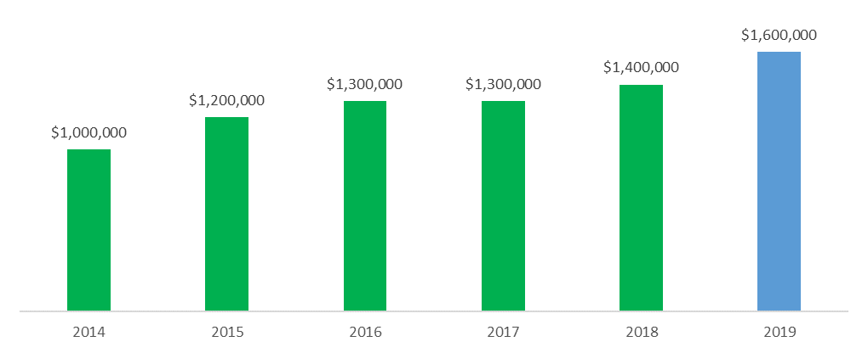
Sales Department Budget Replace this text with the key takeaway of this Powerpoint slide.
Sales Department Budget (US$)
Past & Projection

Slide 47
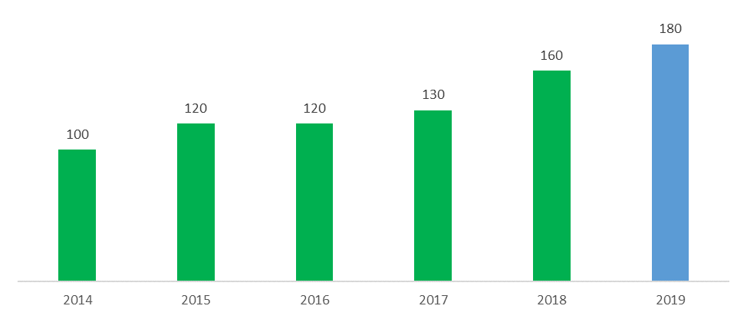
Sales Department Headcount Replace this text with the key takeaway of this Powerpoint slide.
Sales Department Headcount
Past & Projection

Slide 48
Table of Content 4.Sales Plan
1.Internal Analysis
5.Implemen-tation
2.External Analysis
Sales Strategy & Plan
4.Sales Plan
3.Sales Strategy

Slide 49
Table of Contents
Internal Analysis
External Analysis
Sales Strategy
Sales Plan
Implementation
Second option to formalize your table of contents

Slide 50
Plan of actions Replace this text with the key takeaway of this Powerpoint slide.
Month | Jan | Feb | Mar | Apr | May | Jun | Jul | Aug | Sep | Oct | Nov | Dec
1.1 Insert name of initiative
1.2 Insert name of initiative
1.3 Insert name of initiative
2.1 Insert name of initiative
2.2 Insert name of initiative
2.3 Insert name of initiative
3.1 Insert name of initiative
3.2 Insert name of initiative
3.3 Insert name of initiative

Slide 51
Table of Content 4.Sales Plan
1.Internal Analysis
5.Implemen-tation
2.External Analysis
Sales Strategy & Plan
4.Sales Plan
3.Sales Strategy

Slide 52
Table of Contents
Internal Analysis
External Analysis
Sales Strategy
Sales Plan
Implementation
Second option to formalize your table of contents

Slide 53
Dashboard - Sales Strategic Objectives Status Replace this text with the key takeaway of this Powerpoint slide.
Mission
Insert your Mission statement in this grey bow
Vision
This little circles will help the Organization to have clear understanding of the status of each Sales Strategic Objectives. The best practice here is simple: “The simpler the better”. What is too complicated is rarely fully implemented.
Insert your Vision statement in this grey bow
Sales Strategic Objectives
Insert strategic objective #1
Insert strategic objective #2
Insert strategic objective #3
Significantly behind target
Slightly behind target
Meeting target or above target

Slide 54
Dashboard - KPIs Status Replace this text with the key takeaway of this Powerpoint slide.
Sales Strategic Objectives
KPIs
Targets
Status
Insert the sales Strategic Objectives #1
Insert KPI
Insert KPI
Insert KPI
Insert Target
Insert Target
Insert Target
Insert the sales Strategic Objectives #2
Insert KPI
Insert KPI
Insert KPI
Insert Target
Insert Target
Insert Target
Insert the sales Strategic Objectives #3
Insert KPI
Insert KPI
Insert KPI
Insert Target
Insert Target
Insert Target

Slide 55
Dashboard - Initiatives Detailed Level Status Replace this text with the key takeaway of this Powerpoint slide.
Sales Strategic Objectives
Initiatives
Status
Insert the sales Strategic Objectives #1
1.1 Insert the name of the initiative
1.2 Insert the name of the initiative
1.3 Insert the name of the initiative
Insert the sales Strategic Objectives #2
2.1 Insert the name of the initiative
2.2 Insert the name of the initiative
2.3 Insert the name of the initiative
Insert the sales Strategic Objectives #3
3.1 Insert the name of the initiative
3.2 Insert the name of the initiative
3.3 Insert the name of the initiative

Slide 56
Dashboard - Initiatives Detailed Level Status Replace this text with the key takeaway of this Powerpoint slide.
 | Status | Owner | Objective | Deadline | Key Risks | Key Issues | Inter-dependencies
Insert name of the initiative |  | AD
Insert name of the initiative |  | JF
Insert name of the initiative |  | AD
Insert name of the initiative |  | JF
Insert name of the initiative |  | JF
Insert name of the initiative |  | JF
Insert name of the initiative |  | JF
Insert name of the initiative |  | JF
Insert name of the initiative |  | MJ

Slide 57
Next steps
Once your Sales Strategy and Plan has been approved, communicate it to the Organization (Note: most of the key stakeholders should have already been highly engaged in the preparation of this deliverable)
Make sure everyone has a clear understanding of the different roles & responsibilities
Set up a 45-min weekly meeting with all the key stakeholders to follow the Sales Strategic Objectives progress
Display the dashboards on the meeting room. Choose the method below that best suits your company:
Print the dashboards on A1 and stick them on the meeting room wall
Reproduce the dashboards using post-it notes, tapes and Sharpy pens
Use a digital whiteboard such as Google Jamboard. Particularly useful if you have key stakeholders in different cities or countries

