Slide 1
sql基础与拓展
by -彭登云

Slide 2
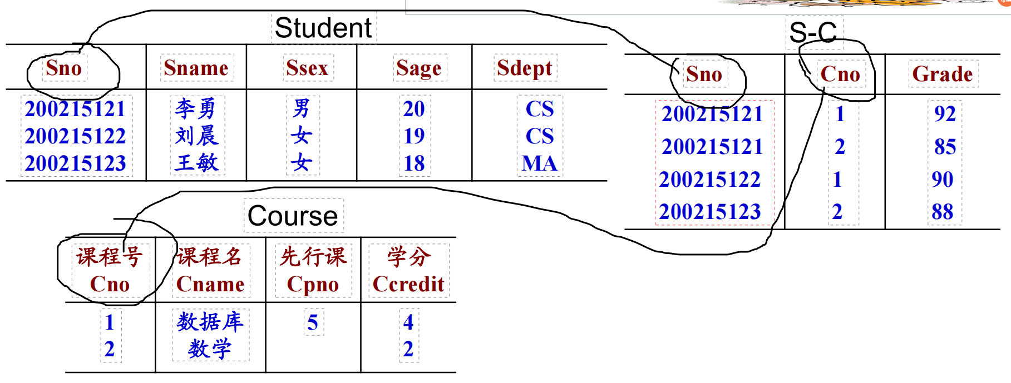
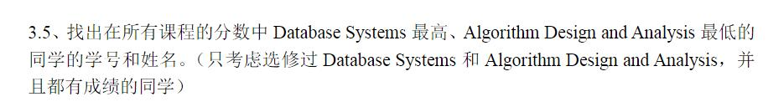
sql基础与拓展-基础

Slide 3
sql基础与拓展
错误解法1：
select distinct s1.Sno,s1.Sname
from Student s1
join SC sc on s1.Sno = sc.Sno
join Course c1 on c1.Cno = sc.Cno
where (sc.Grade = Max(sc.Grade) and
(c1.Cname = ‘Database System’) and
(sc.Grade = Min(sc.Grade)) and
(c1.Cname = ‘Alg,,,,,’)
group by s1.Sno

Slide 4
sql基础与拓展
select s1.Sno,s1.Sname from
Student s1
join SC sc1 on s1.Sno = sc1.Sno
join Course c1 on sc1.Cno = c1.Cno
where c1.Cname = ‘Data,,,,’ and
s1.Sno,sc.Grade =
(select s2.Sno,Max(sc2.Grade)
from Student s2
join SC sc2 on s2.Sno = sc2.Sno
Group by s2.Sno)
intersect(求交集）
....(同理)
错误解法二：

Slide 5
sql基础与拓展
正确解法：
select s1.Sno,s1.Sname from
Student s1
join SC sc1 on s1.Sno = sc1.Sno
join Course c1 on sc1.Cno = c1.Cno
where c1.Cname = ‘Data,,,,’ and
sc.Grade =
(select Max(sc2.Grade)
from SC sc2
where s1.Sno = sc2.Sno)
intersect(求交集）
....(同理)

Slide 6
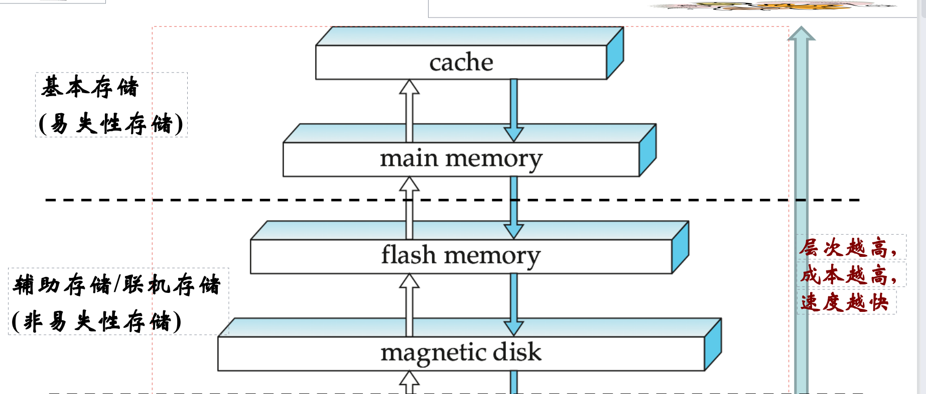
sql基础与拓展
简单介绍计算机的存储方式
缓存，主存，辅存（固态硬盘，磁盘（现已基本弃用））

Slide 7
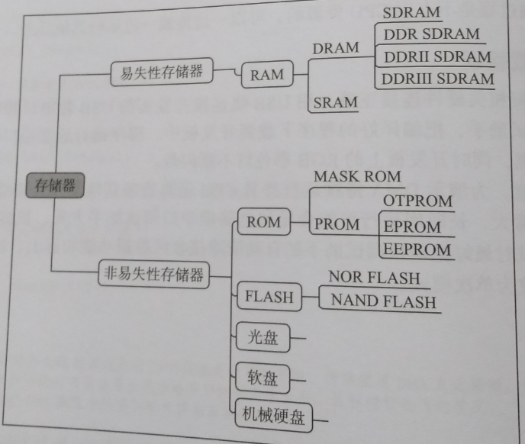
sql基础与拓展

Slide 8
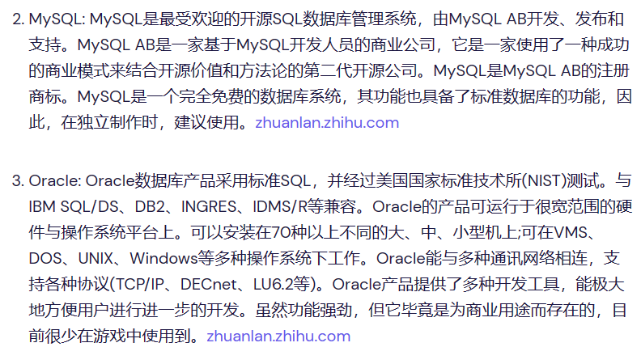
sql基础与拓展
外存中存储的数据如何与内存交互？使用DBMS
DBMS(Database Management System)

Slide 9
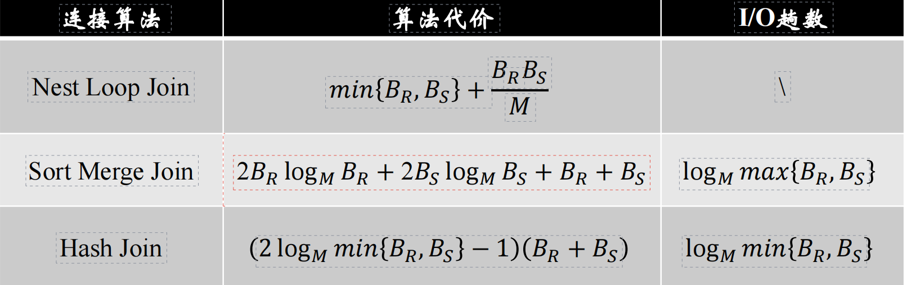
sql基础与拓展
不同的数据交互方法有较大的性能差异
而应对不同的数据最优的交互方法也不同
DBMS(Database Management System)
小例子
1.Nest-Loop-Join
2.Sort-Merge-Join
3.Hash-Join

