Slide 1
Pong
Eric Whites & Wesley Quigley

Slide 2
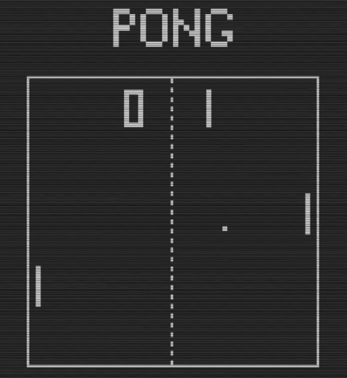
Project Overview
Objective: Develop a game device to play Pong.
Gameplay:
Two players, each controlling a paddle
Paddle movement controlled by the y-axis of potentiometer
Game Displayed on three 8x32 LED Matrices
Audio feedback
Authentication:
Users must authenticate with RFID tag to start the game.

Slide 3
System Design & Peripherals Utilization
Microcontroller
Role: Central controller for the game logic, joystick input, LED matrix display, and RFID authentication.
Joysticks
Role: Input devices for player paddle control, providing analog signals for the movement of
paddles.
LED Matrix Display
Role: Displays the game area and the player data.
RFID Reader
Role: Authenticate the users
Buzzer
Role: Player score indicator

Slide 4
System Flow
User Authentication
Joystick Input
Game Logic
Display Output
Audio Feedback

Slide 5
Actuator & Sensor Integration
Actuator
Upon a player scoring a point, the buzzer will be notified to turn on.
Could have used PWM to adjust the tone.
Similar to the concept of turning the LED on and off from the beginning of the course
8x32 LED Matrices will be a visual implementation of driving LEDs high from an input received from the joysticks.
Sensor
Joystick will help control digital paddles that will be represented on the LED display.
RFID Reader detects and reads the tag and sends a signal to the other board to authenticate the start of the game.

Slide 6
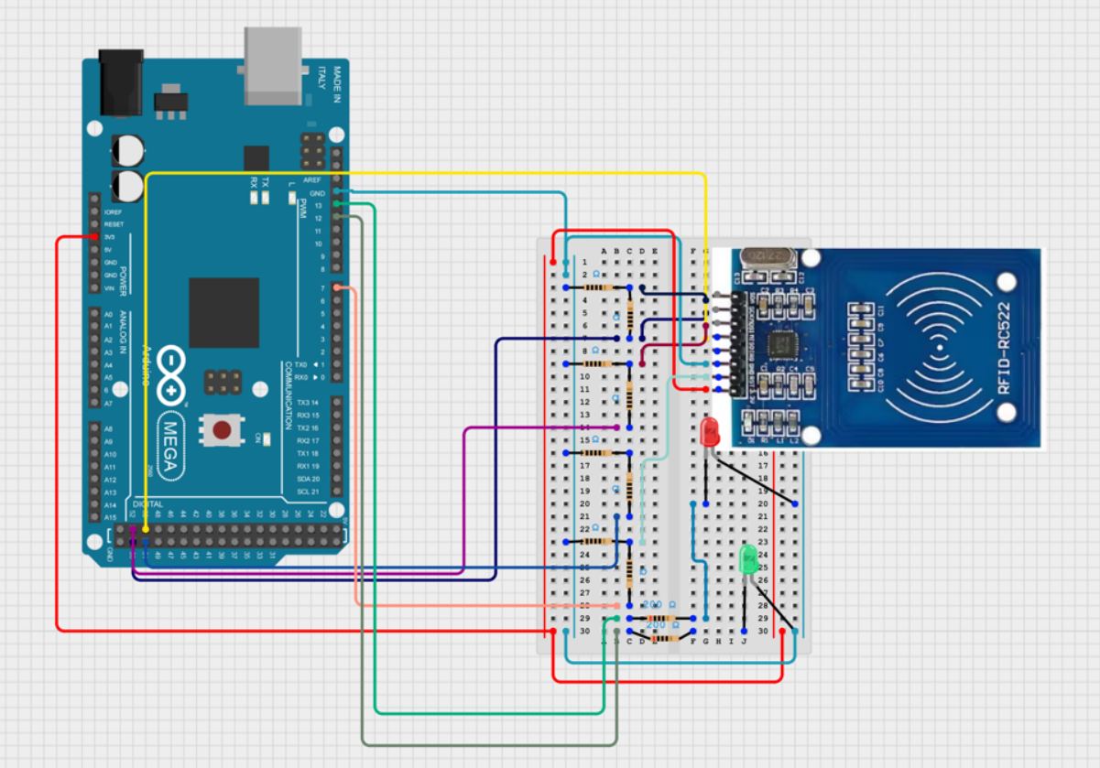
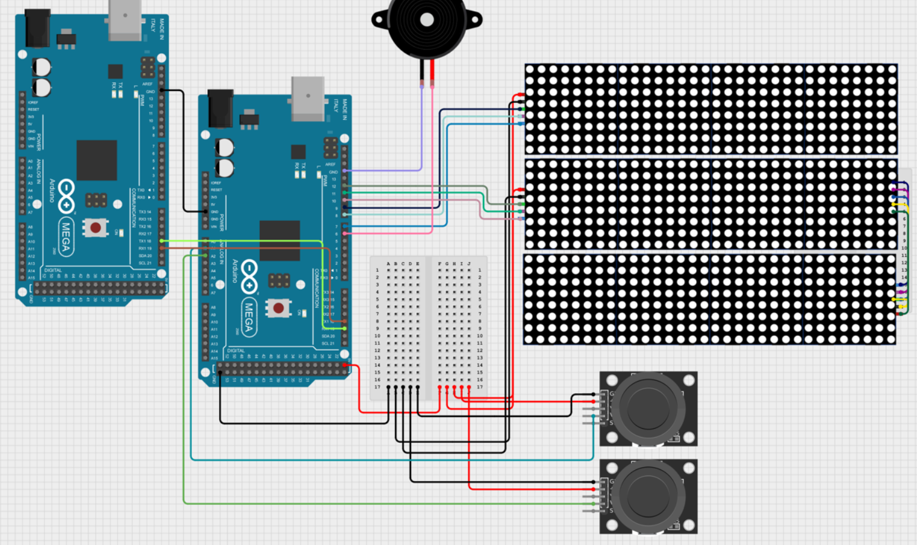
Wiring Diagram

Slide 7
Code Implementation & Software Explanation
Game State Updates
Ball Movement: Ball position (x, y) updated based on diagonal direction movement (dx, dy)
Collision Detection: Bounces on boundaries and paddles.
Scoring: Points awarded when ball crosses left or right sides.
Paddle Controls
Player 1 and 2: Joystick reading determine paddle movement (y position)
Movement Boundaries: Paddles are constrained to the screen.
Display Handling
Display Buffers: There are two different display buffers that are being used to hold onto changes made to the player data and game area. This implementation created a safety net for making sure we are not overwriting data.
Score
Display Score: displayScore() updates the score on the display
Flashing Score: flashScore() creates a flashing effect when a point is scored.
Ball Reset
Reset Position: resetBall() resets the ball to the center after scoring.
Random Ball Direction: dy is randomized for unpredictability.

Slide 8
Challenges
RFID
References to this implementation were hard to find, if any.
The data sheet was extensive and hard to follow.
Timing issues.
Communication needed to be 3.3v which resulted in using a voltage divider, because our board outputs 5v.
Ball Logic
Issues from the displays being interconnected. The displays being connected potentially resulted in the refresh of the ball in the areas of the paddles to be too fast. Made it harder for the user to see ball.
We split the displays into the game area and the player information. This helped with splitting up the updates and we were no longer accidentally overwriting player data or the game area incorrectly.
Paddle Logic
Paddle tracking was difficult due to finding a specific point to track to make things easier to detect boundaries. Currently, the implementation is tracking the top most LED of the paddle.
The coordinate system was flipped, we introduced this somewhere and it was hard getting use to this change which prolonged further progress.

Slide 9
DEMO

