Slide 1
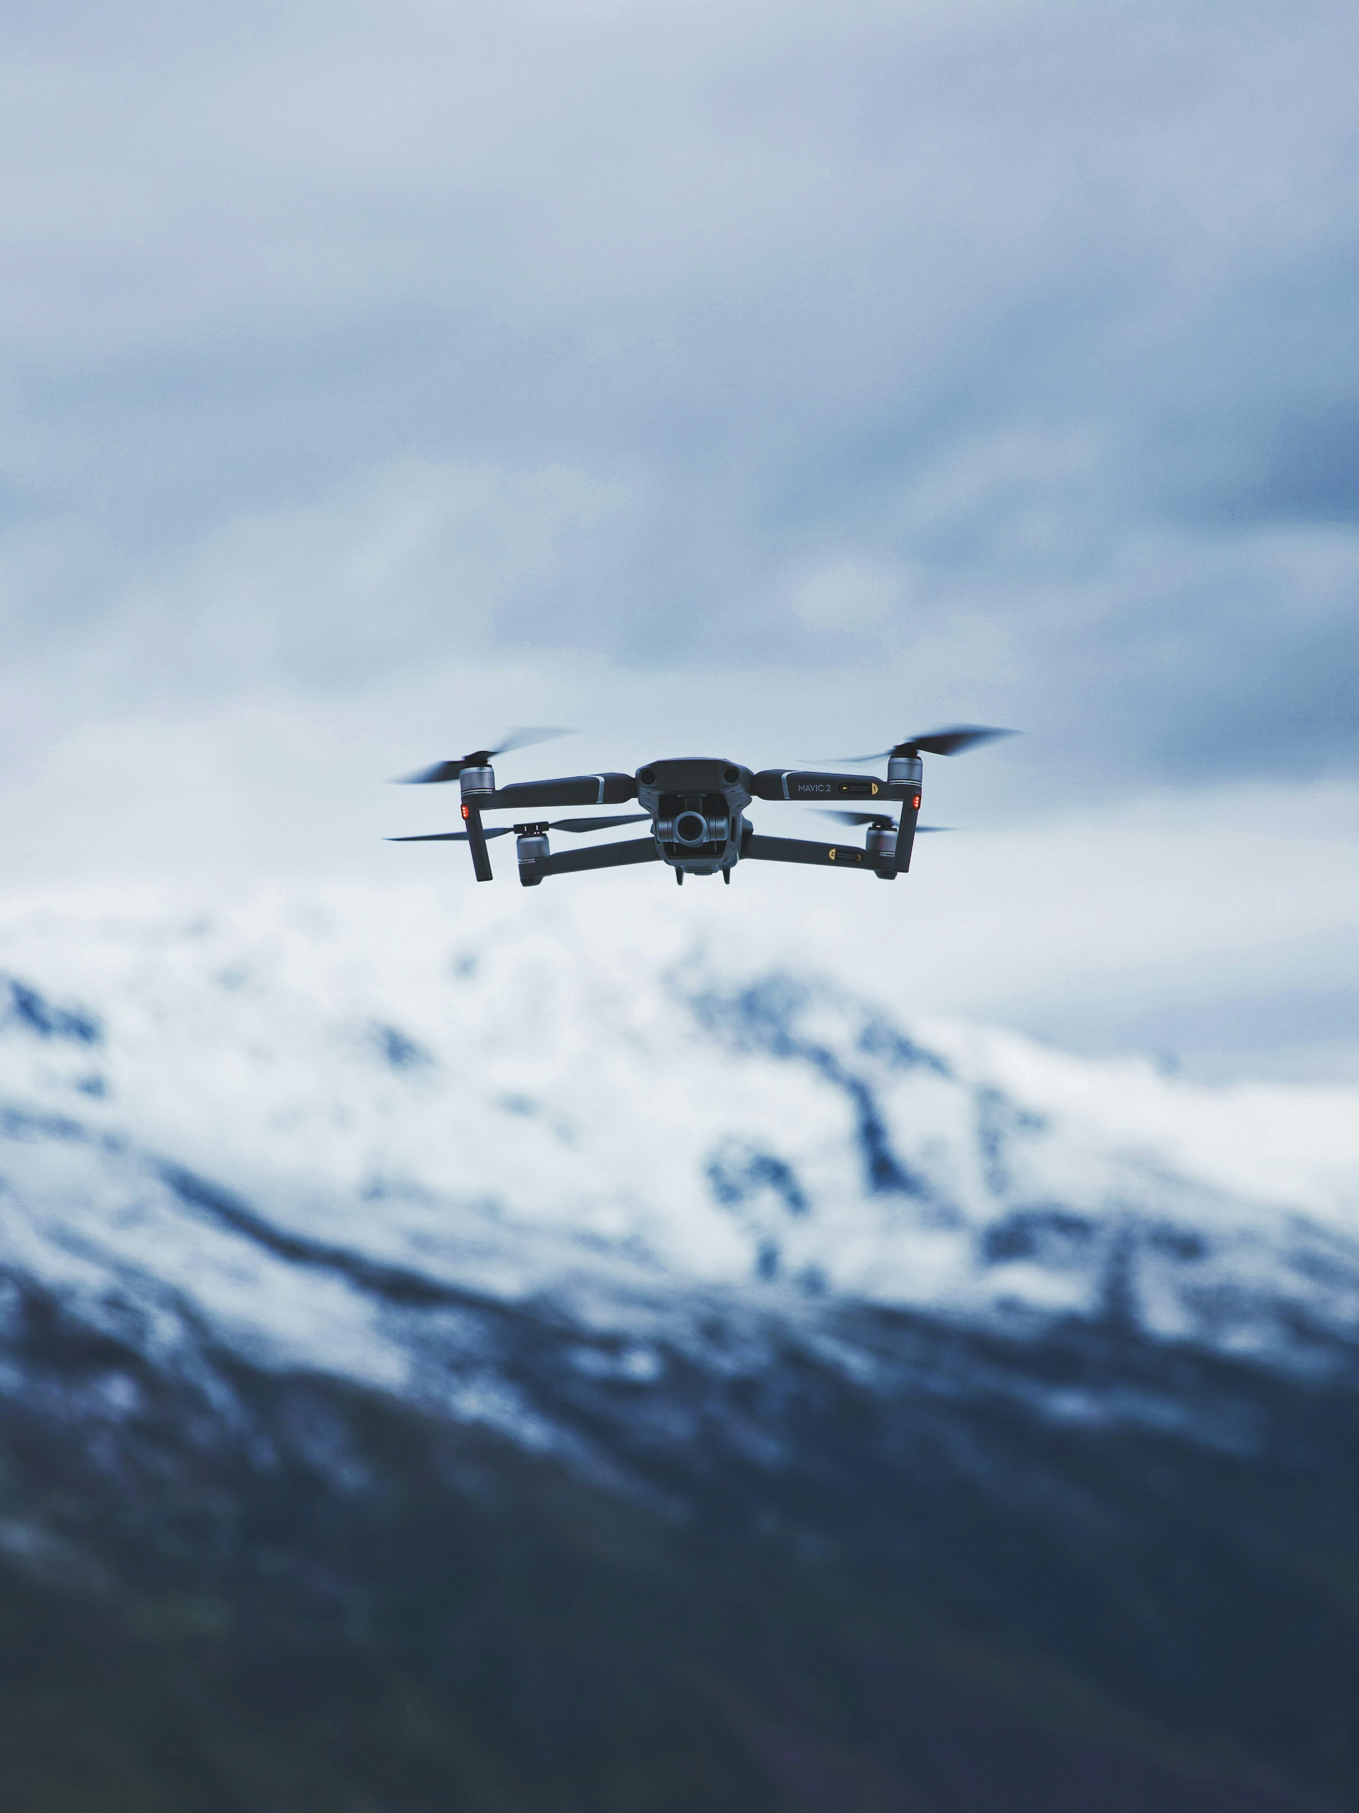
ORBIT
A simulation‑first personal aerial AI companion
Runtime‑authoritative safety
Phone is UI only (never flight‑critical)
Model‑agnostic “AI brain” layer
Investor / Pre‑Kickstarter deck • v0.1
Notes:
[Sources] - https://unsplash.com/photos/gray-quadcopter-drone-under-cloudy-sky-during-daytime-sHO5UXoKyxw (background photo) [/Sources]

Slide 2

Problem
AI assistants live in screens. Drones still require pilots.
Today:
Your assistant can’t “be there” with you
Your camera can’t follow you hands‑free
Safety + privacy are bolted on after the fact
Human attention becomes the control system
What people want:
A trusted AI presence that can see, hear, and help — without requiring constant piloting.
Hands‑free capture
+ real‑world context
Orbit • Investor / Pre‑Kickstarter Deck
01
Notes:
[Sources] - https://unsplash.com/photos/hiker-admires-mountain-view-at-sunset-D83GpHdutAM (photo) [/Sources]

Slide 3
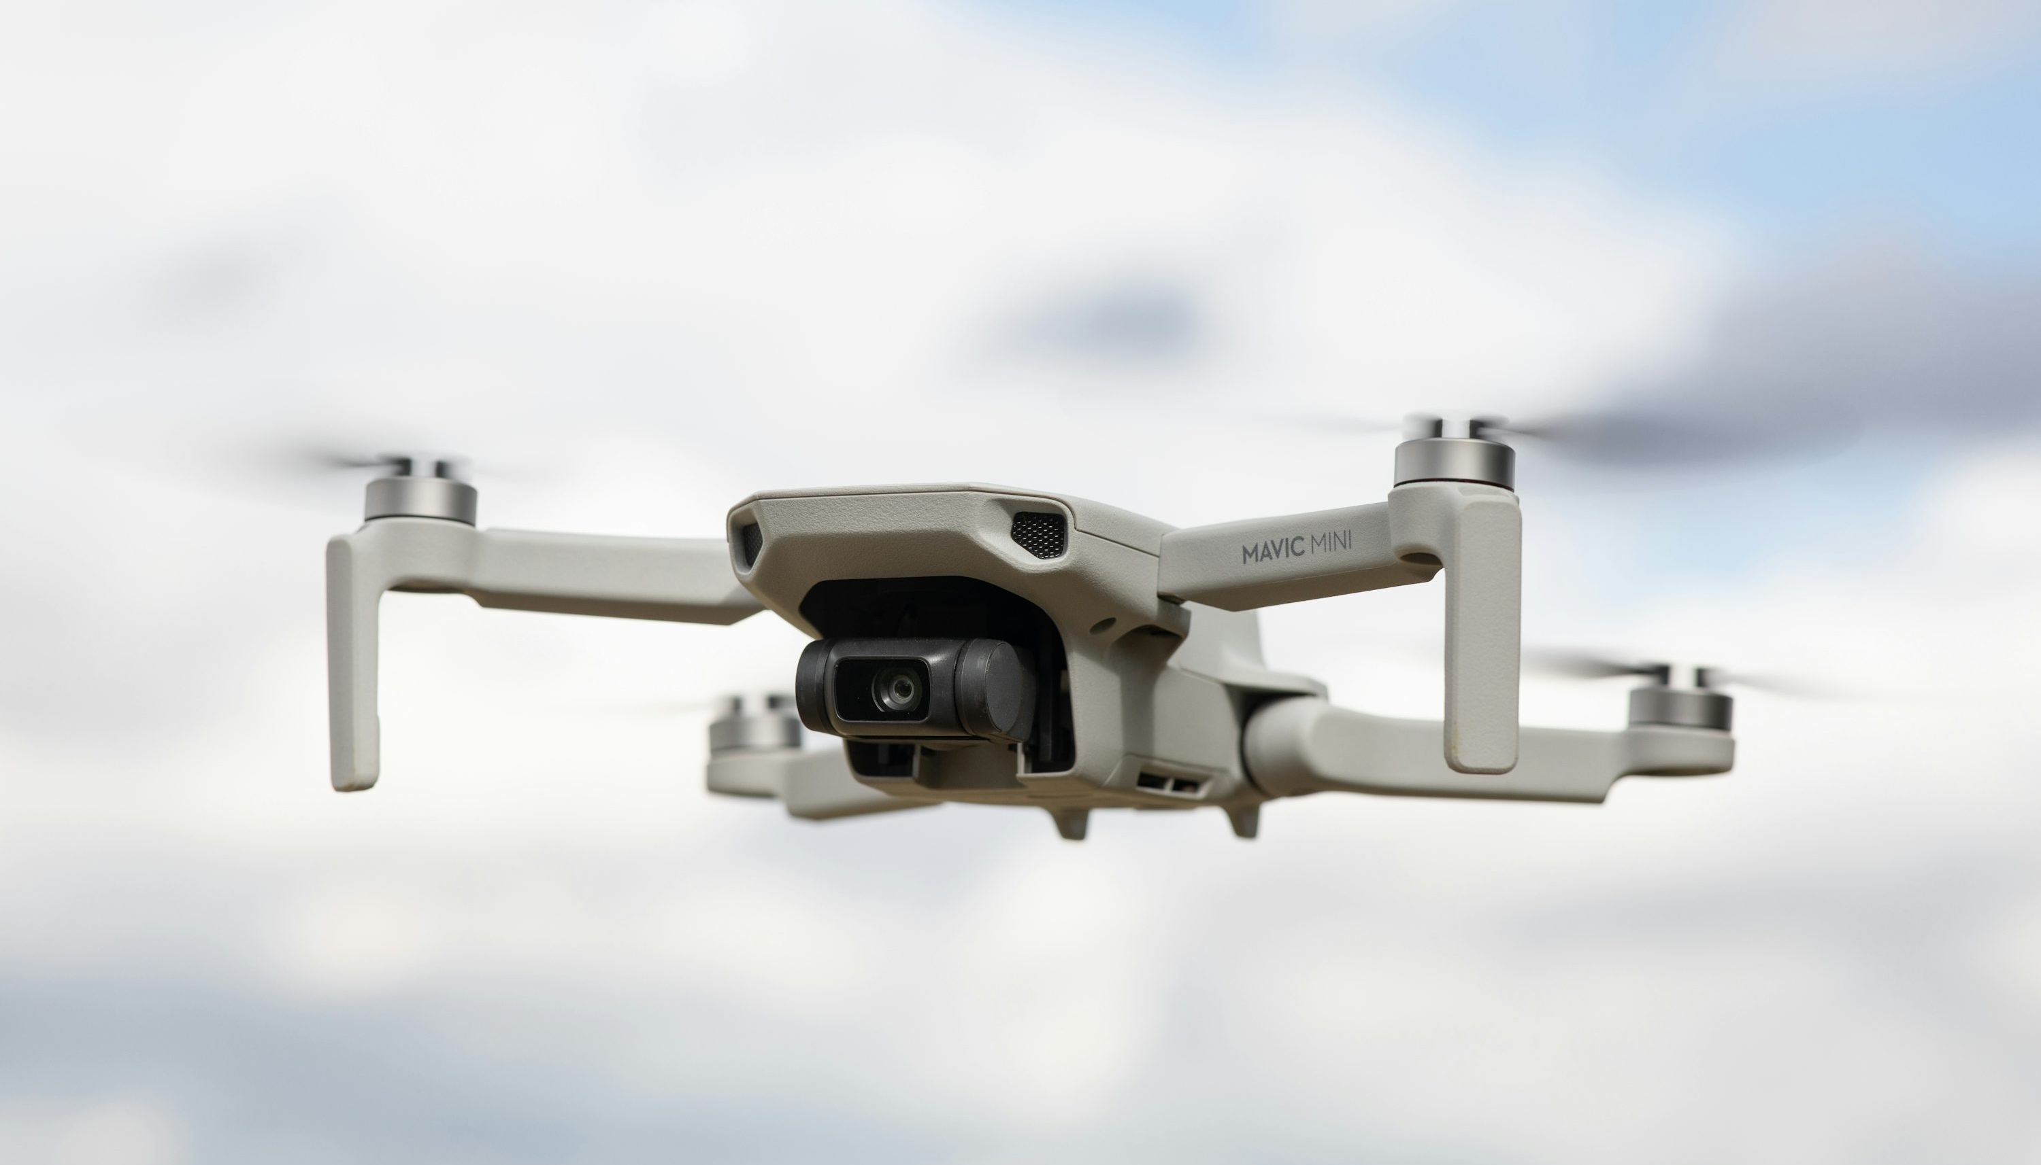
Solution
A physical AI agent that stays in your orbit.
Key design choices
Phone is UI only
Orbit can hold position + fail safe without the phone.
Runtime is authoritative
All commands are validated by a safety supervisor.
Orbit is a small autonomous companion drone that:
Follows you safely
Responds to voice/text commands
Captures moments + context
Returns to dock automatically
Model‑agnostic brain
Pluggable intelligence layer (cloud or local).
Orbit • Investor / Pre‑Kickstarter Deck
02
Notes:
[Sources] - https://unsplash.com/photos/white-and-black-drone-in-mid-air-cMhJ4ld1QbE (photo) [/Sources]

Slide 4
Product — V1 scope
Tight MVP: follow • respond • capture • dock
User flow
V1 “Feature Contract”
We only promise what we can demo reliably.
1) Pair + configure
Choose mode: assistant / companion / guardian / creator
✅ Follow / maintain safe offset
✅ Voice/text command loop
✅ Auto‑dock / auto‑land
✅ Safety: e‑stop, geofence, battery rules
Later (stretch):
• Rich scene understanding
• Advanced mission planning
• Biomimicry / specialty behaviors
2) Launch
Runtime arms + takes off with safety checks
3) Orbit / Focus / Guide
Maintain safe offset; accept commands
4) Capture
Hands‑free photos/video + timestamps
5) Dock
3‑phase approach + charge (backpack or stationary)
Orbit • Investor / Pre‑Kickstarter Deck
03

Slide 5
System architecture
Hard split: flight safety lives on the drone.
Orbit Runtime (on drone)
Companion App (phone)
AI “Brain” (pluggable)
• 20Hz tick loop
• Mode FSM (7 modes)
• Controllers (orbit/hold/dock)
• Safety Supervisor (rule gateway)
• Vehicle adapter (sim now, PX4 later)
• UI + telemetry view
• Command console
• Safety banners + e‑stop
• Reconnect + history
• Never flight‑critical
• Intent + planning
• Optional connectors
• Local or cloud execution
• Memory policy controlled by user
WS Protocol v1
telemetry ~20Hz
status ~1Hz
commands on demand
Optional
Authoritative
Requests only
Model‑agnostic
Orbit • Investor / Pre‑Kickstarter Deck
04

Slide 6
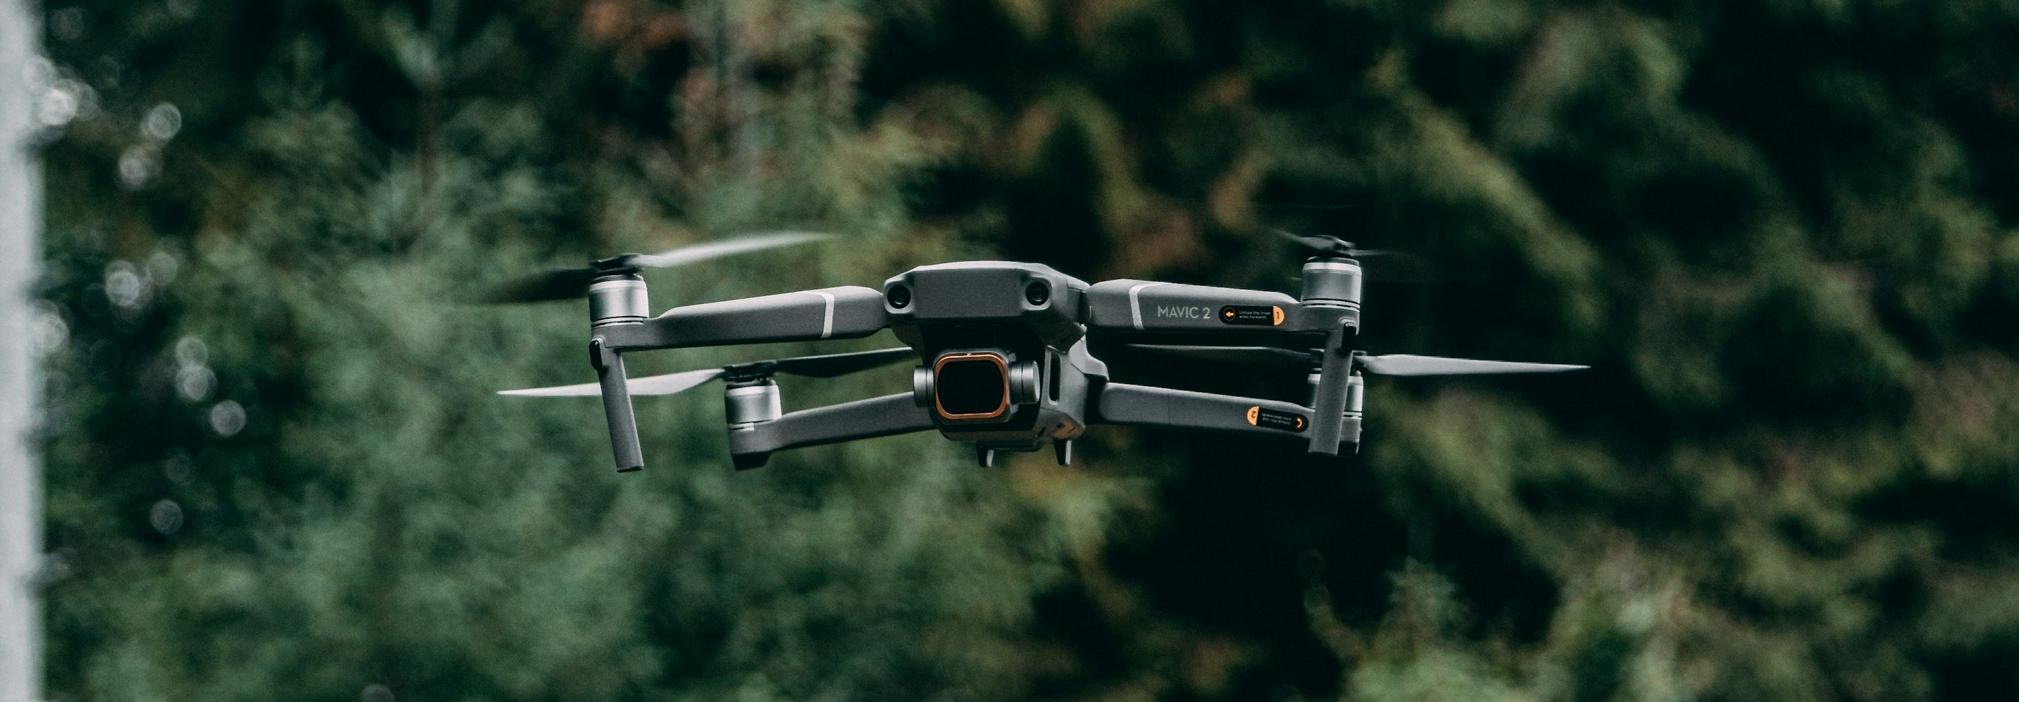
Safety & trust
Safety is a first‑class subsystem, not a feature.
Non‑negotiables
Safety demos (what investors/backers will see)
E‑stop is always allowed
Every command is validated (speed/altitude/battery/geofence)
Disconnect behavior: hold → auto‑land
Runtime is authoritative (UI cannot override safety)
1) Launch blocked when unsafe
2) Geofence rejection + explanation
3) Battery critical → immediate land
4) E‑stop always works
5) Disconnect: hold → auto‑land
Safety states
NOMINAL
WARNING
CRITICAL
EMERGENCY
Orbit • Investor / Pre‑Kickstarter Deck
05
Notes:
[Sources] - https://unsplash.com/photos/black-drone-oOnLpg9IbTI (photo) [/Sources]

Slide 7
Progress (simulation‑first)
A working software spine exists today — ready for real hardware adapters.
Built (now)
Not built (yet)
Protocol v1: typed envelope + stable reject codes
Runtime: 20Hz orchestrator tick + telemetry broadcast
7‑mode FSM (IDLE/ORBIT/FOCUS/GUIDE/CAPTURE/DOCK/EMERGENCY)
Safety supervisor: mandatory command gateway (6 rules)
Simulation engine + controllers (orbit/hold/dock)
Test suite: 37 tests passing
Real hardware adapter (PX4 / autopilot)
LLM brain (current intent parser is keyword‑based)
3D visualization
Mission planning + replay engine (stubs)
Industrial design + dock hardware
Git repo + public engineering log
Orbit • Investor / Pre‑Kickstarter Deck
06

Slide 8
Roadmap to a fundable hardware campaign
Goal: replace “simulation promise” with “real footage proof”.
Phase 1 — Alpha (off‑the‑shelf)
Phase 2 — Beta (integrations)
Phase 3 — Production (Kickstarter ready)
Buy/assemble a small drone platform + compute
Basic follow + hold offset
E‑stop, geofence, battery land demos
Single‑take demo video (no cuts)
Hardware adapter (PX4) + real sensors
Docking prototype (stationary → backpack)
LLM brain behind the existing command protocol
Closed beta with real users
Industrial design + manufacturable dock
Compliance plan + QA test fixtures
BOM + supplier quotes + pilot build
Kickstarter page with working prototype footage
Note: Kickstarter hardware guidelines require working prototypes and prohibit photorealistic renderings as primary proof.
Orbit • Investor / Pre‑Kickstarter Deck
07
Notes:
[Sources] - https://help.kickstarter.com/hc/en-us/articles/115005134554-What-are-the-rules-for-hardware-and-product-design-projects (working prototype / no photorealistic renderings) [/Sources]

Slide 9
Go‑to‑market wedge
Start with the people who want a “real‑world AI sidekick” the most.
Beachhead users
Business model (draft)
Creators + adventurers (hands‑free capture)
Tech enthusiasts (first to live in the future)
Busy parents (extra eyes + reminders)
Hardware: Orbit device + dock
Software: optional subscription
Tier ideas:
• Local‑only (basic)
• Cloud brain + connectors (premium)
• Family / multi‑Orbit (bundle)
Placeholders:
• [Target price]
• [Monthly subscription]
Positioning statement
“Orbit brings AI off the screen and into your world — safely.”
Expand later into additional modes & verticals after V1 trust is earned.
Orbit • Investor / Pre‑Kickstarter Deck
08

Slide 10
The ask
What we need to turn Orbit into a real device
Seeking
• Prototype partners (autopilot / embedded / docking)
• Advisors (hardware manufacturing, compliance, safety)
• Early funding to reach “working prototype footage”
Next milestone
A single‑take real‑flight demo:
takeoff → follow → command → e‑stop → dock/land
Use of funds (draft)
• Alpha hardware build + sensors
• Autonomy + safety integration
• Dock prototype + iterations
• Compliance planning + QA fixtures
• Pilot manufacturing plan + BOM
Contact: [name] • [email] • [link]
Orbit • Investor / Pre‑Kickstarter Deck
09
Notes:
[Sources] - https://unsplash.com/photos/gray-quadcopter-drone-under-cloudy-sky-during-daytime-sHO5UXoKyxw (background photo) [/Sources]

