Slide 1
UX Scenario Document File Version 4.4
Nuvio TV
Submission Date | 27.08.2026
App Ver. | 1.0.0
App Developer | Name: Nuvio Media E-mail address: nayiftapframe@gmail.com
Notes:
[Sources]
- User-provided LG UX Scenario Document File Version 4.4 template
- NuvioTVSmart/appinfo.json
- NuvioTVSmart/store-assets/docs/lg-submission-data.md
[/Sources]

Slide 2
Table of Contents
1. Basic Information
2. Document History
3. Page Description (Guideline)
4. Detailed Login Information
5. Main Page Description
6. Sub Page Description
7. Paid Content
8. In-App Ad
Notes:
[Sources]
- User-provided LG UX Scenario Document File Version 4.4 template
[/Sources]

Slide 3
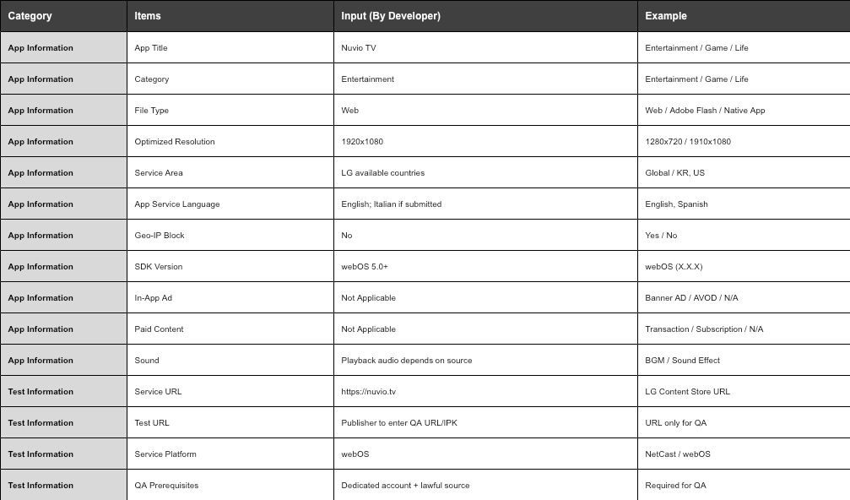
1. Basic Information
Notes:
[Sources]
- NuvioTVSmart/appinfo.json
- NuvioTVSmart/store-assets/docs/lg-submission-data.md
- Generated from editable artifact-tool table source
[/Sources]

Slide 4
2. Document History
No. | Sent | Version | File Name | Contents
1 | 27.08.2026 | 1.0.0 | Nuvio_TV_UX_Scenario_1.0.0 | Initial QA submission draft
Notes:
[Sources]
- User-provided LG UX Scenario Document File Version 4.4 template
- Submission date is the document preparation date
[/Sources]

Slide 5
3. Page Description (Guideline)
1. How to read this scenario
Description
1 | Identify a focusable control or navigation area.
2 | Describe the remote action and expected result.
- Use the real Nuvio TV screen for each page.
- Mark controls in reading order with unique numbers.
- Describe the remote action and expected result in the table.
- Follow the launch, Home, Search, Library, Settings, and playback paths shown on the next pages.
Detailed Information
- Every numbered marker identifies a focusable control or navigation area.
- The right-side table explains what the QA reviewer should select and what result to expect.
*Note
- The document describes Nuvio TV 1.0.0 for webOS 5.0+.
- Screenshots show catalog metadata/UI; Nuvio TV does not host or bundle video content.
Notes:
[Sources]
- User-provided LG UX Scenario Document File Version 4.4 template
- NuvioTVSmart/store-assets/docs/lg-submission-data.md
[/Sources]

Slide 6
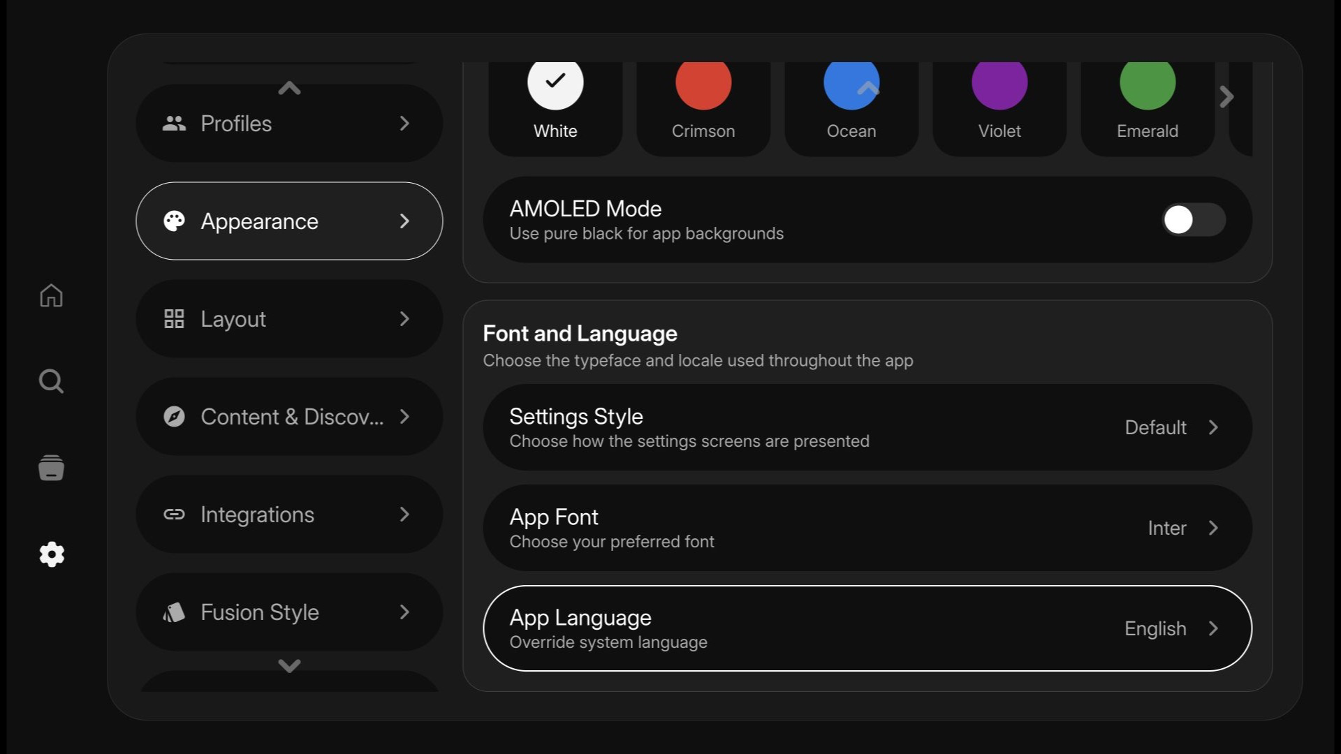
4. Detailed Login Information
Description
1 | Open Settings > Profiles/Account.
2 | Select Sign in.
Authentication options
1 | QR: scan the code on the web account and approve.
2 | Email: enter the dedicated QA email and password.
3 | Select or create a profile after authentication.
1
2
3
①
②
Detailed Information
- Nuvio TV supports QR sign-in and email/password sign-in.
- Open Settings > Profiles/Account, select Sign in, then choose QR or email.
- After authentication, select or create a profile.
*Required before upload: replace bracketed QA values with live publisher credentials and provider configuration.
Notes:
[Sources]
- NuvioTVSmart/js/ui/screens/account/authSignInScreen.js
- NuvioTVSmart/js/ui/screens/account/authQrSignInScreen.js
- NuvioTVSmart/store-assets/screenshots/05-appearance-1920x1080.png
[/Sources]

Slide 7

5. Main Page Description
1. Start Page / first launch
Description
1 | Nuvio TV splash/logo while the app starts.
2 | Continue to QR sign-in, email sign-in, or Guest when enabled.
3 | Back returns to the previous page when available.
①
②
③
Detailed Information
- Splash is followed by onboarding/authentication.
- Choose Guest, QR, or email sign-in; profile selection leads to Home.
Notes:
[Sources]
- NuvioTVSmart/assets/images/splash.png
- NuvioTVSmart/js/core/profile/profileSelectionScreen.js
- NuvioTVSmart/store-assets/docs/lg-submission-data.md
[/Sources]

Slide 8
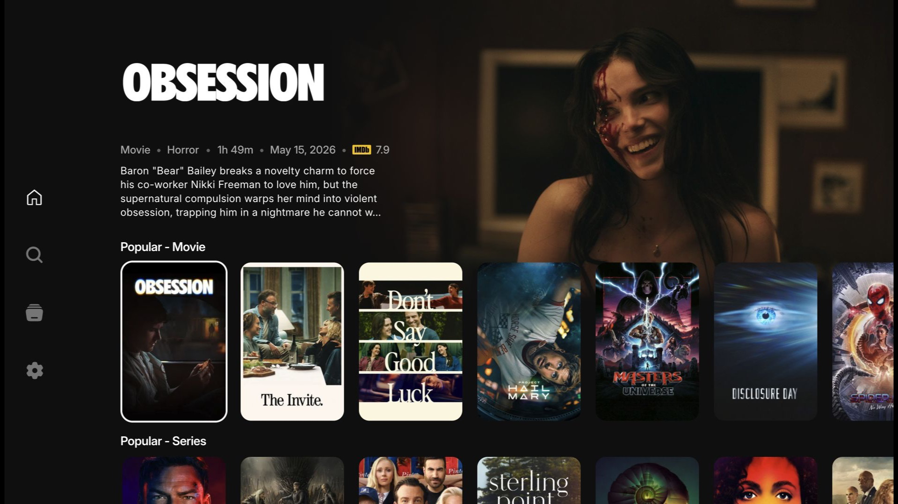
5. Main Page Description
2. Home
Description
1 | Left rail: Home, Search, Library, Settings.
2 | Featured title/card: focus and press OK for details.
3 | Content rails: move horizontally and vertically with the remote.
4 | Back returns to the prior page or closes the current layer.
①
②
Detailed Information
- Home shows configured catalog rows and a featured title.
- Focus a title and press OK to open details.
Notes:
[Sources]
- NuvioTVSmart/store-assets/screenshots/01-home-1920x1080.png
- NuvioTVSmart/store-assets/docs/store-copy.md
[/Sources]

Slide 9
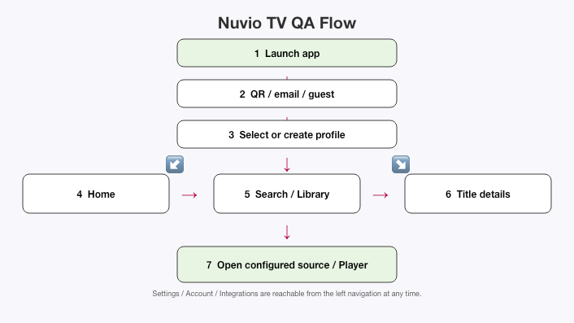
6. Sub Page Description
1. QA Flow Chart
Detailed Information
- Follow launch → authentication/profile → Home → Search/Library → title details → source/player.
- Use a lawful configured test source and verify empty/error handling if it is unavailable.
Notes:
[Sources]
- NuvioTVSmart/js/ui/navigation/router.js
- NuvioTVSmart/js/ui/screens/home/homeScreen.js
- Generated from editable artifact-tool flow source
[/Sources]

Slide 10
6. Sub Page Description
2. Settings / sidebar
Description
1 | Select a sidebar section: Profiles, Appearance, Layout, Integrations, or Playback.
2 | Open an item and change its setting.
3 | Use Account/Connected Services for sign-in and provider configuration.
4 | Press Back to return; relaunch to verify persistence.
①
②
Detailed Information
- Settings manages profiles, appearance, language, integrations, playback, and account/provider configuration.
- Select a section with focus + OK; use Back to return to the previous section.
- Verify changes persist after relaunch.
Notes:
[Sources]
- NuvioTVSmart/store-assets/screenshots/05-appearance-1920x1080.png
- NuvioTVSmart/store-assets/docs/lg-submission-data.md
[/Sources]

Slide 11
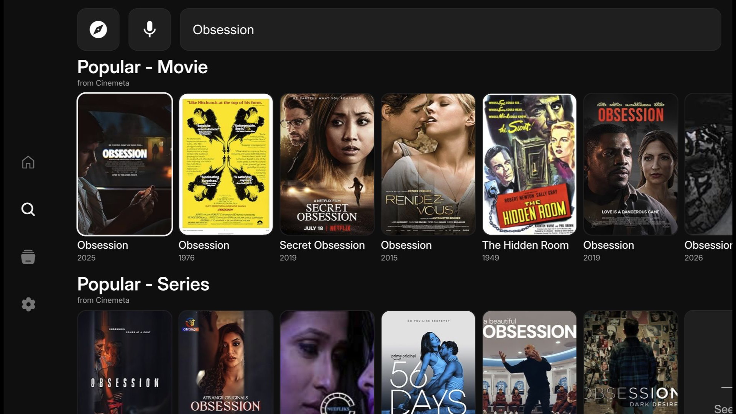
6. Sub Page Description
3. Search results / title details
Description
1 | Back to Search.
2 | Focus a result and press OK to open details.
3 | Save to Library or choose an available configured source.
4 | If a source is unavailable, select another configured source.
5 | Back returns to results.
①
②
Detailed Information
- Search results are metadata from configured catalogs.
- The title detail page can show synopsis, artwork, availability, library/save controls, and source actions supplied by the provider.
- Opening a source launches the TV player; audio, subtitles, DRM, and stream behavior depend on the source and TV model.
Notes:
[Sources]
- NuvioTVSmart/store-assets/screenshots/03-search-results-1920x1080.png
- NuvioTVSmart/store-assets/docs/store-copy.md
[/Sources]

Slide 12
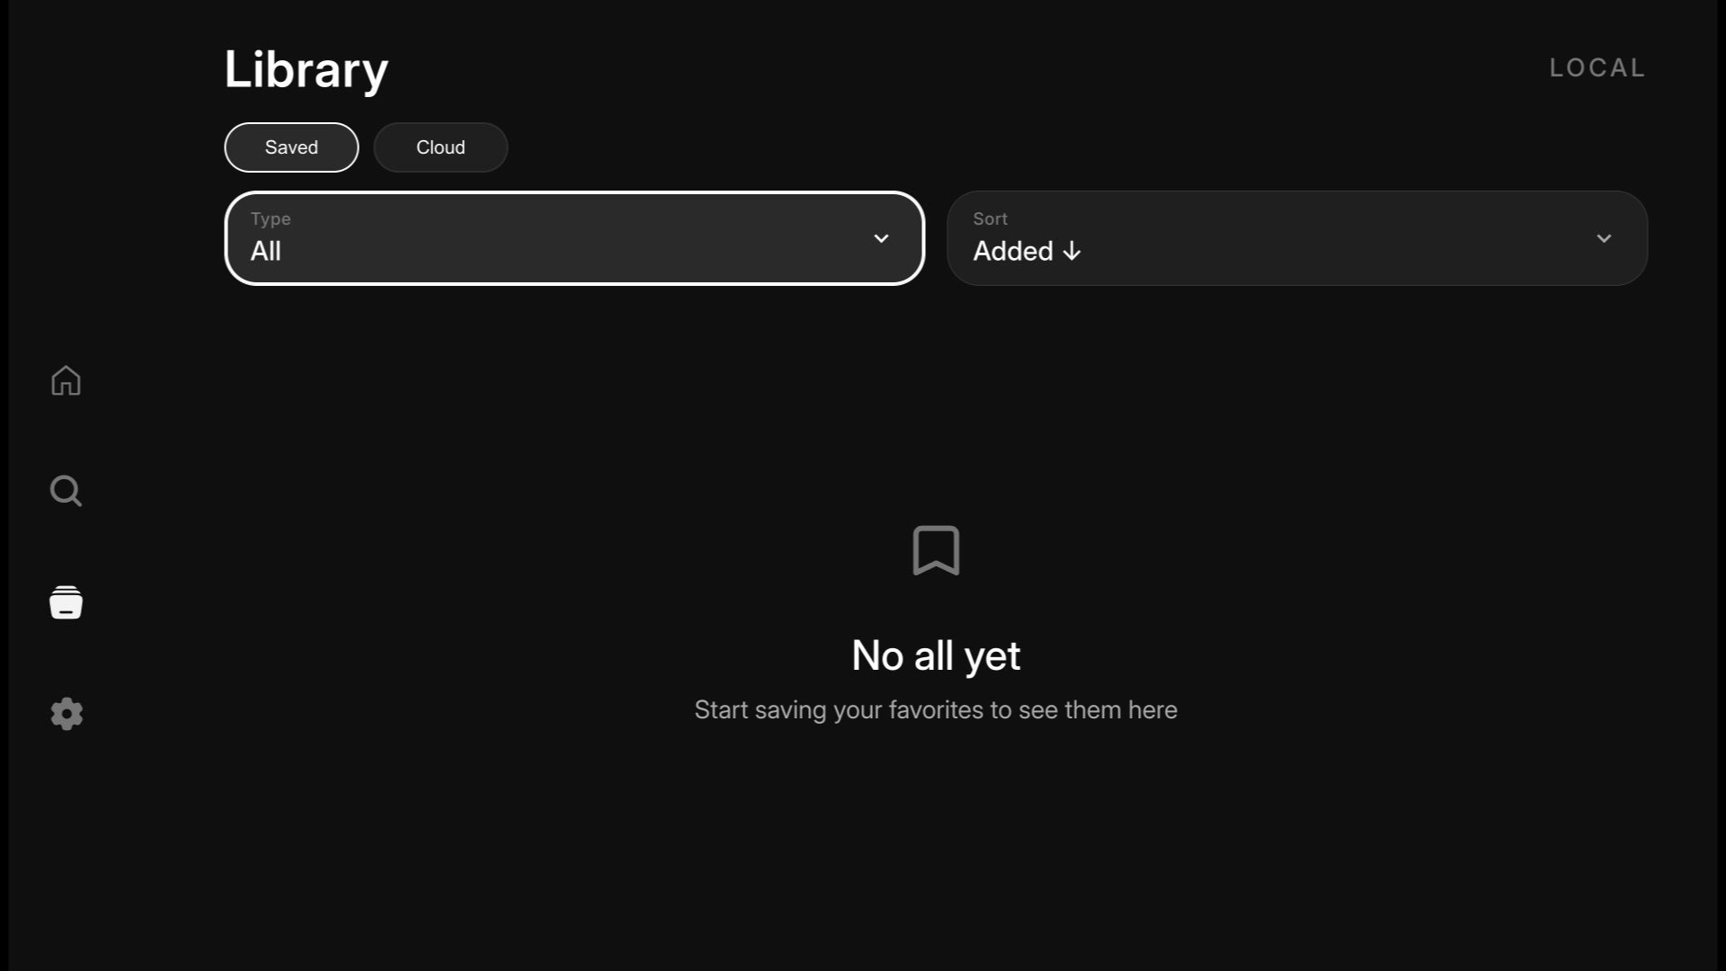
7. Paid Content — Not Applicable
Description
1 | No payment UI in Nuvio TV.
2 | No webOS Pay, credit-card, SMS, PayPal, or voucher method.
3 | External support/membership is outside the TV app and not required for playback.
4 | No test cards or voucher codes are required for QA.
①
Detailed Information
- Nuvio TV has no in-app purchase or paid-content flow in the webOS app.
- There is no webOS Pay, credit-card, SMS, PayPal, or voucher flow.
- Optional external support/membership is outside the TV app and is not required for playback.
- Do not enter payment credentials in LG Seller Lounge.
Notes:
[Sources]
- NuvioTVSmart/store-assets/screenshots/04-library-1920x1080.png
- NuvioTVSmart/store-assets/docs/lg-submission-data.md
[/Sources]

Slide 13
8. In-App Ad — Not Applicable
1. Banner Type — Not Applicable
Description
1 | Page: None. Location: None.
2 | Ad SDK/platform: None.
3 | No banner ads are rendered by the app.
- | Not applicable.
- | Not applicable.
- | Not applicable.
- | Not applicable.
- | Not applicable.
①
②
Detailed Information
- Nuvio TV does not display banner advertising and does not use an in-app advertising SDK.
- No ad placement, tracking purpose, or banner test data applies.
Notes:
[Sources]
- NuvioTVSmart/store-assets/screenshots/04-library-1920x1080.png
- NuvioTVSmart/store-assets/docs/lg-submission-data.md
[/Sources]

Slide 14
8. In-App Ad — Not Applicable
2. Video Type — Not Applicable
Description
1 | No pre-roll, mid-roll, or post-roll video ads.
2 | No AVOD or video advertising SDK.
3 | No ad-area control is present in the app UI.
- | Not applicable.
- | Not applicable.
- | Not applicable.
- | Not applicable.
- | Not applicable.
No ad area
Detailed Information
- Nuvio TV does not insert or play advertising videos.
- The TV player opens a configured source; any source-side behavior is outside the Nuvio TV app and must be tested separately.
Notes:
[Sources]
- NuvioTVSmart/store-assets/screenshots/04-library-1920x1080.png
- NuvioTVSmart/store-assets/docs/lg-submission-data.md
[/Sources]

Slide 15
[Appendix] — QA Notes
Before submitting to LG QA:
Replace the bracketed QA account, password, and source/add-on values on slide 6.
Use a lawful test source reachable from LG QA; verify selection, playback, audio, subtitles, resume, and Back/Home behavior.
Confirm countries/languages, privacy URL, seller contact, support URL, and content rating in Seller Lounge.
Target webOS 5.0+ (2020 and later) at 1920x1080.
Nuvio TV does not host or provide video; catalogs and playable links come from configured services.
Slides 3 and 9 are QA visuals; slides 6-8 and 10-14 use real Nuvio TV UI/assets.
Notes:
[Sources]
- NuvioTVSmart/store-assets/docs/lg-submission-data.md
- NuvioTVSmart/store-assets/README.md
[/Sources]

