Slide 1


SAMSUNG TV
UI DESCRIPTION
Nuvio TV • Tizen 4+ • Seller Office submission draft
A big-screen media organizer for movies and series.
The user brings the sources; Nuvio organizes the experience.
PREPARED FOR CERTIFICATION
UI, navigation and test scenario
Nuvio TV • Samsung TV UI Description • 2026-08 draft
Notes:
[Sources]
Local NuvioTV-Web brand assets and product description.
Samsung Seller Office publication and packaging requirements: https://developer.samsung.com/tv-seller-office/checklists-for-distribution/launch-checklist.html

Slide 2
PRODUCT OVERVIEW
02
What the TV app does
A focused TV experience
Primary navigation
Nuvio is a modern media organizer for movies and TV shows. It helps users discover titles, build a library, save favorites, track progress and keep their watch history in sync with supported services.
Featured and popular rows with a focused hero area.
HOME
SEARCH
Search titles and browse results from configured catalogs.
LIBRARY
Saved titles, cloud libraries and progress-oriented views.
Nuvio does not host a catalog or video library. Catalogs and playable sources come from the user’s configured add-ons and supported services.
SETTINGS
Profiles, integrations, playback, appearance and support.
Nuvio TV • Samsung TV UI Description • submission draft
Notes:
[Sources]
Nuvio Android product positioning and publisher/contact reference: https://play.google.com/store/apps/details?id=com.nuvio.app
Store publisher, support and legal fields are copied into the accompanying submission draft at the publisher’s request and still require Seller Office account verification.

Slide 3
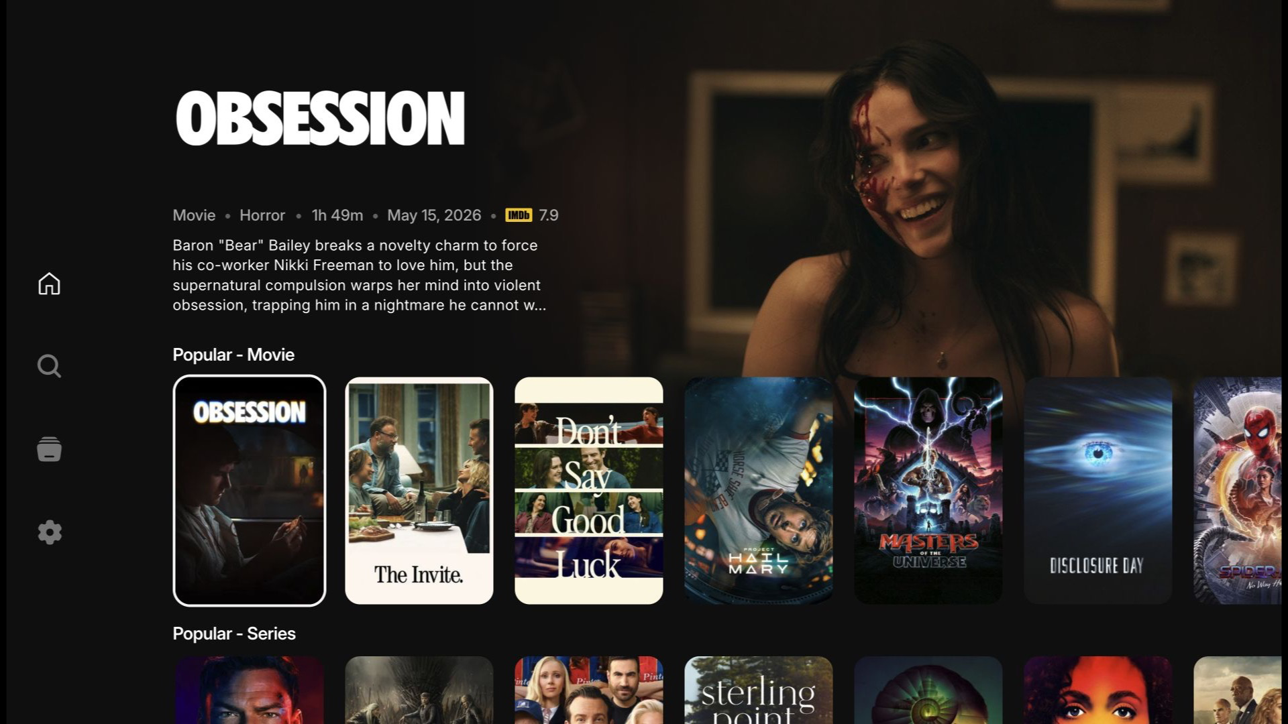
UI FLOW
03
Home: discovery at TV distance
HERO AREA
Highlights a focused title with metadata and a short synopsis.
CONTENT ROWS
Horizontal rails keep browsing predictable with remote control navigation.
FOCUS
The selected item is visually distinct and remains usable at 10-foot distance.
DATA
Home screen captured from the local TV build
Artwork and metadata are loaded from configured catalog providers.
Nuvio TV • Samsung TV UI Description • submission draft
Notes:
[Sources]
Local screenshot captured from the NuvioTV-Web build at 1920x1080.
Nuvio Android product positioning reference: https://play.google.com/store/apps/details?id=com.nuvio.app

Slide 4
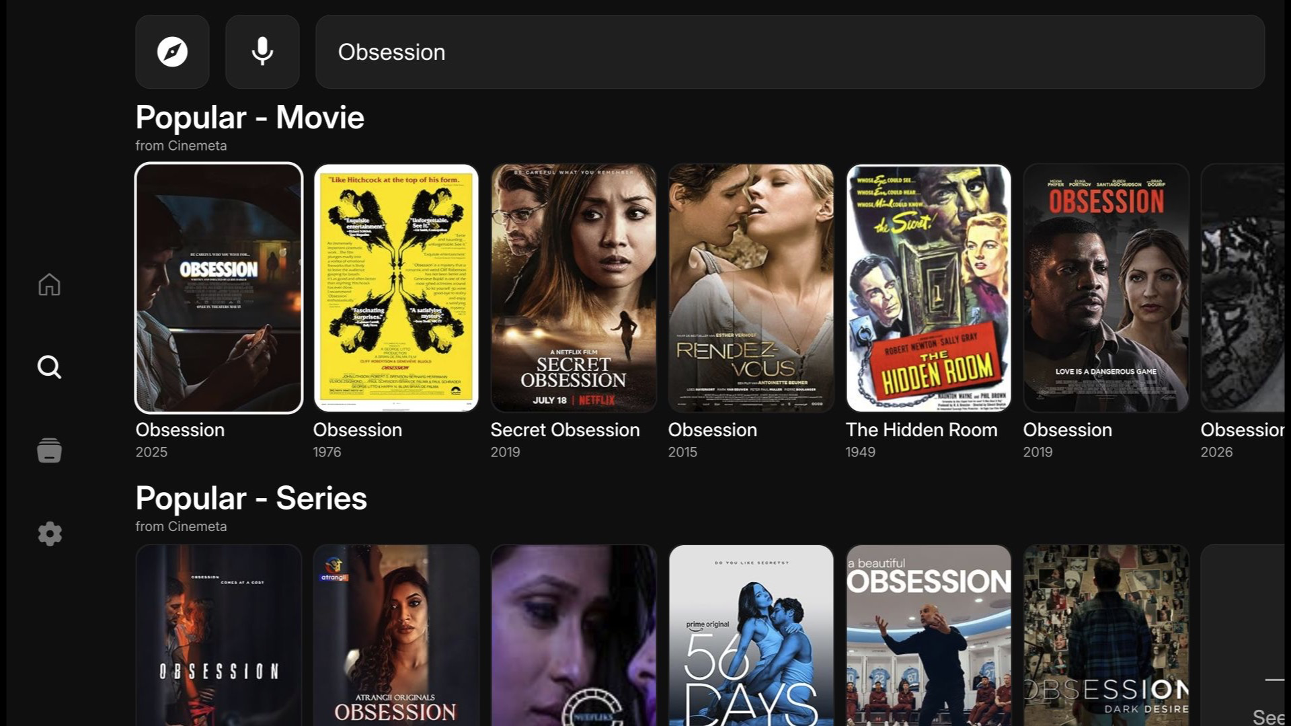
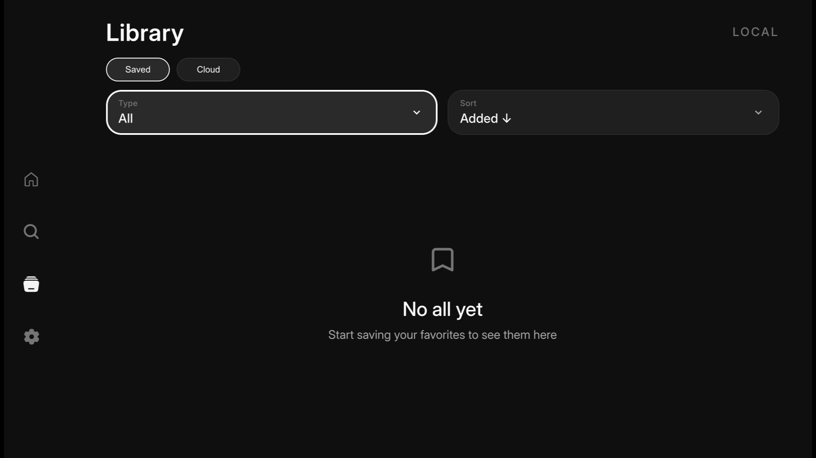
UI FLOW
04
Search and library
Search results
Library and saved titles
SEARCH
LIBRARY
Enter a title with the TV keyboard or voice search.
Switch between saved and cloud-backed views when configured.
Nuvio TV • Samsung TV UI Description • submission draft
Notes:
[Sources]
Local screenshots captured from the NuvioTV-Web build at 1920x1080.
Nuvio Android product positioning reference: https://play.google.com/store/apps/details?id=com.nuvio.app

Slide 5
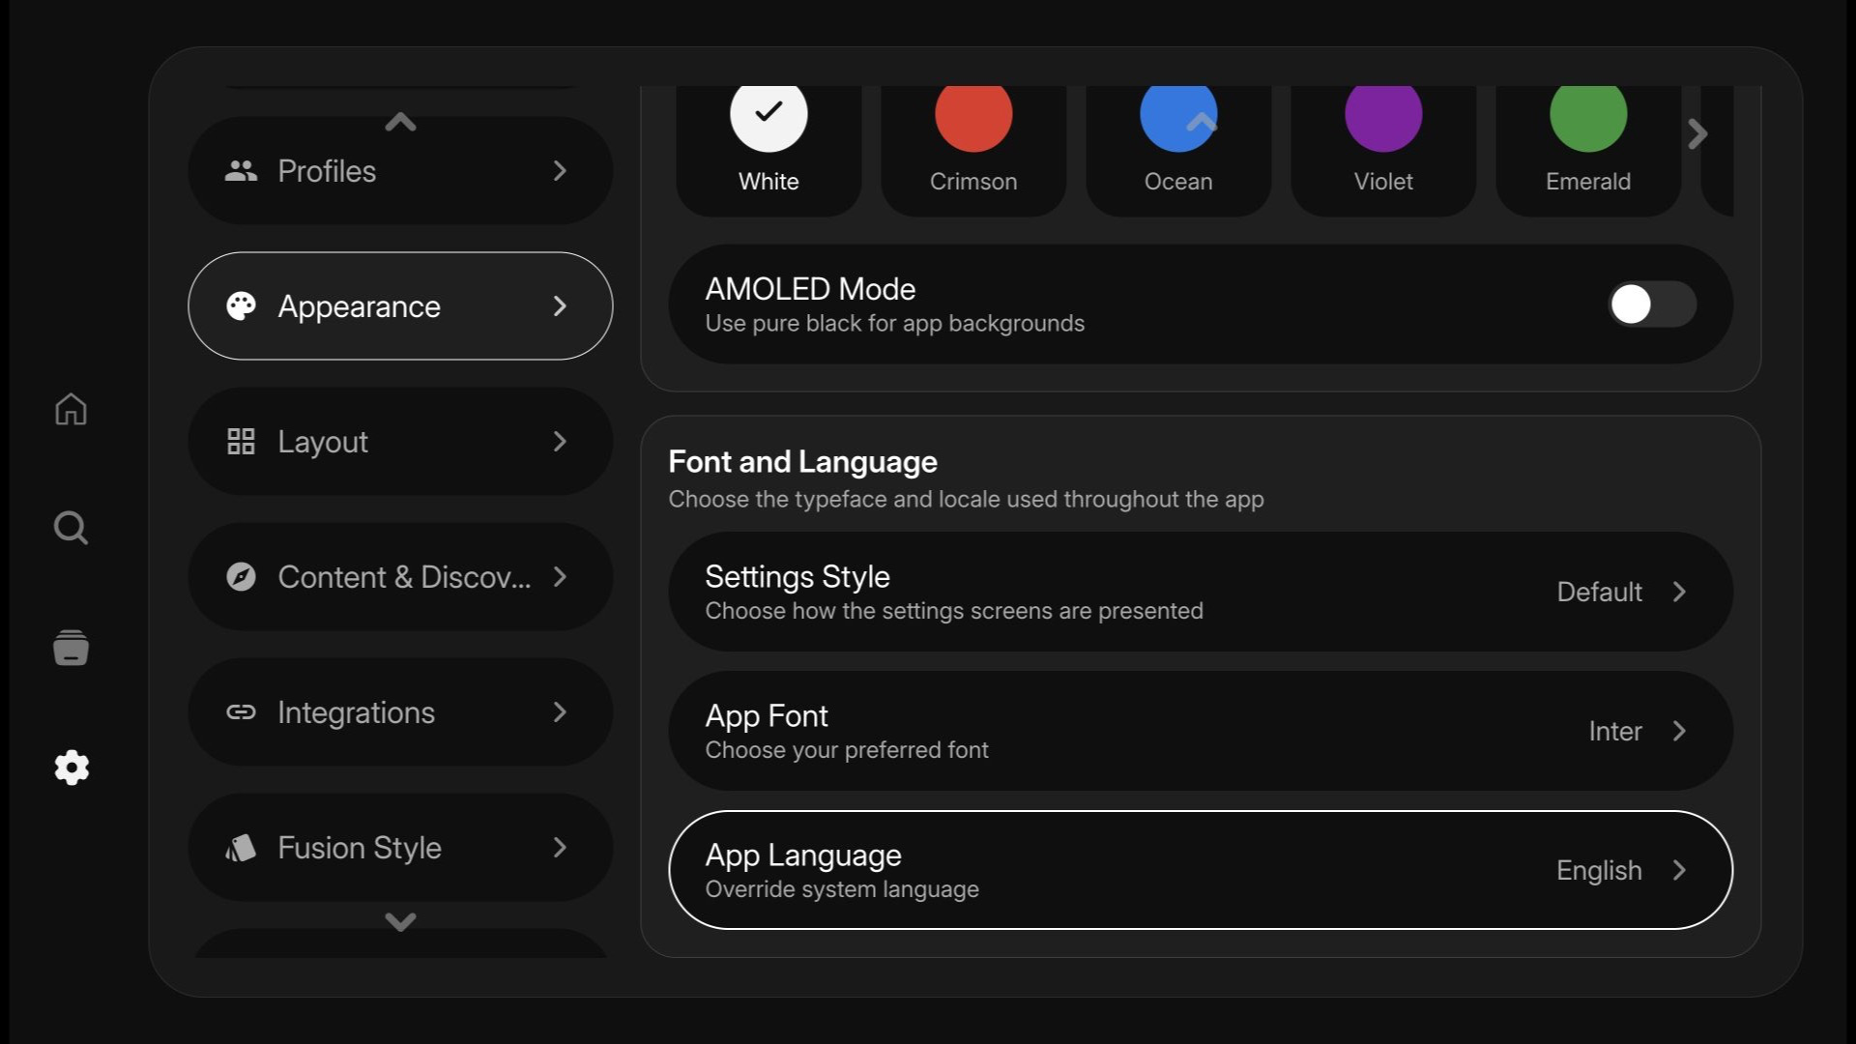
UI FLOW
05
Appearance and color themes
COLOR THEME
Choose the accent color used throughout the TV experience.
AMOLED MODE
Use pure black backgrounds for a high-contrast dark presentation.
SETTINGS STYLE
Choose how settings screens are presented on the TV.
LANGUAGE
Appearance screen captured from the local English TV build
Override the system language with one of the supported app locales.
Nuvio TV • Samsung TV UI Description • submission draft
Notes:
[Sources]
Local English screenshot captured from the NuvioTV-Web build at 1920x1080.
The screenshot shows the first Appearance screen, including color themes, AMOLED mode, settings style and app language.

Slide 6
CERTIFICATION PROFILE
06
Sources and platform routes
Nuvio keeps the TV experience consistent while the signed package follows the selected store profile.
TARGET
DISTRIBUTION
SOURCE MODEL
RELEASE CONTROL
Tizen 4+
TV package floor used by Nuvio.
Public Seller flow with the countries and model groups approved in Seller Office.
User-configured catalogs, add-ons and supported services provide the playable sources.
The signed WGT must contain exactly the privileges, metadata and service routes approved for the release.
Submission note
The final WGT must be signed with the publisher’s Tizen security profile and must contain exactly the privileges and metadata approved in Seller Office.
Nuvio TV • Samsung TV UI Description • submission draft
Notes:
[Sources]
Samsung Launch Checklist: https://developer.samsung.com/tv-seller-office/checklists-for-distribution/launch-checklist.html
Samsung Publishing an application: https://developer.samsung.com/tizen/Smart-TV/Quickstarts/Publishing-an-application.html
Samsung Becoming Partners: https://developer.samsung.com/tv-seller-office/guides/membership/becoming-partner.html
Samsung Privileges Q&A: https://developer.samsung.com/smarttv/develop/faq/privileges.html

Slide 7
CERTIFICATION TEST SCENARIO
07
Suggested verification path
01
Launch
02
Home
03
Search
Open the signed WGT and verify the initial profile screen.
Select a profile and verify hero focus, rows and remote navigation.
Search a known title and open the matching result.
04
Library
05
Playback
06
Recovery
Save a title and confirm it appears in the local library.
Play a publisher-supplied test source and check audio/subtitle controls.
Return to Home, relaunch and confirm saved state remains stable.
Pending publisher input: test account, configured provider/add-on, approved country/model groups, privacy/support contacts and final rating.
Nuvio TV • Samsung TV UI Description • submission draft
Notes:
[Sources]
Samsung Seller Office requires test information for certification and verification: https://developer.samsung.com/tv-seller-office/
Samsung player information fields: https://developer.samsung.com/tv-seller-office/guides/applications/entering-application-information.html

