Slide 1


Slide 2
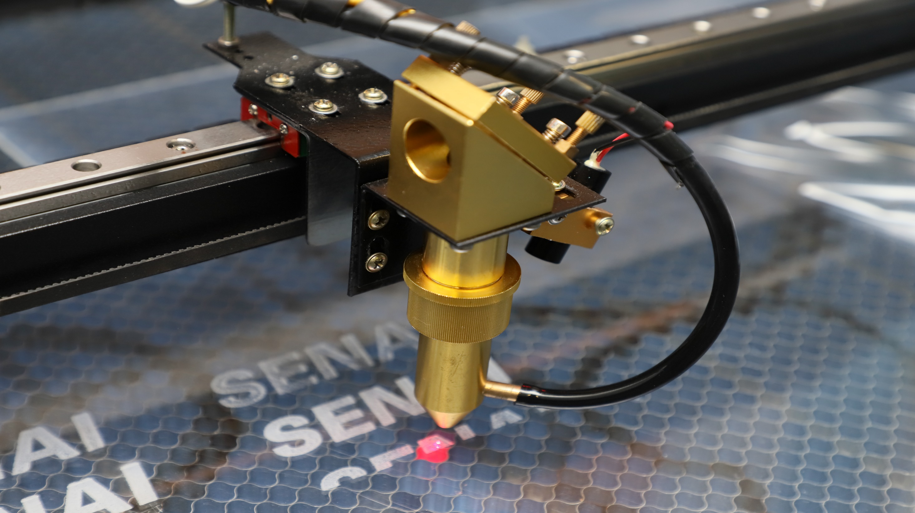
SENAIlab
SENAIlab

Slide 3
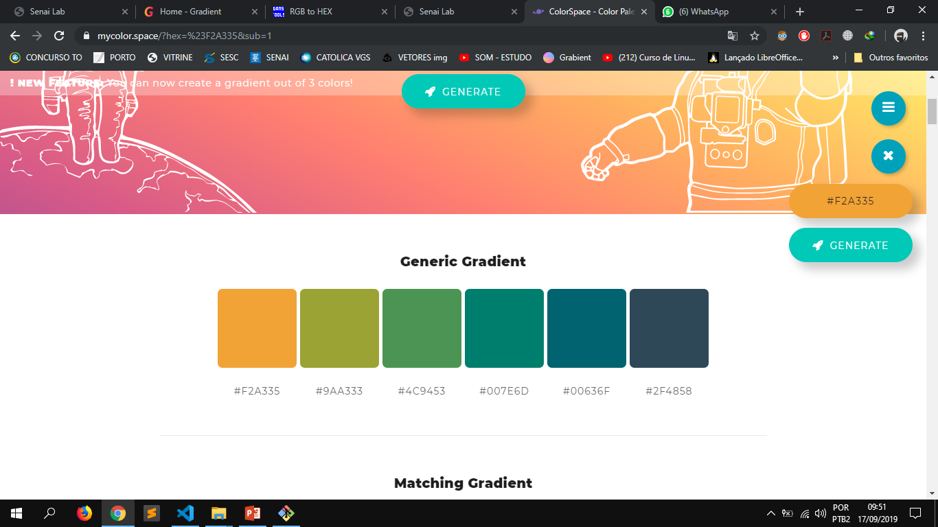
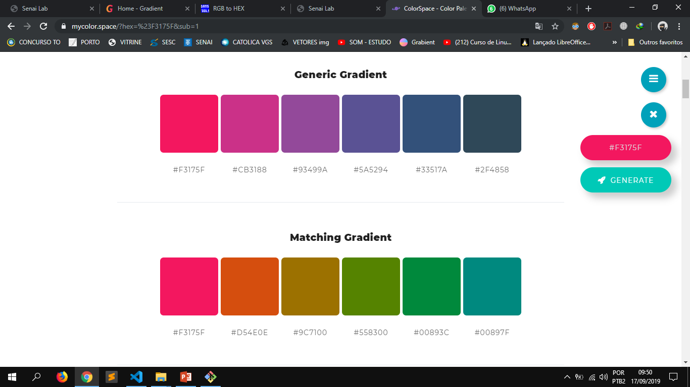
PALETA DE CORES

Slide 4
RÊFERÊNCIA
https://gradient.madebysuperfly.com/

