Slide 1


Slide 2
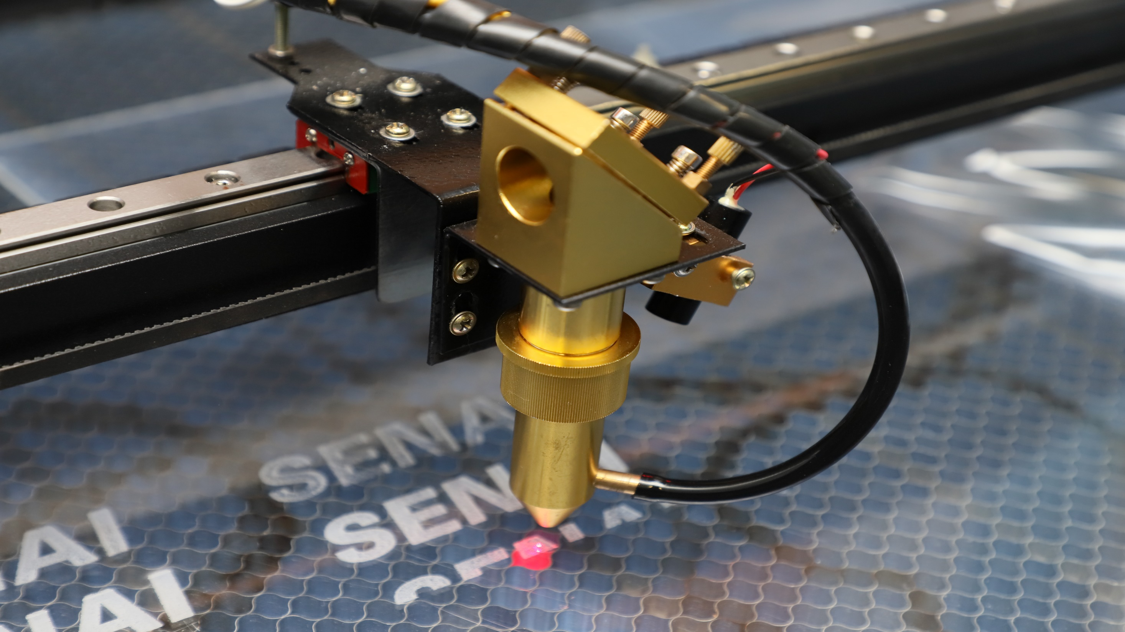

SENAI
lab

