Slide 1
Email Sender Application
Gmail
By WESLEY MBEWE

Slide 2
Outline
Introduction
Code Structure and Key Features
Technical Requirements
Error handling
Conclusion

Slide 3
Introduction
This is an email Sender Application that uses SMTP protocol to send email to other users. The Application connects to the Gmail server to send the email with the help of a app-password.
Here you’ll be able to send, close , view logs(history) , place the dark mode effect to our window.
The window opens with the title “internet messaging” . When saving your file make sure it has the same name as the one you placed at Gmail setting for authentication.

Slide 4
Code structure
Entry Field- here is where one will put the necessary information that will be needed to send the email to the right recipient. These are made using Tkinter which is used to make graphical user interface.
Database- Is where the logs(history) of our application will be kept at we send and keeps it together with time stamps and date. The database used in this application is SQLite.
Viewing From the database- After sending the data is stored ND can be viewed by going to the menu -> tool.
Manu-Here one can access a number of instructions And tools like file, tool and help.

Slide 5
Cont…
Checkbox for background colors change- here we use a checkbox to change the color of the Background once click the Background changes to light gray.

Slide 6
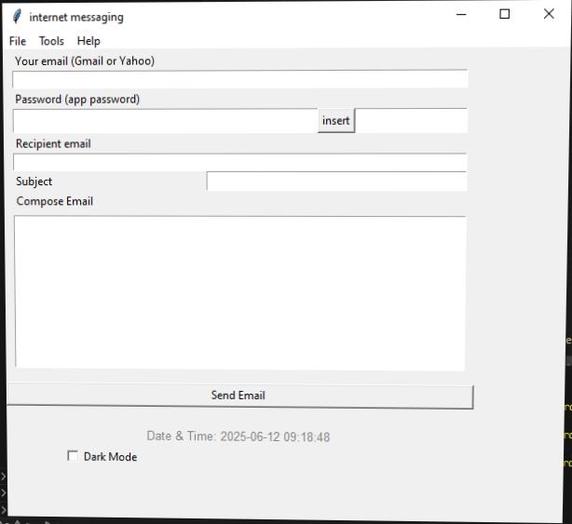
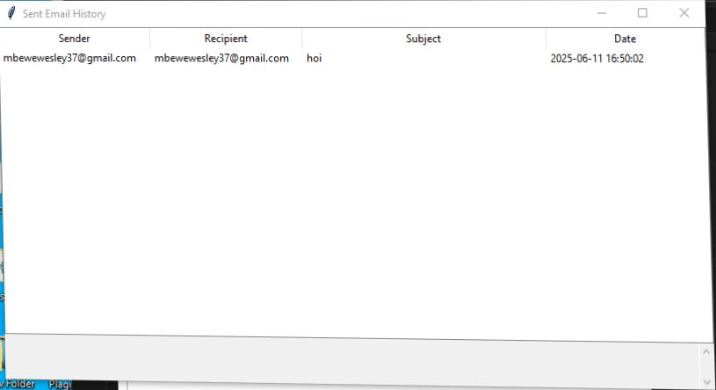
Cont…
Application GUI
Viewing sent emails

Slide 7
Technical Requirements
Programming language- The program Uses a python programming language to create the application and run them on a compiler like vs code and pycham
Graphical user interface- to interact with the user the application needs a graphical user interface like tkinter for easy entry of data and understanding.
Database- use database to store the data of logs which shows messages sent already.
code structuring and organization –the structure and organization of the program has been done with functions to easily apply methods and attributes.

Slide 8
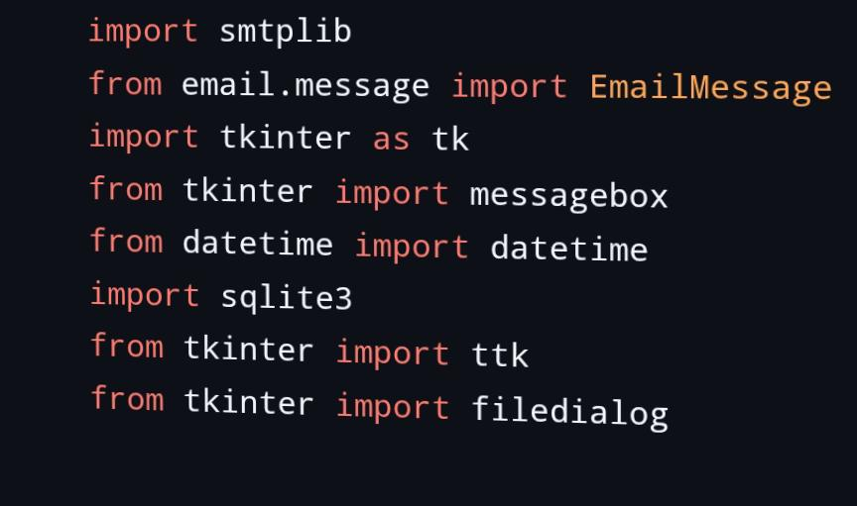
Cont…
Library are also uses for easy execution. These libraries are tkinter, email and SQLite.

Slide 9
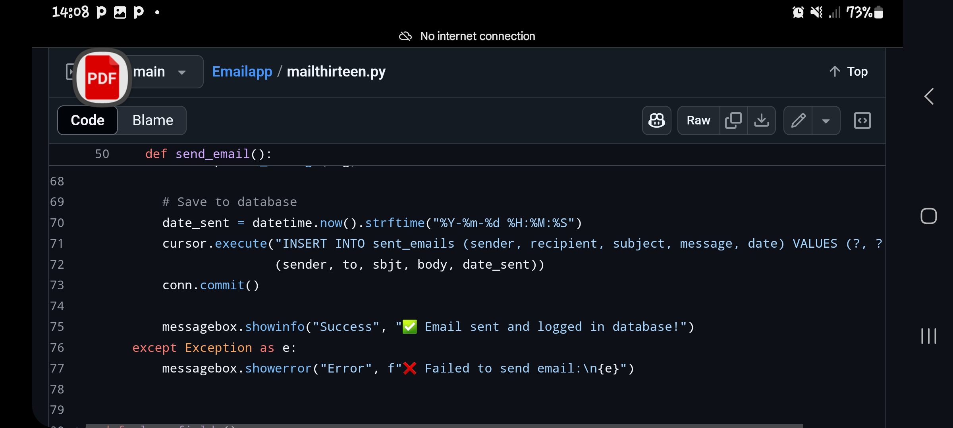
Error handling
Here is where our anticipation, detection and response to error that may occur during the time the program. Therefore this program has a number of ways where we have found these errors by displaying an error message and when displaying a message that shows successful execution
At the right is an example of how our code will handle different scenarios.

Slide 10
conclusion
Email Sender Application is also a user friendly application that uses python programming language Which uses SMTP protocol and working together with a graphical user interface to send emails.
It uses a SQLite as a database to store history of emails sent together with time and date and then they can be viewed later.

Slide 11
THE END
Thank you for your attention

