Slide 1
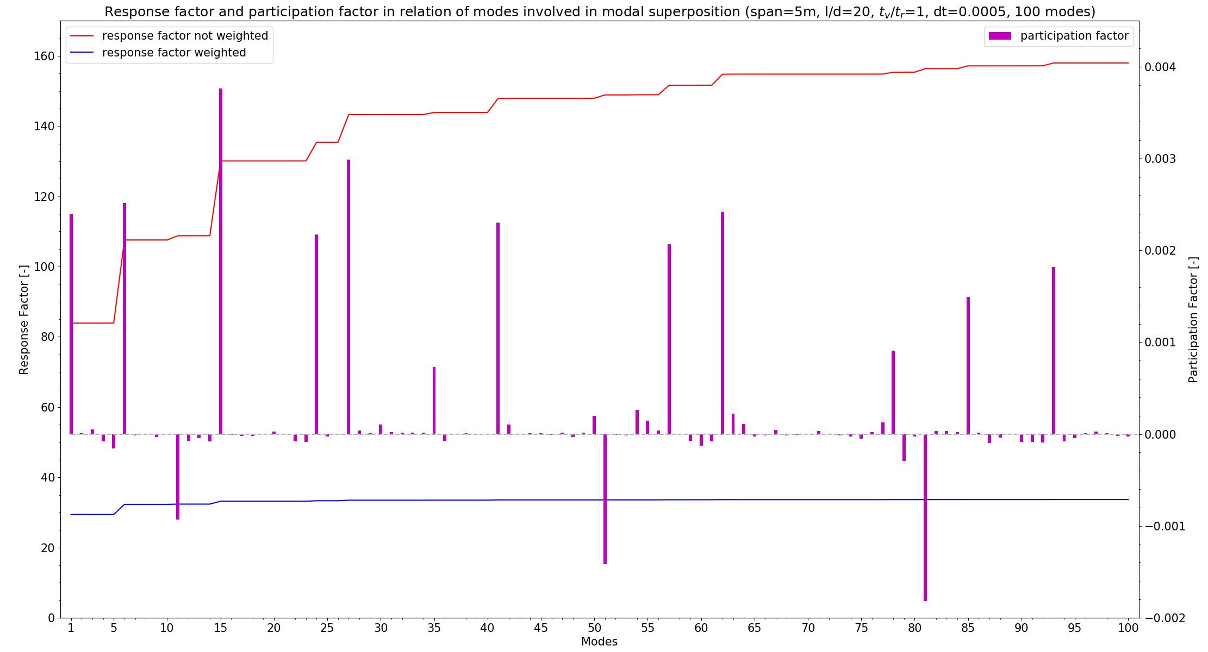
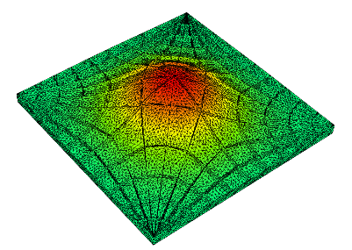
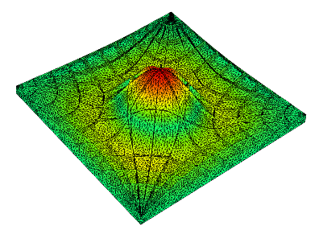
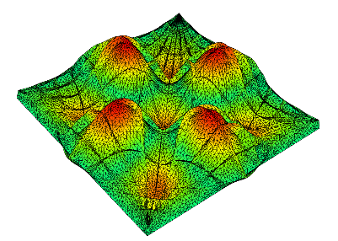
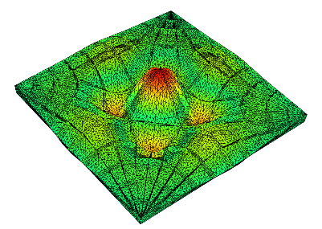
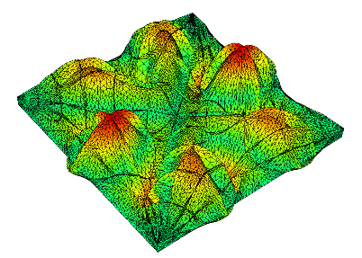
Mode 1
Mode 6
Mode 11
Mode 15
Mode 23

Slide 2
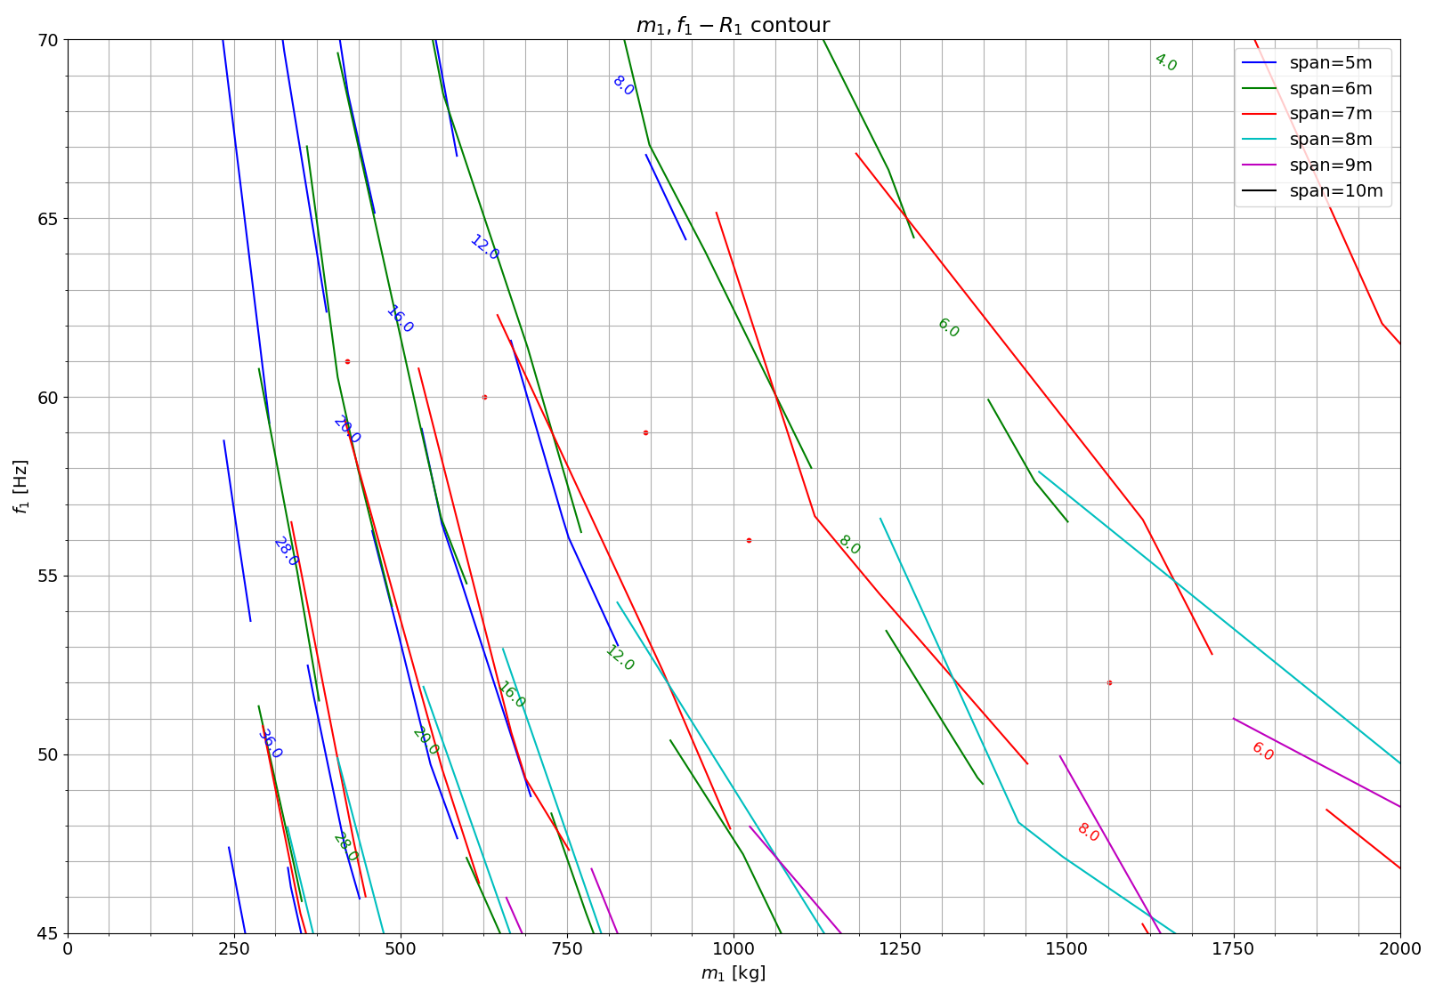
M2, 5%
M2, 10%
M1, 5%
M1, 10%

Slide 3
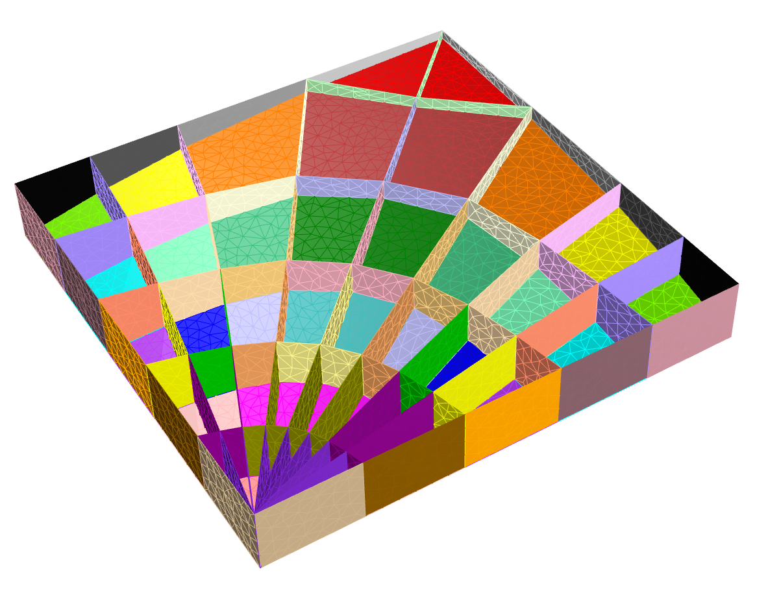

boundary surface x
boundary surface y

Slide 4
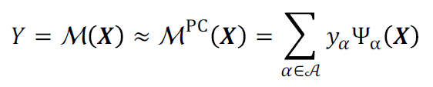


Run Experimental Designs (Full Model)
geometric input from input samples
Mesh Model
Modal Analysis
Dynamic Response
Response Factor
Obtain (input, output)=($X,Y_{ED}$) Data Sets
Build Surrogate Model
Optimize Surrogate Model with GA
geometric input generated by GA
Surrogate
Model
Response Factor
Obtain Input of Optimized Surrogate Model
Recalculate Response Factor with Full Model

