Slide 1
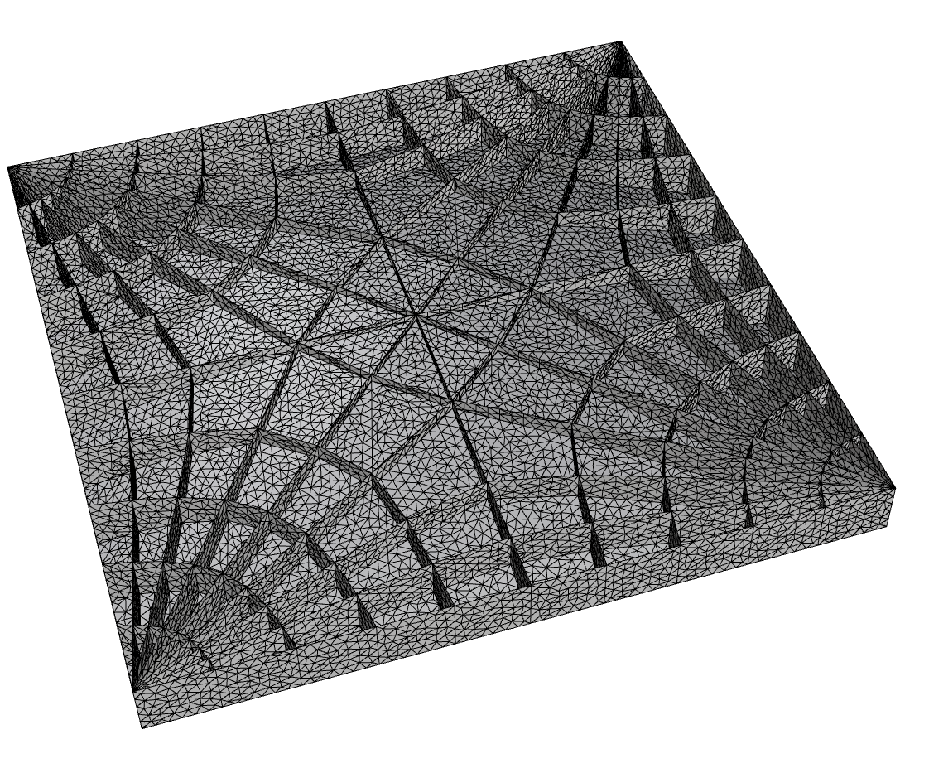
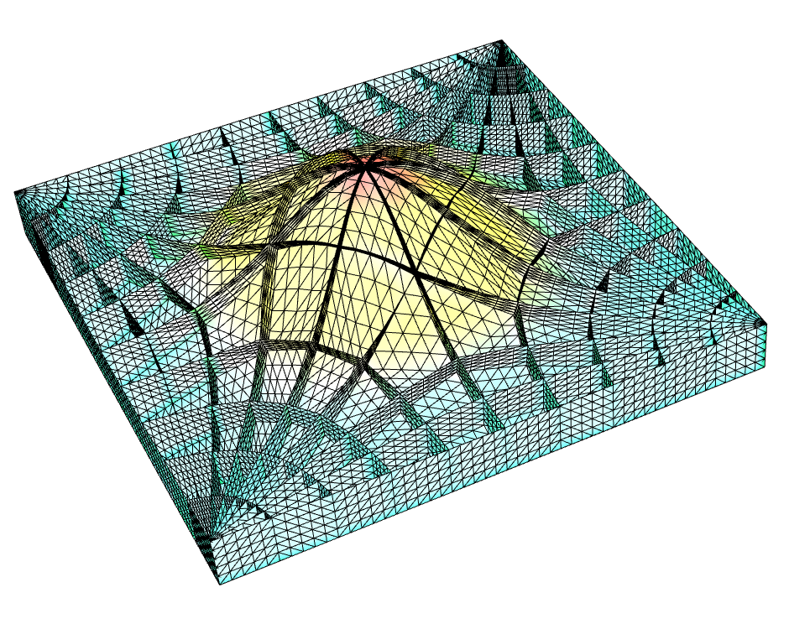
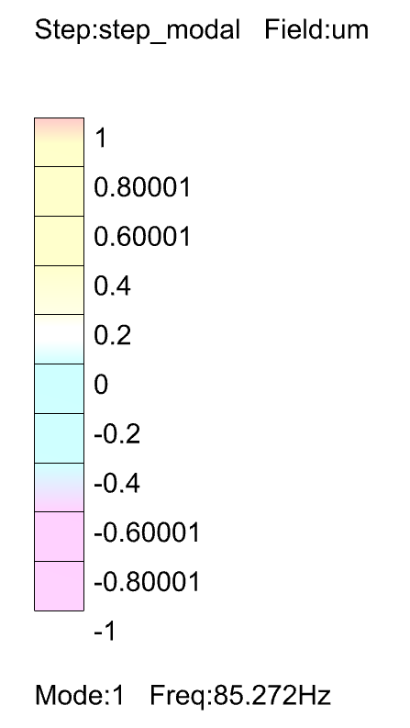
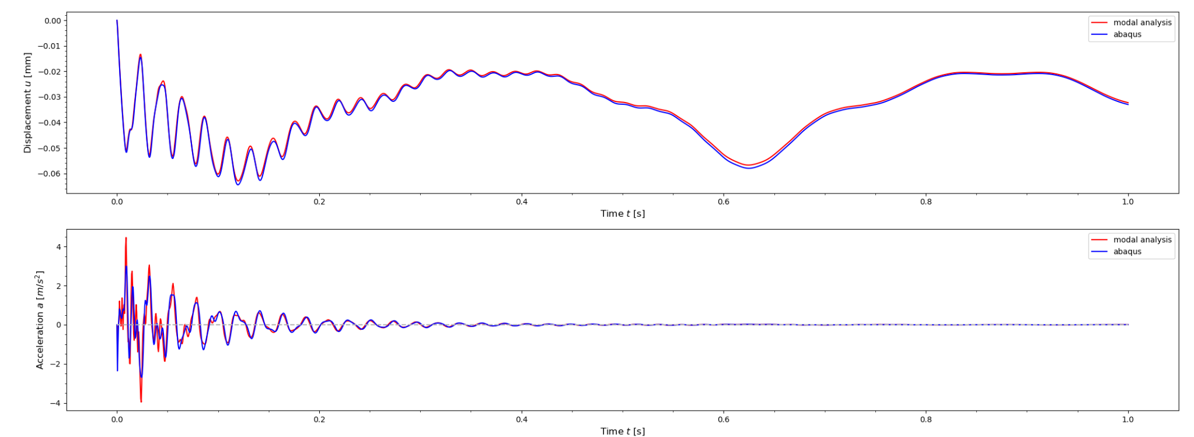
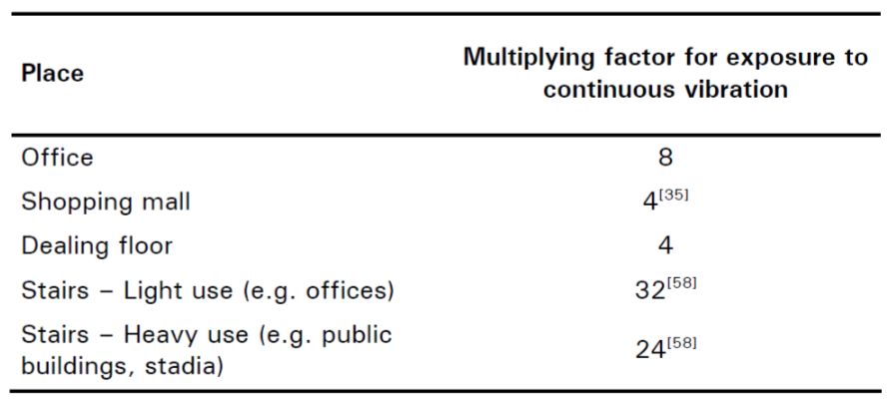
Model
Rhino
model with different
(l, l/d, tv/tr) combinations
Modal Analysis
Abaqus
extract eigenfrequency,
modal mass, mode shape
Dynamic Response
Python
solve response time history with modal superposition
Response Evaluation
Python
post-process response based on chosen acceptance criteria

