Slide 1

SYSTEM STATUS: OPERATIONAL
NSC ICT Service Desk &
Asset Management System
Database Design, Connectivity & System Architecture Report
STUDENT NAME
MATRIC NUMBER
DEPARTMENT
INSTITUTION
[Student Name]
[Matric Number]
[Department]
[Institution]
Prototype academic project — fictional data only

Slide 2







What We’ll Cover
A tour of the system, its database, and how the pieces connect
System Overview
Technology Stack
What the application does and who uses it
The frameworks and libraries behind the system
Architecture & Connectivity
Database Design & ERD
How the frontend, backend, and database talk to each other
Tables, relationships, and normalization
Security Measures
Testing & Verification
How data and accounts are protected
How the system was proven to work

Slide 3





What The System Is
A full-stack prototype web application that tracks ICT hardware assets and manages staff support requests for an ICT department in a shipping-related organization.
Asset Management
Service Desk
Every dashboard figure is calculated live from PostgreSQL — nothing is hard-coded.
FOUR ROLE TIERS
Maintenance Records
Staff Management
Administrator
ICT Officer
Technician
Departments
Audit Log & Reports
Staff / User

Slide 4



Technology Stack
A deliberately simple stack — no build tools required to run the frontend
Frontend
Backend
HTML5, CSS3, vanilla JavaScript — plus Chart.js for the reports dashboard. No React, no build step.
Node.js with Express, structured as a REST API — one route module per feature area.
Database
Auth & Security
PostgreSQL — a normalized relational schema with constraints enforced at the database layer.
JSON Web Tokens for sessions, bcrypt for password hashing, role-based middleware on every route.

Slide 5
How The Pieces Connect
A classic three-tier architecture — the frontend never touches PostgreSQL directly
Browser
Express API
PostgreSQL
Frontend (HTML/CSS/JS)
Backend — routes, auth, validation
Normalized relational database
fetch() + JWT bearer token
parameterized SQL via node-postgres
Every write also logs an entry to the audit_logs table before the response is sent.
Administrator
ICT Officer
Technician
Staff / User
Full access
Manage assets & requests
Own assigned requests
Submit requests, view assets

Slide 6
Database Connectivity
config/db.js — one shared connection pool, reused by every route
const { Pool } = require('pg');
const pool = new Pool({
host: process.env.PGHOST,
port: process.env.PGPORT,
database: process.env.PGDATABASE,
user: process.env.PGUSER,
password: process.env.PGPASSWORD,
});
module.exports = pool;
// In a route file:
await pool.query(
'SELECT * FROM assets WHERE status = $1',
[status] // parameterized — never
); // string-concatenated SQL
Connection pooling
One Pool instance is shared across every request — no per-query connect/disconnect overhead.
Credentials via environment
Host, database, user, and password are read from .env — never hard-coded, never committed.
Parameterized queries only
Every query uses $1/$2 placeholders, which node-postgres binds safely — this is what prevents SQL injection.
Audit logging on writes
State-changing routes call a shared logAction() helper that inserts into audit_logs after each change.

Slide 7
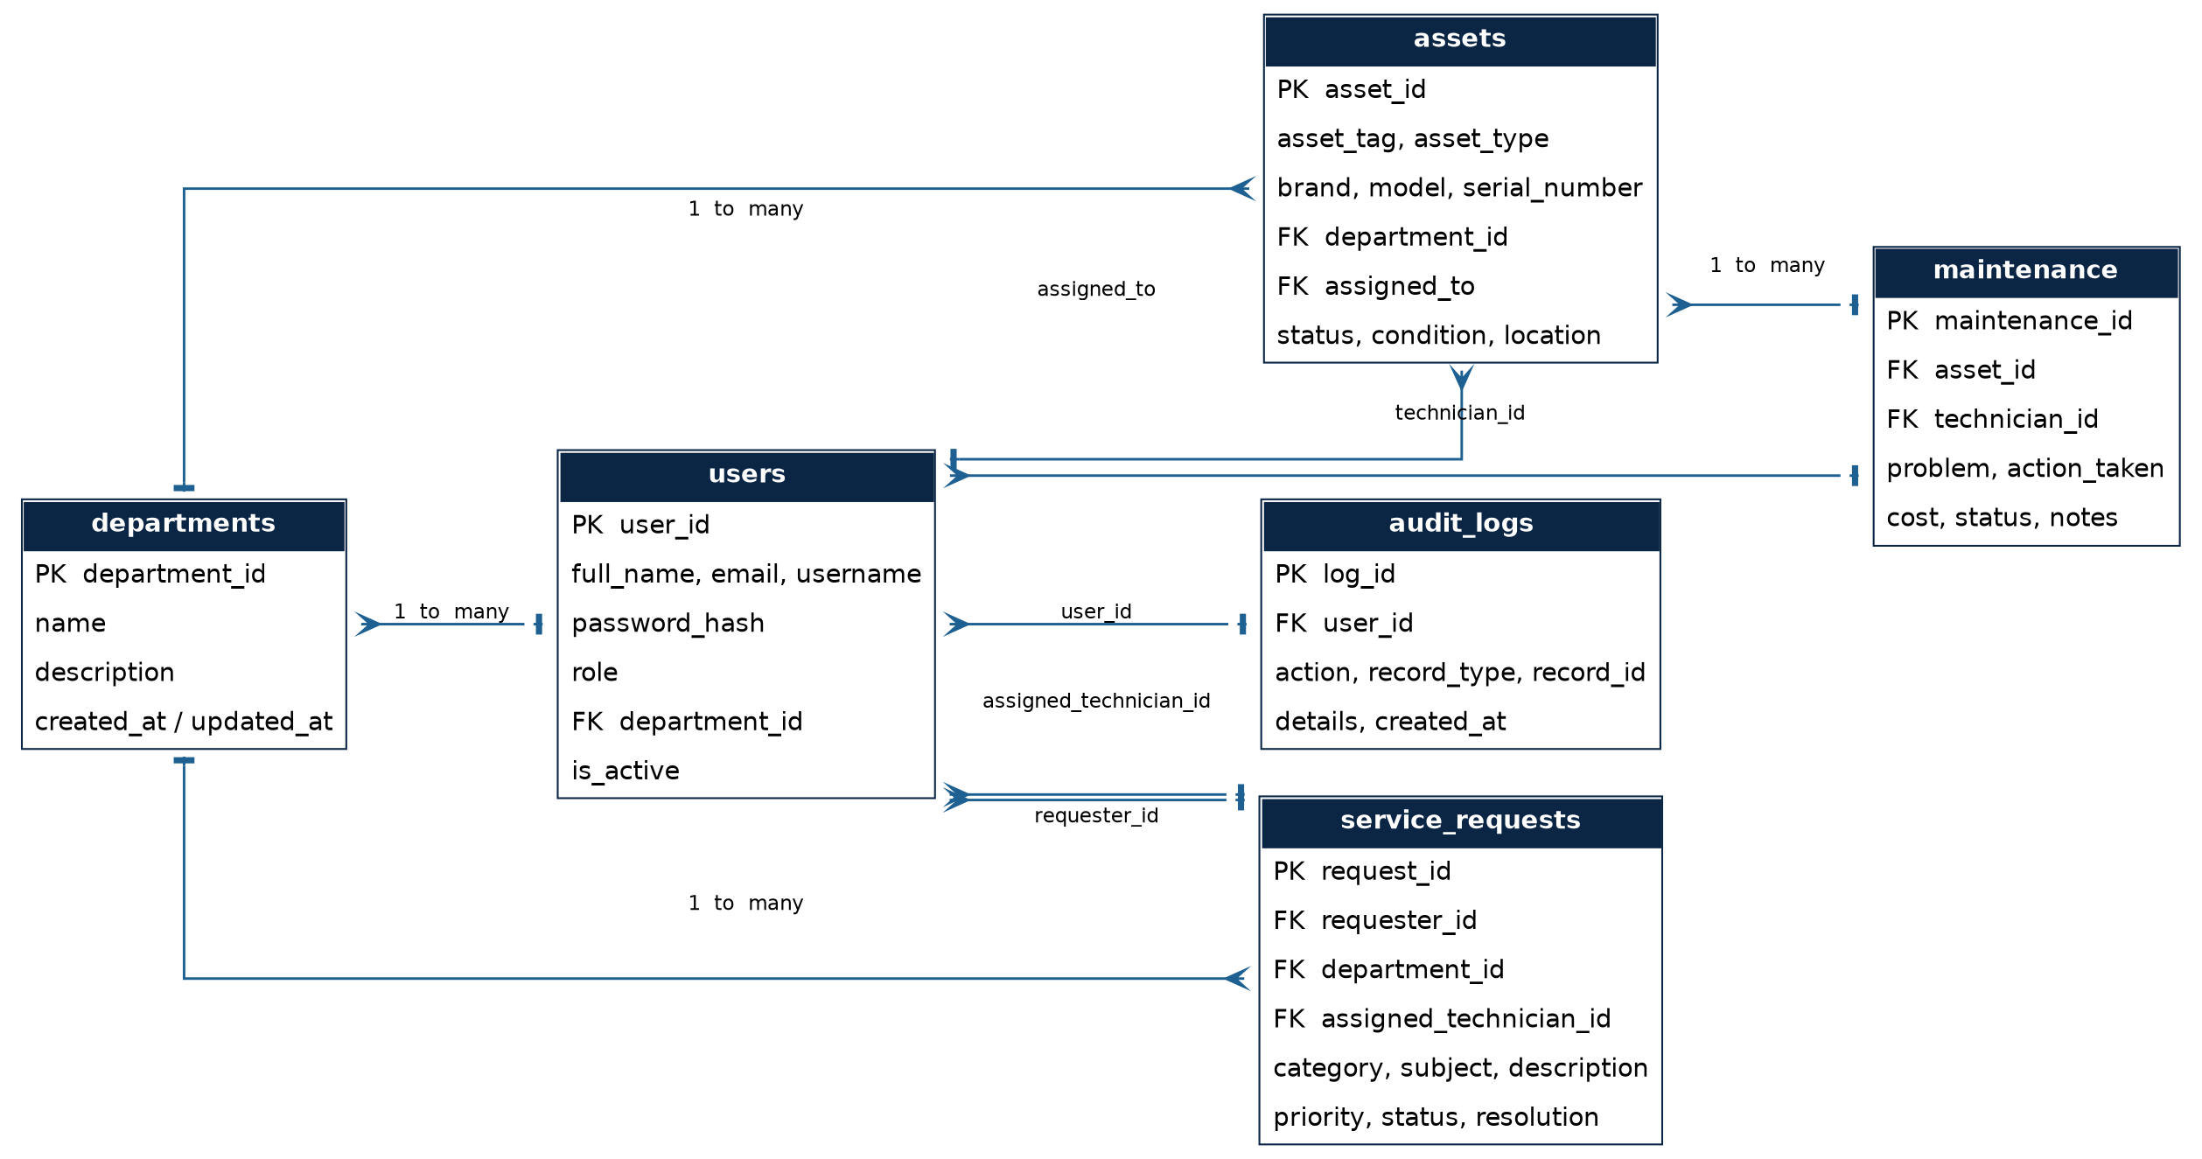
Entity Relationship Diagram
Matches database/schema.sql exactly — six tables, seven foreign-key relationships

Slide 8
Database Tables
Every column, constraint, and index lives in database/schema.sql
Table | Purpose | Key Relationships
departments | Organizational departments | Referenced by users, assets, service_requests
users | All accounts — 4 roles, bcrypt-hashed passwords | FK to departments
assets | ICT hardware inventory and current status | FK to departments, users (assigned_to)
service_requests | Staff support tickets, end to end | FK to users (requester + technician)
maintenance | Repair / service history per asset | FK to assets, users (technician)
audit_logs | Append-only log of significant actions | FK to users

Slide 9


Security Measures
Enforced at the database and API layer — not just hidden buttons in the UI
Password Hashing
JWT Sessions
Parameterized Queries
Every password is hashed with bcrypt before storage — plaintext is never saved or logged.
Signed, expiring tokens carry the user’s role; the signing secret lives only in a local .env file.
All SQL uses $1/$2 placeholders via node-postgres — user input is never concatenated into SQL.
Role-Based Middleware
Full Audit Trail
Account Deactivation
requireAuth and requireRole re-check permissions on the server for every restricted route.
Logins, creates, edits, assignments, and status changes are all written to audit_logs.
Deactivated accounts are blocked at login — even with the correct password.

Slide 10
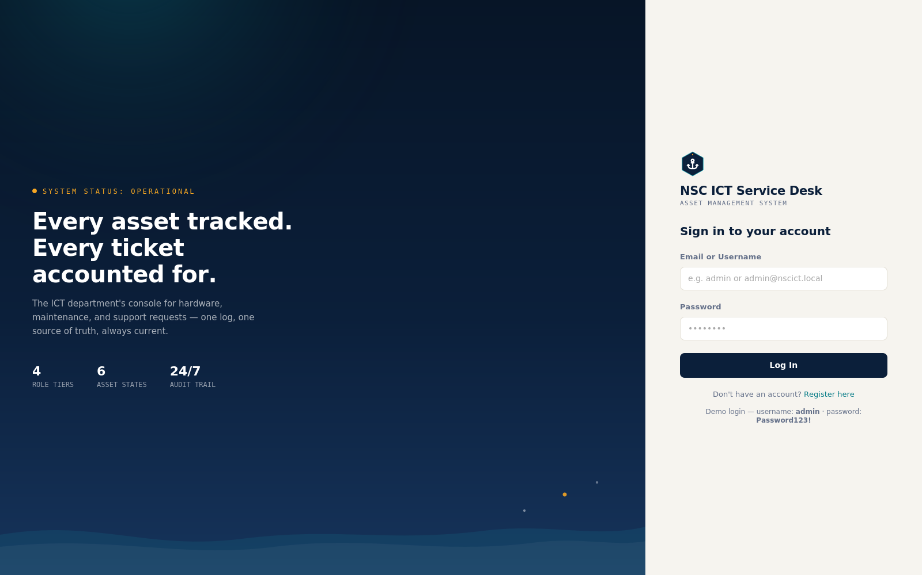
LIVE DEMO — click "Log In"

Slide 11
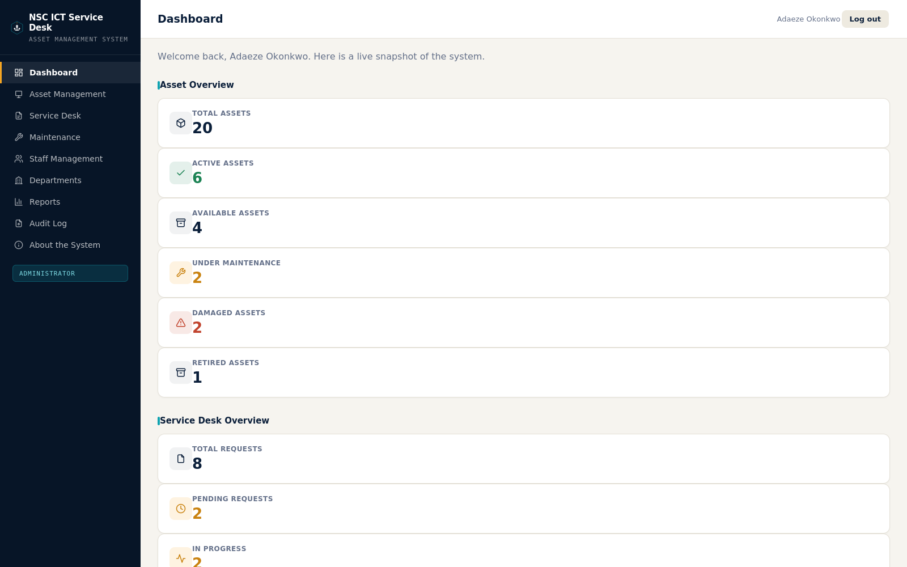
LIVE DEMO — click a sidebar link

Slide 12
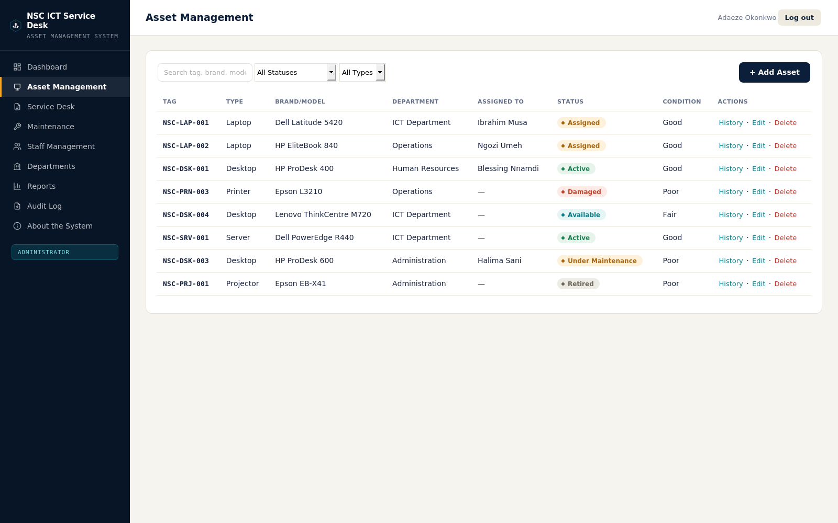
LIVE DEMO — try "+ Add Asset"

Slide 13
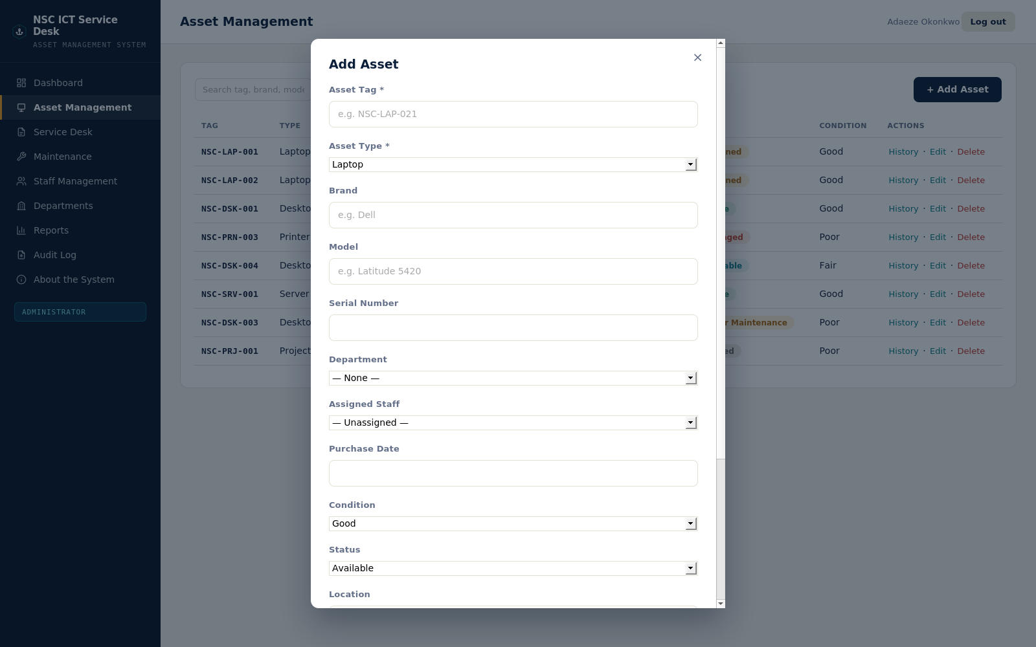
LIVE DEMO — click × to go back

Slide 14
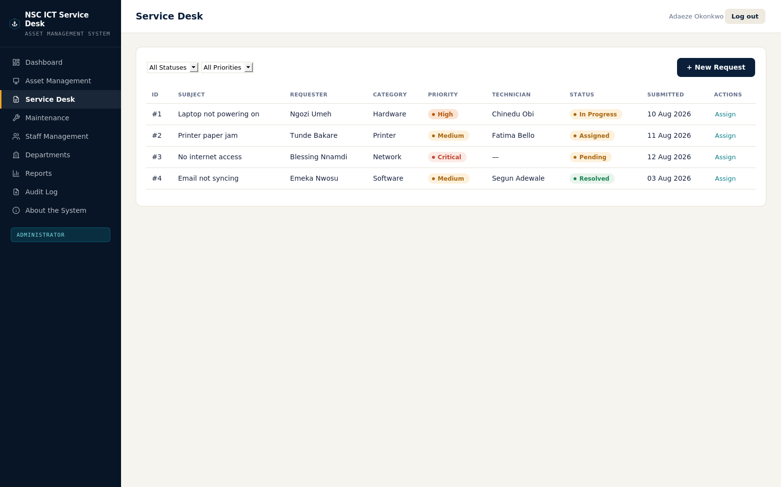
LIVE DEMO — click a sidebar link

Slide 15
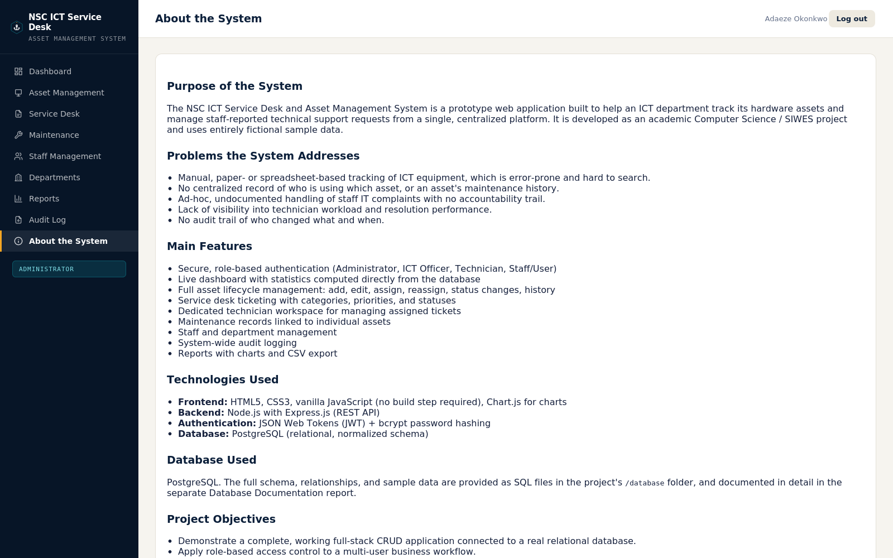
LIVE DEMO — click a sidebar link

Slide 16
Testing & Verification
WHAT WAS COVERED
Authentication — login, registration, deactivated-account lockout, invalid credentials
70 / 70
Role-based permissions — every restricted endpoint checked for every role
Full asset lifecycle — create, search, filter, edit, assign, status change, delete
AUTOMATED INTEGRATION TESTS PASSING
Service desk workflow — submission through assignment to resolution
Run against the real, unmodified backend source — over real HTTP requests.
Maintenance records — creation, status transitions, asset status sync
Staff & department management, audit logging, and report/CSV export

Slide 17
Conclusion & Recommendations
CONCLUSION
RECOMMENDATIONS
The database models the ICT department’s core operations — assets, staff, requests, maintenance, and an audit trail — in a normalized, referentially-sound schema. Every dashboard statistic is computed live, and the frontend-to-database integration was verified end to end through parameterized queries and role-checked middleware.
Add SSL and tuned connection pooling before production use
Introduce scheduled backups (pg_dump) once real data is in use
Add refresh tokens and login rate-limiting to the auth layer
Consider lookup tables if enumerated fields need to grow dynamically
6
4
70/70
22
DATABASE TABLES
ROLE TIERS
TESTS PASSING
REPORT SECTIONS
Full detail in DATABASE_DOCUMENTATION_REPORT.docx — 22 sections including SQL, testing, and security.

Slide 18
● END OF TRANSMISSION
Thank You
Questions on the system, the schema, or the connectivity are welcome.

