Slide 1
Angular Route Guards

Slide 2
What are Angular Route Guards
Angular route guards are used to control whether the user can navigate to or away from a route.
Allows routes to be protected and control access based on certain conditions, such as authentication status, role-based permissions, or custom business logic.
Earlier versions of Angular required the implementation of interfaces for route guards. Interfaces were replaced with class-based route guards which have been deprecated in favor of functional route guards.

Slide 3
What Route Guards are available?
canActivateFn – Controls if a route can be activated.
canDeactivateFn – Controls if the user can leave a route. This guard does not prevent the user from closing the browser or navigating to a different address. It only prevents actions from within the application.
canActivateChildFn – Controls if children of a route can be activated.
canLoadFn – Controls if a route can be loaded and is useful for feature modules that are lazy-loaded.
canMatchFn – When evaluated, it will help with Angular’s router to determine whether or not the associated lazy-loaded route should be evaluated.

Slide 4
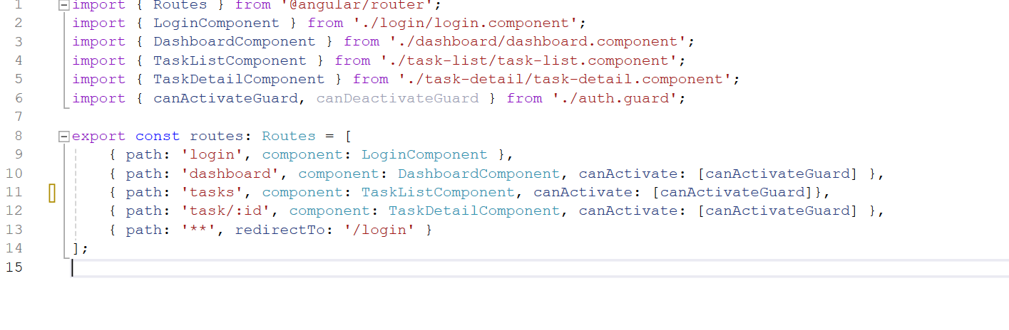
canActivateFn

Slide 5
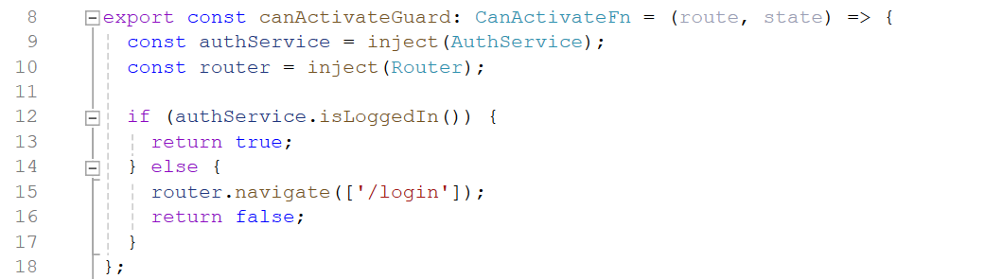
canActivateFn
The signature of the function is of type CanActivateFn and expects the route and the state as parameters. The return determines if the route may be completed.

Slide 6
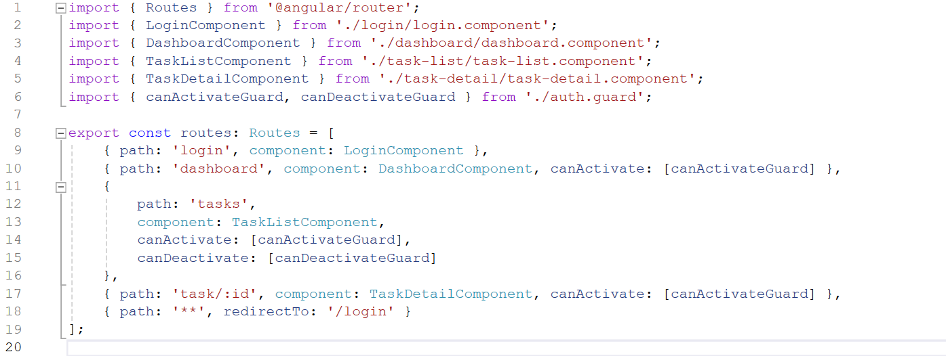
canDeactivateFn

Slide 7
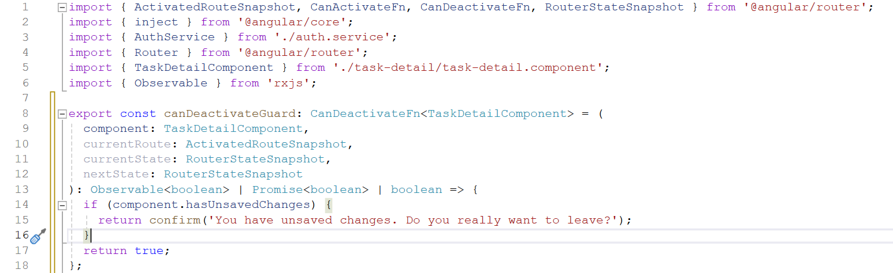
canDeactivateFn

