Slide 1
Test Automation Implementation
Wesley Peng

Slide 2
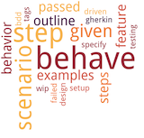
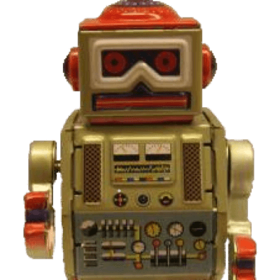
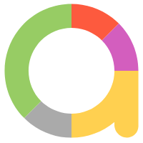

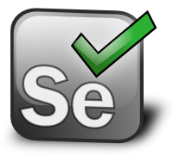

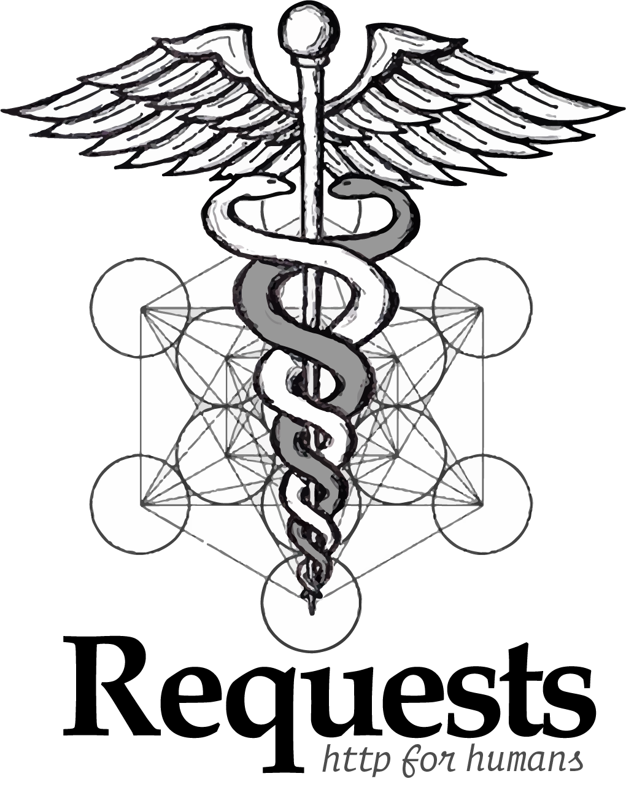

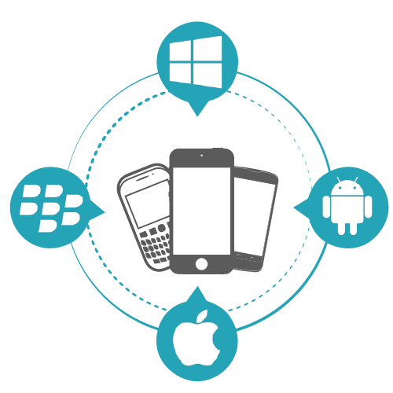

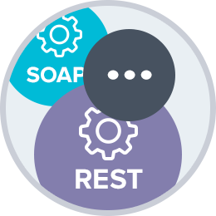
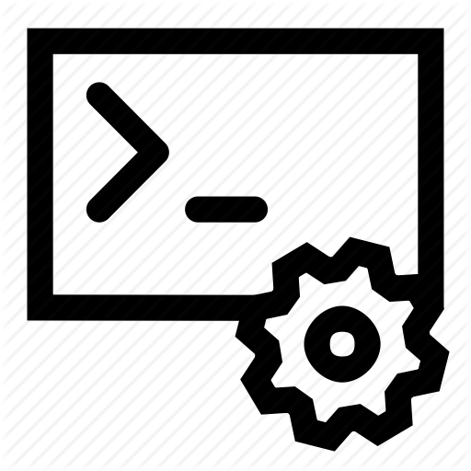
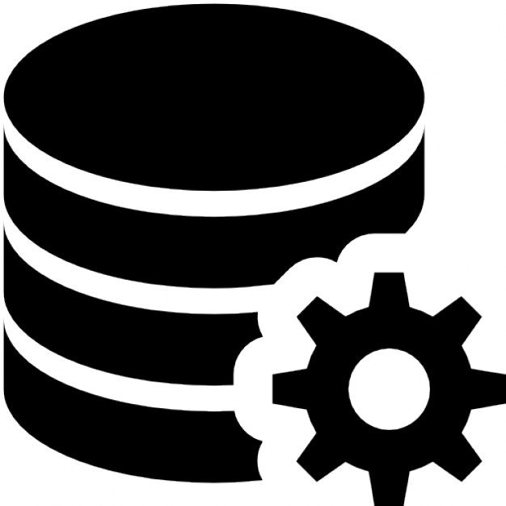
Architecture
UI/API Tests
BPT
BDD / ATDD
Gherkin Steps / Robot Keywords
Page Objects
Common Libraries
Unified APIs
Modeling
TAF
UIA Objects
TBD / Utils
CLI / REST
OSS / Tools
WEB
MOBILE
DESKTOP
DATABASE
CLI
SOAP/REST
Foundation
GUI / Non-GUI Apps
Desktop
AUT
GUI Apps
Web
Mobile
Non-GUI Apps
Service
CLI
Database

Slide 3
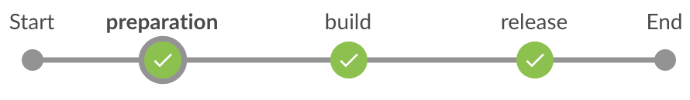


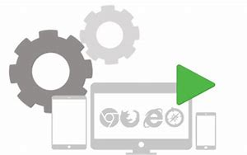
Technologies / Tools
Orchestration

Slide 4
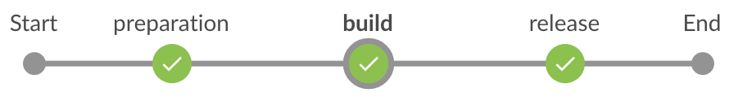

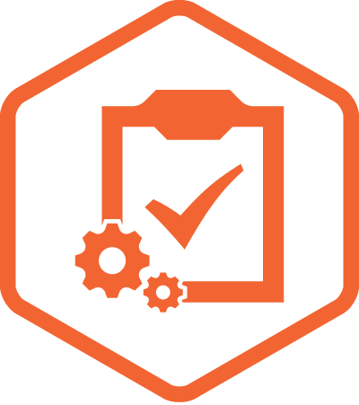
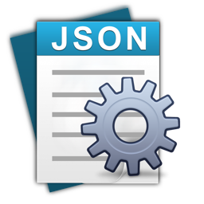
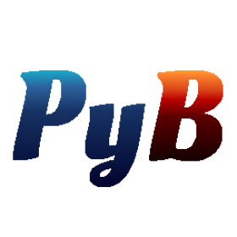

Technologies / Tools
Orchestration
Plugin Framework
Code-Driven (UT)
GUI-Driven (UI object-based)

Slide 5
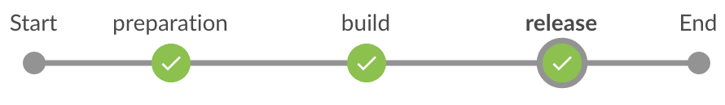
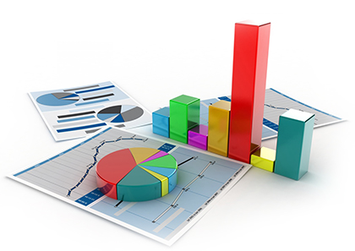

Technologies / Tools
Orchestration
Reporting

Slide 6




Docker Single Node
Single Node Execution
Selenium Grid

Slide 7
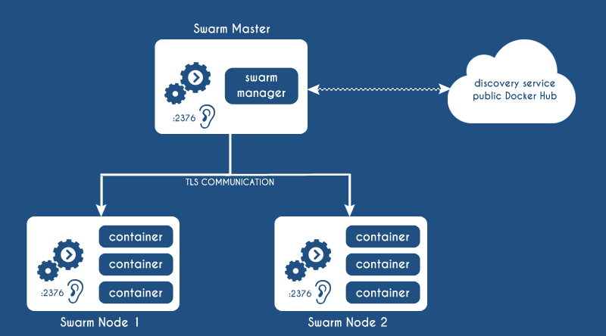
Docker Swarm

Slide 8
Architecture
UI/API Tests
BPT
BDD / ATDD
Gherkin Steps / Robot Keywords
Page Objects
Common Libraries
Unified APIs
Modeling
TAF
UIA Objects
TBD / Utils
CLI / REST
OSS / Tools
WEB
MOBILE
DESKTOP
DATABASE
CLI
SOAP/REST
Foundation
GUI / Non-GUI Apps
Desktop
AUT
GUI Apps
Web
Mobile
Non-GUI Apps
Service
CLI
Database

