Slide 1


Slide 2
I-IoT Low Power Embedded Communication Project: Smart Waste Management
Gregory Gonzalez Lopez
Mouhcine Oulad Ali
Wesley Van Wijnsberghe

Slide 3
What is Smart Waste Management?
Smart garbage bin
Measure temperature + capacity inside
Transmission of data and its location is triggered by movement of lid
Receive email alert if capacity has reached critical level (IFTTT)
Indoor: d7 + fingerprinting (x,y)
Outdoor: LoRa + GPS (latitude, longitude)

Slide 4
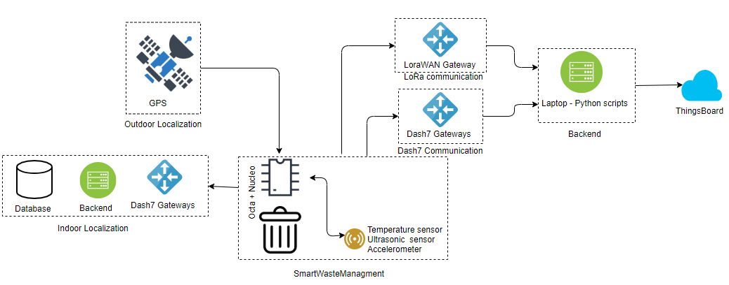
Overview

Slide 5
C-code Algorithm
Initialize sensors -> drivers lsm303agr, sht31, rf04
Initialize interrupt accelerometer
Loop:
active:
- Read sensor values: temp, dist, (x,y,z), GPS
Send using D7
→ error: send using LoRa
Go inactive
- inactive:
- periodic wakeup: 20s (demo purposes)
- if interrupt → go active next wakeup

Slide 6
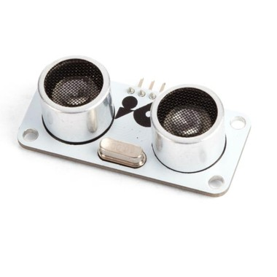
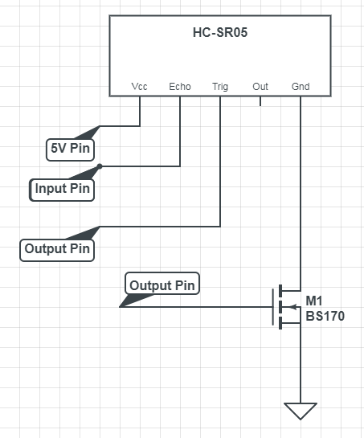
Ultrasonic sensor
MOSFET:
Turn on sensor before measurement
Turn off once measurement is done

Slide 7
Outdoor-localization (GPS)
I²C (read & write registers)
NMEA-sentence
$GNRMC,105824.000,A,5110.577055,N,00420.844651,E,0.42,285.58,080119,,,A*73
Minmea parser (51.176186,N & 4.347366,E)
Coordinates (latitude,longitude)
LoRa
TheThingsNetwork (Riot)
ThingsBoard (MQTT,python)
Stand-By mode (PMTK-command: $PMTK161,1*28\r\n)
Time
Latitude (North)
Longitude (East)
Speed (knots)
Course
(degrees)
Datum
Mode indicator + Checksum
Data valid

Slide 8
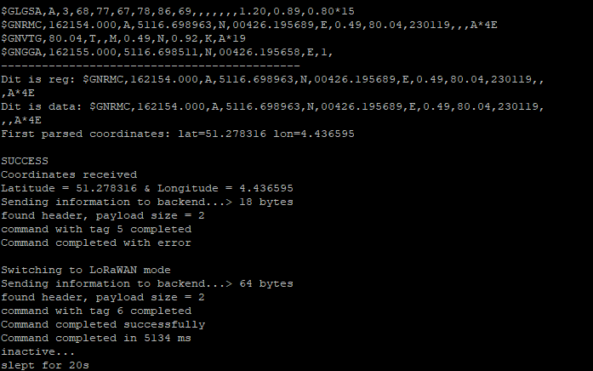
Outdoor-localization (GPS)

Slide 9
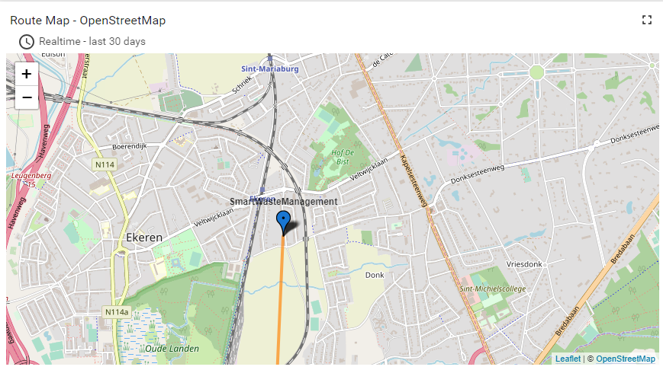
Outdoor-localization (GPS)

Slide 10
Backend
Subscription on topic on both a D7 broker & LoRa broker address
Connection to ThingsBoard
If message received is D7:
1. Start one thread for data processing
→ otherwise sends multiple packets to ThingsBoard
2. Wait a limited time before localization using mongoDB database
→ time to receive packet from all D7 gateways

Slide 11
Backend – Fingerprinting D7
MongoDB database: 100 measurements for each POI
POI: 3 points per block of computers
200 RSS value if gateway not in range/ gateway not in DB
Euclidean distance
25 nearest neighbours

Slide 12
Backend
Perform required conversion depending on D7 or LoRa message
LoRa is first parsed on The Things Network using a custom payload decoder
→ Decoder supports IFTTT trigger
Send telemetry to ThingsBoard for visualization
Indoor: map classroom
Outdoor: Google maps
Distance & Temperature
Container level

Slide 13
Power Management
Send LoRa if D7 failed to send = less airtime
Send coördinates only by LoRa = less payload
Mosfet to turn on ultrasonic if measurement required
Only wakeup active if (x,y,z) movement during sleep interval
Improvements:
Low power mode GPS
Check if indoor or outdoor → no gps measurements/no D7
Ultrasonic sensor draws a lot of current (15mA) = not ideal
Don’t send accelerometer values = useless

