Slide 1


FSEC-SS February Sharing Session 1: A glimpse into the New Normal of CTF
Speakers:
Wesley, David
Final Year Cyber Security Student, Committee of FSEC-SS
# C 4 P T U R 3 _ T H 3 _ F L 4 G # C Y B 3 R S 3 C U R 1 T Y

Slide 2
Agenda
General Overview
Practical Session
Challenge Design
Latest Trends in CTF
Deep Dive into Rust for Reverse Engineering
RSA Variations for Cryptography
Boot2Root
Topics and What to Expect

Slide 3
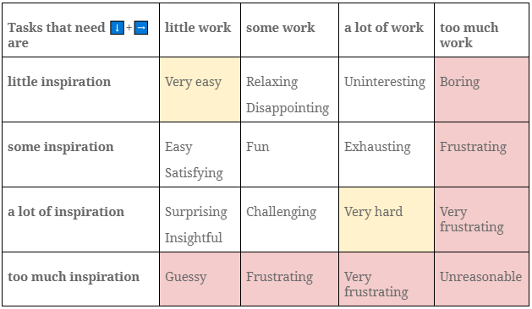
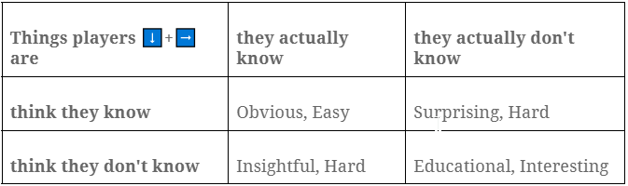


Challenge Design
6 0 %
4 0 %
8 0 %

Slide 4



Recent Trends & Innovations
RUST
BLOCKCHAIN
SAGEMATH
Nightmare for
Reverse Engineers
DeFi Systems, Protocols & Smart Contracts
Perform hard algorithmic calculations such as LLL
Crusaders of Rust
(corCTF 2022)
ALLES! CTF 2021
Crusaders of Rust
(corCTF 2022)
Crypto CTF 2021, 2022

Slide 5
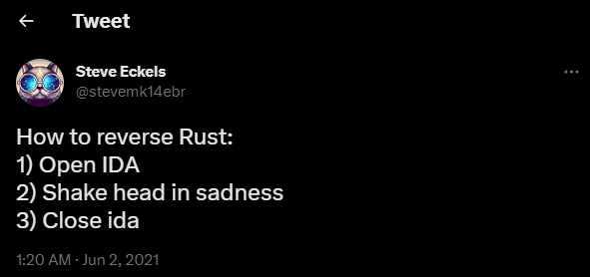
Rust Obstacles
Rust strings are not null terminated. The overlapping of strings can cause confusion to reverse engineering tools.
Large file size = Longer analysis time! Binaries are statically linked and optimized by Rust-Compiler for ease of debugging.
The horrible syntax of decompiled Rust is due to symbol name mangling: _ZN7example3One3foo17h16fcc82fa6043ccbE

Slide 6
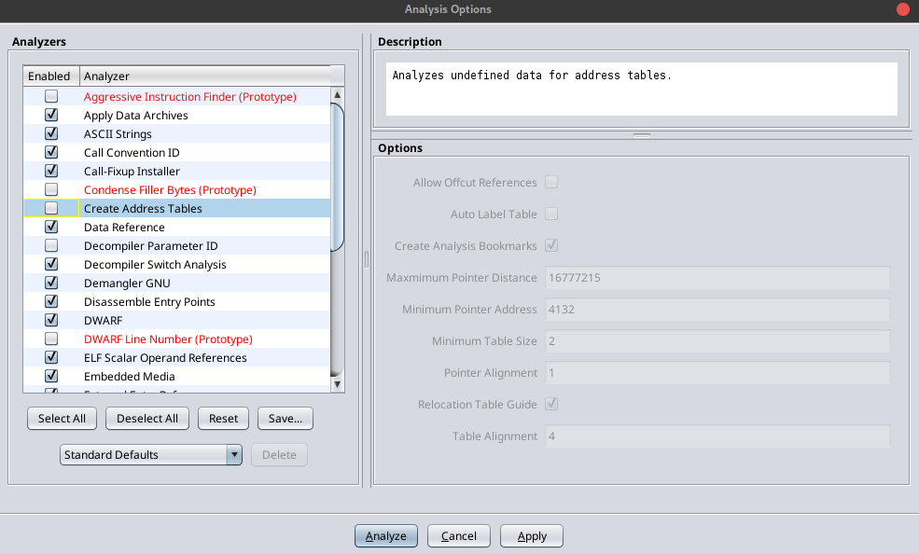
Step 1: Reduce Decompilation Time

Slide 7
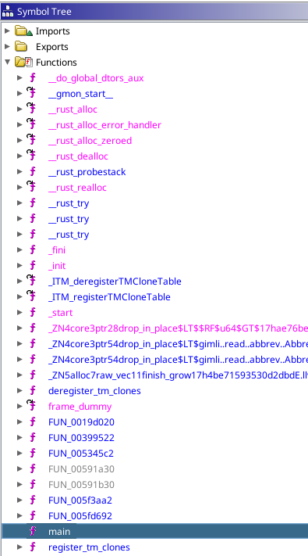
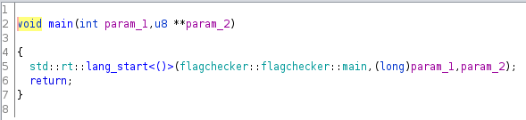
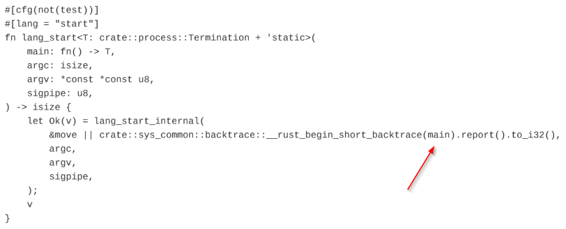
Step 2: Locate Main Function

Slide 8
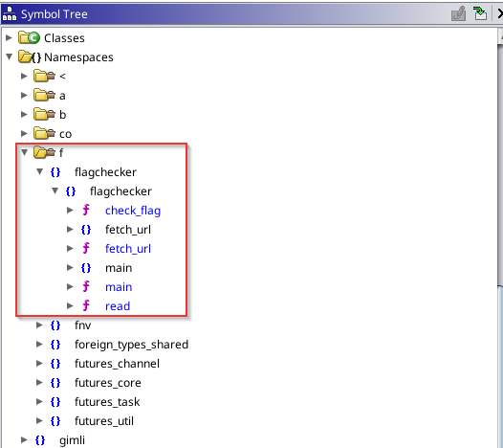
Step 3: Find Sub-functions (Namespaces)

Slide 9
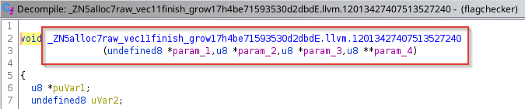
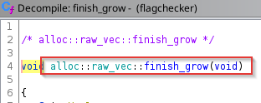
Step 4: Demangling Rust Symbols

Slide 10
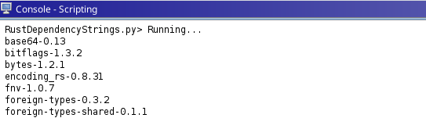
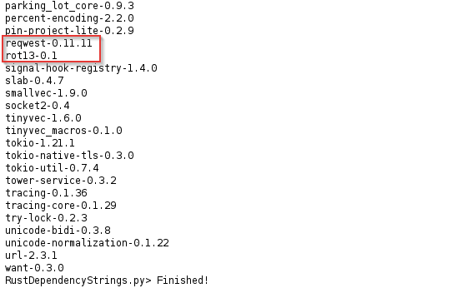
Step 5: Analyze Dependencies (Cargos)

Slide 11

Cryptography – RSA Variations

Slide 12


RSA – Parameters
E S S E N T I A L S
E Q U A T I O N
N : modulus.
p, q : primes that generate N.
phi : totient of N.
e : encryption exponent.
d : decryption exponent.
ct : ciphertext.
m : plaintext/flag.
N = $pq$
p, q = 31337, 96469
phi = $(p−1)(q−1)$
e = 65537
d = $e^{−1} mod (p−1)(q−1)$
ct = $m^{e} mod N$
m = ${ct}^{d} mod N$
E X T R A
$d_{p}$ : $d mod (p−1)$.
$d_{q}$ : $d mod (q−1)$.

Slide 13
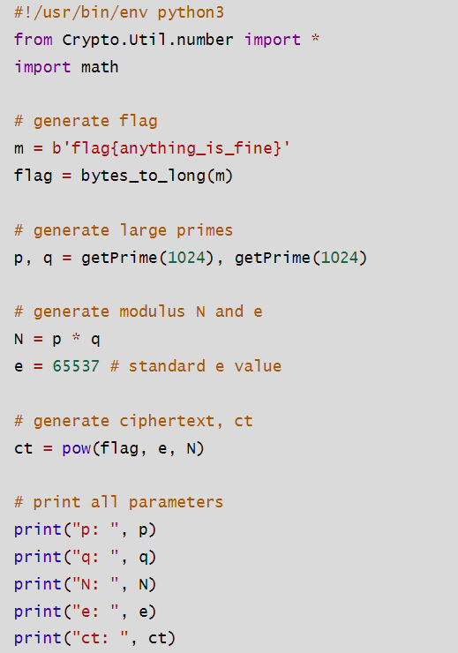
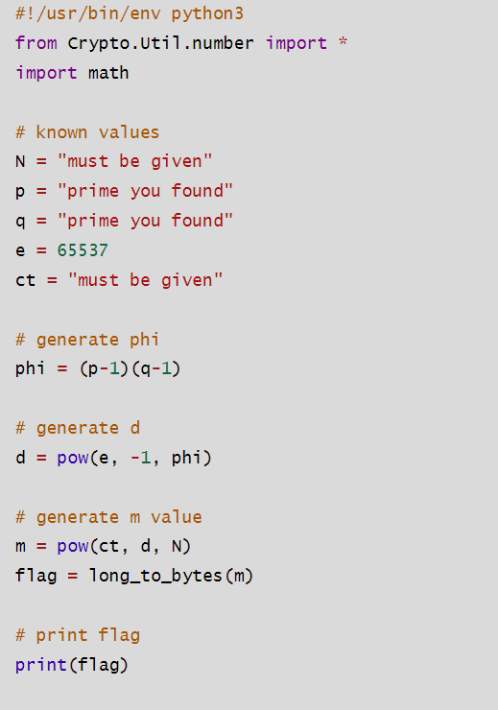
RSA:
Base Block of Creating
&
Solving

Slide 14
Tips & Tricks for creating RSA challenges
P R I M A R Y
Please hide both primes!
p, q must be large enough. (e.g., 1024-bits).
GCD(e, phi) must equal 1.
N must be larger than flag bytes.
S E C O N D A R Y
If beginner, focus on making p and q harder.
If intermediate, can attempt to make random e on top of beginner.
If advanced, can attempt to mix topics on top of intermediate.

Slide 15
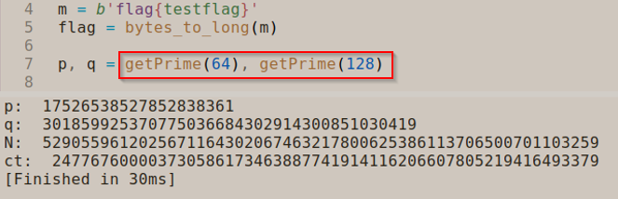
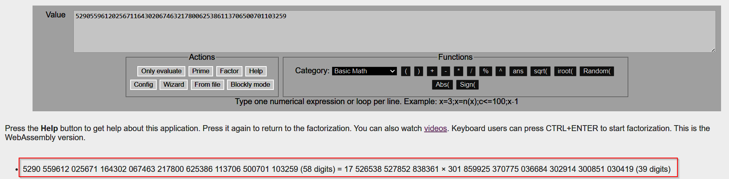
Example 1:
p, q must be large enough

Slide 16
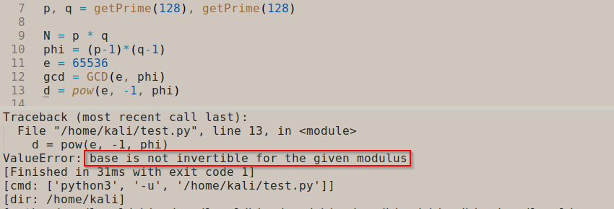
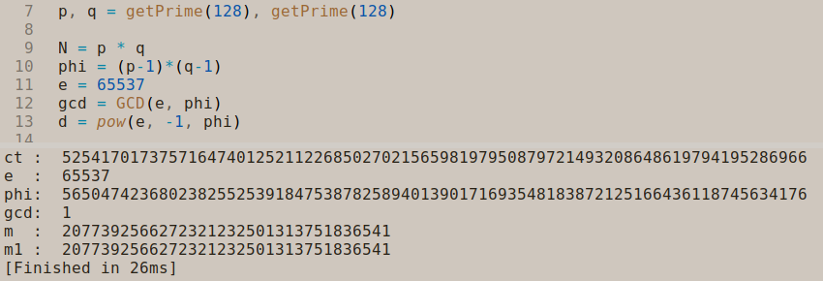
F A I L E D C A S E
Example 2:
GCD(e, phi) must equal 1
S U C C E S S C A S E

Slide 17
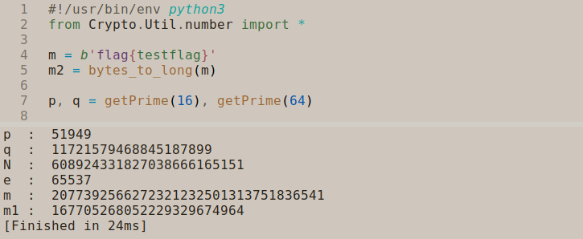
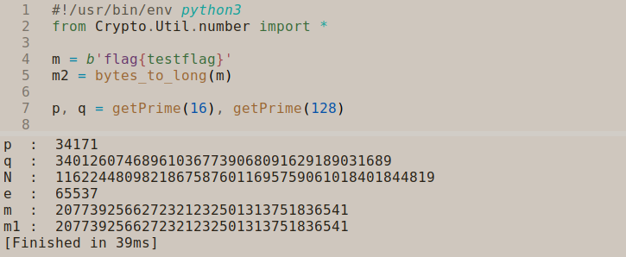
F A I L E D C A S E
Example 3:
N must be larger than flag bytes
S U C C E S S C A S E

Slide 18
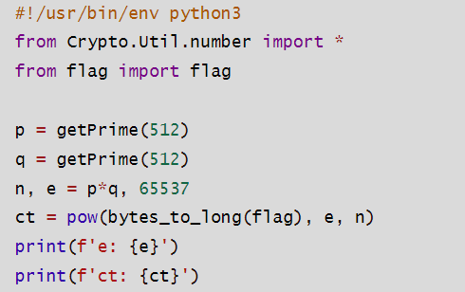
B A S E B L O C K
Example: Create Challenge

Slide 19

Useful Libraries/Functions
L I B R A R I E S - F U N C T I O N S
sympy – nextprime(), prevprime(), isprime()
secrets – randbelow()
Crypto.Util.number – getPrime()
random – getrandbits()
I N T E R E S T I N G T O P I C S - E Q U A T I O N / C O N C E P T
LCG – $f(x) = ( a ∗ x + b ) mod p, p is prime$
Coppersmith – $Z\left[n\right]=\{a_{0}+a_{1}x+a_{2}x^{2}+…+a_{n}x^{n}\}$
Polynomials – $f\left(x\right)= {3x}^{3}+x^{2}−6$
Extended Euclidean – $xgcd\left(\right), k_{1}e_{1}+k_{2}e_{2}=GCD\left(e_{1}, e_{2}\right)=1$

Slide 20
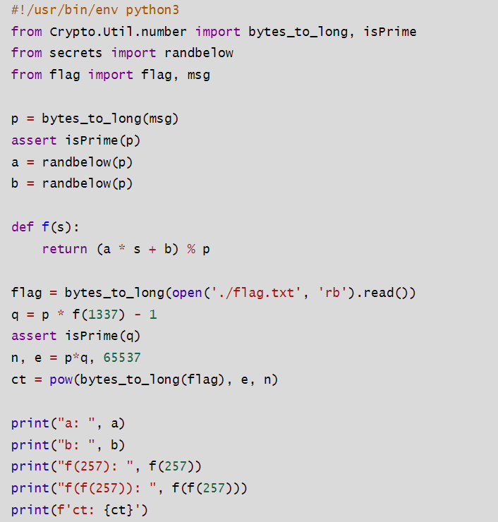
I N S E R T L C G
Example: RSA + LCG

Slide 21
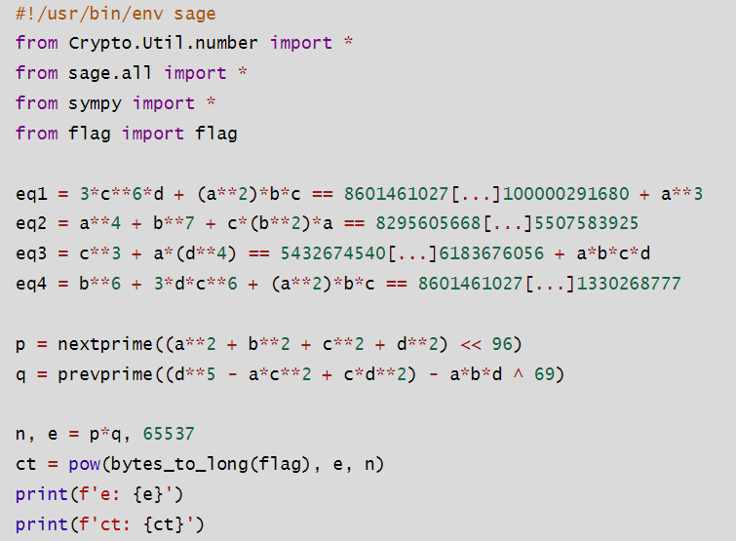
I N S E R T E Q U A T I O N S
Example: RSA + Diophantine Equations

Slide 22

Tips & Tricks for solving RSA challenges
C O M M O N M O D U L U S A T T A C K S
$Let e_{1}=9, e_{2}=13, ct_{1}=32, ct_{2}=127, n=179, with same flag$
$${ct}_{1}^{k_{1}}⋅{ct}_{2}^{k_{2}}={{(m}^{e_{1}})}^{k_{1}}⋅{{(m}^{e_{2}})}^{k_{2}}= m^{e_{1}k_{1}+e_{2}k_{2}}=m^{1}=m$$
$$ct_{1}=m^{e_{1}} mod n, ct_{2}=m^{e_{2}} mod n$$
SAGE:
$xgcd\left(e_{1}, e_{2}\right)$ # output (1, 3, -2) where gcd = 1, k1 = 3, k2 = -2
$$i=ct_{2}^{−1} mod n$$
$$m=ct_{1}^{a}∗i^{−b} mod n$$

Slide 23

Tips & Tricks for solving RSA challenges
S O L V I N G M I S S I N G B I T S
$Let p = 12392839283?????12903923$
SAGE:
$$n = 313373133731337313373133731337313373133731337$$
$$P<x> = PolynomialRing(Zmod(n), Implementation = ‘NTL’)$$
$$p = 12392839283∗{10}^{13}+x∗{10}^{8}+12903923$$
$$poly=p.monic()$$
$$missing_{bits}=poly.small_roots(X={10}^{5}, β=5/24)$$
$$p=12392839283∗{10}^{13}+missing_bits∗{10}^{8}+12903923$$

Slide 24
Some CRYPTO CHALLENGES
https://github.com/WesleyWong420/FSEC-SS-Sharing-Session

Slide 25
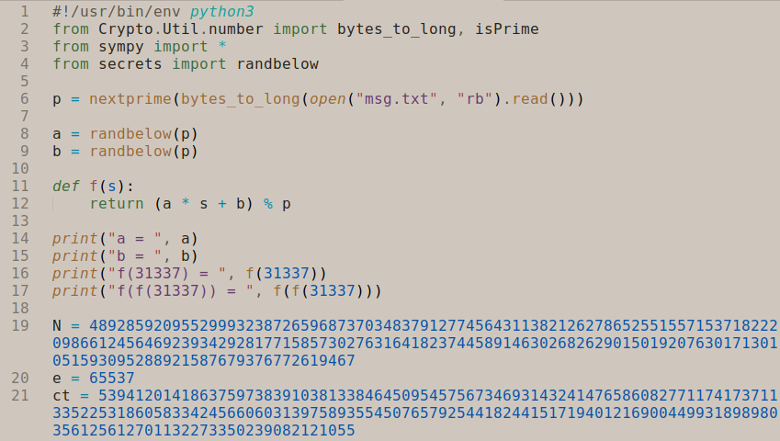
Challenge 1 – ez Walkthrough

Slide 26
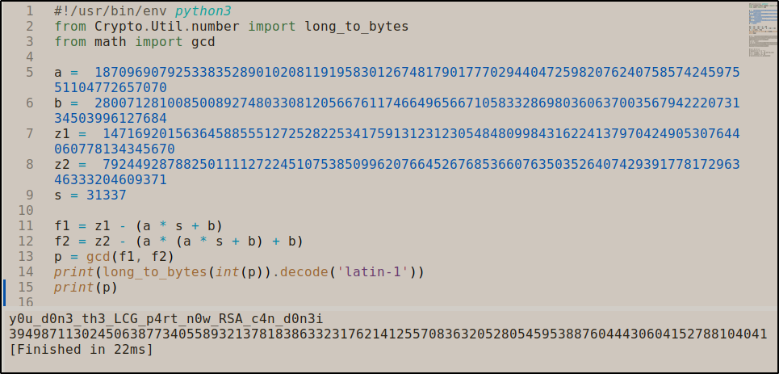
Part 1: LCG to Recover P

Slide 27
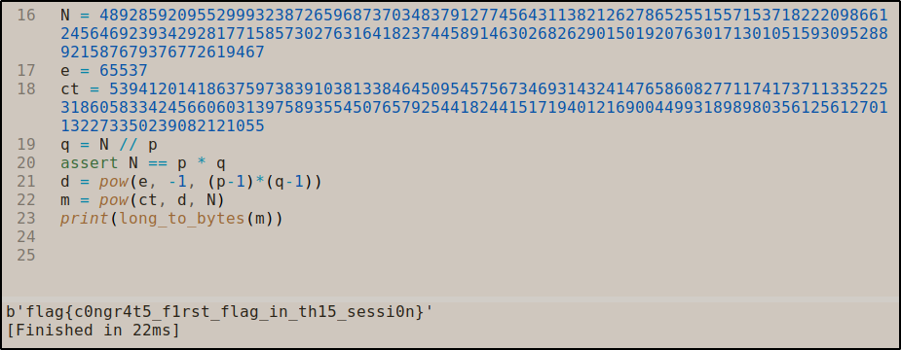
Part 2: Crack RSA

Slide 28
IF INTERESTED, TRY OUT THE EXERCISES
Challenge 2 – Medium
Challenge 3 - Hard
H I N T : A L L C H A L L E N G E S A R E C O V E R E D O R M E N T I O N E D I N T H I S S E S S I O N

Slide 29
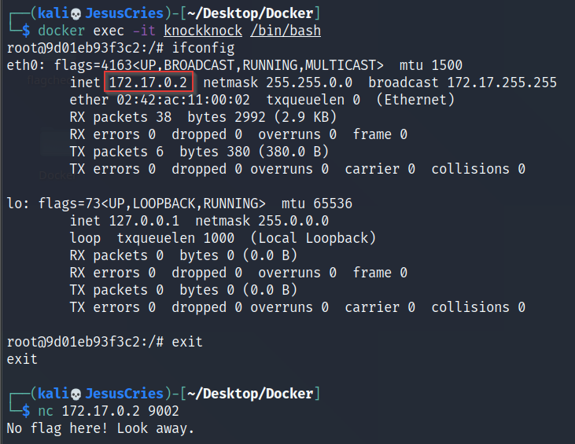
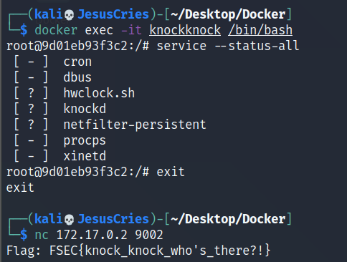
Boot2Root

Slide 30
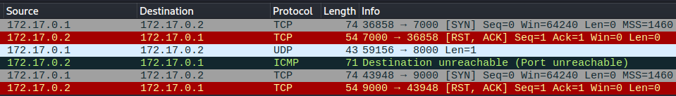
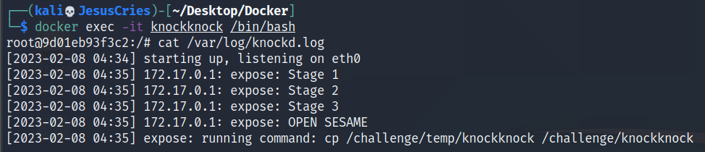
Boot2Root Cont’d

Slide 31
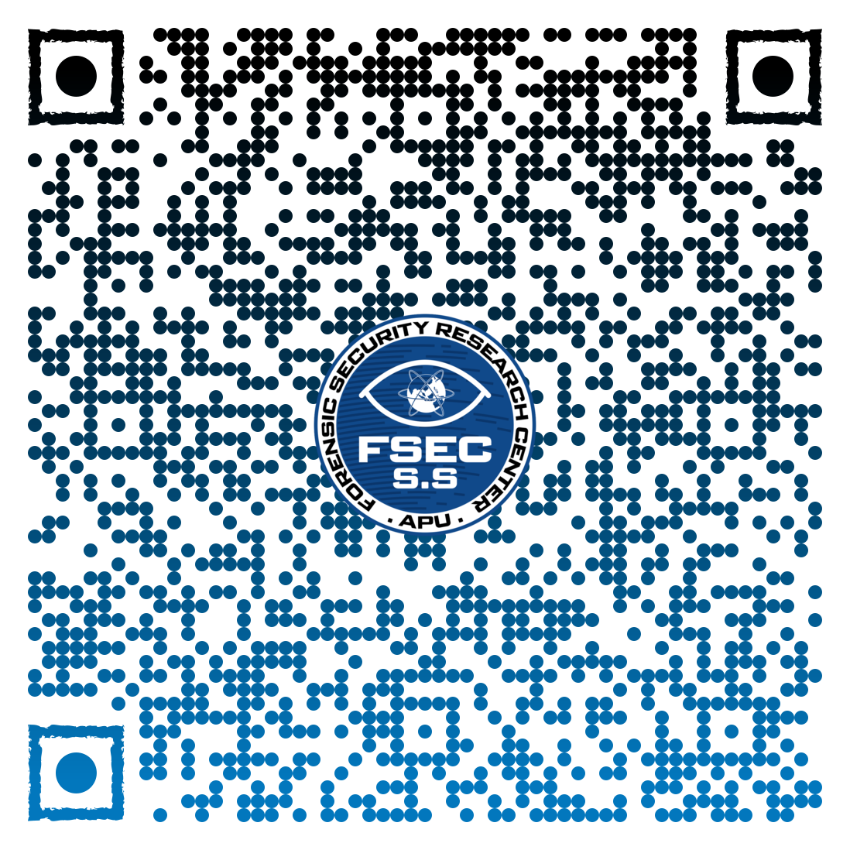
And we're done for the day!
See you next time !!
bit.ly/fsecss-msfeedback

