Slide 1

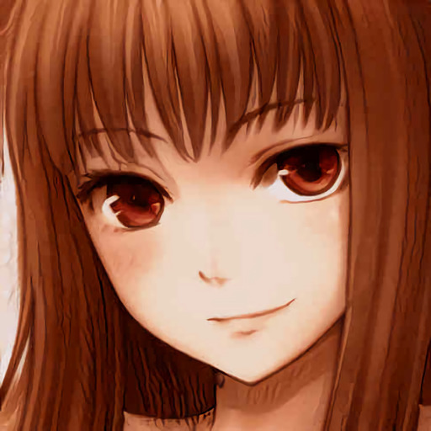
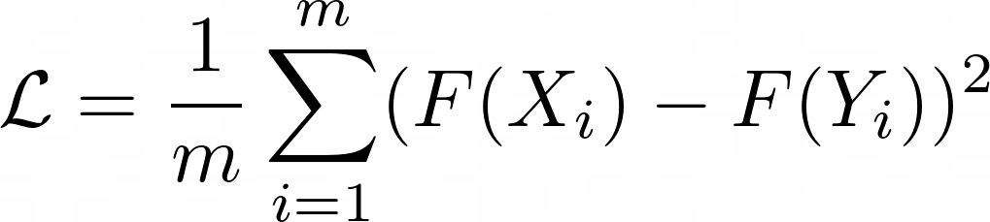
Frankenstein architecture
Face features
Latent vector
Anime face features
Pre-trained Inception Resnet face recognizer
Trained adapter
(fully connected)
Pre-trained StyleGAN2 anime generator
Pre-trained Inception Resnet face recognizer
MSE Loss

