Slide 1
Resolving data silos
Shopify & shopee commerce case study

Slide 2
Contents
Business + Use Case Introduction
Urgency to Resolve Data Silo
Stakeholder Management
Solution 1: SaaS
Solution 2: Code

Slide 3





Business Introduction
Local E-commerce SME
Selling on various platforms
Each platform has its own DB
Difficulty in order fulfillment doing data analysis
They need each platform for its unique functionality I.E. access to new markets or livestreaming functionalities

Slide 4
Problem 1: Difficult to fulfill orders
Each application has its own Database by default which is problematic for the following reasons
Have 3 platforms that perform the same function leads to slow moving processes as employees often navigate through 3 different platforms. This is extremely inefficient.
Seems manageable at 3 but is very unscalable in the long run.
Loss of time and productivity
For these reasons, we need to remove the data silos

Slide 5
Stake holder management
Management Level
Concerns: Does not appreciate solution or see value that Data Engineering brings
Solutions: Need to explain in terms of business terms, how aggregating data will help in terms of business values. I.E. efficiency and productivity will save cost and generate more revenue
Processor Level
Concerns: Resistance to change or learn new workflows
Solutions: Need to explain how this will improve their work quality of life

Slide 6

Solution 1: Saas
Easy Shopee
Paid software that extracts data from shopee and loads it into Shopify
Employees then mark and fulfill orders on shopify, which then inserted back into shopee databases.

Slide 7
Solution 1: takeaways
Integration softwares
“Buy don’t build”!
Using off the shelf data silo integration applications can lead to an elegant resolution.
Some commerce integration software include HubSpot’s Operations Hub, Zapier & Mulesoft.

Slide 8
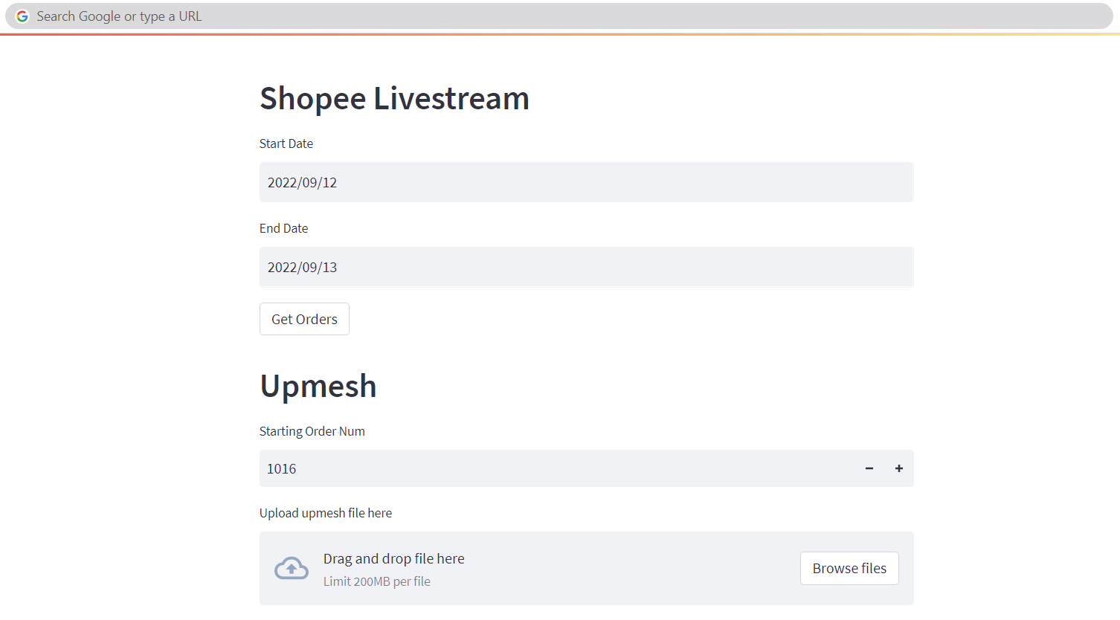
Solution 2: code
Custom Web app
Built using python
Deployed on the cloud

Slide 9

Solution 2: code
Custom Web app
Data is extracted from upmesh db
Inserted into shopify DB via the shopify API

Slide 10
Solution 2: take aways
Custom Web app
Data is extracted from upmesh db
Inserted into shopify DB via the shopify API
Current this process is triggered manually, in the future data ETL pipelines can be implemented to automate this. Useful technologies include:
Dagster
Apache Airflow

