Slide 1
A graduated assignment algorithm for graph matching
----- and possible revision
Steven Gold and Anand Rangarajan

Slide 2





Motivation
Goal:
Match A(ttributed)R(elational)G(raph)
for example:
where [$n_{11}$,$n_{12}$], [$n_{21}$, $n_{22}$] are attributes for nodes and
[$e_{11}$, $e_{12}$] , [$e_{21}$, $e_{22}$] are attributes for edges.
[$n_{11}$,$n_{12}$]
[$n_{21}$,$n_{22}$]
[$e_{21}$,$e_{22}$]
[$e_{11}$,$e_{12}$]

Slide 3
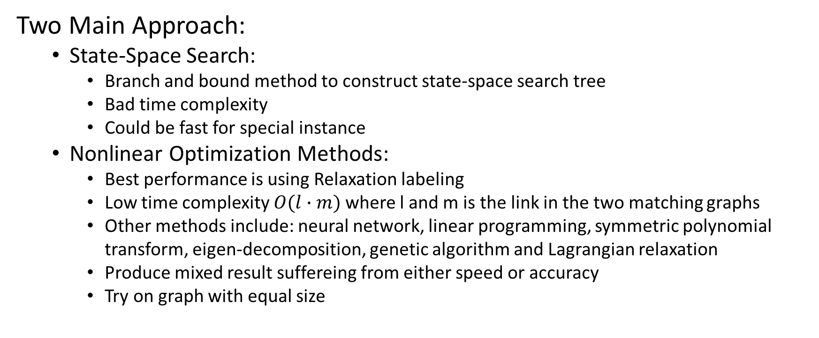
Motivation
Two Main Approach:
State-Space Search:
Branch and bound method to construct state-space search tree
Bad time complexity
Could be fast for special instance
Nonlinear Optimization Methods:
Best performance is using Relaxation labeling
Low time complexity $O(l∙m)$where l and m is the link in the two matching graphs
Other methods include: neural network, linear programming, symmetric polynomial transform, eigen-decomposition, genetic algorithm and Lagrangian relaxation
Produce mixed result suffereing from either speed or accuracy
Try on graph with equal size

Slide 4
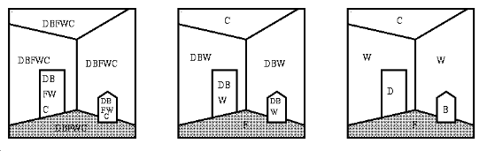
Motivation
Relaxation Labeling
Match object to a single label from a set of labels: a stronger classification algorithm
In the context of matching two graphs G, and H. Nodes in G will be the object (door, wall, bed, ceiling in the picture), and nodes in H will be the labels (D,B,F,W,C) assigned to the object.
Match Assignment: object node <-> label node

Slide 5
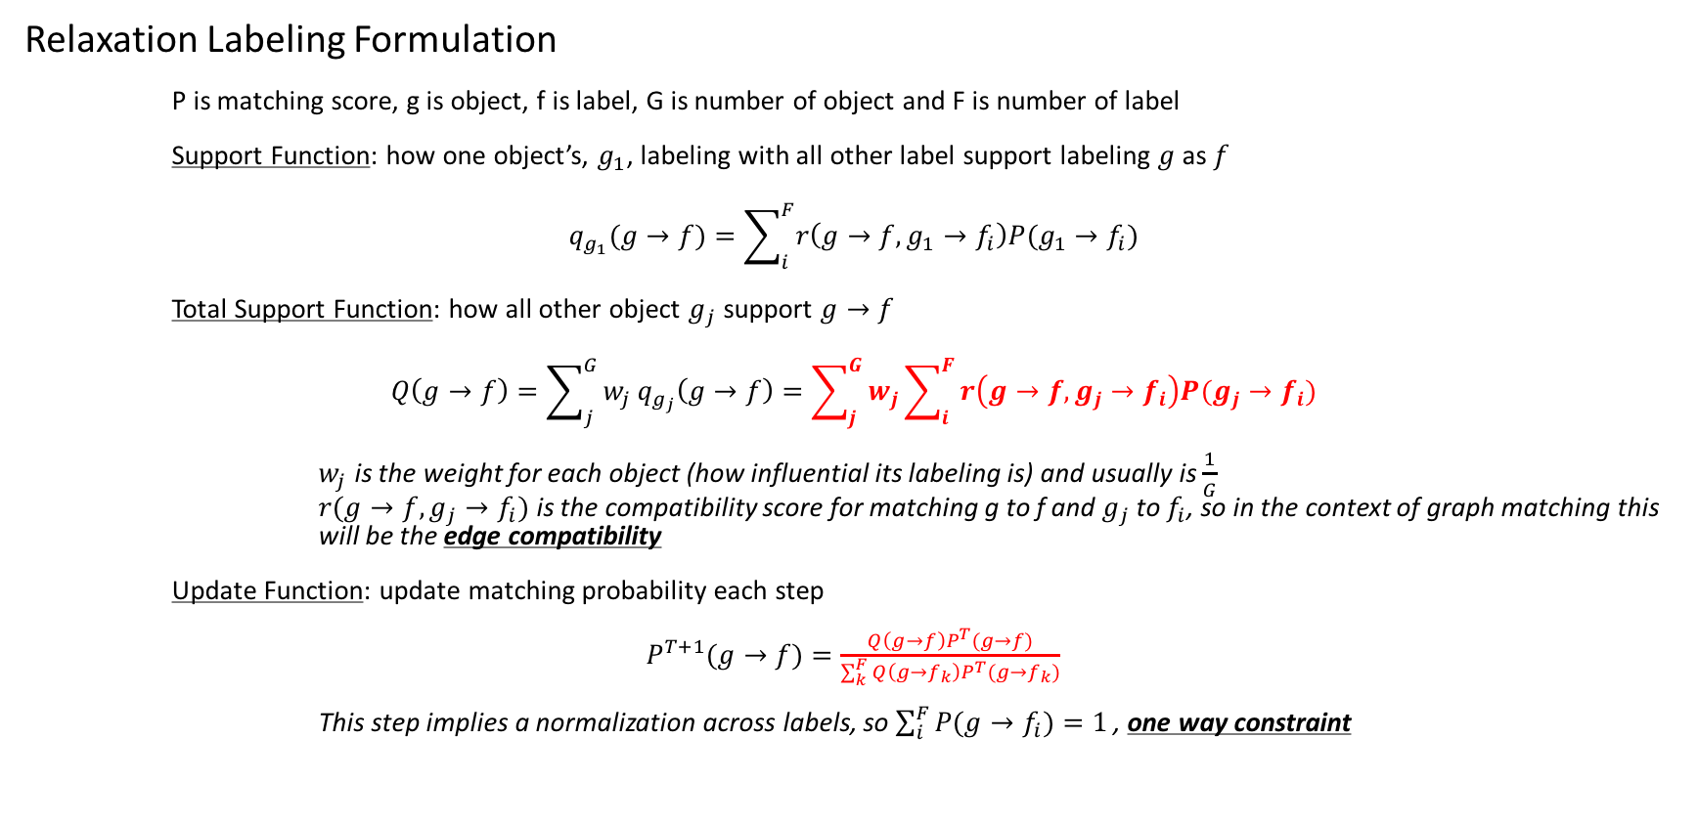
Motivation
Relaxation Labeling Formulation
P is matching score, g is object, f is label, G is number of object and F is number of label
Support Function: how one object’s, $g_{1}$, labeling with all other label support labeling $g$ as $f$
$$q_{g_{1}}(g→f)=\sum_{i}^{F}{r\left(g→f,g_{1}→f_{i}\right)P(g_{1}→f_{i})}$$
Total Support Function: how all other object $g_{j}$ support $g→f$
$$Q\left(g→f\right)=\sum_{j}^{G}{w_{j}}q_{g_{j}}\left(g→f\right)=\sum_{j}^{G}{w_{j}}\sum_{i}^{F}{r\left(g→f,g_{j}→f_{i}\right)P(g_{j}→f_{i})}$$
$w_{j}$ is the weight for each object (how influential its labeling is) and usually is $\frac{1}{G}$
$r(g→f,g_{j}→f_{i})$ is the compatibility score for matching g to f and $g_{j}$ to $f_{i}$, so in the context of graph matching this will be the edge compatibility
Update Function: update matching probability each step
$P^{T+1}(g→f)=\frac{Q\left(g→f\right)P^{T}(g→f)}{\sum_{k}^{F}{Q\left(g→f_{k}\right)P^{T}(g→f_{k})}}$
This step implies a normalization across labels, so $\sum_{i}^{F}{P(g→f_{i})=1 }$, one way constraint

Slide 6
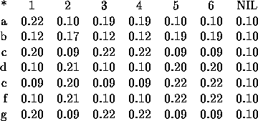


Motivation
Slack (Null) Matching in Relaxation Labeling
For the object that does not have any label match, we can create a nil label. However, we will need to design compatibility function involve nil matching: $r\left(g→f,g′→nil\right)$
Match Score Sample:
Sum = 1
One Way Constraint
Sum $≠1$

Slide 7
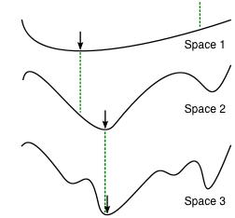
Motivation
Things we can change about Relaxation Labeling:
One Way Constraint vs. Two Way Constraint
In graph matching, Relaxation Labeling treats the nodes from one graph as objects, and the nodes from another graph as a set of label, which can be assigned to each object. While each object/node can only have one label (match to one node), there is no constraint on how much objects one label can assign to and results in a 1:n relationship. Ideally, we would want to have constraint on both graphs and enjoy the beauty of symmetry.
Local Minima vs. Global Optimal
Relaxation Labeling usually use a one-hot representation (0/1) for assignment problem solution. However the solution space can be a complex non-convex one (like Space 3) and we could be easily trapped to some local minima. While relaxation labeling allow probability representation (0.1/0.9), it will stay in a convex (or nearly convex) space (like Space 1) instead of converging to the global optimal that might only show up in the non-convex space (like the one in Space 2 and 3)
Notes:
Sparsity

Slide 8
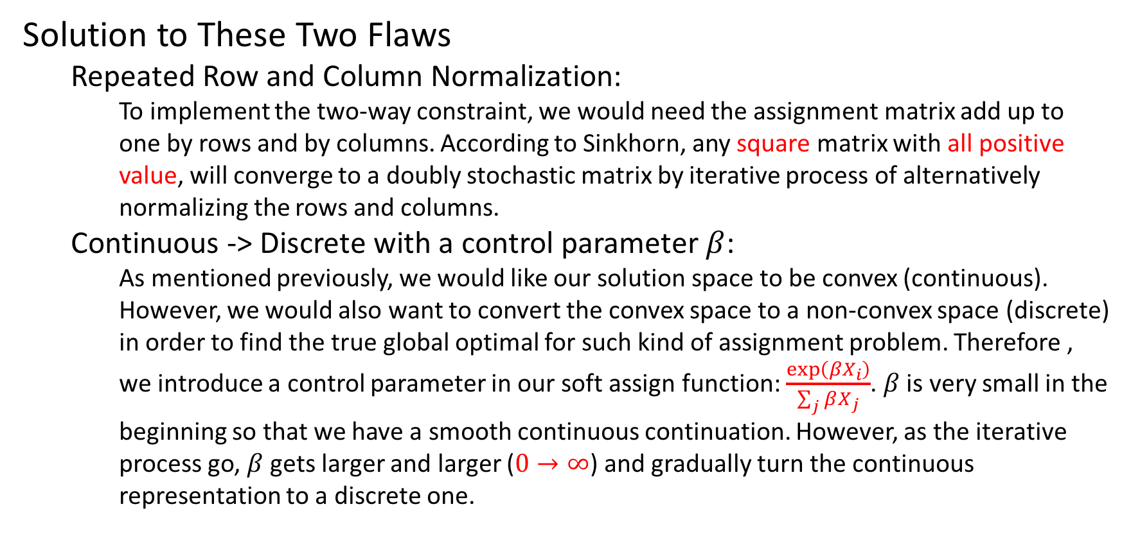
The Algorithm
Solution to These Two Flaws
Repeated Row and Column Normalization:
To implement the two-way constraint, we would need the assignment matrix add up to one by rows and by columns. According to Sinkhorn, any square matrix with all positive value, will converge to a doubly stochastic matrix by iterative process of alternatively normalizing the rows and columns.
Continuous -> Discrete with a control parameter $β$:
As mentioned previously, we would like our solution space to be convex (continuous). However, we would also want to convert the convex space to a non-convex space (discrete) in order to find the true global optimal for such kind of assignment problem. Therefore , we introduce a control parameter in our soft assign function: $\frac{exp\left(βX_{i}\right)}{\sum_{j}{βX_{j}}}$. $β$ is very small in the beginning so that we have a smooth continuous continuation. However, as the iterative process go, $β$ gets larger and larger ($0→∞$) and gradually turn the continuous representation to a discrete one.

Slide 9
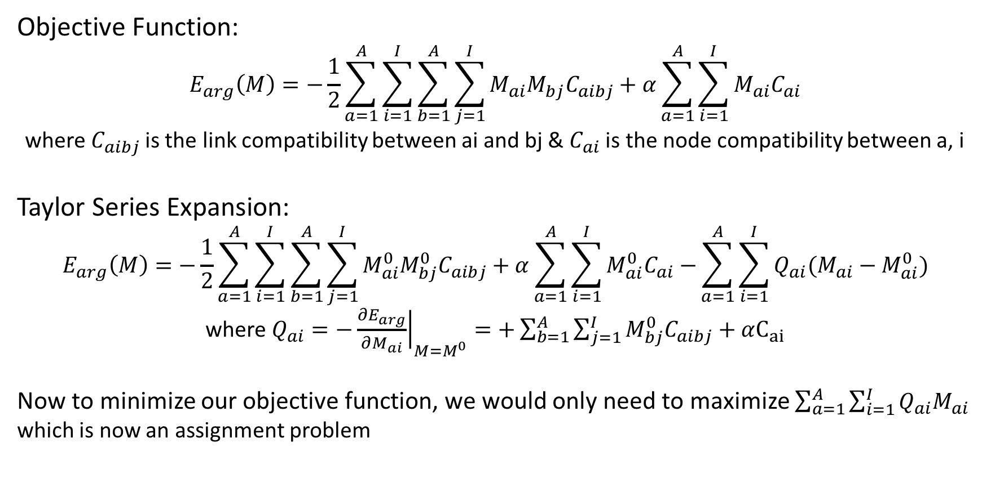
The Algorithm
Objective Function:
$$E_{arg}\left(M\right)=−\frac{1}{2}\sum_{a=1}^{A}{\sum_{i=1}^{I}{\sum_{b=1}^{A}{\sum_{j=1}^{I}{M_{ai}M_{bj}C_{aibj}+α\sum_{a=1}^{A}{\sum_{i=1}^{I}{M_{ai}C_{ai}}}}}}}$$
where $C_{aibj}$ is the link compatibility between ai and bj & $C_{ai}$ is the node compatibility between a, i
Taylor Series Expansion:
$$E_{arg}\left(M\right)=−\frac{1}{2}\sum_{a=1}^{A}{\sum_{i=1}^{I}{\sum_{b=1}^{A}{\sum_{j=1}^{I}{M_{ai}^{0}M_{bj}^{0}C_{aibj}+α\sum_{a=1}^{A}{\sum_{i=1}^{I}{M_{ai}^{0}C_{ai}−}}\sum_{a=1}^{A}{\sum_{i=1}^{I}{Q_{ai}(M_{ai}−M_{ai}^{0})}}}}}}$$
where $Q_{ai}={\left.−\frac{∂E_{arg}}{∂M_{ai}}\right|}_{M=M^{0}}=+\sum_{b=1}^{A}{\sum_{j=1}^{I}{M_{bj}^{0}C_{aibj}}+}$ $αC_{ai}$
Now to minimize our objective function, we would only need to maximize $\sum_{a=1}^{A}{\sum_{i=1}^{I}{Q_{ai}M_{ai}}}$
which is now an assignment problem

Slide 10
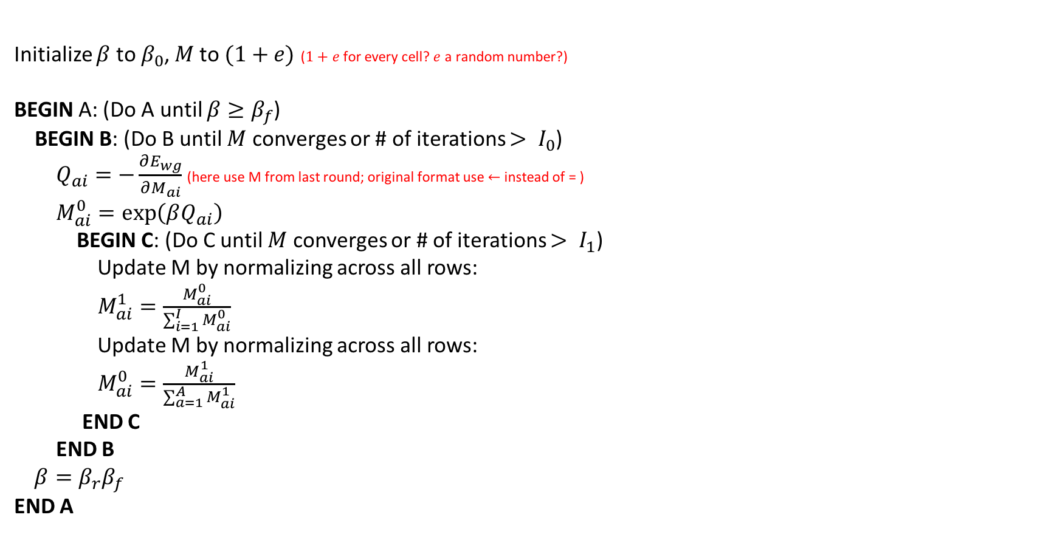
The Algorithm with NO slack
Initialize $β$ to $β_{0}$, $M$to $(1+e)$($1+e$ for every cell? $e$ a random number?)
BEGIN A: (Do A until $β≥β_{f}$)
BEGIN B: (Do B until $M$ converges or # of iterations $> I_{0}$)
$Q_{ai}=−\frac{∂E_{wg}}{∂M_{ai}}$ (here use M from last round; original format use $←$ instead of = )
$M_{ai}^{0}=\exp\left(βQ_{ai}\right)$
BEGIN C: (Do C until $M$ converges or # of iterations $> I_{1}$)
Update M by normalizing across all rows:
$M_{ai}^{1}=\frac{M_{ai}^{0}}{\sum_{i=1}^{I}{M_{ai}^{0}}}$
Update M by normalizing across all rows:
$M_{ai}^{0}=\frac{M_{ai}^{1}}{\sum_{a=1}^{A}{M_{ai}^{1}}}$
END C
END B
$$β=β_{r}β_{f}$$
END A
In simple words:
We first initialize a random match M.
Then we start a iteration doing:
Compute match score Q by previous M
Soft assign on Q
Assign Q to the new M
Make new M satisfy the two way constraints

Slide 11
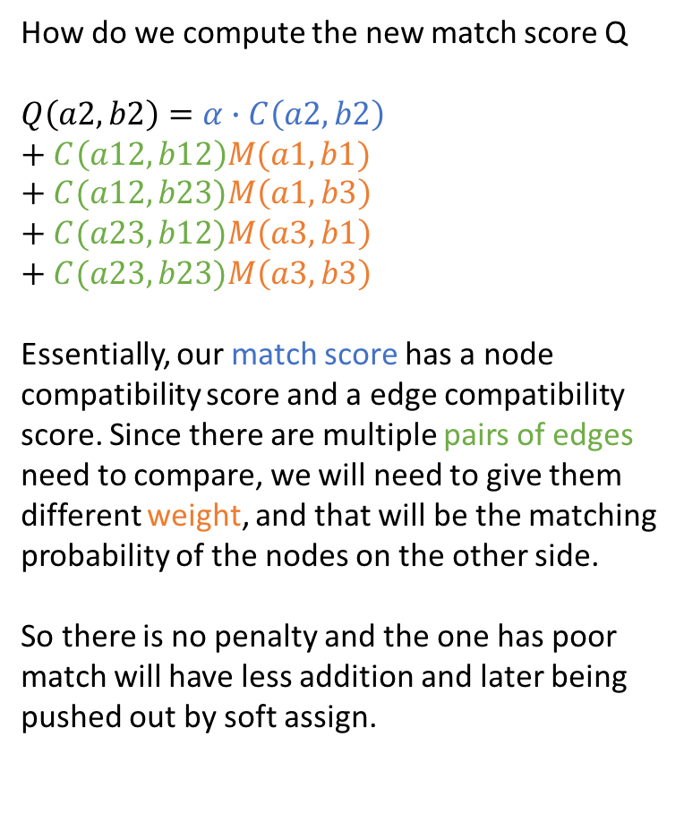
The Algorithm with NO slack
a13
How do we compute the new match score Q
$$Q\left(a2,b2\right)=α∙C\left(a2,b2\right) \\ + C\left(a12,b12\right)M(a1,b1)+C(a12,b23)M\left(a1,b3\right)$$
$$+ C(a23,b12)M\left(a3,b1\right)$$
$$+ C(a23,b23)M\left(a3,b3\right)$$
Essentially, our match score has a node compatibility score and a edge compatibility score. Since there are multiple pairs of edges need to compare, we will need to give them different weight, and that will be the matching probability of the nodes on the other side.
So there is no penalty and the one has poor match will have less addition and later being pushed out by soft assign.
a1
a12
a2
a23
a3
Node Score
Edge Score
(each node has two edges so total edge score need to compute is 2x2)
M(a1,b3)
C(a12,b23)
C(a23,b12)
M(a3,b1)
M(a1,b1)
M(a3,b3)
C(a12,b12)
C(a23,b23)
C(a2,b2)
b1
b2
b3
b12
b23
b13
M is match probability
C is attribute compatibility

