Slide 1
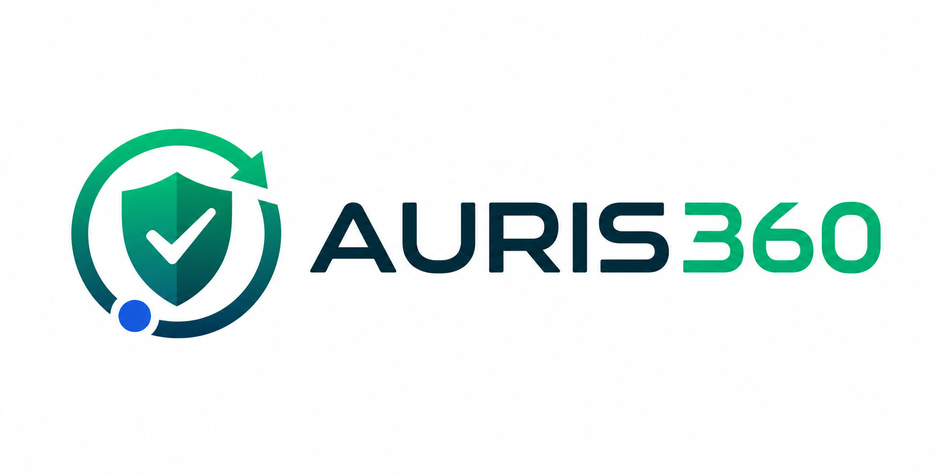
AURIS360 turns HSE work into controlled, visible action
One platform
Incidents
BBS
Risk assessments
Permits
Legal compliance
Chemicals
Actions
Audit trail
A practical HSE management platform built for reporting, follow-up, compliance, and leadership oversight.
Prepared for pilot-client discussions

Slide 2

AURIS360
WHY CHANGE
Most HSE systems fail when follow-up becomes invisible
Safety teams often work across spreadsheets, paper forms, WhatsApp messages, email threads and disconnected registers. The result is not a lack of effort. It is a lack of control.
Reports are captured, but actions drift
Compliance is difficult to prove
Leaders see lagging indicators too late
Incidents, BBS observations and inspections create follow-up work, but ownership and closure are hard to see.
Legal requirements, permits, certificates and evidence are scattered when clients or authorities ask for proof.
Management needs a clear view of risk, overdue actions and weak controls before events become serious.

Slide 3
AURIS360
SOLUTION
AURIS360 connects field reporting to management control
Capture
Control
Prove
Improve
Incidents, BBS, inspections, permits, evidence and observations
Assign actions, approve records, track due dates and verify closure
Maintain legal registers, documents, audit trails and evidence
Use AI insights and trends to target prevention
AURIS360 is designed as the operational layer between workers, supervisors, HSE managers, company admins and executive leadership.

Slide 4
AURIS360
AVAILABLE NOW
The current platform already covers the main HSE workflow
Dashboard
Incidents
BBS
Executive view, KPI cards, readiness panel
Report, evidence, investigation, corrective actions
Positive behaviour, unsafe acts, trend analysis
Master Action Plan
Permit to Work
Risk Assessment
Central CAPA and follow-up register
Permit types, controls and approval routing
RA, JSA, HIRA and PDF import support
Legal Compliance
Chemical Control
Audit Trail
Section-based register and compliance status
SDS data, exposure profile and risk scoring
Chronological accountability across key actions

Slide 5
AURIS360
OPERATIONS
Field users can report quickly while managers keep control
The mobile-first workflows focus on what workers and supervisors need on site: report what happened, add evidence, and move the issue into follow-up.
Simple reporting
Evidence at source
Role-based access
Employees can report incidents or BBS observations without seeing manager-only classification and investigation controls.
Photos and uploaded evidence are visible to managers when they open the saved report on desktop.
Employees, contractors, supervisors, HSE roles and admins see the functions relevant to their responsibility.

Slide 6
AURIS360
GOVERNANCE
Professional HSE software must prove who did what
Approval Center
Audit Trail
Notification Rules
Permits, documents, investigations, risk assessments and other controlled records can follow approval routes before becoming final.
Key create, update and delete actions are logged with user, role, module, record reference and changed fields.
Company admins can define who receives alerts by event type and workflow stage. Email is active, with WhatsApp/SMS as a future channel.
This is what gives clients confidence that the system is not just a register, but a controlled management process.

Slide 7
AURIS360
AI CAPABILITY
AURIS AI adds guidance without replacing professional judgement
AI features are designed to assist HSE teams with drafting, analysis and prioritisation. Outputs remain reviewable by competent persons before use.
Performance insight
Document generation
Predictive support
Ask questions about incidents, actions, KPIs, training, legal gaps and risk trends.
Prepare RAMS, toolbox talks, compliance checks and draft procedures from operational context.
Use incident and near-miss patterns to highlight likely risk areas and suggest controls.

Slide 8
AURIS360
COMING NEXT
The roadmap expands AURIS360 into a full HSE operating system
Specialist RA libraries
Fleet and equipment maturity
Manual handling, fire, chemical, machinery, fleet and ATEX-specific builders
Vehicle checks, fuel logs, RCD testing, tools and equipment controls
Deeper document control
WhatsApp and SMS alerts
SDS, RA, method statements, SOPs, permits, evidence and certificates linked together
Alternative channels for users with login-only local addresses or limited email access
Client portals and branding
Analytics and BI
Company-specific access, branding and future subdomains such as company.auris360.com
Executive reporting, trend dashboards, API integrations and Power BI-style reporting

Slide 9
AURIS360
DECISION
Why choose AURIS360
AURIS360 is being built around how HSE work actually happens: fast reporting from the field, disciplined follow-up by managers, and proof for clients, auditors and regulators.
Local HSE understanding
End-to-end coverage
Designed with practical HSE consulting experience, not only generic software logic.
Connects incidents, observations, risk, permits, legal, chemicals, actions and evidence.
Controlled governance
Expandable platform
Approval workflows, notifications and audit trail create accountability.
Roadmap covers specialist risks, AI assistance, integrations and client-specific portals.

Slide 10
AURIS360
NEXT STEP
The best next step is a controlled pilot
Start with the modules that matter most
Incident Management · BBS Observations · Objectives & KPIs · Dashboard · Action Plan
Use real client feedback to refine workflows before broader rollout, while keeping the roadmap visible for future value.
AURIS360 by SEPHS Consulting

