Slide 1

Automating Pull Requests With
CDK & BedRock
March 2024

Slide 2
Topic Overview
Introductions
User Group Updates
- Schedule one per quarter, subject to change
- Credits raffle
Discord
Side project and AWS related user group collaboration/discussion
Planned projects
Problem Proposal
PR size and review speed -
PR automation – reviews, merges, tagging

Slide 3
Proposed Solution
CDK for infrastructure deployment - Justin
Bundled in app repo
Asset bunding (big benefit)
Write it all in one language!
GitHub - Trent
Repo
CI/CD Actions -
Source of webhooks -
AWS Serverless app - Justin
API Gateway
Cost-effective
Trigger for Lambda based on webhooks
AWS Lambda – python Trent and Justin
Layer process
Same language as CDK
LangChain Python Library
Event-driven
Cost-effective
- Lambda URL as alternative

Slide 4
Cost – Justin
Free tier stuff
Bedrock cost per token
Cost-saving idea – run on-demand
Linter in CI before sending to bedrock
TCO – is less expensive than time spent by team members - time better spent elsewhere
Examples – Justin and Trent
Example 1
Example 2
Detailed implementation
CDK – Justin
CDK Deployment w/ Actions – Justin
Actions tasks
Lambda – Trent
GitHub configuration - Trent

Slide 5
Improvement ideas
Auto – merging regular low-impact pull requests
Auto tag teams – webhook supports creation of reviewer assignments.
Layer version needs improvement
Other stuff
Raffle

Slide 6

Title Slide
AWS User Groups
6

Slide 7
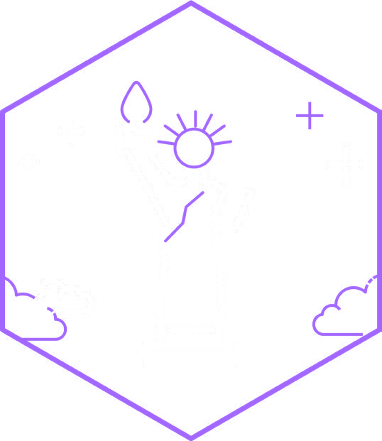
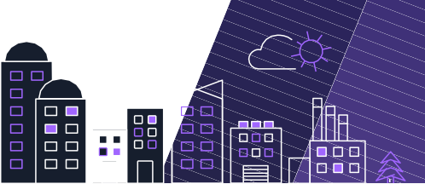

Information
Here is some info about stuff I can put into a graph
1 Do the thing
2 Do another thing
#AWSUserGroup
3 Do the final thing
AWS User Groups
7

