Slide 1
Regression Classifiers
West Grid School - UoC
Abdullah Sarhan
27th May 2019

Slide 2
Instructor Info
Abdullah Sarhan
Email: asarhan@ucalgary.ca

Slide 3
Outline
Analysis Steps
NumPy and Panda
Supervised vs Unsupervised
Regression Classifiers
Evaluation

Slide 4
Data Analysis
Data Analysis has been around for some time but recently gained popularity
Data analysis is used to discover hidden information that can be of specific value

Slide 5
Data Analysis Steps
Define a Question
Collect Data
Explore Data
Clean Data
Analyze Data
Interpret Results

Slide 6
What is NumPy ?
NumPy is a Python C extension library for array-oriented computing
Elements in NumPy array all should be the same type
Suited for many application such as image processing and signal processing
Notes:
CPython is the default byte-code interpreter of Python,

Slide 7
What is NumPy (Cont.) ?
Matrix is of fixed size => once created the size is fixed
How can we add more values?

Slide 8
Quick Start
pip install numpy
import numpy as np

Slide 9
1D-Array
x= np.array([2,3,4])
x.dtype
y= np.array([2,3.4,4])
y.dtype

Slide 10
2D-Array
2D array in python can be done by having each element in the list is a list.
Tables are example of 2D arrays where the elements is a the columns and the values for each element are the rows value
a = np.array([[1,2,3,4], [5,6,7,8], [9,10,11,12]])
print(a.shape)

Slide 11
Basics
arrayName.ndim returns back the number of dimensions in array
arrayName.shape returns back number of rows and column in a tuple
arrayName.size return back number of elements
arrayName.dtype returns back type of elements in array
arrayName.data returns back the buffer in memory containing the actual data

Slide 12
Split Array
Split only the horizontal axis
np.hsplit(a,2) # Split a into 2
Notes:
https://repl.it/repls/FrighteningIncompleteScriptinglanguages

Slide 13
Matplotlib with NumPy
Matplotlib is a python library used to create 2D graphs
It has a module named pyplot which make it easy for plot manipulation

Slide 14
Example –Plot one Line
import numpy as np
import matplotlib.pyplot as plt
# Compute the x and y coordinates for points on a sine curve
x = np.arange(0, 3 * np.pi, 0.1)
y = np.sin(x)
# Plot the points using matplotlib
plt.plot(x, y)
plt.show()

Slide 15
Example –Plot Two Lines
import numpy as np
import matplotlib.pyplot as plt
# Compute the x and y coordinates for points on a sine curve
x = np.arange(0, 3 * np.pi, 0.1)
y_sin = np.sin(x)
Y_cos=np.cos(x)
# Plot the points using matplotlib
plt.plot(x, y_sin )
plt.plot(x, y_cos )
plt.legend([‘Sin’,’Cos’])
plt.show()

Slide 16

Panda
https://tinyurl.com/y4zo8h4u
Python Library used for data manipulation in data frames.
Allow loading data into in-memory data objects from different file formats
Allow queries to datasets such as slicing and aggregation

Slide 17
Quick Start
pip install panda
import panda as pd

Slide 18
Panda
Load/Save csv files
Print columns
Drop columns
Normalization

Slide 19
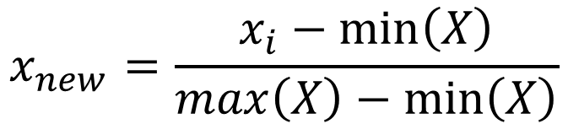
Normalization
A way to standardize values between 0 and 1
A way to standardize values between 0 and 1
$$x_{new}=\frac{x_{i}−\min\left(X\right)}{max\left(X\right)−\min\left(X\right)}$$

Slide 20
Supervised vs Unsupervised
Machine Learning
Supervised
Unsupervised
Reinforcement
Classification
Regression
Dimensionality Reduction
Clustering
Game AI
Robot Navigation

Slide 21
Regression Analysis
It I a predictive analytical technique that uses historical data to predict an output variable
There are different types of regression analysis. We will only cover two of them namely Linear and Logistic regression

Slide 22
Linear Regression
There are two kind of variables known as input and output variables
Input variables are the variables used to predict the output. Usually refers to as X
Output variable is the predicted variable. Usually Known as Y

Slide 23
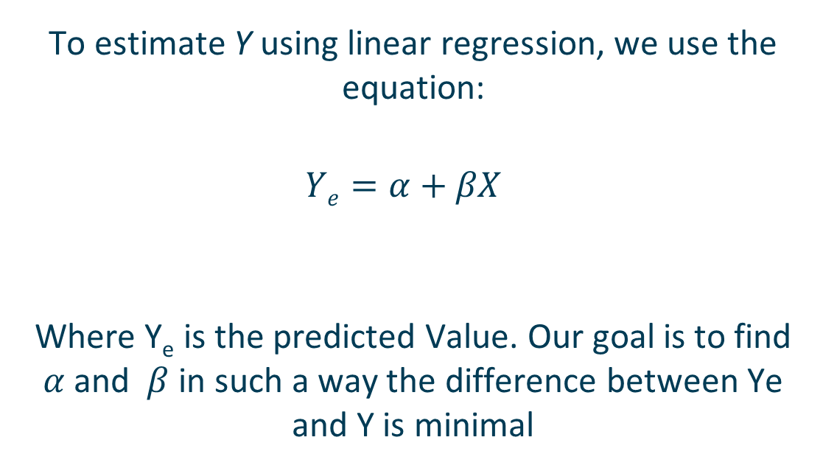
Linear Regression (Cont.)
To estimate Y using linear regression, we use the equation:
$$Ye=α+βX$$
Where Y_{e} is the predicted Value. Our goal is to find $α$ and $β$ in such a way the difference between Ye and Y is minimal

Slide 24
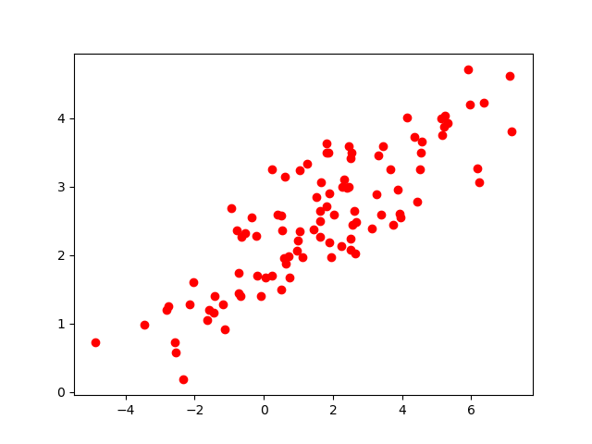
Our Goal?

Slide 25
Exercise

Slide 26
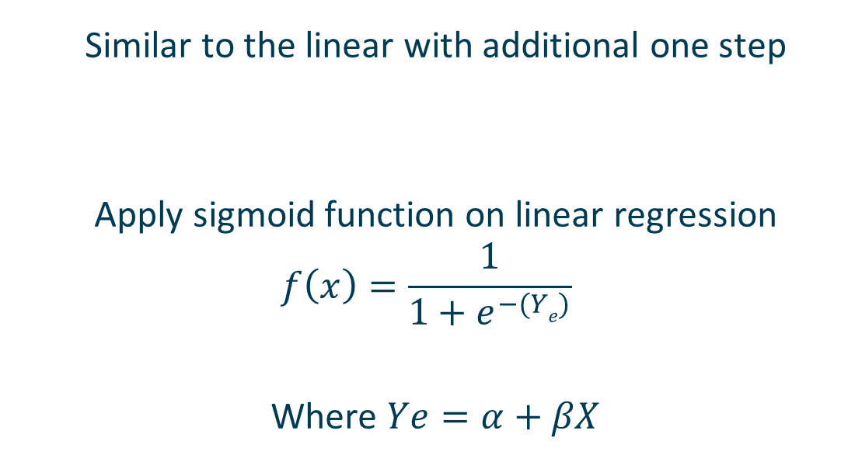
Logistic Regression
Similar to the linear with additional one step
Apply sigmoid function on linear regression
$$f\left(x\right)=\frac{1}{1+e^{−(Ye)}}$$
Where $Ye=α+βX$

Slide 27
Exercise

Slide 28
Limitations
Sensitive to outliers
If all your data is within the range of 10 to 40 on the x-axis and have two points or more in the range of 200 then this could significantly affect the results
Overfitting
Assume there is linear relation between dependent and independent variables

Slide 29
Validation
Cross Validation
Confusion Matrices
Overfitting?

Slide 30
Cross Validation
Is used to evaluate a machine learning model by running it K times.
Usually K is set to 10
How does it work?

Slide 31
Confusion Matrix
Predicted Class
P
N
TP
FN
P
Actual Class
FP
TN
N

Slide 32
Validation
Precision
Recall
Fscore
Specificity

Slide 33
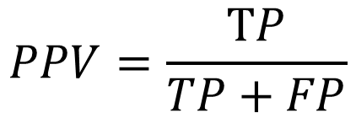
Precision
Measures how many data points are actually positives over how many are predicted as positives
$$PPV=\frac{TP}{TP+FP}$$

Slide 34
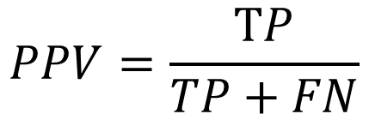
Recall
Measures how many data points are actually positive over how many are predicted as positives and how many are incorrectly labeled as not positives
$$PPV=\frac{TP}{TP+FN}$$
Known also as sensitivity

Slide 35
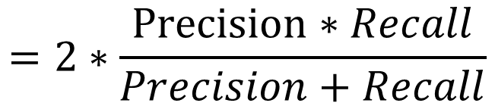
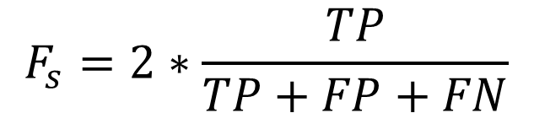
Fscore
$$F_{s}=2∗\frac{TP}{TP+FP+FN}$$
$$=2∗\frac{Precision∗Recall}{Precision+Recall}$$

Slide 36
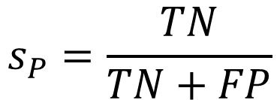
Specificity
$$s_{P}=\frac{TN}{TN+FP}$$

Slide 37
Output Interpretation
Communicate output with domain experts
Does the data answer your questions? How?
Are there any factors that may influence the output generated
Do results make sense or provide something interesting to investigate.

Slide 38
Analysis Pitfalls
Don’t jump directly to conclusions as results may be of broad applicability or reverse causation
Make sure to understand tools being used
Make sure you understand the data

Slide 39
Any Questions?

