Slide 1


Slide 2
Multiple Imputation with Denoising Autoencoder using Metamorphic Truth and Imputation Feedback Haw-minn Lu, Giancarlo Perrone, José Unpingco
16th International Conference on
Machine Learning and Data Mining
MLDM 2020
July 20-21, 2020
Amsterdam, The Netherlands

Slide 3
Introduction
Resources
Slides are available at https://github.com/WestHealth/mldm2020/
Institute Website: https://www.westhealth.org
Missing Data Problem
Imputation
Missingness Model
Denoising Autoencoders
Training with Metamorphic Truth and Imputation Feedback
Experiment/Results

Slide 4
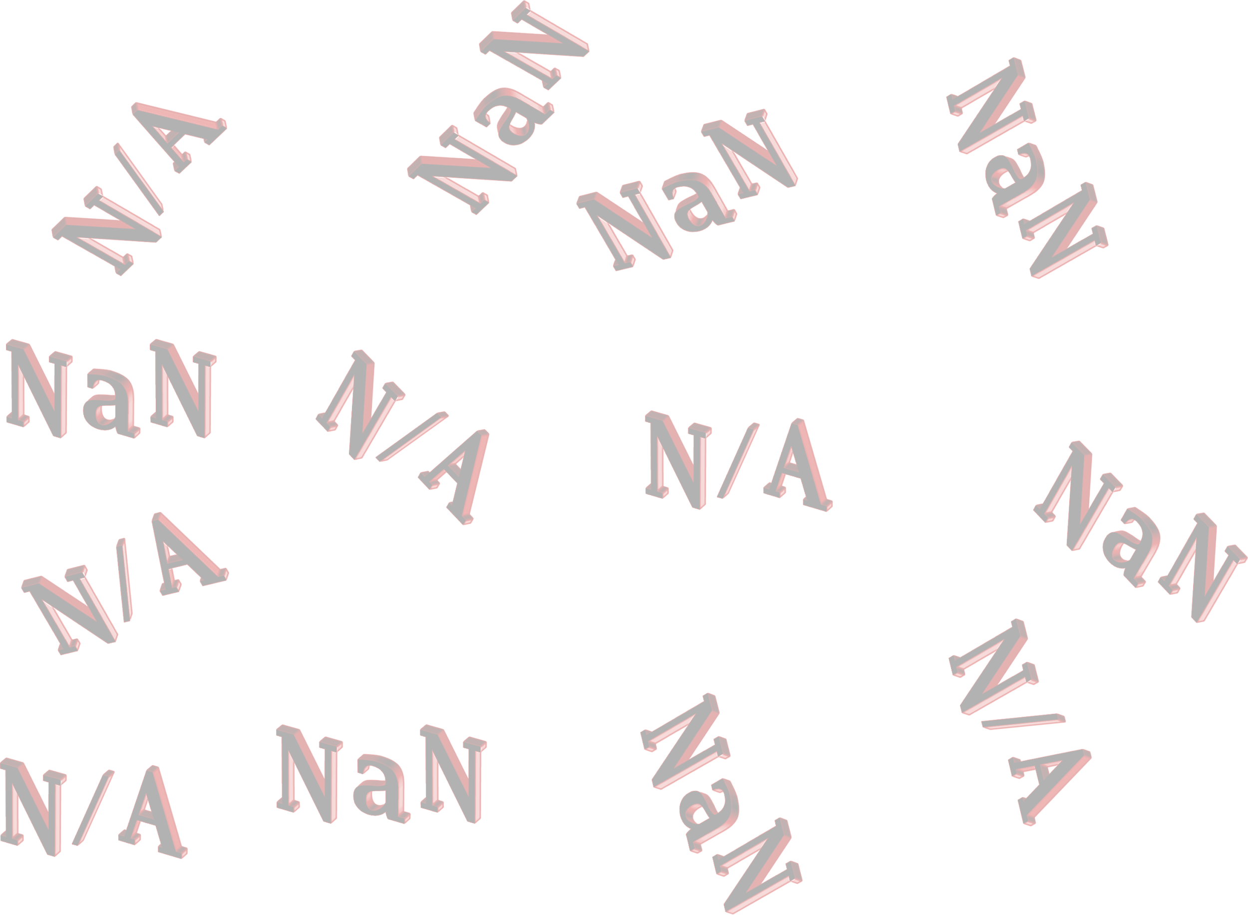
The Problem of Missing Data
Missing Data Happens for All Sorts of Reasons
How People Treat Missing Data
Imputation of Missing Data
Zero Fill
Mean/Median Fill
MICE

Slide 5

Missingness Models
Missing Completely At Random
Missing At Random
Missing Not At Random
Missingness Patterns
Uniform
Random

Slide 6
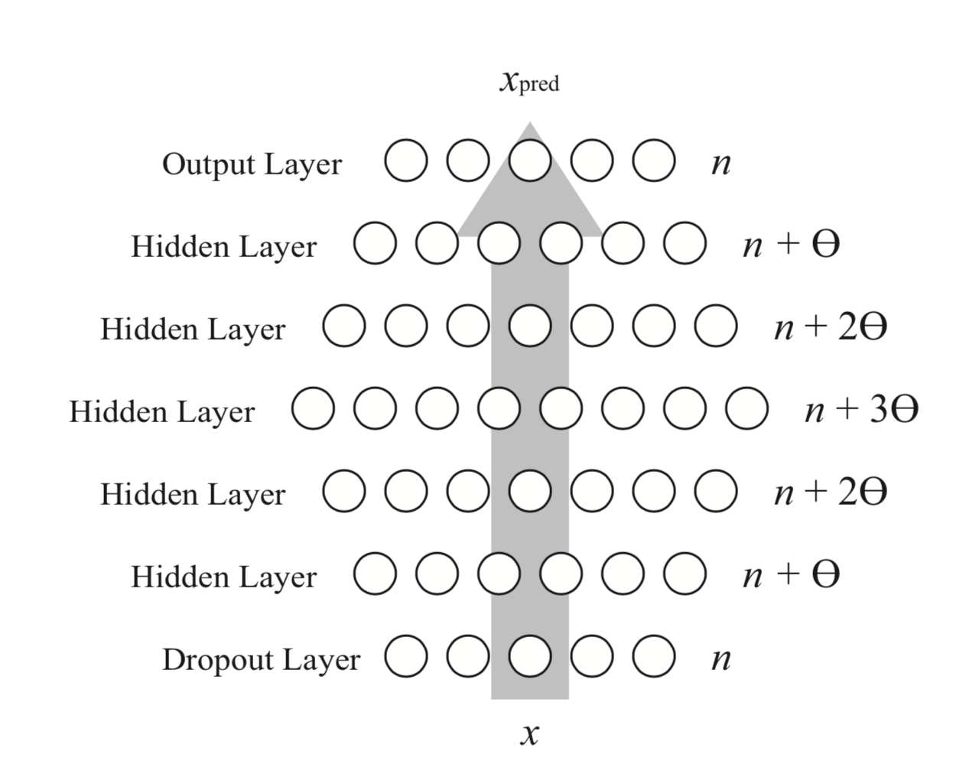
Denoising Autoencoders
L. Gondara and K. Wang, MIDA: Multiple Imputation Using Denoising Autoencoders, Proceedings of Advances in Knowledge Discovery and Data Mining - 22nd Pacific-Asia Conference, PAKDD 2018, Melbourne, VIC, Australia, June 3-6, 2018, pp. 260-272

Slide 7
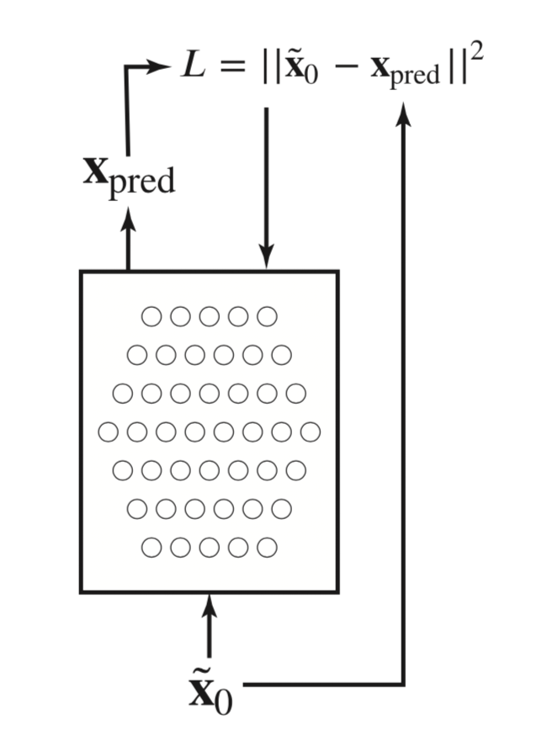
Thinking Outside the Box with Denoising Autoencoders
Metamorphic Truth
Feedback of Imputed Inputs
Training Set Size

Slide 8
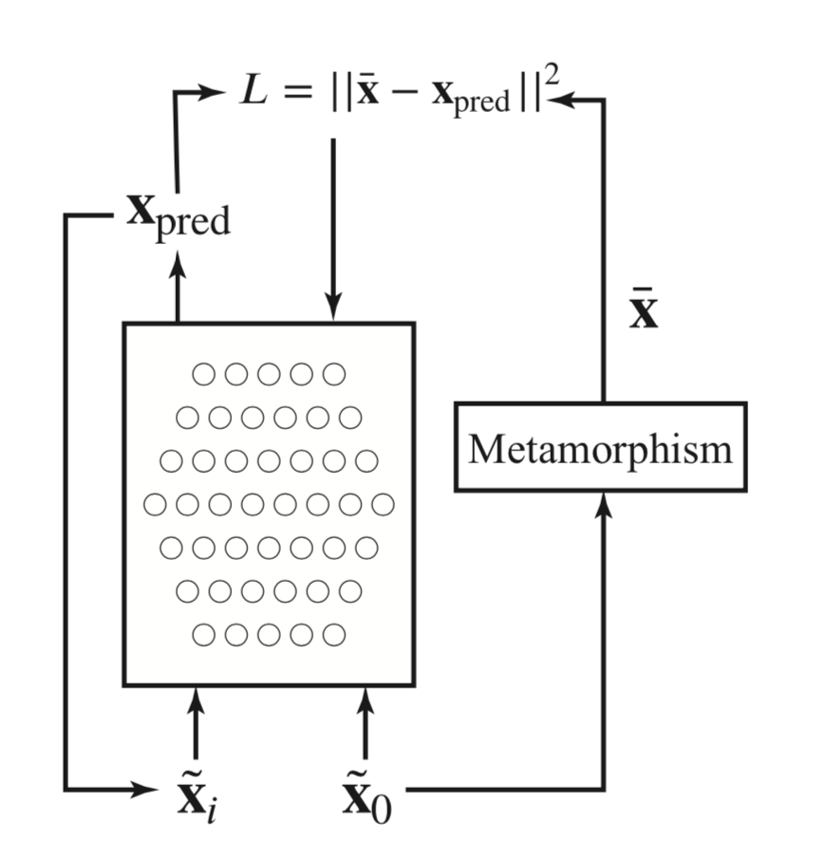
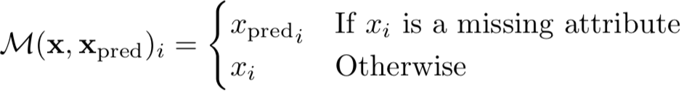
Metamorphic Truth

Slide 9
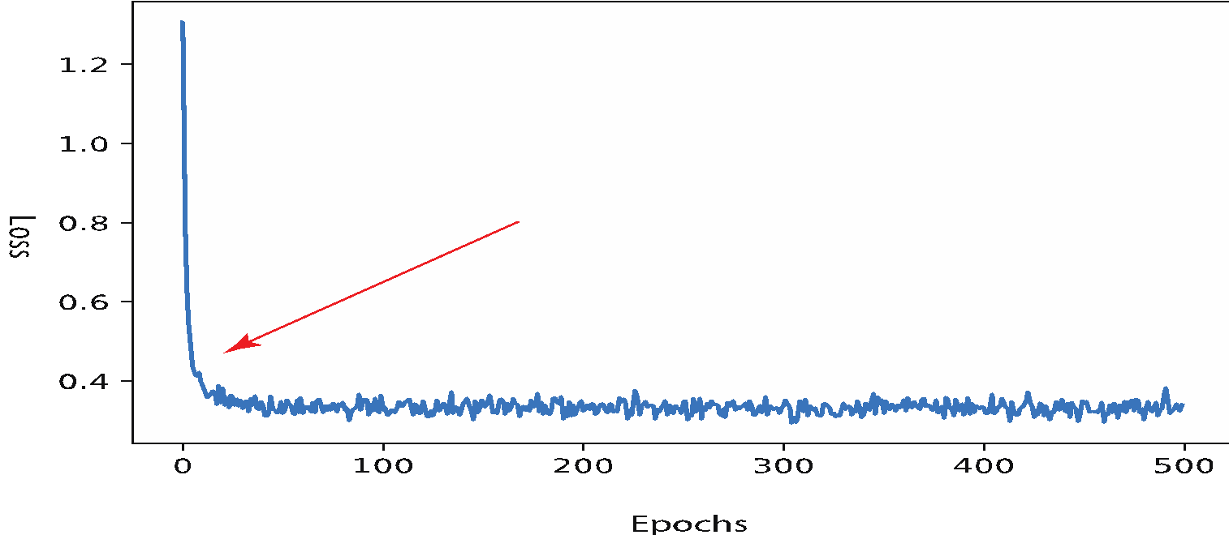
Training Method

Slide 10
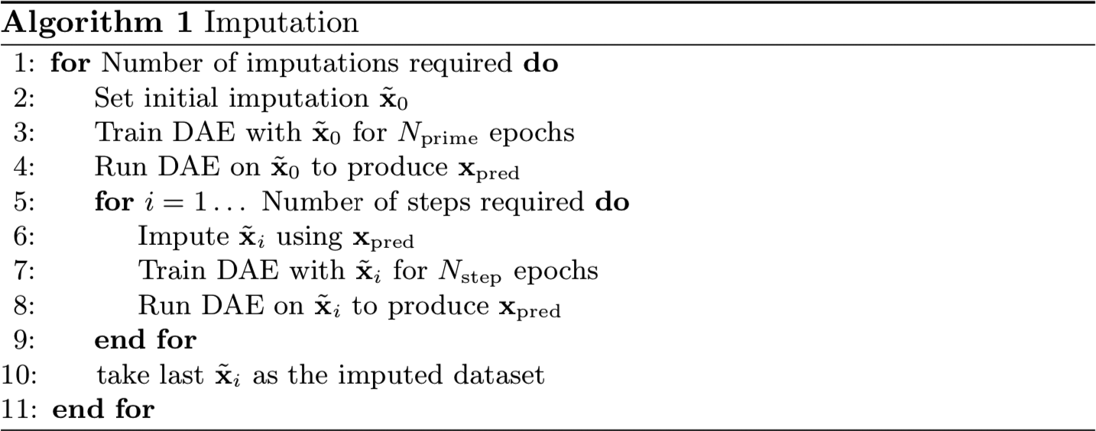
The Algorithm

Slide 11
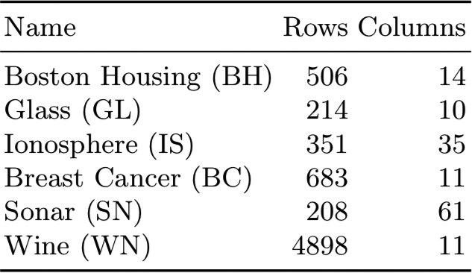
Experiment
6 Public Datasets
Implemented Using Tensorflow
Subjected 3 Missingness Mechanisms
MAR and MNAR
Designate trigger columns
Compared Mean, Gondara’s DAE, MICE and our technique.

Slide 12
Evaluating Imputation Models
Complete Data Set
Clobber Data
Impute Data
Compare Data

Slide 13
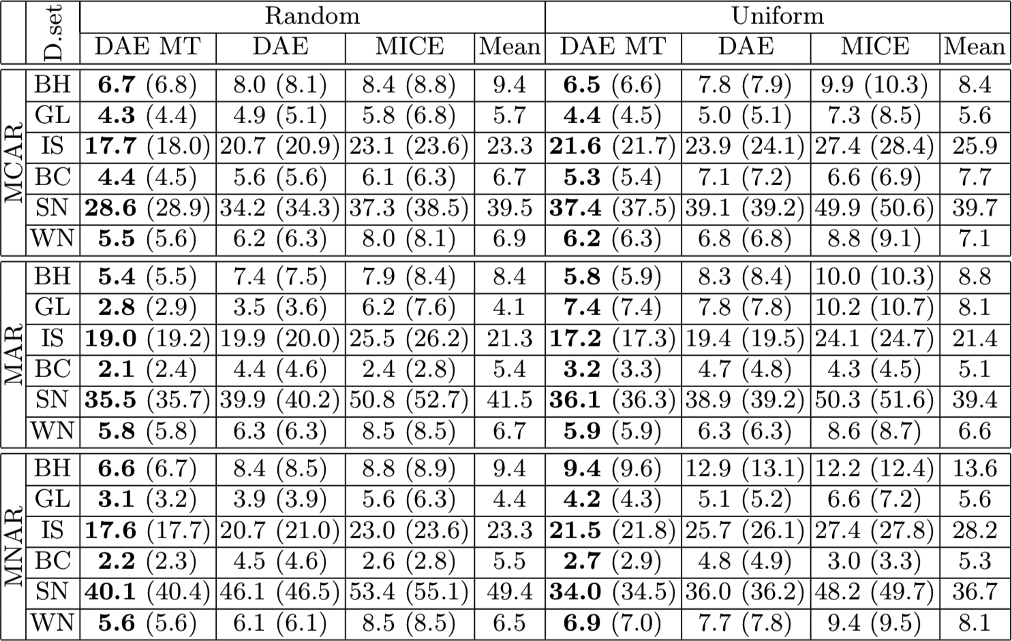
Results
RMS Error on Imputed Values

Slide 14
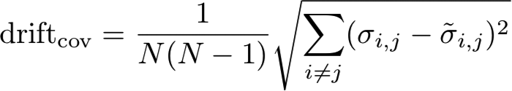
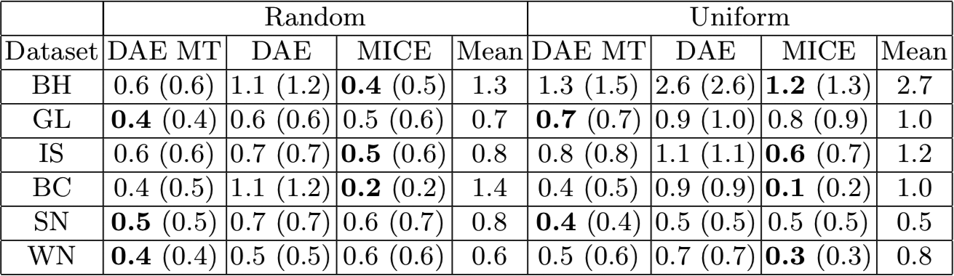
Other Metrics
Covariance Drift x10 MNAR Missingness

Slide 15
Conclusion
Denoising Autoencoders with Metamorphic Truth and Imputation Feedback outperforms DAE and MICE with respect to RMSE
Our technique is on par with MICE on preserving covariance relationships
Metamorphic Truth: a possible new training mechanism that warrants further investigation.

Slide 16
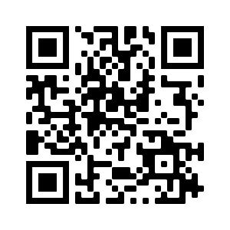
Questions
Submit an issue at https://github.com/WestHealth/mldm2020/issues/

