Slide 1


Slide 2
Missing Data in the Age of Machine Learning Winnie Xu Haw-minn Lu, PhD
PyData Global 2022
December 1-3, 2022
Anywhere on Earth

Slide 3
Background
Real World/
Unclean/Missing Data
Machine Learning
World
Artificial Neural Network
World

Slide 4
For Those Playing at Home
Binder:
https://mybinder.org/v2/gh/westhealth/pydataglobal-2022/HEAD
Notebooks not saved
Has a 5-10 minute inactivity timeout
Colab:
https://colab.research.google.com upload files from github at https://github.com/WestHealth/pydataglobal-2022
Notebooks are persistent
Must upload data each time into the virtual machine
You need to add the python magic %pip install autoimpute
Docker:
docker pull westhealth/pydata-ml-missing-data
Notebooks not saved
Requires a hash to copied from your screen

Slide 5
Outline
Crash Course in Missingness
Crash Course in Imputation
Neural Networks Autoencoder Imputers
Missing Data Resilient Machine Learning Pipelines
Multiple Imputation with Machine Learning
Q & A

Slide 6
Crash Course on Missingness

Slide 7
What are missing data?
Empty value for variables/participants in the dataset
3 Types of Missing data:
Missing Completely at Random (MCAR)
Probabilities of missingness is unrelated to any observed/unobserved variables
Rare because “true randomness” is rare
Missing at Random (MAR)
Probabilities of missingness is related to observed variables, but not unobserved variables
Missing not at Random (MNAR)
Probabilities of missingness is related to unobserved variables
Notes:
MNAR is not correlated with anything observed, give example of MNAR

Slide 8
How to deal with it?
Examine if data is truly missing and identify type of missingness
Missing data could represent zero, “Not Applicable”, or null values
Common solutions:
MCAR → deletion
MAR → imputation
MNAR → requires more information outside of the dataset
Notes:
Give quick example of how different scenarios of missing data – n/A could mean mathematically doesn’t work

Slide 9
How to identify missingness mechanism?
Simple MAR test
Little’s Test for MCAR
Utilized statistical method to examine whether the statistical features are different between complete subsets and subsets with missing values only
If no difference → not MAR
Difference → MAR

Slide 10
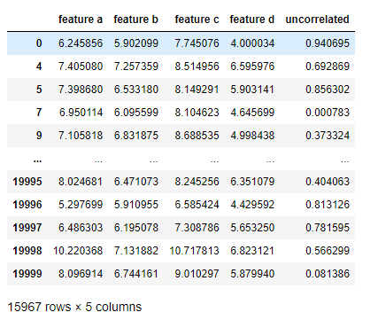
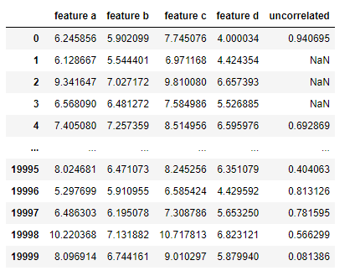
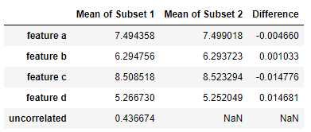
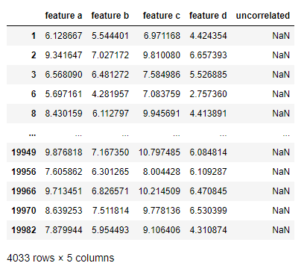
Little’s Test for MCAR
Subset 1: entries without missing data only
Sample MCAR dataset
Subset 2: entries with missing data only
Notes:
Mention that if you try it on a MNAR dataset, result is the same

Slide 11
Notes on identifying missingness mechanism
No way to distinguish between MCAR and MNAR based on the data itself
If the missingness is not MAR, recommend to treat it as MNAR
If missingness is MAR, you should use imputation not deletion

Slide 12
Crash Course on Imputation

Slide 13
Imputation Techniques in a Nutshell
Univariate
Multivariate
Single missing
Multivariate
Multimissing
Multivariate
(Stochastic) Fill
(Stochastic)
Regression
Hot Deck
Imputation
MICE
Autoencoders
Imputation Types
Single imputation
Multiple imputation for stochastic methods

Slide 14
Regression/Classification
Fit
Predict
(σ)
(σ)

Slide 15
Regression, Machine Learning, Artificial Neural Networks
Stochastic linear regression is typical
Any machine learning regression could be used.
What could be used:
Linear regression, especially stochastic LR
Random forest regression, but not much found in literature
Artificial neural networks, possibly not in use due to the computational complexity
Let’s try it.

Slide 16
Benchmarking Imputation Techniques
clobber
impute
Data Set
Data Set
w/ missing
Data Set
w/
imputed
compare
No magic answer for comparing, lots of metrics
Mean Square Error
Compare Covariances
ML Performance Comparisons

Slide 17
Exercise

Slide 18
Hot Deck Imputation
Donor Pool Creation
Donor Selection

Slide 19
Hot Deck Imputation, ML, ANN
Gold Standard HDI is call predictive mean matching
PMM uses linear regression as part of its donor pool creation.
Once again other regression techniques could be used.
Random Forest Regression
Artificial Neural Network

Slide 20
MICE
Univariate
Multivariate
Repeat

Slide 21
Multiple Imputation
Single Imputation
Repeat

Slide 22
Neural Networks Autoencoder Imputers

Slide 23
Resources and References
From West Health:
notebooks: https://github.com/WestHealth/pydataglobal2022
blog: https://westhealth.github.io/
missingness: https://github.com/WestHealth/scipy2022 and https://youtube.com/watch?v=xySfPLTgTEg
References:
Missingness:
Leyrat, C., Williamson E.,: Missing data in propensity score analysis. Perils and promises of propensity scores, https://www.ucl.ac.uk/population-health-sciences/sites/population_health_sciences/files/nash-missing_dataps_clemence_leyret.pdf
Little, R. J. A., A test of missing completely at random for multivariate data with missing values. Journal of the American Statistical Association 83 1988 pages 1198–1202. https://doi.org/10.1080/01621459.1988.10478722
Imputation:
van Buuren, S., Groothuis-Oudshoorn, K.: mice: Multivariate imputation by chained equations in r. Journal of Statistical Software, Articles 45(3), 1–67 (2011). https://doi.org/10.18637/jss.v045.i03, https://www.jstatsoft.org/v045/i03

Slide 24
Resources and References
References:
AutoEncoders:
Gondara, L., Wang, K.: Mida: Multiple imputation using denoising autoencoders. In: Phung, D., Tseng, V.S., Webb, G.I., Ho, B., Ganji, M., Rashidi, L. (eds.) Advances in Knowledge Discovery and Data Mining. pp. 260–272. Springer International Publishing, Cham (2018)
Lu, H.-m., Perrone, G., & Unpingco, J.: Multiple imputation with denoising autoencoder using metamorphic truth and imputation feedback, Machine Learning and Data Mining in Pattern Recognition, 16th International Conference on Machine Learning and Data Mining, MLDM 2020,Amsterdam, The Netherlands, July 20-21, 2020, Proceedings, pages 197–208.
Multiple Imputation and Machine Learning:
Perez-Lebel, A., Varoquaux, G., Le Morvan, M., Josse, J., Poline, J.-B.: Benchmarking missing-values approaches for predictive models on health databases, GigaScience, Volume 11, 2022, https://doi.org/10.1093/gigascience/giac013
Khan, S., Ahmad, A., Mihailidis, A.: Bootstrapping and Multiple Imputation Ensemble Approaches for Missing Data, Journal of Intelligent and Fuzzy Systems, 2019. https://doi.org/10.48550/arXiv.1802.00154

Slide 25
Questions?
Contact Us through Issues on the github repo
Thank You

