Slide 1
Machine Learning: Neural Networks randomForest Logistic Regression
West Michigan R Users Group
Paul Egeler
16 August 2016

Slide 2
What is machine learning?
Supervised learning
Response Types
Regression
Classification
Model Types
Data models
Algorithm models
Unsupervised learning

Slide 3
Linear and non-linear models
Artificial neural networks (ANN)
Generalized linear models (GLM)
Simple and multiple linear regression
Poisson regression
Support vector machines
Principal components
Partial least squares (PLS)
Principal component regression (PCR)
Classification and regression trees (CART)
Decision trees
Regression trees
Ensembles
Gradient boosting
Rule-based models
Bayesian networks
Distance-based models
K-nearest neighbors (k-NN)
Linear discriminant analysis (LDA)
Logistic regression
Binary logistic regression
Multinomial logistic regression
Cumulative logit
randomForest

Slide 4
LOGISTIC REGRESSION
GENERERALIZED LINEAR MODELS

Slide 5

Logistic Regression
Generalized Linear Model (GLM)
Binary, multinomial, or ordinal response
Statistical model

Slide 6
Classification and Regression Trees

Slide 7
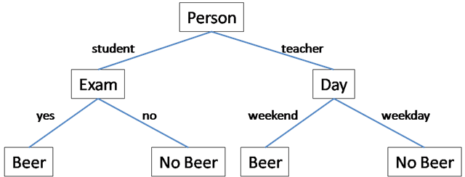

Slide 8
randomForest
Classification and regression trees (CART)
Bootstrap aggregating (Bagging)
Feature bagging
Observation bagging
Out-of-bag (OOB) error

Slide 9
Artificial Neural Nets

Slide 10
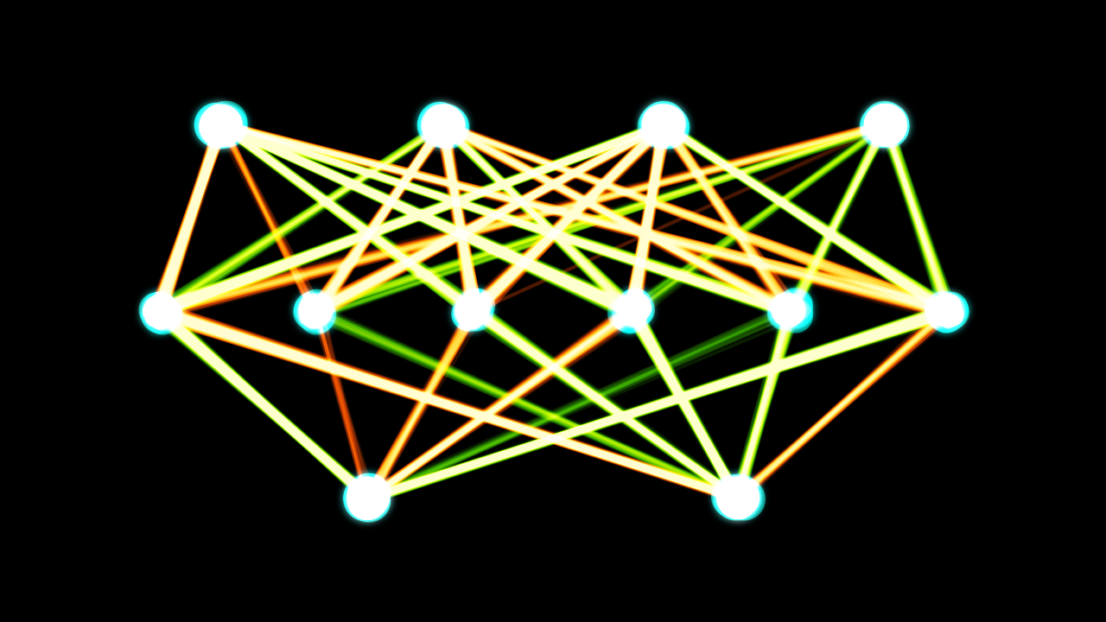
Artificial Neural Networks (ANNs)

Slide 11
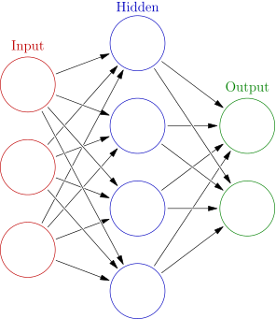

Slide 12
