Slide 2
Objectives
Explore the history of the web
Create the structure of an HTML document
Insert HTML elements and attributes
Insert metadata into a document
Define a page title
FREECODECAMP.COM

Slide 3
Objectives (continued 1)
Mark page structures with sectioning elements
Organize page content with grouping elements
Mark content with text-level elements
Insert inline images
Insert symbols based on character codes

Slide 4
Objectives (continued 2)
Mark content using lists
Create a navigation list
Link to files within a website with hypertext links
Link to e-mail addresses and telephone numbers
Notes:
Check the footer.

Slide 5
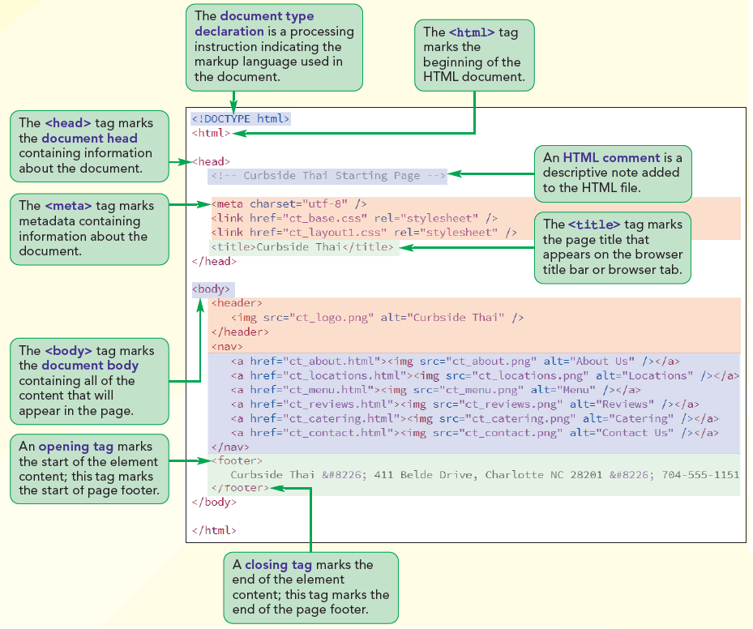
The Structure of an HTML5 Document

Slide 6
Exploring the World Wide Web
A network is a structure in which information and services are shared among devices
A host or a node can be any device that is capable of sending and/or receiving data electronically
A server is a host that provides information or a service to other devices on the network

Slide 7
Exploring the World Wide Web (continued 1)
A computer or other device that receives a service is called a client
In a client-server network, clients access information provided by one or more users
Local area network - A network confined to a small geographic area, such as within a building or department

Slide 8
Exploring the World Wide Web (continued 2)
A network that covers a wide area, such as several buildings or cities, is called a wide area network (WAN)
The largest WAN in existence is the Internet

Slide 9
Exploring the World Wide Web (continued 3)
Timothy Berners-Lee and other researchers at the CERN nuclear research facility near Geneva, Switzerland laid, the foundations for the World Wide Web, or the Web, in 1989
They developed a system of interconnected hypertext documents that allowed their users to easily navigate from one topic to another
Hypertext is a method of organization in which data sources are interconnected through a series of links or hyperlinks that users can activate to jump from one piece of information to another

Slide 10
Web Pages and Web Servers
Each document on the web is referred to as a web page
Web pages are stored on web servers
Documents on the web are accessed through a software program called a web browser

Slide 11
Introducing HTML
A Web page is a text file written in HTML (Hypertext Markup Language)
A markup language describes the content and structure of a document by identifying, or tagging, different document elements

Slide 12
The History of HTML
In the early years of HTML, browser developers were free to define and modify the language as no rules or syntax were defined
The World Wide Web Consortium, or the W3C, created a set of standards or specifications for all browser manufacturers to follow

Slide 13
The History of HTML (continued 1)
The W3C has no enforcement power
The recommendations of the W3C are usually followed since a uniform approach to Web page creation is beneficial to everyone

Slide 14
The History of HTML (continued 2)
XHTML (Extensible Hypertext Markup Language) is a different version of HTML enforced with a stricter set of standards
HTML5 was developed as the de facto standard for the next generation of HTML
Older features of HTML are often deprecated, or phased out; you may need to use them if you are supporting older browsers

Slide 15
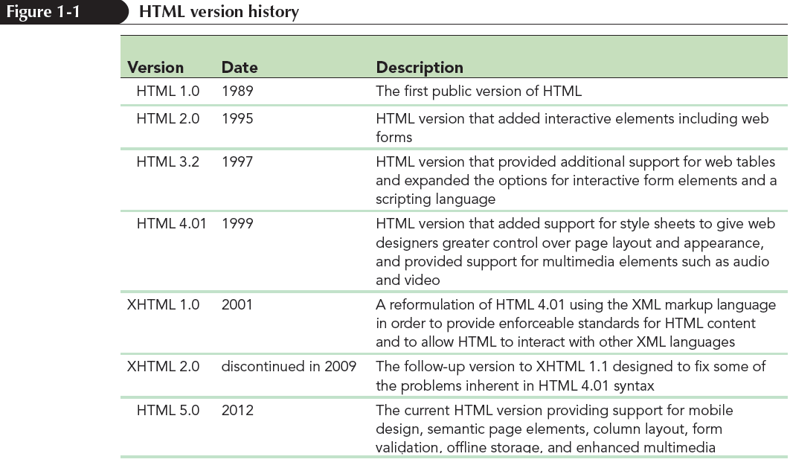
The History of HTML (continued 3)

Slide 16
Tools for Working with HTML
Basic text editor such as Windows Notepad
Other HTML editors such as Notepad++, UltraEdit, CoffeeCup, BBEdit, and ConTEXT

Slide 17
Tools for Working with HTML (continued)
IDE (Integrated Development Environment) - A software package that provides comprehensive coverage of all phases of the development process from writing HTML code to creating scripts for programs running on web servers
Validators are programs that test code to ensure that it contains no syntax errors

Slide 18
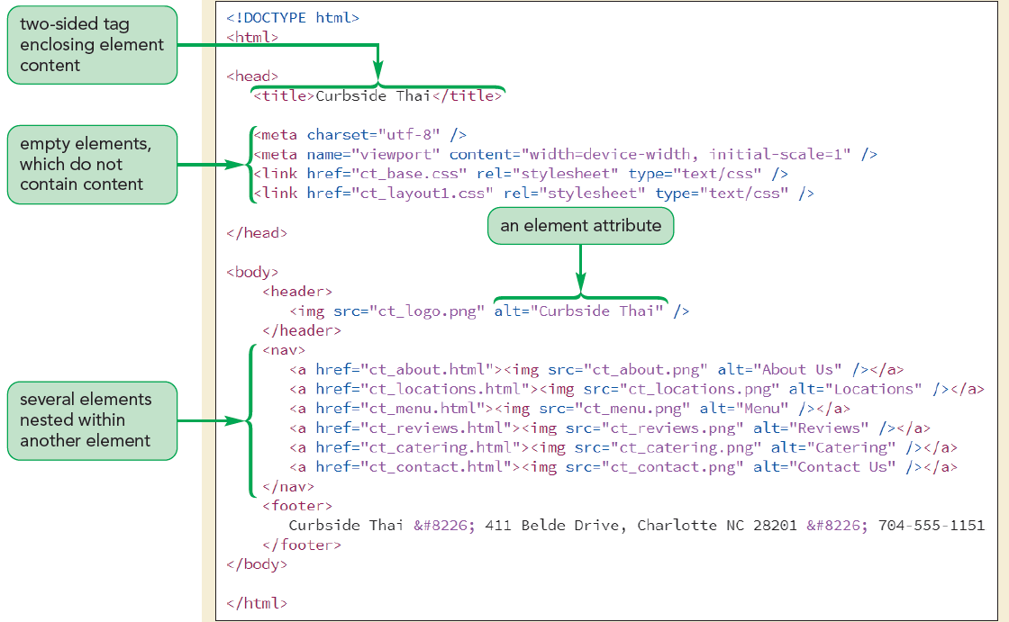
Exploring an HTML File

Slide 19
The Document Type Declaration
The first line in an HTML file is the document type declaration, or doctype, that indicates the type of markup language used in the document
<!DOCTYPE html>

Slide 20
Introducing Element Tags
Element tag is the fundamental building block in every HTML document that marks an element in the document
A starting tag (<element>) indicates the beginning of an element, while an ending tag (</element>) indicates the ending
The general syntax of a two-sided element tag is
<element>content</element>

Slide 21
Introducing Element Tags (continued)
The following code marks a paragraph element
<p>Welcome to Curbside Thai.</p>
Empty elements are elements that are either nontextual (images) or contain directives to the browser about how the page should be treated
For example, <br /> is used to indicate the presence of a line break in the text

Slide 22
The Element Hierarchy
<!DOCTYPE html>
<html>
<head>
head content
</head>
<body>
body content
</body>
</html>

Slide 23
The Element Hierarchy (continued)
An HTML document is divided into two main sections: the head and the body
The head element marks information about the document
The body element marks the content that will appear in the web page
The body element is always placed after the head element

Slide 24
Introducing Element Attributes
Element attributes provide additional information to the browser about the purpose of the element
The general syntax of an element attribute is
<element attr1=”value1” attr2=”value2” ...> content</element>
where attr1, attr2, etc. are the names of attributes associated with the element and value1, value2, etc., are the attribute values

Slide 25
Handling White Space
HTML file documents are composed of text characters and white space
A white-space character is any empty or blank character such as a space, tabs, or a line break
You can use white space to make your file easier to read by separating one code block from another

Slide 26
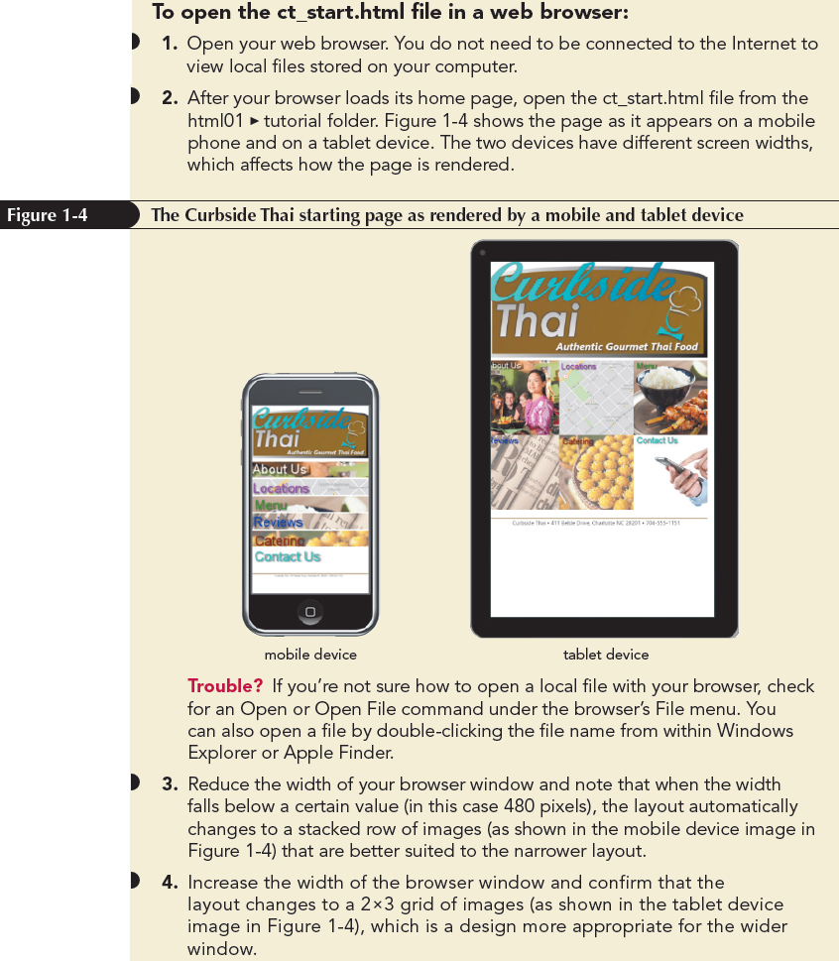
Viewing HTML File in a Browser

Slide 27
Viewing HTML File in a Browser (continued)
HTML describes a document’s content and structure, but not its appearance
The actual appearance of the document is determined by style sheets

Slide 28
Creating the Document Head
The document head contains metadata
Metadata is the content that describes or provides information about how the document should be processed by the browser

Slide 29
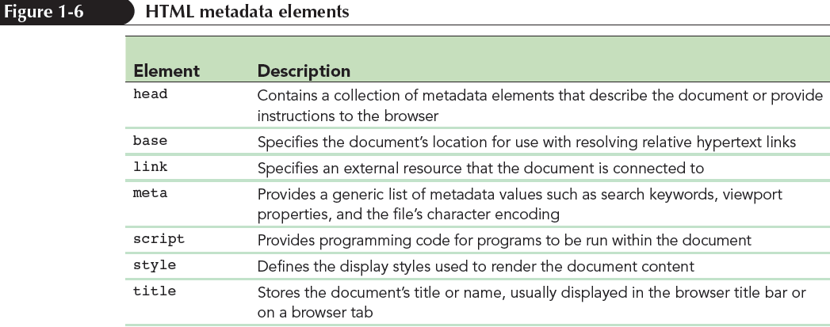
Creating the Document Head (continued)

Slide 30
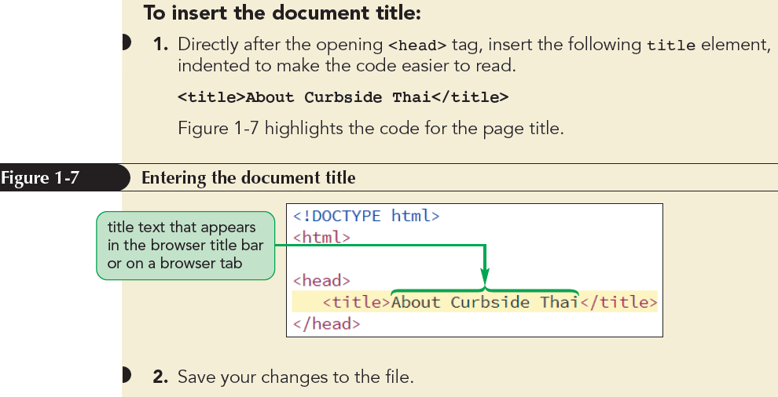
Setting the Page Title

Slide 31
Adding Metadata to the Document
Meta element is used for general lists of metadata values.
The meta element structure is
<meta attributes />
Character encoding is the process by which a computer converts text into a sequence of bytes and vice versa when it stores the text and when the text is read.

Slide 32
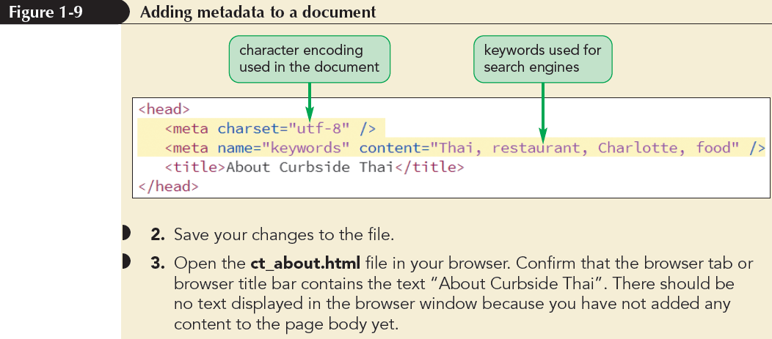
Adding Metadata to the Document (continued)

Slide 33
Adding Comments to Your Document
A comment is descriptive text that is added to the HTML file but does not appear in the browser window
<!-- comment -->
Comments can be spread across several lines
It is a good practice to always include a comment in the document head

Slide 34
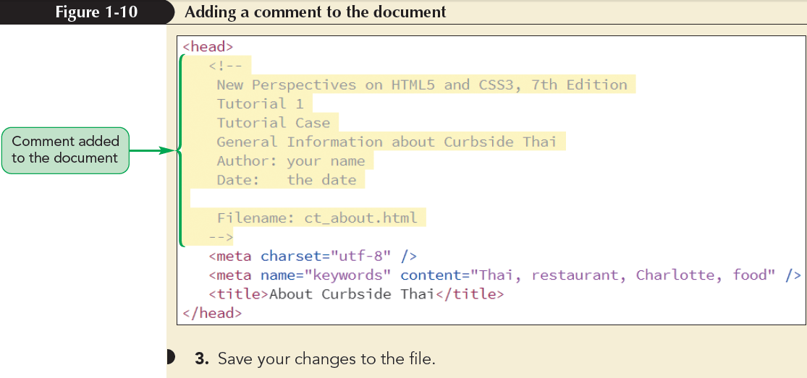
Adding Comments to your Document (continued)

Slide 35
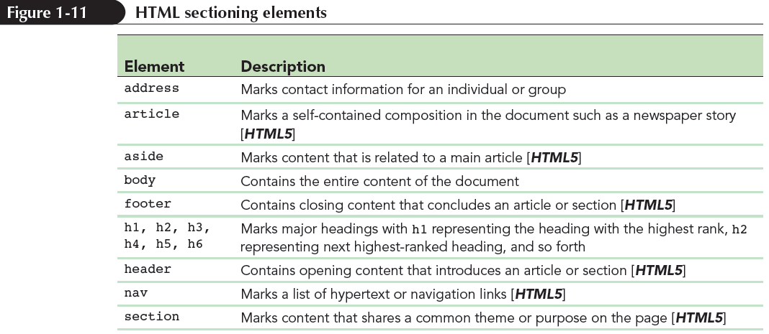
Writing the Page Body
HTML marks the major topical areas of a page using sectioning elements also referred to as semantic elements.

Slide 36
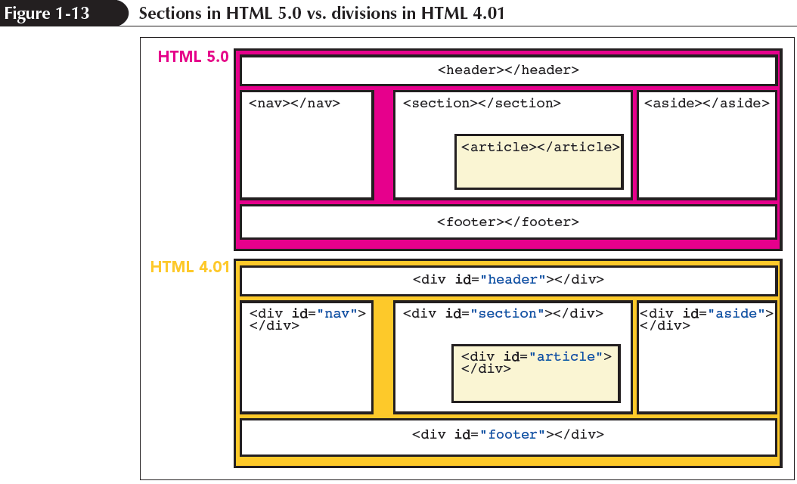
Comparing Sections in HTML4 and HTML5

Slide 37
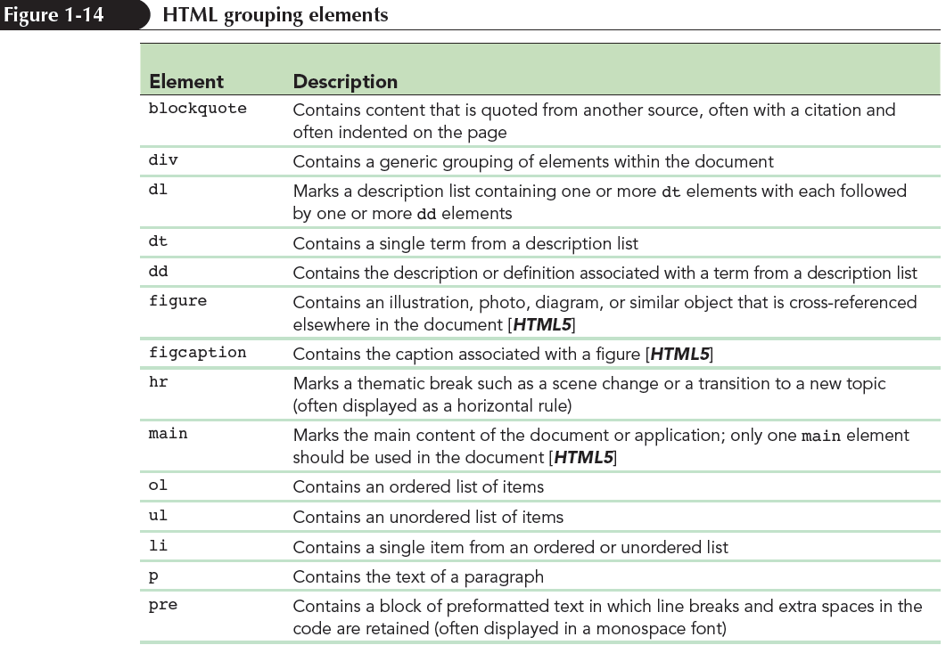
Using Grouping Elements

Slide 38
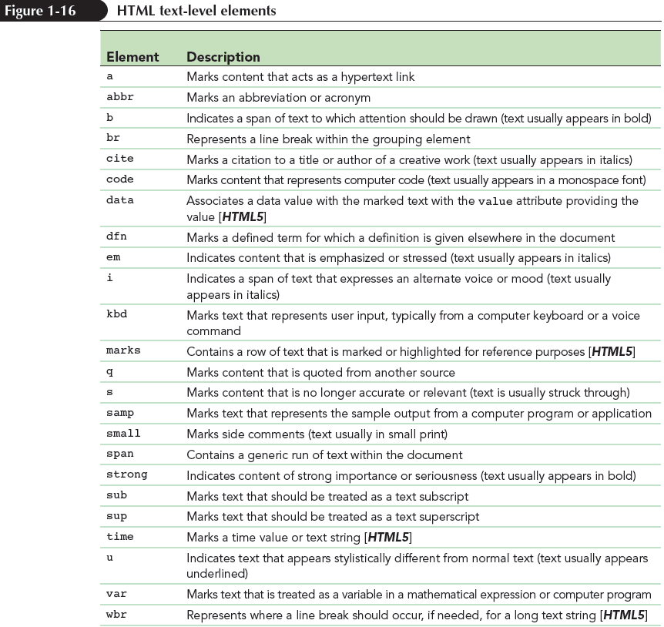
Using Text-Level Elements

Slide 39
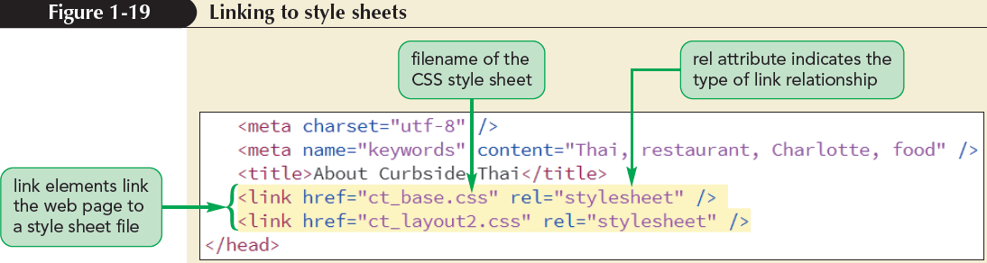
Linking an HTML Document to a Style Sheet
A style sheet is a set of rules specifying how page elements are displayed; it is written in the Cascading Style Sheet (CSS) language
To link an HTML document to an external style sheet file, add the following element:
<link href=”file” rel=”stylesheet” />

Slide 40
Working with Character Sets and Special Characters
Character set is a collection of characters and symbols rendered by the browser
Character encoding associates each character from a character set that can be stored and read by a computer program
Character entity reference is also used to insert a special symbol using the syntax
&char;
where char is the character’s entity reference

Slide 41
Working with Inline Images
To support embedded content, content imported from another resource, HTML provides embedded elements
Inline images are images that are placed like text-level elements in line with the surrounding content
To embed an inline image into the document, use
<img src=“file” alt=“text” />

Slide 42
Working with Lists
List is a type of grouping element
Ordered lists are used for items that follow some defined sequential order, such as items arranged alphabetically or numerically
Unordered lists are used for lists in which the items have no sequential order
Description lists contain a list of terms and matching descriptions
Navigation lists are unordered lists of hypertext links placed within the nav element

Slide 43
Working with Hypertext Links
Hypertext is created by enclosing content within a set of opening and closing <a> tags like:
<a href=“url”>content</a>
where url is Uniform Resource Locator (URL)
Inline images can also be turned into links by enclosing the image within opening and closing <a> tags
<a href=“ct_start.html”><img src=“ct_logo2.png” /></a>

Slide 44
Linking to the Internet and Other Resources
The type of resource that a hypertext link points to is indicated by the link’s URL
scheme: location
where scheme indicates the resource type and location provides the resource
Protocol is a set of rules defining how information is passed between two devices

Slide 45
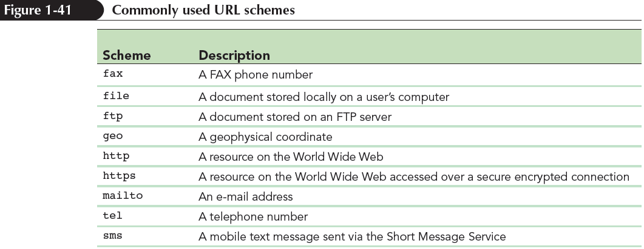
Linking to the Internet and Other Resources (continued)

Slide 46
Linking to a Web Resource
Links to Web resources have a general structure like:
http://server/path/filename#id
where server is the name of the web server hosting the resource, path is the path to the file on that server, filename is the name of the file, and if necessary, id is the name of an id within a file

Slide 47
Linking to an E-Mail Address
E-mail address can be turned into a hypertext link using the URL:
mailto : address

Slide 48
Linking to a Phone Number
Many developers include links to phone numbers for their company’s customer service or help line
The URL for a phone link is
tel : phone

