Slide 1
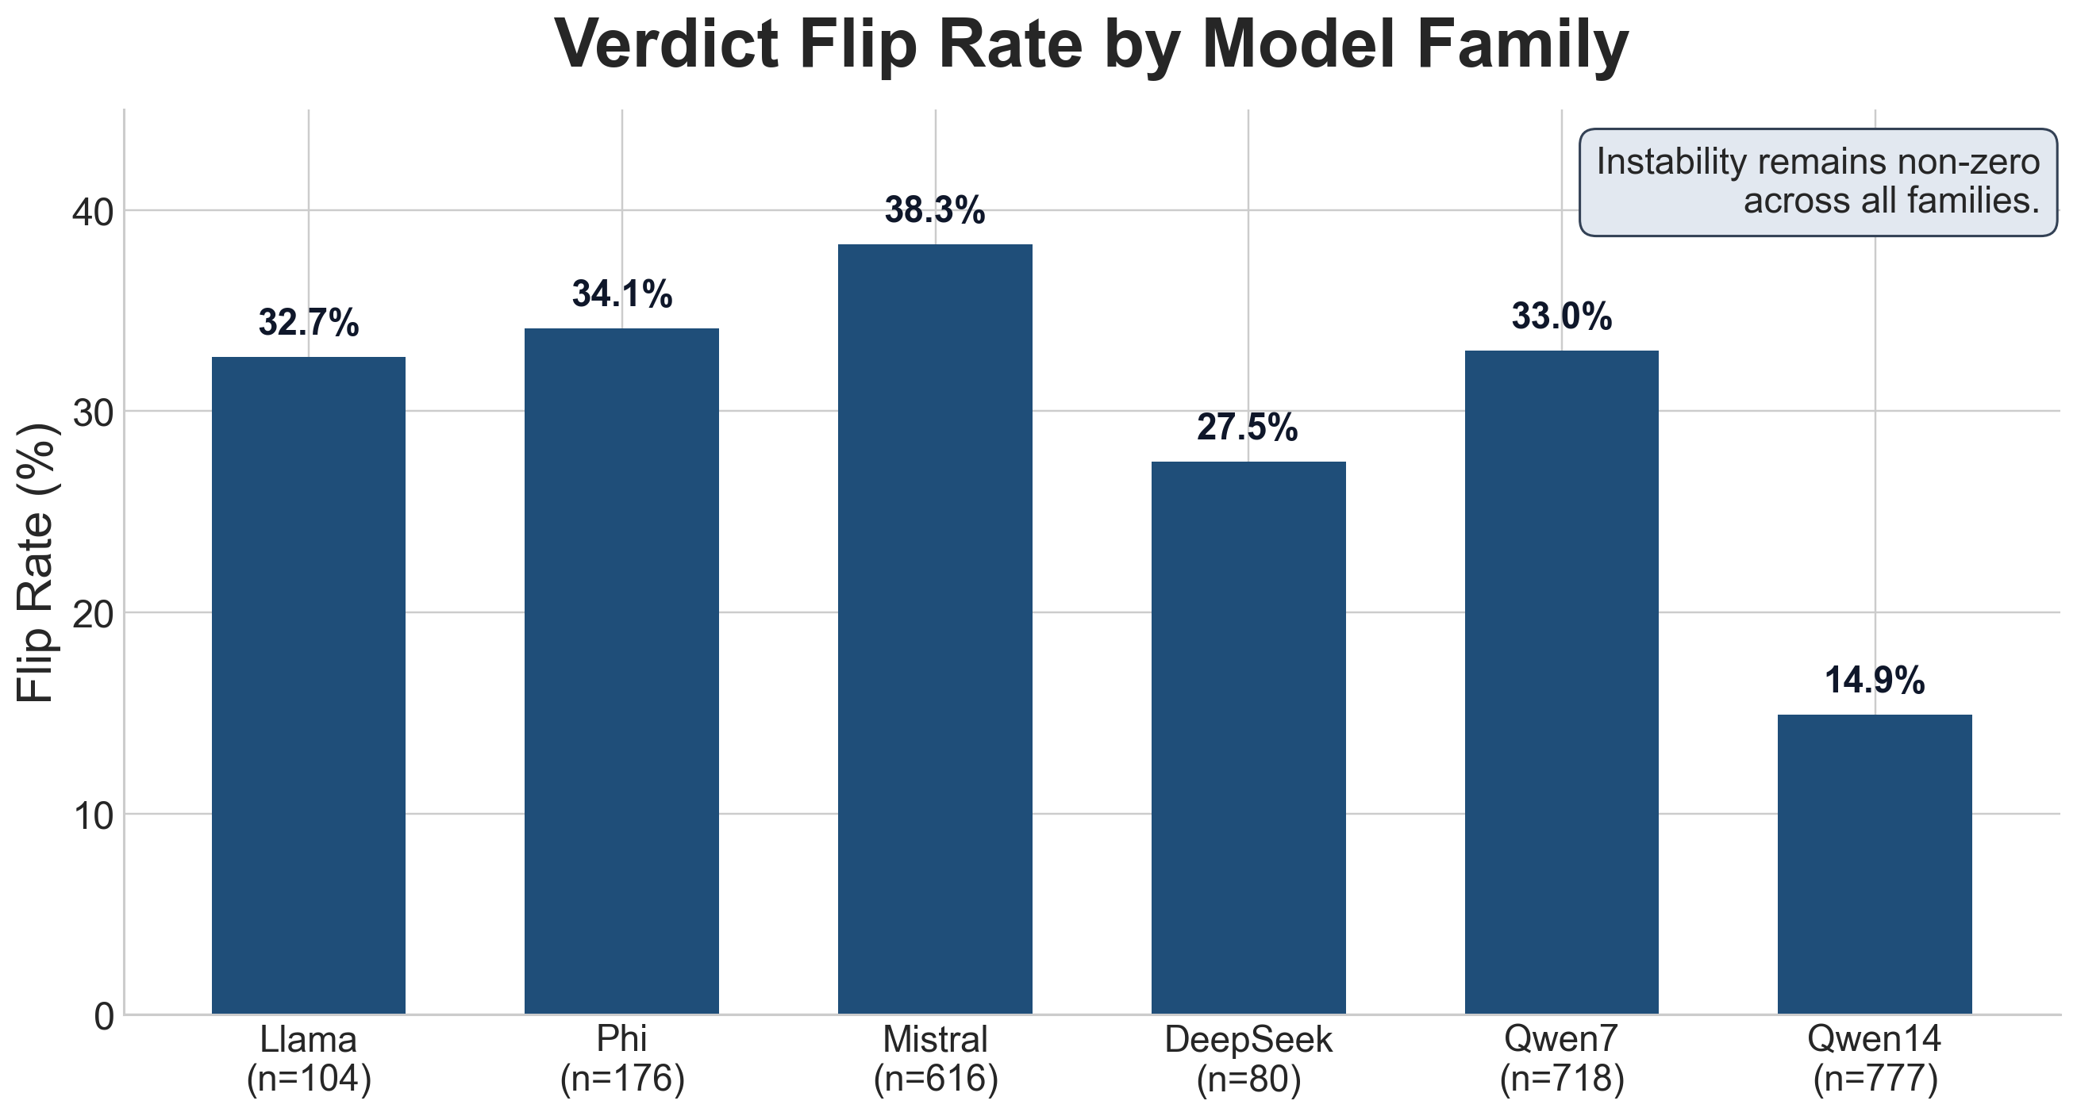
Can AI Hold a Fair Trial?
B.A.I.L.I.F.F. audits legal AI with adversarial, paired mock trials
What we tested
Observed stability by model family
• Same case facts, only demographic cue toggled • Three-agent courtroom: Judge, Prosecution, Defense • We measured both: - Verdict direction (delta, OR) - Procedural stability (flip rate)
Key message: Even when pooled outcome shifts are modest, flip rates stay non-zero across model families.
Single static slide (3MT-compliant): no animations, no transitions, no embedded media

