Slide 1
AFRICA DIGITAL DEVELOPMENT ANALYSIS (200-2024)
using the World Bank Development Indicators (WDI) dataset.
PREPARED BY
ONWUSA, CHUKWUDI
TOOLS USED
PYTHON | SQL| POWER BI | POWER QUERY | DAX | EXCEL

Slide 2

PROJECT OBJECTIVES
The objective of this project was to analyze digital development across 54 African countries between 2000 and 2024.
Specifically, I wanted to answer questions such as:
How has Internet usage changed over time?
How widespread are mobile subscriptions across Africa?
Is there a relationship between Internet adoption and economic growth?
Which countries are leading in digital development?
The goal is to provide insights that can support policymakers, investors, and other stakeholders in making informed decisions.

Slide 3
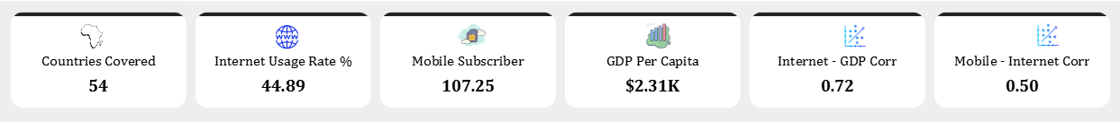
DATASET OVERVIEW
The dataset was obtained from the World Bank Development Indicators (WDI).
It contains thousands of development indicators covering over 200 countries worldwide.
For this project, I filtered the dataset to include only 54 African countries and focused on four key indicators:
Individuals using the Internet (% of population)
Mobile cellular subscriptions (per 100 people)
GDP per capita (Current US Dollars)
GDP Growth (Annual Percentage)

Slide 4
DATA CLEANING PROCESS
Python and Pandas a Python Framework for data analysis were used to clean and prepare the data.
The cleaning process included:
Importing the dataset.
Filtering only African countries.
Selecting the required indicators.
Removing duplicate records.
Handling missing and placeholder values.
Standardizing the Year column.
Merging country information such as Region and Income Group.
Exporting the cleaned dataset for Power BI.
These steps ensured that the dataset was consistent and suitable for analysis.

Slide 5
DATA ANALYSIS PROCESS
Several analysis were performed using Python, SQL and Power BI.
These included:
Trend analysis over time.
Country comparisons.
Correlation analysis.
KPI calculations.
Interactive dashboard creation.
The project also explored the relationships between:
Internet usage and GDP per capita.
Mobile subscriptions and Internet usage.
This helped reveal how digital connectivity relates to economic development across Africa.

Slide 6
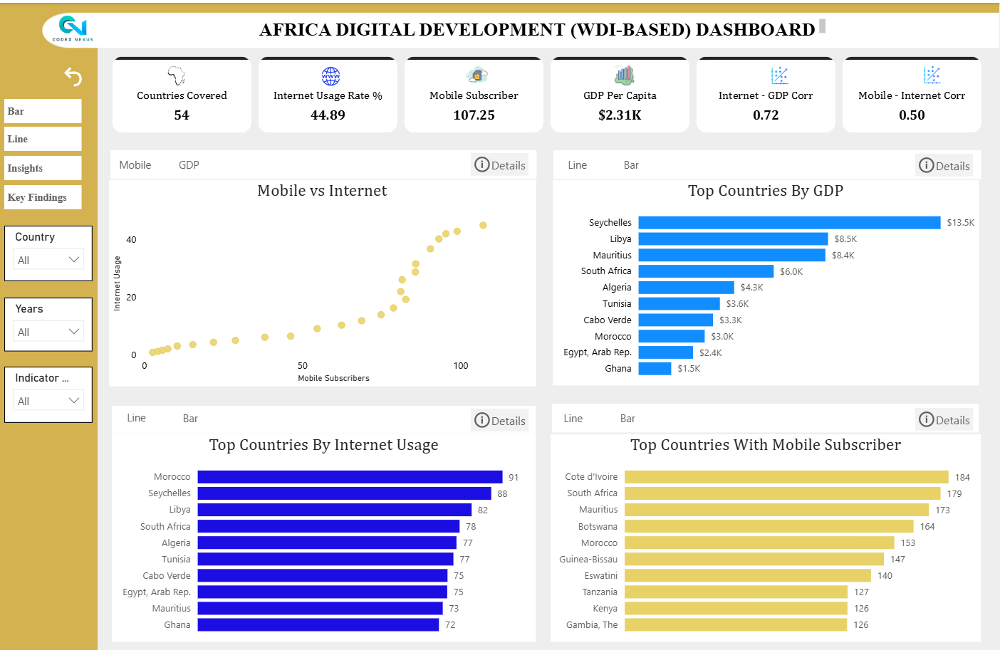
DASHBOARD

Slide 7
KEY INSIGHTS
The analysis produced several important insights.
Average Internet usage across Africa reached 44.89%.
Mobile subscriptions averaged 107.25 per 100 people, indicating widespread mobile connectivity.
Average GDP per capita was approximately $2.31K.
Internet usage showed a strong positive correlation of 0.72 with GDP per capita.
Mobile subscriptions showed a moderate positive correlation of 0.50 with Internet usage.
Overall, countries with stronger digital infrastructure generally experience better economic performance.

Slide 8
RECOMMENDATIONS
Based on the findings, I recommend:
Expanding broadband infrastructure to increase internet usage.
Making Internet services more affordable.
Investing in digital literacy programs.
Supporting innovation and digital entrepreneurship.
Leveraging Africa's strong mobile penetration to expand digital financial services, e-government, and online education.
These initiatives can help bridge the digital divide and promote inclusive economic growth.

Slide 9
CONCLUSION
In conclusion, this project demonstrates how data analytics can uncover valuable insights from large-scale development data.
Using Python and Power BI, I transformed raw World Bank data into an interactive dashboard that highlights Africa's digital transformation and its relationship with economic growth.
Thank you for watching, and I appreciate your time.

