Slide 1
FRC Programming Practices Workshop
Gautam Subbacharya
Gowri Visweswaran
Team 2186
Westfield High School

Slide 2
The presenters
Date: November 15th – 9 am to 1 pm Location: Bechtel’s Reston Facility 12011 Sunset Hills Road Reston, VA 20190
Presenters
Josh Long: jalong@bechtel.com (240)480-2798
Jeffery Crockett: did not get his contact info.
Mike Anderson(Herndon HS mentor): robot-maker12@verizon.net
Mike Anderson volunteered to come to our school with their robot prototype and guide us, we are also welcome to go to Herndon HS on Tue evenings to see their demos and talk to them.
Attendees from 2186: Gautam, Colman, Sabrina

Slide 3
Agenda of FRC workshop
Hands-on workshops
Safety procedure practices
Program design and code documentation
Programming style guideline
RobotDrive demo
Program creation with netbeans and Eclipse
Beta 2015 control system demo by Herndon HS
Programming challenge: solve a problem using a flowchart

Slide 4
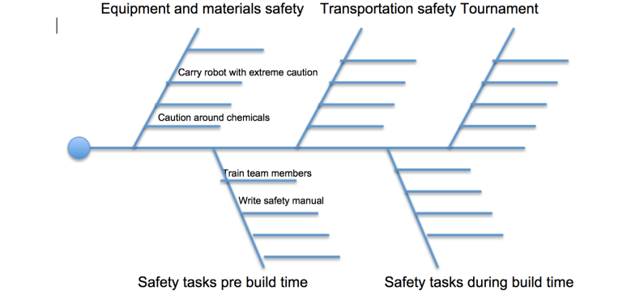
Safety procedures
Teams collaborated to think up safety procedures and present as a fishbone diagram, such as the incomplete one below

Slide 5
Documentation
Flowchart your program before implementing to document the design
Standard IE61131. Part 3 of IEC 61131 deals with programming languages and defines two graphical and two textual PLC programming language standards:
Ladder diagram (LD), graphical
Function block diagram (FBD), graphical
Structured text (ST), textual
Instruction list (IL), textual
Sequential function chart (SFC), has elements to organize programs for sequential and parallel control processing.

Slide 6
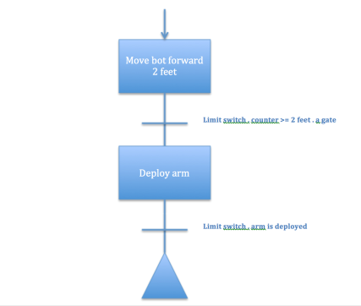
Example SFC

Slide 7
Programming Style
Introductory comment block1
Introductory comment block 2
Introductory comment block 3
Comment and whitespace conventions
Choose meaningful variable names
Whitespace to make code readable
Pretty printer for formatting code
Variable scope and variable data type are important
Avoid globals and use local variables
Use namespaces
Proper use of static variables
Use appropriate variable type
Use floats judiciously
Use only integers for counters

Slide 8
General advice/guidelines
Use API WPI as a reference
Reach out to more experienced teams for help
Start the drive train well before the build season
Refer to the Herndon HS team Facebook page for help: https://www.facebook.com/FRC2015ControlsBeta
Make a diagram of wiring and connections and correlate to code and hand out to wiring team
WPI Robot builder

Slide 9
General advice/guidelines(continued)
Use your programming language reference as needed
Specify the problem definition
Keep the IDE reference, Eclipse or netbeans
WPI Robotics library users guide.
CAN tutorial (Controller Area Network), become familiar
Jaguar CAN documentation, read it
RoboBio website, become familiar
Wireshark, become familiar with it

Slide 10
Source Control
Github or svn to archive, re-use code, maintain history and logs
Our code from 2013 is on github on a github repository for the 2013 source code on:
https://github.com/WestfieldRoboticsTeam2186/Robotics2013
Username: team2186
Password: westfieldrobotics
Gautam and Gowri added all the code we got from Dhiman's laptop for 2013.
Please create accounts on github and get access to this code.

Slide 11
Beta 2015 Control System
https://www.facebook.com/FRC2015ControlsBeta
Facebook group we need to look at in detail about what the Herndon HS team is working on with the new beta 2015 control system.

Slide 12
Thank you!

