Slide 1
Westfield Robotics
Team 2186

Slide 2

What is FIRST?
Prepares students for careers in STEM fields by providing real world engineering experience
Offers a range of robotics competitions for K-12 students

Slide 3
FIRST Robotics Competition
For High School students, mentored by engineering professionals
120 lb robots play games in a different challenge every year
Robots are built from parts in a six week build season followed by a three day tournament

Slide 4

This Year’s Challenge
Robots had to work with alliance partners
The robot had to maneuver a large exercise ball into a goal
The matches were two and a half minutes long with a fifteen second autonomous period

Slide 5
Design Process
Brainstorm
Prototype
Refine
Integrate
Maintenance and Repair

Slide 6
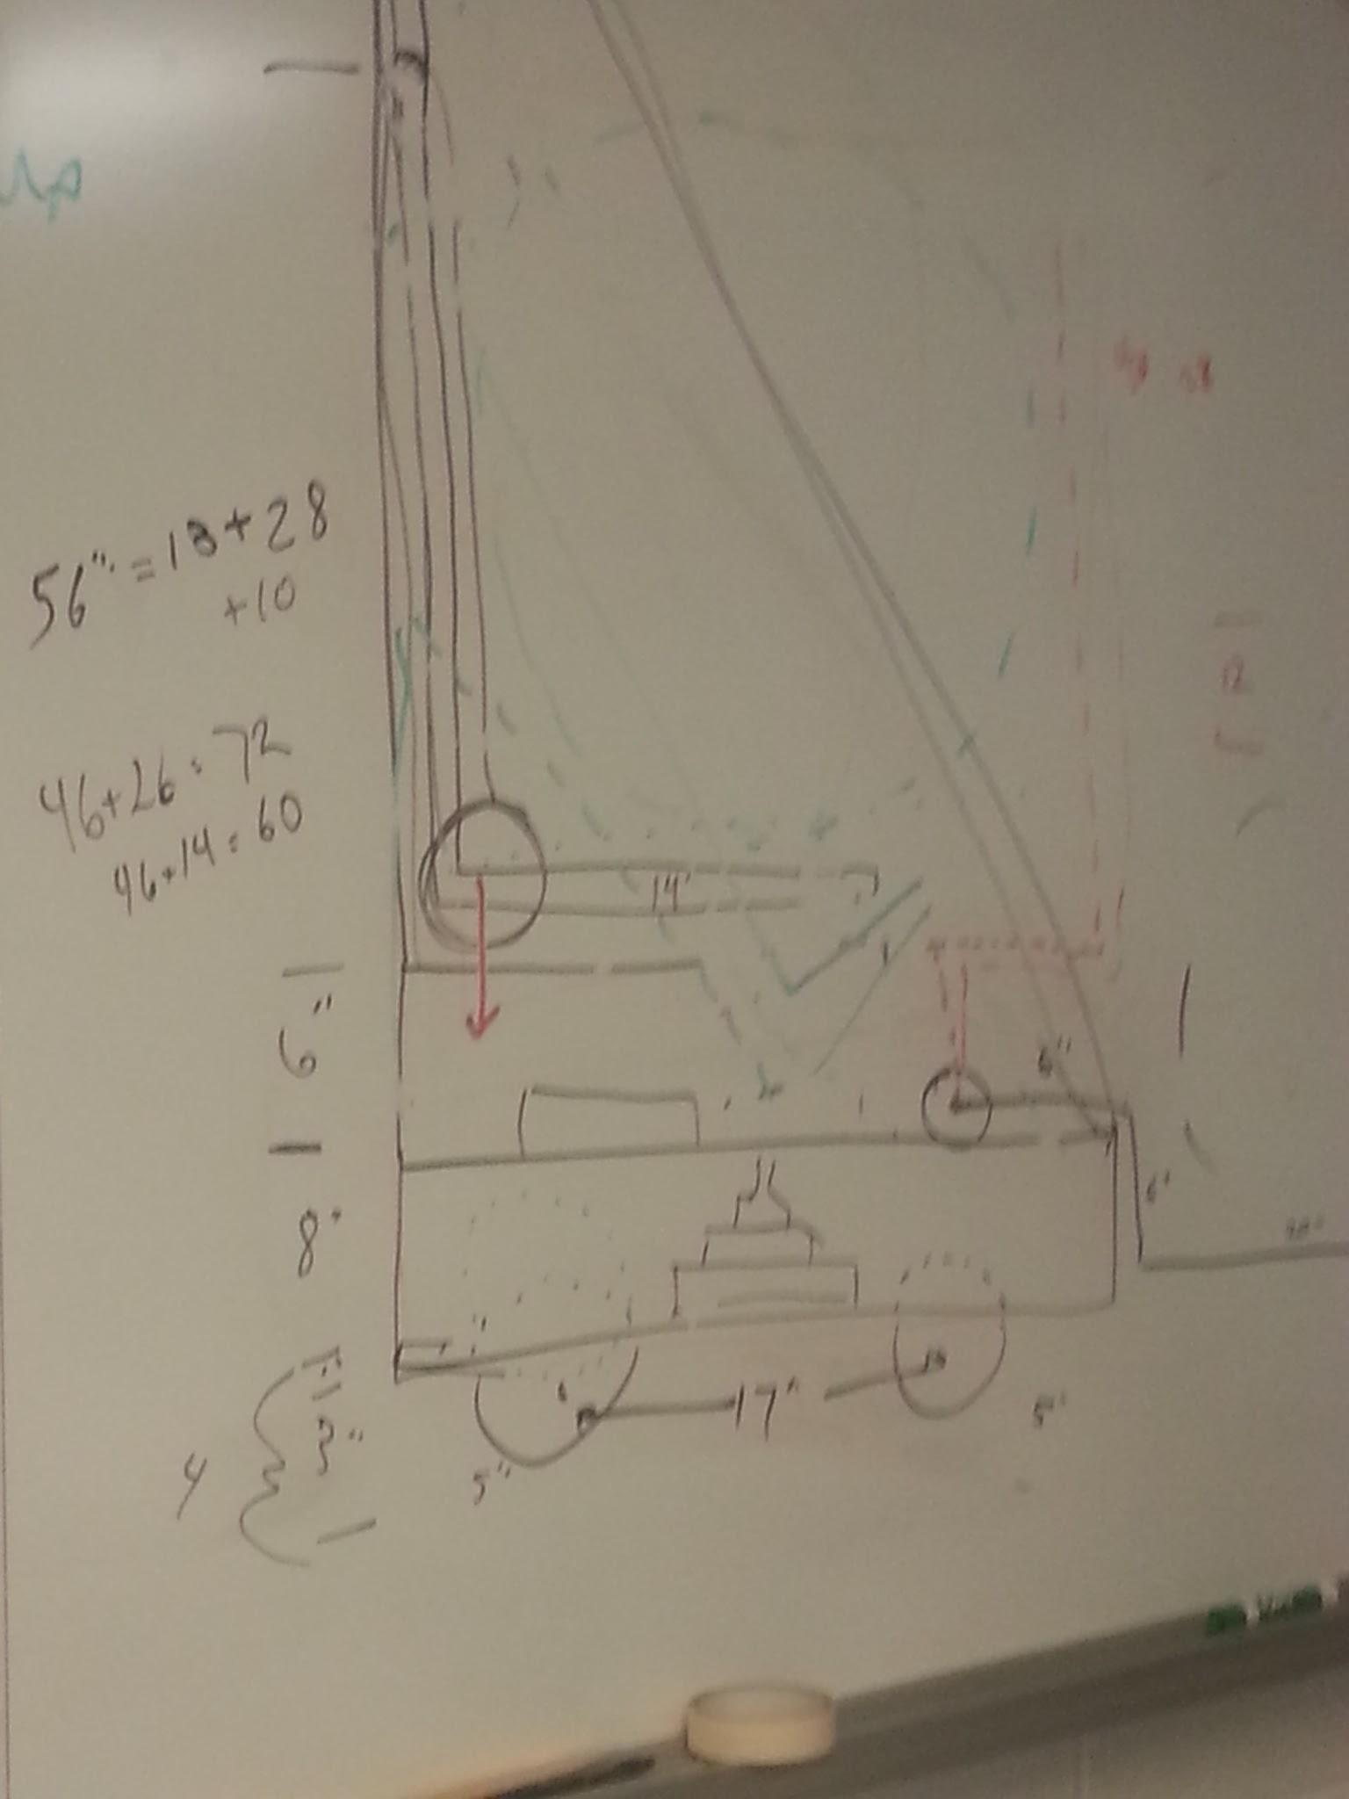
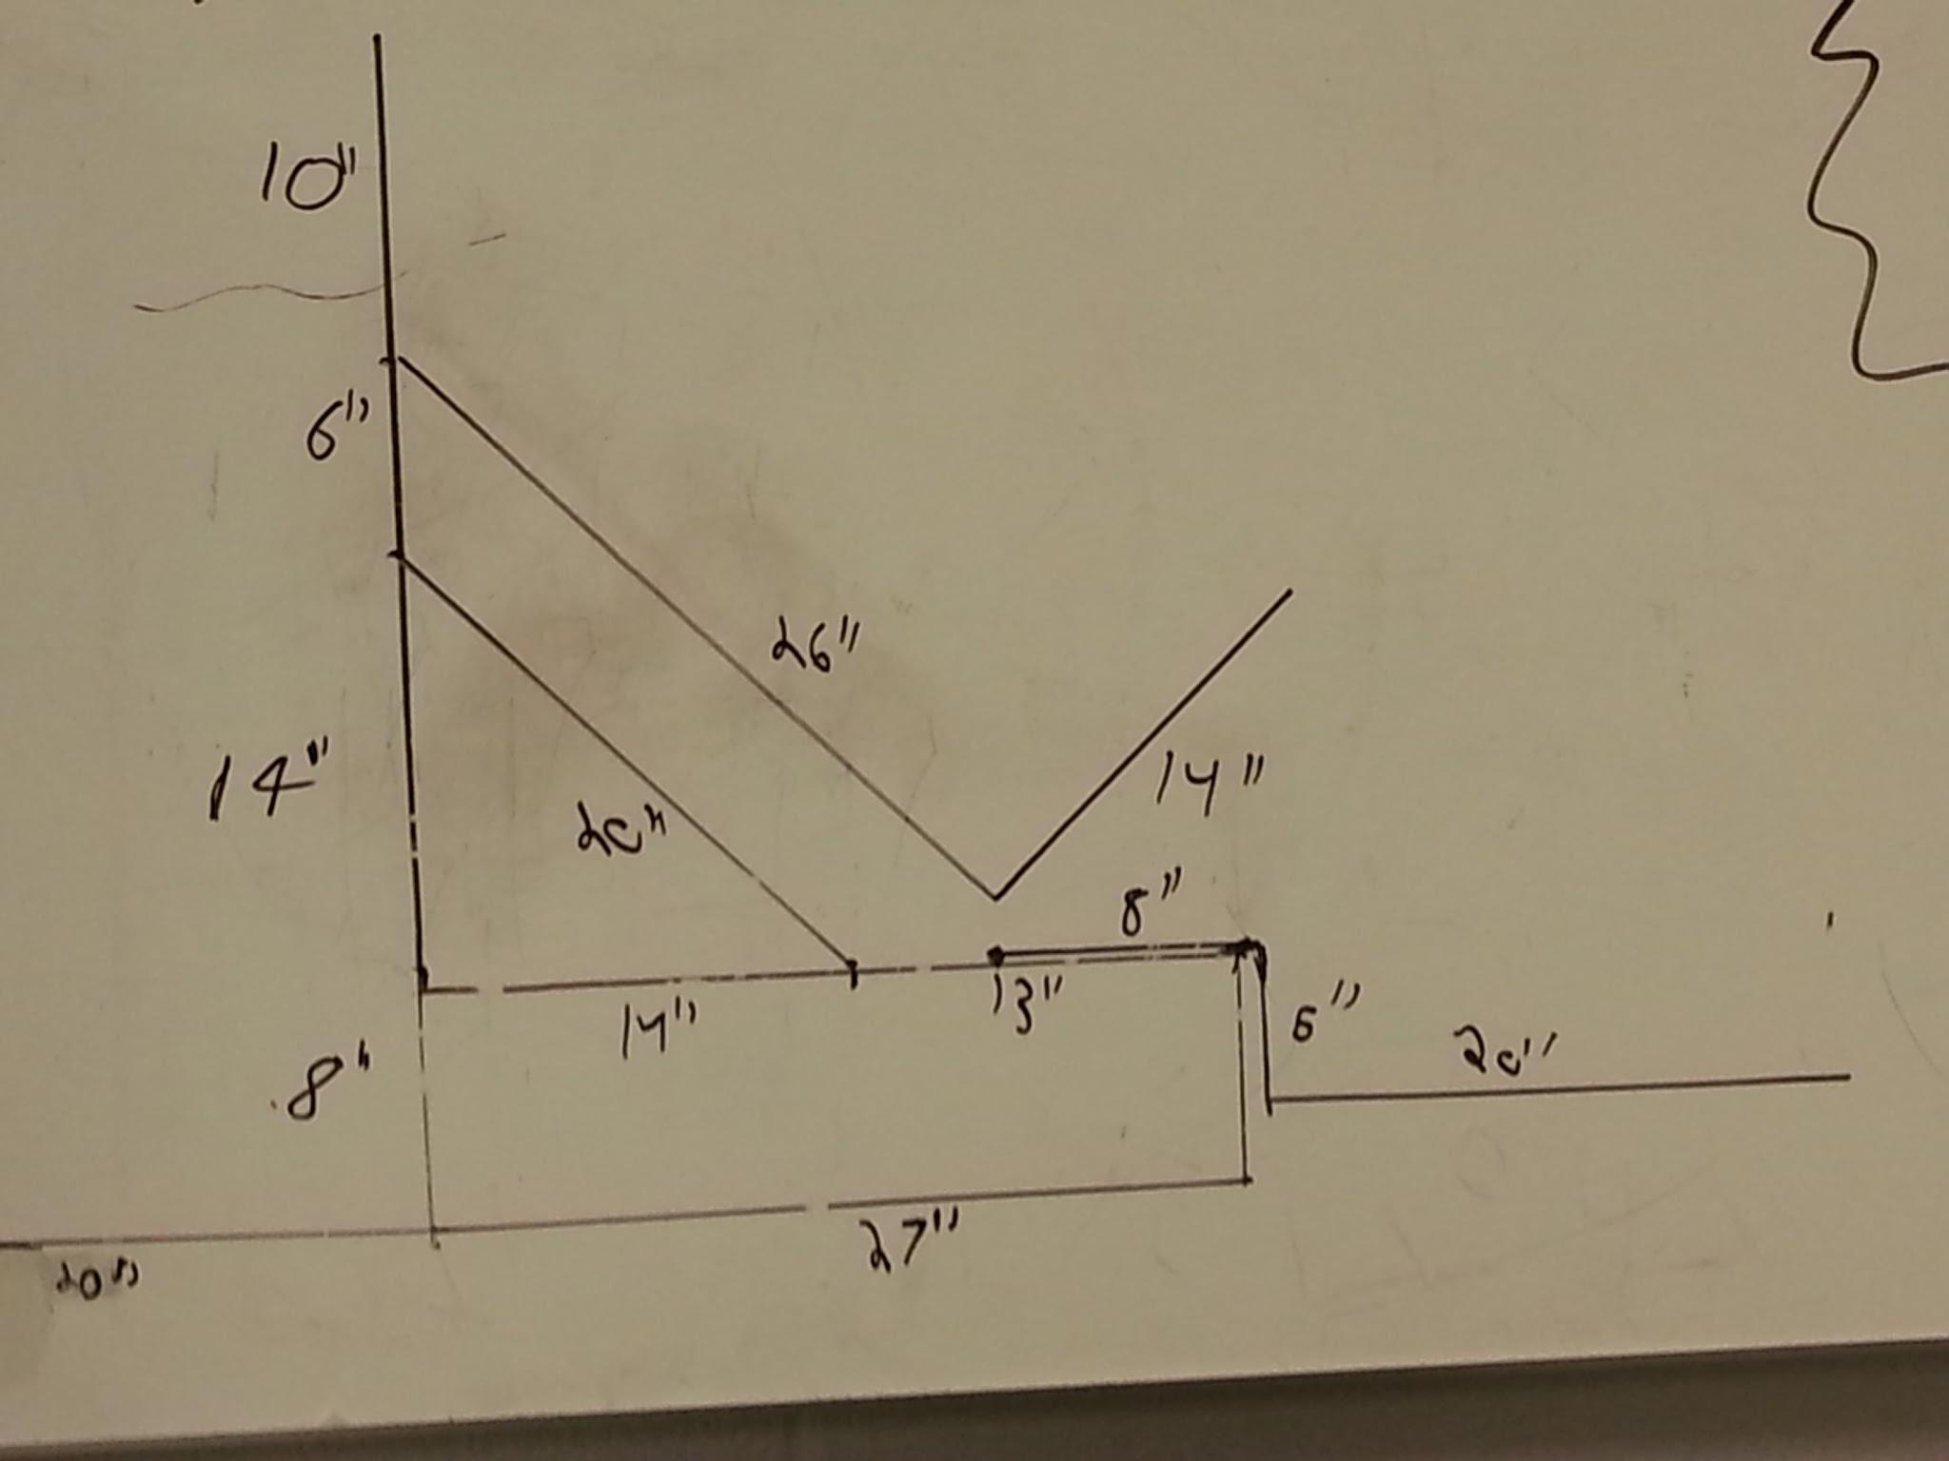
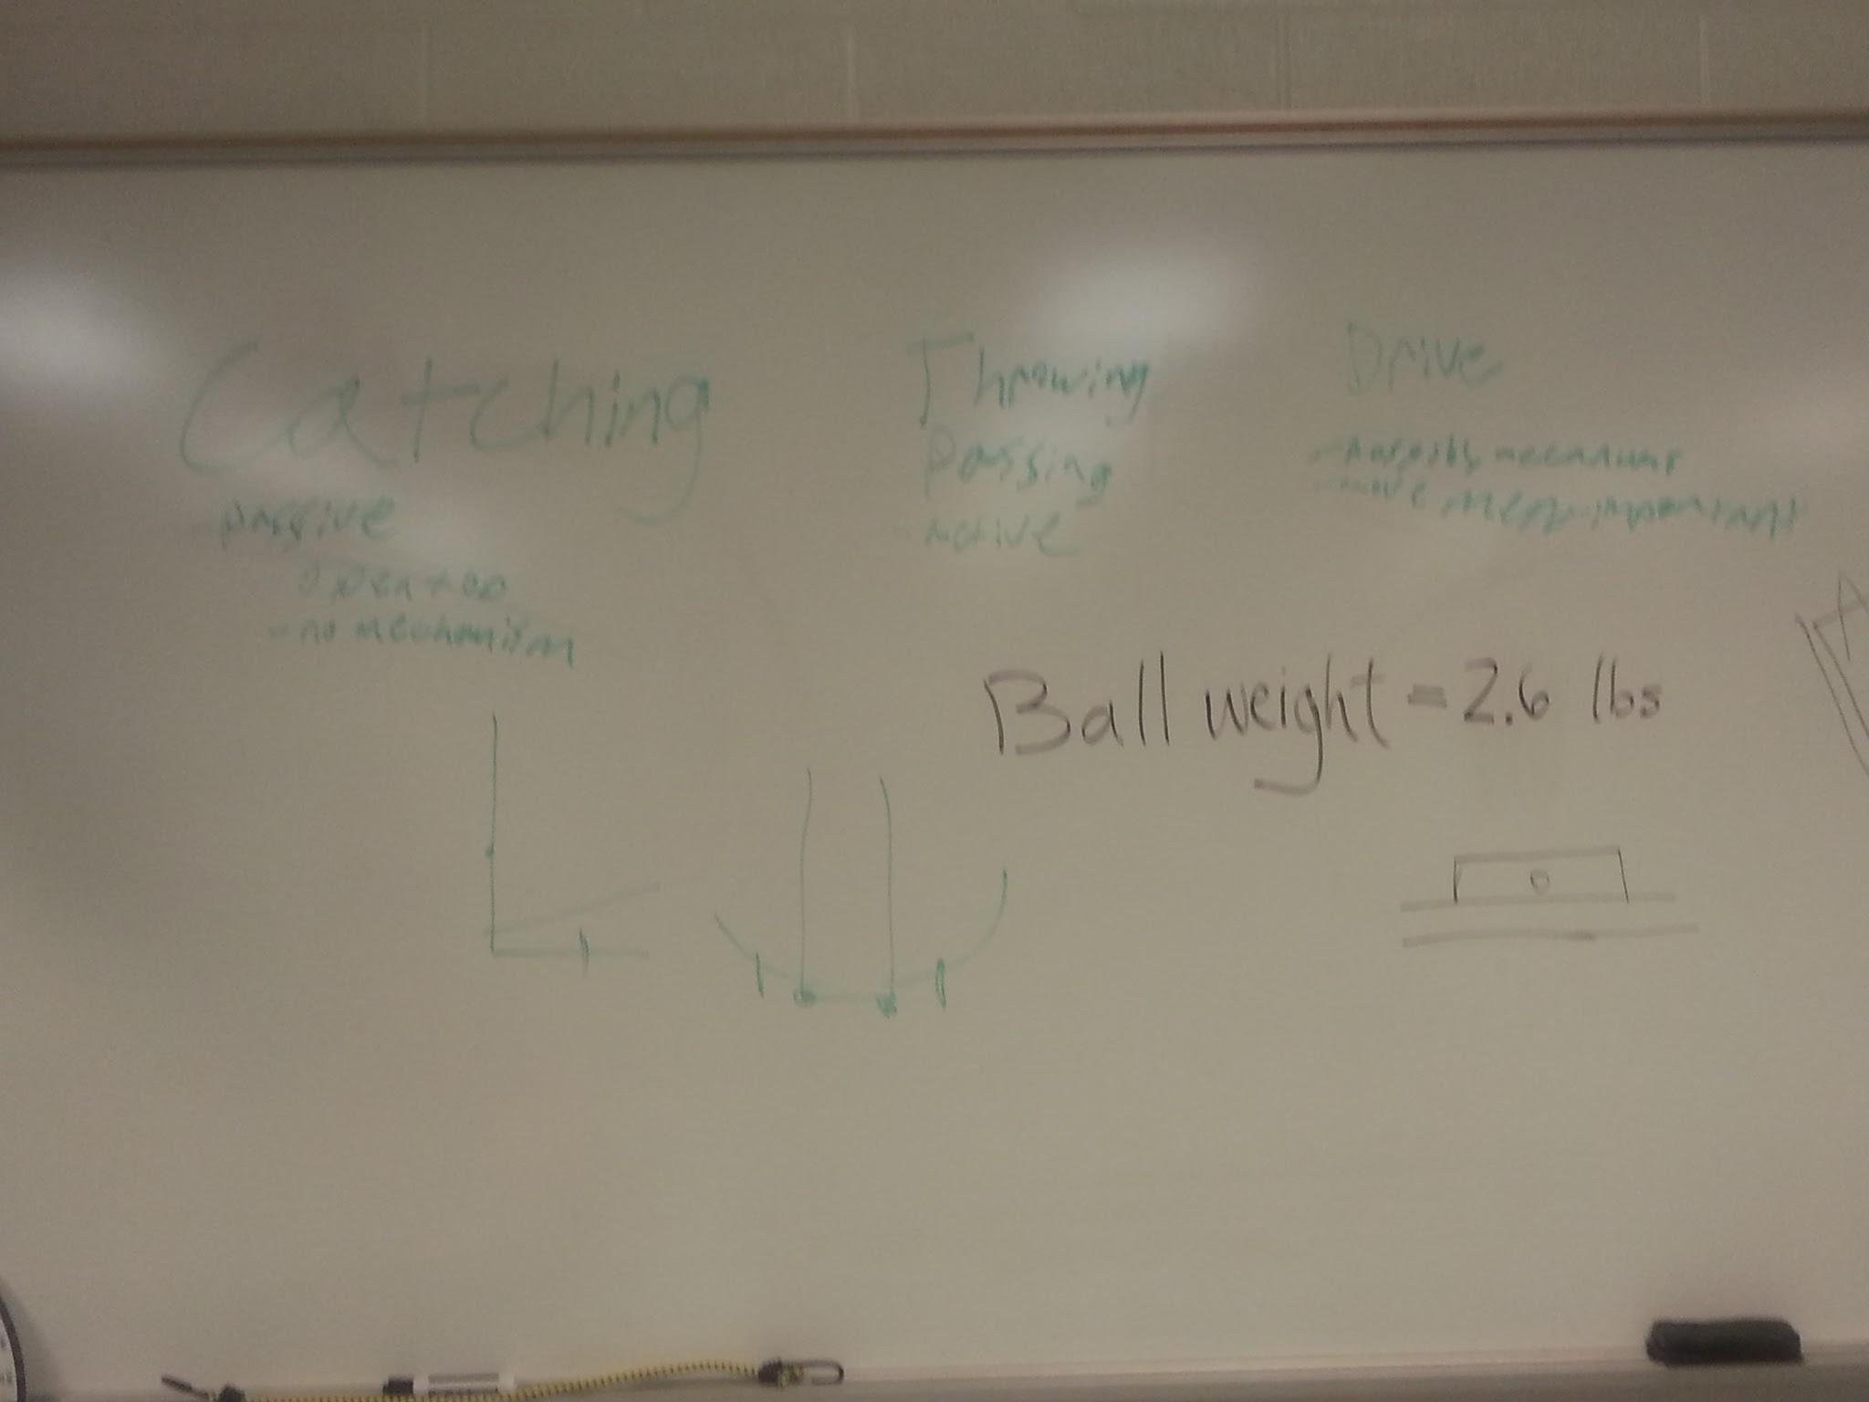
Brainstorming
We divided into groups and discussed possible manipulator designs
Prioritized capabilities and selected possible designs

Slide 7
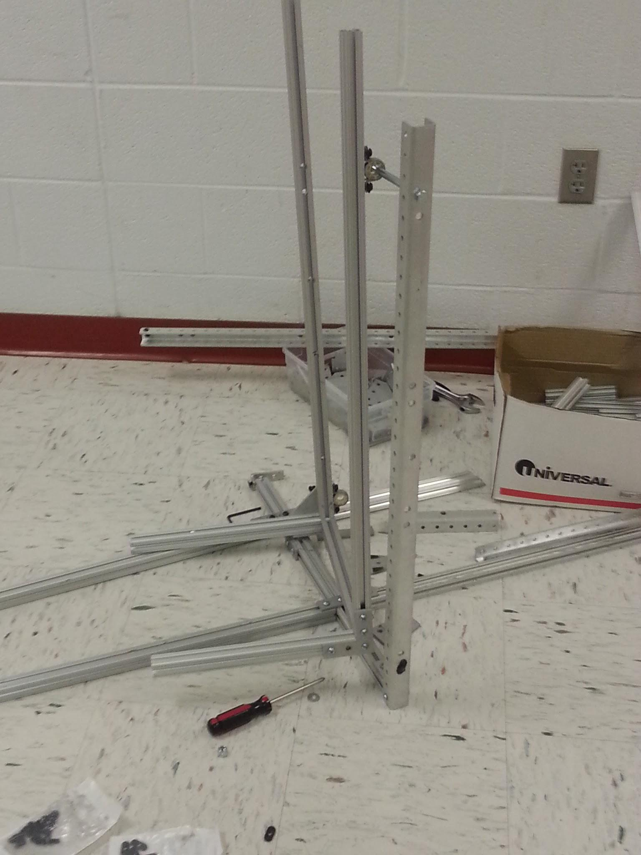
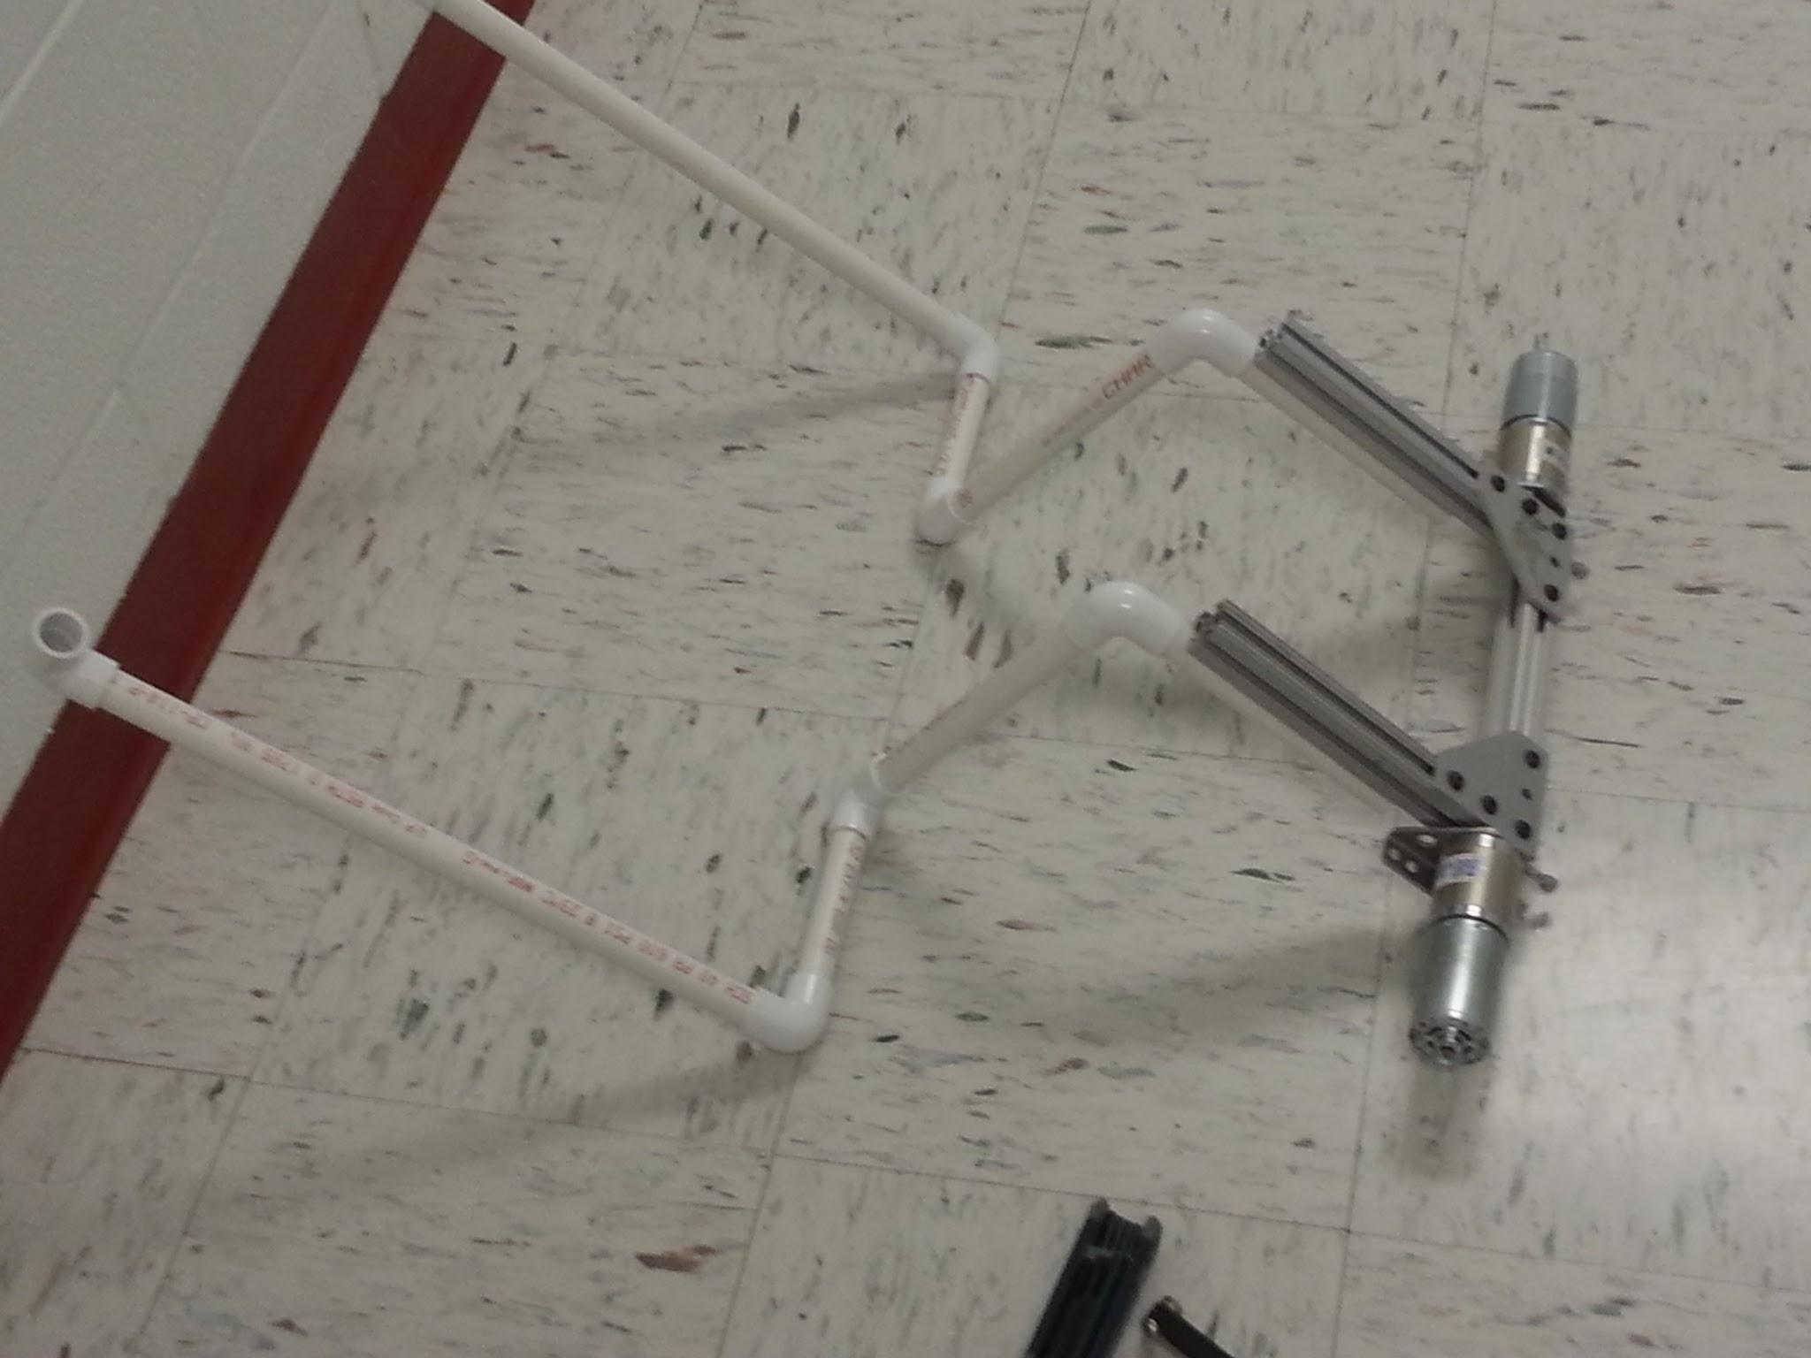
Prototyping
Built prototypes of several designs
Discovered limitations of motors and materials

Slide 8
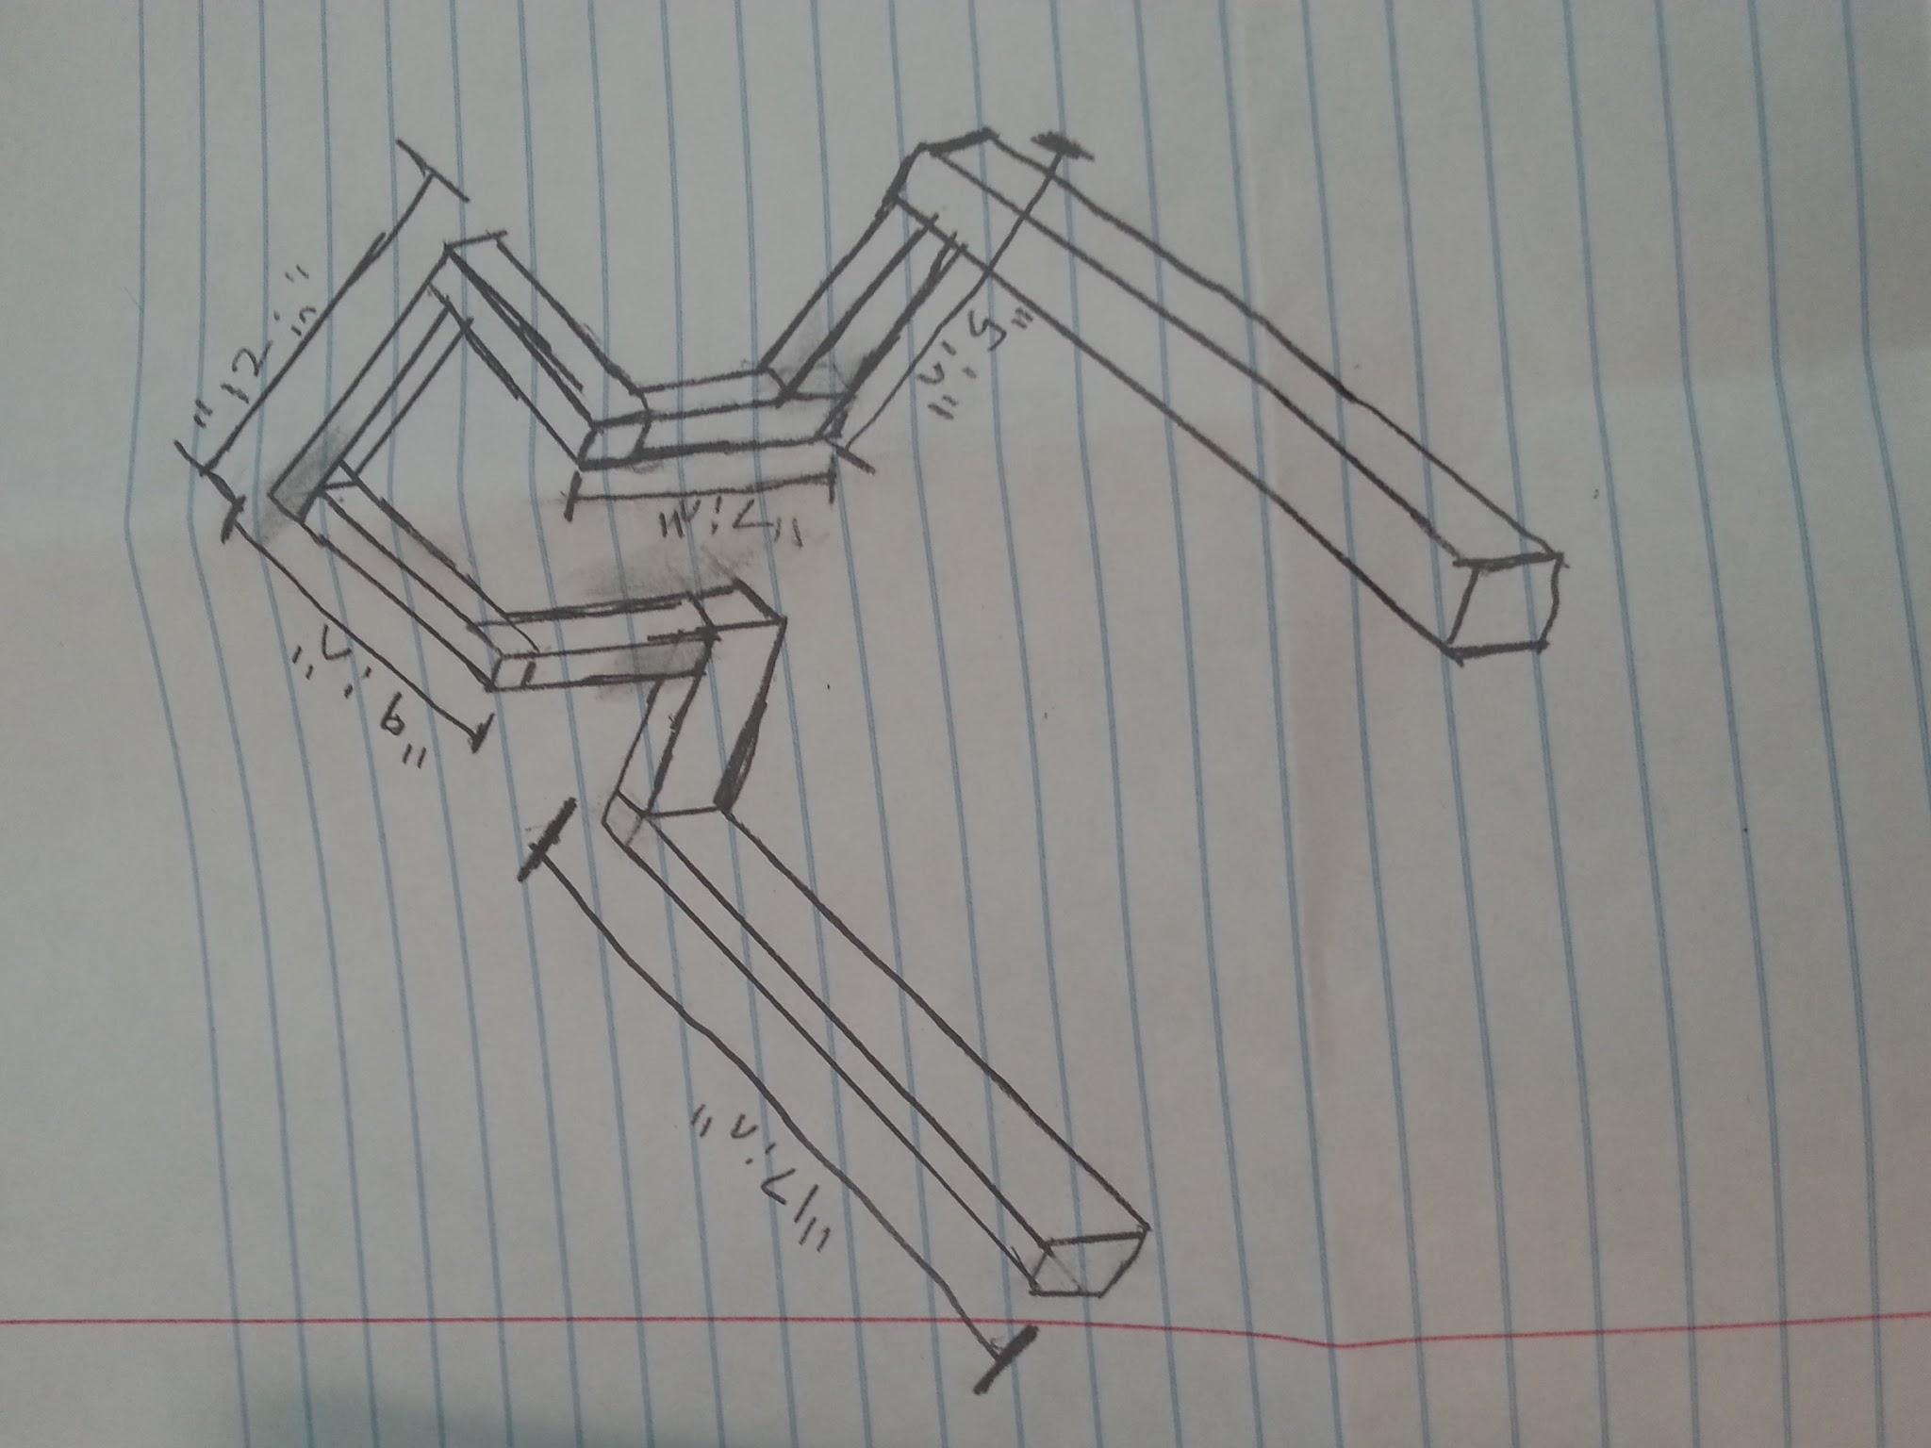
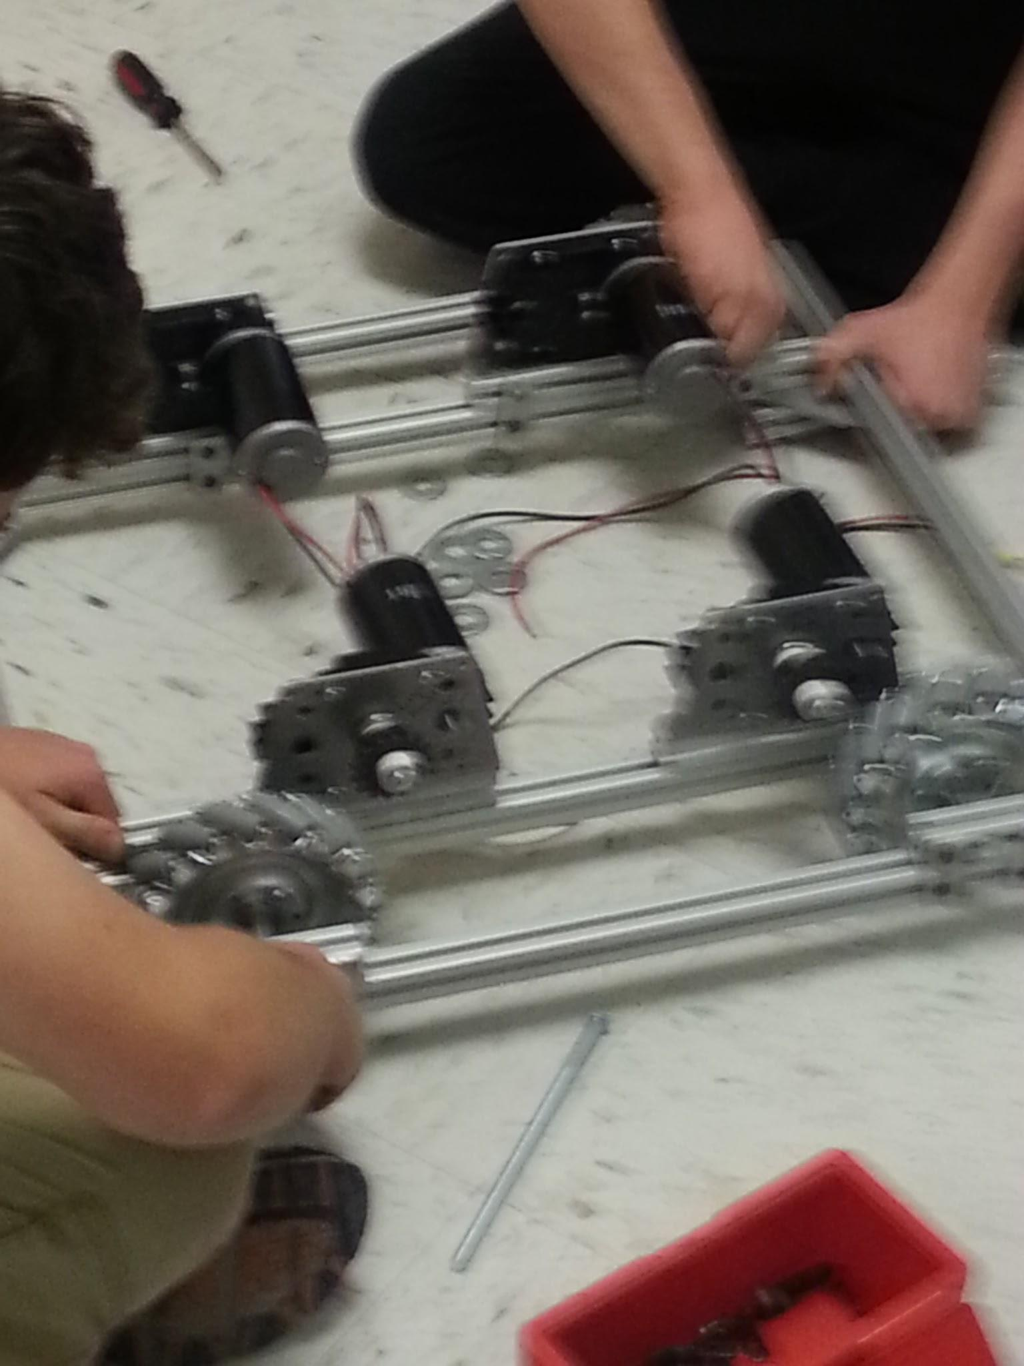
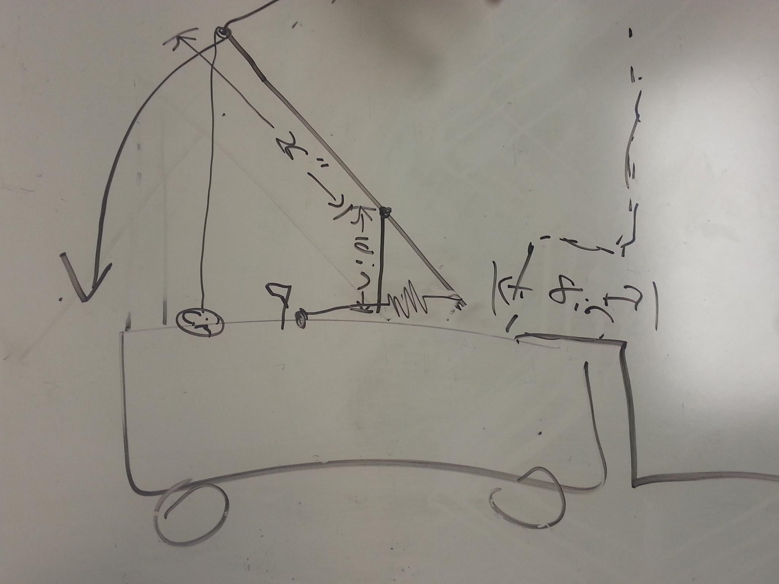
Redesign and Chassis Build
Switched from a thrower to a catapult
Tried several loader designs
But chose the original one built in metal
Finalized Chassis dimensions and built frame

Slide 9
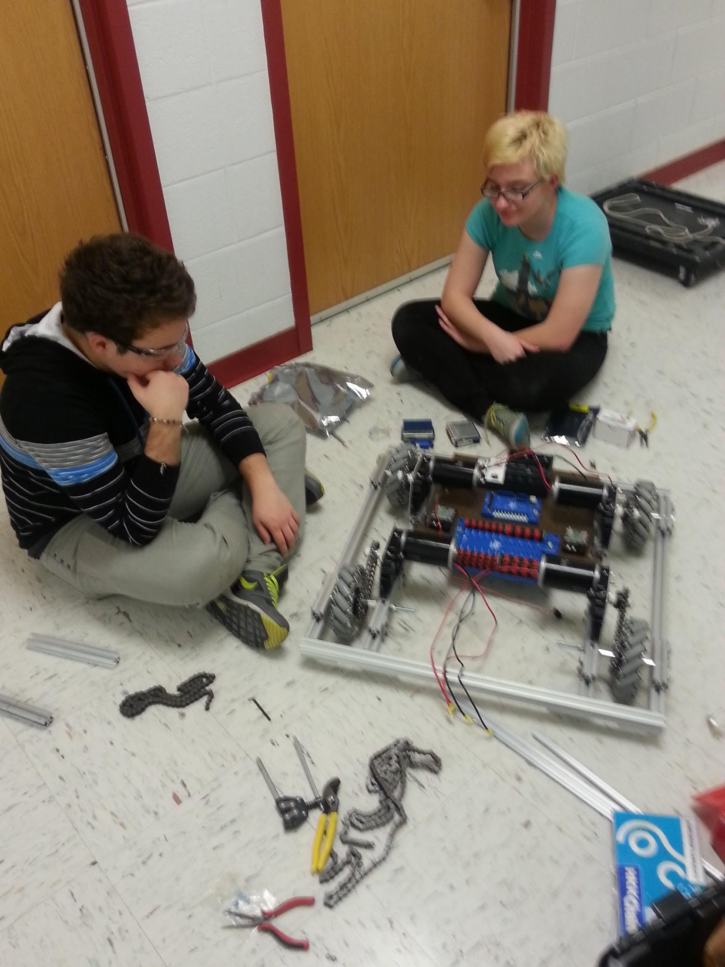
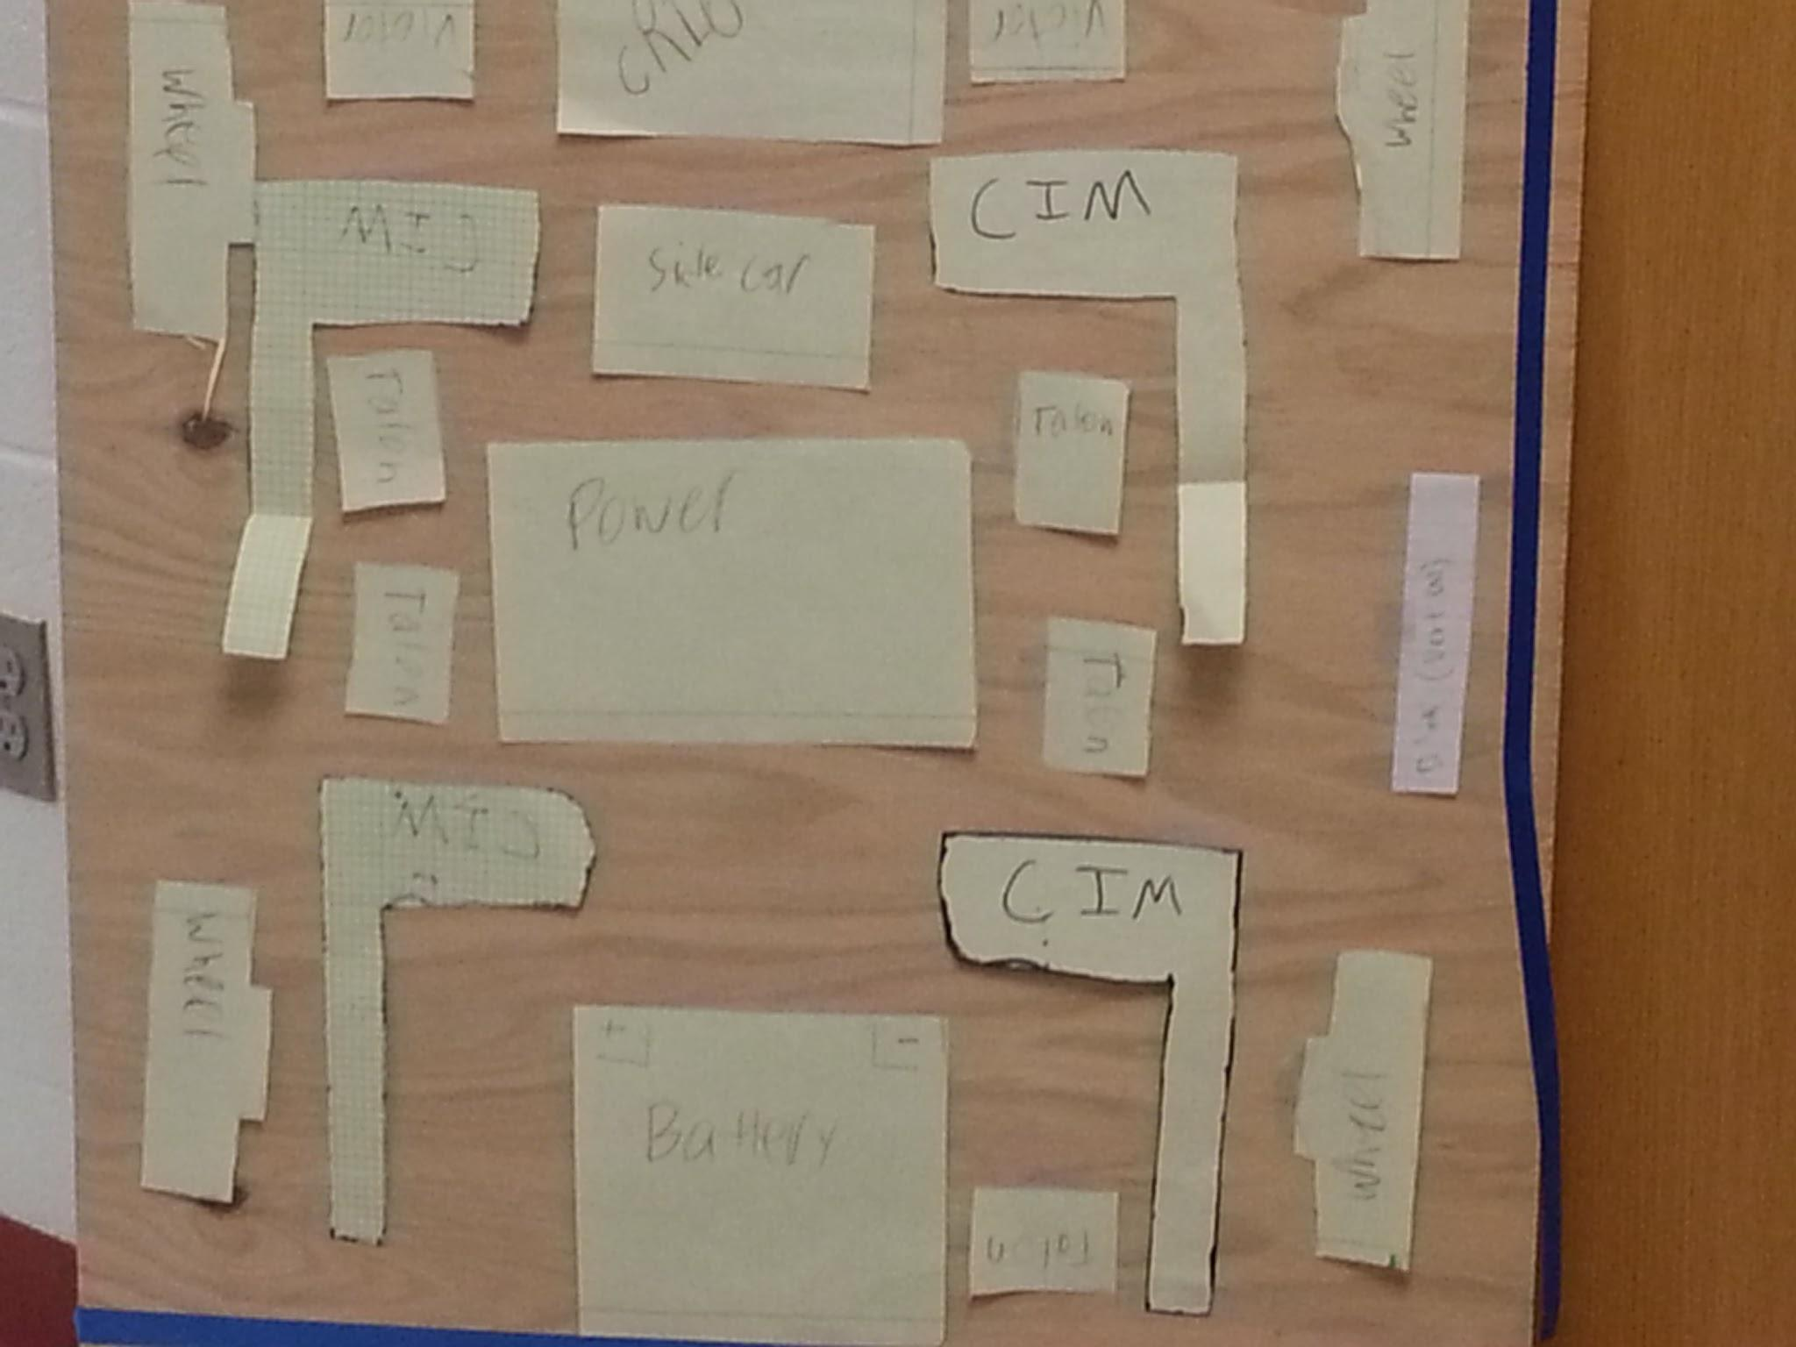
Building
Paper electronics layout
First build of catapult
Frame for catapult testing
Electronics assembled

Slide 10
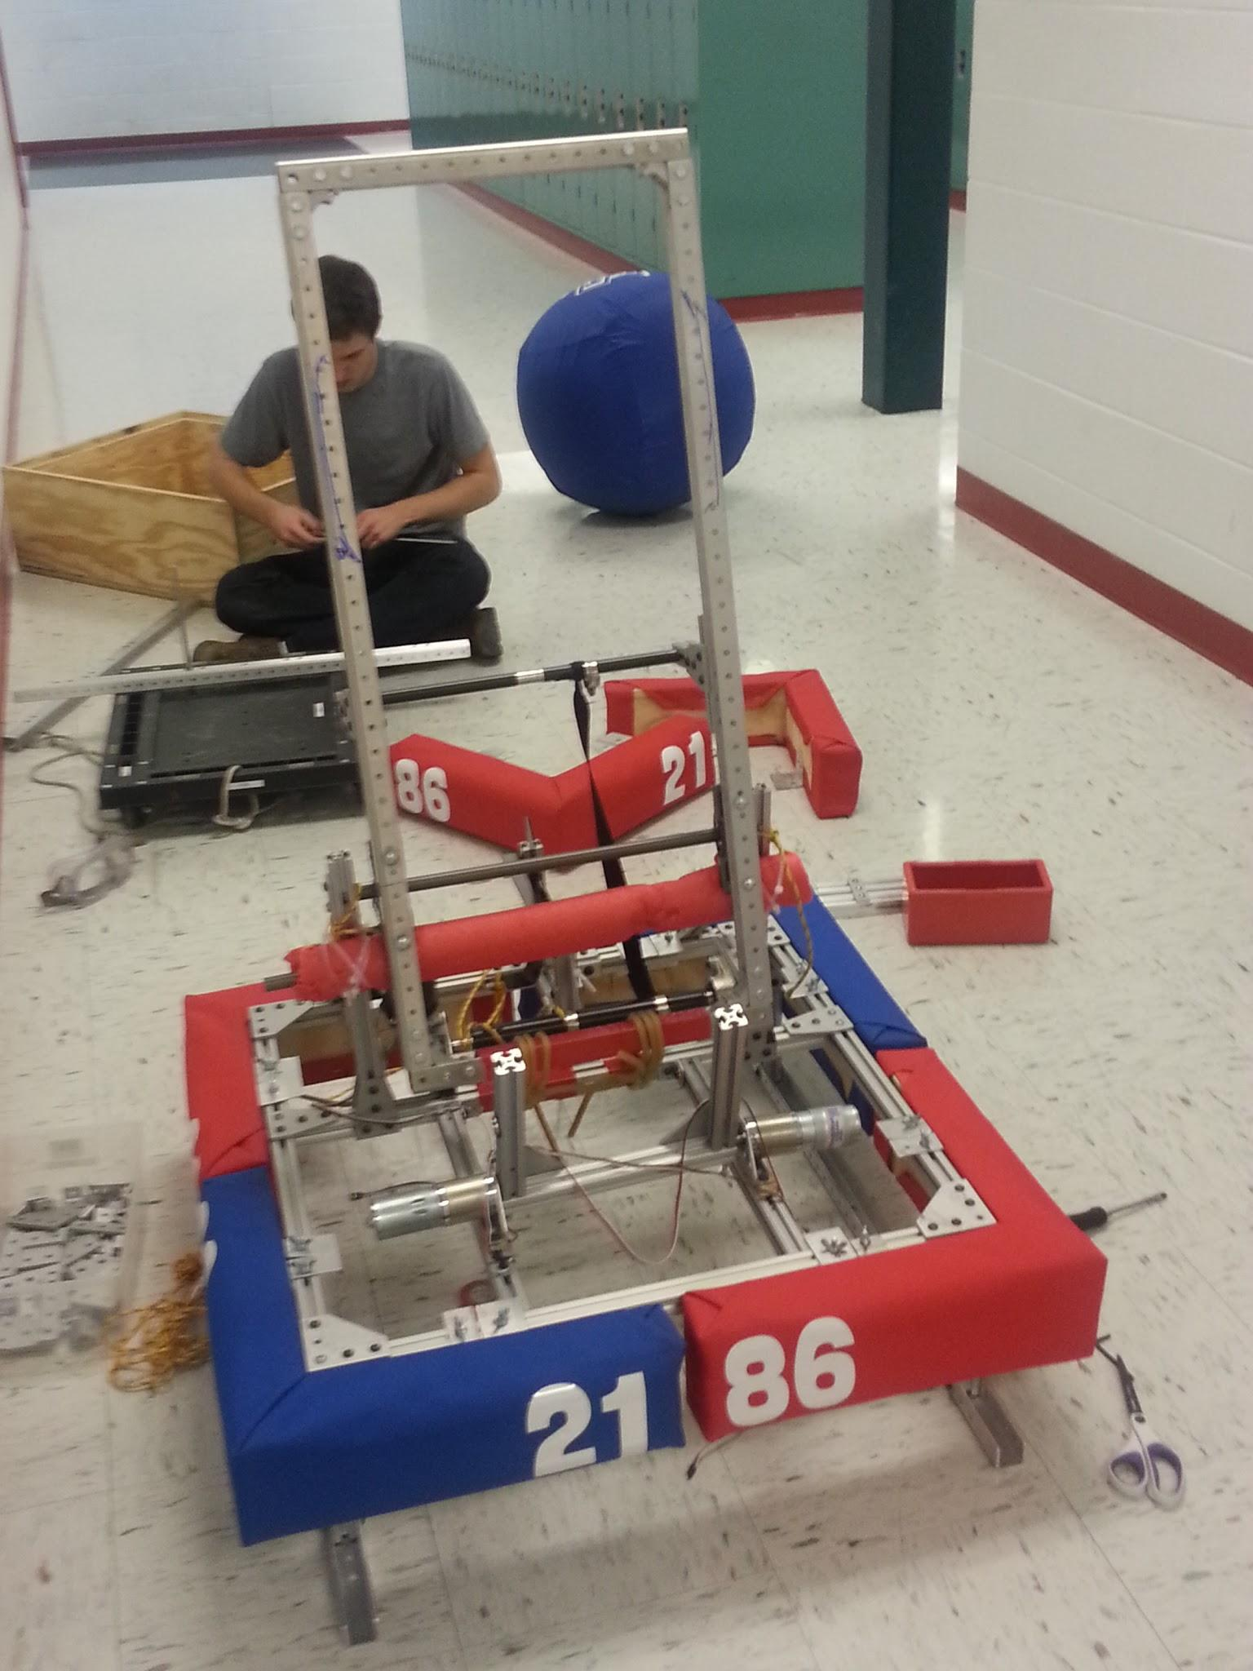
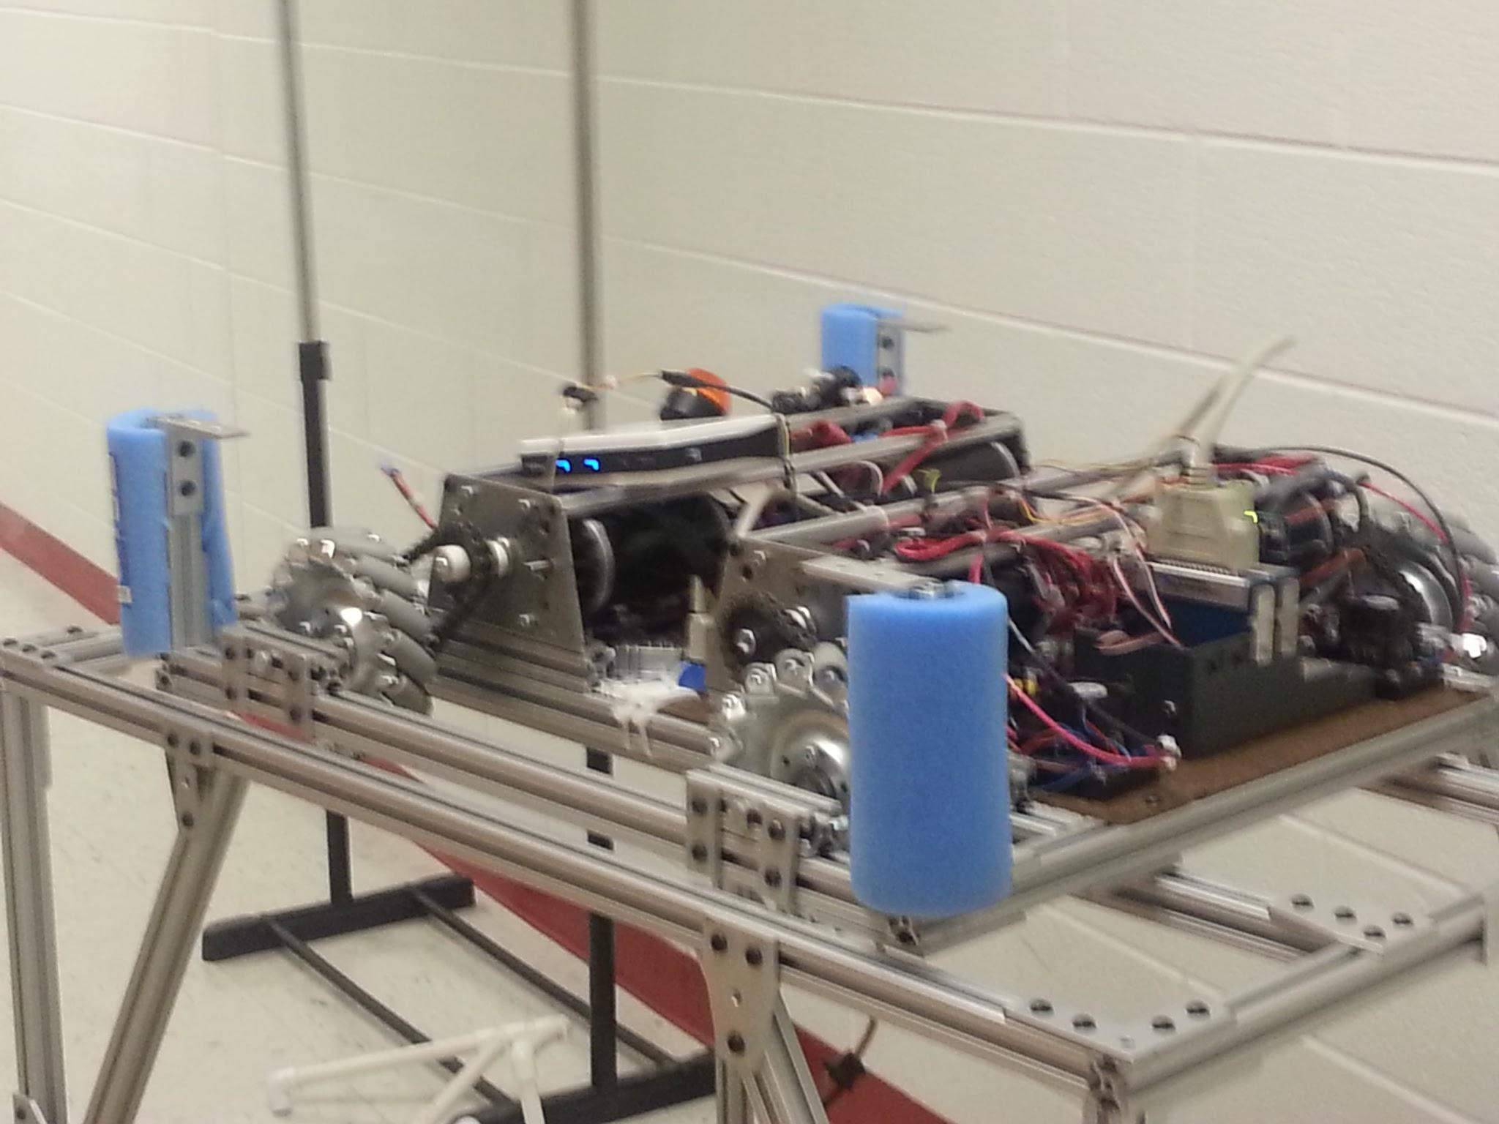
Stop Build Day (Integration)
Mechanical integration went very easily
Found some issues with catapult connections
Wires designed for disassembly
Motor calibration and drive practice
Last day with full robot before competition

Slide 11
Between Stop Build Day and Competition
45 lb withholding allowance (snowday compensation)
Withheld upper chassis
Bagged drive base
Reinforced catapult
Ran catapult and lifter from testbed

Slide 12
Competition

Slide 13
Lessons Learned
Modular design made integration go smoothly
Full integration before stop build day would have given time for more debugging
Battery and bumper changeout needs to be designed by experienced members
We need better record-keeping for our designs

Slide 14
Goals
Have all designs in one CAD system
Take advantage of available machining resources
Fundraise effectively - we were held back by a lack of spare parts and inventory
Attend 2 Regional Competitions
Attend at least 1 offseason competition
Write down team bylaws and leadership structure

