Slide 1
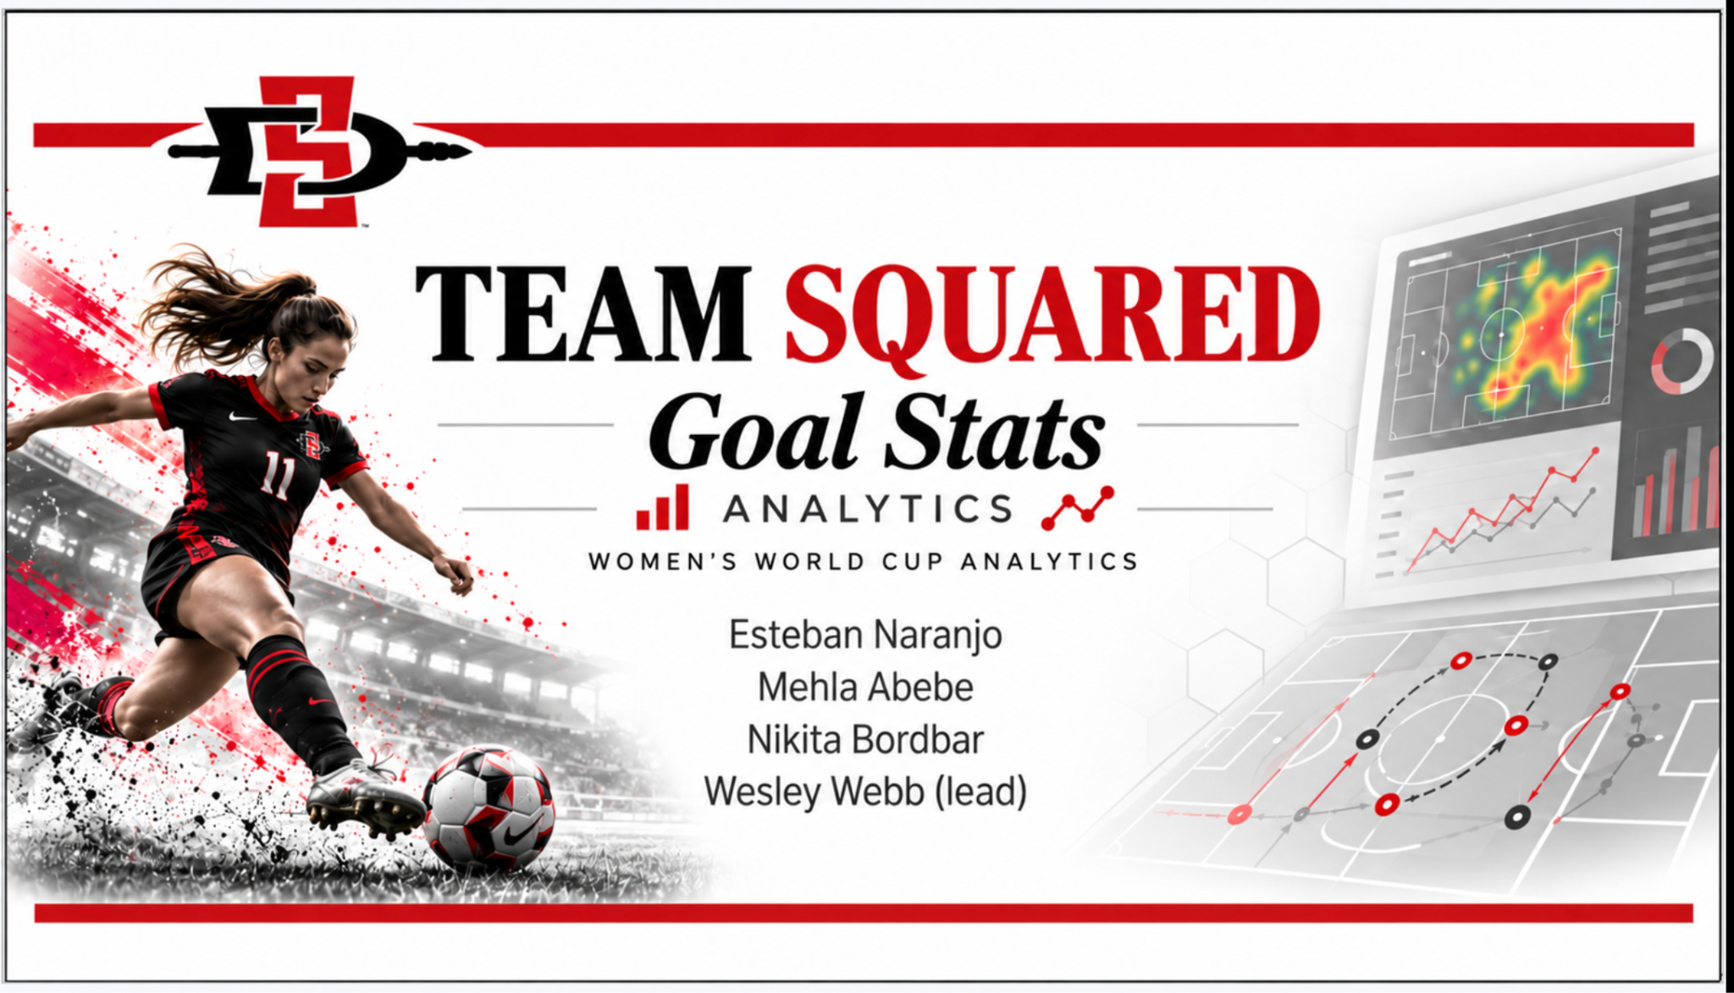

Road to the Final
Esteban Naranjo
Mehla Abebe
Nikita Bordbar
Wesley Webb (lead)

Slide 2



Slide 3
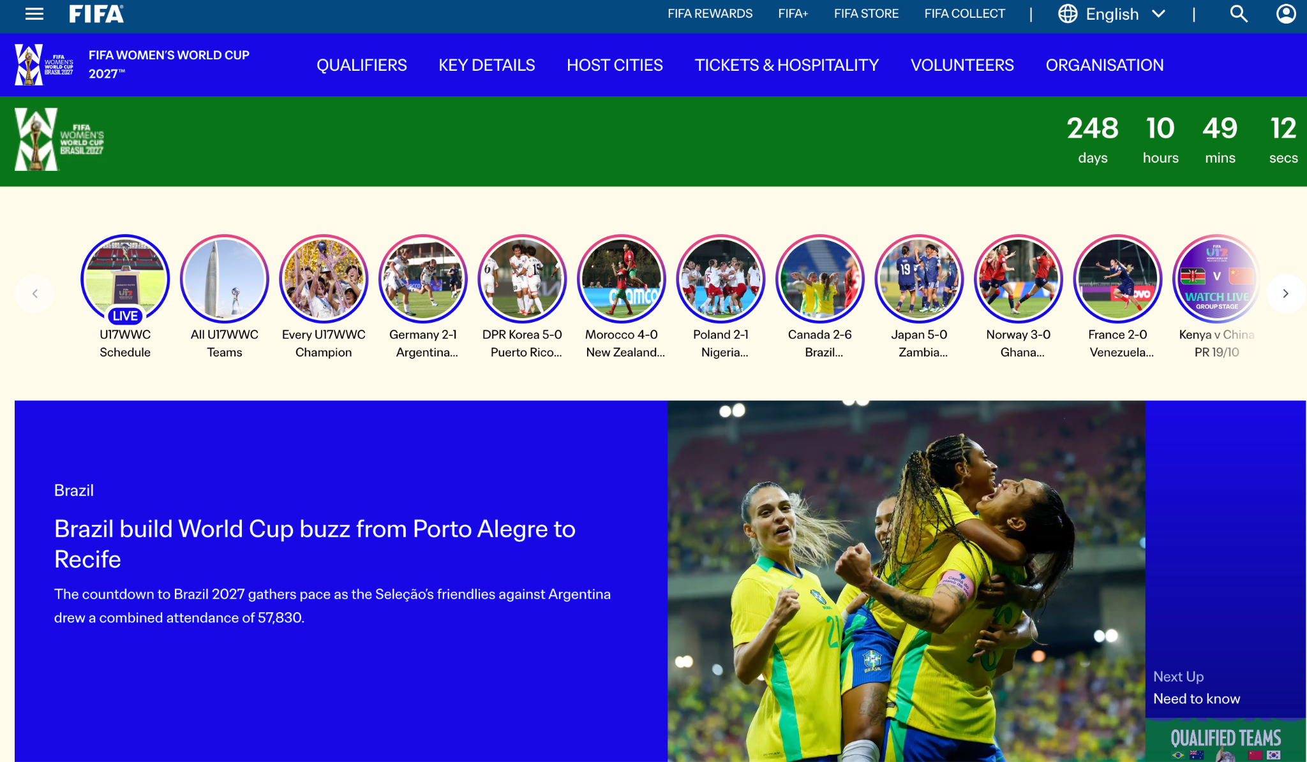
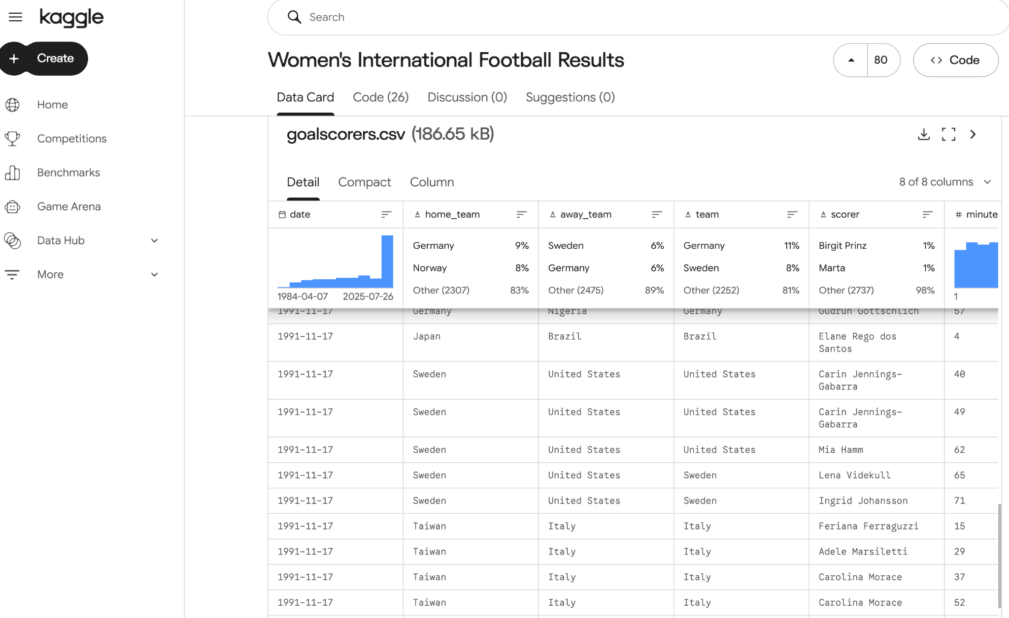


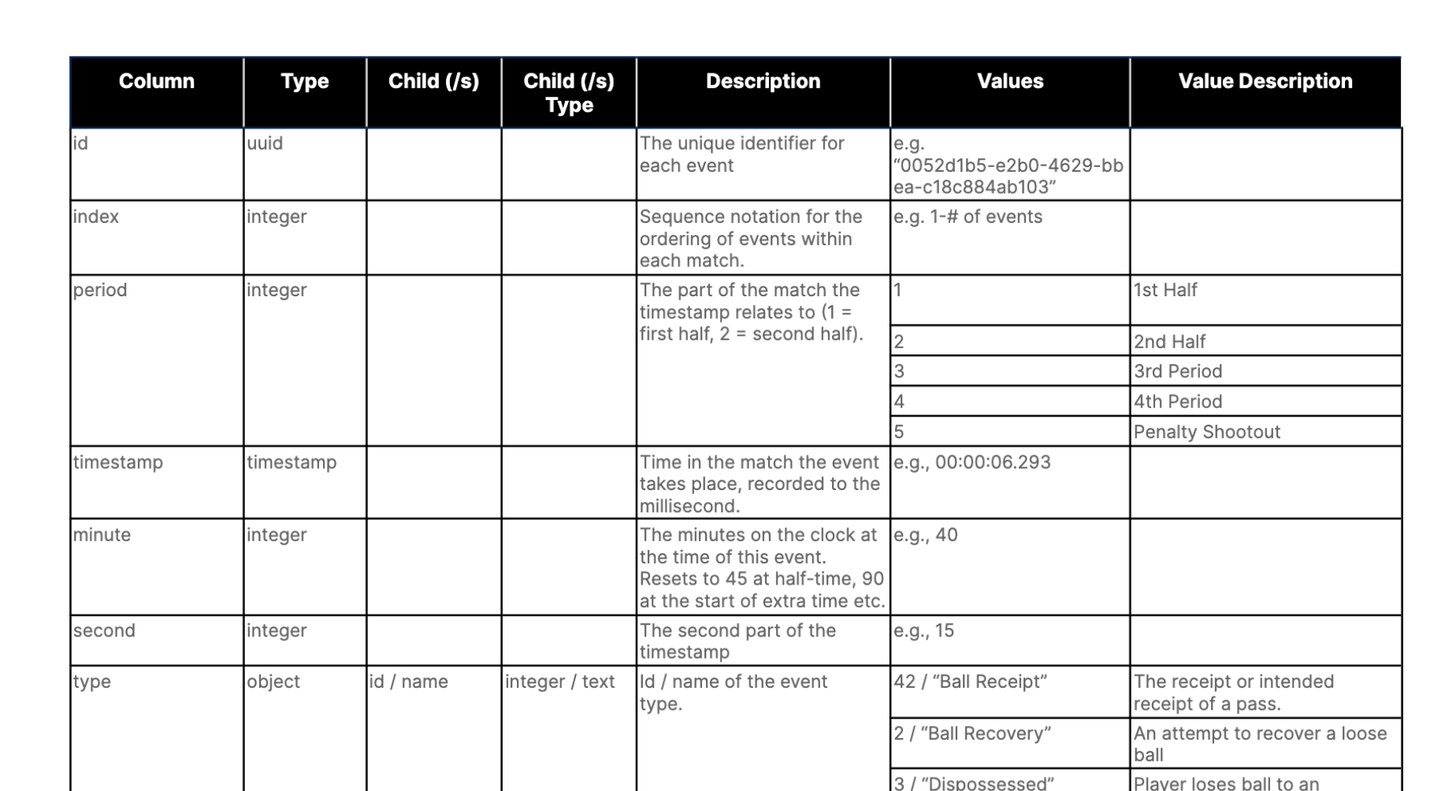

TEAM SQUARED / GOAL STATS
NIKITA BORDBAR
Player & Team Statistics
Our Research Focus
Data Sources
StatsBomb, Kaggle, FIFA
Key Statistics
Goals scored, match results, team performance
Data Reliability
Verify accuracy and relevance
Research Goal – Identify reliable football statistics to support team comparisons and match predictions

Slide 4







TEAM SQUARED / GOAL STATS
NIKITA BORDBAR
How Statistics Support Match Predictions
Our Prediction Research
Historical Performance
Analyze past results, goals, and scoring trends
Team Comparisons
Compare performance between two national teams
Prediction Model Inputs
Identify useful statistics and missing data
Development Collaboration
Coordinate with the database and application team
Example: USA vs. Spain
Historical match results
Goals scored and conceded
Recent team performance
Potential Match Prediction
Hypothetical output - not an actual prediction
Research Goal – Transform reliable football statistics into meaningful match comparisons and predictions

Slide 5
Data Preparation
The historical women’s football data was imported using a validated process. The system checked the match records for accuracy, complete team and competition information, valid dates, and nonnegative scores.
The data was then organized into separate PostgreSQL tables for Teams, Competitions, Matches, Scenarios, and Predictions. Primary keys and foreign keys connected the tables and reduced unnecessary duplication.
Finally, the original source details—including the source file, row number, version, and URL were preserved. This made the data traceable and allowed the team to verify where each record came from. User-created prediction scenarios were also validated before being saved.
Mehla Abebe

Slide 6

Data Preparation
Uniqueness constraints - a database rule that ensures all values in a column or a group of columns are distinct across every row in a table to prevent duplicate records.
CHECK constraints - another database rule that forces a value to be read as valid only when it meets the given range. This allowed us to prevent invalid values, such as negative scores
Indexes - help the database find information faster.
Mehla Abebe

Slide 7

Database Design & ER Diagram
Database Design Decisions
Seven foreign keys establish relationships between tables.
Normalization reduces unnecessary data duplication.
Primary keys, uniqueness rules, and CHECK constraints enforce integrity.
One scenario can have multiple saved predictions.
JSONB snapshots preserve the inputs used for earlier predictions.
PostgreSQL: Five Relational Tables
Teams: National teams and available ratings.
Competitions: Women's World Cup editions.
Matches: Historical results linked to teams and competitions.
Scenarios: Editable hypothetical match conditions.
Predictions: Saved results and input snapshots.
Wes Webb

Slide 8
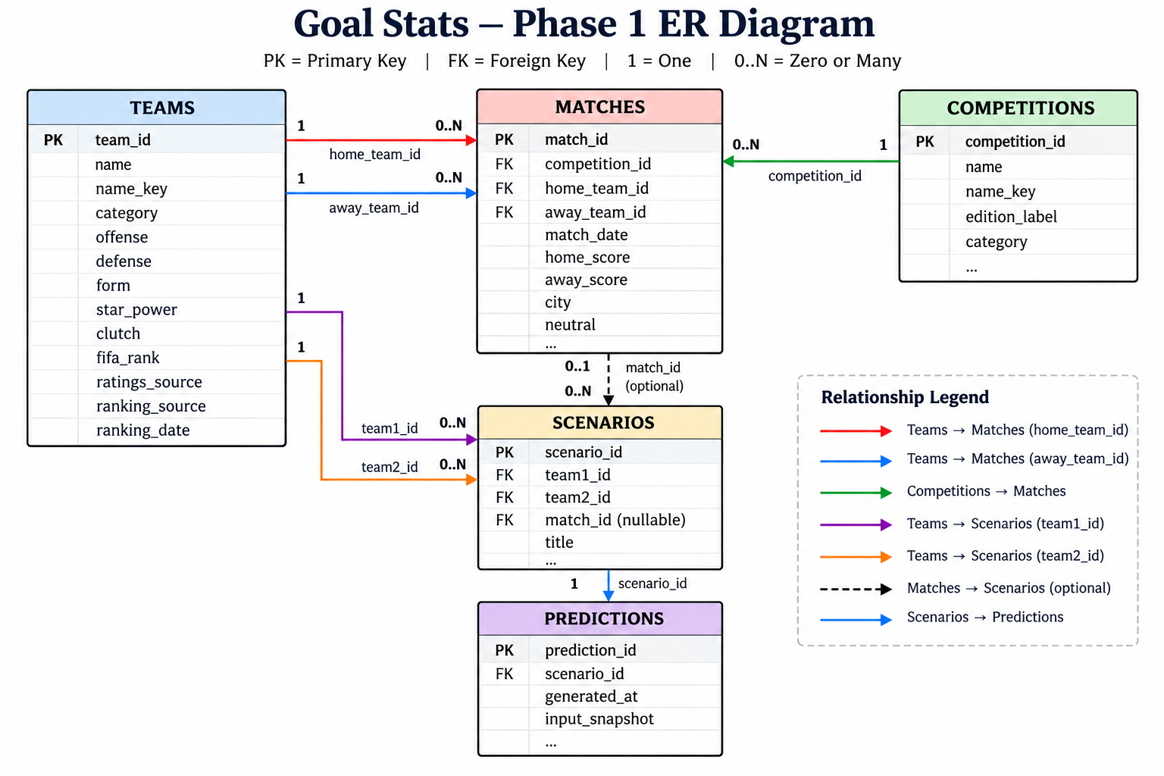
Database Design & ER Diagram
Wes Webb

Slide 9
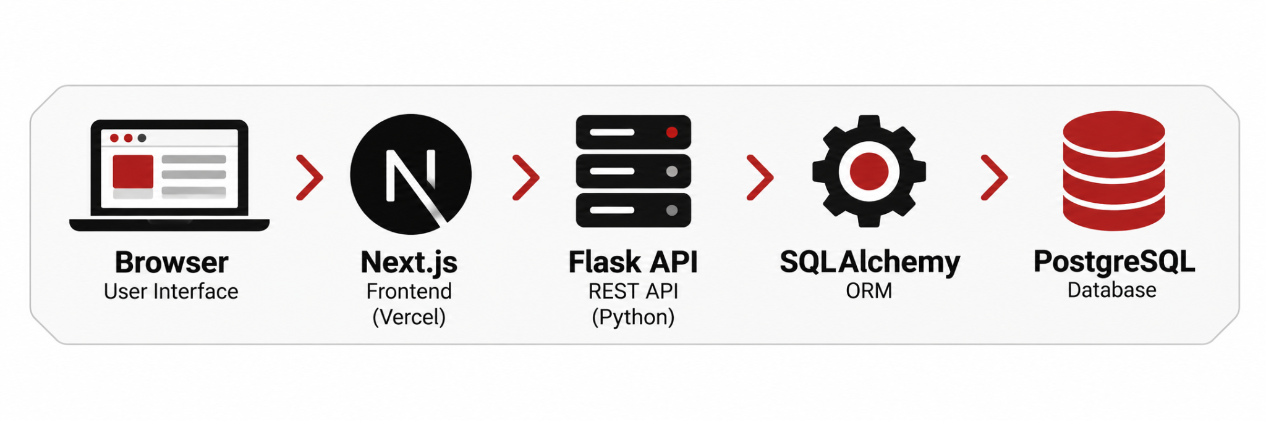
Database Integration & Application Architecture
Database Integration: Goal Stats Architecture
Frontend: React / Next.js deployed on Vercel.
Backend: Flask REST API deployed on Render.
Database: PostgreSQL accessed through SQLAlchemy.
Operations: SELECT, JOIN, INSERT, and UPDATE.
Transactions: Validate and protect database changes.
Database-Driven Prediction Workflow
Preview: Calculate a prediction without saving.
Save: Create a scenario, then store its prediction.
Update: Modify scenario statistics using transactions and row locking.
Retrieve: Load saved predictions and snapshots for History and Analytics.
Wes Webb

Slide 10

Esteban Naranjo

Slide 11
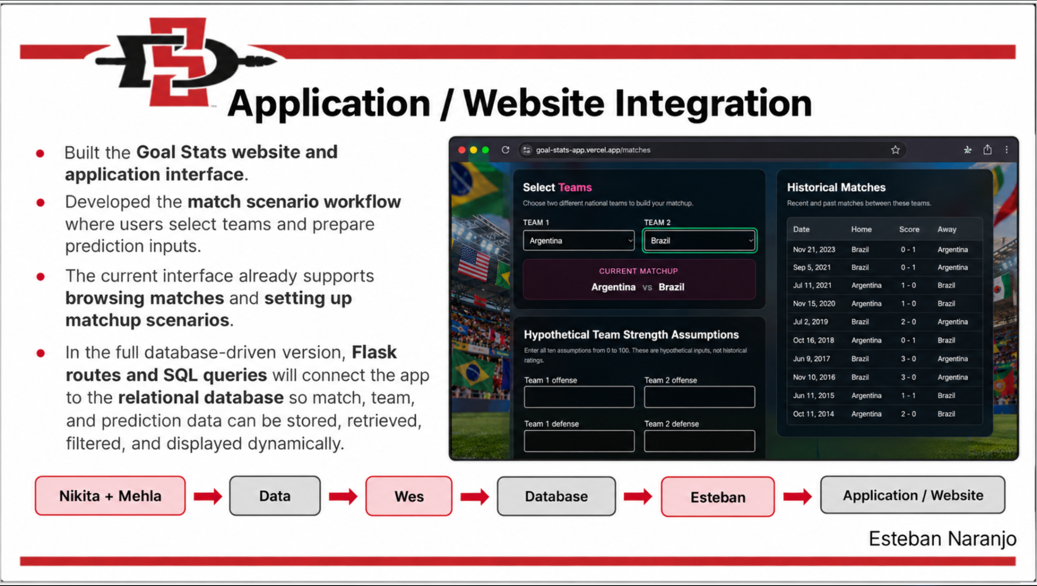
Esteban Naranjo

Slide 12


