Slide 1

New Store Sales Forecasting

Slide 2



Team Presentation
Sampoornaa Ghosh
Christopher Porter
Samruddhi Supekar

Slide 3
Business Problem
Optimizing New Store Performance
Enhancing Operational Efficiency
Measuring Success through Metrics
Notes:
As Maverik continues to expand operations and open new locations, it is important both for planning as well as for evaluation of ongoing business operations to be able to accurately identify expected revenues of new stores. It’s important to have an accurate forecast of the sales within the four key sales segments (Diesel, Unleaded, Inside Sales, and Food Service) for the first year of an individual store’s operation. Secondarily, is to have an accurate daily performance forecast for each of the 4 key sales segments.

Slide 4
Purpose
Correct Prediction of the First Year Annual Sales
Correct Prediction of Daily Sales
Notes:
We developed models to accurately forecast the annual sales in each of the 4 key sales segments, taking into account store characteristics. We made model to accurately forecast the daily sales in each of the 4 key sales segments, taking into account seasonality (both annual and weekly), store characteristics.

Slide 5
Day 0 Performance Metrics
Metric | Inside Sales | Food Service | Diesel (gal) | Unleaded (gal)
Daily MAE | $688.27 | $222.90 | 875 | 761
Daily MAPE | 24.15% | 27.96% | 66.25% | 54.71%
Annual Average Error per Store | -$140,468.76 | -$69,233.33 | 251,607 | 109,111
Annual Cumulative Error % | -12.79% | -22.97% | 45.22% | 15.52%
Minimum Annual Cumulative Error % (Store) | 1.54% | -15.84% | -3.61% | 1.53%
Maximum Annual Cumulative Error % (Store) | -28.78% | -32.00% | 68.54% | 144.20%

Slide 6
Data Explanation
37 Stores in total
1 Store (21980) is so different it was excluded
5 Stores (22925, 22680, 23415, 22785, 23380) were selected at random as test stores
31 Stores for Training Data
Notes:
“Day of the Week” - Peak Sales on Friday and decreased sales on weekends.
“Annual Fiscal Week” - Shows recognizable seasonality trend across all four key segments.

Slide 7
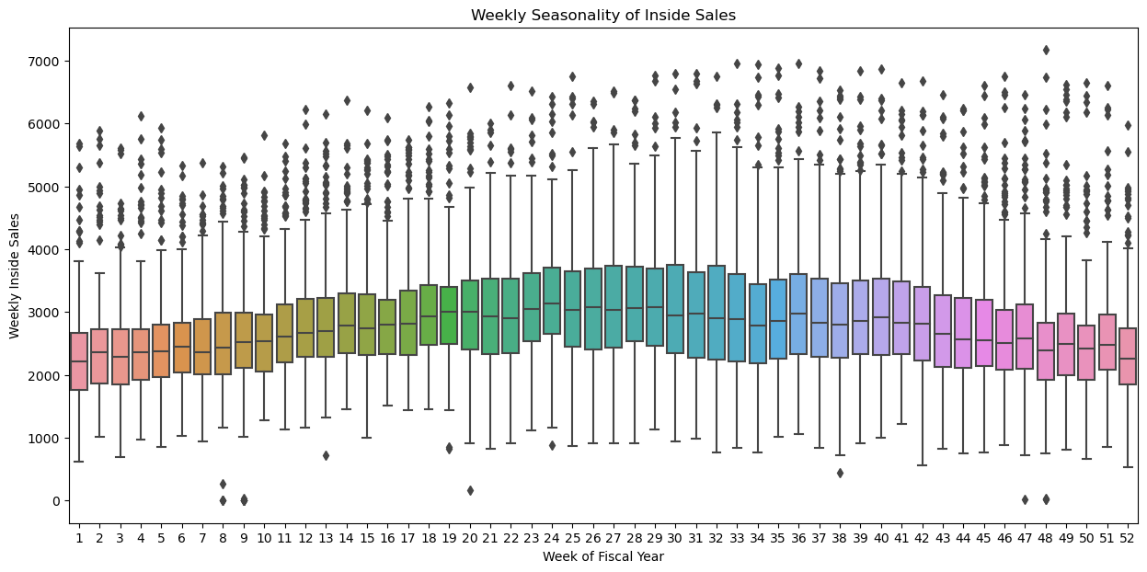
Exploratory Data Analysis

Slide 8
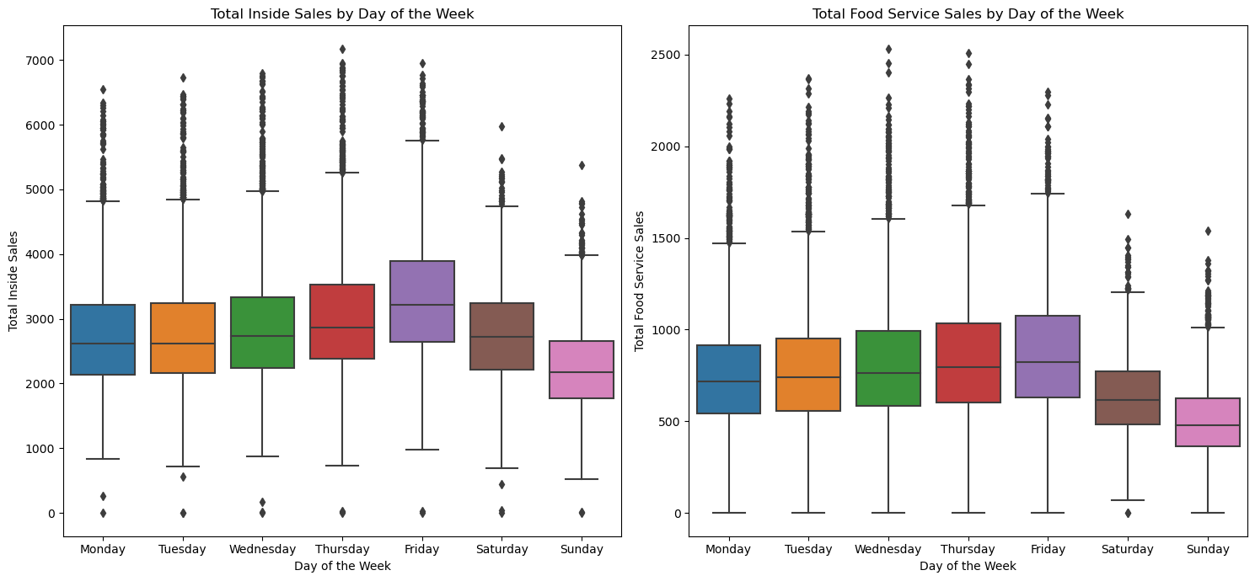
Exploratory Data Analysis

Slide 9
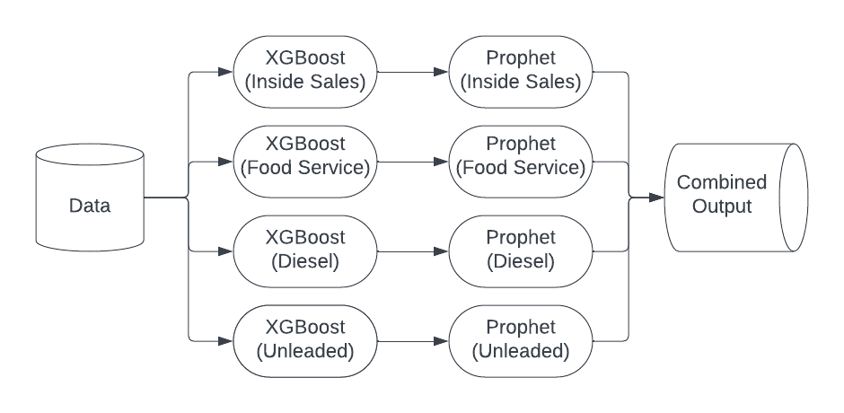
Model Architecture
XGBoost creates naive prediction of sales prior to store opening
Prophet predicts future sales based on actual sales data

Slide 10
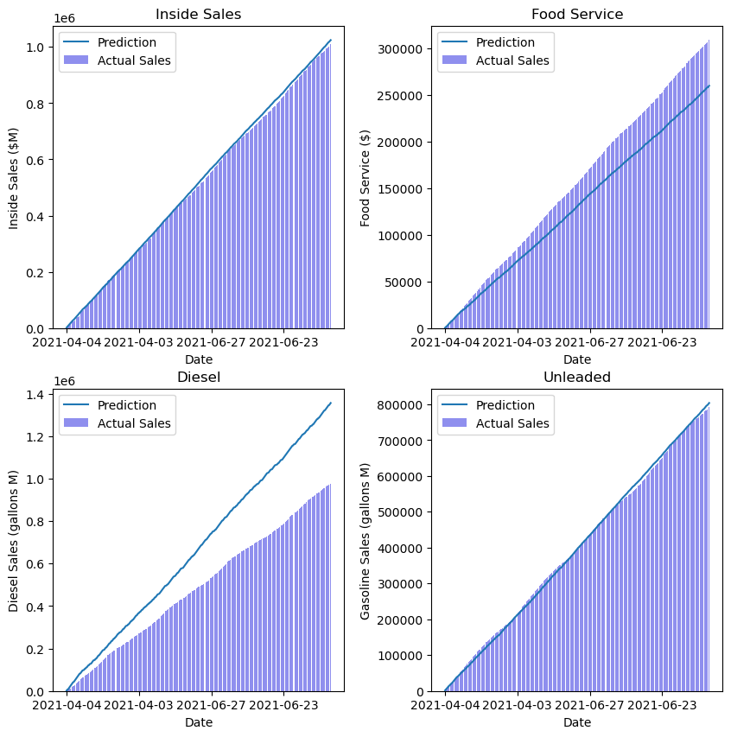
Model Performance
XGBoost (Naive) Model can accurately predict Annual Sales in many instances

Slide 11
Model Performance
XGBoost (Naive) Model can accurately predict Annual Sales in many instances.
But not in every case.

Slide 12
Two Models with different strengths
XGBoost
Good prediction capability.
No previous data needed
Data Hungry
No Temporal Awareness
Stagnant Accuracy

Slide 13
Two Models with different strengths
XGBoost
Good prediction capability.
No previous data needed
Data Hungry
No Temporal Awareness
Stagnant Accuracy
Prophet
Temporal Awareness
Needs prior data to be accurate
Gets less accurate the longer the horizon
Improving Accuracy

Slide 14
Two Models with different strengths
XGBoost
Good prediction capability.
No previous data needed
Data Hungry
No Temporal Awareness
Stagnant Accuracy
Prophet
Temporal Awareness
Needs prior data to be accurate
Gets less accurate the longer the horizon
Improving Accuracy
Composite Model
Can predict with no prior data
Can use prior data to refine predictions
Gets more accurate over time

Slide 15
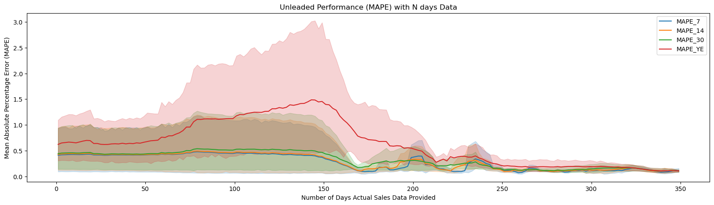
A picture is worth a thousand words

Slide 16
Model Analysis
Strengths
Can be very accurate
Fulfills Use Case

Slide 17
Model Analysis
Strengths
Can be very accurate
Fulfills Use Case
Weaknesses
Holidays
Small Sample Size Issues
1 of 5 types of store not included

Slide 18
Model Analysis
Strengths
Can be very accurate
Fulfills Use Case
Weaknesses
Holidays
Small Sample Size Issues
1 of 5 types of store not included
Opportunities
400 Stores & Multiple Years
Opportunities to improve sensitivity to Seasonality
Better Forecasting Models

Slide 19
Model Analysis
Strengths
Can be very accurate
Fulfills Use Case
Weaknesses
Holidays
Small Sample Size Issues
1 of 5 types of store not included
Opportunities
400 Stores & Multiple Years
Opportunities to improve sensitivity to Seasonality
Threats
Kum ‘n’ Go
Regionality

Slide 20
Business Value
Accurately Predict Annual and Daily Sales prior to store opening within 25% of actual performance in key sales segments
Improve Predictions throughout the year as actual sales data becomes available
Provide very accurate 7 day, 2 week, and 1 month forecasts to benchmark store performance

Slide 21
Thank You!

Slide 22
Extra Resources

Slide 23
Benchmark Comparison
 | Inside Sales | Food Service | Diesel | Unleaded
14-day MSE | 661003 | 80331 | 1600325 | 831857
14-day RMSE | 793 | 265 | 996 | 835
21-day MSE | 646277 | 79586 | 1450307 | 824445
21-day RMSE | 784 | 263 | 951 | 826
Minimum MSE | 241722 | 40325 | 5316 | 150815

Slide 24
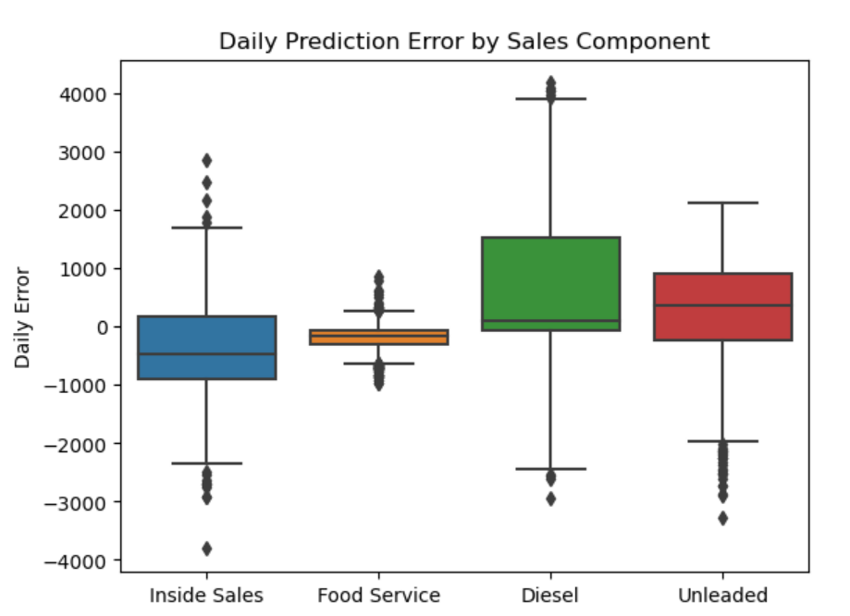
Daily Prediction Error

Slide 25
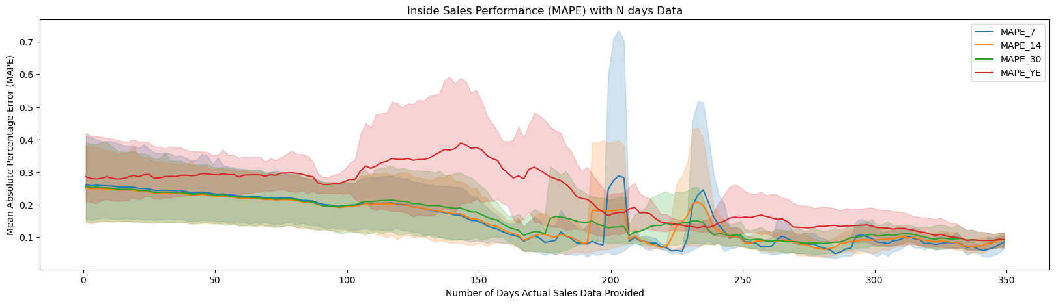
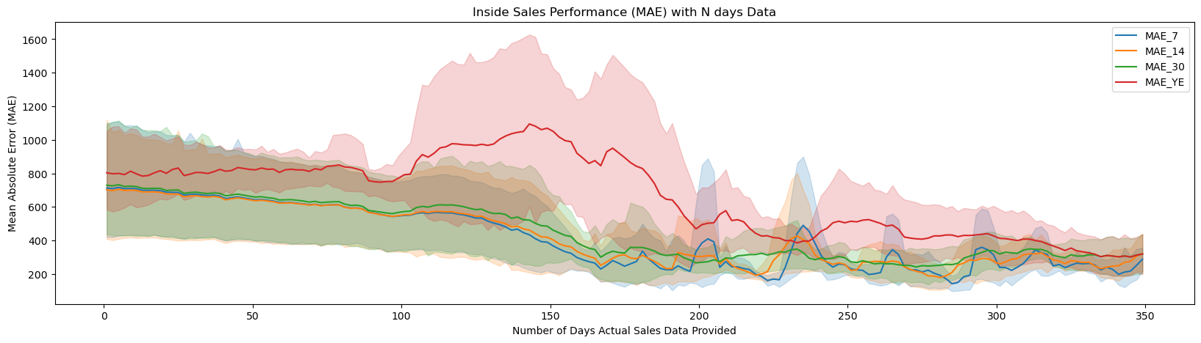

Slide 26
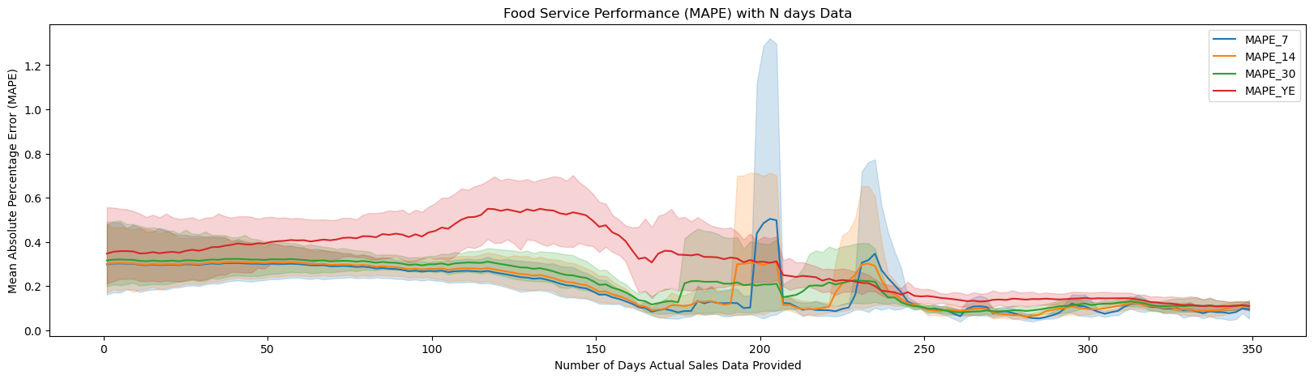
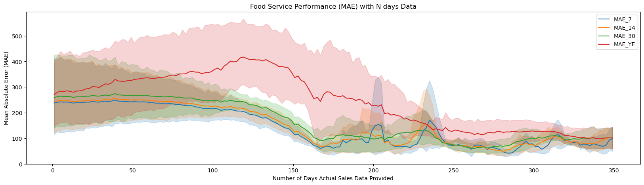

Slide 27
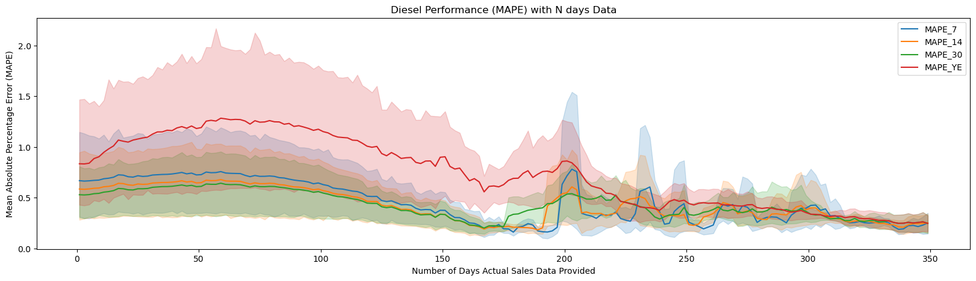
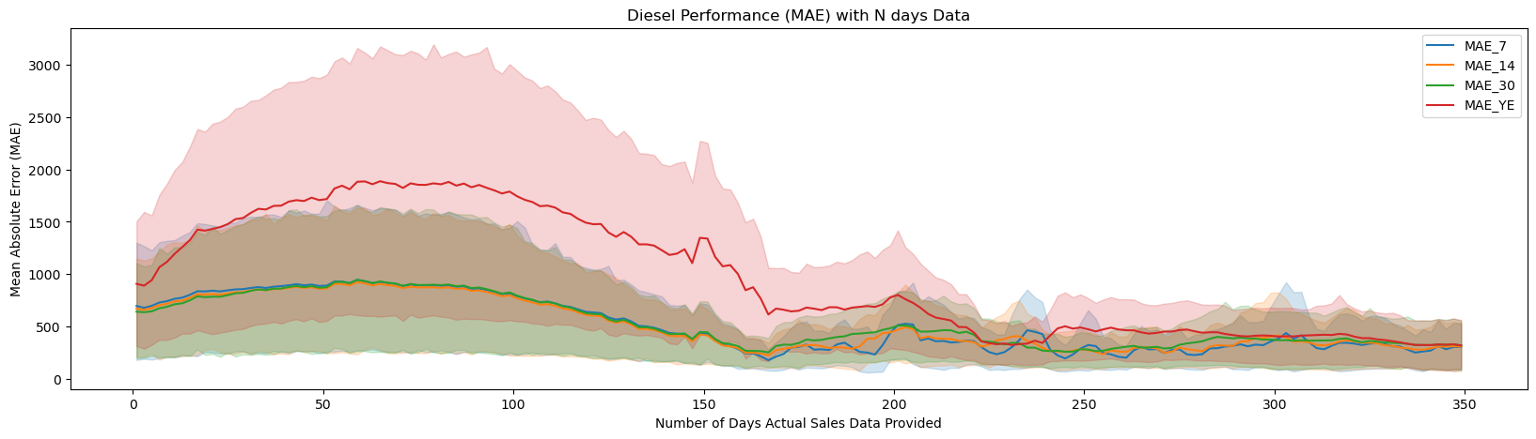

Slide 28
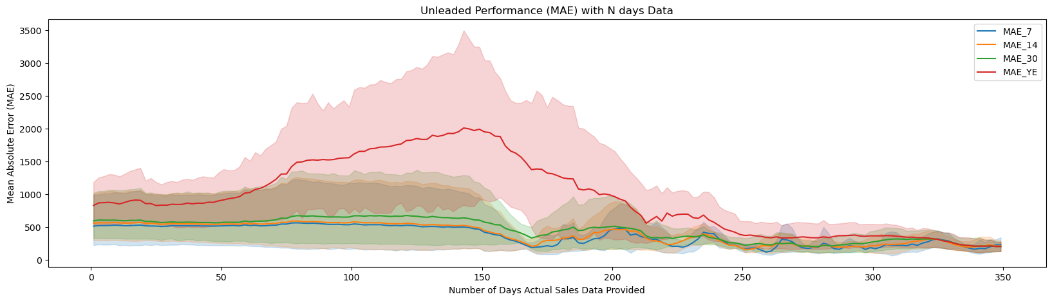

Slide 29
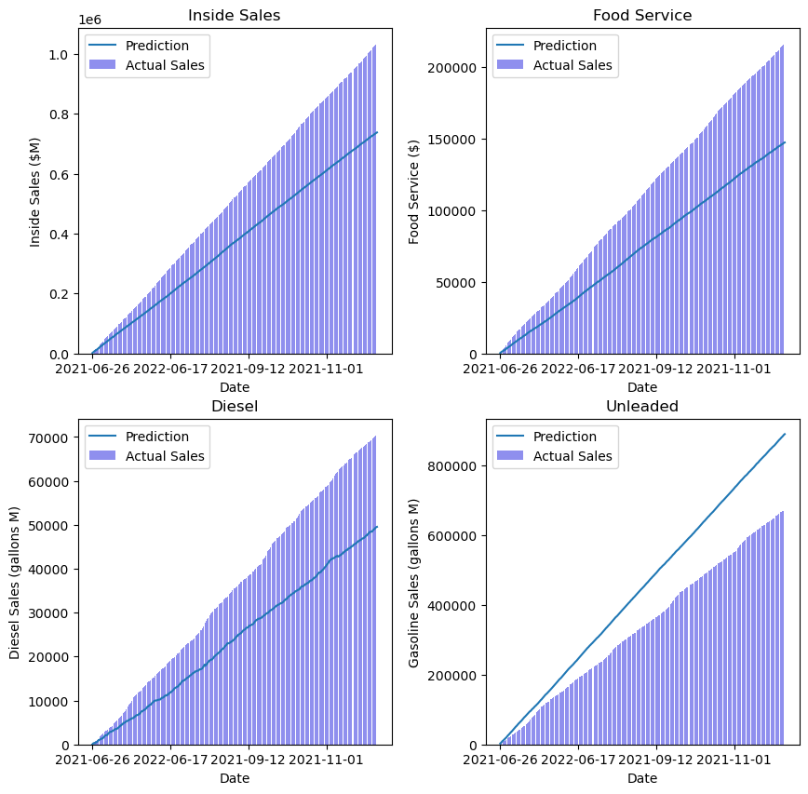
Test Store
XGBoost Performance

Slide 30
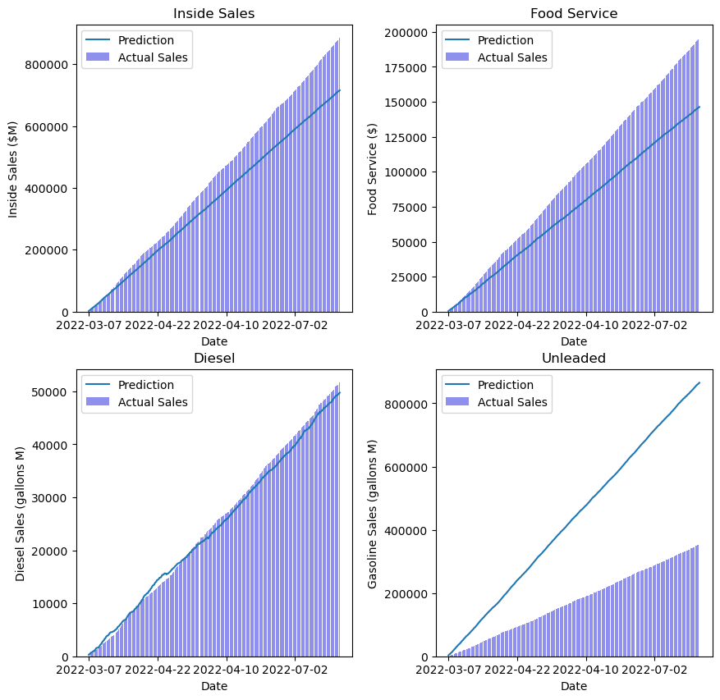
Test Store
XGBoost Performance

Slide 31
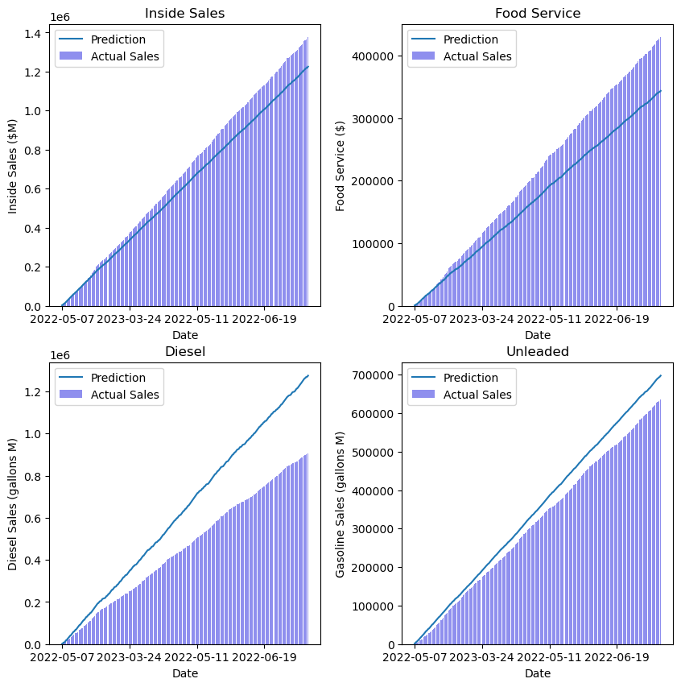
Test Store
XGBoost Performance

Slide 32
Test Store
XGBoost Performance

Slide 33
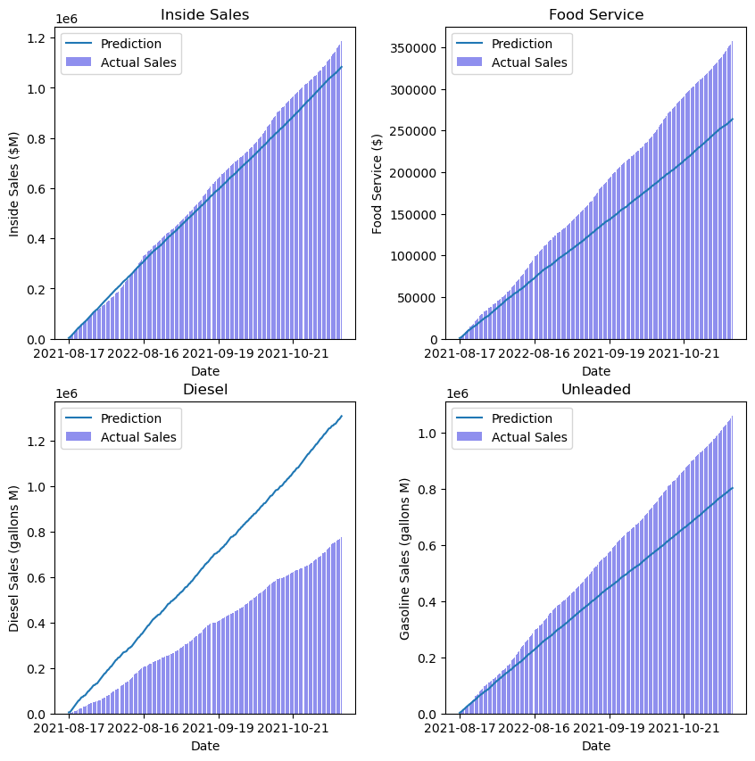
Test Store
XGBoost Performance

Slide 34
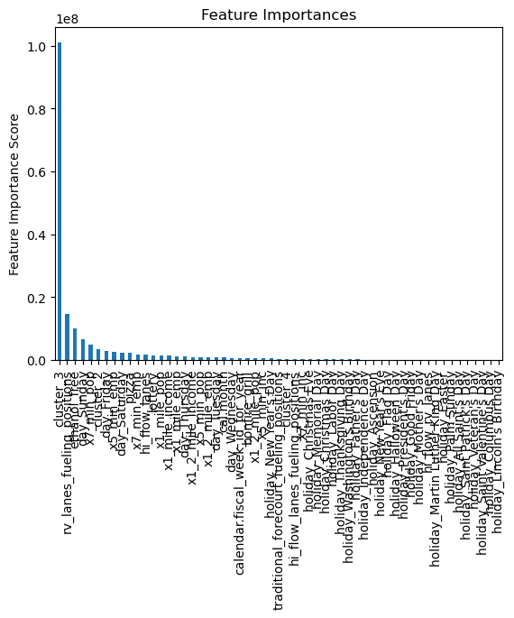
Feature Importance
XGBoost

Slide 35
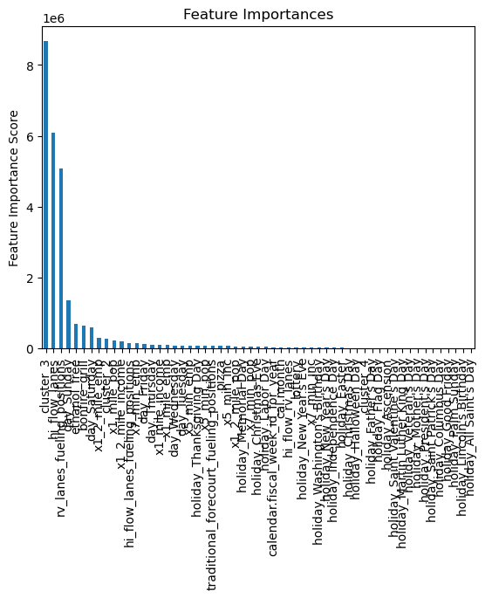
Feature Importance
XGBoost

Slide 36
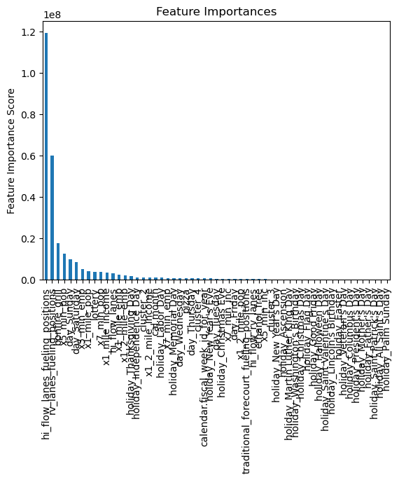
Feature Importance
XGBoost

Slide 37
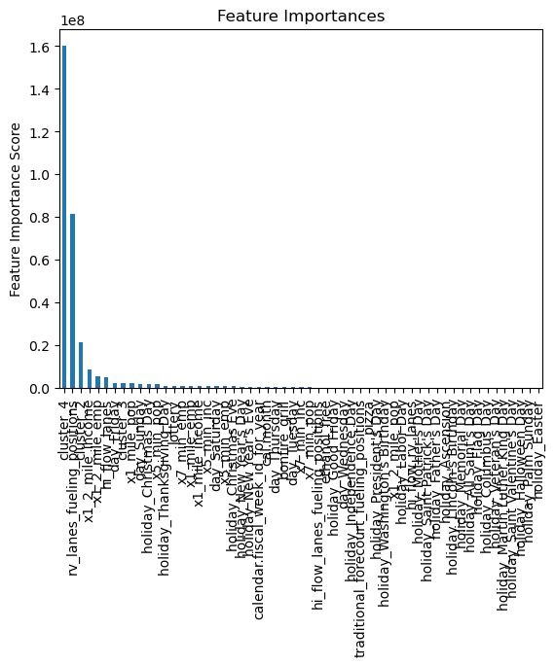
Feature Importance
XGBoost

