Slide 1
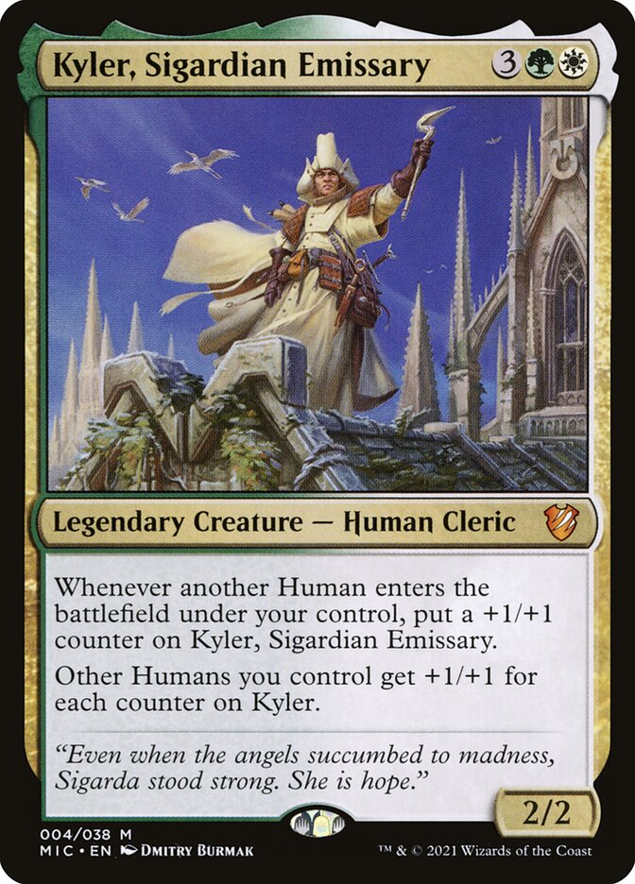
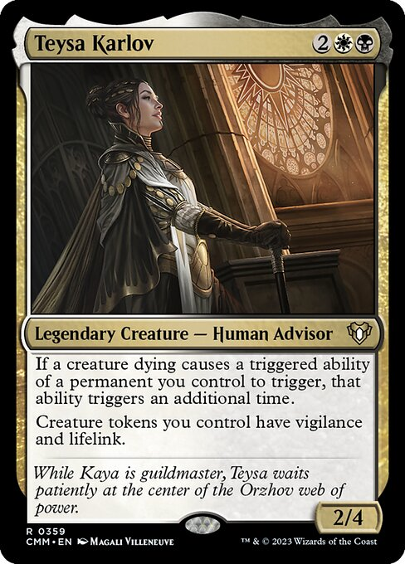


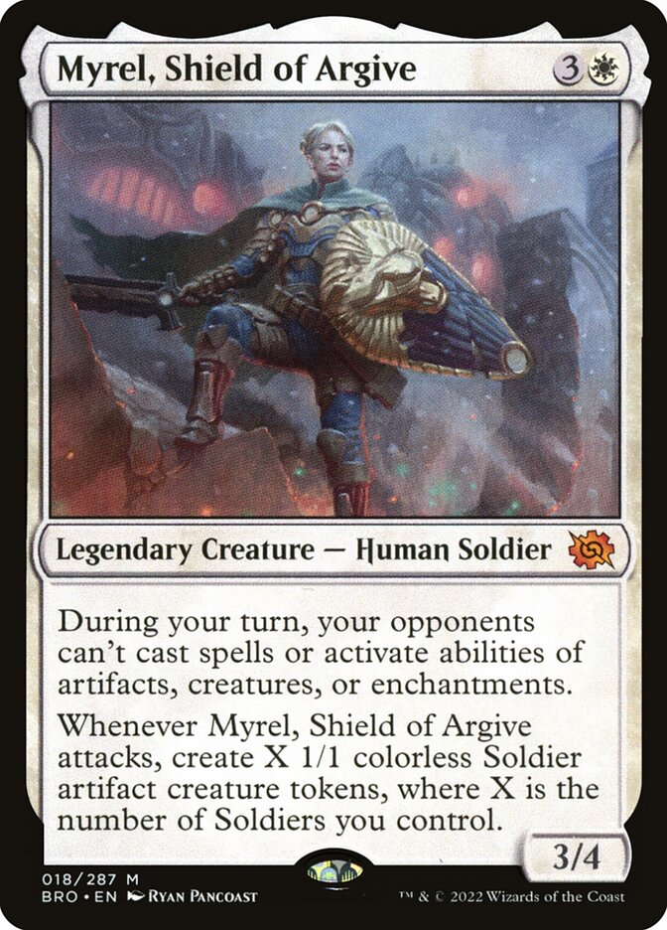
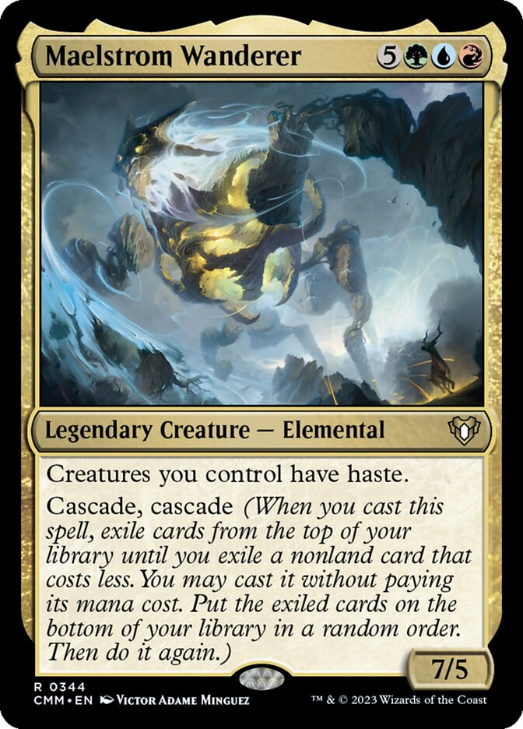


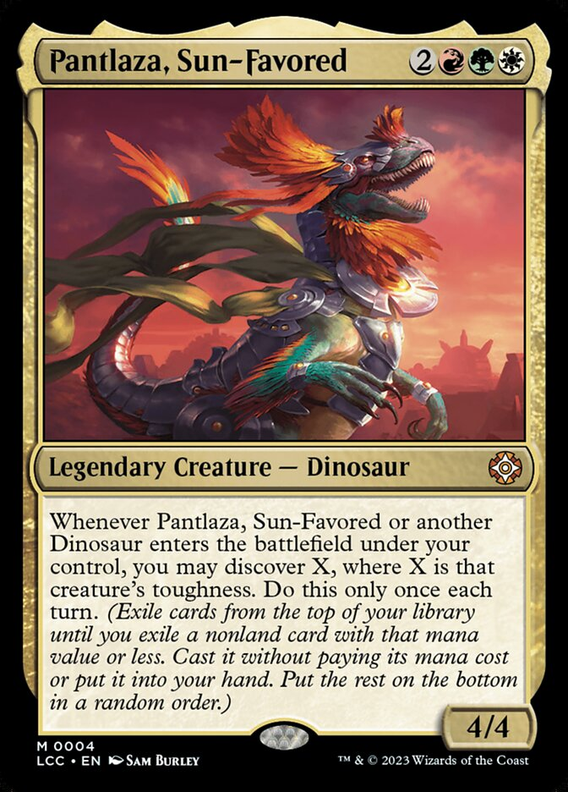

Win Condition | Go wide with humans on steroids
Salt Score | 33.67 (36.26 avg)
Salty Cards | Esper Sentinel; Grand Abolisher; Heroic Intervention
Win Condition | Drain the table with double death triggers
Salt Score | 34.62 (36.26 avg)
Salty Cards | Grave Pact; Syr Conrad, the Grim; Damnation
0-Mana Cards | ✘ | Extra Turns | ✘ | Land Destruction | ✘
1-Sided Wipes | 1 | Fast Mana | ✘ | $TAX | 1
‘I Win’ Cards | 3 | Hate bears | 1 | Theft | ✘
Dual Lands | ✘ | Inf. Combos | ✘ | Tutors | 1
0-Mana Cards | ✘ | Extra Turns | ✘ | Land Destruction | ✘
1-Sided Wipes | ✘ | Fast Mana | ✘ | $TAX | ✘
‘I Win’ Cards | ✘ | Hate bears | ✘ | Theft | ✘
Dual Lands | ✘ | Inf. Combos | ✘ | Tutors | ✘
Pile of Cards
Pre-Con
CEDH
Pile of Cards
Pre-Con
CEDH
Jank
Tuned
Short Turns
Long Turns
Jank
Tuned
Short Turns
Long Turns
Win Condition | Make Soldiers -> Beat Face
Salt Score | 36.97 (36.26 avg)
Salty Cards | Esper Sentinel; Grand Abolisher; Big & Tiny Thalia
Win Condition | Ramp -> Cheat out big boys with cascade
Salt Score | 36.30 (36.26 avg)
Salty Cards | Koma, Cosmos Serpent; Last March of the Ents
0-Mana Cards | ✘ | Extra Turns | ✘ | Land Destruction | ✘
1-Sided Wipes | 2 | Fast Mana | ✘ | $TAX | 1
‘I Win’ Cards | 4 | Hate bears | 4 | Theft | ✘
Dual Lands | ✘ | Inf. Combos | ✘ | Tutors | 1
0-Mana Cards | ✘ | Extra Turns | ✘ | Land Destruction | ✘
1-Sided Wipes | ✘ | Fast Mana | ✘ | $TAX | ✘
‘I Win’ Cards | 3 | Hate bears | ✘ | Theft | ✘
Dual Lands | ✘ | Inf. Combos | ✘ | Tutors | ✘
Pile of Cards
Pre-Con
CEDH
Pile of Cards
Pre-Con
CEDH
Jank
Tuned
Short Turns
Long Turns
Jank
Tuned
Short Turns
Long Turns
Win Condition | Cheat out big Timmy dinos
Salt Score | 21.78 (36.26 avg)
Salty Cards | Akroma’s Will; Kinjalli’s Sunwing
0-Mana Cards | ✘ | Extra Turns | ✘ | Land Destruction | ✘
1-Sided Wipes | 1 | Fast Mana | ✘ | $TAX | ✘
‘I Win’ Cards | 3 | Hate bears | ✘ | Theft | ✘
Dual Lands | ✘ | Inf. Combos | ✘ | Tutors | ✘
Pile of Cards
Pre-Con
CEDH
Jank
Tuned
Short Turns
Long Turns

