Slide 1
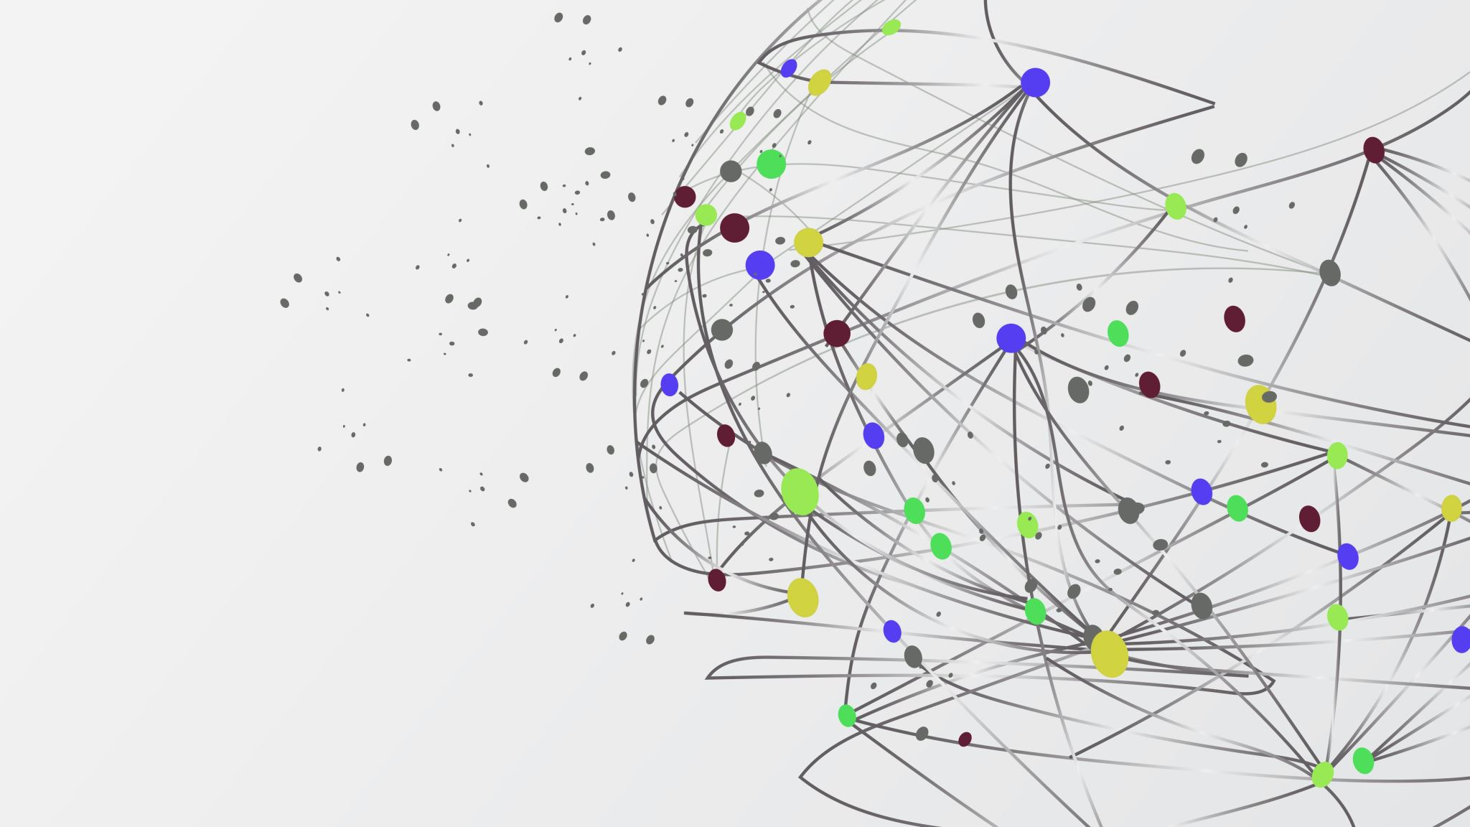
Emergency calc
Developers: Dylan Engle, Eric Bunch, Weston Abner

Slide 2

What is Emergency calc
Emergency calc is a web-based calculator
It contains a database, server, and website
Its intended audience is stem students

Slide 3
What does emergency calc do
Emergency calc solves a couple of problems for stem students
It provides an easy to uses calculator in case the students don’t have on.
It provides a graphing interface that can be used remotely, and the graphs can be saved and shared for use in projects and when working with peers .

Slide 4
What does Emergency calc use
Emergency calc is ran using JavaScript and html5
It is ran on a server coded in java script with a database made using MySQL
The server uses Nodejs and the express library
The graph canvas uses the p5.js library.

Slide 5
How does the calculator work
First the calculator form takes user input
The calculator then organizes the inputs as either nums or operators
It then changes it from infix notation to reverse polish notation to make it easier for the computer to read.
It then runs the array in revers polish notation through an algorithm that takes the nums and applies the operators to them and then displays it to the user

Slide 6
How does the graph canvas work
The graph canvas works using the p5.js library
It takes an equation runs it through a loop multiple times to get the x and y location of points in the line and then takes these points and puts them in the begin shape function from p5.
The canvas can be adjusted for gridlines and add whatever color the user wants.
It then uses the p5 saveimage function to saves the image as either a jpg or png
The scale of the canvas can be expanded, or lowered can’t zoom in on a single point

Slide 7
How does the server work
The local server is based off the express package in node.js.
This has made many things extremely easy, and others rather difficult.
Overall, the choice to use this package to host a server has provided us with a dynamic website experience that has allowed us to quickly create new pages on the fly.
Unfortunately, due to time constraints, hosting the server on https through this package proved to be slightly difficult.
This led to problems with the graph canvas, and this is how we lost the ability to use the website on google chrome and Microsoft edge, as the package needed for graphing can only be ran on https.
For the scale of the project that we did, it was a great choice to use Node.js express to host our server.

Slide 8
How does the database work
The final database has a very simple design.
There are only two tables. One that stores the user's data, and another to hold the calculation data.
Once logged in, Users can choose from a list of created calculations that they have saved into the database.
The selected calculation can be pushed into a field where the corresponding calculation will go.

Slide 9
How is the Ui designed
The UI and the menus are all created using HTML/Javascript/CSS
The UI was modelled after the footsteps of other calculators, Desmos/Ti84
The aesthetics and color choices were done due to the preference of darker themes on the team and that in most cases it is easier on the eyes.

Slide 10
UI Changes
Due to scope, there were a few changes we were unable to lock into completion.
The Different colors of multiple functions was something that was close to completion but didn’t make the deadline due to lower prioritization.
The Zoom in and out buttons were phased out due to graph functionality and time frame.
Action Forms were going to be utilized instead of separate webpages, along with a drop down menu for historical functions, but since the code wasn’t completed with enough time to test and debug our current design is as follows.

Slide 11
Known bugs
There is currently no user input validator so the calculator will attempt to use any letters passed into the function as an operator. This means if you pass letters into graph function it will crash.
The function to save user inputs is broken. User input in the database can be ran through the use calculation's function but attempting to save data will bring the user a 404 error.

Slide 12
What could we have done differently?
A better attempt at project management would have helped the scale of the project.
By utilizing to-do boards such as Trello it would have saved a lot of time on redundant work and helped to keep fluid priorities as requirements changed.
Prioritization of some later features should have been moved up such as the zooming of functions.
Targeting a different platform, such as mobile could have had a positive impact on the project by creating a mobile application over a web application.

Slide 13
The future of the project
Fix the users function saving, and the user input validation.
Add physics variables
Add inverse trigonometric functions
Add a true zoom function.

Slide 14
Thank you for listening to the presentation. HAVE A great rest of the year.

