Slide 1
Emergency calc
Developers: Dylan Engle, Eric Bunch, Weston Abner

Slide 2



Overview
What is Emergency calc
What changed
What has been accomplished
What still needs to be implemented
Unresolved issues

Slide 3


What is Emergency calc
Emergency calc is a web-based calculator
It is programmed in java script, type script and html5
It is ran on a server coded in java script with a database made using MySQL
Its intended audience is stem students

Slide 4
Backend updates
Login functionality is completed
Registration functionality is completed
Able to use website without logging in

Slide 5


Graph Updates
The majority of graphing function is complete
Added a function to remove gridlines
The actual graphs themselves have not changed since the last update

Slide 6
UI Changes
Layout and colors changed to be more user friendly.
Calculator now comes from the side rather then the bottom.
Dropdown formula menus for saved formulas under the user's profile.

Slide 7

Server and database completion
The server and data base are completely finished
Assuming that everything goes as planned there will be no further updates to this

Slide 8

Graph canvas Progress
It is now able to accept user input
Major progress has been made on on graph canvas
Everything finished except zoom function

Slide 9
UI completion
Large Parts of Layout Completed
Hamburger Menu that controls user options completed.
Layers added in order to accommodate for graphic canvas.
Prototype for Calculator added into project.

Slide 10
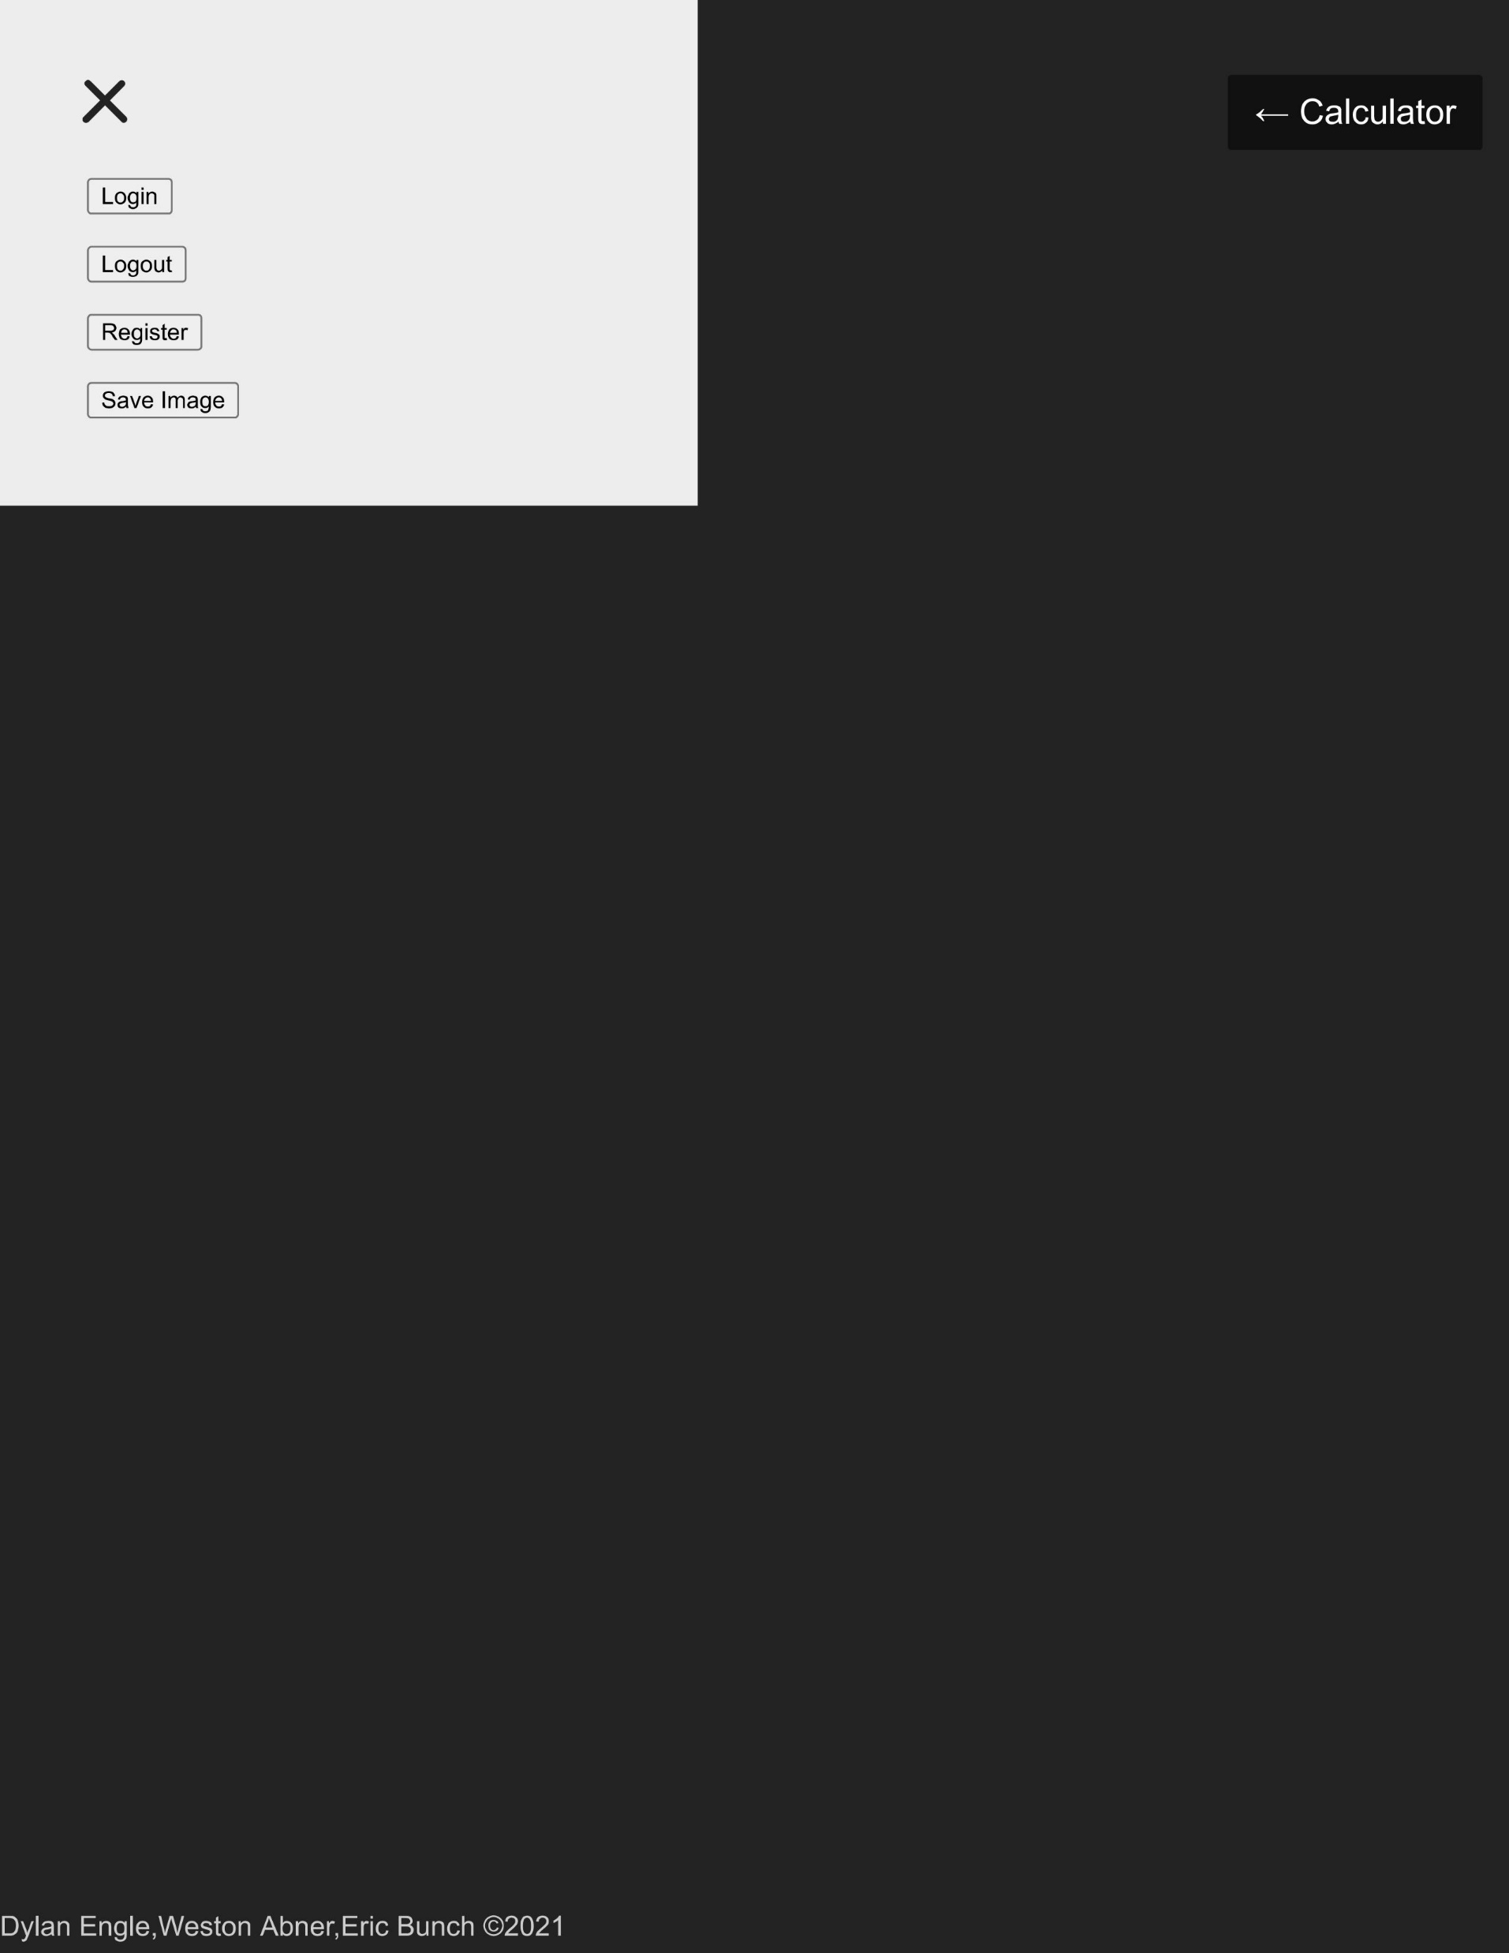

Slide 11
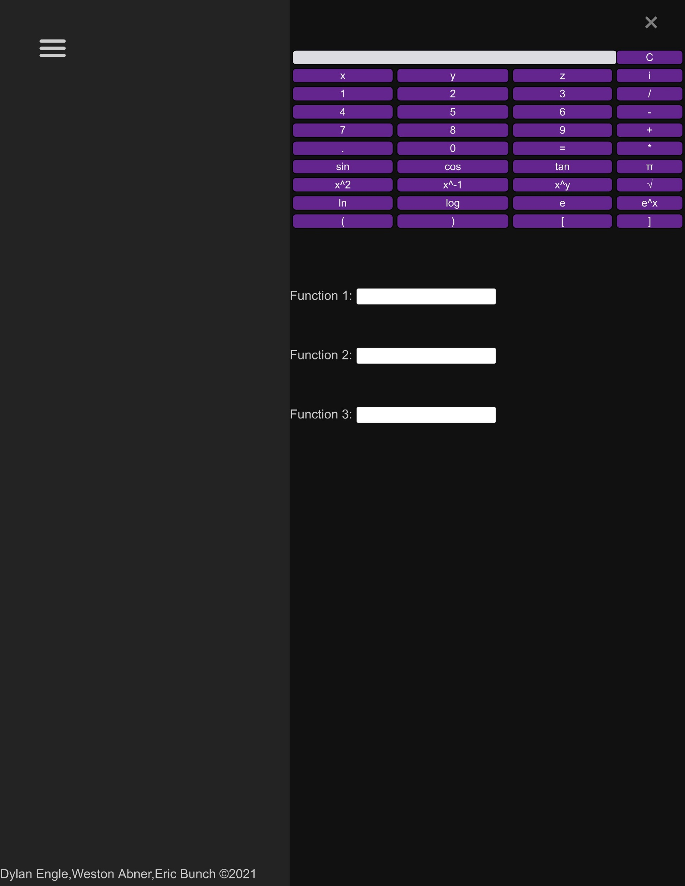

Slide 12
UI Decisions
Is the color scheme appropriate and user friendly?
How should the saving and loading feature be intuitively linked to the back end and user profile?
Should the Login/Logout/Register pages being separate from the main page or a pop-up menu?
What is the best way to handle user inputs for the calculator in order to graph efficiently?

Slide 13
Calculator functions themselves are incomplete
The calculator functions themselves have been started but not completed
Most of the basic functions can be handled using the Math object built into JavaScript
Need a way to parse equation from user input

Slide 14
Exporting graphs
The exporting graph's function is complete
Uses a built in function from the p5 database to do 90% of the work
Allows user to name the file and decide where to store it.

Slide 15
What Next?
Complete the Merging of the Frontend with the Backend database.
Complete the saving and loading functions.
Applying the grid canvas to the main page layer.
Connection the calculator buttons and action form with calculator back end.
Graphing.

