Slide 1
Emergency Calc Project Design
Dylan Engle, Eric Bunch, Weston Abner

Slide 2
Design
Emergency Calc is a web-based calculator built for STEM students in need
Ran off HTML,CSS, JavaScript, Typescript for frontend
Backend will consist of Docker, Node.js, Microsoft SQL server, SQL
Will run on Google Chrome

Slide 3
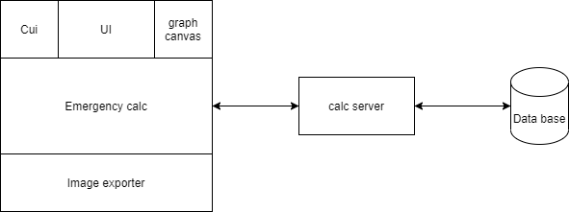
Block Diagram
Cui, UI, graphing canvas, and image exporter are all built upon the main website
Website will communicate with the server, and server with the database

Slide 4

Backend
Website will communicate directly with the server, which in turn communicates with the database.
Database used to store user information, share user created graphs, and save and load calculations
Graph functions will be saved to database, images of graphs will be saved locally
Will be susceptible to hacking

Slide 5
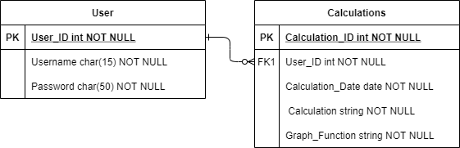
Database
Will consist of two tables
User
User_ID - PK
Username
Password
Calculations
Calculation_ID –PK
User_ID -FK
Calculation_Date
Calculation
Graph_Functions

Slide 6
Server Messaging
Messages will be sent using .JSON files
Create Account
Login
Login not correct
Request to save calculation
Request to load calculation
Request to save graph function
Request to load graph function
Request to share calculation
Request to share graph function
Requested username to share with does not exist
JSON Samples:
Create Account:
{“Username”: “ShadowGear”, “Password”: “AbCd1846”}
Request to save application:
JSON Sample: {"Calculation" : "a^2 + b^2 = c^2", "Calculation_Date": "09/20/2021"}

Slide 7

Frontend
Calculator UI (cui) is how the interface for the calculator portion of the website will look
Separate from the user interface
Can be expanded using the button in the hamburger menu
Graph Canvas is how the inputted graph function will be overlayed onto the screen.
Will have buttons for basic graphing functions (+, -, / , cos, tan, sin etc.)
These buttons will also work for cui
Graphing is based upon a table menu that will allow users to input functions

Slide 8
Frontend
Hamburger style menu is where many features of website will be housed
Where the save, share, load, and image export buttons will be saved
Option to expand to have more functionality than a default calculator
Buttons such as sin and cos will not be on the screen at default but can be shown on screen with click of button
Graph will allow for different colors for lines and different patterns for lines
Colors will include yellow, green, blue, violet, red, orange, and black
Patterns will include Points, lines, and dotted lines

Slide 9
Image Exporter
Saves an image of the graph/graphs that are currently inside of the graphing canvas
Will be located inside of the hamburger menu
Upon button click, will pull up menu for user to decide their save location
Will give option for .PNG or .JPG
This save menu will just be the normal file save menu

Slide 10

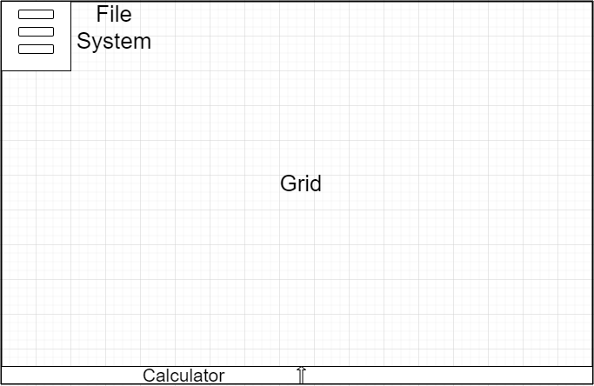
Base UI

Slide 11
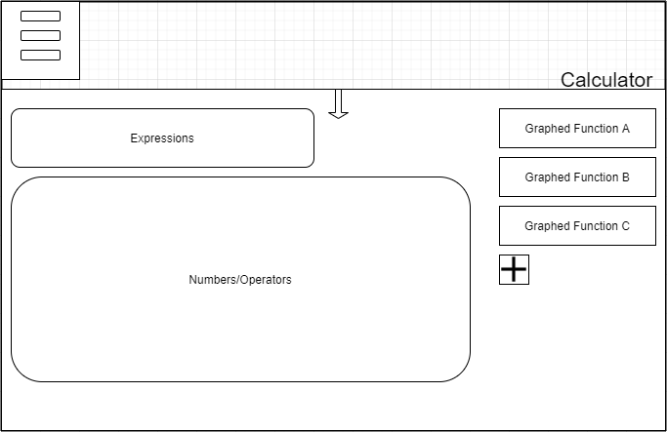
Calculator UI

Slide 12
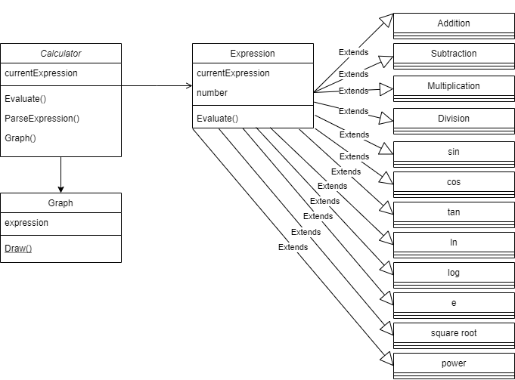

Slide 13
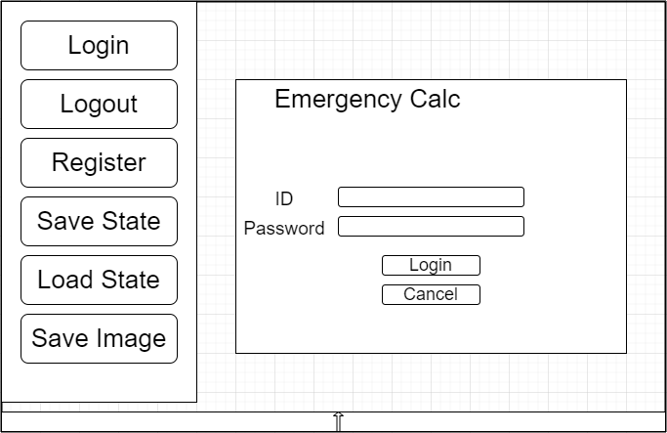
File Sytem UI

Slide 14
