Slide 1
PROJECT：Crime rates of every state in U.S.A.
Introduction
By:程浩(515080910012)
2017-7-27

Slide 2
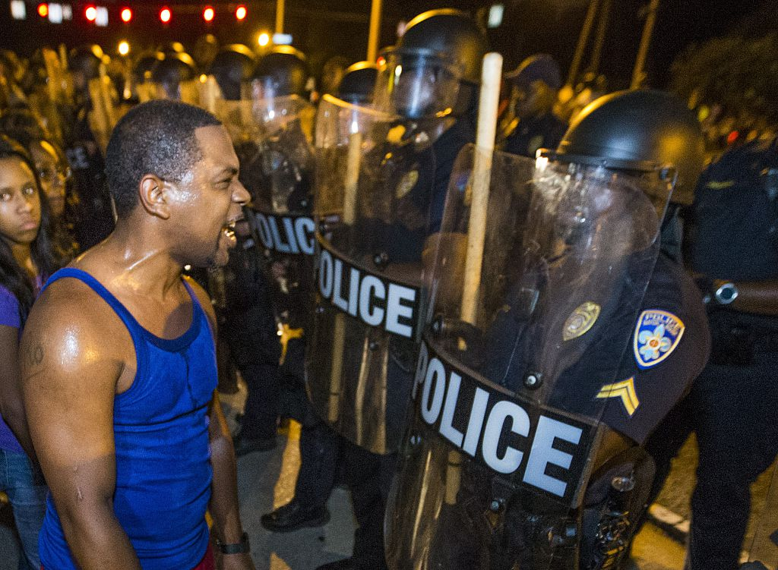
Background
Over the past few years, with the pursuit of academic, many students choose to go abroad after graduation, such as the United States. But in recent years the United States more and more concerned about the security issues, especially in the shooting case was exposed, it makes everyone think about the security issue as one of the criteria to the United States.

Slide 3
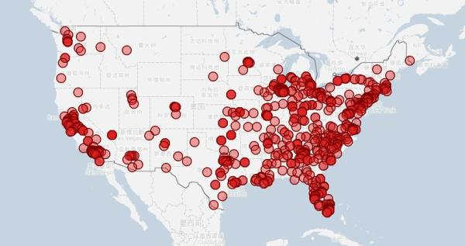



Slide 4

And the cause of the United States a lot of panic-prone crimes, mainly because the United States citizens can pass the law through the possession of firearms.

Slide 5





Slide 6

Once saw a news interview, a 62-year-old Europeans said: "I was twenty years old when there is a dream, first of all I now earn enough money, the enjoyment of life have also enjoyed. Flee to the United States at the time of her seventies, test a gun and then buy a M4A1 to go to Times Square, and I think my life is perfect.

Slide 7
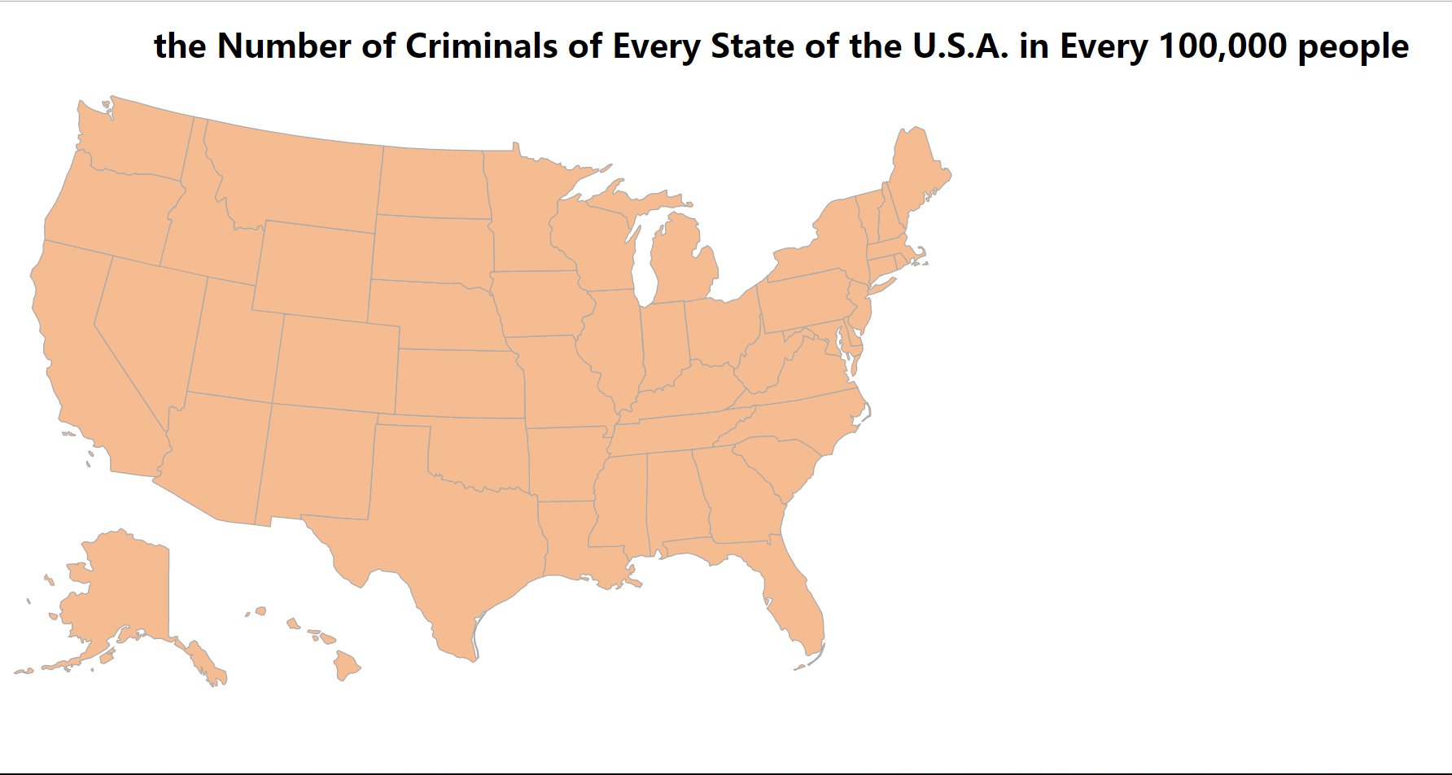
Introduction
Based on the background and this AI project, I want to show you the crim rate of every state in the U.S.A. (the number of criminals in every 100,000 people).

Slide 8
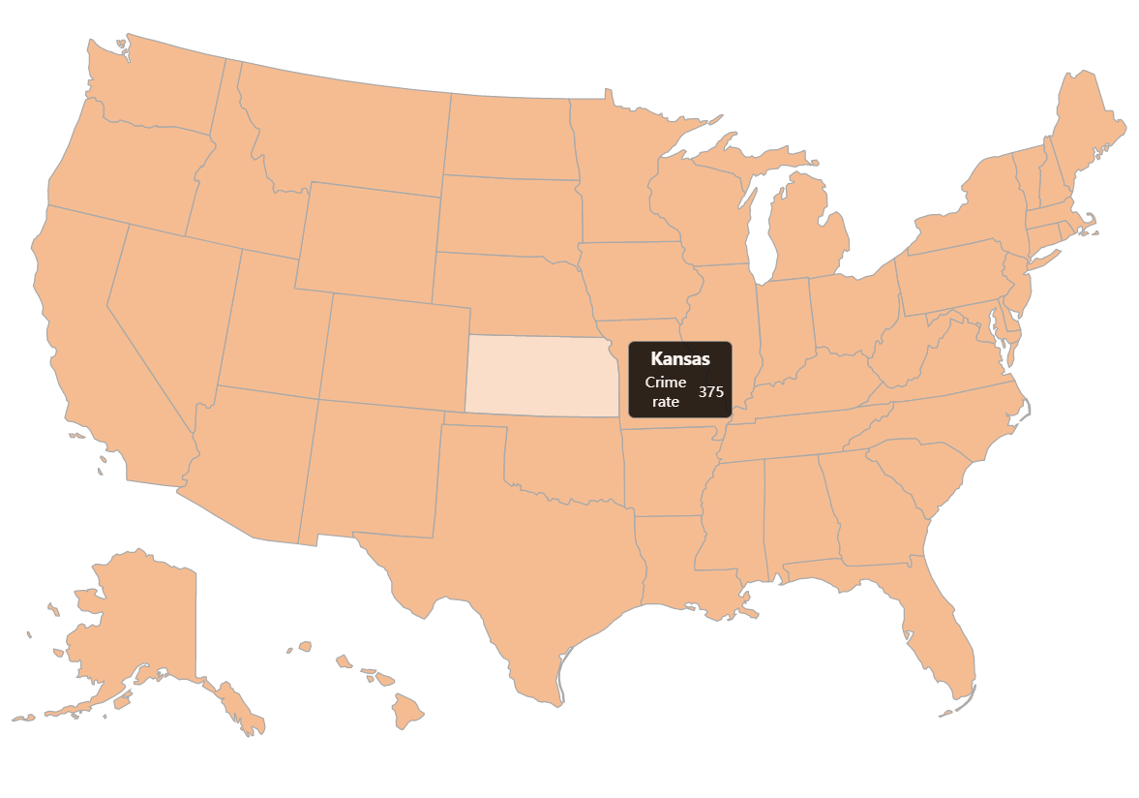
And you can use the cursor to check the number and the name of state to see the number of criminals in 100,000 people.

Slide 9
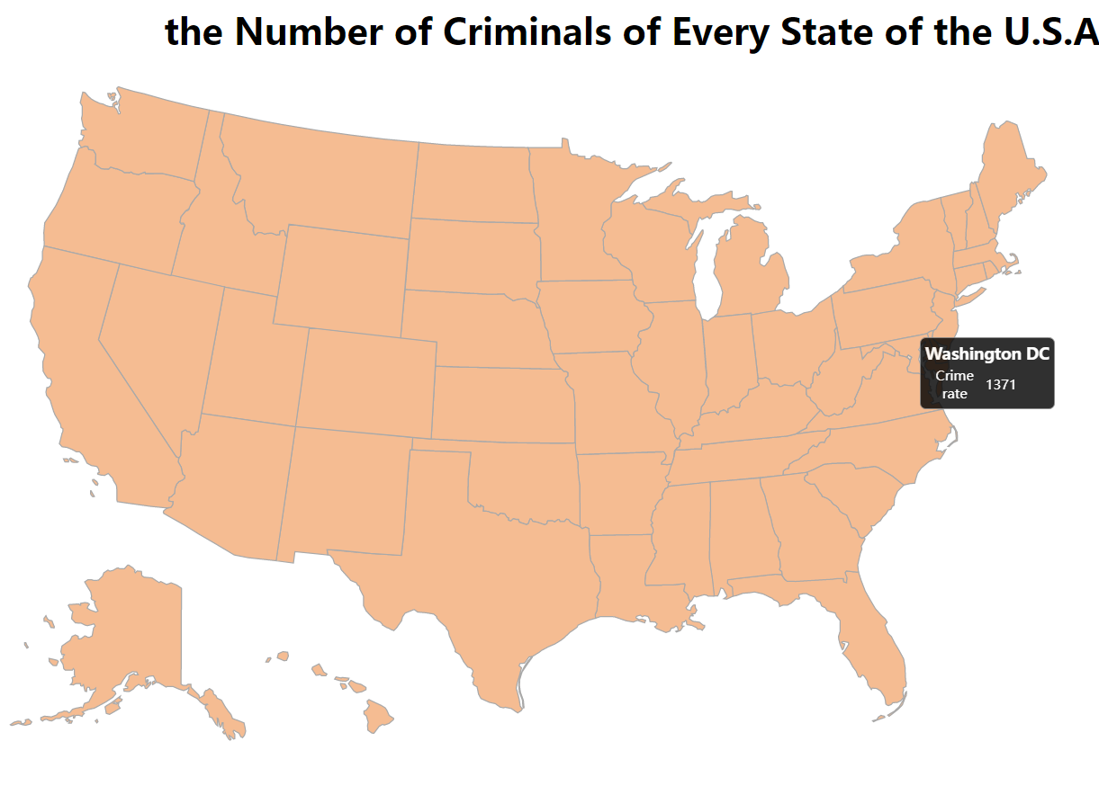

Slide 10
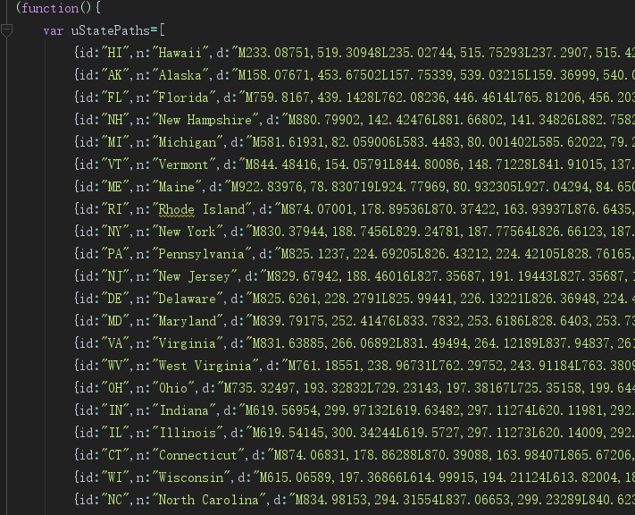
Implementation
d3.v3.min.js---requirement
uStates.js---draw the map of the U.S.A.
uStates.js

Slide 11
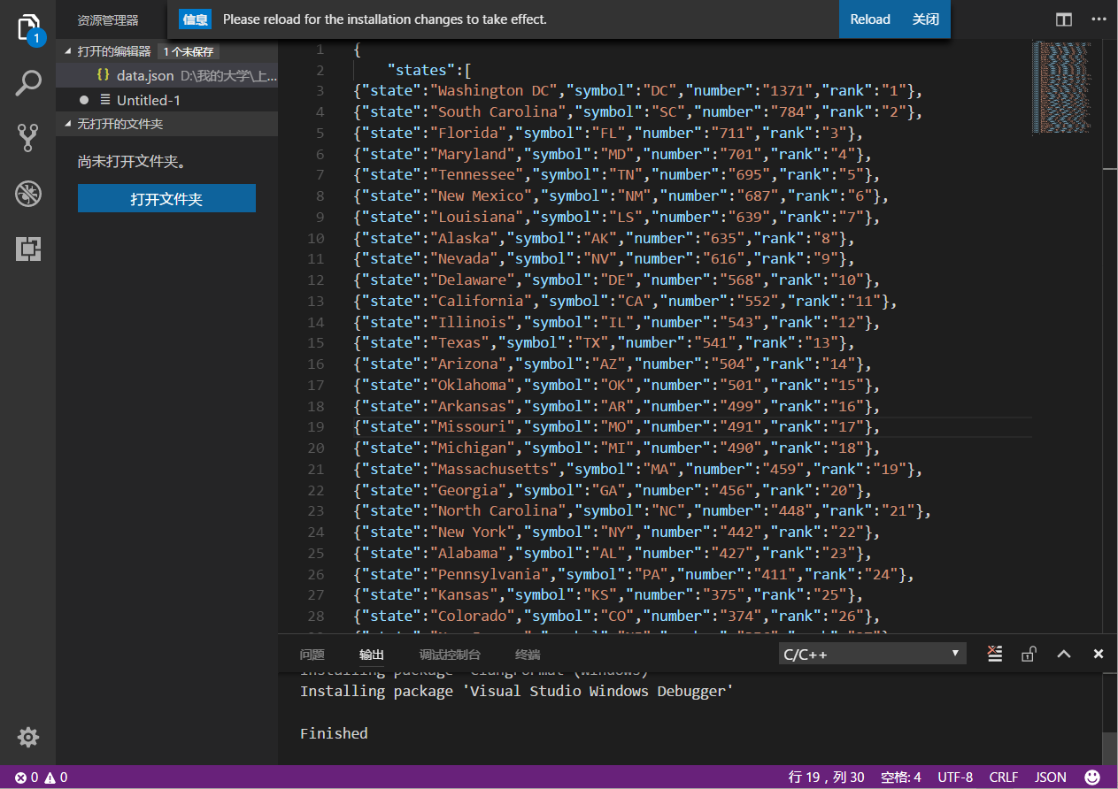
data.json---the data file

Slide 12
Conclusion
This project needs to read file and get the data from the “json” file, therefore, the unit test I wrote just test whether the number is correct compare with the map.
The project is a static program, the data is given. I think it can be optimized to be the updating program in the future.
Hope you can get the information you want from this small project.

Slide 13
Reference
American Census Bureau

Slide 14
THANK YOU !

