Slide 1

iCode
DAY 2
EMPOWERING FUTURE INNOVATORS
VR Creator - Day 2
1

Slide 2
iCode
DAY 2
EMPOWERING FUTURE INNOVATORS
[ MISSING: D2Pacman2.png ]
Dots to chomp. Ghosts to dodge. A tunnel that wraps. Every visible thing on screen is a tile painted on a grid — and the code you'll write moves the player and spawns the ghosts.
2

Slide 3
iCode
DAY 2
EMPOWERING FUTURE INNOVATORS
Why Pac-Man changed everything (1980)
• Pre-1980 arcades = almost all space shooters (Space Invaders, Asteroids). Pac-Man invented the maze chase.
• First game with a character that had personality — Pac-Man + 4 named ghosts (Blinky, Pinky, Inky, Clyde), each its own AI brain.
• First game with cutscenes (the intermissions between levels).
• First arcade game marketed beyond boys — broke the "arcade = boys only" mold.
• First giant merchandising wave — lunchboxes, a cartoon, a hit song ("Pac-Man Fever").
• Bottom line: no Pac-Man → maybe no Mario, no Sonic, no character mascots at all.
3

Slide 4
iCode
DAY 2
EMPOWERING FUTURE INNOVATORS
Yesterday → Today
• Day 1 — Variables + Conditions. You named things and made choices.
• Day 2 — Loops + Functions. You repeat things and package code into reusable recipes.
• Same var, same if. Two new tools on top.
4

Slide 5
iCode
DAY 2
EMPOWERING FUTURE INNOVATORS
The 5-day arc
• Day 1 ✓ Pong — Vars + Conditions
• Day 2 ← Pac-Man — Loops + Functions
• Day 3 Tower Defense — Lists + Objects (preview)
• Day 4 Fighter — Objects deep
• Day 5 VR Escape Room — Showcase
5

Slide 6
iCode
DAY 2
EMPOWERING FUTURE INNOVATORS
Today's concepts: Loops + Functions
• Loops — make the same code run again and again (spawn 3 ghosts, move every ghost, scan 868 tiles).
• Functions — give a block of code a name, call it whenever you need it.
6

Slide 7
iCode
DAY 2
EMPOWERING FUTURE INNOVATORS
GDScript is Python — except one word
Code
Python: for i in range(5): GDScript: for i in range(5):
print(i) print(i)
Python: for item in stuff: GDScript: for item in stuff:
print(item) print(item)
Python: while lives > 0: GDScript: while lives > 0:
keep_playing() keep_playing()
Python: def add(a, b): GDScript: func add(a, b):
return a + b return a + b
7

Slide 8
iCode
DAY 2
EMPOWERING FUTURE INNOVATORS
Pre-coding setup
8

Slide 9
iCode
DAY 2
EMPOWERING FUTURE INNOVATORS
Open the Day 2 Maze project
Open the Day 2 Maze project the same way you did yesterday.
9

Slide 10
iCode
DAY 2
EMPOWERING FUTURE INNOVATORS
Walk A — Hint
• Godot Launcher → Import button
• Navigate to Day2_Maze_Game/project.godot
• Click Import & Edit
10

Slide 11
iCode
DAY 2
EMPOWERING FUTURE INNOVATORS
Open main.gd
Open main.gd and switch to the Script editor — same way as yesterday.
11

Slide 12
iCode
DAY 2
EMPOWERING FUTURE INNOVATORS
Walk B — Hint
• FileSystem panel (bottom-left) → find main.gd
• Double-click → Script editor opens
12

Slide 13
iCode
DAY 2
EMPOWERING FUTURE INNOVATORS
New today: TileSet and TileMapLayer
• TileSet = the palette. A resource file that chops the Kenney atlas PNG into named 16×16 tiles.
• TileMapLayer = a node in the scene that paints tiles from the TileSet onto a 2D grid.
• Think: TileSet = the box of crayons. TileMapLayer = the coloring page.
13

Slide 14
iCode
DAY 2
EMPOWERING FUTURE INNOVATORS
Two layers share one TileSet
• Walls layer — collision tiles that block movement.
• Dots layer — the pellets to chomp.
• Both layers use the same TileSet palette. Two painted canvases, one box of crayons.
• Your chunk #6 call: wall_layer.get_cell_source_id(cell) → returns tile ID or -1 if empty.
14

Slide 15
iCode
DAY 2
EMPOWERING FUTURE INNOVATORS
Step T.3 — TileSet panel at the bottom
• TileSet panel appears at the bottom of the editor.
• Left side = Sources — one source: the Kenney atlas (tilemap_packed.png).
15

Slide 16
iCode
DAY 2
EMPOWERING FUTURE INNOVATORS
Step T.4 — Click the source row
• Click the source row in the Sources list.
• The atlas appears on the right, chopped into 16×16 tiles.
• Each tile has an ID — that's what get_cell_source_id() returns.
16

Slide 17
iCode
DAY 2
EMPOWERING FUTURE INNOVATORS
get_cell_source_id(cell) — your one TileSet call
# Returns the tile's source ID, or -1 if no tile is painted there.
var id = wall_layer.get_cell_source_id(cell)
if id == -1:
print("open floor")
17

Slide 18
iCode
DAY 2
EMPOWERING FUTURE INNOVATORS
Step T.6 — Back to the 2D view
• Click the 2D button at the top of the editor.
• You've seen the full TileSet pipeline. Now you know what the grid is made of.
18

Slide 19
iCode
DAY 2
EMPOWERING FUTURE INNOVATORS
Lesson chunks
19

Slide 20
iCode
DAY 2
EMPOWERING FUTURE INNOVATORS
Loop
20

Slide 21
iCode
DAY 2
EMPOWERING FUTURE INNOVATORS
What does 'loop' mean?
• Roller coaster loop — the track comes back around.
• A rope tied in a loop — no beginning, no end.
• In code: a loop = code that repeats.
21

Slide 22
iCode
DAY 2
EMPOWERING FUTURE INNOVATORS
A loop runs the same code again and again
• You write the action once.
• The loop runs it as many times as you say.
• No copy-paste. No 50 lines of the same thing.
22

Slide 23
iCode
DAY 2
EMPOWERING FUTURE INNOVATORS
for i in range(3): — the shape
for i in range(3):
print(i)
# prints: 0 1 2
23

Slide 24
iCode
DAY 2
EMPOWERING FUTURE INNOVATORS
14 stairs to your bedroom
• Every night: step, step, step — 14 times. Same motion. Known count.
• for i in range(14): → climb_one_stair()
• You know exactly how many stairs. The loop counts for you.
24

Slide 25
iCode
DAY 2
EMPOWERING FUTURE INNOVATORS
How many times does range(5) run?
25

Slide 26
iCode
DAY 2
EMPOWERING FUTURE INNOVATORS
range(N) = N runs
• range(3) → runs 3 times (i = 0, 1, 2).
• range(10) → runs 10 times.
• range(0) → runs zero times — no stairs to climb.
• Rule: `range(N)` gives you N stairs.
26

Slide 27
iCode
DAY 2
EMPOWERING FUTURE INNOVATORS
Games loop all the time
• Spawn 50 trees in a forest level → for i in range(50):
• Deal 4 cards at game start → for i in range(4):
• Create 12 enemies in the first wave → for i in range(12):
• Write the action once. The loop handles the rest.
27

Slide 28
iCode
DAY 2
EMPOWERING FUTURE INNOVATORS
In our game: spawn 3 ghosts
• At startup, 3 ghosts need to appear in the pen.
• Without a loop: write spawn_ghost_at(...) three times. Copy-paste.
• With a loop: write it once. for i in range(3): handles 3.
28

Slide 29
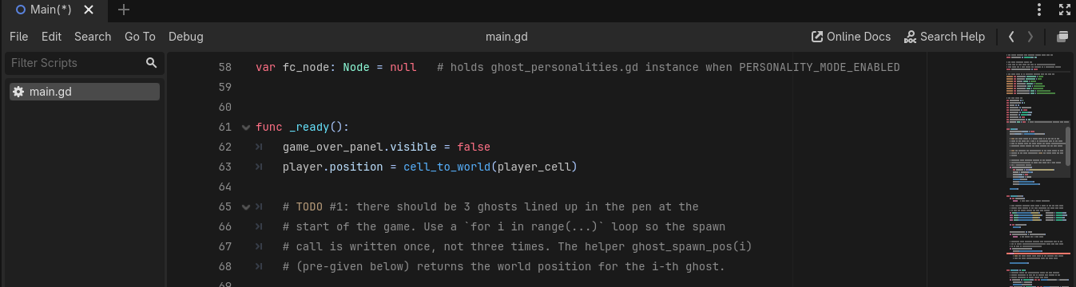
iCode
DAY 2
EMPOWERING FUTURE INNOVATORS
At the # TODO #1 marker inside _ready(). This runs once when the game starts.
29

Slide 30
iCode
DAY 2
EMPOWERING FUTURE INNOVATORS
Spawn three ghosts in the pen — but write the spawn call only once.
Pattern (board example):
Where in your code (Godot):
for i in range(3):
print(i)
30

Slide 31
iCode
DAY 2
EMPOWERING FUTURE INNOVATORS
Run your game
Press the same key you used yesterday to start the project.
31

Slide 32
iCode
DAY 2
EMPOWERING FUTURE INNOVATORS
Walk C — Hint
• Press F5 → "Set Main Scene?" dialog → Select Current → game window opens.
• Press F8 to stop.
32

Slide 33
iCode
DAY 2
EMPOWERING FUTURE INNOVATORS
Game didn't open? Find the error.
33

Slide 34
iCode
DAY 2
EMPOWERING FUTURE INNOVATORS
Walk D — Hint
• Look at the Output panel at the bottom of the editor.
• Find the error line → click the blue line number → editor jumps to it.
• Fix the typo → Ctrl+S → F5 again.
34

Slide 35
iCode
DAY 2
EMPOWERING FUTURE INNOVATORS
Same for. New shape.
• Last chunk: for i in range(3) — you wrote a number after range. Known count.
• This chunk: for ghost in ghosts — you write the name of a list you already have.
• The loop visits every item in the list, one by one.
35

Slide 36
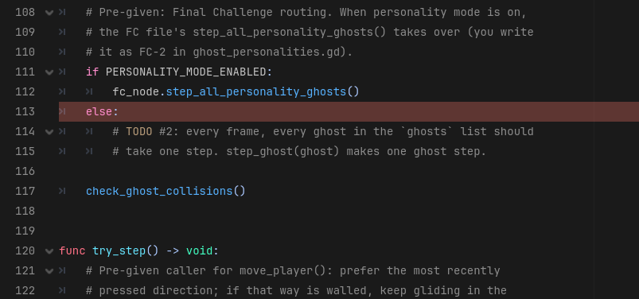
iCode
DAY 2
EMPOWERING FUTURE INNOVATORS
Each frame, walk through all the ghosts and move each one.
Pattern (board example):
Where in your code (Godot):
for colour in ["red", "green", "blue"]:
print(colour)
36

Slide 37
iCode
DAY 2
EMPOWERING FUTURE INNOVATORS
[ MISSING: unspecified ]
Run the game. After 2 seconds, ghosts start moving.
37

Slide 38
iCode
DAY 2
EMPOWERING FUTURE INNOVATORS
Loops have a cousin: while
38

Slide 39
iCode
DAY 2
EMPOWERING FUTURE INNOVATORS
while
39

Slide 40
iCode
DAY 2
EMPOWERING FUTURE INNOVATORS
while = as long as
• While it's raining, stay inside.
• While there's food on the plate, keep eating.
• In code: while runs the block again and again — as long as the condition is true.
40

Slide 41
iCode
DAY 2
EMPOWERING FUTURE INNOVATORS
while — the shape
var n := 0
while n < 5:
print(n)
n += 1
# prints: 0 1 2 3 4
41

Slide 42
iCode
DAY 2
EMPOWERING FUTURE INNOVATORS
for vs while — same stairs, different light
• `for` — you KNOW the count. (14 stairs to your bedroom — you've climbed them 1000 times.)
• `while` — you DON'T know the count. (Stairs in the dark — step up, stop when your foot finds no stair.)
• Same repeated motion. Different stopping rule.
42

Slide 43
iCode
DAY 2
EMPOWERING FUTURE INNOVATORS
Stairs in the dark
• Power's out. You're climbing stairs. You can't see the top.
• Step. Step. Step. Each time: is there another stair? Yes → keep going. No → stop.
• You don't know the count in advance. You stop when the condition is false.
43

Slide 44
iCode
DAY 2
EMPOWERING FUTURE INNOVATORS
How many times does this run?
var n := 3
while n > 0:
print(n)
n -= 1
44

Slide 45
iCode
DAY 2
EMPOWERING FUTURE INNOVATORS
while = keep going until the condition is false
• while n < 5: → stop when n reaches 5.
• while lives > 0: → stop when lives hit 0.
• while has_more_dots(): → stop when no dots remain.
45

Slide 46
iCode
DAY 2
EMPOWERING FUTURE INNOVATORS
while in games
• Scan a grid for coins: while x < map_width:
• Fall until you hit the floor: while not on_ground:
• Keep playing until lives run out: while lives > 0:
• Anything where you don't know the count in advance.
46

Slide 47
iCode
DAY 2
EMPOWERING FUTURE INNOVATORS
In our game: count every dot
• The maze is 28 × 31 = 868 tiles.
• At startup, count how many tiles have a dot — that's the win target.
• Scan every column (x) → every row (y) → count the dots.
• Neither loop knows the tile count in advance → while.
47

Slide 48
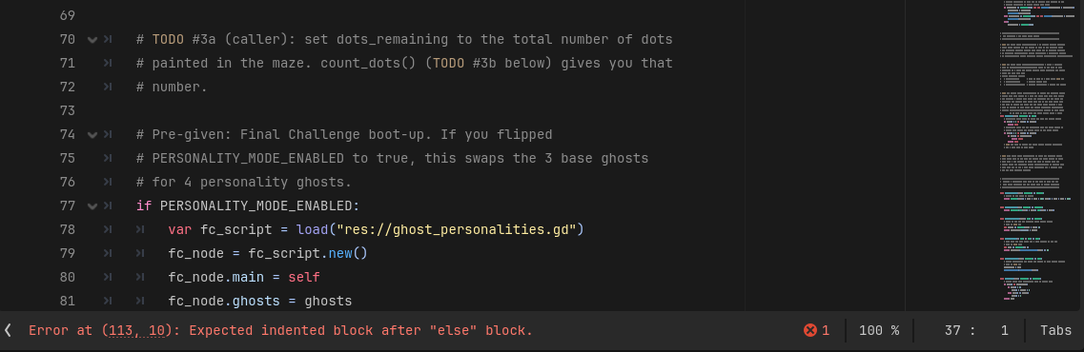
iCode
DAY 2
EMPOWERING FUTURE INNOVATORS
One line in _ready(): call count_dots() and store the result.
48

Slide 49
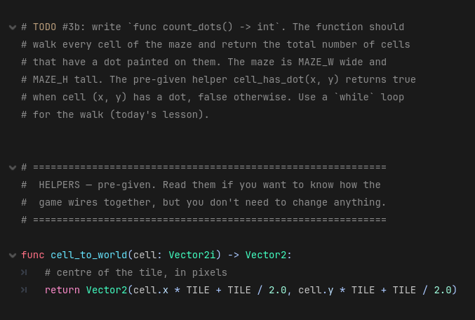
iCode
DAY 2
EMPOWERING FUTURE INNOVATORS
The whole count_dots() function body. You'll write the nested while loops inside.
49

Slide 50
iCode
DAY 2
EMPOWERING FUTURE INNOVATORS
Get the dot total from count_dots() and store it in dots_remaining.
Pattern (board example):
Where in your code (Godot):
dots_remaining = count_dots()
50

Slide 51
iCode
DAY 2
EMPOWERING FUTURE INNOVATORS
Scan the whole maze with a while loop. Count the dots. Return the count.
Pattern (board example):
Where in your code (Godot):
var n := 0
while n < 5:
print(n)
n += 1
51

Slide 52
iCode
DAY 2
EMPOWERING FUTURE INNOVATORS
Function
52

Slide 53
iCode
DAY 2
EMPOWERING FUTURE INNOVATORS
What's the function of…?
• A remote control → change the channel. That's its function.
• A calculator → do math. That's its function.
• A door → let you through (or keep you out). That's its function.
• Function = the thing it DOES.
53

Slide 54
iCode
DAY 2
EMPOWERING FUTURE INNOVATORS
Function = a name for a block of code
• func say_hi(): → defines the function named say_hi.
• say_hi() → calls it — runs the block.
• Define the recipe once. Call it any number of times.
54

Slide 55
iCode
DAY 2
EMPOWERING FUTURE INNOVATORS
func say_hi(): — the shape
func say_hi():
print("hi!")
say_hi() # → "hi!"
say_hi() # → "hi!"
55

Slide 56
iCode
DAY 2
EMPOWERING FUTURE INNOVATORS
The pizza order
• You walk into a pizza shop. You say: "Margherita."
• The kitchen makes dough → adds tomato → adds cheese → bakes → cuts → boxes.
• You didn't say any of that. You just said the name. The recipe ran.
56

Slide 57
iCode
DAY 2
EMPOWERING FUTURE INNOVATORS
How many times does say_hi() print if you call it 3 times?
57

Slide 58
iCode
DAY 2
EMPOWERING FUTURE INNOVATORS
Define once. Call anywhere.
• Without functions: copy-paste the same 5 lines every time you need them.
• With functions: write once, call by name from anywhere in the file.
• Change the recipe once → every call gets the update automatically.
58

Slide 59
iCode
DAY 2
EMPOWERING FUTURE INNOVATORS
Functions are everywhere in games
• jump() — called whenever player presses space.
• die() — called when health hits 0.
• spawn_enemy() — called at the start of each wave.
• Define once. Call from many places. No copy-paste.
59

Slide 60
iCode
DAY 2
EMPOWERING FUTURE INNOVATORS
In our game: reset_player()
• When a ghost catches the player, we need to: send them home, clear movement, wipe direction.
• That's 5 lines. We wrap them in a function called reset_player().
• The game calls reset_player() every time a ghost catches the player.
60

Slide 61
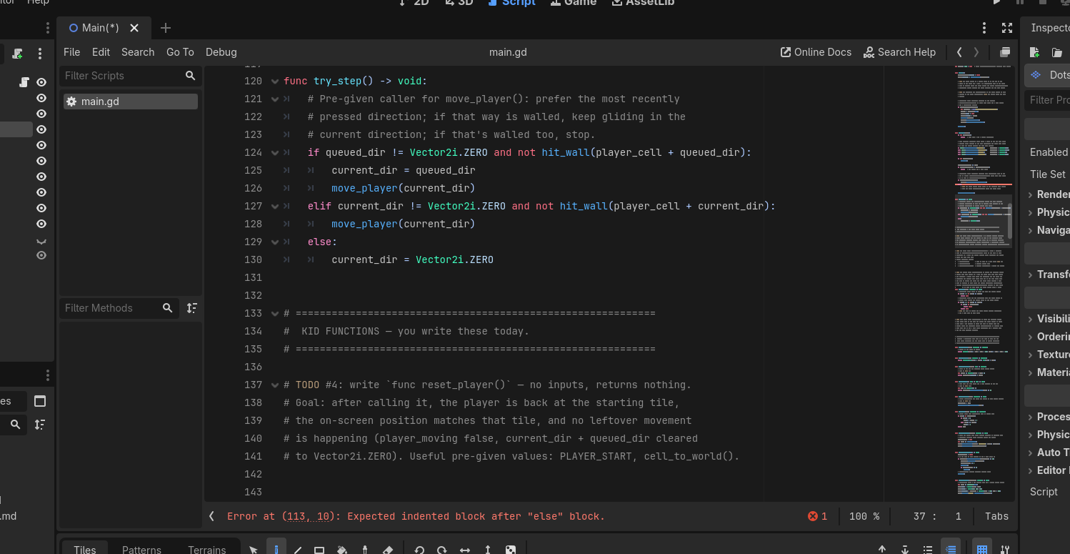
iCode
DAY 2
EMPOWERING FUTURE INNOVATORS
The function body is at main.gd:153-160. You'll write the contents.
61

Slide 62
iCode
DAY 2
EMPOWERING FUTURE INNOVATORS
Send the player back to the starting tile.
Pattern (board example):
Where in your code (Godot):
func say_hi():
print("hi!")
62

Slide 63
iCode
DAY 2
EMPOWERING FUTURE INNOVATORS
[ MISSING: unspecified ]
Run the game. Walk into a ghost. You pop back to the start.
63

Slide 64
iCode
DAY 2
EMPOWERING FUTURE INNOVATORS
Functions can take INPUTS
• Last chunk: func reset_player() — no inputs. Same thing every time.
• This chunk: func move_player(direction) — something between the parentheses.
• That thing is called a parameter — an input you hand to the function.
64

Slide 65
iCode
DAY 2
EMPOWERING FUTURE INNOVATORS
Parameter
65

Slide 66
iCode
DAY 2
EMPOWERING FUTURE INNOVATORS
A parameter is info you hand to the function
• func add_points(amount): — amount is the parameter.
• Call add_points(10) → amount is 10 inside the function.
• Call add_points(50) → amount is 50.
• Same function. Different input each time.
66

Slide 67
iCode
DAY 2
EMPOWERING FUTURE INNOVATORS
func add_points(amount): — the shape
func add_points(amount):
score += amount
add_points(10) # score goes up 10
add_points(50) # score goes up 50
67

Slide 68
iCode
DAY 2
EMPOWERING FUTURE INNOVATORS
Margherita — large or small?
• You say: "Margherita large." Kitchen runs the same recipe. Big ball of dough.
• You say: "Margherita small." Same recipe. Small ball of dough.
• The size is the parameter. One recipe, different inputs.
68

Slide 69
iCode
DAY 2
EMPOWERING FUTURE INNOVATORS
One function. Different inputs each time.
• move_player(Vector2i.UP) → moves up.
• move_player(Vector2i.DOWN) → moves down.
• Same function, called 4 times a second with whatever key is pressed.
69

Slide 70
iCode
DAY 2
EMPOWERING FUTURE INNOVATORS
In our game: move_player(direction)
• direction is the parameter — a Vector2i for up, down, left, or right.
• Arrow key pressed → direction is set → move_player(direction) is called.
• The function moves the player one tile in that direction (if no wall is in the way).
70

Slide 71
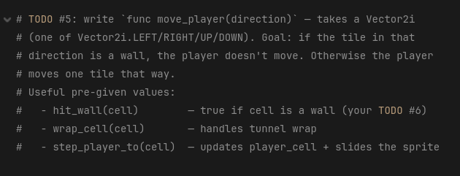
iCode
DAY 2
EMPOWERING FUTURE INNOVATORS
Inside move_player(direction) at main.gd:171-178. The direction: Vector2i in the signature is today's lesson — that's the parameter.
71

Slide 72
iCode
DAY 2
EMPOWERING FUTURE INNOVATORS
Move the player one tile in the direction they pressed — but only if a wall isn't in the way.
Pattern (board example):
Where in your code (Godot):
func add_points(amount):
score += amount
72

Slide 73
iCode
DAY 2
EMPOWERING FUTURE INNOVATORS
[ MISSING: unspecified ]
Run the game. Press arrow keys. Player slides one tile at a time.
73

Slide 74
iCode
DAY 2
EMPOWERING FUTURE INNOVATORS
Functions can HAND BACK an answer
• So far: functions do something. reset_player() moves the player. move_player(dir) slides them.
• New idea: a function can also return a value — hand an answer back to the caller.
• That answer has a name: the return value.
74

Slide 75
iCode
DAY 2
EMPOWERING FUTURE INNOVATORS
return
75

Slide 76
iCode
DAY 2
EMPOWERING FUTURE INNOVATORS
return hands a value back to the caller
• return = "here's your answer."
• The caller gets the value and can use it.
• var y = double(5) → double returns 10 → y is 10.
76

Slide 77
iCode
DAY 2
EMPOWERING FUTURE INNOVATORS
func double(n) -> int: — the shape
func double(n) -> int:
return n * 2
var y = double(5) # y = 10
var z = double(3) # z = 6
77

Slide 78
iCode
DAY 2
EMPOWERING FUTURE INNOVATORS
Remember booleans from Day 1?
• A boolean is a true/false value — the light switch.
• true = on. false = off.
• Today: our function hands back a boolean — "yes this is a wall" or "no it isn't."
78

Slide 79
iCode
DAY 2
EMPOWERING FUTURE INNOVATORS
The kitchen hands the pizza BACK
• Old version: you say "margherita", kitchen makes it. No pizza in your hands.
• New version: var dinner = margherita("large") — kitchen makes it AND hands it to you.
• dinner IS the pizza. That's the return value.
79

Slide 80
iCode
DAY 2
EMPOWERING FUTURE INNOVATORS
-> bool = this function answers yes or no
• hit_wall(cell) -> bool — "is there a wall at this cell?"
• is_alive() -> bool — "is the player still alive?"
• in_range(target) -> bool — "is the enemy close enough to shoot?"
• Every yes/no check in a game is a bool-returning function.
80

Slide 81
iCode
DAY 2
EMPOWERING FUTURE INNOVATORS
In our game: hit_wall(cell)
• move_player(direction) needs to know: "is the next tile a wall?"
• It calls hit_wall(next_cell) → gets back true or false.
• If true → don't move. If false → move.
• One question. One yes/no answer.
81

Slide 82
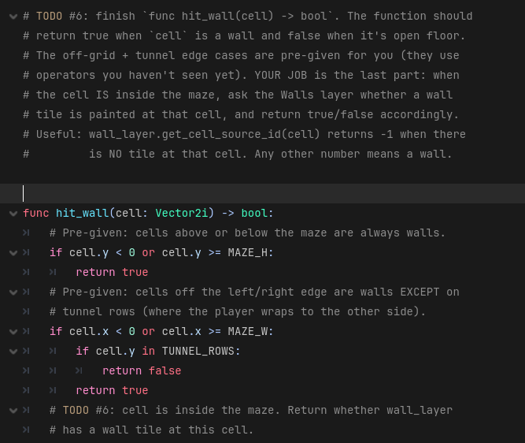
iCode
DAY 2
EMPOWERING FUTURE INNOVATORS
Inside hit_wall(cell) at main.gd:201-204. Off-grid + tunnel guards are pre-given. You write only the in-grid wall query.
82

Slide 83
iCode
DAY 2
EMPOWERING FUTURE INNOVATORS
Given a cell, hand back true if it's blocked, false if it's open. (off-grid + tunnel pre-given)
Pattern (board example):
Where in your code (Godot):
func is_even(n) -> bool:
return n % 2 == 0
83

Slide 84
iCode
DAY 2
EMPOWERING FUTURE INNOVATORS
[ MISSING: unspecified ]
Run the game. Walls block. Tunnel wraps. Ghosts patrol. Dots are chompable.
84

Slide 85
iCode
DAY 2
EMPOWERING FUTURE INNOVATORS
Make it yours
• The game works — now make it YOURS. Use the skills you've learned to personalize it however you like.
• Repaint the walls and dots, move the tunnel row, tweak the ghost timing, swap the player for a different sprite.
• Download free art from kenney.nl and drop it in. No wrong answers — make it your own.
85

Slide 86
iCode
DAY 2
EMPOWERING FUTURE INNOVATORS
Final Challenge
• Unlock the real Pac-Man ghosts. Open ghost_personalities.gd — six #@todo holes, each a reskin of a morning chunk.
• When all six are filled: open main.gd, flip PERSONALITY_MODE_ENABLED to true, and run. Four personality ghosts replace the three plain ones.
86

Slide 87
iCode
DAY 2
EMPOWERING FUTURE INNOVATORS
You already know how to do this.
• Each TODO in ghost_personalities.gd mirrors a chunk you wrote this morning. If you get stuck, scroll up to that chunk in main.gd and copy the shape (not the words).
• FC-1 ← Chunk #1 (for i in range(N))
• FC-2 ← Chunk #2 (for item in list)
• FC-3 ← Chunk #3 (while loop + count + return)
• FC-4 ← Chunk #4 (func no params)
• FC-5 ← Chunk #5 (func with a parameter)
• FC-6 ← Chunk #6 (func returning a bool)
87

Slide 88
iCode
DAY 2
EMPOWERING FUTURE INNOVATORS
The 4 personalities
| Ghost | Colour | What it does | |---|---|---| | **Blinky** | Red | Heads straight for the player. Most aggressive. | | **Pinky** | Pink | Aims 4 tiles ahead of the player to ambush. | | **Inky** | Cyan | Uses Blinky's position to flank from the opposite side. | | **Clyde** | Orange | Chases when far. Scatters to the corner when close. |
88

Slide 89
iCode
DAY 2
EMPOWERING FUTURE INNOVATORS
FC-1 — spawn_personality_ghosts()
• Mirrors Chunk #1 — same for i in range(N): shape you wrote this morning
• Goal: spawn one ghost per personality; when done, 4 personality ghosts appear in the pen at startup
• Given: PERSONALITY_COUNT (= 4) and spawn_one_personality(i) — spawns the i-th personality ghost for you
• You write: 2 lines — one for loop that calls spawn_one_personality(i) each turn
• Syntax: for i in range(PERSONALITY_COUNT): then spawn_one_personality(i)
89

Slide 90
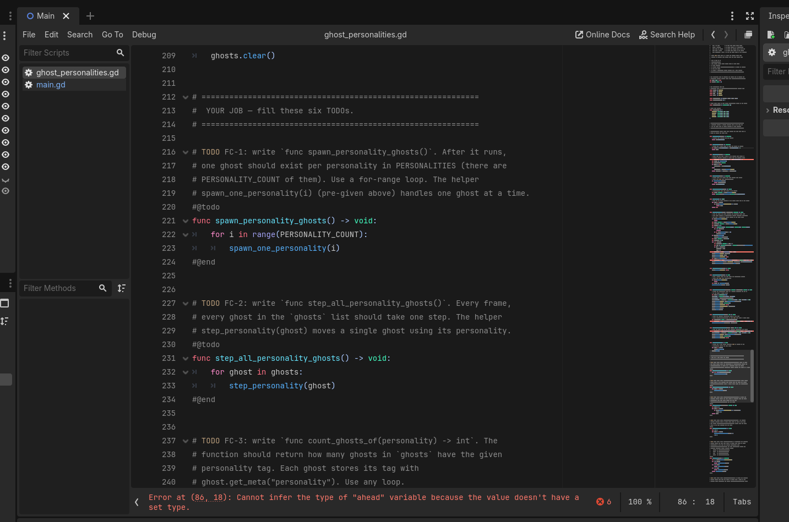
iCode
DAY 2
EMPOWERING FUTURE INNOVATORS
Spawn one ghost per personality — use range(PERSONALITY_COUNT) and call spawn_one_personality(i) each time.
Pattern (board example):
Where in your code (Godot):
for i in range(3):
print(i)
90

Slide 91
iCode
DAY 2
EMPOWERING FUTURE INNOVATORS
FC-2 — step_all_personality_ghosts()
• Mirrors Chunk #2 — same for item in list: shape you wrote this morning
• Goal: every frame, give each personality ghost one movement step — after this, the 4 ghosts start patrolling the maze
• Given: ghosts (list of all active personality ghosts) and step_personality(ghost) — moves one ghost one tile
• You write: 2 lines — loop over ghosts, call step_personality(ghost) each turn
• Syntax: for ghost in ghosts: then step_personality(ghost)
91

Slide 92
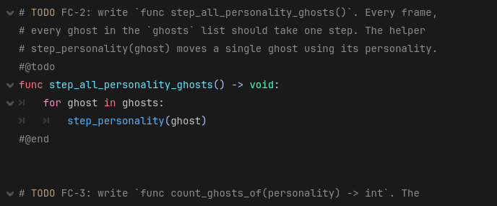
iCode
DAY 2
EMPOWERING FUTURE INNOVATORS
Every frame, give every personality ghost one step — loop over ghosts and call step_personality(ghost).
Pattern (board example):
Where in your code (Godot):
for colour in ["red", "green", "blue"]:
print(colour)
92

Slide 93
iCode
DAY 2
EMPOWERING FUTURE INNOVATORS
FC-3 — count_ghosts_of(personality) -> int
• Mirrors Chunk #3 — loop + counter pattern; return the total at the end
• Goal: count how many ghosts in ghosts have the given personality tag; return that number
• Given: ghosts (the list), ghost.get_meta(\"personality\") reads one ghost's tag, and personality (the parameter passed in)
• You write: ~5 lines — var count := 0, loop, check each tag with if, increment, then return count
• Syntax: for ghost in ghosts: / if ghost.get_meta(\"personality\") == personality: / count += 1
93

Slide 94
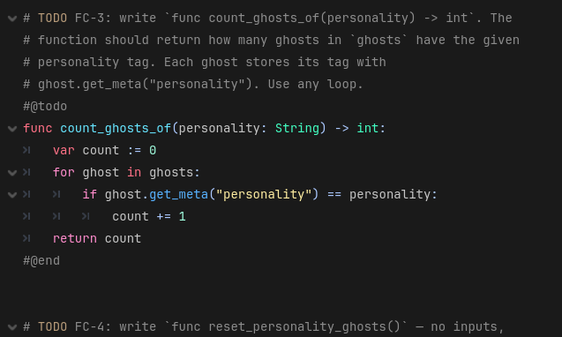
iCode
DAY 2
EMPOWERING FUTURE INNOVATORS
Count how many ghosts in ghosts have the given personality tag. Return the count.
Pattern (board example):
Where in your code (Godot):
var n := 0
while n < 5:
print(n)
n += 1
94

Slide 95
iCode
DAY 2
EMPOWERING FUTURE INNOVATORS
FC-4 — reset_personality_ghosts()
• Mirrors Chunk #4 — loop with a manual index counter (same pattern as morning chunk #4)
• Goal: send every personality ghost back to the pen; called automatically when the player loses a life
• Given: ghosts (the list) and respawn_personality_ghost(ghost, i) — teleports one ghost to pen slot i
• You write: ~4 lines — var i := 0, loop over ghosts, call respawn_personality_ghost(ghost, i), then i += 1
• Syntax: var i := 0 / for ghost in ghosts: / respawn_personality_ghost(ghost, i) / i += 1
95

Slide 96
iCode
DAY 2
EMPOWERING FUTURE INNOVATORS
Send every personality ghost back to the pen. Loop over ghosts with an index counter and call respawn_personality_ghost(ghost, i).
Pattern (board example):
Where in your code (Godot):
func say_hi():
print("hi!")
[ MISSING: D2FC4.png ]
96

Slide 97
iCode
DAY 2
EMPOWERING FUTURE INNOVATORS
FC-5 — target_for(ghost) -> Vector2i
• Mirrors Chunk #5 — function that takes a parameter and returns a value
• Goal: given a ghost, return its target tile by reading its personality and calling the right pre-given helper
• Given: ghost.get_meta(\"personality\") reads the tag; constants BLINKY, PINKY, INKY, CLYDE; and helpers blinky_target(ghost), pinky_target(ghost), inky_target(ghost), clyde_target(ghost)
• You write: ~9 lines — var p = ghost.get_meta(\"personality\") then 4 if/elif branches, each returning the matching target helper
• Syntax: if p == BLINKY: return blinky_target(ghost) — repeat for PINKY, INKY, CLYDE
97

Slide 98
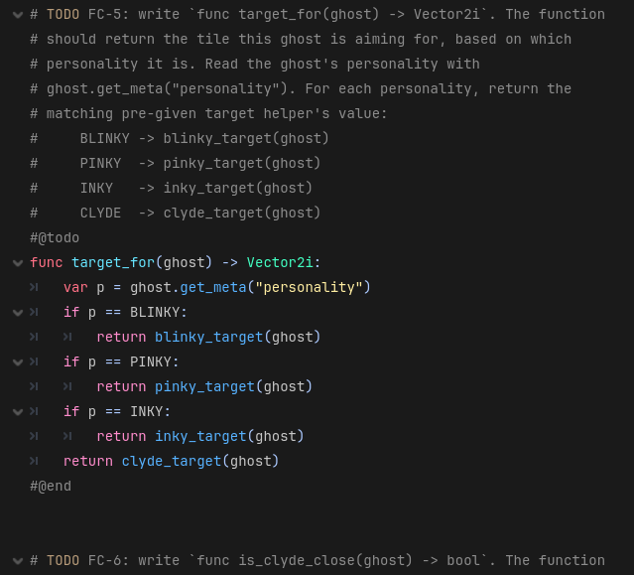
iCode
DAY 2
EMPOWERING FUTURE INNOVATORS
Given a ghost, return its target tile. Read its personality, then return the right pre-given target helper.
Pattern (board example):
Where in your code (Godot):
func add_points(amount):
score += amount
98

Slide 99
iCode
DAY 2
EMPOWERING FUTURE INNOVATORS
FC-6 — is_clyde_close(ghost) -> bool
• Mirrors Chunk #6 — function that returns a bool (true or false)
• Goal: return true when the given ghost is within 8 tiles of the player, false otherwise
• Given: distance_to_player(ghost) — returns a float tile distance from the ghost to the player
• You write: 2 lines — store the distance in var d, then return d < 8.0
• Syntax: var d := distance_to_player(ghost) / return d < 8.0
99

Slide 100
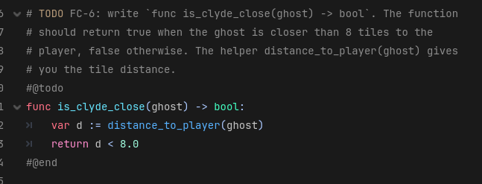
iCode
DAY 2
EMPOWERING FUTURE INNOVATORS
Return true if the ghost is closer than 8 tiles to the player — call distance_to_player(ghost) and compare.
Pattern (board example):
Where in your code (Godot):
func is_even(n) -> bool:
return n % 2 == 0
100

Slide 101
iCode
DAY 2
EMPOWERING FUTURE INNOVATORS
Take it home
Turn your maze game into a real Windows program — a .exe you can run on any PC, no Godot needed. Show your family tonight.
101

Slide 102
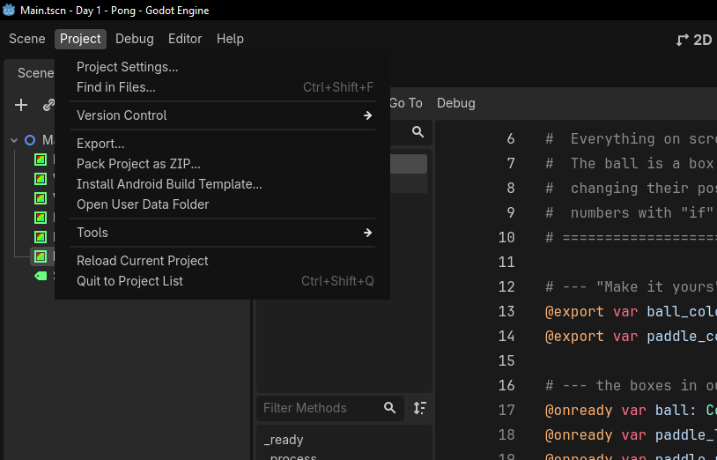
iCode
DAY 2
EMPOWERING FUTURE INNOVATORS
In the top menu bar, click Project, then Export…
102

Slide 103
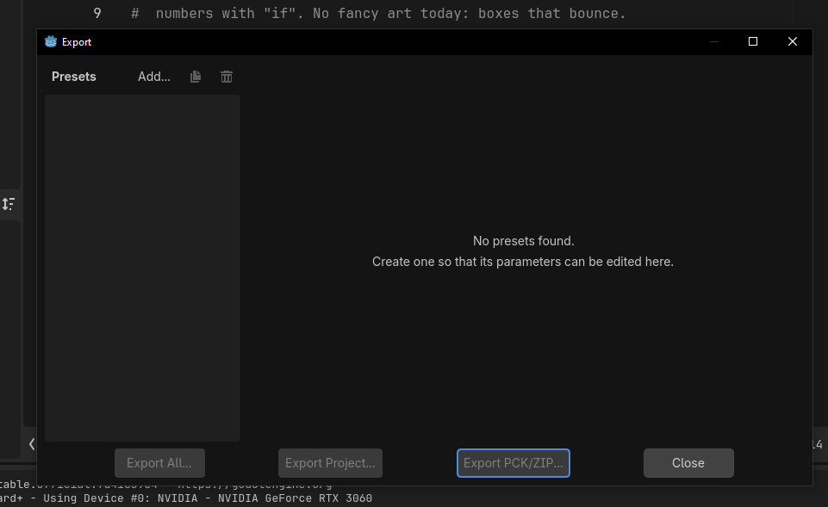
iCode
DAY 2
EMPOWERING FUTURE INNOVATORS
The Export window opens. It's empty the first time — click Add… at the top to add a target.
103

Slide 104
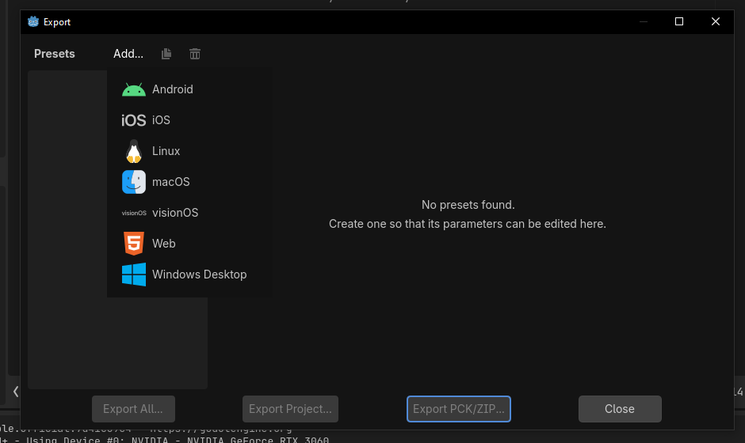
iCode
DAY 2
EMPOWERING FUTURE INNOVATORS
From the list, pick Windows Desktop — that's the kind of program Windows PCs run.
104

Slide 105
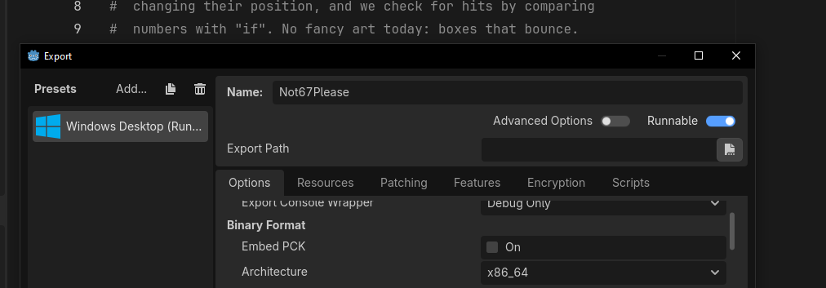
iCode
DAY 2
EMPOWERING FUTURE INNOVATORS
Godot adds a Windows Desktop preset on the left. Leave the options as they are — Runnable on, Architecture x86_64.
105

Slide 106
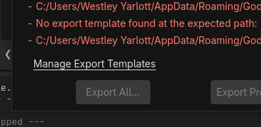
iCode
DAY 2
EMPOWERING FUTURE INNOVATORS
The first time on a new PC you may see a red 'No export template found' message. Click Manage Export Templates to fix it.
106

Slide 107
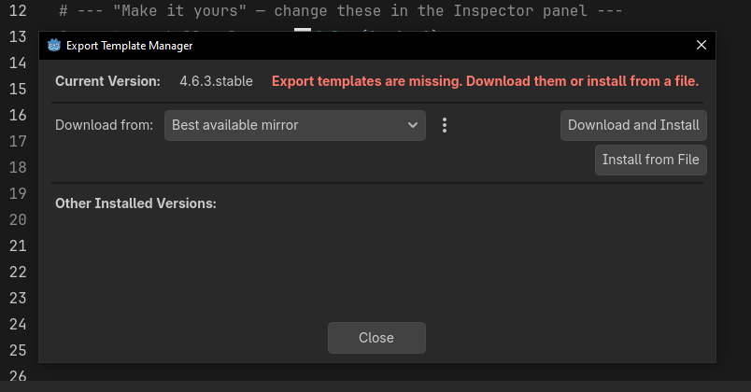
iCode
DAY 2
EMPOWERING FUTURE INNOVATORS
In the Export Template Manager, click Download and Install. Let it finish, then close. (One-time setup per computer.)
107

Slide 108
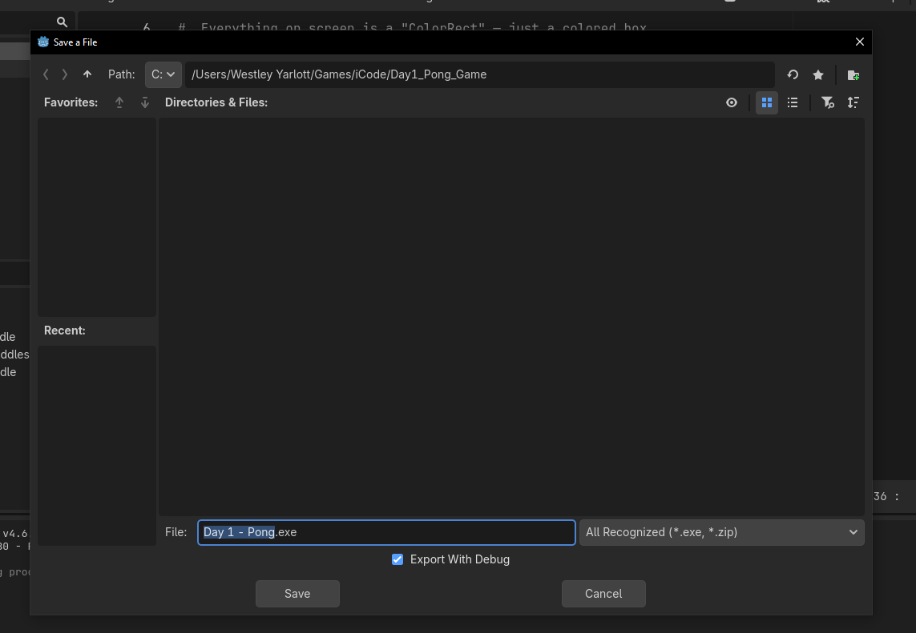
iCode
DAY 2
EMPOWERING FUTURE INNOVATORS
Click Export Project, type a name (e.g. Day 2 - Maze), pick your folder, and click Save. Godot builds your game.
108

Slide 109
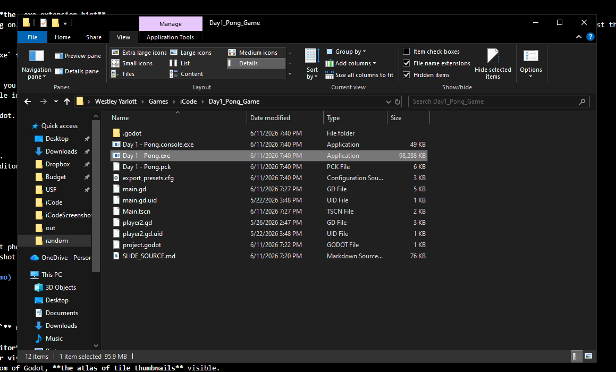
iCode
DAY 2
EMPOWERING FUTURE INNOVATORS
Godot writes your .exe plus a .pck data file into your folder. Double-click the .exe — your maze game runs with no Godot needed. Keep the two files together.
109

Slide 110
iCode
DAY 2
EMPOWERING FUTURE INNOVATORS
Tomorrow: defend your base
1990s. Tower & base defense. We go deeper on functions and meet lists — to spawn waves of enemies and the towers that stop them.
110

