Slide 1

iCode
DAY 2
EMPOWERING FUTURE INNOVATORS
<exact title text>
<bullets, prose, or code block — verbatim>
1

Slide 2
iCode
DAY 2
EMPOWERING FUTURE INNOVATORS
VR Creator - Day 2
Pac-Man · 1980 · Namco
2

Slide 3
iCode
DAY 2
EMPOWERING FUTURE INNOVATORS
Why Pac-Man changed everything (1980)
• Pre-1980 arcades = almost all space shooters. Pac-Man invented the maze chase.
• First game with a character with personality — Pac-Man + 4 named ghosts (Blinky, Pinky, Inky, Clyde), each with its own AI.
• First game with cutscenes between levels.
• First arcade game marketed beyond boys — broke the 'arcade = boys only' mold.
• First giant merchandising wave — lunchboxes, a cartoon, a hit song.
• No Pac-Man → maybe no Mario, no Sonic, no character mascots at all.
3

Slide 4
iCode
DAY 2
EMPOWERING FUTURE INNOVATORS
Yesterday → Today
• Day 1 — Variables + Conditions. You named things and made choices.
• Day 2 — Loops + Functions. You repeat things and package code into reusable recipes.
• Same var, same if. Two new tools on top.
4

Slide 5
iCode
DAY 2
EMPOWERING FUTURE INNOVATORS
The 5-day arc
• Day 1 ✓ Pong — Vars + Conditions
• Day 2 ← Pac-Man — Loops + Functions
• Day 3 Tower Defense — Lists + Functions deep
• Day 4 Fighter — Objects
• Day 5 VR Escape Room — Showcase
5

Slide 6
iCode
DAY 2
EMPOWERING FUTURE INNOVATORS
Today's concepts: Loops + Functions
• Loops — make the same code run again and again.
• Functions — give a block of code a name, call it whenever you need it.
6

Slide 7
iCode
DAY 2
EMPOWERING FUTURE INNOVATORS
GDScript is just like Python
Python
GDScript
def update():
pass
func update():
pass
7

Slide 8
iCode
DAY 2
EMPOWERING FUTURE INNOVATORS
Pre-coding setup
8

Slide 9
iCode
DAY 2
EMPOWERING FUTURE INNOVATORS
Open the Day 2 Maze project
Open the Day 2 Maze project the same way you did yesterday.
9

Slide 10
iCode
DAY 2
EMPOWERING FUTURE INNOVATORS
Walk A — Hint
• Godot Launcher → Import button
• Navigate to Day2_Maze_Game/project.godot
• Click Import & Edit
10

Slide 11
iCode
DAY 2
EMPOWERING FUTURE INNOVATORS
Open main.gd
Open main.gd and switch to the Script editor — same way as yesterday.
11

Slide 12
iCode
DAY 2
EMPOWERING FUTURE INNOVATORS
Walk B — Hint
• FileSystem panel (bottom-left) → find main.gd
• Double-click → Script editor opens
12

Slide 13
iCode
DAY 2
EMPOWERING FUTURE INNOVATORS
New today: TileSet and TileMapLayer
• TileSet = the palette. A resource that chops the Kenney atlas into named 16×16 tiles.
• TileMapLayer = a node that paints tiles from the TileSet onto a 2D grid.
• TileSet = box of crayons. TileMapLayer = the coloring page.
• Your code just asks the layer: 'is there a wall here?' You don't touch the TileSet panel.
13

Slide 14
iCode
DAY 2
EMPOWERING FUTURE INNOVATORS
Two layers share one TileSet
• Walls layer — collision tiles that block movement.
• Dots layer — the pellets to chomp.
• Both use the same TileSet palette. Two painted canvases, one box of crayons.
14

Slide 15
iCode
DAY 2
EMPOWERING FUTURE INNOVATORS
Lesson chunks
15

Slide 16
iCode
DAY 2
EMPOWERING FUTURE INNOVATORS
There are thousands of right answers
• Any piece of code has millions of valid ways to write it.
• The examples on the LEFT side of TODO slides are one way.
• Your way works if it runs. Seriously.
16

Slide 17
iCode
DAY 2
EMPOWERING FUTURE INNOVATORS
Loop
17

Slide 18
iCode
DAY 2
EMPOWERING FUTURE INNOVATORS
What does 'loop' mean?
• Roller coaster loop — the track comes back around.
• A rope tied in a loop — no beginning, no end.
• In code: a loop = code that repeats.
18

Slide 19
iCode
DAY 2
EMPOWERING FUTURE INNOVATORS
A loop runs the same code again and again
• You write the action once.
• The loop runs it as many times as you say.
• No copy-paste. No 50 lines of the same thing.
19

Slide 20
iCode
DAY 2
EMPOWERING FUTURE INNOVATORS
for i in range(3): — the shape
for i in range(3):
print(i)
# prints: 0 1 2
20

Slide 21
iCode
DAY 2
EMPOWERING FUTURE INNOVATORS
14 stairs to your bedroom
• Every night: step, step, step — 14 times. Same motion. Known count.
• for i in range(14): → climb_one_stair()
• You know exactly how many stairs. The loop counts for you.
21

Slide 22
iCode
DAY 2
EMPOWERING FUTURE INNOVATORS
How many times does range(5) run?
22

Slide 23
iCode
DAY 2
EMPOWERING FUTURE INNOVATORS
range(N) = N runs
• range(3) → runs 3 times (i = 0, 1, 2).
• range(10) → runs 10 times.
• range(0) → runs zero times.
23

Slide 24
iCode
DAY 2
EMPOWERING FUTURE INNOVATORS
Watch the loop run — step 1
• → `for i in range(3):` — i = 0
• print(i) → prints 0
• ↑ Back to the top of the loop
24

Slide 25
iCode
DAY 2
EMPOWERING FUTURE INNOVATORS
Watch the loop run — step 2
• → `for i in range(3):` — i = 1
• print(i) → prints 1
• ↑ Back to the top of the loop
25

Slide 26
iCode
DAY 2
EMPOWERING FUTURE INNOVATORS
Watch the loop run — step 3 → done
• → `for i in range(3):` — i = 2
• print(i) → prints 2
• ↑ Back to top — range(3) exhausted → loop exits
26

Slide 27
iCode
DAY 2
EMPOWERING FUTURE INNOVATORS
Games loop all the time
• Spawn 50 trees in a forest level → for i in range(50):
• Deal 4 cards at game start → for i in range(4):
• Create 12 enemies in the first wave → for i in range(12):
27

Slide 28
iCode
DAY 2
EMPOWERING FUTURE INNOVATORS
In our game: spawn 3 ghosts
• At startup, 3 ghosts need to appear in the pen.
• Without a loop: write spawn_ghost_at(...) three times.
• With a loop: write it once. for i in range(3): handles 3.
• If the designer adds a 4th ghost — you change one number.
28

Slide 29
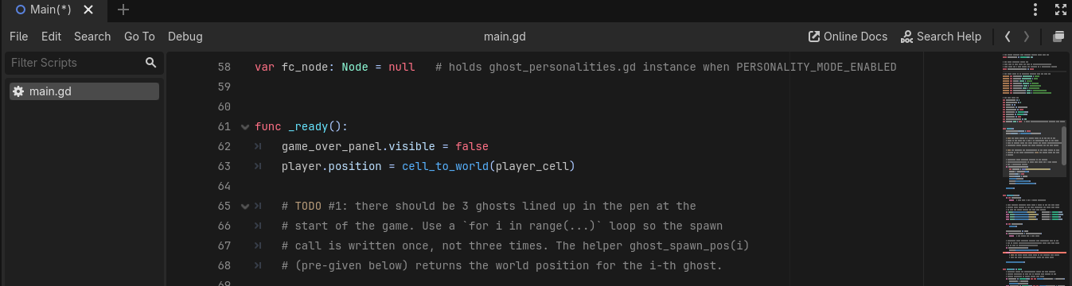
iCode
DAY 2
EMPOWERING FUTURE INNOVATORS
At the # TODO #1 marker inside _ready(). This runs once when the game starts.
29

Slide 30
iCode
DAY 2
EMPOWERING FUTURE INNOVATORS
What you're about to write
# for i going from 0 to 2 (range(3)):
# call spawn_ghost_at(ghost_spawn_pos(i))
• What: A for loop that spawns 3 ghosts at startup — one per iteration.
• Why: Without this loop, no ghosts appear. The maze is empty.
• How: for i in range(3): runs 3 times. Each run, call the pre-given spawn_ghost_at(ghost_spawn_pos(i)).
This is one approach — yours works if it runs.
30

Slide 31
iCode
DAY 2
EMPOWERING FUTURE INNOVATORS
TODO #1 — Spawn 3 ghosts
SYNTAX
WRITE THIS
for i in range(N):
do_something(i)
# for i going from 0 to 2 (range(3)):
# call spawn_ghost_at(ghost_spawn_pos(i))
Detailed instructions are in your code file, right next to this TODO.
31

Slide 32
iCode
DAY 2
EMPOWERING FUTURE INNOVATORS
Run your game
Press the same key you used yesterday to start the project.
32

Slide 33
iCode
DAY 2
EMPOWERING FUTURE INNOVATORS
Walk C — Hint
• Press F5 → 'Set Main Scene?' → Select Current → game window opens.
• Press F8 to stop.
33

Slide 34
iCode
DAY 2
EMPOWERING FUTURE INNOVATORS
Game didn't open? Find the error.
34

Slide 35
iCode
DAY 2
EMPOWERING FUTURE INNOVATORS
Walk D — Hint
• Look at the Output panel (bottom of editor).
• Find the error line → click the blue line number → editor jumps there.
• Fix the typo → Ctrl+S → F5 again.
35

Slide 36
iCode
DAY 2
EMPOWERING FUTURE INNOVATORS
Personalization #1
• 3 ghosts feel right — but try 4, or even 1.
• Find for i in range(3) in your _ready(). Change the number. Run it.
• What happens with 10 ghosts?
• Low on time? Skip this and keep going. Finished early? This is for you.
36

Slide 37
iCode
DAY 2
EMPOWERING FUTURE INNOVATORS
Same for. New shape.
• Last chunk: for i in range(3) — a number after range. Known count.
• This chunk: for ghost in ghosts — the name of a list you already have.
• The loop visits every item in the list, one by one.
37

Slide 38
iCode
DAY 2
EMPOWERING FUTURE INNOVATORS
What you're about to write
# for each ghost in the ghosts list:
# call step_ghost(ghost)
• What: A for loop that moves every ghost by one step, every frame.
• Why: Without this, ghosts spawn but never move.
• How: for ghost in ghosts: visits each ghost. step_ghost(ghost) is the pre-given helper that moves one ghost.
This is one approach — yours works if it runs.
38

Slide 39
iCode
DAY 2
EMPOWERING FUTURE INNOVATORS
TODO #2 — Step every ghost each frame
SYNTAX
WRITE THIS
for item in collection:
do_something(item)
# for each ghost in the ghosts list:
# call step_ghost(ghost)
Detailed instructions are in your code file, right next to this TODO.
39

Slide 40
iCode
DAY 2
EMPOWERING FUTURE INNOVATORS
Run the game. After 2 seconds, ghosts start moving.
40

Slide 41
iCode
DAY 2
EMPOWERING FUTURE INNOVATORS
Loops have a cousin: while
41

Slide 42
iCode
DAY 2
EMPOWERING FUTURE INNOVATORS
while
42

Slide 43
iCode
DAY 2
EMPOWERING FUTURE INNOVATORS
while = as long as
• While it's raining, stay inside.
• While there's food on the plate, keep eating.
• In code: while runs the block again and again — as long as the condition is true.
43

Slide 44
iCode
DAY 2
EMPOWERING FUTURE INNOVATORS
while — the shape
var n := 0
while n < 5:
print(n)
n += 1
# prints: 0 1 2 3 4
44

Slide 45
iCode
DAY 2
EMPOWERING FUTURE INNOVATORS
for vs while — same stairs, different light
• `for` — you KNOW the count. (14 stairs to your bedroom — you've climbed them 1000 times.)
• `while` — you DON'T know the count. (Stairs in the dark — step up, stop when your foot finds no stair.)
• Same repeated motion. Different stopping rule.
45

Slide 46
iCode
DAY 2
EMPOWERING FUTURE INNOVATORS
Stairs in the dark
• Power's out. You're climbing stairs. You can't see the top.
• Step. Step. Step. Each time: is there another stair? Yes → keep going. No → stop.
• You don't know the count in advance. You stop when the condition is false.
46

Slide 47
iCode
DAY 2
EMPOWERING FUTURE INNOVATORS
How many times does this run?
var n := 3
while n > 0:
print(n)
n -= 1
47

Slide 48
iCode
DAY 2
EMPOWERING FUTURE INNOVATORS
while = keep going until the condition is false
• while n < 5: → stop when n reaches 5.
• while lives > 0: → stop when lives hit 0.
• while has_more_dots(): → stop when no dots remain.
48

Slide 49
iCode
DAY 2
EMPOWERING FUTURE INNOVATORS
while in games
• Scan a grid for coins: while x < map_width:
• Fall until you hit the floor: while not on_ground:
• Keep playing until lives run out: while lives > 0:
49

Slide 50
iCode
DAY 2
EMPOWERING FUTURE INNOVATORS
In our game: count every dot
• The maze is 28 × 31 = 868 tiles.
• At startup, count how many tiles have a dot — that's the win target.
• Scan every column (x) → every row (y) → count the dots.
50

Slide 51
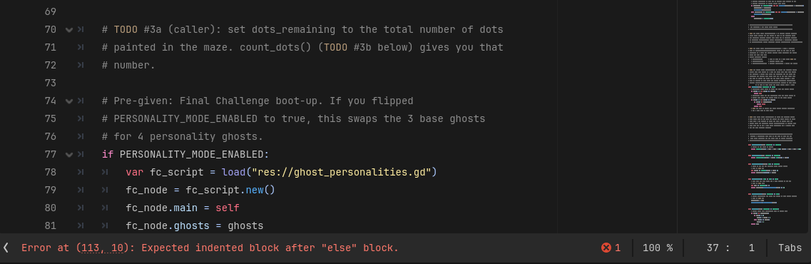
iCode
DAY 2
EMPOWERING FUTURE INNOVATORS
One line in _ready(): call count_dots() and store the result.
51

Slide 52
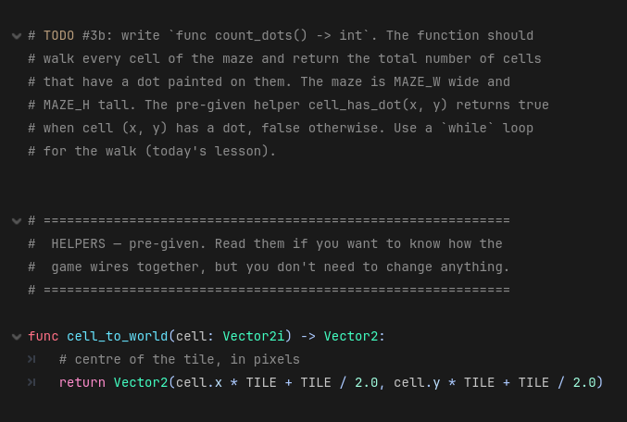
iCode
DAY 2
EMPOWERING FUTURE INNOVATORS
The whole count_dots() function body. You'll write the nested while loops inside.
52

Slide 53
iCode
DAY 2
EMPOWERING FUTURE INNOVATORS
What you're about to write
# set dots_remaining to the result of count_dots()
• What: One line — call count_dots() and store the answer.
• Why: dots_remaining is the win counter. Without this, it stays 0 forever.
• How: dots_remaining = count_dots() — assign the return value to the variable.
This is one approach — yours works if it runs.
53

Slide 54
iCode
DAY 2
EMPOWERING FUTURE INNOVATORS
TODO #3a — Store the dot count
SYNTAX
WRITE THIS
func name(param) -> ReturnType:
return value
var name := value
# set dots_remaining to the result of count_dots()
Detailed instructions are in your code file, right next to this TODO.
54

Slide 55
iCode
DAY 2
EMPOWERING FUTURE INNOVATORS
What does a nested loop do?
• A nested loop = a loop inside another loop.
• The inner loop runs completely before the outer loop takes one step.
• Scanning a grid needs exactly this.
55

Slide 56
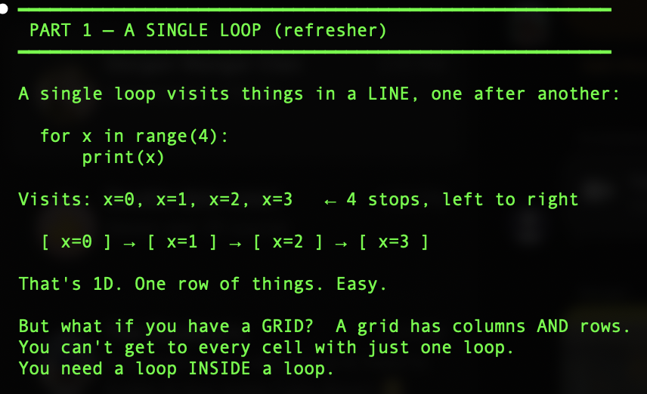
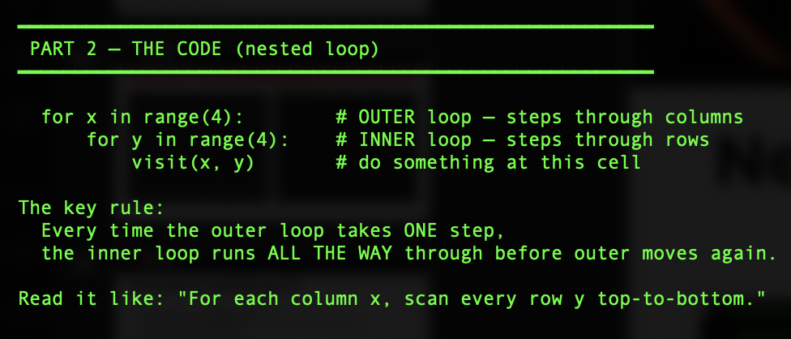
iCode
DAY 2
EMPOWERING FUTURE INNOVATORS
Nested loop
57

Slide 57
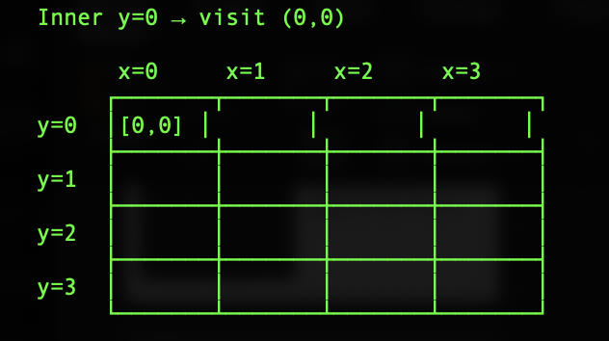
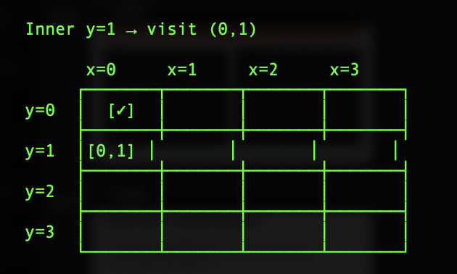
iCode
DAY 2
EMPOWERING FUTURE INNOVATORS
Nested loop
->
57

Slide 58
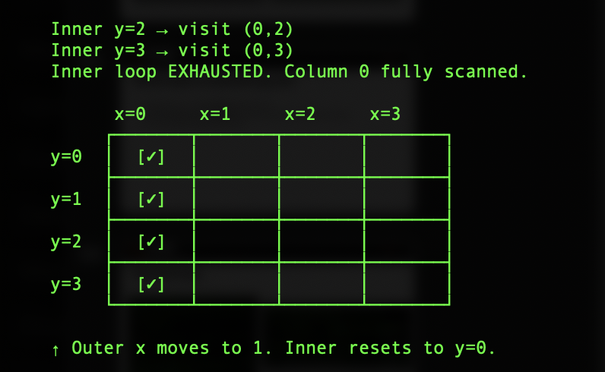
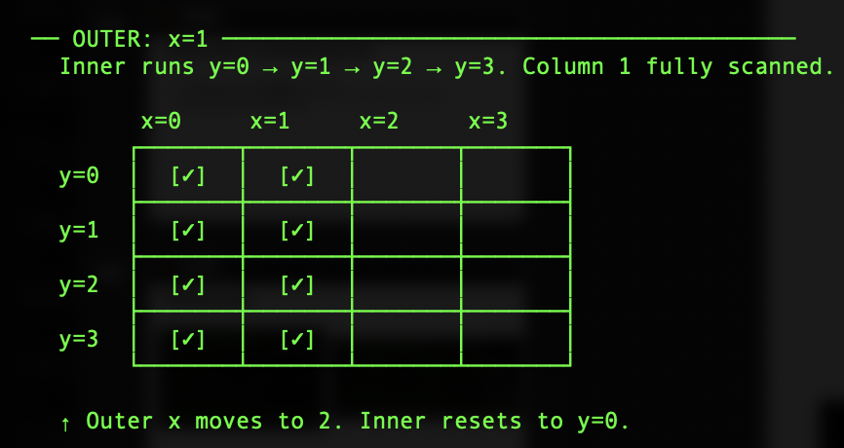
iCode
DAY 2
EMPOWERING FUTURE INNOVATORS
Nested loop
->
57

Slide 59
iCode
DAY 2
EMPOWERING FUTURE INNOVATORS
Your pacman game IS a grid
• A nested loop can scan every single tile in the map
55

Slide 60
iCode
DAY 2
EMPOWERING FUTURE INNOVATORS
What you're about to write
# start count at 0
# start x at 0
# while x < MAZE_W:
# start y at 0
# while y < MAZE_H:
# if cell_has_dot(x, y):
# add 1 to count
# add 1 to y
# add 1 to x
# return count
• What: Nested while loops that scan every tile and count dots.
• Why: count_dots() is called by #3a. Without it, the win counter never starts.
• How: Outer loop scans columns (x), inner loop scans rows (y). cell_has_dot(x, y) is pre-given.
This is one approach — yours works if it runs.
59

Slide 61
iCode
DAY 2
EMPOWERING FUTURE INNOVATORS
TODO #3b — Write `count_dots()` body
SYNTAX
WRITE THIS
var n := 0
while n < limit:
do_something()
n += 1
var name := value
return
if condition:
do_this
# start count at 0
# start x at 0
# while x < MAZE_W:
# start y at 0
# while y < MAZE_H:
# if cell_has_dot(x, y):
# add 1 to count
# add 1 to y
# add 1 to x
# return count
Detailed instructions are in your code file, right next to this TODO.
60

Slide 62
iCode
DAY 2
EMPOWERING FUTURE INNOVATORS
Function
61

Slide 63
iCode
DAY 2
EMPOWERING FUTURE INNOVATORS
What's the function of…?
• A remote control → change the channel. That's its function.
• A calculator → do math. That's its function.
• Function = the thing it DOES.
62

Slide 64
iCode
DAY 2
EMPOWERING FUTURE INNOVATORS
Function = a name for a block of code
• func say_hi(): → defines the function named say_hi.
• say_hi() → calls it — runs the block.
• Define the recipe once. Call it any number of times.
63

Slide 65
iCode
DAY 2
EMPOWERING FUTURE INNOVATORS
Defined once — called from two different places
func reset_player():
player_cell = PLAYER_START
player_moving = false
# called when a ghost catches you:
func on_ghost_collision():
reset_player()
# called when a new game starts:
func start_game():
reset_player()
64

Slide 66
iCode
DAY 2
EMPOWERING FUTURE INNOVATORS
The pizza order
• You walk into a pizza shop. You say: 'Margherita.'
• The kitchen does dough → tomato → cheese → bakes → cuts → boxes.
• You didn't say any of that. You just said the name. The recipe ran.
65

Slide 67
iCode
DAY 2
EMPOWERING FUTURE INNOVATORS
How many times does say_hi() print if you call it 3 times?
66

Slide 68
iCode
DAY 2
EMPOWERING FUTURE INNOVATORS
Define once. Call anywhere.
• Without functions: copy-paste the same 5 lines every time you need them.
• With functions: write once, call by name from anywhere in the file.
• Change the recipe once → every call gets the update automatically.
67

Slide 69
iCode
DAY 2
EMPOWERING FUTURE INNOVATORS
Functions are everywhere in games
• jump() — called whenever player presses space.
• die() — called when health hits 0.
• spawn_enemy() — called at the start of each wave.
68

Slide 70
iCode
DAY 2
EMPOWERING FUTURE INNOVATORS
In our game: reset_player()
• When a ghost catches the player: send them home, clear movement, wipe direction.
• That's 5 lines. We wrap them in reset_player().
• Called every time a ghost catches the player — and from the start-game code too.
69

Slide 71
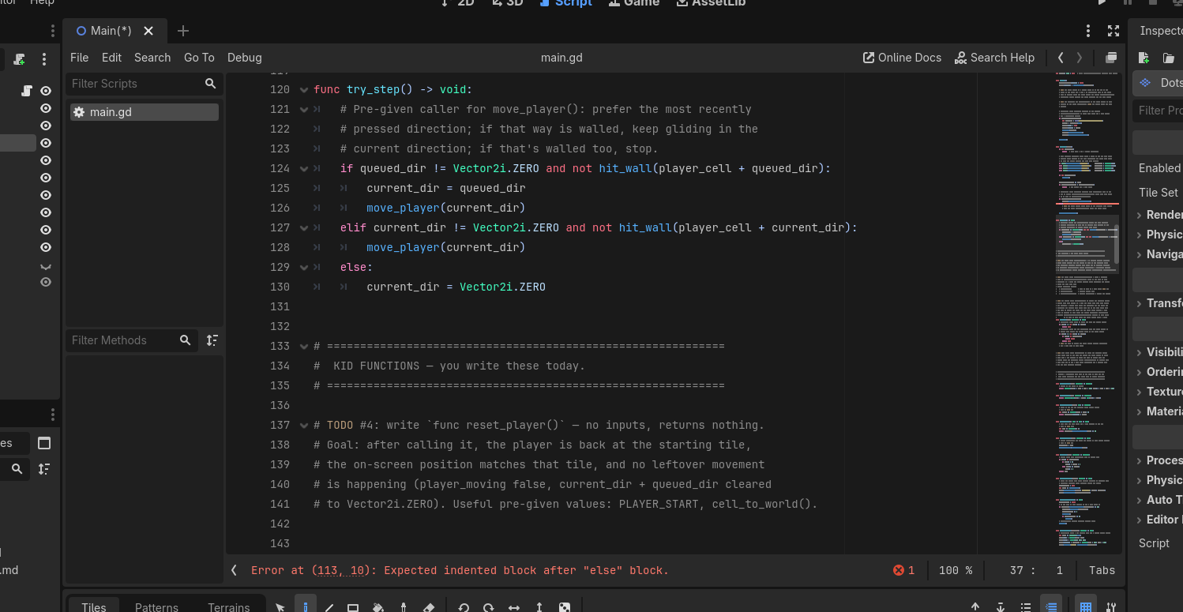
iCode
DAY 2
EMPOWERING FUTURE INNOVATORS
The function body is at main.gd lines 164-191. You'll write the contents.
70

Slide 72
iCode
DAY 2
EMPOWERING FUTURE INNOVATORS
What you're about to write
# set player_cell to PLAYER_START
# set player.position to cell_to_world(player_cell)
# set player_moving to false
# set current_dir to Vector2i.ZERO
# set queued_dir to Vector2i.ZERO
• What: Five assignments that send the player home with a clean slate.
• Why: Without this, a ghost catch leaves the player stuck mid-tile.
• How: cell_to_world(player_cell) is pre-given — converts tile coords to screen position.
This is one approach — yours works if it runs.
71

Slide 73
iCode
DAY 2
EMPOWERING FUTURE INNOVATORS
TODO #4 — Write `reset_player()` body
SYNTAX
WRITE THIS
func name() -> void:
do_something()
object.property += amount
# set player_cell to PLAYER_START
# set player.position to cell_to_world(player_cell)
# set player_moving to false
# set current_dir to Vector2i.ZERO
# set queued_dir to Vector2i.ZERO
Detailed instructions are in your code file, right next to this TODO.
72

Slide 74
iCode
DAY 2
EMPOWERING FUTURE INNOVATORS
Run the game. Walk into a ghost. You pop back to the start.
73

Slide 75
iCode
DAY 2
EMPOWERING FUTURE INNOVATORS
Personalization #2
• Where should the player respawn? Find const PLAYER_START near the top of main.gd.
• Change the tile coordinate. Run it. Where does the player land after a ghost catch?
• Low on time? Skip this and keep going. Finished early? This is for you.
74

Slide 76
iCode
DAY 2
EMPOWERING FUTURE INNOVATORS
Functions can take INPUTS
• Last chunk: func reset_player() — no inputs. Same thing every time.
• This chunk: func move_player(direction) — something between the parentheses.
• That thing is called a parameter — an input you hand to the function.
75

Slide 77
iCode
DAY 2
EMPOWERING FUTURE INNOVATORS
Parameter
76

Slide 78
iCode
DAY 2
EMPOWERING FUTURE INNOVATORS
A parameter is info you hand to the function
• func add_points(amount): — amount is the parameter.
• Call add_points(10) → amount is 10 inside the function.
• Call add_points(50) → amount is 50.
• Same function. Different input each time.
77

Slide 79
iCode
DAY 2
EMPOWERING FUTURE INNOVATORS
func add_points(amount): — the shape
func add_points(amount):
score += amount
add_points(10) # score goes up 10
add_points(50) # score goes up 50
78

Slide 80
iCode
DAY 2
EMPOWERING FUTURE INNOVATORS
Margherita — large or small?
• You say: 'Margherita large.' Kitchen runs the same recipe. Big ball of dough.
• You say: 'Margherita small.' Same recipe. Small ball of dough.
• The size is the parameter. One recipe, different inputs.
79

Slide 81
iCode
DAY 2
EMPOWERING FUTURE INNOVATORS
One function. Different inputs each time.
• move_player(Vector2i.UP) → moves up.
• move_player(Vector2i.DOWN) → moves down.
• Same function, called with whatever key is pressed.
80

Slide 82
iCode
DAY 2
EMPOWERING FUTURE INNOVATORS
In our game: move_player(direction)
• direction is the parameter — a Vector2i for up, down, left, or right.
• Arrow key pressed → direction is set → move_player(direction) is called.
• The function moves the player one tile in that direction (if no wall is in the way).
81

Slide 83
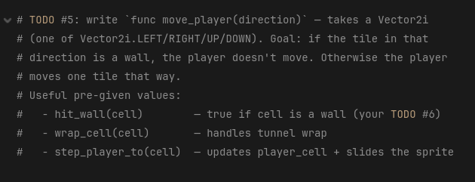
iCode
DAY 2
EMPOWERING FUTURE INNOVATORS
Inside move_player(direction) at main.gd lines 194-229. The direction: Vector2i parameter is already in the signature.
82

Slide 84
iCode
DAY 2
EMPOWERING FUTURE INNOVATORS
What you're about to write
# calculate next_cell as player_cell + direction
# if hit_wall(next_cell): return early (don't move)
# set next_cell to wrap_cell(next_cell)
# call step_player_to(next_cell)
• What: Move the player one tile — wall check first, tunnel wrap after.
• Why: Without this, arrow keys do nothing.
• How: hit_wall, wrap_cell, step_player_to are all pre-given helpers.
This is one approach — yours works if it runs.
83

Slide 85
iCode
DAY 2
EMPOWERING FUTURE INNOVATORS
TODO #5 — Write `move_player(direction)` body
SYNTAX
WRITE THIS
func name(param):
use(param)
if condition:
do_this
return
function_name()
# calculate next_cell as player_cell + direction
# if hit_wall(next_cell): return early (don't move)
# set next_cell to wrap_cell(next_cell)
# call step_player_to(next_cell)
Detailed instructions are in your code file, right next to this TODO.
84

Slide 86
iCode
DAY 2
EMPOWERING FUTURE INNOVATORS
Run the game. Press arrow keys. Player slides one tile at a time.
85

Slide 87
iCode
DAY 2
EMPOWERING FUTURE INNOVATORS
Functions can HAND BACK an answer
• So far: functions do something.
• New idea: a function can also return a value — hand an answer back to the caller.
• That answer is called the return value.
86

Slide 88
iCode
DAY 2
EMPOWERING FUTURE INNOVATORS
return
87

Slide 89
iCode
DAY 2
EMPOWERING FUTURE INNOVATORS
return hands a value back to the caller
• return = 'here's your answer.'
• The caller gets the value and can store it or use it immediately.
88

Slide 90
iCode
DAY 2
EMPOWERING FUTURE INNOVATORS
Storing a return value — from your game
# count_dots() scans the maze and returns a number.
# Store that number so we know the win target.
var dots_left := count_dots()
# hit_wall() scans one tile and returns true or false.
# Use the answer immediately in an if — no var needed.
if hit_wall(next_cell):
return
89

Slide 91
iCode
DAY 2
EMPOWERING FUTURE INNOVATORS
Remember booleans from Day 1?
• A boolean is a true/false value — the light switch.
• true = on. false = off.
• Today: our function hands back a boolean — 'yes this is a wall' or 'no it isn't.'
90

Slide 92
iCode
DAY 2
EMPOWERING FUTURE INNOVATORS
The kitchen hands the pizza BACK
• Old: you say 'margherita', kitchen makes it. No pizza in your hands.
• New: var dinner = margherita('large') — kitchen makes it AND hands it to you.
• dinner IS the pizza. That's the return value.
91

Slide 93
iCode
DAY 2
EMPOWERING FUTURE INNOVATORS
-> bool = this function answers yes or no
• hit_wall(cell) -> bool — 'is there a wall at this cell?'
• is_alive() -> bool — 'is the player still alive?'
• in_range(target) -> bool — 'is the enemy close enough to shoot?'
92

Slide 94
iCode
DAY 2
EMPOWERING FUTURE INNOVATORS
In our game: hit_wall(cell)
• move_player(direction) needs to know: 'is the next tile a wall?'
• It calls hit_wall(next_cell) → gets back true or false.
• If true → don't move. If false → move.
93

Slide 95
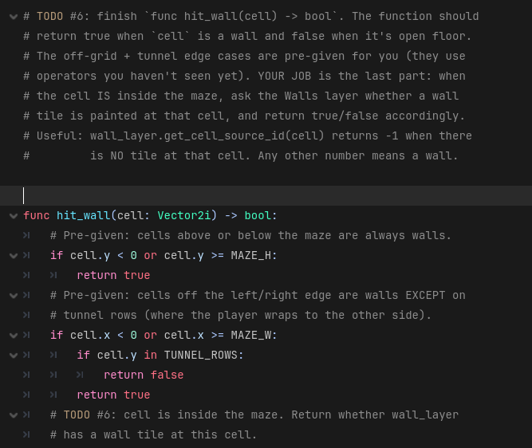
iCode
DAY 2
EMPOWERING FUTURE INNOVATORS
Inside hit_wall(cell) at main.gd lines 232-257. Off-grid + tunnel guards are pre-given. You write only the in-grid wall query.
94

Slide 96
iCode
DAY 2
EMPOWERING FUTURE INNOVATORS
What you're about to write
# get the tile id: wall_layer.get_cell_source_id(cell)
# return true if id is not -1, false otherwise
• What: Two lines inside the #@todo block — the in-grid wall check.
• Why: The off-grid and tunnel guards above are pre-given. Your section answers: is there a wall tile here?
• How: get_cell_source_id(cell) returns -1 if no tile exists. Any other number = wall tile.
This is one approach — yours works if it runs.
95

Slide 97
iCode
DAY 2
EMPOWERING FUTURE INNOVATORS
TODO #6 — Write the in-grid wall check
SYNTAX
WRITE THIS
func name(param) -> ReturnType:
return value
object.property
# get the tile id: wall_layer.get_cell_source_id(cell)
# return true if id is not -1, false otherwise
Detailed instructions are in your code file, right next to this TODO.
96

Slide 98
iCode
DAY 2
EMPOWERING FUTURE INNOVATORS
Run the game. Walls block. Tunnel wraps. Ghosts patrol. Dots are chompable.
97

Slide 99
iCode
DAY 2
EMPOWERING FUTURE INNOVATORS
Personalization #3 — Make it yours
• The game works. Now make it YOURS.
• Repaint the walls and dots. Move the tunnel row. Tweak the ghost timing. Swap the player sprite.
• Download free art from kenney.nl and drop it in.
• Low on time? Skip this and keep going. Finished early? This is for you.
98

Slide 100
iCode
DAY 2
EMPOWERING FUTURE INNOVATORS
Final Challenge
• Unlock the real Pac-Man ghosts. Open ghost_personalities.gd — six #@todo holes.
• When all six are filled: open main.gd, flip PERSONALITY_MODE_ENABLED to true, and run.
• Four personality ghosts replace the three plain ones.
99

Slide 101
iCode
DAY 2
EMPOWERING FUTURE INNOVATORS
You already know how to do this.
• Each TODO in ghost_personalities.gd mirrors a chunk you wrote this morning.
• FC-1 ← Chunk #1 (for i in range(N))
• FC-2 ← Chunk #2 (for item in list)
• FC-3 ← Chunk #3 (while loop + counter + return)
• FC-4 ← Chunk #4 (func no params)
• FC-5 ← Chunk #5 (func with parameter + return)
• FC-6 ← Chunk #6 (func returning bool)
100

Slide 102
iCode
DAY 2
EMPOWERING FUTURE INNOVATORS
The 4 personalities
• | Ghost | Colour | Behaviour | |---|---|---| | Blinky | Red | Heads straight for the player | | Pinky | Pink | Aims 4 tiles ahead of the player | | Inky | Cyan | Flanks from the opposite side of Blinky | | Clyde | Orange | Chases when far, scatters when close |
101

Slide 103
iCode
DAY 2
EMPOWERING FUTURE INNOVATORS
Final Challenge — all 6 holes
• | FC | Syntax | Write this (comments) | |---|---|---| | FC-1 spawn_personality_ghosts() | for_range | # for i in range(PERSONALITY_COUNT): / # spawn_one_personality(i) | | FC-2 step_all_personality_ghosts() | for_in | # for ghost in ghosts: / # step_personality(ghost) | | FC-3 count_ghosts_of(personality) -> int | while_loop, return | # var count := 0 / # for ghost in ghosts: if get_meta == personality: count += 1 / # return count | | FC-4 reset_personality_ghosts() | for_in, var, plus_eq | # var i := 0 / # for ghost in ghosts: respawn_personality_ghost(ghost, i) / i += 1 | | FC-5 target_for(ghost) -> Vector2i | func_return, if | # var p = ghost.get_meta("personality") / # if p == BLINKY: return blinky_target(ghost) / # elif PINKY … INKY … CLYDE | | FC-6 is_clyde_close(ghost) -> bool | func_return | # var d := distance_to_player(ghost) / # return d < 8.0 |
102

Slide 104
iCode
DAY 2
EMPOWERING FUTURE INNOVATORS
Take it home
Turn your maze game into a real Windows program — a .exe you can run on any PC, no Godot needed.
103

Slide 105
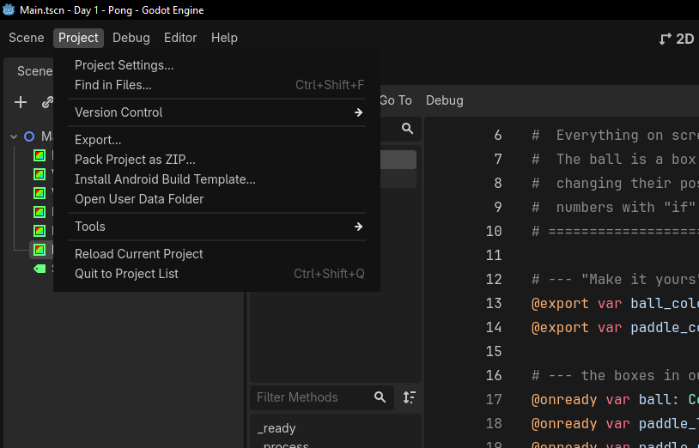
iCode
DAY 2
EMPOWERING FUTURE INNOVATORS
In the top menu bar, click Project, then Export…
104

Slide 106
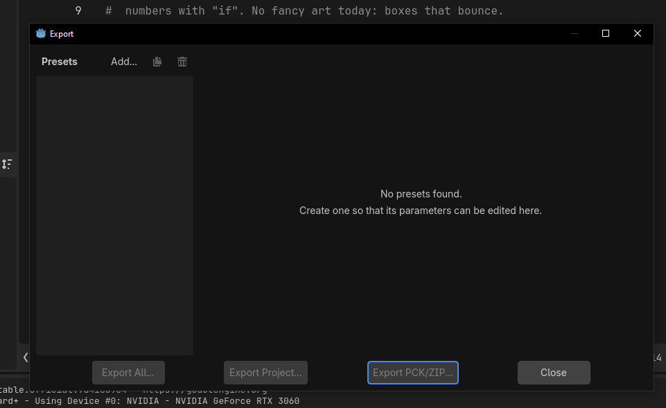
iCode
DAY 2
EMPOWERING FUTURE INNOVATORS
The Export window opens. Click Add… at the top to add a target.
105

Slide 107
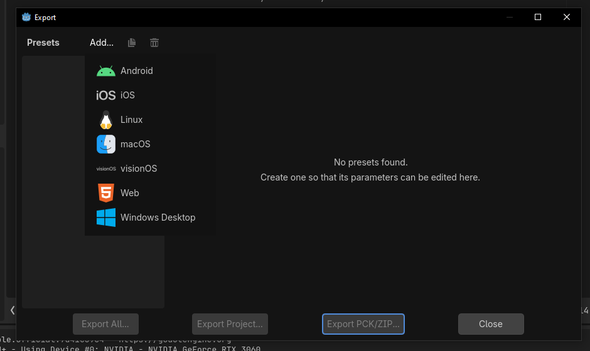
iCode
DAY 2
EMPOWERING FUTURE INNOVATORS
From the list, pick Windows Desktop.
106

Slide 108
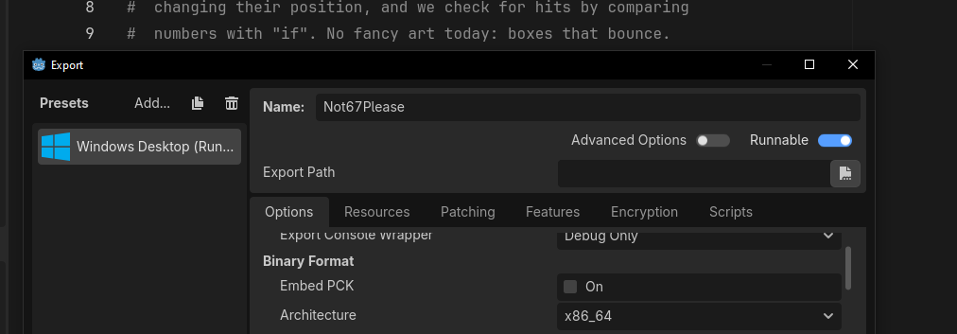
iCode
DAY 2
EMPOWERING FUTURE INNOVATORS
Godot adds a Windows Desktop preset. Leave the options as they are — Runnable on, Architecture x86_64.
107

Slide 109
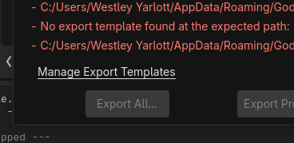
iCode
DAY 2
EMPOWERING FUTURE INNOVATORS
If you see 'No export template found', click Manage Export Templates.
108

Slide 110
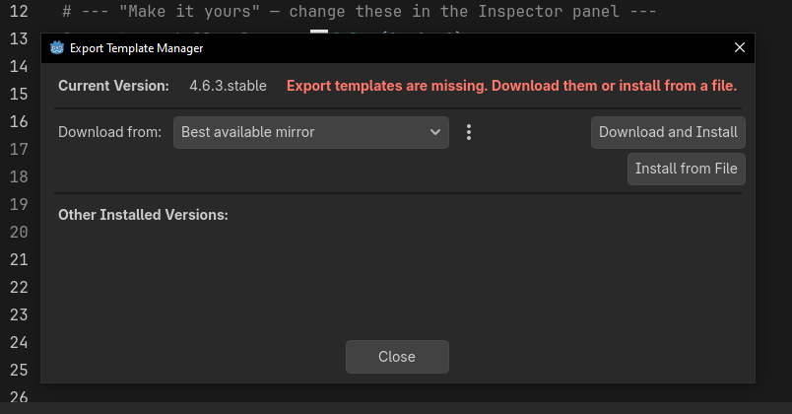
iCode
DAY 2
EMPOWERING FUTURE INNOVATORS
Click Download and Install. Let it finish, then close.
109

Slide 111
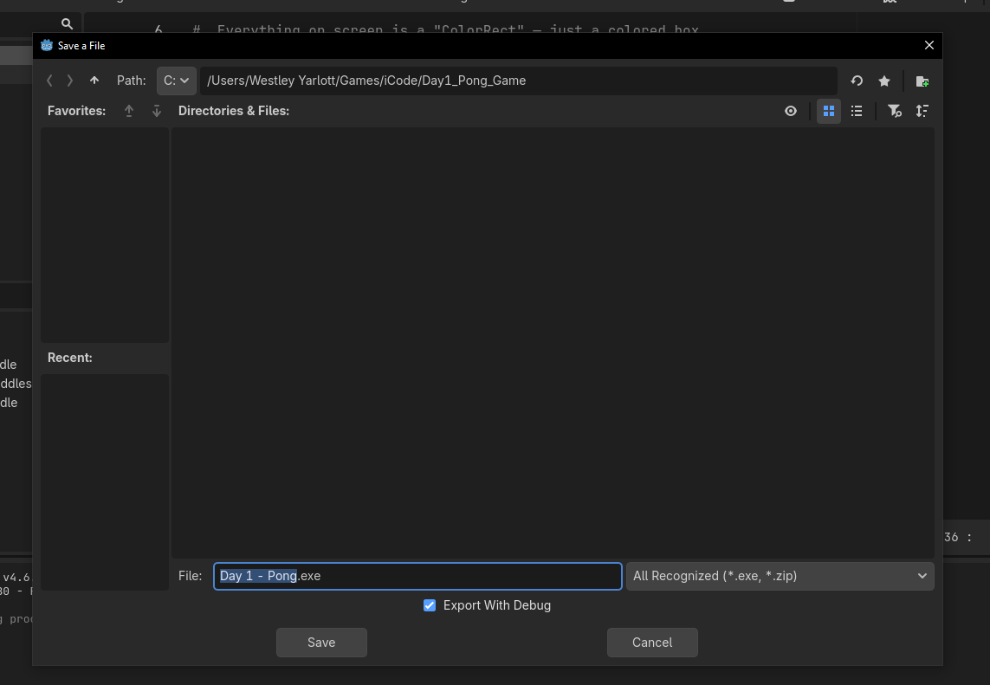
iCode
DAY 2
EMPOWERING FUTURE INNOVATORS
Click Export Project, type a name (e.g. Day 2 - Maze), pick your folder, and click Save.
110

Slide 112
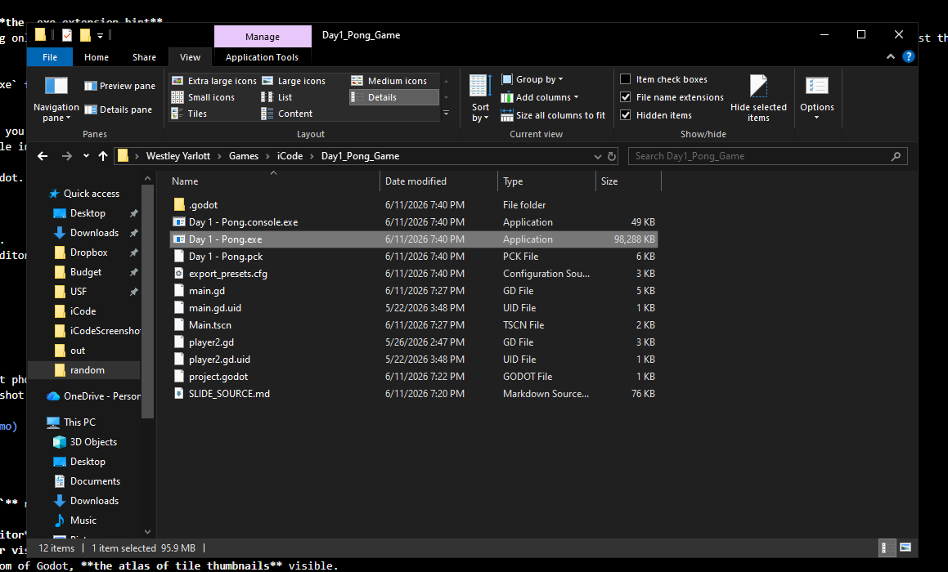
iCode
DAY 2
EMPOWERING FUTURE INNOVATORS
Godot writes your .exe plus a .pck data file. Double-click the .exe — your maze game runs with no Godot needed. Keep the two files together.
111

Slide 113
iCode
DAY 2
EMPOWERING FUTURE INNOVATORS
Tomorrow: defend your base
1990s. Tower & base defense. We go deeper on functions and meet lists — to spawn waves of enemies and the towers that stop them.
112

