Slide 1

iCode
DAY 3
EMPOWERING FUTURE INNOVATORS
<exact title text>
<bullets, prose, or code block — verbatim>
1

Slide 2
iCode
DAY 3
EMPOWERING FUTURE INNOVATORS
VR Creator - Day 3
Base Defense · 1990 → 2009 · Tower Defense Era
2

Slide 3
iCode
DAY 3
EMPOWERING FUTURE INNOVATORS
A whole genre — invented by modders
• Rampart (1990) — hybrid first attempt. Castle walls + cannonballs.
• Warcraft III custom maps (2002–2007) — the entire genre invented by players tweaking someone else's game.
• Plants vs Zombies (2009) — mainstream breakout. 6 million copies in a year.
• Bloons / Kingdom Rush — mobile-era boom. Still going.
• Every tower defense game you've played traces back to a Warcraft III modder.
3

Slide 4
iCode
DAY 3
EMPOWERING FUTURE INNOVATORS
Yesterday → Today
• Day 2 — Loops + intro Functions. for loops, named blocks of code.
• Day 3 — Lists + Deeper Functions. Same for-loop shape, new things to loop over.
• Today's two new ideas: a list is a collection of things. A deeper function scans a list and returns something useful.
4

Slide 5
iCode
DAY 3
EMPOWERING FUTURE INNOVATORS
The 5-day arc
• Day 1 ✓ Pong — Vars + Conditions
• Day 2 ✓ Pac-Man — Loops + Functions
• Day 3 ← Base Defense — Lists + Deeper Functions
• Day 4 Fighter — Objects + State
• Day 5 Escape Room — Showcase
5

Slide 6
iCode
DAY 3
EMPOWERING FUTURE INNOVATORS
Today: Lists + Deeper Functions
• Lists — a collection of things your code can remember, walk through, add to, or remove from.
• Deeper Functions — functions that scan lists, return something useful, and chain into each other.
6

Slide 7
iCode
DAY 3
EMPOWERING FUTURE INNOVATORS
GDScript list ops — two things change
Python
GDScript
list = []
list.remove(x)
len(list)
var list = []
list.erase(x)
list.size()
7

Slide 8
iCode
DAY 3
EMPOWERING FUTURE INNOVATORS
Pre-coding setup
8

Slide 9
iCode
DAY 3
EMPOWERING FUTURE INNOVATORS
Walk A — Open the Day 3 project
Open the Base Defense project. You know how. Do it like yesterday.
9

Slide 10
iCode
DAY 3
EMPOWERING FUTURE INNOVATORS
Walk B — Open main.gd
Open main.gd in the Script editor. Same as always.
10

Slide 11
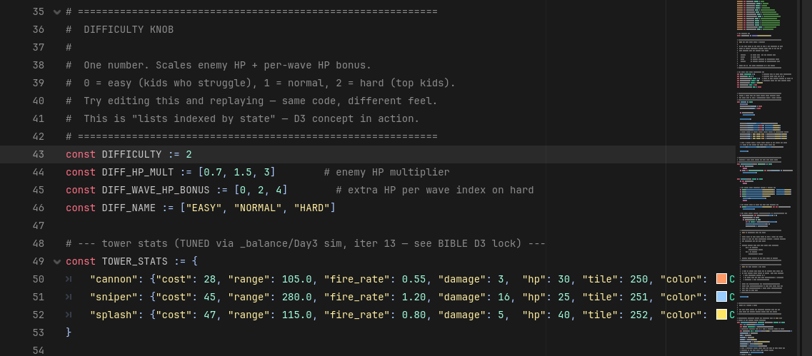
iCode
DAY 3
EMPOWERING FUTURE INNOVATORS
Near the top of main.gd, there's a const DIFFICULTY := 2. This one number changes how hard the whole game is.
11

Slide 12
iCode
DAY 3
EMPOWERING FUTURE INNOVATORS
Walk DK — What this number controls
• 0 = Easy — enemies have less HP.
• 1 = Medium — standard HP.
• 2 = Hard — full HP (what you're coding on).
• Change one number → the whole game runs at a different difficulty. You'll try this in a personalization session later.
12

Slide 13
iCode
DAY 3
EMPOWERING FUTURE INNOVATORS
Lesson chunks
13

Slide 14
iCode
DAY 3
EMPOWERING FUTURE INNOVATORS
Reminder: there are millions of right answers
• The examples on the LEFT of TODO slides are one way.
• Your way is valid if it runs.
14

Slide 15
iCode
DAY 3
EMPOWERING FUTURE INNOVATORS
List
15

Slide 16
iCode
DAY 3
EMPOWERING FUTURE INNOVATORS
A list = things in order
• A grocery list holds items in order. You can add an item, remove one, or walk through all of them.
• In code: a list holds values. You can .append(), .erase(), and loop through them.
16

Slide 17
iCode
DAY 3
EMPOWERING FUTURE INNOVATORS
A list in GDScript
var fruits: Array = [] # empty list
fruits.append("apple") # add to the end
fruits.append("banana")
print(fruits.size()) # prints: 2
fruits.erase("apple") # remove by value
print(fruits.size()) # prints: 1
17

Slide 18
iCode
DAY 3
EMPOWERING FUTURE INNOVATORS
Lists are everywhere in games
• All the active enemies on screen → a list.
• All the towers the player has placed → a list.
• Inventory items, quests, bullet projectiles — all lists.
18

Slide 19
iCode
DAY 3
EMPOWERING FUTURE INNOVATORS
In our game: enemies and towers
• enemies — every enemy currently walking toward your base.
• towers — every tower the player has placed.
• Both start empty []. They grow as the game runs.
19

Slide 20
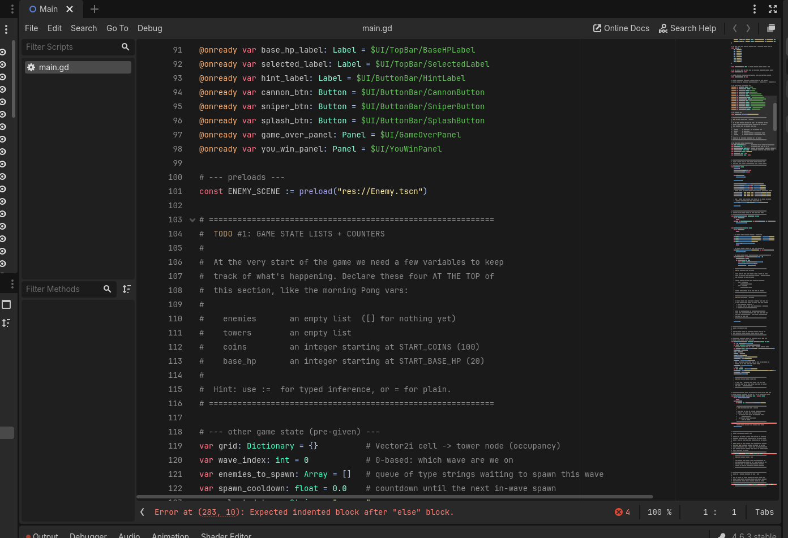
iCode
DAY 3
EMPOWERING FUTURE INNOVATORS
At the # TODO #1 marker near the top of main.gd, after the preloads.
20

Slide 21
iCode
DAY 3
EMPOWERING FUTURE INNOVATORS
What you're about to write
# Create an empty list to track all enemies on screen
# Create an empty list to track all placed towers
# Set the starting coin count to the value of START_COINS
# Set the starting base HP to the value of START_BASE_HP
• What: Four variable declarations — two empty lists, two integer counters.
• Why: Without these, the game has nowhere to store enemies, towers, or score.
• How: Array = [] makes an empty list. int = START_COINS sets a typed integer to the starting constant.
This is one approach — yours works if it runs.
21

Slide 22
iCode
DAY 3
EMPOWERING FUTURE INNOVATORS
TODO #1 — Declare game state variables
SYNTAX
WRITE THIS
var items: Array = []
var name := value
const NAME := value
# Create an empty list to track all enemies on screen
# Create an empty list to track all placed towers
# Set the starting coin count to the value of START_COINS
# Set the starting base HP to the value of START_BASE_HP
Detailed instructions are in your code file, right next to this TODO.
22

Slide 23
iCode
DAY 3
EMPOWERING FUTURE INNOVATORS
Personalization #1
• Want more starting coins? Find const START_COINS near the top of main.gd.
• Change the number. Run the game. How does it feel with 500 coins vs 50?
• Low on time? Skip this and keep going. Finished early? This is for you.
23

Slide 24
iCode
DAY 3
EMPOWERING FUTURE INNOVATORS
Adding to lists and removing from them
• Last chunk: you declared the lists.
• This chunk: you wire the game so enemies appear in the list when they spawn, and disappear from it when they die.
24

Slide 25
iCode
DAY 3
EMPOWERING FUTURE INNOVATORS
.append() — add an item to the end
var scores: Array = []
scores.append(10)
scores.append(20)
# scores is now [10, 20]
25

Slide 26
iCode
DAY 3
EMPOWERING FUTURE INNOVATORS
.erase() — remove an item by value
var scores: Array = [10, 20, 30]
scores.erase(20)
# scores is now [10, 30]
26

Slide 27
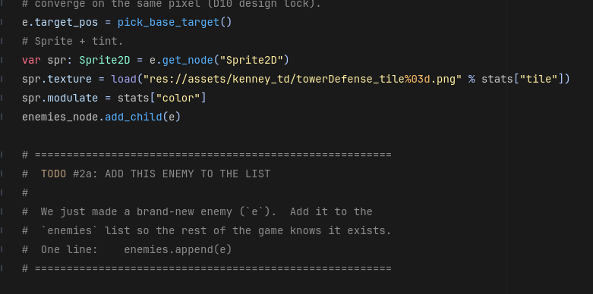
iCode
DAY 3
EMPOWERING FUTURE INNOVATORS
One line at the bottom of spawn_enemy(). After the enemy is built, add it to the list.
27

Slide 28
iCode
DAY 3
EMPOWERING FUTURE INNOVATORS
What you're about to write
# Add the newly spawned enemy to the enemies list
• What: One line — append the new enemy to enemies.
• Why: Without this, spawned enemies never enter the list. The game loop can't see them.
• How: enemies.append(e) — e is the enemy node just built above your hole.
This is one approach — yours works if it runs.
28

Slide 29
iCode
DAY 3
EMPOWERING FUTURE INNOVATORS
TODO #2a — Add enemy to list
SYNTAX
WRITE THIS
items.append(item)
# Add the newly spawned enemy to the enemies list
Detailed instructions are in your code file, right next to this TODO.
29

Slide 30
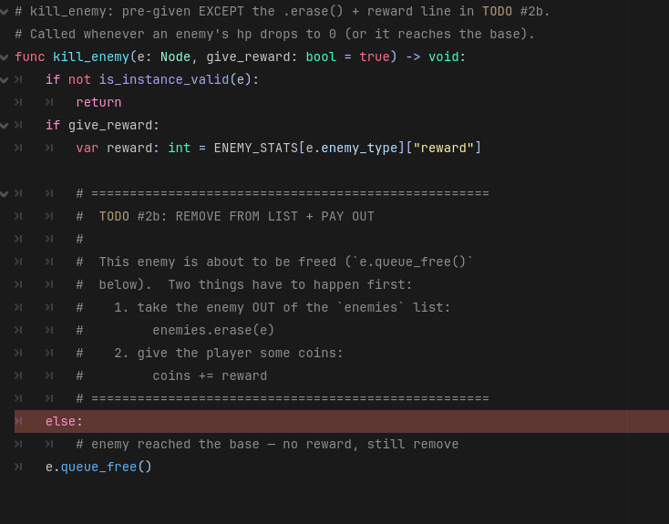
iCode
DAY 3
EMPOWERING FUTURE INNOVATORS
Two holes inside kill_enemy(): one in the reward branch (erase + pay out), one in the no-reward branch (erase only).
30

Slide 31
iCode
DAY 3
EMPOWERING FUTURE INNOVATORS
What you're about to write
# Reward branch (enemy killed by a tower):
# Remove this enemy from the enemies list
# Add the reward amount to the player's coins
# No-reward branch (enemy reached the base):
# Remove this enemy from the enemies list
• What: Two holes — both erase e from the list. The reward branch also pays out coins.
• Why: Without the erase, dead enemies stay in the list forever. The wave never ends.
• How: enemies.erase(e) removes by value. coins += reward adds the payout.
This is one approach — yours works if it runs.
31

Slide 32
iCode
DAY 3
EMPOWERING FUTURE INNOVATORS
TODO #2b — Remove enemy from list
SYNTAX
WRITE THIS
items.erase(item)
x += amount
# Reward branch (enemy killed by a tower):
# Remove this enemy from the enemies list
# Add the reward amount to the player's coins
# No-reward branch (enemy reached the base):
# Remove this enemy from the enemies list
Detailed instructions are in your code file, right next to this TODO.
32

Slide 33
iCode
DAY 3
EMPOWERING FUTURE INNOVATORS
The game loop — move everything, every frame
• Every frame, the game needs to: step each enemy forward, tick each tower.
• You have a list of enemies. You have a list of towers.
• Two for loops — one for each list.
33

Slide 34
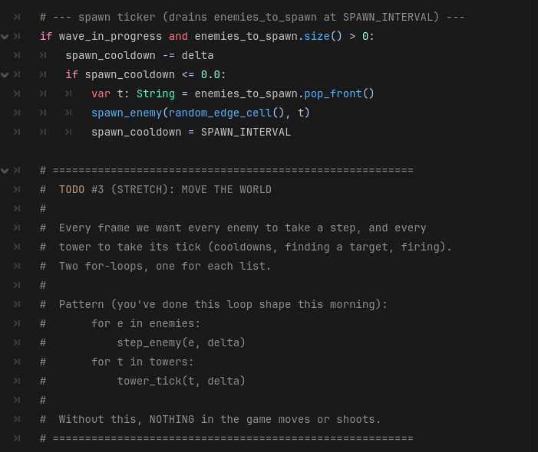
iCode
DAY 3
EMPOWERING FUTURE INNOVATORS
Inside _process(delta), after the spawn ticker. This code runs every frame.
34

Slide 35
iCode
DAY 3
EMPOWERING FUTURE INNOVATORS
What you're about to write
# Use a for loop to visit each enemy and move it one step forward
# Use a for loop to visit each tower and let it take its turn
• What: Two for-loops — move every enemy, tick every tower.
• Why: Without this, nothing on screen moves. The game is frozen.
• How: step_enemy(e, delta) and tower_tick(t, delta) are pre-given helpers. You write the loops.
This is one approach — yours works if it runs.
35

Slide 36
iCode
DAY 3
EMPOWERING FUTURE INNOVATORS
TODO #3 — Move the world each frame
SYNTAX
for item in collection:
do_something(item)
WRITE THIS
# Use a for loop to visit each enemy and move it one step forward
# Use a for loop to visit each tower and let it take its turn
Detailed instructions are in your code file, right next to this TODO.
36

Slide 37
iCode
DAY 3
EMPOWERING FUTURE INNOVATORS
Run the game. Press Space. Wave 1 spawns — enemies walk in.
37

Slide 38
iCode
DAY 3
EMPOWERING FUTURE INNOVATORS
Packaging a loop in a function
• You just wrote for e in enemies: step_enemy(e, delta) directly.
• The Final Challenge code needs the same loop — but passing in a different list.
• move_all(enemy_list, delta) is a function that takes any list and loops it.
38

Slide 39
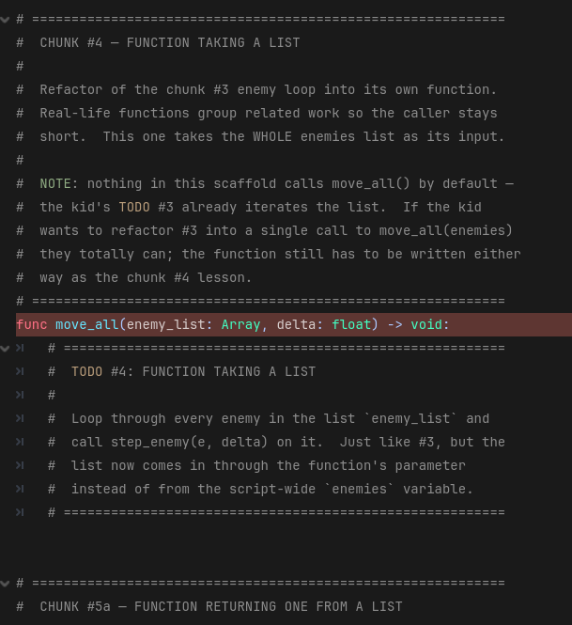
iCode
DAY 3
EMPOWERING FUTURE INNOVATORS
Inside func move_all(enemy_list, delta). The function signature is pre-given; you write the body.
39

Slide 40
iCode
DAY 3
EMPOWERING FUTURE INNOVATORS
What you're about to write
# Use a for loop to visit each enemy in the list and move it one step forward
• What: One line — loop the parameter list, step each enemy.
• Why: The FC (endless mode) calls move_all() with its own list. Same loop, different input.
• How: enemy_list is the parameter (not enemies). step_enemy(e, delta) is pre-given.
This is one approach — yours works if it runs.
40

Slide 41
iCode
DAY 3
EMPOWERING FUTURE INNOVATORS
TODO #4 — Write `move_all()` body
SYNTAX
for item in collection:
do_something(item)
func name(param):
use(param)
WRITE THIS
# Use a for loop to visit each enemy in the list and move it one step forward
Detailed instructions are in your code file, right next to this TODO.
41

Slide 42
iCode
DAY 3
EMPOWERING FUTURE INNOVATORS
Personalization #2 — Flip the difficulty knob
• Find const DIFFICULTY := 2 near the top of main.gd.
• Change to 0 (easy) or 1 (medium). Run the game. Feel the difference.
• Change it back to 2 when you're done experimenting.
• Low on time? Skip this and keep going. Finished early? This is for you.
42

Slide 43
iCode
DAY 3
EMPOWERING FUTURE INNOVATORS
Functions that SEARCH a list and return an answer
• So far: functions that do things (step_enemy) or loop lists (move_all).
• New: a function that scans the enemies list and hands back one result.
• get_nearest_enemy_in_range() — scans all enemies, returns the closest one in range (or null).
43

Slide 44
iCode
DAY 3
EMPOWERING FUTURE INNOVATORS
Before you write: what does this need to DO?
• Tower has a position and a range. There are N enemies on the map.
• Goal: find which enemy is closest to the tower AND within its range.
• Available: enemies list, pos (tower position), tower_range, pos.distance_to(e.position).
44

Slide 45
iCode
DAY 3
EMPOWERING FUTURE INNOVATORS
How would YOU design this?
• How do you find the closest thing in a list?
• What do you need to track as you walk through the list?
• When you arrive at the TODO, try your own approach first.
45

Slide 46
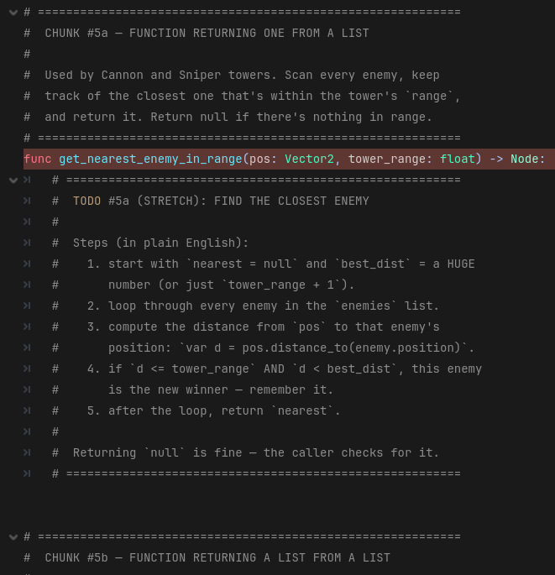
iCode
DAY 3
EMPOWERING FUTURE INNOVATORS
Inside the function body. nearest = null and best_dist = tower_range + 1 are pre-given above your hole.
46

Slide 47
iCode
DAY 3
EMPOWERING FUTURE INNOVATORS
What you're about to write
# Use a for loop to check each enemy in the enemies list:
# Measure the distance from the tower to this enemy
# If the enemy is within range and closer than the previous best:
# Remember this enemy as the closest so far
# Update the closest distance found
• What: Walk the enemies list; update nearest and best_dist when you find a closer in-range enemy.
• Why: Towers need to know WHO to shoot. This function finds the answer.
• How: best_dist starts just outside range — the first in-range enemy automatically beats it.
This is one approach — yours works if it runs.
47

Slide 48
iCode
DAY 3
EMPOWERING FUTURE INNOVATORS
TODO #5a — Find nearest enemy in range
SYNTAX
for item in collection:
do_something(item)
if condition:
do_this
if a or b:
do_this
object.property
WRITE THIS
# Use a for loop to check each enemy in the enemies list:
# Measure the distance from the tower to this enemy
# If the enemy is within range and closer than the previous best:
# Remember this enemy as the closest so far
# Update the closest distance found
Detailed instructions are in your code file, right next to this TODO.
48

Slide 49
iCode
DAY 3
EMPOWERING FUTURE INNOVATORS
Splash towers need ALL enemies in range
• Cannon/Sniper: one target. get_nearest_enemy_in_range() returns ONE enemy.
• Splash: hits everyone nearby. Need ALL enemies within radius.
• get_enemies_in_radius() — scans enemies, returns a list of all within radius.
49

Slide 50
iCode
DAY 3
EMPOWERING FUTURE INNOVATORS
Before you write: what does this need to DO?
• Goal: return a new list containing every enemy within radius of pos.
• Available: enemies list, pos, radius, pos.distance_to(e.position).
• Pattern you know: var result := [] → loop → conditional .append() → return result.
50

Slide 51
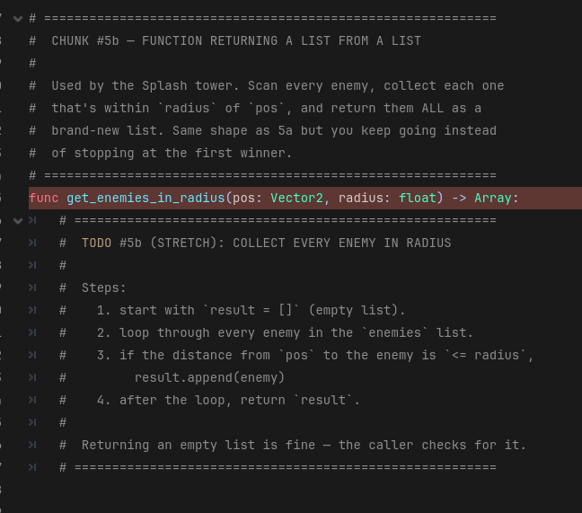
iCode
DAY 3
EMPOWERING FUTURE INNOVATORS
The whole function body — you write it all. The function signature is pre-given.
51

Slide 52
iCode
DAY 3
EMPOWERING FUTURE INNOVATORS
What you're about to write
# Start with an empty list to hold matching enemies
# Use a for loop to check each enemy in the enemies list:
# If this enemy is within the splash radius:
# Add it to the result list
# Return the list of enemies in range
• What: Build and return a new list of every enemy within radius.
• Why: The Splash tower needs this list to fire at everyone in range.
• How: Start with an empty list, loop enemies, append those in range, return.
This is one approach — yours works if it runs.
52

Slide 53
iCode
DAY 3
EMPOWERING FUTURE INNOVATORS
TODO #5b — Collect enemies in radius
SYNTAX
WRITE THIS
var items: Array = []
for item in collection:
do_something(item)
items.append(item)
return
if condition:
do_this
# Start with an empty list to hold matching enemies
# Use a for loop to check each enemy in the enemies list:
# If this enemy is within the splash radius:
# Add it to the result list
# Return the list of enemies in range
Detailed instructions are in your code file, right next to this TODO.
53

Slide 54
iCode
DAY 3
EMPOWERING FUTURE INNOVATORS
Towers can now find targets
Run the game. Enemies walk — towers don't fire yet (that's chunk #6). But the targeting logic is live.
54

Slide 55
iCode
DAY 3
EMPOWERING FUTURE INNOVATORS
Tower tick: pick a target and fire
• tower_tick(t, delta) runs once per tower per frame.
• Cooldown handling is pre-given. Your job: pick the right finder, call it, fire if something was found.
• Cannon + Sniper → single target. Splash → list of targets.
55

Slide 56
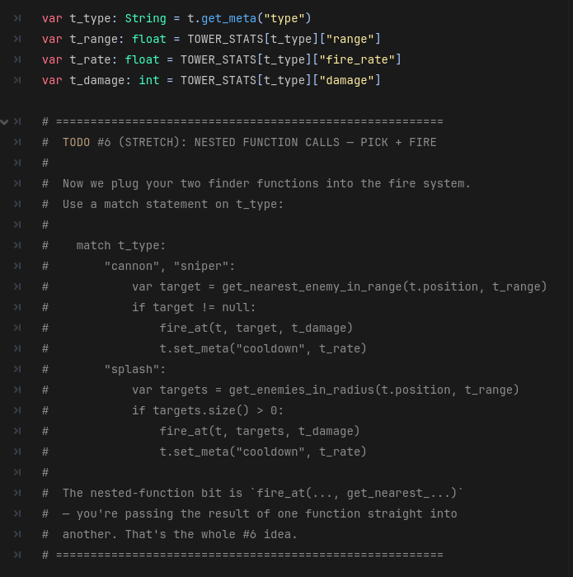
iCode
DAY 3
EMPOWERING FUTURE INNOVATORS
Inside tower_tick(), there's a match t_type: block. You fill the two branches: \"cannon\", \"sniper\": and \"splash\":.
56

Slide 57
iCode
DAY 3
EMPOWERING FUTURE INNOVATORS
match — like a multi-way if
match tower_type:
"cannon":
fire_cannon()
"sniper":
fire_sniper()
"splash":
fire_splash()
57

Slide 58
iCode
DAY 3
EMPOWERING FUTURE INNOVATORS
What you're about to write — \"cannon\", \"sniper\": branch
# Find the closest enemy within this tower's range
# If an enemy was found:
# Fire at that enemy
# Reset the cooldown timer so the tower must wait before firing again
• What: Find one target; if found, fire and reset the cooldown.
• Why: Without this, Cannon and Sniper towers never shoot.
• How: t.position, t_range, t_damage, t_rate are already unpacked above your hole.
This is one approach — yours works if it runs.
58

Slide 59
iCode
DAY 3
EMPOWERING FUTURE INNOVATORS
TODO #6a — Cannon + Sniper: find target and fire
SYNTAX
func name(param) -> ReturnType:
return value
if condition:
do_this
function_name()
WRITE THIS
# Find the closest enemy within this tower's range
# If an enemy was found:
# Fire at that enemy
# Reset the cooldown timer so the tower must wait before firing again
Detailed instructions are in your code file, right next to this TODO.
59

Slide 60
iCode
DAY 3
EMPOWERING FUTURE INNOVATORS
What you're about to write — \"splash\": branch
# Collect all enemies within the splash radius into a list
# If the list is not empty (at least one enemy is in range):
# Fire at all of them
# Reset the cooldown timer so the tower must wait before firing again
• What: Collect a list of targets in the splash radius; if any found, fire at all of them.
• Why: Without this, Splash towers never shoot.
• How: fire_at handles lists and single nodes — pass targets directly.
This is one approach — yours works if it runs.
60

Slide 61
iCode
DAY 3
EMPOWERING FUTURE INNOVATORS
TODO #6b — Splash: collect targets and fire
SYNTAX
func name(param) -> ReturnType:
return value
items.size()
if condition:
do_this
function_name()
WRITE THIS
# Collect all enemies within the splash radius into a list
# If the list is not empty (at least one enemy is in range):
# Fire at all of them
# Reset the cooldown timer so the tower must wait before firing again
Detailed instructions are in your code file, right next to this TODO.
61

Slide 62
iCode
DAY 3
EMPOWERING FUTURE INNOVATORS
Run the game. Place a tower. Watch it shoot.
62

Slide 63
iCode
DAY 3
EMPOWERING FUTURE INNOVATORS
Personalization #3 — Tune your tower stats
• Find const TOWER_STATS near the top of main.gd.
• Change the damage, range, or fire_rate for any tower. Run it. Does it feel better?
• Try making a super-slow cannon that one-shots everything. Or a tiny-range rapid-fire sniper.
• Low on time? Skip this and keep going. Finished early? This is for you.
63

Slide 64
iCode
DAY 3
EMPOWERING FUTURE INNOVATORS
How does the game know a wave ended?
• A wave is over when: no enemies are alive AND no enemies are queued to spawn.
• Check: enemies.size() == 0 and enemies_to_spawn.size() == 0.
• Then: advance wave_index. Check if more waves remain. Win or start the next.
64

Slide 65
iCode
DAY 3
EMPOWERING FUTURE INNOVATORS
Before you write: what does this need to DO?
• Goal: when the wave is done, advance the wave counter. Call you_win() or start_next_wave().
• Available: wave_in_progress, enemies, enemies_to_spawn, wave_index, WAVES, you_win(), start_next_wave().
• Condition: wave_in_progress must be true AND both lists must be empty.
65

Slide 66
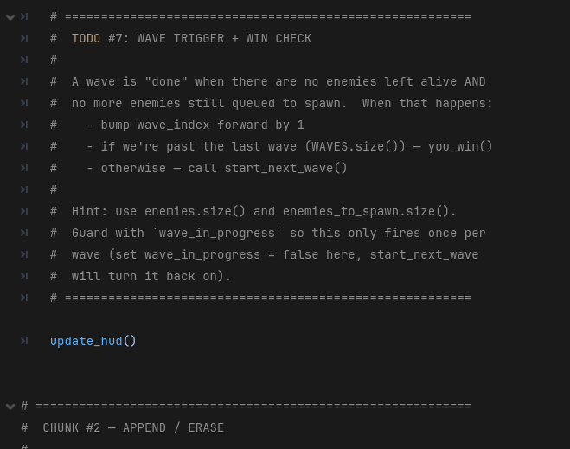
iCode
DAY 3
EMPOWERING FUTURE INNOVATORS
In _process(delta), after the spawn ticker block. Runs every frame.
66

Slide 67
iCode
DAY 3
EMPOWERING FUTURE INNOVATORS
What you're about to write
# If a wave is running and all enemies are gone and no more enemies are queued:
# Mark the wave as finished
# Move to the next wave number
# If all waves have been completed:
# Trigger the win screen
# Otherwise:
# Start the next wave
• What: Detect when a wave ends, advance the counter, win or loop.
• Why: Without this, the game never advances past wave 1.
• How: WAVES.size() is the total number of waves. wave_index >= WAVES.size() means all waves done.
This is one approach — yours works if it runs.
67

Slide 68
iCode
DAY 3
EMPOWERING FUTURE INNOVATORS
TODO #7 — Wave advance and win check
SYNTAX
if condition:
do_this
items.size()
x += amount
function_name()
WRITE THIS
# If a wave is running and all enemies are gone and no more enemies are queued:
# Mark the wave as finished
# Move to the next wave number
# If all waves have been completed:
# Trigger the win screen
# Otherwise:
# Start the next wave
Detailed instructions are in your code file, right next to this TODO.
68

Slide 69
iCode
DAY 3
EMPOWERING FUTURE INNOVATORS
Run the game. Survive all 8 waves. The YOU WIN panel appears.
69

Slide 70
iCode
DAY 3
EMPOWERING FUTURE INNOVATORS
Personalization #4 — Edit the wave list
• Find const WAVES near the top of main.gd. It's a list of lists.
• Each entry is [count, type] — e.g. [5, \"grunt\"] spawns 5 grunts.
• Add a wave. Change counts. Swap types. Make wave 1 send 50 grunts for chaos.
• Low on time? Skip this and keep going. Finished early? This is for you.
70

Slide 71
iCode
DAY 3
EMPOWERING FUTURE INNOVATORS
Final Challenge — Endless Mode
• Open endless_mode.gd — a separate script with #@todo holes.
• When all holes are filled: open main.gd, flip ENDLESS_MODE to true, and run.
• Enemies spawn forever, getting harder each wave.
• Boss wave is an optional extra if you want a harder challenge.
71

Slide 72
iCode
DAY 3
EMPOWERING FUTURE INNOVATORS
You already know how to do this.
• Each TODO in endless_mode.gd mirrors a chunk you wrote this morning.
• FC-1 ← Chunk #3 (for loops — step enemies + towers)
• FC-2 ← Chunk #4 (move_all — loop a parameter list)
• FC-3 ← Chunk #5b (collect list, return it)
• FC-4 ← Chunk #7 (wave counter + win check pattern)
72

Slide 73
iCode
DAY 3
EMPOWERING FUTURE INNOVATORS
Final Challenge — all holes
• | FC | Mirrors | Syntax | Write this (comments) | |---|---|---|---| | FC-1 endless_tick(delta) | Chunk #3 | for_in | # for e in enemies: step_enemy(e, delta) / # for t in towers: tower_tick(t, delta) | | FC-2 move_all_endless(list, delta) | Chunk #4 | for_in, func_param | # for e in enemy_list: step_enemy(e, delta) | | FC-3 get_in_radius_endless(pos, r) | Chunk #5b | list_init, for_in, list_append, return | # var r := [] / # for e in enemies: if dist <= radius: r.append(e) / # return r | | FC-4 check_wave_end() | Chunk #7 | if, list_size, plus_eq, func_call | # if wave_in_progress and enemies.size()==0: / # wave_in_progress=false / wave_index+=1 / # if wave_index>=WAVES.size(): you_win() / else: next_wave() |
73

Slide 74
iCode
DAY 3
EMPOWERING FUTURE INNOVATORS
Take it home
Turn your Base Defense game into a real Windows .exe — no Godot needed.
74

Slide 75
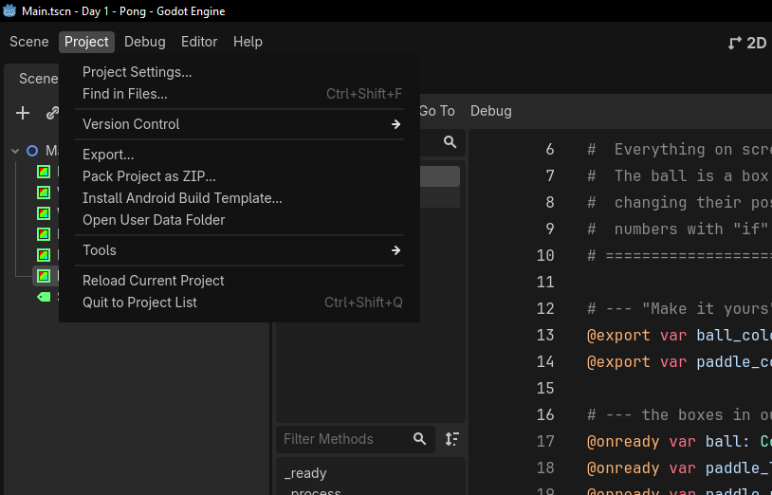
iCode
DAY 3
EMPOWERING FUTURE INNOVATORS
In the top menu bar, click Project, then Export…
75

Slide 76
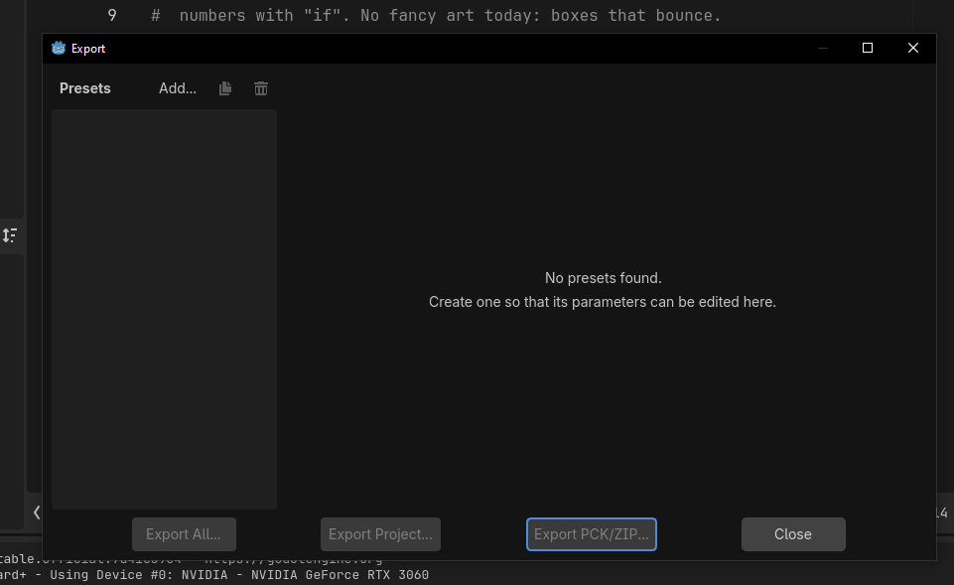
iCode
DAY 3
EMPOWERING FUTURE INNOVATORS
The Export window opens. Click Add… at the top to add a target.
76

Slide 77
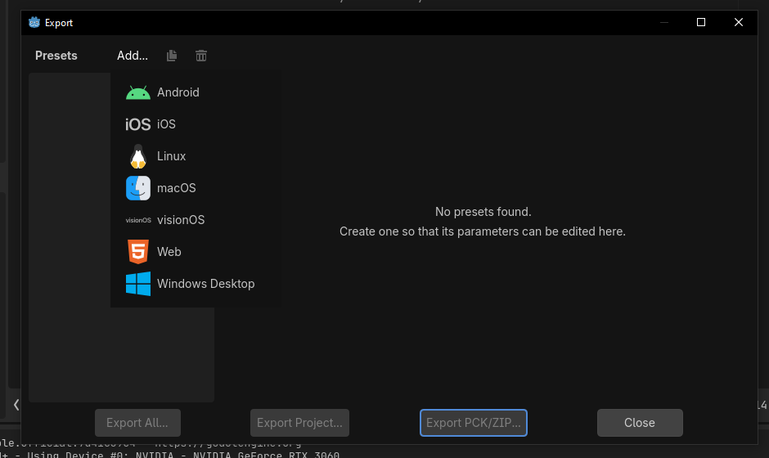
iCode
DAY 3
EMPOWERING FUTURE INNOVATORS
From the list, pick Windows Desktop.
77

Slide 78
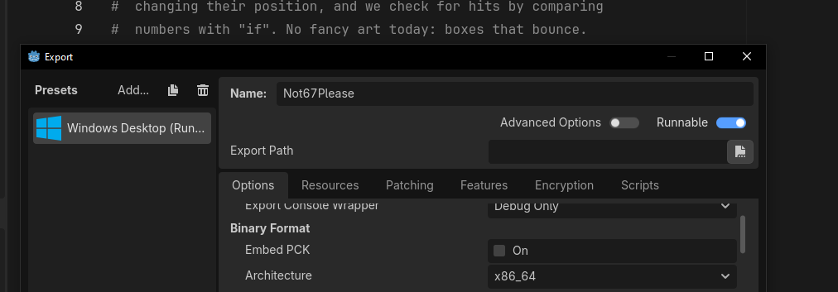
iCode
DAY 3
EMPOWERING FUTURE INNOVATORS
Godot adds a Windows Desktop preset. Leave options as-is — Runnable on, Architecture x86_64.
78

Slide 79
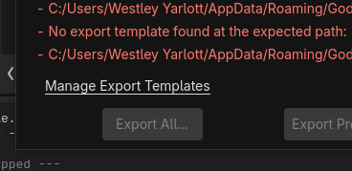
iCode
DAY 3
EMPOWERING FUTURE INNOVATORS
If you see 'No export template found', click Manage Export Templates.
79

Slide 80
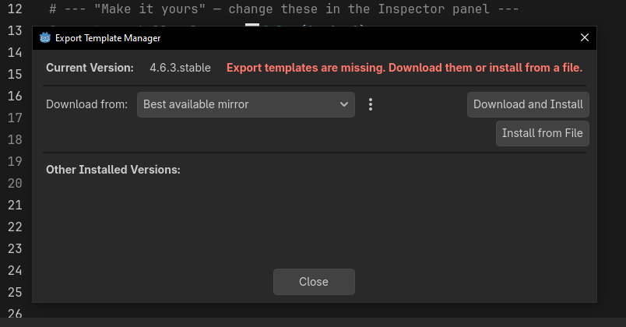
iCode
DAY 3
EMPOWERING FUTURE INNOVATORS
Click Download and Install. Let it finish, then close.
80

Slide 81
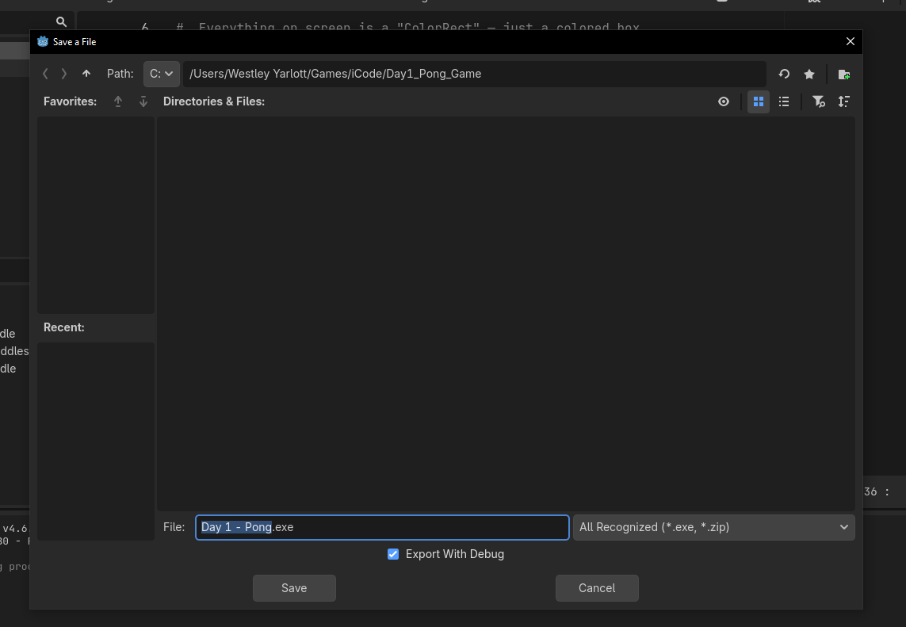
iCode
DAY 3
EMPOWERING FUTURE INNOVATORS
Click Export Project, type a name (e.g. Day 3 - Base Defense), pick your folder, and click Save.
81

Slide 82
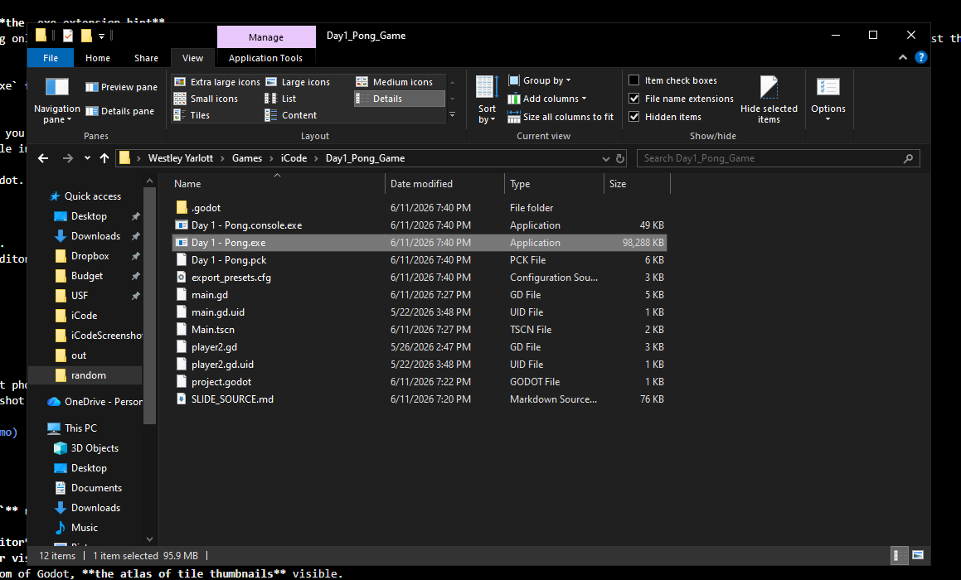
iCode
DAY 3
EMPOWERING FUTURE INNOVATORS
Godot writes your .exe plus a .pck data file. Double-click the .exe — your game runs with no Godot needed. Keep the two files together.
82

Slide 83
iCode
DAY 3
EMPOWERING FUTURE INNOVATORS
Tomorrow: build a fighter
Late 1990s. Street Fighter era. We go deep on objects — code that knows what it IS and what it can DO.
83

