Slide 1

iCode
DAY 4
EMPOWERING FUTURE INNOVATORS
Day 4 — 2-Player Fighter
1

Slide 2
iCode
DAY 4
EMPOWERING FUTURE INNOVATORS
Today we'll build…
• A 2-player fighter game — one keyboard, two players.
• Four characters. Three maps. Last fighter standing wins.
• All playable on a Windows PC before you leave today.
2

Slide 3
iCode
DAY 4
EMPOWERING FUTURE INNOVATORS
Why fighters matter
• 1991 — Street Fighter II: solo-vs-solo arcade boom.
• 1992 — Mortal Kombat: breakout home-console fighter.
• 1999 — Super Smash Bros (N64): invented roster + multi-character + percent-damage.
• Today — Smash Ultimate has 87 characters. All trace back to that N64 disc.
3

Slide 4
iCode
DAY 4
EMPOWERING FUTURE INNOVATORS
Yesterday → Today
• D3: Lists + deeper functions — enemies, towers, waves.
• D4: Two new ideas — Objects and State.
• Same for loops. Same func shapes. New way to package code.
4

Slide 5
iCode
DAY 4
EMPOWERING FUTURE INNOVATORS
5-day arc
• D1 ✓ Variables + Conditions (Pong)
• D2 ✓ Loops + Functions (Maze)
• D3 ✓ Functions deep + Lists (Base Defense)
• D4 → TODAY Objects + State (Fighter)
• D5 No new code — Escape Simulator + showcase
5

Slide 6
iCode
DAY 4
EMPOWERING FUTURE INNOVATORS
Today's two big ideas
• Objects — blueprints that hold data + methods together. One class, many instances, each with its own copy of every property.
• State — a label that lets one object behave differently depending on what mode it's in.
6

Slide 7
iCode
DAY 4
EMPOWERING FUTURE INNOVATORS
GDScript vs Python — classes
Python
GDScript
class Player:
def __init__(self):
self.hp = 100
def take_damage(self, n):
self.hp -= n
extends CharacterBody2D
var hp = 100
func take_damage(n):
hp -= n
7

Slide 8
iCode
DAY 4
EMPOWERING FUTURE INNOVATORS
Pre-coding setup
Open the project and meet the menu flow before writing any code.
8

Slide 9
iCode
DAY 4
EMPOWERING FUTURE INNOVATORS
Walk A — open the Day 4 project
Open the Day 4 Fighter project the same way you did yesterday.
9

Slide 10
iCode
DAY 4
EMPOWERING FUTURE INNOVATORS
Walk A — hint
• Godot launcher → Import → navigate to Day4_Fighter_Game/project.godot → Import & Edit
10

Slide 11
iCode
DAY 4
EMPOWERING FUTURE INNOVATORS
Walk B — open player.gd
Open player.gd in the script editor — most of today's work lives here.
11

Slide 12
iCode
DAY 4
EMPOWERING FUTURE INNOVATORS
Walk B — hint
• FileSystem panel → player.gd → double-click → Script editor opens
12

Slide 13
iCode
DAY 4
EMPOWERING FUTURE INNOVATORS
11 properties per character
• display_name, sprite, tint
• walk_speed, jump_impulse ← become chunk #2 vars
• attack_type, attack_damage, attack_cooldown, attack_range ← chunk #2 vars
• projectile_speed, projectile_gravity_scale ← pre-given, projectile chars only
13

Slide 14
iCode
DAY 4
EMPOWERING FUTURE INNOVATORS
The Player class mirrors this dict
• Each character's numbers live in CHARACTERS.
• setup() copies them onto the Player object.
• Pick Knight → your Player gets Knight's walk_speed, attack_damage, etc.
14

Slide 15
iCode
DAY 4
EMPOWERING FUTURE INNOVATORS
Code isn't the only way.
• D1, D2, D3 — every solution looked different. All ran.
• Same rule today. If your version makes the game work, it's correct.
15

Slide 16
iCode
DAY 4
EMPOWERING FUTURE INNOVATORS
Let's code.
Seven chunks. Two big ideas. One fighter game.
16

Slide 17
iCode
DAY 4
EMPOWERING FUTURE INNOVATORS
Big idea #1 — Objects
Every fighter is an object. Let's see what that means.
17

Slide 18
iCode
DAY 4
EMPOWERING FUTURE INNOVATORS
Each panda is one Object.
• Minecraft has ONE panda script.
• But it can spawn as many pandas as it wants.
• Each one is its own object — its own HP, its own personality, its own position.
18

Slide 19
iCode
DAY 4
EMPOWERING FUTURE INNOVATORS
Blueprint → Instances
┌────────────────────────┐
│ Panda (blueprint) │
│ hp: int │
│ personality: String │
│ facing: int │
└────────────────────────┘
↓ ↓ ↓
┌──────────┐ ┌──────────┐ ┌──────────┐
│ Panda A │ │ Panda B │ │ Panda C │
│ hp=20 │ │ hp=18 │ │ hp=5 │
│ lazy │ │ playful │ │ worried │
│ facing=1│ │ facing=-1│ │ facing=1│
└──────────┘ └──────────┘ └──────────┘
19

Slide 20
iCode
DAY 4
EMPOWERING FUTURE INNOVATORS
Properties + Methods
• Properties — what each panda remembers: hp, personality, facing
• Methods — what each panda can do: eat(), roll_over(), take_damage()
• An object bundles both together.
20

Slide 21
iCode
DAY 4
EMPOWERING FUTURE INNOVATORS
Quiz
• Panda A — HP: 18. Panda B — HP: 20.
• You damage Panda A for 5.
• What's Panda B's HP?
• → 20. Hitting A doesn't touch B. Each instance has its own copy.
21

Slide 22
iCode
DAY 4
EMPOWERING FUTURE INNOVATORS
What a class looks like in code
extends CharacterBody2D # "I am a CharacterBody2D"
var hp = 100 # property — each panda's own HP
var personality = "lazy" # property — each panda's own mood
func eat(): # method — what pandas can do
hp += 5
22

Slide 23
iCode
DAY 4
EMPOWERING FUTURE INNOVATORS
7 panda personalities — same script, different behavior
• lazy / worried / playful / aggressive / weak / brown / normal
• Each personality changes how the panda acts.
• That's the second big idea today: State. You'll meet it after chunk #4.
23

Slide 24
iCode
DAY 4
EMPOWERING FUTURE INNOVATORS
Objects everywhere in games
• Mario coin = object (collected flag, position)
• Zelda enemy = object (HP, AI state, facing)
• Fortnite weapon = object (ammo, damage, rarity)
• If a thing has its own stats and behavior — it's an object.
24

Slide 25
iCode
DAY 4
EMPOWERING FUTURE INNOVATORS
Today: one Player class, two instances
• ONE Player.tscn blueprint (same file for P1 and P2)
• TWO instances at runtime (P1 Knight + P2 Ninja)
• Same code — different player_num, different character, different HP
25

Slide 26
iCode
DAY 4
EMPOWERING FUTURE INNOVATORS
Where in player.gd — TODO #1
# player.gd — after setup(), declare your core properties:
# TODO #1: Declare the three core properties every Player needs...
#
# Syntax:
# - var name: int = value
#@todo
← your code goes here
#@end
26

Slide 27
iCode
DAY 4
EMPOWERING FUTURE INNOVATORS
TODO #1 — prep: three core properties
# Declare the player's current health points, starting at 100
# Declare the player's maximum health, also starting at 100
# Declare which direction the player faces (1 = right, -1 = left), starting right
• What: Every Player needs to track its own HP and which direction it faces.
• Why: hp and max_hp scale the HP bar. facing drives sprite flip and attack direction.
• How: Three var lines directly inside the #@todo block.
This is one approach — yours works if it runs.
27

Slide 28
iCode
DAY 4
EMPOWERING FUTURE INNOVATORS
TODO #1 — three core properties
SYNTAX
var name := value
WRITE THIS
# Declare the player's current health points, starting at 100
# Declare the player's maximum health, also starting at 100
# Declare which direction the player faces (1 = right, -1 = left), starting right
Detailed instructions are in your code file, right next to this TODO.
28

Slide 29
iCode
DAY 4
EMPOWERING FUTURE INNOVATORS
Chunk #2 — what kind of panda are you?
Core HP is declared. Now declare which character's stats apply.
29

Slide 30
iCode
DAY 4
EMPOWERING FUTURE INNOVATORS
Each character is a dictionary of stats
• CHARACTERS[\"knight\"] → {walk_speed: 220, attack_damage: 18, ...}
• setup() copies those values onto the Player object.
• Pick Knight → your Player gets Knight's numbers.
30

Slide 31
iCode
DAY 4
EMPOWERING FUTURE INNOVATORS
Quiz
• P1 picks Knight — walk_speed = 220.
• P2 picks Ninja — walk_speed = 320.
• Same property name. Who walks faster?
• → P2 (Ninja). Same name, each instance has its OWN value.
31

Slide 32
iCode
DAY 4
EMPOWERING FUTURE INNOVATORS
Where in player.gd — TODO #2
# player.gd — right after TODO #1:
# TODO #2: Declare the five properties that mirror the character config.
#
# Syntax:
# - var name: float = value
# - var name: String = "value"
#@todo
← your code goes here
#@end
32

Slide 33
iCode
DAY 4
EMPOWERING FUTURE INNOVATORS
TODO #2 — prep: character config vars
# Declare the player's walking speed, using Knight's default value
# Declare the player's jump strength, using Knight's default value
# Declare the player's attack style ("melee" or "projectile"), defaulting to melee
# Declare how much damage each hit deals, using Knight's default value
# Declare how long between attacks in seconds, using Knight's default value
• What: Declare five properties that mirror the character dict keys.
• Why: setup() overwrites these from CHARACTERS[char_name]. Defaults let the file compile before the game starts.
• How: Five var lines right after TODO #1's block.
This is one approach — yours works if it runs.
33

Slide 34
iCode
DAY 4
EMPOWERING FUTURE INNOVATORS
TODO #2 — character config vars
SYNTAX
var name := value
WRITE THIS
# Declare the player's walking speed, using Knight's default value
# Declare the player's jump strength, using Knight's default value
# Declare the player's attack style ("melee" or "projectile"), defaulting to melee
# Declare how much damage each hit deals, using Knight's default value
# Declare how long between attacks in seconds, using Knight's default value
Detailed instructions are in your code file, right next to this TODO.
34

Slide 35
iCode
DAY 4
EMPOWERING FUTURE INNOVATORS
Personalization #1 — tune your fighter
• In main.gd lines 6–59: find your character and change some numbers.
• Double Knight's walk_speed. Give Ninja's attack_damage a boost.
• Run the game (F5) and feel the difference.
• Low on time? Skip this and keep going. Finished early? This is for you.
35

Slide 36
iCode
DAY 4
EMPOWERING FUTURE INNOVATORS
Chunk #3 — teach the panda how to take damage
You declared HP. Now write the method that makes it go down.
36

Slide 37
iCode
DAY 4
EMPOWERING FUTURE INNOVATORS
Methods — functions inside a class
# A method is a func INSIDE a class.
# It can read and change the object's own properties.
func eat():
hunger -= 10 # changes THIS panda's hunger
37

Slide 38
iCode
DAY 4
EMPOWERING FUTURE INNOVATORS
What's available in take_damage()
• hp — your chunk #1 property
• max_hp — also chunk #1
• hit_flash_timer — set to 0.2 to start the red flash
• set_state(\"hit\") — chunk #5, not written yet. Type the line and move on.
• hp_bar_fill.size.x — set to float(hp) / max_hp * 80.0 to shrink the bar
• die() — pre-given, call if hp <= 0
38

Slide 39
iCode
DAY 4
EMPOWERING FUTURE INNOVATORS
Where in player.gd — TODO #3
func take_damage(amount: int) -> void:
# TODO #3: Fill this function body.
# Given: hp, max_hp, hit_flash_timer
# set_state("hit"), hp_bar_fill.size.x, die()
#@todo
← your code goes here
#@end
39

Slide 40
iCode
DAY 4
EMPOWERING FUTURE INNOVATORS
TODO #3 — prep: take_damage body
# Subtract the incoming damage from the player's current HP
# Start a brief flash effect so the hit is visible on screen
# Switch the player into the "hit" state
# Resize the HP bar to reflect the new HP percentage
# If HP has reached zero or below:
# Trigger the player's death
• What: Fill the take_damage() body so opponents can actually hurt each other.
• Why: Without this, the HP bar never changes and nobody dies — no fight.
• How: Five lines in order: subtract hp, set flash timer, switch state, resize bar, check for death.
This is one approach — yours works if it runs.
40

Slide 41
iCode
DAY 4
EMPOWERING FUTURE INNOVATORS
TODO #3 — take_damage body
SYNTAX
WRITE THIS
x -= amount
object.property += amount
if condition:
do_this
function_name()
# Subtract the incoming damage from the player's current HP
# Start a brief flash effect so the hit is visible on screen
# Switch the player into the "hit" state
# Resize the HP bar to reflect the new HP percentage
# If HP has reached zero or below:
# Trigger the player's death
Detailed instructions are in your code file, right next to this TODO.
41

Slide 42
iCode
DAY 4
EMPOWERING FUTURE INNOVATORS
Walk C — run the project
Run the game. Confirm it opens without errors.
42

Slide 43
iCode
DAY 4
EMPOWERING FUTURE INNOVATORS
Walk C — hint
• F5 → Set Main Scene? → Select Current → game opens → F8 to stop
43

Slide 44
iCode
DAY 4
EMPOWERING FUTURE INNOVATORS
Walk D — reading an error
Game didn't open? Find the error and fix it.
44

Slide 45
iCode
DAY 4
EMPOWERING FUTURE INNOVATORS
Walk D — hint
• Output panel → click the blue line number → script editor jumps to error → fix → Ctrl+S → F5 again
45

Slide 46
iCode
DAY 4
EMPOWERING FUTURE INNOVATORS
Chunk #4 — two fighters appear
You have a Player class. Time to make two of them.
46

Slide 47
iCode
DAY 4
EMPOWERING FUTURE INNOVATORS
Instantiate = /summon panda
# Minecraft: /summon panda → one new panda instance
# Godot: PLAYER_SCENE.instantiate() → one new Player instance
var player1 = PLAYER_SCENE.instantiate()
add_child(player1) # puts it in the scene tree (it exists + runs)
player1.setup(1, "knight", Vector2(200, 500)) # configures it
47

Slide 48
iCode
DAY 4
EMPOWERING FUTURE INNOVATORS
Where in main.gd — TODO #4
func start_match(p1_char: String, p2_char: String, map_id: String) -> void:
clear_match_state()
build_map(map_id)
# TODO #4: Build two Player instances — one for P1, one for P2.
# Given: PLAYER_SCENE, player1, player2, p1_char, p2_char
# PLAYER_SCENE.instantiate(), add_child(node)
# node.setup(num, char, Vector2(x, y))
#@todo
← your code goes here
#@end
set_screen("countdown")
48

Slide 49
iCode
DAY 4
EMPOWERING FUTURE INNOVATORS
TODO #4 — prep: two Player instances
# Create a new Player 1 instance from the player scene
# Add Player 1 to the game world so it exists and runs
# Set up Player 1 as player number 1 with their chosen character on the left side
# Create a new Player 2 instance from the player scene
# Add Player 2 to the game world so it exists and runs
# Set up Player 2 as player number 2 with their chosen character on the right side
• What: Spawn two Player instances at opposite ends of the map.
• Why: Without this, the fight screen stays empty — no fighters appear.
• How: Instantiate, add to scene, call setup. Do it twice — P1 left side, P2 right side.
This is one approach — yours works if it runs.
49

Slide 50
iCode
DAY 4
EMPOWERING FUTURE INNOVATORS
TODO #4 — two Player instances
SYNTAX
var node := SCENE.instantiate()
add_child(node)
node.setup(args)
function_name()
WRITE THIS
# Create a new Player 1 instance from the player scene
# Add Player 1 to the game world so it exists and runs
# Set up Player 1 as player number 1 with their chosen character on the left side
# Create a new Player 2 instance from the player scene
# Add Player 2 to the game world so it exists and runs
# Set up Player 2 as player number 2 with their chosen character on the right side
Detailed instructions are in your code file, right next to this TODO.
50

Slide 51
iCode
DAY 4
EMPOWERING FUTURE INNOVATORS
Big idea #2 — State
Your fighters exist. Now teach them to change mode.
51

Slide 52
iCode
DAY 4
EMPOWERING FUTURE INNOVATORS
The light's current mode is its State.
• Right now the state is \"red\". Cars stop.
• 30 seconds later the state is \"green\". Same intersection. Cars go.
• Same hardware. Different behavior. That's state.
52

Slide 53
iCode
DAY 4
EMPOWERING FUTURE INNOVATORS
Three states — three behaviors
• | State | Cars do | |---|---| | "red" | Stop | | "yellow" | Slow down | | "green" | Go | Same intersection. The state decides everything.
53

Slide 54
iCode
DAY 4
EMPOWERING FUTURE INNOVATORS
States change on events
• \"red\" → (30 s timer) → \"green\"
• \"green\" → (25 s timer) → \"yellow\"
• \"yellow\" → (3 s timer) → \"red\"
• For your fighter: \"idle\" → (jump pressed) → \"jump\"
54

Slide 55
iCode
DAY 4
EMPOWERING FUTURE INNOVATORS
State machine in code
var state = "red"
match state: # check current mode
"red":
cars_must_stop()
"yellow":
cars_slow_down()
"green":
cars_go()
func set_state(new_state): # helper to change mode
if new_state == state:
return
print(new_state)
state = new_state
55

Slide 56
iCode
DAY 4
EMPOWERING FUTURE INNOVATORS
Quiz
• Light is green. Pedestrian hits the crosswalk button. What state comes next?
• → yellow (then red). Green never jumps straight to red.
• Same rule for your panda: \"idle\" never jumps straight to \"fall\".
56

Slide 57
iCode
DAY 4
EMPOWERING FUTURE INNOVATORS
Your fighter's 6 states
• \"idle\" ↔ \"walk\" (move direction changes)
• \"idle\" / \"walk\" → \"jump\" (jump pressed on floor)
• \"jump\" → \"fall\" (velocity.y goes positive)
• \"fall\" → \"idle\" (landed on floor)
• → \"attack\" from any movement state (attack pressed)
• → \"hit\" when damaged
57

Slide 58
iCode
DAY 4
EMPOWERING FUTURE INNOVATORS
Where in player.gd — TODO #5
# player.gd — after TODO #1 and #2:
# TODO #5: Declare `state` and write the set_state() helper.
#@todo
← var state goes here
← func set_state() goes here
#@end
58

Slide 59
iCode
DAY 4
EMPOWERING FUTURE INNOVATORS
TODO #5 — prep: state var + set_state helper
# Declare the player's current state, starting as "idle"
#
# Write a helper function that changes the state safely:
# If the new state is already the current state, return early — don't change anything
# Print the new state name so you can watch transitions in the Output panel
# Update the state variable to the new value
• What: Declare the state variable and write the helper that changes it safely.
• Why: Chunk #6 reads state every frame. Without it, the match statement breaks.
• How: Declare var state first. Then write func set_state() with the guard + print + assignment.
This is one approach — yours works if it runs.
59

Slide 60
iCode
DAY 4
EMPOWERING FUTURE INNOVATORS
TODO #5 — state var + set_state helper
SYNTAX
var name := value
func name(param):
use(param)
if condition:
do_this
return
print("message")
WRITE THIS
# Declare the player's current state, starting as "idle"
#
# Write a helper function that changes the state safely:
# If the new state is already the current state, return early — don't change anything
# Print the new state name so you can watch transitions in the Output panel
# Update the state variable to the new value
Detailed instructions are in your code file, right next to this TODO.
60

Slide 61
iCode
DAY 4
EMPOWERING FUTURE INNOVATORS
Personalization #2 — watch your states print
• After filling chunk #5, run the game (F5). Watch the Output panel.
• Every state change prints: idle, walk, jump, fall, attack, hit…
• Try renaming \"idle\" to \"chilling\" in your var state line. Does it still work?
• Low on time? Skip. Finished early? This is for you.
61

Slide 62
iCode
DAY 4
EMPOWERING FUTURE INNOVATORS
Chunk #6 — write the state machine
You have a state variable. Now decide WHEN the state changes.
62

Slide 63
iCode
DAY 4
EMPOWERING FUTURE INNOVATORS
Back to the traffic light
• The match block runs every frame — it's already in _physics_process (pre-given).
• Each branch checks: should I switch state right now?
• \"idle\" branch: if moving → \"walk\". If jump pressed → \"jump\".
• You fill the if blocks inside each branch.
63

Slide 64
iCode
DAY 4
EMPOWERING FUTURE INNOVATORS
Where in player.gd — TODO #6 (inside _physics_process)
match state:
"idle":
velocity.x = 0 # pre-given (gray)
# TODO #6a: switch to "walk" or "jump"
#@todo ← your if blocks #@end
"walk":
velocity.x = walk_speed * get_move_direction() # pre-given (gray)
# TODO #6b: switch to "idle" or "jump"
#@todo ← your if blocks #@end
"jump":
velocity.x = walk_speed * get_move_direction() * 0.85 # pre-given (gray)
# TODO #6c: switch to "fall" when rising is done
#@todo ← #@end
"fall":
velocity.x = walk_speed * get_move_direction() * 0.85 # pre-given (gray)
# TODO #6d: switch to "idle" when landed
#@todo ← #@end
64

Slide 65
iCode
DAY 4
EMPOWERING FUTURE INNOVATORS
TODO #6 — prep: 4 state transitions
# "idle" branch (#6a):
# If the player presses a direction key, switch to "walk"
# If the player presses jump while standing on the floor:
# Launch the player upward
# Switch to "jump"
# "walk" branch (#6b):
# If the player releases the direction key, switch to "idle"
# If the player presses jump while standing on the floor:
# Launch the player upward
# Switch to "jump"
# "jump" branch (#6c):
# If the player starts moving downward, switch to "fall"
# "fall" branch (#6d):
# If the player lands on the floor, switch to "idle"
• What: Fill four if blocks — one per state branch — deciding when to transition.
• Why: Without this, fighters can't move, jump, or fall.
• How: Each branch gets if checks on the given conditions. Call set_state() to switch.
This is one approach — yours works if it runs.
65

Slide 66
iCode
DAY 4
EMPOWERING FUTURE INNOVATORS
TODO #6 — 4 state transitions (6a / 6b / 6c / 6d)
SYNTAX
if condition:
do_this
function_name()
WRITE THIS
# "idle" branch (#6a):
# If the player presses a direction key, switch to "walk"
# If the player presses jump while standing on the floor:
# Launch the player upward
# Switch to "jump"
# "walk" branch (#6b):
# If the player releases the direction key, switch to "idle"
# If the player presses jump while standing on the floor:
# Launch the player upward
# Switch to "jump"
# "jump" branch (#6c):
# If the player starts moving downward, switch to "fall"
# "fall" branch (#6d):
# If the player lands on the floor, switch to "idle"
Detailed instructions are in your code file, right next to this TODO.
66

Slide 67
iCode
DAY 4
EMPOWERING FUTURE INNOVATORS
Personalization #3 — build your own map
• In main.gd, find const MAPS := {...}. Each platform is [x, y, w, h, one_way].
• Add a new platform to \"battlefield\" — try [540, 500, 150, 16, true].
• Run the game (F5). Jump on your platform.
• Low on time? Skip. Finished early? This is for you.
67

Slide 68
iCode
DAY 4
EMPOWERING FUTURE INNOVATORS
Chunk #7 — let them fight
State machine works. Time to write the hit check.
68

Slide 69
iCode
DAY 4
EMPOWERING FUTURE INNOVATORS
attack() — the outer shell (pre-given)
func attack() -> void:
attack_cooldown_timer = attack_cooldown # pre-given
match attack_type: # pre-given
"melee":
melee_swing_timer = 0.15 # pre-given
queue_redraw() # pre-given
var opponent = get_opponent() # pre-given
# ── pre-given math (gray) ──────────────────
var in_range = abs(to_opp.x) <= character_data["attack_range"]
var facing_opponent = sign(to_opp.x) == facing
var same_height = abs(to_opp.y) <= 60
# ← YOUR HOLE: the if check that uses these three
"projectile":
spawn_projectile() # pre-given
69

Slide 70
iCode
DAY 4
EMPOWERING FUTURE INNOVATORS
Where in player.gd — TODO #7
# Pre-given (gray — you don't write this):
var in_range = abs(to_opp.x) <= character_data["attack_range"]
var facing_opponent = sign(to_opp.x) == facing
var same_height = abs(to_opp.y) <= 60
# TODO #7: write the if check that uses all three:
#@todo
← just the if block goes here
#@end
70

Slide 71
iCode
DAY 4
EMPOWERING FUTURE INNOVATORS
TODO #7 — prep: the hit-check if
# If the opponent is close enough, being faced, and at the same height:
# Deal attack damage to the opponent
• What: Write the if that decides whether a melee attack lands.
• Why: Three conditions must all be true: close enough, facing them, same height.
• How: Two lines. in_range, facing_opponent, same_height are all pre-given above your hole.
This is one approach — yours works if it runs.
71

Slide 72
iCode
DAY 4
EMPOWERING FUTURE INNOVATORS
TODO #7 — the hit-check `if`
SYNTAX
if condition:
do_this
function_name()
WRITE THIS
# If the opponent is close enough, being faced, and at the same height:
# Deal attack damage to the opponent
Detailed instructions are in your code file, right next to this TODO.
72

Slide 73
iCode
DAY 4
EMPOWERING FUTURE INNOVATORS
Personalization #4 — tune your attack
• In main.gd CHARACTERS dict: find your fighter.
• attack_range — smaller = must be close. Bigger = long reach.
• attack_cooldown — smaller = faster attacks. Bigger = slower.
• Make one fighter feel sluggish and one feel snappy.
• Low on time? Skip. Finished early? This is for you.
73

Slide 74
iCode
DAY 4
EMPOWERING FUTURE INNOVATORS
Final Challenge — Invent your own character
• Open final_challenge.gd — a separate script with #@todo holes.
• Fill FC-1, FC-2, FC-3 to add a brand-new 5th character to the roster.
• Pick any sprite, any stats, any attack behavior.
74

Slide 75
iCode
DAY 4
EMPOWERING FUTURE INNOVATORS
Add a new character — every step
• Step 1 — In final_challenge.gd: fill CUSTOM_CHARACTER dict (FC-1). Set attack_type: \"custom\".
• Step 2 — In main.gd _ready(): add CHARACTERS[\"custom\"] = CUSTOM_CHARACTER.
• Step 3 — In main.gd _unhandled_input: add \"custom\" to the keys array as index 4.
• Step 4 — Update title_label.text to include 5 = <YourCharacterName>.
• Step 5 — In player.gd attack(): add \"custom\": branch to match attack_type: (FC-3). Write any behavior.
• Step 6 — Save all three files (final_challenge.gd, main.gd, player.gd). Press F5. Press 5 at char select.
75

Slide 76
iCode
DAY 4
EMPOWERING FUTURE INNOVATORS
You already know how to do this.
• FC-1 ← Chunks #1 + #2 (property declarations — fill the stats dict)
• FC-2 ← Chunk #4 (hook a new instance into the system)
• FC-3 ← Chunks #6 + #7 (match branch + hit check)
76

Slide 77
iCode
DAY 4
EMPOWERING FUTURE INNOVATORS
Final Challenge — all holes
• | FC | Mirrors | Syntax | Write this (comments) | |---|---|---|---| | FC-1 CUSTOM_CHARACTER dict | #1 + #2 | var | # Fill all 11 keys: display_name, sprite, tint, walk_speed, jump_impulse, attack_type ("custom"), attack_damage, attack_cooldown, attack_range, projectile_speed, projectile_gravity_scale | | FC-2 Register in CHARACTERS | #4 | func_call | # CHARACTERS["custom"] = CUSTOM_CHARACTER / # Add "custom" to keys array / # Update title_label.text to show "5 = YourName" | | FC-3 custom attack branch | #6 + #7 | match_stmt, if, func_call | # "custom": / # opponent.take_damage(attack_damage) / # (or: spawn_projectile(), hp += 5, or anything) |
77

Slide 78
iCode
DAY 4
EMPOWERING FUTURE INNOVATORS
Take it home
Turn your Fighter game into a real Windows .exe — no Godot needed.
78

Slide 79
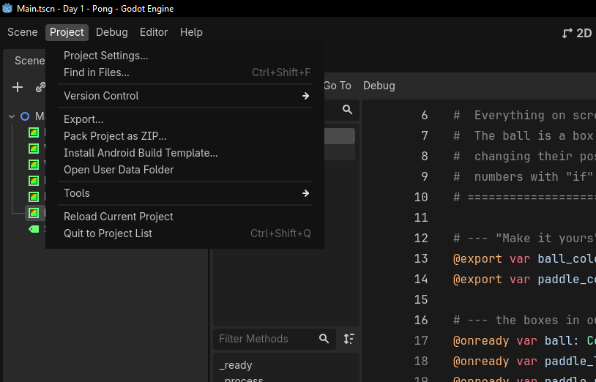
iCode
DAY 4
EMPOWERING FUTURE INNOVATORS
In the top menu bar, click Project, then Export…
79

Slide 80
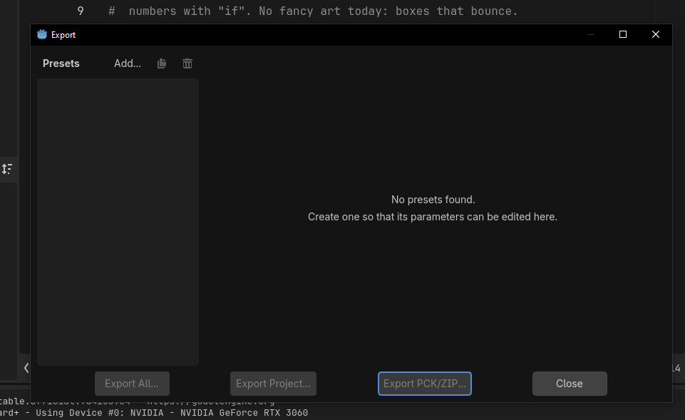
iCode
DAY 4
EMPOWERING FUTURE INNOVATORS
Click Add… to add a platform target.
80

Slide 81
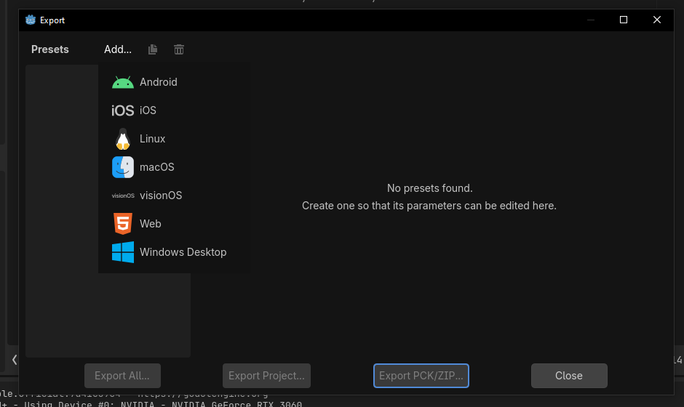
iCode
DAY 4
EMPOWERING FUTURE INNOVATORS
Pick Windows Desktop.
81

Slide 82
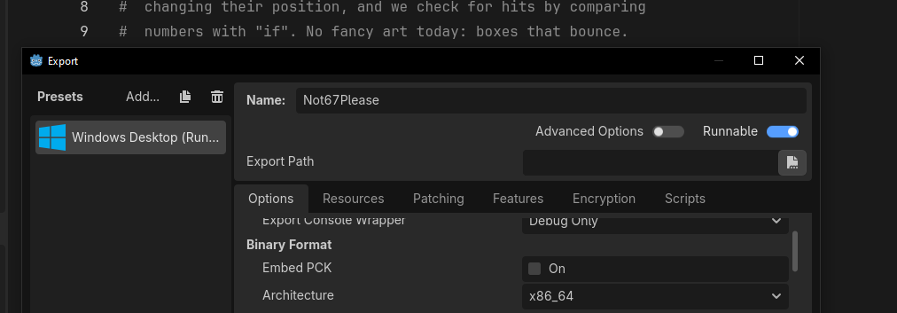
iCode
DAY 4
EMPOWERING FUTURE INNOVATORS
Windows Desktop preset added. Leave options as-is — Runnable on, x86_64.
82

Slide 83
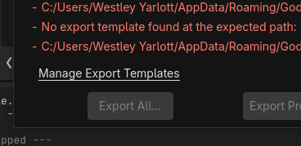
iCode
DAY 4
EMPOWERING FUTURE INNOVATORS
See 'No export template found'? Click Manage Export Templates.
83

Slide 84
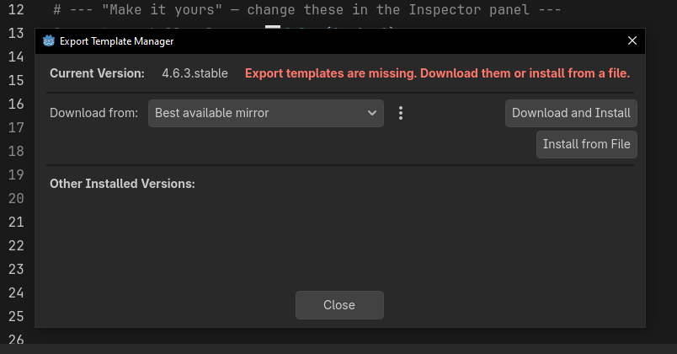
iCode
DAY 4
EMPOWERING FUTURE INNOVATORS
Click Download and Install. Let it finish.
84

Slide 85
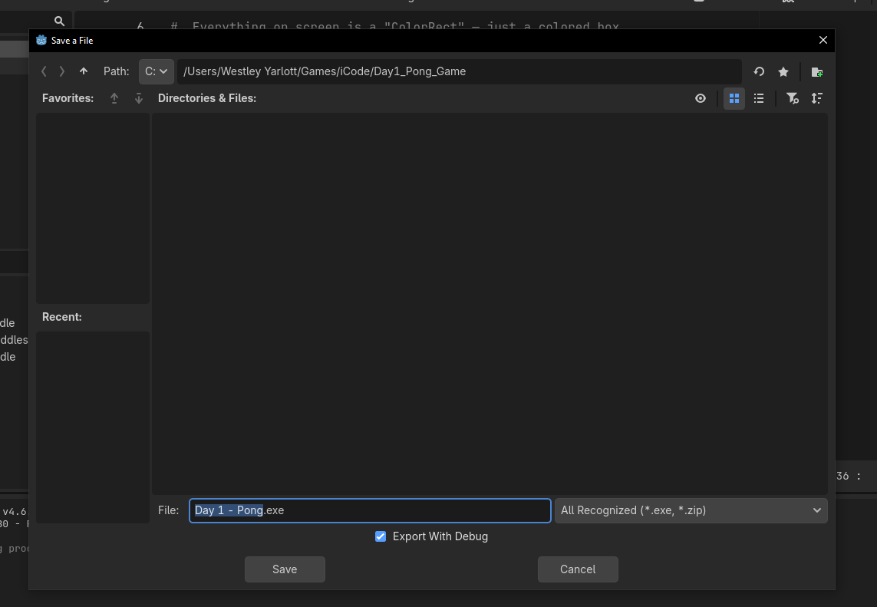
iCode
DAY 4
EMPOWERING FUTURE INNOVATORS
Click Export Project → type Day 4 - Fighter → pick folder → Save.
85

Slide 86
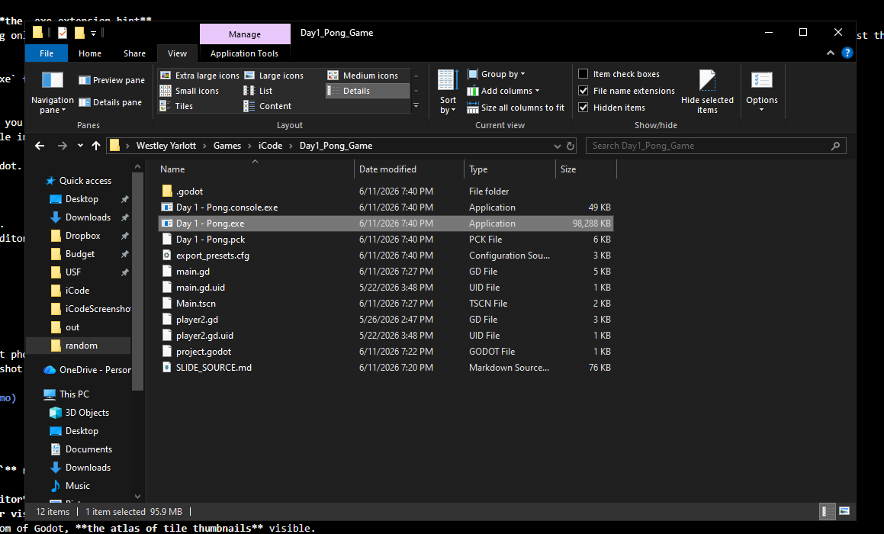
iCode
DAY 4
EMPOWERING FUTURE INNOVATORS
Godot writes .exe + .pck. Double-click the .exe — runs without Godot. Keep both files together.
86

Slide 87
iCode
DAY 4
EMPOWERING FUTURE INNOVATORS
Tomorrow: no new code
Day 5 = Steam Escape Simulator workshop + showcase. You BUILD an escape room. Then you play each other's.
87

