Slide 1

iCode
DAY 3
EMPOWERING FUTURE INNOVATORS
Day 3 — Base Defense
1

Slide 2
iCode
DAY 3
EMPOWERING FUTURE INNOVATORS
A whole genre — invented by modders
• Rampart (1990) — hybrid first attempt. Castle walls + cannonballs.
• Warcraft III custom maps (2002–2007) — entire genre invented by players tweaking someone else's game.
• Plants vs Zombies (2009) — mainstream breakout. 6 million copies in a year.
• Bloons / Kingdom Rush — mobile-era boom. Still going.
• Takeaway: every tower defense game you've ever played traces back to a Warcraft III modder.
2

Slide 3
iCode
DAY 3
EMPOWERING FUTURE INNOVATORS
Yesterday → Today
• Day 2 — Loops + intro Functions. You made for loops and named blocks of code.
• Day 3 — Lists + Deeper Functions. Same for-loop shape, new things to loop over.
• Today's two new ideas: a list is a collection of things. A deeper function scans a list, returns something, and calls other functions.
3

Slide 4
iCode
DAY 3
EMPOWERING FUTURE INNOVATORS
The 5-day arc
• Day 1 ✓ Pong — Vars + Conditions
• Day 2 ✓ Pac-Man — Loops + Functions
• Day 3 ← Base Defense — Lists + Deeper Functions
• Day 4 Fighter — Objects + State
• Day 5 Escape Room — Showcase
4

Slide 5
iCode
DAY 3
EMPOWERING FUTURE INNOVATORS
Today: Lists + Deeper Functions
• Lists — a collection of things your code can remember, walk through, add to, or remove from.
• Deeper Functions — functions that scan lists, return something useful, and chain into each other.
5

Slide 6
iCode
DAY 3
EMPOWERING FUTURE INNOVATORS
Lists work the same. Functions look the same. The only two-word change: .remove → .erase and len() → .size().
Pattern (board example):
Python: enemies = []
GDScript: var enemies = []
Python: enemies.append("grunt")
GDScript: enemies.append("grunt")
Python: enemies.remove("grunt")
GDScript: enemies.erase("grunt")
Python: len(enemies)
GDScript: enemies.size()
Python: def total(numbers):
GDScript: func total(numbers):
6

Slide 7
iCode
DAY 3
EMPOWERING FUTURE INNOVATORS
Pre-coding setup
7

Slide 8
iCode
DAY 3
EMPOWERING FUTURE INNOVATORS
Walk A — Open the Day 3 project
• Open the Base Defense project the same way you did yesterday.
8

Slide 9
iCode
DAY 3
EMPOWERING FUTURE INNOVATORS
Walk A — Hint
• Godot Launcher → Import button
• Navigate to Day3_BaseDef_Game/project.godot
• Click Import & Edit
9

Slide 10
iCode
DAY 3
EMPOWERING FUTURE INNOVATORS
Open main.gd
• Open main.gd in the Script editor — same way as yesterday.
10

Slide 11
iCode
DAY 3
EMPOWERING FUTURE INNOVATORS
Walk B — Hint
• FileSystem panel (bottom-left) → find main.gd
• Double-click → Script editor opens
11

Slide 12
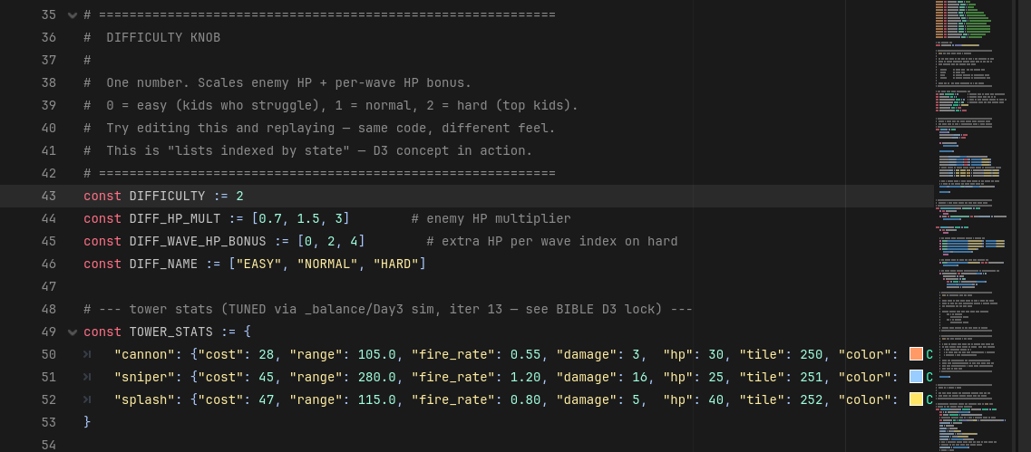
iCode
DAY 3
EMPOWERING FUTURE INNOVATORS
Find the difficulty constant in main.gd.
12

Slide 13
iCode
DAY 3
EMPOWERING FUTURE INNOVATORS
Walk DK — Change it to 0
• Find const DIFFICULTY := 2
• Change 2 → 0
• Ctrl+S to save
13

Slide 14
iCode
DAY 3
EMPOWERING FUTURE INNOVATORS
What just happened?
• That's a list used as a lookup table: DIFF_HP_MULT[DIFFICULTY] picks the multiplier at index 0, 1, or 2.
• You'll learn how lists work in a minute. Change DIFFICULTY back to 2 for now.
14

Slide 15
iCode
DAY 3
EMPOWERING FUTURE INNOVATORS
Lists
16

Slide 16
iCode
DAY 3
EMPOWERING FUTURE INNOVATORS
A list is things in a line
• Position 0 is the first slot. Position 4 is the last.
• Each thing has a number — its index.
17

Slide 17
iCode
DAY 3
EMPOWERING FUTURE INNOVATORS
Five things you can do to a list
• add something to the end — .append()
• remove something — .erase()
• count how many — .size()
• walk through them one at a time — for x in list:
• filter for only the ones you care about — write a function
• Each of these has a code word. You'll use all of them today.
18

Slide 18
iCode
DAY 3
EMPOWERING FUTURE INNOVATORS
What a list looks like in code
var games := [] # empty list var fruits := ["apple", "banana"] # list with two items var score := 0 # not a list — just a counter
19

Slide 19
iCode
DAY 3
EMPOWERING FUTURE INNOVATORS
Adding to the library
• New game. Slides into the next open slot.
• In Base Defense: every time an enemy spawns, it slides into enemies.
20

Slide 20
iCode
DAY 3
EMPOWERING FUTURE INNOVATORS
Lists in every game
• Pac-Man: a list of ghost positions — already used this in D2.
• Every RPG: inventory list, quest list, party list.
• Base Defense: enemies (who's alive), towers (what's placed), enemies_to_spawn (spawn queue for this wave).
21

Slide 21
iCode
DAY 3
EMPOWERING FUTURE INNOVATORS
Base Defense needs four things to remember
• enemies — a list of every enemy currently on the field
• towers — a list of every tower the player has placed
• coins — how many coins the player has right now
• base_hp — how much health the base has left
• Nothing else in the file works without these four. They're the memory of the whole game.
22

Slide 22
iCode
DAY 3
EMPOWERING FUTURE INNOVATORS
Why these live at the top of the file
• Variables declared outside any function are file-level. Every function can read and change them.
• spawn_enemy() will push into enemies. kill_enemy() will pull from it. _process() will walk it.
• If they weren't at the top, each function would have its own private copy — and they'd never talk to each other.
23

Slide 23
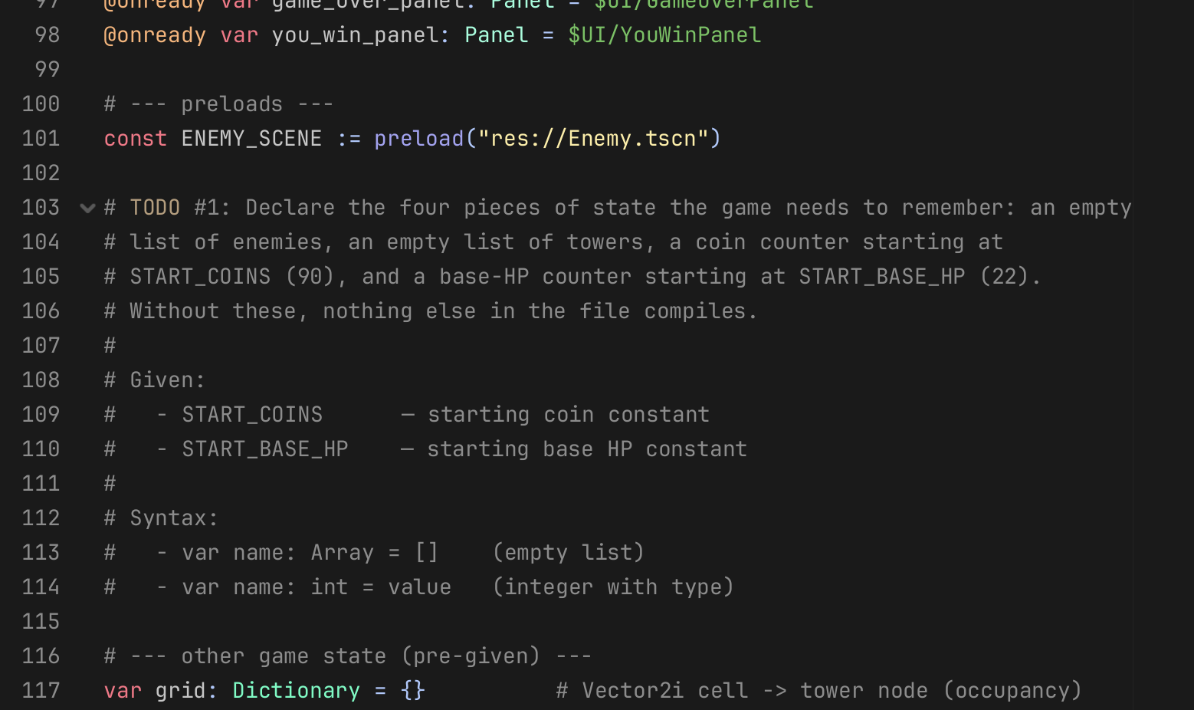
iCode
DAY 3
EMPOWERING FUTURE INNOVATORS
Two empty libraries and two counters. The whole game hangs on these four lines.
Pattern (board example):
Where in your code (Godot):
var games := []
var coins := 100
25

Slide 24
iCode
DAY 3
EMPOWERING FUTURE INNOVATORS
Declarations done — no fireworks yet
These variables are invisible until the rest of the chunks wire them up. Trust the process.
26

Slide 25
iCode
DAY 3
EMPOWERING FUTURE INNOVATORS
Quick check before running
• Four vars declared at file level?
• enemies and towers are empty lists []?
• coins = START_COINS, base_hp = START_BASE_HP?
• Yes to all three → let's run.
27

Slide 26
iCode
DAY 3
EMPOWERING FUTURE INNOVATORS
Walk C — Run your game
• Run the game and confirm it opens without errors.
28

Slide 27
iCode
DAY 3
EMPOWERING FUTURE INNOVATORS
Walk C — Hint
• F5 → "Set Main Scene?" → Select Current → game window opens
• F8 to stop
29

Slide 28
iCode
DAY 3
EMPOWERING FUTURE INNOVATORS
Walk D — Game didn't open?
• Find the error in the Output panel.
30

Slide 29
iCode
DAY 3
EMPOWERING FUTURE INNOVATORS
Walk D — Hint
• Output panel (bottom of editor) → look for red text
• Click the blue line number → editor jumps to the problem
• Fix the typo → Ctrl+S → F5 again
31

Slide 30
iCode
DAY 3
EMPOWERING FUTURE INNOVATORS
You've got two empty libraries — time to fill and drain them
• enemies starts empty. The game needs to add enemies when they spawn, and remove them when they die or reach the base.
• towers starts empty. The game adds a tower when the player places one.
• Two operations. One word each: .append() adds. .erase() removes.
32

Slide 31
iCode
DAY 3
EMPOWERING FUTURE INNOVATORS
.append() and .erase()
• Left: row of 4 tiles, 5th tile slides in from right.
• Right: row of 5 tiles, one fades out, others shift left.
• In Base Defense: enemies.append(e) when a new enemy spawns. enemies.erase(e) when it dies or gets through.
33

Slide 32
iCode
DAY 3
EMPOWERING FUTURE INNOVATORS
Quiz — what's at position 2?
• Library: ["Spider-Man", "FIFA", "Minecraft", "Stardew"]
• You delete "Minecraft".
• What's at position 2 now?
• Answer: "Stardew". Erasing shifts everything after it forward by one.
34

Slide 33
iCode
DAY 3
EMPOWERING FUTURE INNOVATORS
Three places in Base Defense
• Enemy spawns → .append to enemies.
• Tower kills enemy → .erase from enemies + add reward coins.
• Enemy reaches base → .erase from enemies (no bounty — the enemy got through).
35

Slide 34
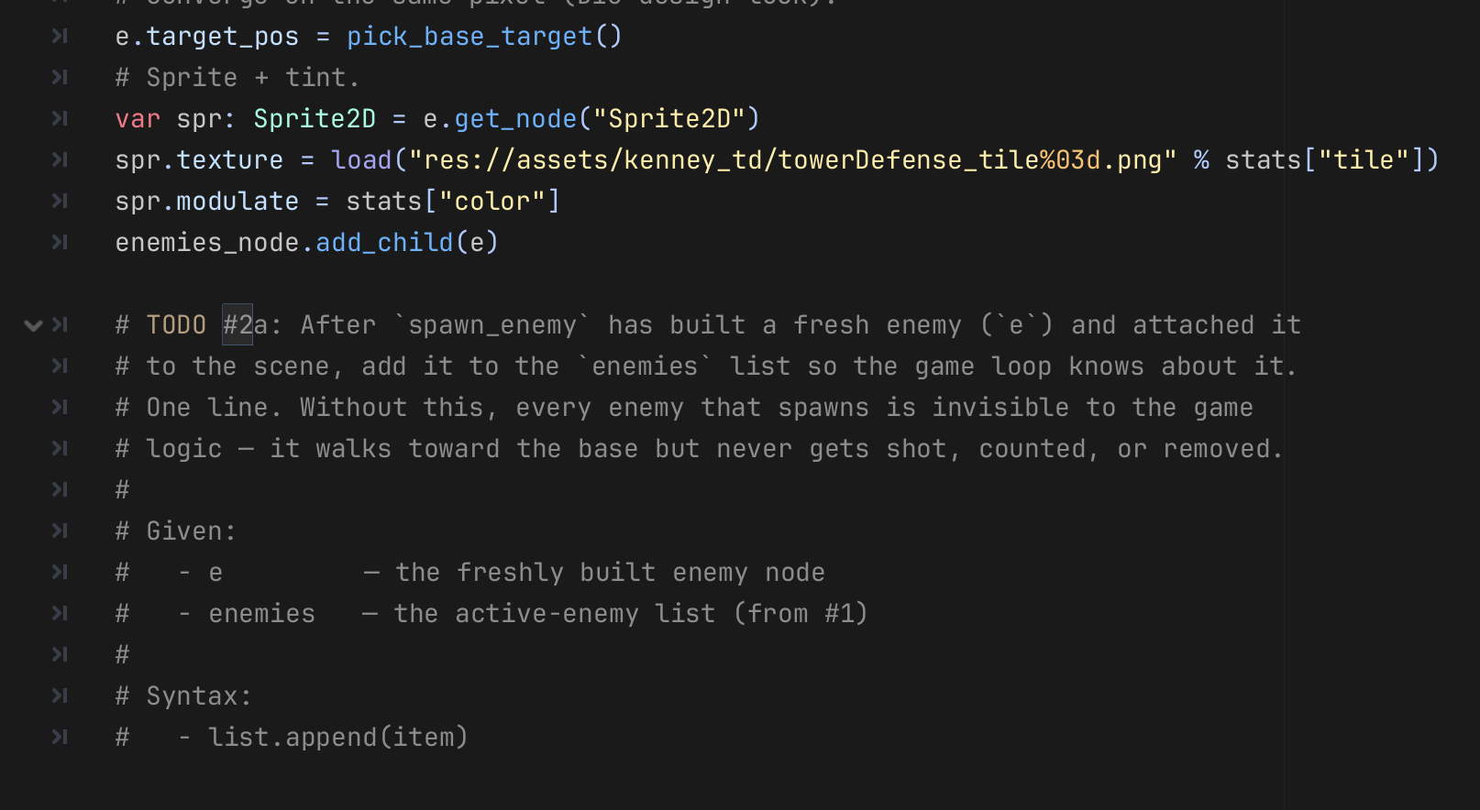
iCode
DAY 3
EMPOWERING FUTURE INNOVATORS
Three holes. Same idea.
Pattern (board example):
Where in your code (Godot):
# append:
library.append("Hogwarts Legacy")
# erase + pay:
library.erase("Old Game")
coins += 50
# erase only:
library.erase("Bad Game")
36

Slide 35
iCode
DAY 3
EMPOWERING FUTURE INNOVATORS
Same for. Same shape. New lists.
• D2: for ghost in ghosts: — you walked every ghost.
• D3: for enemy in enemies: — same. for tower in towers: — same again.
• The only new thing: you're doing it twice, once for each list.
38

Slide 36
iCode
DAY 3
EMPOWERING FUTURE INNOVATORS
D2 shape — you already wrote this
for colour in ["red", "green", "blue"]: print(colour) Same shape you wrote yesterday. Today the list is enemies. The action is step_enemy(e).
39

Slide 37
iCode
DAY 3
EMPOWERING FUTURE INNOVATORS
Every frame: two sweeps
• Every frame: walk every enemy → step it forward by delta. It moves one tick toward the base.
• Every frame: walk every tower → tick its cooldown. If cooldown hits zero, it tries to fire.
• Without both loops: the field is frozen. Nothing moves, nothing shoots.
40

Slide 38
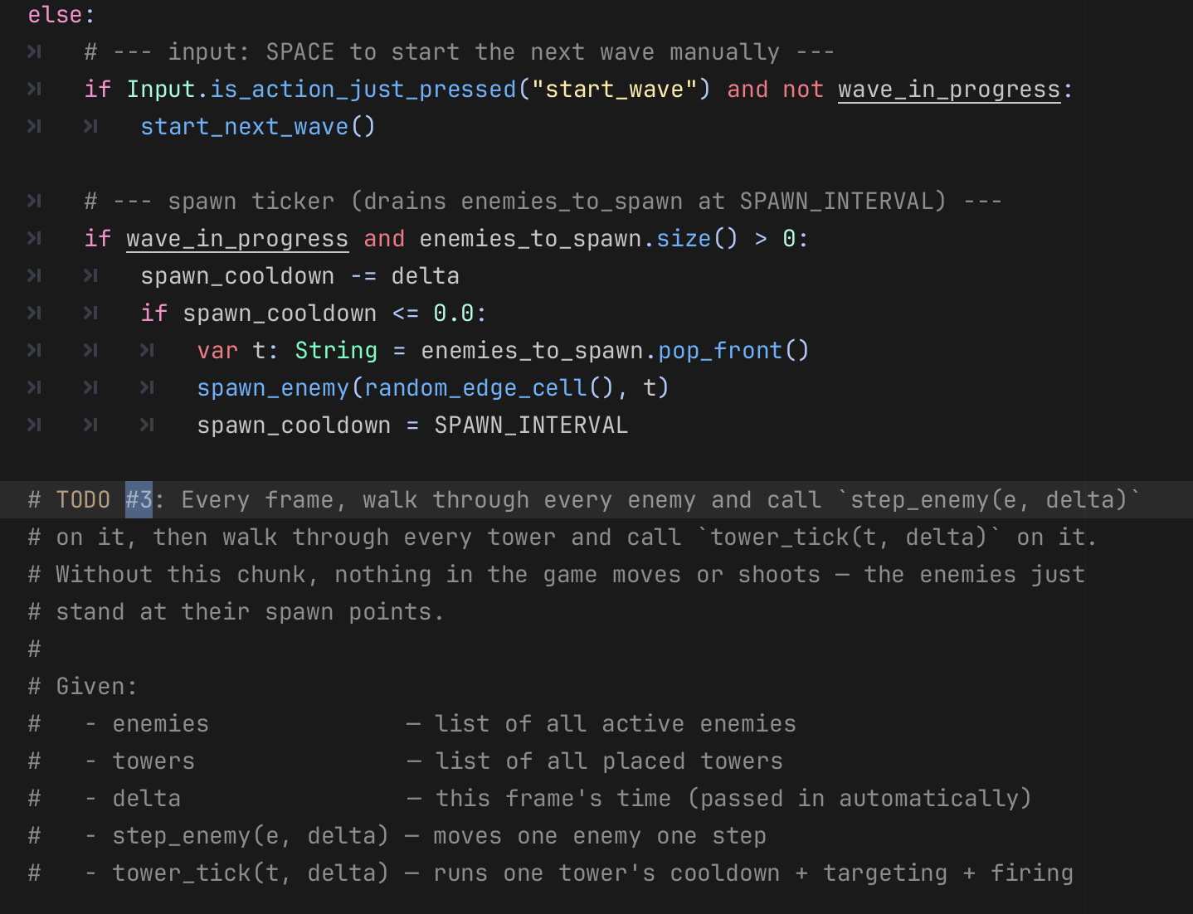
iCode
DAY 3
EMPOWERING FUTURE INNOVATORS
Two for-loops, back to back. Each sweeps one list.
Pattern (board example):
Where in your code (Godot):
for game in library:
print(game)
41

Slide 39
iCode
DAY 3
EMPOWERING FUTURE INNOVATORS
Yesterday: one value in. Today: a whole list in.
• D2: func add_points(amount): — you handed in one number.
• D3: func move_all(enemy_list, delta): — you hand in a whole list.
• A function can take anything as input — including a list you've already built.
43

Slide 40
iCode
DAY 3
EMPOWERING FUTURE INNOVATORS
D2: one thing in
func add_points(amount): score += amount Yesterday: amount was a number. Today: it can be a list.
44

Slide 41
iCode
DAY 3
EMPOWERING FUTURE INNOVATORS
Imagine import_library(games)
• You hand the function your whole PS5 library at once.
• Inside the function, it does something to every game in that list.
• move_all(enemy_list, delta) is the same idea — hand it the list, it steps every item.
45

Slide 42
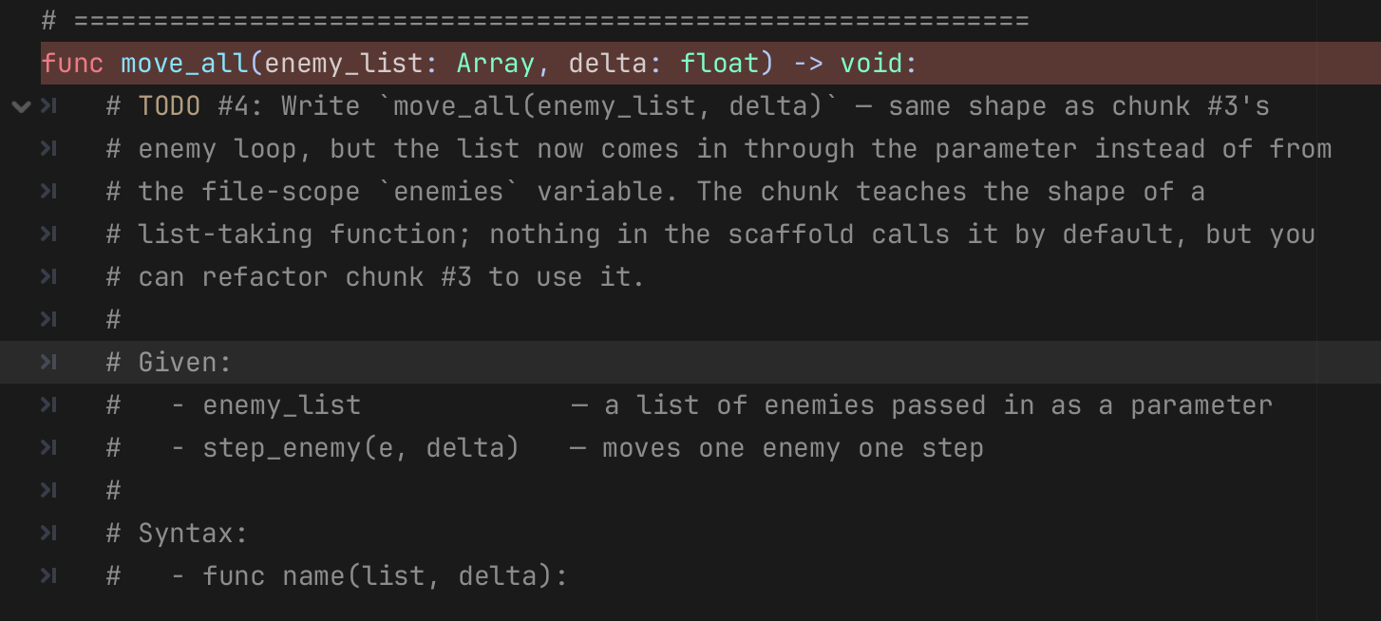
iCode
DAY 3
EMPOWERING FUTURE INNOVATORS
Same shape as chunk #3 — just using the list that was handed in.
Pattern (board example):
Where in your code (Godot):
func total(numbers):
var s = 0
for n in numbers:
s += n
return s
46

Slide 43
iCode
DAY 3
EMPOWERING FUTURE INNOVATORS
Tool in the toolbox
• move_all() is done but nothing calls it yet.
• You could refactor your chunk #3 enemy loop to move_all(enemies, delta) — same result.
• Concept: the same loop logic, but packaged so anyone can hand in any list, not just enemies.
48

Slide 44
iCode
DAY 3
EMPOWERING FUTURE INNOVATORS
Deeper Functions
49

Slide 45
iCode
DAY 3
EMPOWERING FUTURE INNOVATORS
A function that hands something back
• So far: functions do things. step_enemy(), spawn_enemy(), move_all() — all do.
• New: a function can also answer a question. You call it → it gives you something back.
• That "something back" is called the return value.
• ```gdscript
• Image: none
• Caption: "The function runs, does work, then hands the result back with return."
• Notes: This is the D2 Chunk #6 callback (they wrote hit_wall which returned a bool). Lean on it: "You already did this — hit_wall returned true or false. Today the function returns a game node."
50

Slide 46
iCode
DAY 3
EMPOWERING FUTURE INNOVATORS
Return — code shape
func find_best(list): var best = null for item in list: # check if item is better than best best = item return best Three parts: start with nothing (null), scan the list, hand back the winner.
51

Slide 47
iCode
DAY 3
EMPOWERING FUTURE INNOVATORS
The backpack
You grab the snack. You put it in your backpack. add_to_backpack(snack). Another function. Input = snack, output = nothing (your backpack just changed).
52

Slide 48
iCode
DAY 3
EMPOWERING FUTURE INNOVATORS
Output of one feeds input of the next
Diagram with arrow: vend("B4") → returns snack → add_to_backpack(snack) The first function's answer is the second function's question.
53

Slide 49
iCode
DAY 3
EMPOWERING FUTURE INNOVATORS
Two ways to write the same thing
# Long form (two lines): var snack = vend("B4") add_to_backpack(snack) # Short / nested form (one line): add_to_backpack(vend("B4")) Same exact result. The inside function runs first.
54

Slide 50
iCode
DAY 3
EMPOWERING FUTURE INNOVATORS
Best-so-far — the shape of get_nearest
var best = null var best_d = 999999.0 for item in list: var d = pos.distance_to(item.position) if d < best_d: best = item best_d = d return best Start with no winner. Walk the list. If this one is closer than the current best, it's the new best.
55

Slide 51
iCode
DAY 3
EMPOWERING FUTURE INNOVATORS
Base Defense — which enemy to shoot?
• Cannon and Sniper both ask: which enemy is closest AND still in range?
• get_nearest_enemy_in_range(pos, tower_range) walks enemies, tracks the closest one within range, and returns it.
• The vending machine drops that enemy. The backpack (fire_at) will be chunk #6's job.
56

Slide 52
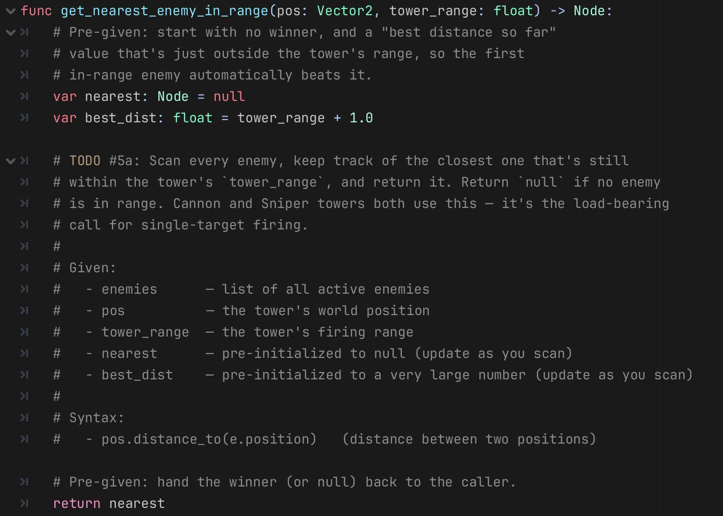
iCode
DAY 3
EMPOWERING FUTURE INNOVATORS
Walk every enemy. Track the closest one in range. The init and return are already written.
Pattern (board example):
Where in your code (Godot):
func nearest(list, pos):
var best = null
var best_d = 999999.0
for item in list:
var d = pos.distance_to(item.position)
if d < best_d:
best = item
best_d = d
return best
58

Slide 53
iCode
DAY 3
EMPOWERING FUTURE INNOVATORS
What #5a just gave you
• get_nearest_enemy_in_range is the vending machine.
• You call it with a position and a range. It hands back the closest enemy — or null if no one's in range.
• Chunk #6 will be the backpack: take that enemy and fire at it.
59

Slide 54
iCode
DAY 3
EMPOWERING FUTURE INNOVATORS
No payoff yet — towers fire in chunk #6
The function is built. The vending machine is stocked. Next: plug it into the tower loop.
60

Slide 55
iCode
DAY 3
EMPOWERING FUTURE INNOVATORS
#5a returned one enemy. #5b returns all enemies in range.
• Cannon: finds the nearest enemy. Returns one node.
• Splash: finds every enemy in a radius. Returns a list of nodes.
• Same vending machine idea — different output size.
61

Slide 56
iCode
DAY 3
EMPOWERING FUTURE INNOVATORS
Filter the list — keep only what you want
func filter_close(list, pos, radius): var result := [] for item in list: if pos.distance_to(item.position) <= radius: result.append(item) return result Start with an empty list. Walk. If this item passes the test, add it to result. Return the full result at the end.
62

Slide 57
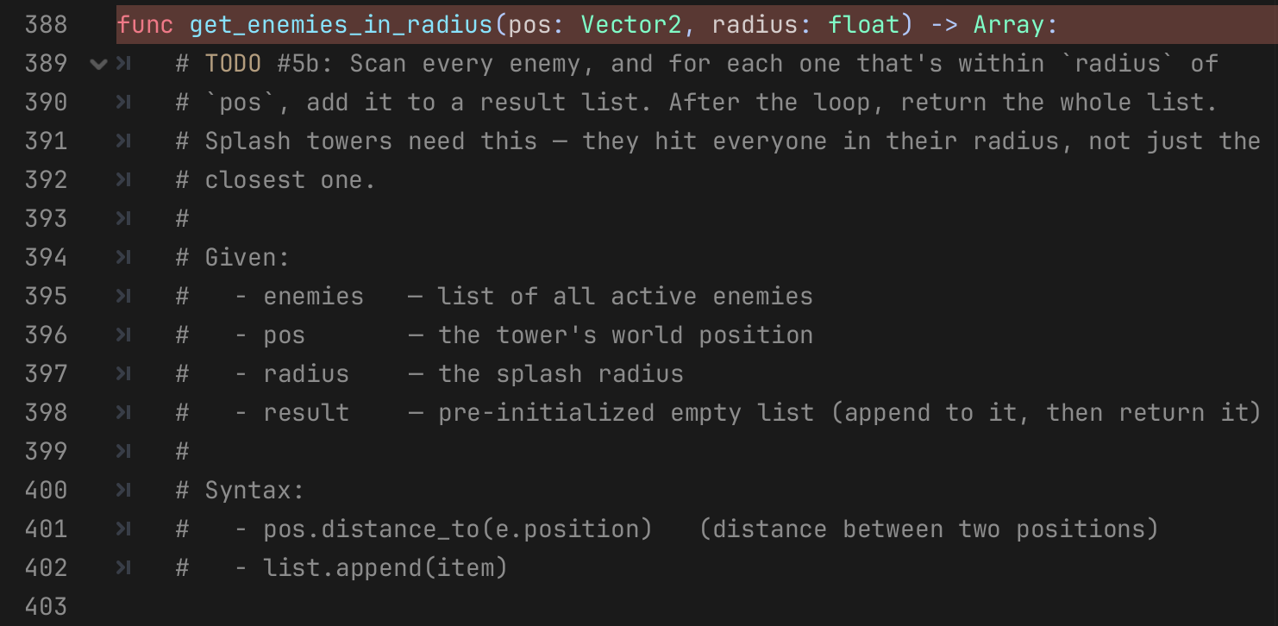
iCode
DAY 3
EMPOWERING FUTURE INNOVATORS
Build a fresh list. Add every enemy within radius. Return it.
Pattern (board example):
Where in your code (Godot):
var result := []
for e in enemies:
if pos.distance_to(e.position) <= radius:
result.append(e)
return result
64

Slide 58
iCode
DAY 3
EMPOWERING FUTURE INNOVATORS
Three functions built. Time to plug them in.
• move_all — steps every enemy. ✓
• get_nearest_enemy_in_range — finds the closest target. ✓
• get_enemies_in_radius — finds everyone in a blast zone. ✓
• Chunk #6: connect the vending machines to the backpacks. This is the chunk that makes the game playable.
65

Slide 59
iCode
DAY 3
EMPOWERING FUTURE INNOVATORS
The match dispatcher is pre-given
• match is a Day 4 concept — it routes based on what something equals.
• Today: it's already written for you. It checks the tower type and jumps to the right branch.
• You fill in what each branch does.
• Diagram: tower type → match t_type: → two paths: "cannon"/"sniper" branch → #6a, "splash" branch → #6b
66

Slide 60
iCode
DAY 3
EMPOWERING FUTURE INNOVATORS
Two tower types, two targeting functions
| Tower | Targeting | Function |
|---|---|---|
| Cannon, Sniper | Single nearest enemy
get_nearest_enemy_in_range (#5a)
Splash | All enemies in radius
get_enemies_in_radius (#5b)
Each branch: pick the target, fire if something's there, reset the cooldown.
67

Slide 61
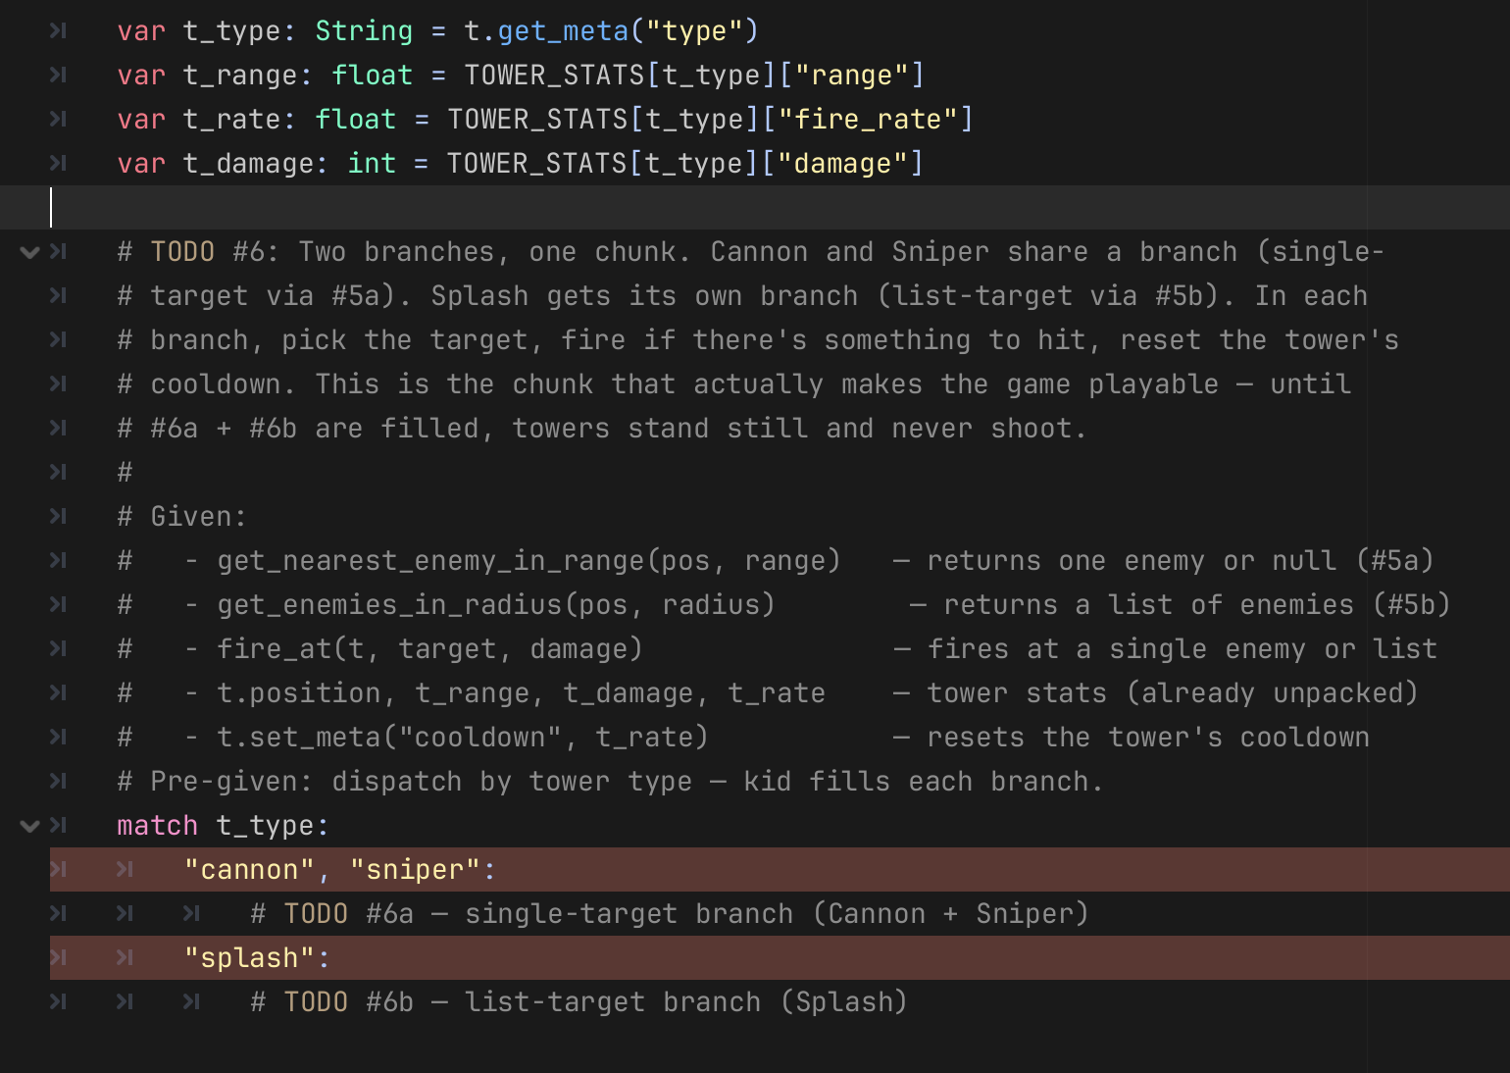
iCode
DAY 3
EMPOWERING FUTURE INNOVATORS
Vending machine drops the target. If something dropped, fire at it.
Pattern (board example):
Where in your code (Godot):
var snack = vend("B4")
if snack != null:
add_to_backpack(snack)
69

Slide 62
iCode
DAY 3
EMPOWERING FUTURE INNOVATORS
Quick playtest — place towers, start a wave
Press 1 (Cannon), 2 (Sniper), 3 (Splash). Click to place. Enter to start the wave.
71

Slide 63
iCode
DAY 3
EMPOWERING FUTURE INNOVATORS
One more thing — how does the game know a wave is done?
• You just beat wave 1 (maybe). How did the game know it was over?
• That's chunk #7 — the wave trigger check. Last chunk.
72

Slide 64
iCode
DAY 3
EMPOWERING FUTURE INNOVATORS
How does the game know a wave is done?
• "enemies.size() = how many enemies are alive on the field right now.
• library.size() = how many games you own. Same .size() — same idea.
• When enemies.size() == 0 — the field is empty. But is the wave actually done?
73

Slide 65
iCode
DAY 3
EMPOWERING FUTURE INNOVATORS
Quiz — is the wave done?
• "enemies.size() == 0 — is the wave done?
• Trick question. Maybe not. There could still be enemies waiting to spawn (enemies_to_spawn.size() > 0).
• Both lists must be empty AND a wave must actually be in progress.
• Answer: check three conditions together with and.
74

Slide 66
iCode
DAY 3
EMPOWERING FUTURE INNOVATORS
Wave done → what happens next
• Flip wave_in_progress off.
• Bump wave_index.
• If wave_index is past the last wave → you_win().
• Otherwise → start_next_wave().
75

Slide 67
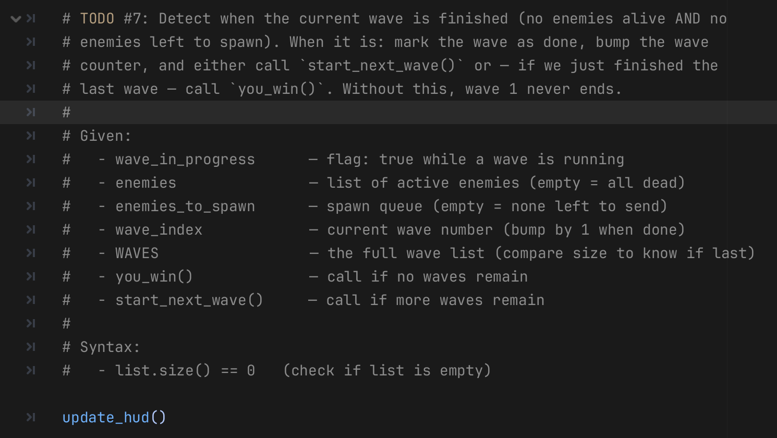
iCode
DAY 3
EMPOWERING FUTURE INNOVATORS
IF Both lists empty AND wave in progress → end the wave.
Pattern (board example):
Where in your code (Godot):
if library.size() == 0:
print("buy a game!")
77

Slide 68
iCode
DAY 3
EMPOWERING FUTURE INNOVATORS
Make it yours
78

Slide 69
iCode
DAY 3
EMPOWERING FUTURE INNOVATORS
Seven ways to make Base Defense yours
1. Tune tower stats in code 2. Re-tint a tower with Modulate 3. Swap a tower's sprite tile 4. Drag a Kenney scenery prop into the scene 5. Flip the difficulty knob 6. (stretch) Edit the wave list 7. (stretch) Add a new wave entry
79

Slide 70
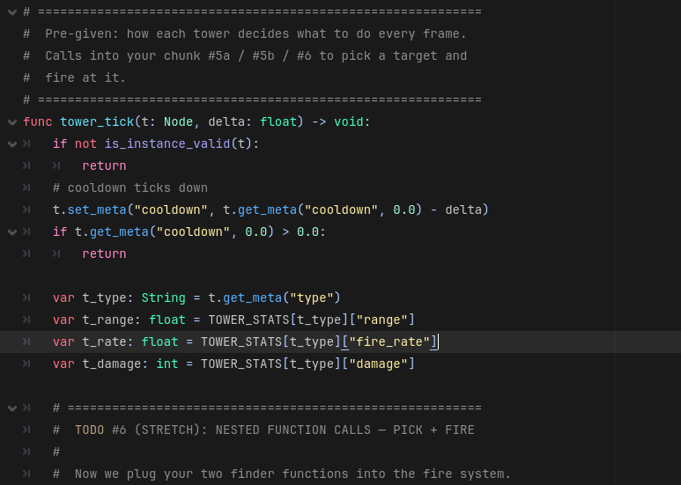
iCode
DAY 3
EMPOWERING FUTURE INNOVATORS
Find TOWER_STATS in main.gd. It's near the top.
80

Slide 71
iCode
DAY 3
EMPOWERING FUTURE INNOVATORS
Beat 1 — Change the damage
• Find the "damage" key for Cannon (default: 3).
• Change it to something wild — try 30.
• Ctrl+S.
81

Slide 72
iCode
DAY 3
EMPOWERING FUTURE INNOVATORS
Beat 2 — Re-tint a tower
• The Cannon is orange by default. Find the color value in TOWER_STATS.
82

Slide 73
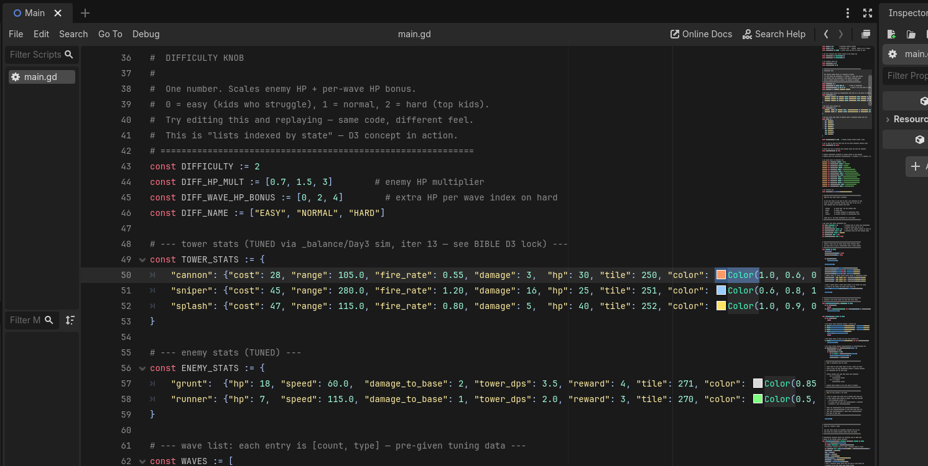
iCode
DAY 3
EMPOWERING FUTURE INNOVATORS
Beat 2 — Change the color
83

Slide 74
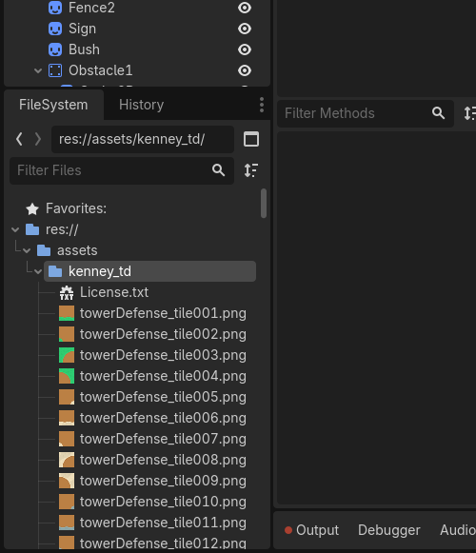
iCode
DAY 3
EMPOWERING FUTURE INNOVATORS
Browse assets/kenney_td/ in the FileSystem panel. Pick a tile number you like.
84

Slide 75
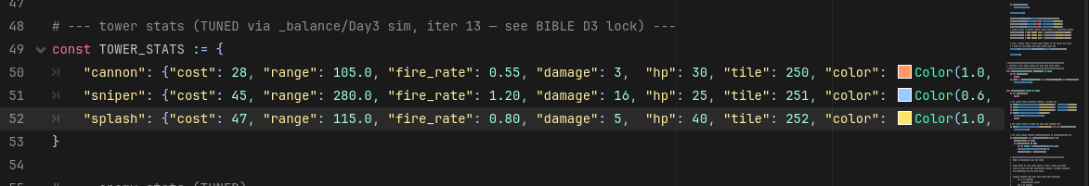
iCode
DAY 3
EMPOWERING FUTURE INNOVATORS
Beat 3 — Edit the tile number
85

Slide 76
iCode
DAY 3
EMPOWERING FUTURE INNOVATORS
Beat 3 — New tile number
Ctrl+S → F5. Your Cannon now has a different sprite.
86

Slide 77
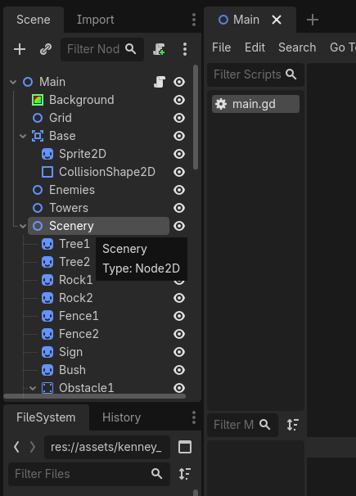
iCode
DAY 3
EMPOWERING FUTURE INNOVATORS
In the Scene dock, find and click the Scenery node.
87

Slide 78
iCode
DAY 3
EMPOWERING FUTURE INNOVATORS
Beat 4 — Drag a prop from FileSystem
• In the FileSystem panel, browse assets/kenney_td/.
• Find a tree, rock, or decorative tile you like.
• Drag it from FileSystem into the viewport (while Scenery is selected).
88

Slide 79
iCode
DAY 3
EMPOWERING FUTURE INNOVATORS
Beat 5 — Make it brutally hard (or easy)
• Remember DIFFICULTY from Walk DK? Change it again. Try 0 (easy), 1 (medium), 2 (hard).
90

Slide 80
iCode
DAY 3
EMPOWERING FUTURE INNOVATORS
Beat 6 — Edit the wave list (stretch)
• Find the WAVES array near the top of main.gd. Add a wave, change a count, change a type.
91

Slide 81
iCode
DAY 3
EMPOWERING FUTURE INNOVATORS
Beat 6 — Change a wave
• Find a wave entry like [5, "basic"].
• Change the count: [20, "basic"] — twenty basics!
• Or change the type: [5, "runner"] — fast runners.
• Ctrl+S, F5.
92

Slide 82
iCode
DAY 3
EMPOWERING FUTURE INNOVATORS
Beat 7 — Add a boss wave (stretch)
• At the end of the WAVES array, add a new entry: [20, \"runner\"]. That's your boss wave.
93

Slide 83
iCode
DAY 3
EMPOWERING FUTURE INNOVATORS
Final Challenge — Endless Mode
94

Slide 84
iCode
DAY 3
EMPOWERING FUTURE INNOVATORS
What endless mode looks like
• Rip out the 8 waves. Spawn forever. Everything ramps.
• No win screen. The game ends only when the base falls.
• Waves get harder every time you clear the field. The gap between spawns shrinks. Enemies get faster.
95

Slide 85
iCode
DAY 3
EMPOWERING FUTURE INNOVATORS
You already know how to do this
• FC-1 ← Chunk #1 (declare state vars)
• FC-2a ← Chunk #2a (.append() to a list)
• FC-2b ← Chunk #2b (.erase() from a list + reward)
• FC-3 ← Chunk #3 (iterate two lists each frame)
• FC-4 ← Chunk #4 (function takes a list as a parameter)
• FC-5a ← Chunk #5a (function returns ONE from a list)
• FC-5b ← Chunk #5b (function returns a LIST from a list)
• FC-6 ← Chunk #6 (match + per-branch nested calls)
• FC-7 ← Chunk #7 (list.size() check + state transition)
96

Slide 86
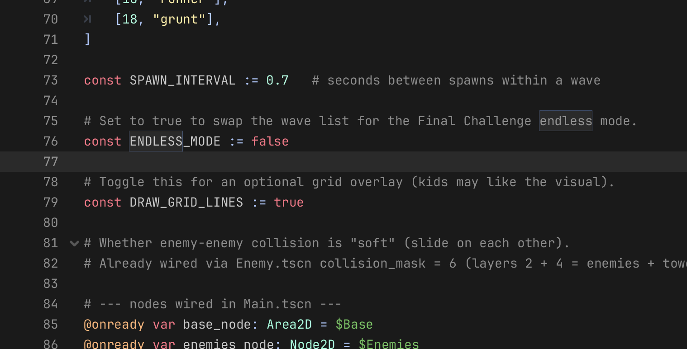
iCode
DAY 3
EMPOWERING FUTURE INNOVATORS
Open main.gd and scroll to the ENDLESS_MODE constant near the top.
97

Slide 87
iCode
DAY 3
EMPOWERING FUTURE INNOVATORS
Enable endless mode — step 2
• Change const ENDLESS_MODE := false → const ENDLESS_MODE := true
• Ctrl+S
98

Slide 88
iCode
Final Challenge — Board Examples
DAY 3
EMPOWERING FUTURE INNOVATORS
FC-1 state vars
FC-2a .append()
FC-2b .pop_front() + reward
var spawn_timer: float = 0.0
var difficulty: int = 1
var spawn_interval: float = SPAWN_INTERVAL_START
var spawn_queue: Array = []
var clear_streak: int = 0
spawn_queue.append(t)
var t: String = spawn_queue.pop_front()
main.spawn_enemy(random_edge(), t)
main.coins += STREAK_BONUS
FC-3 per-frame buff sweep
FC-4 buff_all(list, delta)
FC-5a get_fastest_enemy()
for e in main.enemies:
endless_buff(e, delta)
for t in main.towers:
buff_tower(t, delta)
for e in enemy_list:
endless_buff(e, delta)
for e in main.enemies:
if e.speed > best_speed:
fastest = e
best_speed = e.speed
FC-5b get_wounded_enemies()
FC-6 escalate() match branch
FC-7 check_for_screen_clear()
var result: Array = []
for e in main.enemies:
if e.hp <= WOUNDED_HP_THRESHOLD:
result.append(e)
return result
"medium":
var t: String = pick_type_for_band(band)
queue_spawn(t)
queue_spawn(t)
if main.enemies.size() == 0 and spawn_queue.size() == 0:
clear_streak += 1
difficulty += 1
spawn_interval *= SPAWN_INTERVAL_SHRINK
escalate()

Slide 89
iCode
DAY 3
EMPOWERING FUTURE INNOVATORS
Export it bro.
You did it yesterday 🤌
108

Slide 90
iCode
DAY 3
EMPOWERING FUTURE INNOVATORS
Today: Lists + Deeper Functions
• Lists — a collection your code can grow, shrink, walk, and filter. .append(), .erase(), .size(), for x in list.
• Deeper Functions — functions that scan lists, return something, and chain into each other. Vending machine + backpack.
• Two ideas. Whole game.
109

Slide 91
iCode
DAY 3
EMPOWERING FUTURE INNOVATORS
Tomorrow — Day 4: 2-Player Fighter
• Objects + State. Your code starts to feel like a blueprint instead of a script.
• Two players. Four characters. One fight.
110

Slide 92
iCode
DAY 3
EMPOWERING FUTURE INNOVATORS
Export it bro.
You did it yesterday 🤌
108

